Slide 1
Internal Control in Higher Education
Daniel Adams
Inst. Audit & Advisory Services

Slide 2
About IAAS
Evaluate (internal) control processes
Monitor:
  Compliance with policies, procedures laws and regulations
  Means of safeguarding assets
  Effectiveness and efficiency
  Risk management processes
  Quality and continuous improvement in operations
Investigate suspected fiscal misconduct
Source: http://www.montana.edu/audit/iaas_charter.html

Slide 3
Internal Control in HE Overview
5 elements and 17 principles of internal control
Areas where internal control processes should commonly be implemented in HE
Tools for assessing and improving internal control processes in your unit

Slide 4
Office of Management and Budget (OMB) Circular A-81 §200.303 Internal controls.
The non-Federal entity must:
(a) Establish and maintain effective internal control over the Federal award that provides reasonable assurance that the non-Federal entity is managing the Federal award in compliance with Federal statutes, regulations, and the terms and conditions of the Federal award.

Slide 5
OMB Circular A-81
§200.303 Internal controls.
These internal controls should be in compliance with guidance in ‘‘Standards for Internal Control in the Federal Government’’ issued by the Comptroller General of the United States and the ‘‘Internal Control Integrated Framework’’, issued by the Committee of Sponsoring Organizations of the Treadway Commission (COSO).

Slide 6
What is internal control?

Slide 7
Internal Control Frameworks

Slide 8
COSO Internal Control–Integrated Framework
COSO (Committee of Sponsoring Organizations) of the Treadway Commission
  American Accounting Association (AAA)
  American Institute of Certified Public Accountants (AICPA)
  Financial Executives International (FEI)
  Institute of Management Accountants (IMA)
  The Institute of Internal Auditors (IIA)
Notes:
James Treadway http://www.coso.org/publications/ncffr.pdf

Slide 9
The Green Book
Standards for Internal Control in the Federal Government
  Government Accountability Office (GAO)
  Comptroller General of the United States
  “May also be adopted by state, local, and quasi-governmental entities as a framework for an internal control system”
Source: Standards for Internal Control in the Federal Government. GAO. September 2014.

Slide 10
Other Internal Control Frameworks
Canadian Institute of Chartered Accountants Control Framework
Control Objectives for Information and Related Technology (COBIT)
International Organization for Standardization (ISO)

Slide 11
Internal Control Definitions

Slide 12
COSO Internal Control Definition
Internal control is a process, effected by an entity’s board of directors, management, and other personnel, designed to provide reasonable assurance regarding the achievement of objectives relating to operations, reporting, and compliance.
Source: COSO Internal Control – Integrated Framework. May 2013.

Slide 13
Green Book Internal Control Definition
Internal control is a process effected by an entity’s oversight body, management, and other personnel that provides reasonable assurance that the objectives of an entity will be achieved.
Source: Standards for Internal Control in the Federal Government. GAO. September 2014.

Slide 14
Green Book Internal Control Definition
These objectives and related risks can be broadly classified into one or more of the following three categories:
Operations - Effectiveness and efficiency of operations
Reporting - Reliability of reporting for internal and external use
Compliance - Compliance with applicable laws and regulations
Source: Standards for Internal Control in the Federal Government. GAO. September 2014.

Slide 15
OMB Circular A-81
§200.303 Internal controls.
(b) Comply with Federal statutes, regulations, and the terms and conditions of the Federal awards.

Slide 16
Green Book Internal Control Definition
Internal control comprises the plans, methods, policies, and procedures used to fulfill the mission, strategic plan, goals, and objectives of the entity.
Source: Standards for Internal Control in the Federal Government. GAO. September 2014.

Slide 17
Green Book Internal Control Definition
Internal control serves as the first line of defense in safeguarding assets.
Source: Standards for Internal Control in the Federal Government. GAO. September 2014.

Slide 18
Green Book Internal Control Definition
In short, internal control helps managers achieve desired results through effective stewardship of public resources.
Source: Standards for Internal Control in the Federal Government. GAO. September 2014.

Slide 19
International Organization for Standardization (ISO) Control Definition
Administrative, managerial, technical or legal methods for managing risk, including policies, procedures, guidelines, practices or organizational structures
Source: ISO 27000 Information security management systems.

Slide 20
ISO Risk Definition
Combination of the probability (likelihood) of an event and its consequence (impact)
Source: ISO 27000 Information security management systems.
Notes:
See risk rating criteria
Inherent risk

Slide 21
Who is responsible for internal control at MSU?

Slide 22
Green Book Internal Control Definition
People are what make internal control work. Management is responsible for an effective internal control system. However, personnel throughout an entity play important roles in implementing and operating an effective internal control system.
Source: Standards for Internal Control in the Federal Government. GAO. September 2014.

Slide 23
Characteristics of Higher Education
Large organizations
  Offices with functional (e.g., finance, HR) expertise
Decentralized
Partially taxpayer funded
Highly regulated
Some managers do not have prior business-type experience

Slide 24
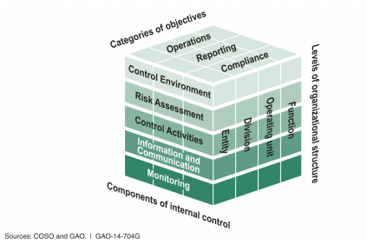
Five Components of Internal Control

Slide 25
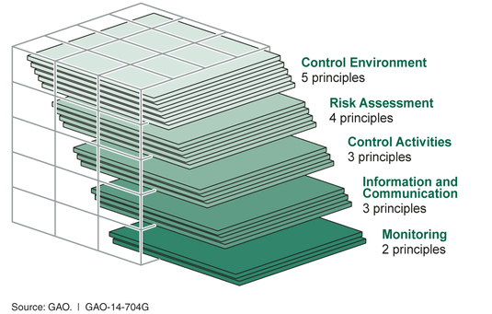
17 Principles Support the Five Components

Slide 26
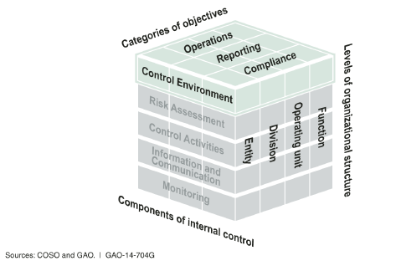
Control Environment
The oversight body and management establish and maintain an environment throughout the entity that sets a positive attitude toward internal control.
Source: Standards for Internal Control in the Federal Government. GAO. September 2014.

Slide 27
Control Environment - Principle 1
The oversight body and management demonstrate a commitment to integrity and ethical values.
  Tone at the Top
  Standards of Conduct
  Adherence to Standards of Conduct
Source: Standards for Internal Control in the Federal Government. GAO. September 2014.

Slide 28
What do you think about MSU’s commitment to integrity and ethical values?

Slide 29
MSU Compliance Hotline
Montana State University’s four campuses are committed to acting with integrity in their pursuit of excellence. As part of this commitment, the university has selected a private contractor, EthicsPoint, to provide an independent avenue for confidential reporting of concerns about suspected legal, regulatory or policy violations.
www.msucompliancehotline.ethicspoint.com

Slide 30
Reporting Suspected Legal, Regulatory and Policy Violations
Montana State University encourages all faculty, staff, students, and volunteers, acting in good faith, to report suspected legal, regulatory or policy violations. The university is committed to protecting individuals from retaliation for making a good faith report.
http://www.montana.edu/policy/reporting-violations/

Slide 31
Fiscal Misconduct Policy
Any employee or student associated with the University who knows of or suspects fiscal misconduct should promptly notify one of the following: the director of Institutional Audit & Advisory Services, Legal Counsel, or director of University Police.
http://www.montana.edu/policy/fiscal_misconduct/audit100.html

Slide 32
Control Environment - Principle 2
The oversight body should oversee the entity’s internal control system.
  Oversight Structure
  Oversight for the Internal Control System
  Input for Remediation of Deficiencies
Source: Standards for Internal Control in the Federal Government. GAO. September 2014.

Slide 33
How do MSU’s oversight bodies oversee the internal control system?

Slide 34
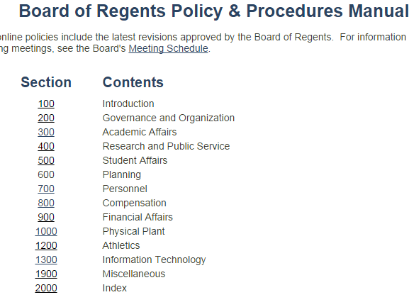
http://www.mus.edu/borpol/default.asp

Slide 35
How do they provide input for remediation of deficiencies?

Slide 36
BOR Policy 930.1 – Internal Audit Reports
An internal audit report for a campus of the Montana University System shall be provided to the Commissioner's Office when the report contains a conclusion that there has been or may have been a violation of institutional or system policy or of state or federal law.
http://www.mus.edu/borpol/bor900/9301.htm

Slide 37
Montana Code Annotated (MCA) 5-13-309.
Information from state agencies.
[…]
(3) The head of each state agency shall immediately notify both the attorney general and the legislative auditor in writing upon the discovery of any theft, actual or suspected, involving state money or property under that agency's control or for which the agency is responsible.
http://leg.mt.gov/bills/mca/5/13/5-13-309.htm

Slide 38
Control Environment - Principle 3
Management should establish an organizational structure, assign responsibility, and delegate authority to achieve the entity’s objectives.
  Organizational Structure
  Assignment of Responsibility and Delegation of Authority
  Documentation of the Internal Control System
Source: Standards for Internal Control in the Federal Government. GAO. September 2014.

Slide 39
Do you think authority and responsibility are clearly assigned at MSU?

Slide 40
Principal Investigator Guide
710.00 Responsibilities of the PI in Post-Award Administration.
720.00 Role of Departmental Business Managers/Accountants in Post-Award Administration.
730.00 Role of OSP in Post-Award Administration.
http://www.montana.edu/research/osp/piguide/700.00.html

Slide 41
Do you have the authority to ensure that your unit is in compliance with policies, laws and regulations?

Slide 42
Documentation of the Control System
Establishing and communicating who, what, when, where and why of internal control execution to personnel
Means to retain organizational knowledge that could be limited to a few personnel
Means to communicate effective control design to outside parties (e.g., auditors)
Source: Standards for Internal Control in the Federal Government. GAO. September 2014.

Slide 43
Guidance on Adequate Documentation
  Departmental Revenue Collection Procedures Model
  This document should be used by departments as a guide for the development or enhancement of their revenue collection procedures and should be tailored to each department’s specific situation.
http://www.montana.edu/audit/guidance.html

Slide 44
Control Environment - Principle 4
Management should demonstrate a commitment to recruit, develop, and retain competent individuals.
  Expectations of Competence
  Recruitment, Development, and Retention of Individuals
  Succession and Contingency Plans and Preparation
Source: Standards for Internal Control in the Federal Government. GAO. September 2014.

Slide 45
How does MSU do at developing and training its people?

Slide 46
How does MSU do at providing incentives to motivate and retain people?

Slide 47
Control Environment - Principle 5
Management should evaluate performance and hold individuals accountable for their internal control responsibilities.
  Enforcement of Accountability
  Consideration of Excessive Pressures
Source: Standards for Internal Control in the Federal Government. GAO. September 2014.

Slide 48
Are people at MSU held accountable?

Slide 49
Could people at MSU be feeling excessive pressures that could lead to corner cutting?

Slide 50
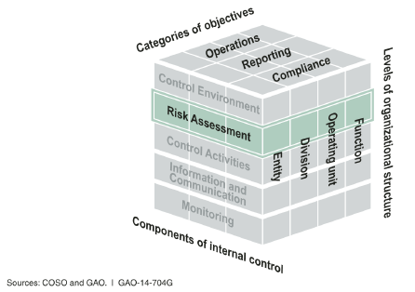
Risk Assessment
Management assesses the risks facing the entity as it seeks to achieve its objectives. This assessment provides the basis for developing appropriate risk
responses.
Source: Standards for Internal Control in the Federal Government. GAO. September 2014.

Slide 51
17 Principles Support the Five Components

Slide 52
Risk Assessment - Principle 6
Management should define objectives clearly to enable the identification of risks and define risk tolerances.
  Definitions of Objectives
  Definitions of Risk Tolerances
Source: Standards for Internal Control in the Federal Government. GAO. September 2014.

Slide 53
Definitions of Objectives
For quantitative objectives, performance measures may be a targeted percentage or numerical value.
For qualitative objectives, management may need to design performance measures that indicate a level or degree of performance, such as milestones.
Source: Standards for Internal Control in the Federal Government. GAO. September 2014.

Slide 54


MSU Strategic Objectives

Slide 55
Definitions of Risk Tolerances
Risk tolerance is the acceptable level of variation in performance relative to the achievement of objectives.
  For financial reporting objectives, risk tolerance is typically expressed in terms of materiality.
Source: Standards for Internal Control in the Federal Government. GAO. September 2014.
Source: COSO Internal Control – Integrated Framework. May 2013.

Slide 56
Definitions of Risk Tolerances
Compliance objectives - Concept of risk tolerance does not apply. An entity is either compliant or not compliant.
Source: Standards for Internal Control in the Federal Government. GAO. September 2014.

Slide 57
Risk Assessment - Principle 7
Management should identify, analyze, and respond to risks related to achieving the defined objectives.
  Identification of Risks
  Analysis of Risks
  Response to Risks
Source: Standards for Internal Control in the Federal Government. GAO. September 2014.

Slide 58
Guidance on Risk Assessment
Internal Control Assessments
  These questionnaires were designed to make it easy for staff members to determine if their units have implemented many of the control activities that are commonly needed at MSU and are based on MSU and State of Montana policies and procedures and sound administrative practices.
http://www.montana.edu/audit/guidance.html

Slide 59
Accounting & Budgeting
Control Assessment (CA)
How do you ensure that all indexes are regularly monitored to know that you have adequate resources and prevent budget deficits?
Do you have plans for handling an unexpected deficit?
Do you use a subsidiary accounting system (e.g., CatBooks)? How is it used? Is it regularly reconciled to Banner (monthly)?
What reconciliations do you perform and at what frequency? What do you do if you detect errors or omissions?
http://www.montana.edu/audit/guidance.html

Slide 60
Human Resources CA
Recruitment and hiring are conducted in compliance with applicable requirements.
Regular, extra (e.g., overtime) and exception time (e.g., leave) is recorded, complete, reviewed and properly approved.
Payroll reports are reconciled periodically and discrepancies are properly resolved.
http://www.montana.edu/audit/guidance.html

Slide 61
Information Security CA
The unit has identified the types of information for which it is responsible. Sensitive information is not stored on hard drives of computers assigned to unit employees or students.
Information system access privileges for unit employees are periodically reviewed and accordingly changed or terminated.
http://www.montana.edu/audit/guidance.html

Slide 62
Information Security CA
Unit personnel do not download software from unknown sources or open attachments or links included in email without first thinking about the potential for resulting information security issues.
Software and operating system updates are applied immediately on unit information systems.
http://www.montana.edu/audit/guidance.html

Slide 63
OMB Circular A-81
§200.303 Internal controls.
(e) Take reasonable measures to safeguard protected personally identifiable information and other information the Federal awarding agency or pass-through entity designates as sensitive or the non-Federal entity considers sensitive consistent with applicable Federal, state and local laws regarding privacy and obligations of confidentiality.

Slide 64
Procurement & Disbursements CA
Purchases are not manipulated (e.g., two payments of $4,900 for a single item) to avoid following procurement procedures.
A written contract exists for all purchased services that amount to $500 or more.
Prior to entering into a contract, the unit determines whether the relationship with the person or firm is an employment relationship or an independent contractor relationship.
P-card expense statements/reports are properly reviewed and approved in a timely manner.
http://www.montana.edu/audit/guidance.html

Slide 65
Property Management CA
The unit maintains capital and minor and sensitive equipment inventory listings.
Sensitive property includes items that possess a special risk of theft due to marketability and/or portability or that present a risk to safety.
MSU Property Management is notified and proper procedures are followed in the sale or disposition of property.
http://www.montana.edu/audit/guidance.html

Slide 66
Property Management CA
Actual and suspected losses of assets are reported to MSU Property Management.
University facilities and equipment are not used for personal gain (i.e., no personal use).
http://www.montana.edu/audit/guidance.html

Slide 67
Revenue Collection CA
Procedures must prevent skimming at the initial receipt of revenue. Records of initial receipt must be retained to prove that all revenue received was deposited.
The change fund is balanced each day it is in use (amount authorized for the change fund plus amount recorded as received that day equals amount on hand).
If there is insufficient staff for ideal separation of duties, procedures are in place that compensate for the lack of separation (e.g., supervisory review).
http://www.montana.edu/audit/guidance.html

Slide 68
Safety & Risk Management CA
Workers’ compensation issues are reported.
International travel is approved and reported.
Student travel is conducted in accordance with student travel policy (http://www2.montana.edu/policy/student_trips/)
http://www.montana.edu/audit/guidance.html

Slide 69
Sponsored Programs CA
Costs charged to sponsored programs are allowable.
Time and effort reporting is accurate, complete, timely and properly certified.
Cost transfers are minimized, properly approved, completed in a timely manner and reasonable in amount and frequency.
http://www.montana.edu/audit/guidance.html

Slide 70
Montana Operations Manual (MOM) 399
Internal Control Guidebook
https://montana.policytech.com/default.aspx?public=true&siteid=1
(Accounting category)

Slide 71
Risk Assessment - Principle 8
Management should consider the potential for fraud when identifying, analyzing, and responding to risks.
  Types of Fraud
  Fraud Risk Factors
  Response to Fraud Risks
Source: Standards for Internal Control in the Federal Government. GAO. September 2014.

Slide 72
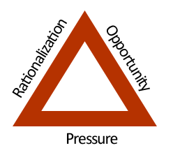
Fraud Risk Factors
Source: http://www.flawd.se/5percentfraud/. Retrieved October 17, 2014.

Slide 73
Fiscal Misconduct Risk Assessment
Revenue collection
Purchasing card
Property management
Payroll
Conflict of interest
Sponsored programs noncompliance

Slide 74
Risk Assessment - Principle 9
Management should identify, analyze, and respond to significant changes that could impact the internal control system.
  Identification of Change
  Analysis of and Response to Change
Source: Standards for Internal Control in the Federal Government. GAO. September 2014.

Slide 75
What types of changes affect the internal control system?
Notes:
Regulation
Technology
Org Structure

Slide 76
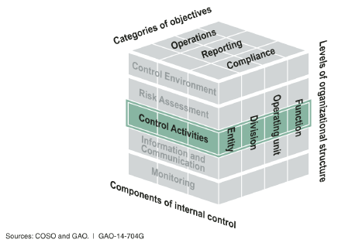
Control Activities
Control activities are the actions management establishes through policies and procedures to achieve objectives and respond to risks in the internal control system, which includes the entity’s information system.
Source: Standards for Internal Control in the Federal Government. GAO. September 2014.

Slide 77
17 Principles Support the Five Components

Slide 78
Control Activities - Principle 10
Management should design control activities to achieve objectives and respond to risks.
  Response to Objectives and Risks
  Design of Appropriate Types of Control Activities
  Design of Control Activities at Various Levels
  Segregation of Duties
Source: Standards for Internal Control in the Federal Government. GAO. September 2014.

Slide 79
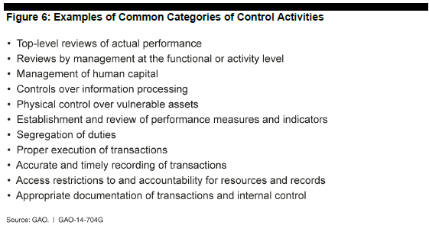
See pages 46-48.
Source: Standards for Internal Control in the Federal Government. GAO. September 2014.

Slide 80
Segregation of Duties
  Authority to execute transactions (e.g., can delete revenue transactions in software application)
  Custody of assets (e.g., cash and checks)
  Recording of transactions (e.g., preparation of bank deposit)
  Reviewing transactions (e.g., reconciling bank statement)
Source: Standards for Internal Control in the Federal Government. GAO. September 2014.

Slide 81
Control Activities - Principle 11
Management should design the entity’s information system and related control activities to achieve objectives and respond to risks.
  Design of the Entity’s Information System
  Design of Appropriate Types of Control Activities
  Design of Information Technology Infrastructure
  Design of Security Management
  Design of Information Technology Acquisition, Development, and Maintenance
Source: Standards for Internal Control in the Federal Government. GAO. September 2014.

Slide 82
Information Processing Objectives
Completeness - Transactions that occur are recorded and not understated.
Accuracy - Transactions are recorded at the correct amount in the right account (and on a timely basis) at each stage of processing.
Validity - Recorded transactions represent economic events that actually occurred and were executed according to prescribed procedures.
Source: Standards for Internal Control in the Federal Government. GAO. September 2014.

Slide 83
Information Security Objectives
Confidentiality - Data, reports, and other outputs are safeguarded against unauthorized access.
Integrity - Information is safeguarded against improper modification or destruction, which includes ensuring information’s nonrepudiation and authenticity.
Availability - Data, reports, and other relevant information are readily available to users when needed.
Source: Standards for Internal Control in the Federal Government. GAO. September 2014.

Slide 84
Control Activities - Principle 12
Management should implement control activities through policies (what) and procedures (how).
  Documentation of Responsibilities through Policies
  Periodic Review of Control Activities
Source: Standards for Internal Control in the Federal Government. GAO. September 2014.

Slide 85
MSU Policies and Procedures
http://www.montana.edu/policy/
  http://www.montana.edu/policy/personnel/
  http://www.montana.edu/policy/business_manual/
  http://www.montana.edu/policy/purchasing/
  http://www.montana.edu/policy/property/manual.html
  http://www.montana.edu/research/osp/piguide/index.html

Slide 86
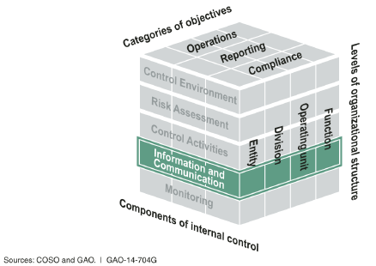
Information and Communication
Effective information and communication are vital for an entity to achieve its objectives. Entity management needs access to relevant and reliable communication related to internal as well as external events.
Source: Standards for Internal Control in the Federal Government. GAO. September 2014.

Slide 87
Information & Communication - Principle 13
Management should use quality information to achieve the entity’s objectives.
  Identification of Information Requirements
  Relevant Data from Reliable Sources
  Data Processed into Quality Information
Source: Standards for Internal Control in the Federal Government. GAO. September 2014.

Slide 88
Banner
Notes:
Regulation
Technology
Org Structure

Slide 89
Other Examples of Sources of Data
Office of Planning & Analysis
Minutes from committee meetings
Web time entry system
OSP effort reporting system
Responses to surveys
Office of Commissioner of Higher Education (OCHE) Data and Reports

Slide 90
Information & Communication - Principle 14
Management should internally communicate the necessary quality information to achieve the entity’s objectives.
  Communication throughout the Entity
  Appropriate Methods of Communication
Source: Standards for Internal Control in the Federal Government. GAO. September 2014.

Slide 91
Communication throughout the Entity
Mgmt.
Personnel

Slide 92
Appropriate methods of communication
Notes:
Regulation
Technology
Org Structure

Slide 93
How effective are internal communications at MSU?
Notes:
Regulation
Technology
Org Structure

Slide 94
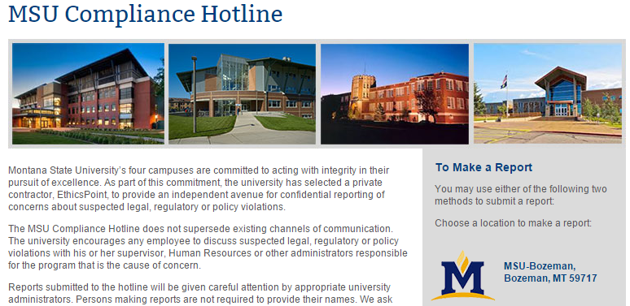

Slide 95
Information & Communication - Principle 15
Management should externally communicate the necessary quality information to achieve the entity’s objectives.
  Communication with External Parties
  Appropriate Methods of Communication
Source: Standards for Internal Control in the Federal Government. GAO. September 2014.

Slide 96
Examples of Recipients of External Communications
State agencies
  Legislative Audit Division (LAD)
Federal agencies
The Integrated Postsecondary Education Data System (IPEDS)

Slide 97
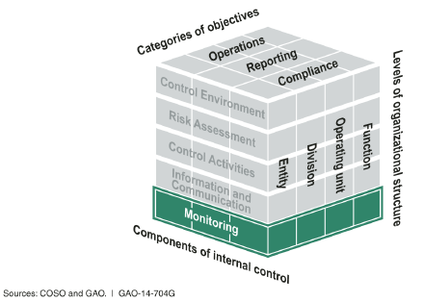
Monitoring
Internal control monitoring assesses the quality of performance over time and promptly resolves the findings of audits and other reviews. Corrective actions are a necessary complement to control activities in order to achieve objectives.
Source: Standards for Internal Control in the Federal Government. GAO. September 2014.

Slide 98
17 Principles Support the Five Components

Slide 99
Monitoring - Principle 16
Management should establish and operate monitoring activities to monitor the internal control system and evaluate the results.
  Establishment of a Baseline
  Internal Control System Monitoring
  Evaluation of Results
Source: Standards for Internal Control in the Federal Government. GAO. September 2014.

Slide 100
Internal Control System Monitoring
Ongoing monitoring – regular management and supervisory activities, comparisons, reconciliations, and other routine actions
Separate evaluations – can be conducted by management or others such as internal auditors or management consultants

Slide 101
3 Lines of Defense for Risk Management
(Institute of Internal Auditors Position Paper, January 2013)
Management and Personnel
Deans, Directors, Dept Heads, Faculty & Staff
Risk and Compliance
SRM, Info Security, Research Compliance
Audit

Slide 102
OMB Circular A-81
§200.303 Internal controls.
(c) Evaluate and monitor the non-Federal entity’s compliance with statute, regulations and the terms and conditions of Federal awards.

Slide 103
Monitoring - Principle 17
Management should remediate identified internal control deficiencies on a timely basis.
  Reporting of Issues
  Evaluation of Issues
  Corrective Actions
Source: Standards for Internal Control in the Federal Government. GAO. September 2014.

Slide 104
OMB Circular A-81
§200.303 Internal controls.
(d) Take prompt action when instances of noncompliance are identified including noncompliance identified in audit findings.

Slide 105
Five Components of Internal Control

Slide 106
Limitations of Internal Control
Human judgment
External events
Breakdowns
Management override
Collusion
Source: COSO Internal Control – Integrated Framework. May 2013.

Slide 107
Office of Management and Budget (OMB) Circular A-81 §200.303 Internal controls.
The non-Federal entity must:
(a) Establish and maintain effective internal control over the Federal award that provides reasonable assurance that the non-Federal entity is managing the Federal award in compliance with Federal statutes, regulations, and the terms and conditions of the Federal award.

Slide 108
Has MSU established and does it maintain an effective internal control system?
Notes:
Regulation
Technology
Org Structure

Slide 109
Thanks!

