Slide 1
A Portable Lab Kit for Teaching Introduction to Logic Circuits & Logic Design
Brock J. LaMeres Associate Professor Department of Electrical & Computer Engineering Montana State University - Bozeman

Slide 2
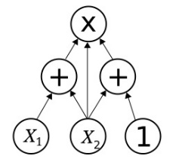
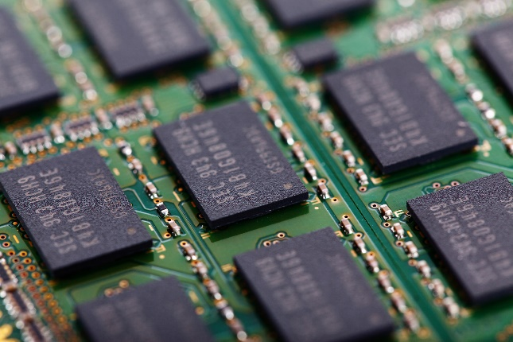
Course Overview
Logic Circuits & Logic Design are found in nearly every ABET accredited electrical engineering and computer engineering programs.
These topics are also popular electives for computer scientists & mechanical engineers.

Slide 3
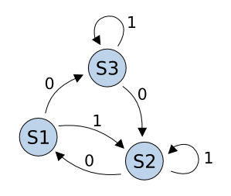
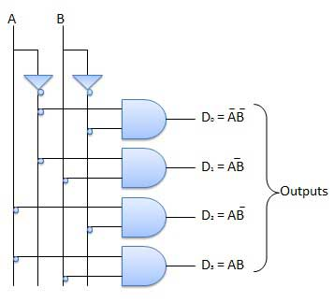
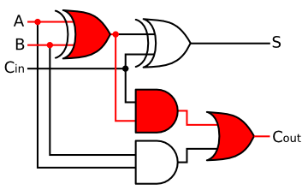
Typical Topics
Classical Digital Design
Number Systems
Digital Circuit Operation
Boolean Algebra
Combinational Logic Design
MSI Logic
State Machines

Slide 4
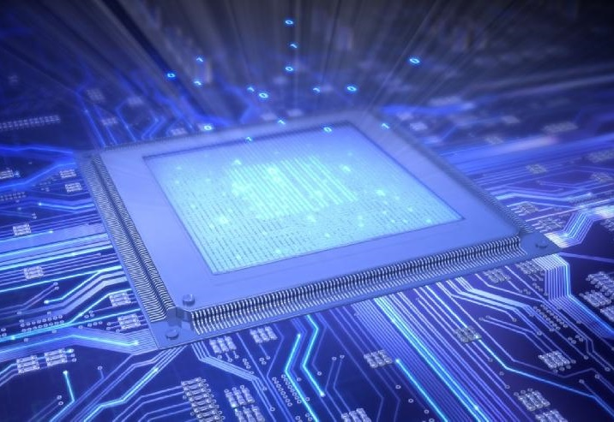
Typical Topics
Modern Digital Design
Hardware Description Languages (VHDL, Verilog)
HDL Modeling Techniques (concurrency, sequential, structural, RTL)
Memory Devices
Arithmetic Circuits
Programmable Logic
Computer Systems

Slide 5
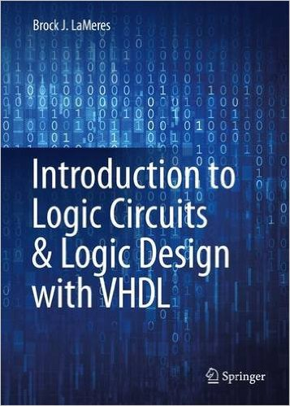
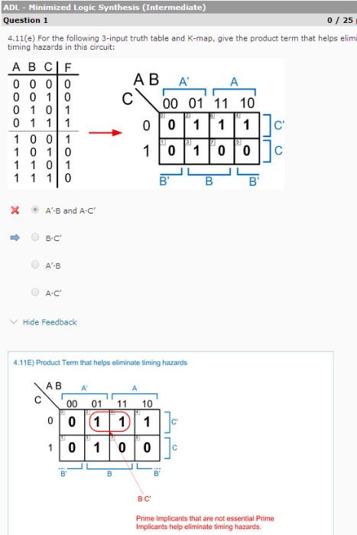
Moving This Content Online
The Lecture - Relatively straight forward…
Reading
Assignments
Lecture Videos using DocCam or Screen Capture
Online Homework Assessments

Slide 6
Moving This Content Online
The Laboratory… - This is where the challenge is… - Our Requirements:
Portable
Low Cost
Experience with classical & modern design flows
Experience with measurement techniques

Slide 7
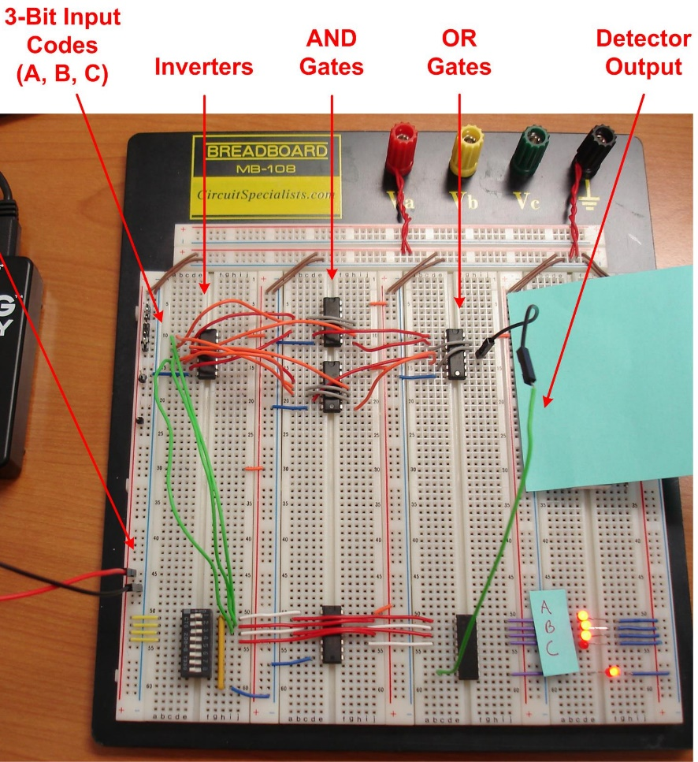
Portable Lab Kit
Our Kit Consists of Three Items 1) A breadboard and an assortment of discrete parts & I/O ($25)
74HC Series parts (ANDs, ORs, etc). These provide experience with interfacing and circuit operation using very little power.
Basic I/O in the form of LEDs, switches, buzzers, 7-segment displays. These provide visual/auditory feedback on the circuit operation.
This helps teach the concepts of classical digital design.

Slide 8
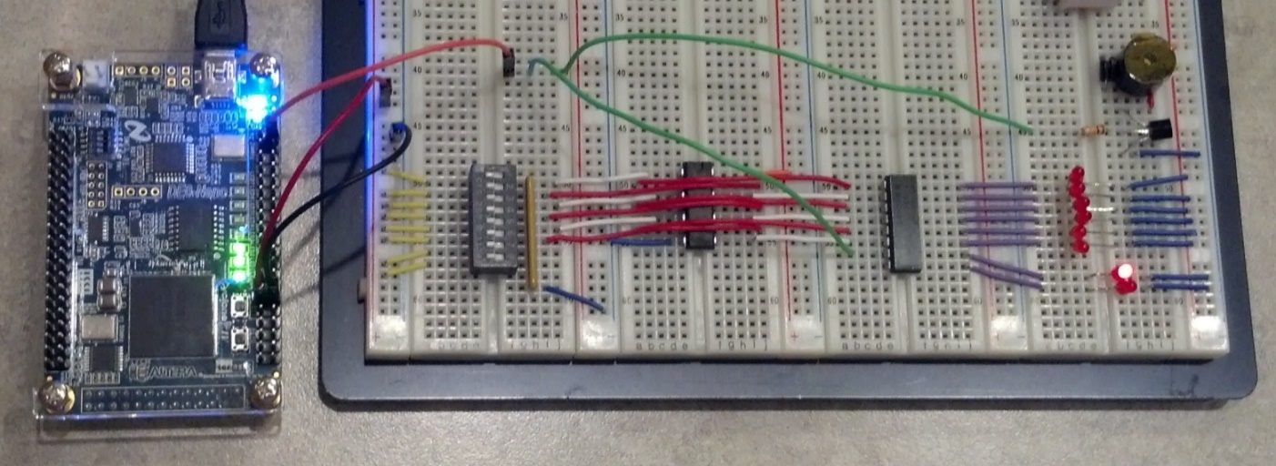
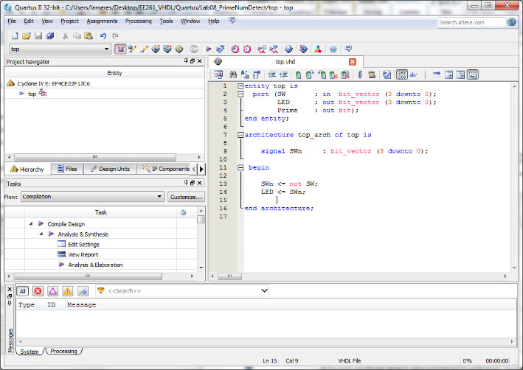
Portable Lab Kit
Our Kit Consists of Three Items 2) Terasic DE0-nano FPGA Board ($60) purchased 2 years ago. Now ~$90.
Free Altera Quartus software allows HDL-based designs to be fully implemented and downloaded to FPGA.
FPGA board can be interfaced with breadboard I/O.
This helps teach the concepts of modern digital design.

Slide 9
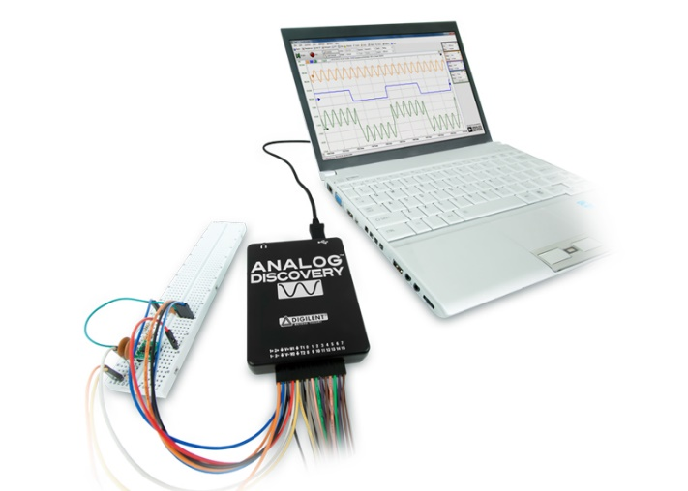
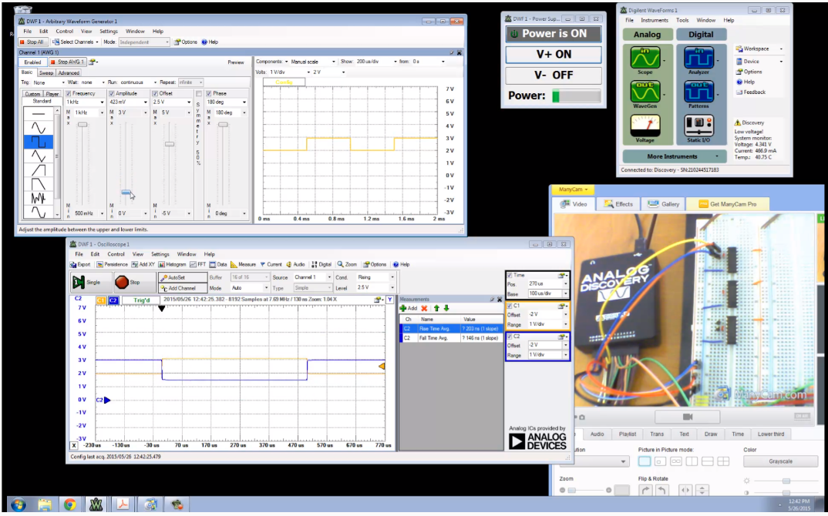
Portable Lab Kit
Our Kit Consists of Three Items 3) Digilent Analog Discovery ($99) purchased 2 years ago. Now ~$179.
USB-based instrument that provides: power supply, AWG, Volt Meter, Logic Analyzer, & Oscilloscope.

Slide 10
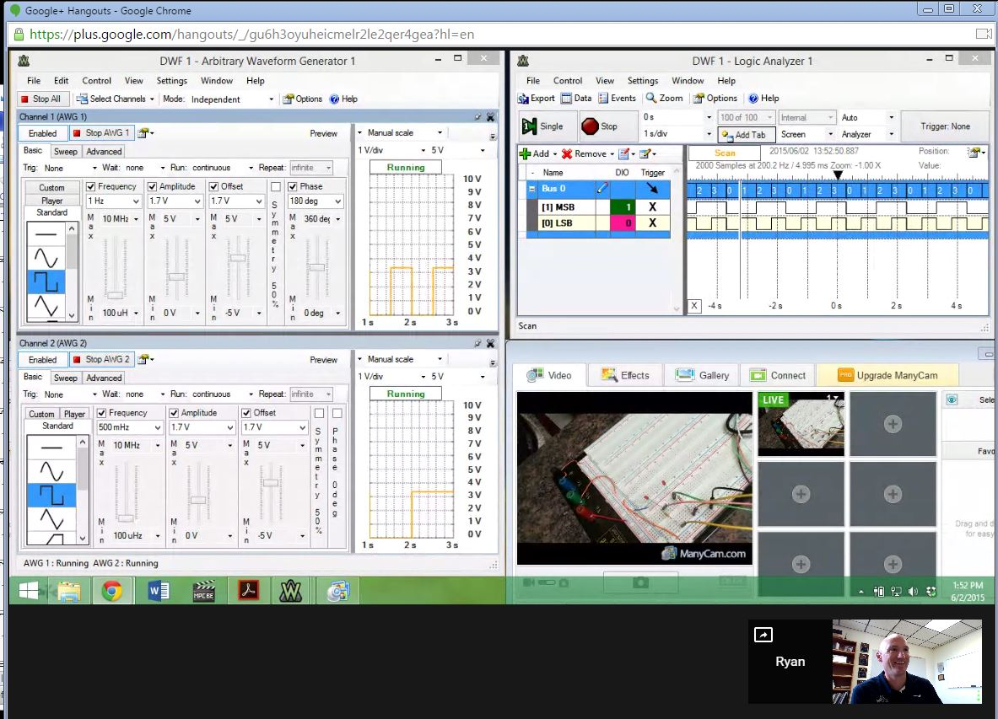
Student Demo’s
Demo’s taken by uploading videos or using Google Hangouts
Google Hangout

Slide 11
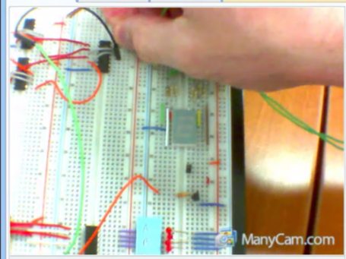
Pros and Cons
Pros
This approach has been successfully used for the past four semesters at MSU.
The kit is full portable with an original cost of $185.
Course offerings have been extended state-wide. Last semesters we had students from MSU-Bozeman, MSU-Billings, and Flathead Valley Community College.
This approach is being used to address large enrollments that are exceeding classroom & lab capacity.
This approach allows the course to be offered spring, fall, and summer to help students meet key pre-requisite chains.

Slide 12
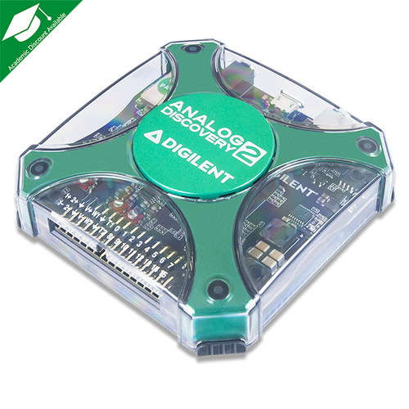
Pros and Cons
Cons
Product obsolescence. The Analog Discovery now has a version 2. The DE0-nano has been replaced. This has impact on kit maintenance and keeping lab handouts/videos up to date.
Cost. The original $99 Analog Discovery cost is no longer available. It is now $179 (academic). The DE0-nano now costs $90 since it is being obsoleted. The replacement (DE0-CV costs $99). Cost creep could eventually make this unsustainable at smaller public universities.

Slide 13
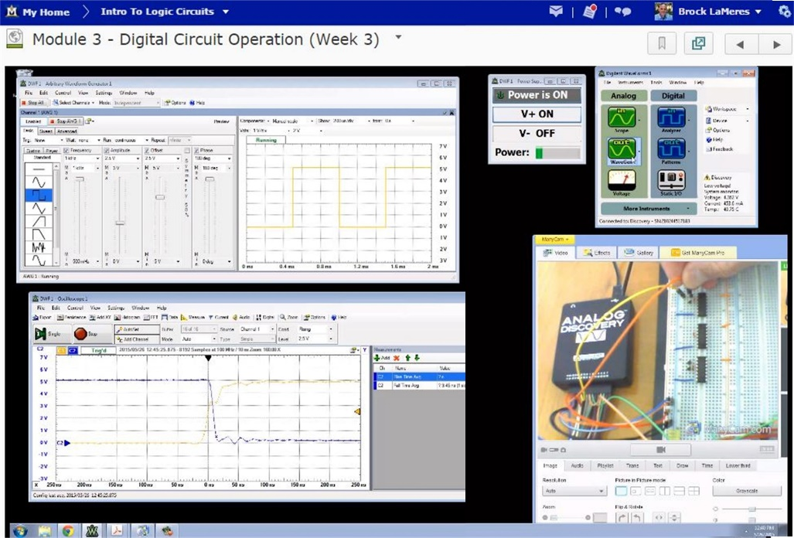
Summary
This portable kit has enabled a fully online offering of a logic circuits class including laboratory component.
No significant difference in student understanding has been measured.
This work was supported through NSF DUE Awards IDs 0836961 and 1432373.

