Slide 1
A Personalized Learning System to Address Background Deficiencies and Highlight the Value of Digital Logic
Brock J. LaMeres Director, Montana Engineering Education Research Center Associate Professor, Electrical & Computer Engineering Department
Carolyn Plumb
Director of Educational Innovation, College of Engineering
Jessi Smith
Director, NSF ADVANCE - Project TRACS
Professor of Psychology
International Conference on Engineering Education & Research (iCEER)
Sydney Australia
November 21-24, 2016

Slide 2
Agenda
Motivation – The STEM Workforce & Pipeline
Demographic-Specific Content Can Stress Value
Current Status of our Work - Personalized Learning

Slide 3
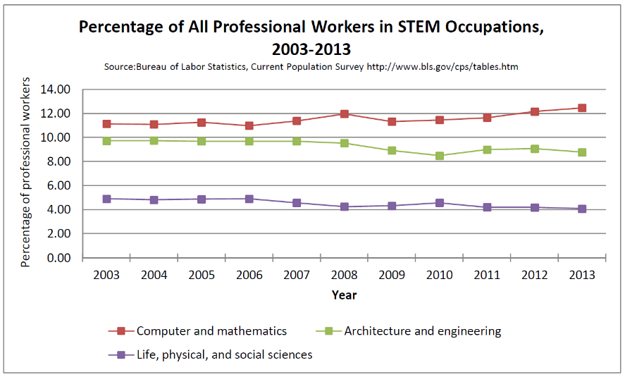
Motivation – The STEM Workforce
What is STEM anyway?
STEM = Science, Technology, Engineering, and Math.
Defined as “people who create knowledge”.
This doesn’t include health practitioners.
Who are these STEM people?
In 2013, there were 142M jobs in the US.
Of these, 8M were in STEM (1 of ~18).
3.8M in Computers & Math
2.85M in Architecture & Engineering
1.35 in Science
That’s 25% of the professional workforce.
That’s 5% of the overall workforce

Slide 4
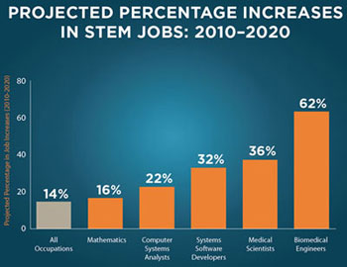
Motivation – The STEM Workforce
STEM Fuels the US economy
STEM innovations account for 50% of the growth in U.S. economy.
Predicted growth rate through 2018 in STEM jobs (20.6%).
Predicted growth rate through 2018 in non-STEM jobs (10.1%).
Jobs are shifting from non-STEM to STEM.

Slide 5
Motivation – The STEM Workforce
Are We Producing Enough STEM Grads To Meet the Demand?
There are 8M STEM workers in the U.S. right now.
9M+ by 2022.
U.S. STEM Workforce (8M)
287k STEM Openings

Slide 6
Motivation – The STEM Workforce
The Question requires looking at the entire pipeline
Data can be difficult to find.
Different sources define STEM professions differently. We use NSF def.
K-12
(3M/yr)
U.S. STEM Higher Ed
U.S. STEM Workforce (8M)
287k STEM Openings

Slide 7
Motivation – The STEM Workforce
The STEM Pipeline
Who enters U.S. higher education system?
International
K-12
(3M/yr)
U.S. STEM Higher Ed
U.S. STEM Workforce (8M)
25% STEM
60% entering choose STEM
287k STEM Openings
40% non-STEM
35% Don’t Enter College

Slide 8
Motivation – The STEM Workforce
The STEM Pipeline
Who obtains a STEM degree?
International
65k – 80k H1B
K-12
(3M/yr)
U.S. STEM Higher Ed
U.S. STEM Workforce (8M)
287k BS
25% STEM
92k MS
60% entering choose STEM
287k STEM Openings
25k PhD
40% non-STEM
35% Don’t Enter College
40% Don’t Persist to Graduation

Slide 9
Motivation – The STEM Workforce
The STEM Pipeline
Including retirement completes the flow diagram. Looks like we are fine?
International
65k – 80k H1B
K-12
(3M/yr)
U.S. STEM Higher Ed
U.S. STEM Workforce (8M)
Retire
287k BS
25% STEM
92k MS
235k
60% entering choose STEM
287k STEM Openings
25k PhD
~3%
40% non-STEM
35% Don’t Enter College
40% Don’t Persist to Graduation

Slide 10
Motivation – The STEM Workforce
The STEM Pipeline – The off roads are the concern.
Some STEM graduates don’t enter the field after getting a degree.
International
65k – 80k H1B
K-12
(3M/yr)
U.S. STEM Higher Ed
U.S. STEM Workforce (8M)
Retire
287k BS
25% STEM
92k MS
235k
60% entering choose STEM
287k STEM Openings
25k PhD
~3%
40% non-STEM
35% Don’t Enter College
40% Don’t Persist to Graduation
50% Don’t Choose a STEM Career

Slide 11
Motivation – The STEM Workforce
The STEM Pipeline – The off roads are the concern.
People leave the workforce at an alarming rate.
International
65k – 80k H1B
K-12
(3M/yr)
U.S. STEM Higher Ed
U.S. STEM Workforce (8M)
Retire
287k BS
25% STEM
92k MS
235k
60% entering choose STEM
287k STEM Openings
25k PhD
~3%
40% non-STEM
35% Don’t Enter College
40% Don’t Persist to Graduation
50% Don’t Choose a STEM Career
Opt Out of Profession
(only 26% of people w/ STEM degrees work in STEM ages 22-65)

Slide 12
Motivation – The STEM Workforce
The off-roads impact certain demographics more than others
The fastest growing fields have the most severe underrepresentation of women.

Slide 13
Motivation – The STEM Workforce
The off-roads impact certain demographics more than others
The fastest growing fields have the most severe underrepresentation of women.
Growth in the area of computers accounted for over 90% of the job growth in STEM occupations between 2003 and 2013.
Yet only 26% of jobs in this area were held by women.
The percentage of BS degrees awarded to women in this area decreased from 23% to 18% between 2004 and 2014.

Slide 14
Motivation – The STEM Workforce
The off-roads impact certain demographics more than others
The fastest growing fields have the most severe underrepresentation of women.
Growth in the area of computers accounted for over 90% of the job growth in STEM occupations between 2003 and 2013.
Yet only 26% of jobs in this area were held by women.
The percentage of BS degrees awarded to women in this area decreased from 23% to 18% between 2004 and 2014.
Women are 45% more likely than their male peers to leave the STEM industry within their first year. By age 35, 52% of women employed in STEM leave the field (Hewlett, 2008).

Slide 15
Personal Learning
Why do people leave STEM? It depends on the student.
Our intellectual skills.
The first thing we think of when we talk about “learning”.
1) COGNITIVE
Our feelings (attitudes, motivation, willingness to participate, value of what is being learned).
Heavily influences success of cognition.
2) AFFECTIVE
Motor skills.
Cognition is underlying component, but practice-makes-perfect.
3) PSYCHOMOTOR

Slide 16
Personal Learning
Why do people leave STEM? It depends on the student.
Motivation = Expectancy x Value
More than just wanting good grades & lots of money…
Will a student “choose” a STEM degree
Will the student put in the time necessary to achieve graduation.
Will the person “choose” a STEM profession.
Will the professional “choose” to stay in STEM.
(Atkinson 50’s 60’s, Eccles 80’s)

Slide 17
Personal Learning
Why do people leave STEM? It depends on the student.
Motivation = Expectancy x Value
Beliefs about one’s own ability and chances for success.
(Atkinson 50’s 60’s, Eccles 80’s)

Slide 18
Personal Learning
Why do people leave STEM? It depends on the student.
Motivation = Expectancy x Value
Beliefs about the importance of the tasks.
(Atkinson 50’s 60’s, Eccles 80’s)

Slide 19
Personal Learning
Why do people leave STEM? It depends on the student.
Motivation = Expectancy x Value
Beliefs about the importance of the tasks
Agentic
(self)
Communal
(others)
(Atkinson 50’s 60’s, Eccles 80’s)

Slide 20
Personal Learning
Why do people leave STEM? It depends on the student.
Motivation = Expectancy x Value
Beliefs about the importance of the tasks
Agentic
(self)
Communal
(others)
Simple interventions can make a big difference.

Slide 21
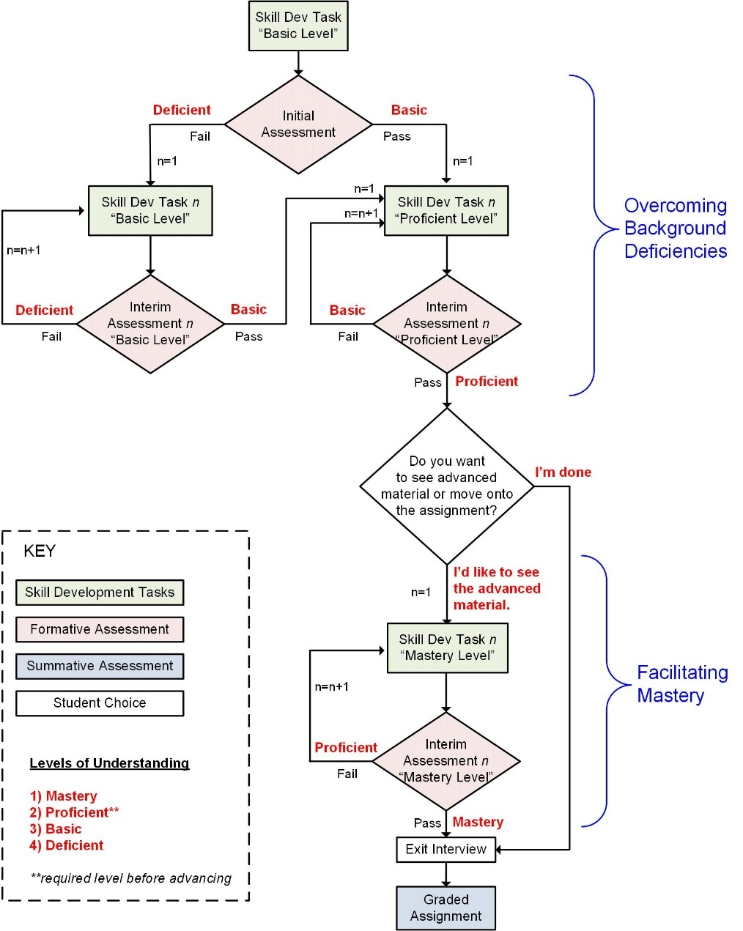
Adaptive Learning System
E-Learning Systems Have Major Potential
Personalized instruction without instructor resources
Address background deficiencies
Challenge top students

Slide 22
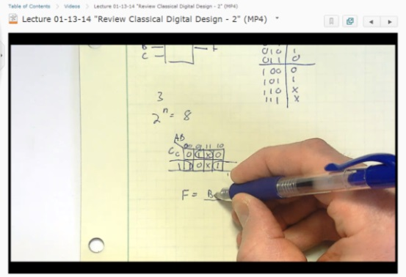
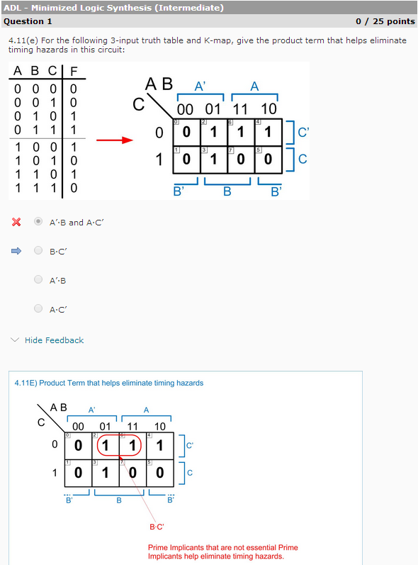
Adaptive Learning System
They are becoming practical
Course management systems support the creation.
Publishers are providing more sophisticated e-learning environments.

Slide 23
Demographic Consideration
If we have the attention of the student, why not make the material “relevant”.
Wording of problems and choice of examples can make material “relevant”.
“Relevance” varies between students
Agentic vs. Communal value systems.
Values often track demographics.
But it’s a lot of work to make material relevant to many different student groups!
That’s where the e-learning system has great potential.
The system automatically tailors the material based on the individual.

Slide 24
Personal Learning
A simple example: The traditional question format
Example 1. Calculating How Long a Battery Will Last
Concept | DC Power Consumption
Problem Statement | A 9v battery is has a capacity of 500 mAh. If you are driving a circuit that consumes 20mW of power, how long will the battery last?

Slide 25
Personal Learning
A simple example: More relevant to the millennials.
Example 2. Calculating How Long a Battery Will Last
Concept | DC Power Consumption
Problem Statement | Your smart phone consumes 1W of power. Its rechargeable battery has a capacity of 1000 mAh. If you charge your phone overnight and then disconnect it at 8am when you go to class, at what time will you run out of power?

Slide 26
Personal Learning
A simple example: More relevant to communal value systems.
Example 3. Calculating How Long a Battery Will Last
Concept | DC Power Consumption
Problem Statement | A pacemaker consumes 1nW of power. Its battery has a capacity of 100mAh. How long will the pacemaker operate before it needs to be replaced?

Slide 27
Our Current Work
Introduction Logic Circuits Course
A lower-level course found is all ABET accredited EE/CpE Programs
Analog vs. Digital
Number Systems
Digital Circuits & Interfacing
Combinational Logic Design
VHDL – part 1
MSI Logic
Sequential Logic Design
VHDL – part 2
Behavioral Modeling Techniques
Semiconductor Memory
Programmable Logic
Arithmetic Circuits
Computer Systems

Slide 28
Current Work
Step 1: Define Learning Outcomes

Slide 29
Current Work
Step 1: Define Learning Outcomes Cont…

Slide 30
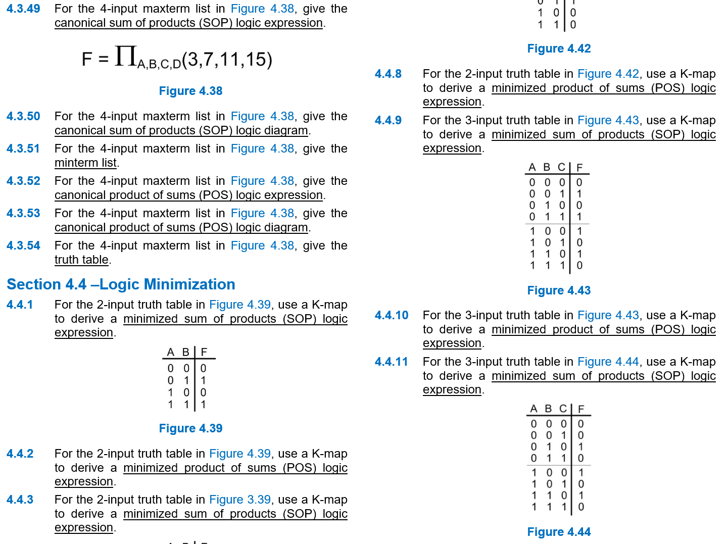
Current Work
Step 2: Create Assessment Tools
Over 600 questions developed.
Care taken to match assessment to level of learning (i.e., knowledge, design, etc..)
Multiple-Choice + VHDL Design

Slide 31
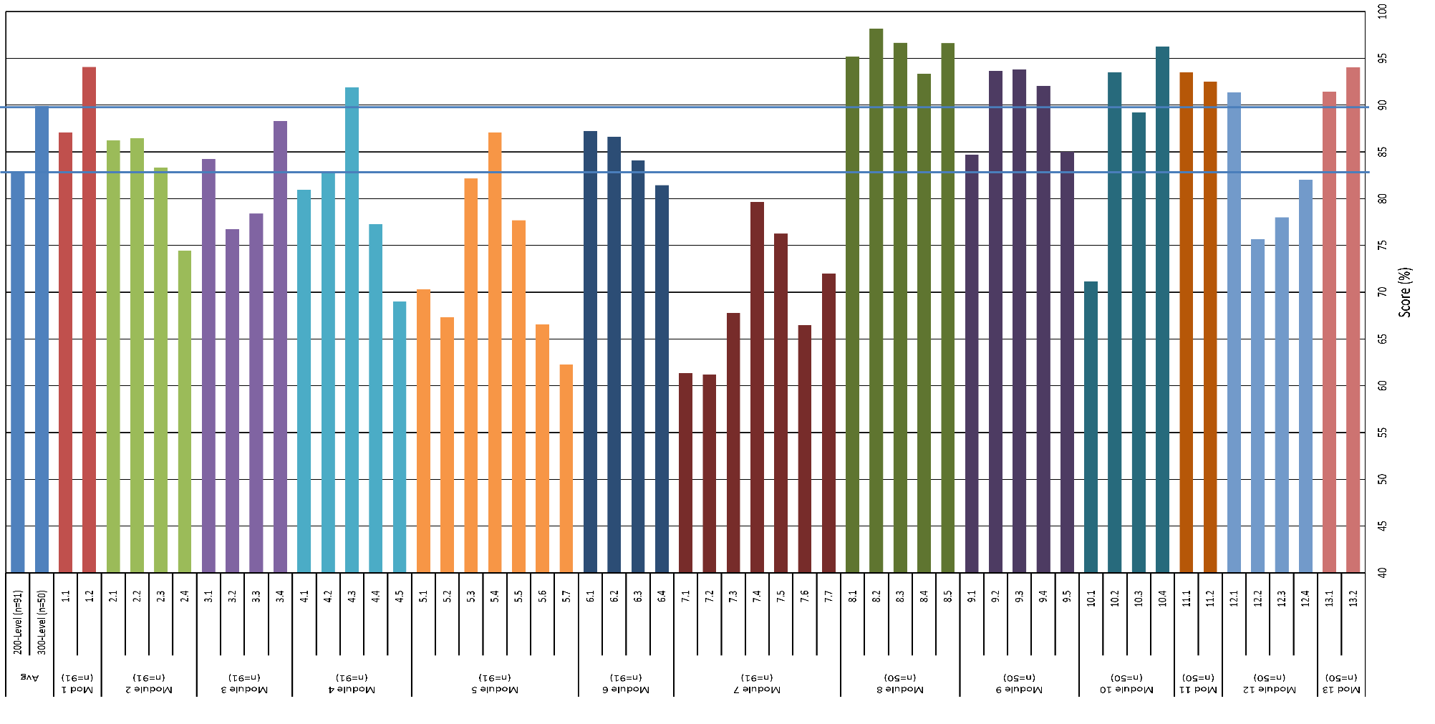
Current Work
Step 3: Collect Baseline Understanding to Identify “Stress-Points”
Mod 1
(n=91)
Module 2
(n=91)
Module 3
(n=91)
Module 4
(n=91)
Module 5
(n=91)
Module 6
(n=91)
Module 7
(n=91)
Module 8
(n=50)
Module 9
(n=50)
Module 10
(n=50)
Mod 11
(n=50)
Module 12
(n=50)
Mod 13
(n=50)

Slide 32
Current Work
Step 3: Collect Baseline Understanding to Identify “Stress-Points”
Fall 2016: Targets have both low score AND high “cognitive difficulty”.
Module 4.4
Module 5.5
Mod 1
(n=91)
Module 2
(n=91)
Module 3
(n=91)
Module 4
(n=91)
Module 5
(n=91)
Module 6
(n=91)
Module 7
(n=91)
Module 8
(n=50)
Module 9
(n=50)
Module 10
(n=50)
Mod 11
(n=50)
Module 12
(n=50)
Mod 13
(n=50)

Slide 33
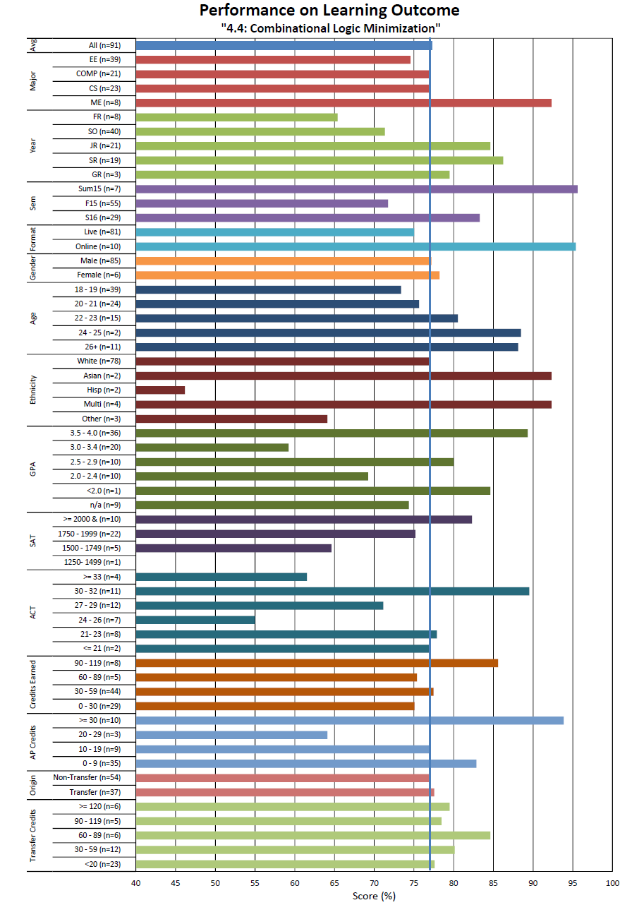
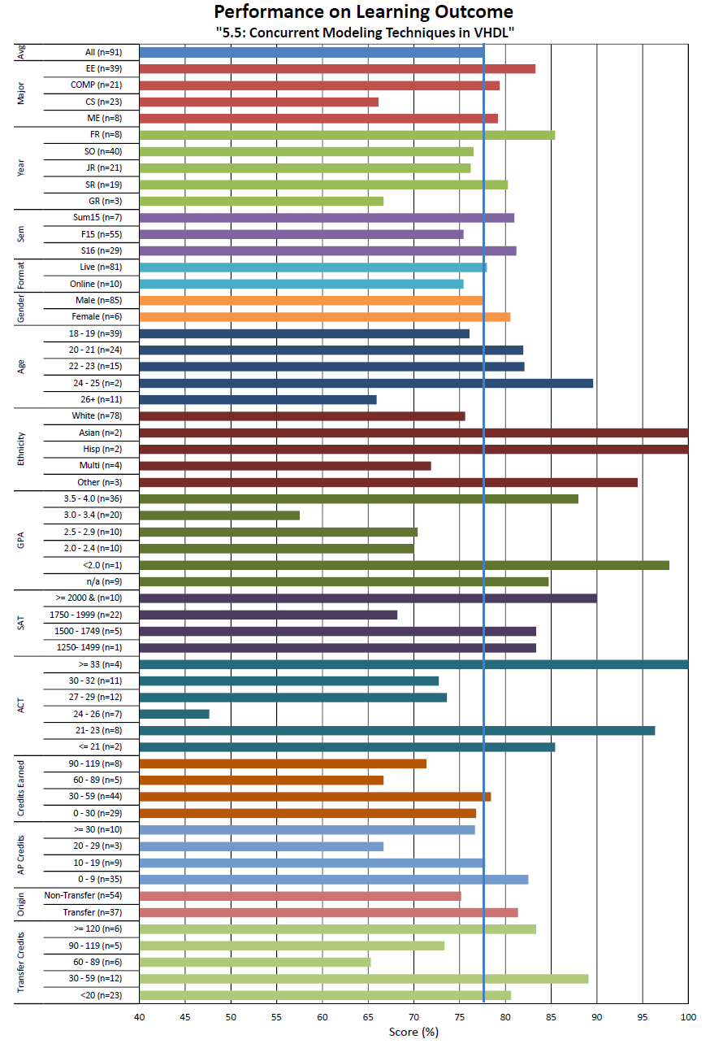
Current Work
Step 3: Collect Baseline Understanding to Identify “Stress-Points”
Also breakdown demographics for more insight

Slide 34
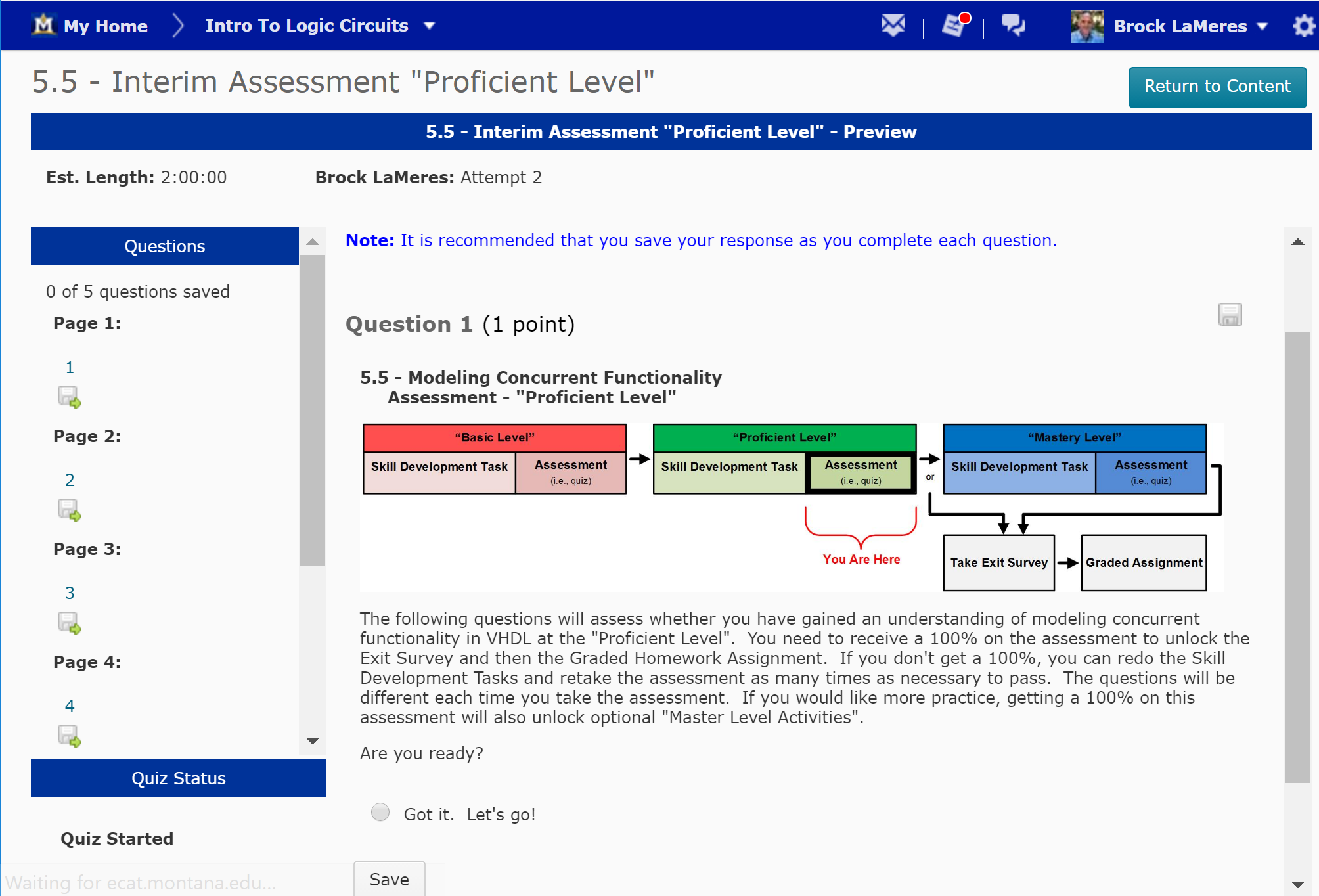
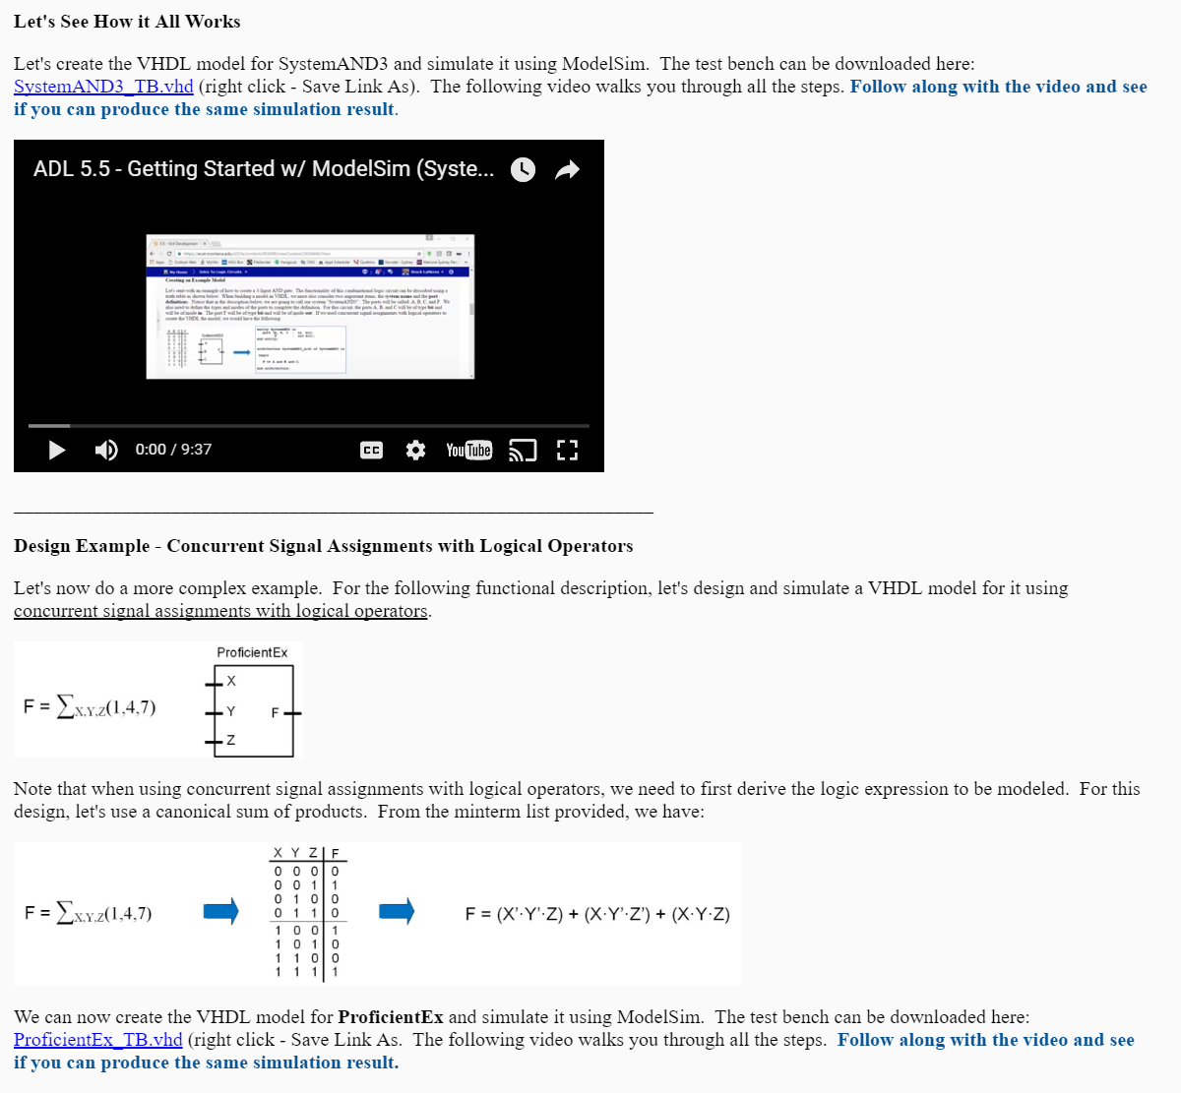
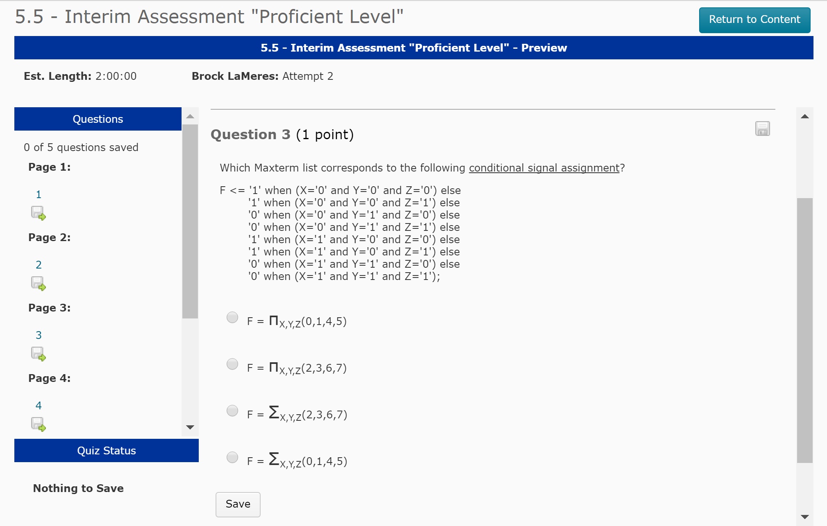
Current Work
Step 4: Implement Adaptive Learning Modules

Slide 35
Current Work
Step 5: Measure Impact
Initial Results Look Promising
+14%
+18%
Mod 1
(n=91)
Module 2
(n=91)
Module 3
(n=91)
Module 4
(n=91)
Module 5
(n=91)
Module 6
(n=91)
Module 7
(n=91)
Module 8
(n=50)
Module 9
(n=50)
Module 10
(n=50)
Mod 11
(n=50)
Module 12
(n=50)
Mod 13
(n=50)

Slide 36
Next Steps
Year 1 (done)
Defined 13 broad learning objectives across two courses in digital logic.
Defined 60 specific learning outcomes to be measured.
Developed over 600 assessment tools (i.e., homework questions).
Implemented in course management system as auto-graded assignments.
Collected baseline data on student performance across 3 semesters (n=220).
Year 2 (now)
Implement adaptive learning modules.
Assess Impact.
Year 3 (future)
Implement demographic-specific examples and implement in adaptive learning modules.
Assess Impact.

Slide 37
Lessons Learned
Consent Forms
Difficult to obtain demographic information.
We learned if coded sufficiently, we can pull data from university data base.
Auto-grading leads to poor students impacting results.
Failing students are able to login and turn in assignments at the last minute.
Assessment measures need to match learning outcome category.
If the learning outcome targets “synthesis”, the assessment tools can’t ask questions about “analysis”.
Labs are rich with assessment data, but hard to grade.
Most learning in engineering occurs in the lab. But lab demonstrations are typically pass/fail.
Lab reports graded with rubrics give great assessment data, but scaling becomes impractical.

Slide 38
Questions
Thank you
[G]

Slide 39
References
J. Bourne, D. Harris, and F. Mayadas, “Online engineering education: Learning anywhere, anytime”, J. Eng.Educ., vol. 94, pp. 131-146, Jan. 2005.
R.E., Gomery, “Internet Learning: Is it real and what does it mean for universities?”, Journal of Asynchronous Learning Networks, vol. 5, No. 1, pp. 139-146, 2001.
Grose, T.K., “Can Distance Education be Unlocked?”, Prsim, Vol 12, No. 8, April 19-23, 2003.
“The Power of the Internet for Learning – Moving from Promise to Practice”, Report of the Web-Based Education Commission to the President and the Congress of the United States, Dec. 2000.
B. Means, et. Al., “Evaluation of Evidence-Based Practices in Online Learning: A Meta-Analysis and Review of Online Learning Studies”, U. S. Dept of Education, Office of Planning, Evaluation, and Policy Development, Center for Technology in Learning, Sept 2010.
A.F. Mayadas, “Testimony to the Kerrey Commission on Web-Based Education”, Journal of Asynchronous Learning Networks, Vol. 5, No. 1, pp. 134-138, 2001.
A. Jaggars and T. Bailey, “Effectiveness of Fully Online Courses for College Students: Response to a Department of Education Meta-Analysis”, Community College Research Center, Teachers College, Columbia University, New York, 2010.
D. Figlio, M. Rush, and L. Yin, “Is It Live or Is It Internet? Experimental Estimates of the Effects of Online Instruction on Student Learning”, Working Paper 16089, National Bureau of Economic Research, Cambridge, MA, June 2010.
Maki, W.S.; Maki, R.H.; , "Learning without lectures: a case study," Computer , vol.30, no.5, pp.107-111, May 1997.
C. Scherrer, R. Butler, and S. Burns, "Student Perceptions of On-Line Education," Advances in Eng. Edu., 2010.
M. Holdhusen, "A Comparison of Engineering Graphics Courses Delivered Face to Face, On Line, Via Synchronous Distance Education, and in Hybrid Formats," Proceedings of the Annual Conference of the American Society for Engineering Education, June 2009.
A. Enriquez, "Assessing the Effectiveness of Dual Delivery Mode in an Online Introductory Circuits Analysis Course," Proceedings of the Annual Conference of the ASEE, June 2010.
J. Carpinelli, R. Calluori, V. Briller, E. Deess, and K. Joshi, "Factors Affecting Student Performance and Satisfaction in Distance Learning Courses”, Proceedings of the Annual Conference of the ASEE, June 2006.
D. R. Wallace and P. Mutooni, “A comparative evaluation of world wide web-based and classroom teaching”, Journal of Engineering Education, vol. 86, pp. 211–220, Jul. 1997.
K.S. Cheung, J. Lam, t. Im, R. Szeto, J. Yau, "Exploring a Pedagogy-Driven Approach to E-courses Development", Education Technology and Training, 2008. and 2008 International Workshop on Geoscience and Remote Sensing. ETT and GRS 2008. International Workshop on, vol.1, no., pp.22-25, 21-22 Dec. 2008.
“ADEC Guiding Principles for Distance Learning”, American Distance Education Consortium, 2002.
“Southern Regional Education Board’s (SREB) Electronic Campus Principles of Good Practice Checklist”, 2002.
“Middle States Commission on Higher Education. http://www.msche.org Distance Learning Programs: Interregional Guidelines for Electronically Offered Degree and Certificate Programs”, 2002.
L.D. Feisel and A.J. Rosa, “The Role of the Laboratory in Undergraduate Engineering Education”, Journal of Engineering Education, Vol. 94, No. 1, pp. 121-130, 2001.
L. Feisel, G.D. Peterson, “A Colloquy of Learning Objectives for Engineering Educational Laboratories”, 2002 ASEE Annual Conference and Exposition, Montreal, Ontario, Canada, June 16-19, 2002.
M. Cooper, J.M.M. Ferreira, "Remote Laboratories Extending Access to Science and Engineering Curricular," Learning Technologies, IEEE Transactions on , vol.2, no.4, pp.342-353, Oct.-Dec. 2009.
Michael E Auer, Christophe Gravier, "Guest Editorial: The Many Facets of Remote Laboratories in Online Engineering Education", Learning Technologies, IEEE Transactions on , vol.2, no.4, pp.260-262, Oct.-Dec. 2009.

Slide 40
References
J. Ventura, R. Drake, J. McGrory, "NI ELVIS has entered the lab [educational laboratory virtual instrumentation suite]," SoutheastCon, 2005. Proceedings. IEEE, pp. 670- 679, 8-10 April 2005.
E. Sancristobal, et al., "State of Art, Initiatives and New Challenges for Virtual and Remote Labs", Advanced Learning Technologies (ICALT), 2012 IEEE 12th International Conference on, pp.714-715, 4-6 July 2012.
N. Lewis, M. Billaud, D. Geoffroy, P. Cazenave, T. Zimmer, "A Distance Measurement Platform Dedicated to Electrical Engineering", Learning Technologies, IEEE Transactions on , vol.2, no.4, pp.312-319, Oct.-Dec. 2009.
B. Pradarelli, L. Latorre, M.L. Flottes, Y. Bertrand, P. Nouet, "Remote Labs for Industrial IC Testing," Learning Technologies, IEEE Transactions on , vol.2, no.4, pp.304-311, Oct.-Dec. 2009.
“Desire2Learn Learning Management System”, Available [Online]: http://www.desire2learn.com/
“Camtasia Screen Recording and Video Editing Software”, Available [Online]: http://www.techsmith.com/camtasia.html
“7 things you should know about Lecture Capture”, EDUCAUSE, 2008, Available [Online]: http://www.educause.edu
“Getting Started with CodeWarrior Development Tools”, Available [Online]: www.freescale.com/mcu
“TLA5000B Logic Analyzer Series”, Tektronix Inc., Available [Online]: http://www.tek.com/logic-analyzer/tla5000
M. Stassen, M. Blaustein, R. Rogers, M. Shih, “Undergraduate Student Outcomes: A Comparison of Online and Face-to-Face Courses”, Report from the Comparative Outcomes Subcommittee for the University of Massachusetts Amherst Faculty Senate Ad Hoc Committee on Online Learning, July 2007, Available [Online]: http://www.umass.edu/oapa/oapa/publications/misc_docs/undergrad-student-outcomes.pdf
R.N. Gerlich, M. Sollosy, “Comparing outcomes between a traditional F2F course and a blended ITV course”, Journal of Case Studies in Education, vol.1., Jan. 2011.
J. Collins, E.T. Pascarella, “Learning on Campus and Learning at a Distance: A Randomized Instructional Experiment”, Research in Higher Education, Vol. 44, No. 3, June 2003.
M.D. Stroup, M.M. Pickard and K.E. Kahler, “Testing the Effectiveness of Lecture Capture Technology Using Prior GPA as a Performance Indicator”, Teacher-Scholar: The Journal of the State Comprehensive University, vol. 4, no. 1 Fall 2012.
Jeffrey Mervis, Data check: U.S. producing more STEM graduates even without proposed initiatives, ScienceInsider, June 30, 2014.
National Science Board, National Science Indicators, 2014 Report.

Slide 41
Figure References
NASA scientists at work. Circa 1960’s, www.reddit.com.
Bob Pease's Famously Tangles Prototype Circuit Board - RF Cafe, www.rfcafe.com
Open Access PLoS, CC BY-SA 3.0, http://www.plos.org/
The Importance of Personalized Learning, BY JEFFREY KATZMAN | PUBLISHED: OCTOBER 24, 2012, http://blog.xyleme.com/importance-personalized-learning-%E2%80%93-part-1-3-%E2%80%93-k12
FOMI, The Cost of Education in the States, 2010 http://www.fomi.nu/2010/03/the-cost-of-education-in-the-states/
Dr. Fly, Games, Simulations and Virtual Labs for STEM, flyrussell.com
Virtual Labs, www.wlz.da.in
Cartoon Man Thinking, www.dreamstime.com
Systems Thinking and Blooms Taxonomy, systemsandus.com
What we know, ICON Productions, www.icomproductions.ca
Lonesome spur Ranch, Bridger, MT, www.lonesomespur.com
Lexi Leventini, Confessions of a Farm Girl, http://lexileventini.wordpress.com/2013/03/25/confessions-of-a-farm-girl/, March 25, 2013
The Heart of Innovation, 14 Ways to Get Break Though Ideas, The Heart of Innovation: 14 Ways to Get Breakthrough Ideaswww.ideachampions.com
The History of Online Education, straighterline.com,
Non-Degree & Alumni, admissions.yale.edu
Teaching through Questions, NIU, niu.edu

Slide 42
HICE REF
Plugging the leaks in the STEM pipeline, Complete College American, March 2014

