Slide 1
Welcome to Faculty Senate!
Colter Ellis
Faculty Senate Chair
Sociology & Anthropology
Stephanie McCalla
Faculty Senate Chair-Elect
Chemical & Biological Engineering

Slide 2
Gentle Reminders
Faculty Senate is an open and public meeting
Please, only Senators speak in the meeting, unless you are specifically called on by the Chair or Chair-elect to speak
Public may address the Senate at end of the meeting during public comment
Be kind to each other.

Slide 3
Approval of FS Minutes from April 3, 2024
Do I have a motion to approve?
Any discussion?
All those in favor of the motion indicate by saying aye
Those not in favor of the motion indicate by saying nay

Slide 4
FYI Items
Choices (benefits) re-enrollment starts April 24, 2024 and will be open through May 15. The new plan year begins July 1, 2024
The deadline for 12 month pay (26 paychecks) is May 17, 2024. No action is necessary if you do not wish to opt into this program.
  Form to opt into 12 month pay
  FAQ on 12 month pay
  For more information, contact: msupayroll@montana.edu or call 406.994.3651.
Dean Ilse-Mari Lee’s retirement celebration is Monday, April 22, 2024 at 4-6pm in the Leigh Lounge (SUB).
Bringing back a faculty senate tradition

Slide 5
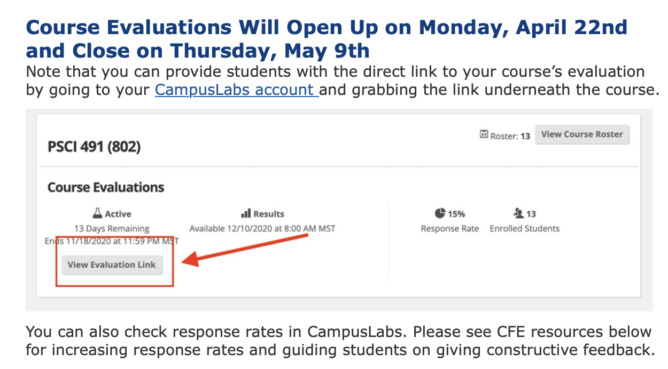
FYI Items

Slide 6
FYI Items
Pat Hughes, a dynamic facilitator, coach, and leadership educator, on April 26th, 2024, from 12:00 to 1:00 PM in Jabs Hall 103.
In September 2023, Pat published her latest book, "Creating Equity with Gracious Space: Applications in Inclusion and Belonging," offering practical strategies for cultivating inclusivity and equity in organizational settings.
This event is a rare opportunity to gain insights from Pat's innovative Gracious Space framework and learn how to create authentically inclusive climates. It promises to be an enlightening afternoon of empowerment and transformation!

Slide 7
Information Updates
AVP of Accounting and Finance Aaron Mitchell will discuss equipment inventory.

Slide 8
Questions?

Slide 9
Undergraduate Courses and Programs

Slide 10
Courses – First Reading
HEE 341 : Methods of Health Education 2
HEE 360 : Youth Movement Science
M 140 : College Math for Healthcare
M 170 : Supplemental Instruction in Trigonometry for Calculus
PSYX 194 : Psychology Pathways

Slide 11
Course Changes – First Reading
ACT 282 : Personal Trainer Certification
  Change in credits from one to two
ECP 122 : Wilderness First Responder
  Changes align with CCN course
    Change in rubric from ACT
    Change in number from 267
ECP 123 : Wilderness First Responder
  Changes align with ECP 122 change
  Change in rubric from ACT
  Change in number from 278
EIND 477 : Applied Statistical Quality Control with Python
  Title change from Quality Management Systems
  Changes to learning outcomes and description

Slide 12
Courses– Second Reading
ITS 299: Capstone
GPHY 408: Advanced Geospatial Analysis for Earth Sciences

Slide 13
Course Changes – Second Reading
BGEN 104US: First Year Business Seminar
  Title change from Business & Entrepreneurship fundamentals Seminar
PLTT 298: Internship/Cooperative Education or Final Project
  Title changed from Internship/Cooperative Education

Slide 14
Course Inactivations – Second Reading
MAS 260: USAF Aerospace Weapons

Slide 15
Programs – First Reading
-CTS : Certificate of Technical Studies in Behavioral Health

Slide 16
Graduate Courses and Programs

Slide 17
Courses – Second Reading
BGEN 525: Life Design and Career Development 2
BGEN 570: Business Law, Government, Society, and Ethics

Slide 18
Courses – Second Reading
BMGT 535: Applied Data Science
BMGT 560 : Innovation and Technology Strategy
BMGT 565: Operations and Supply Chain Management
BMGT 570: Leading for Influence
BMKT 580: New Product Innovation
BMKT 585: New Product Introduction

Slide 19
Courses – Second Reading
NRSG 651: FNP Diagnosis & Management I
NRSG 652: FNP Diagnosis & Management II
NRSG 653: FNP Diagnosis & Management III
NRSG 654: FNP Role Transition
NRSG 655: FNP Advanced Clinical I
NRSG 656: FNP Advanced Clinical II
NRSG 657: FNP Advanced Clinical III
NRSG 658: FNP Advanced Clinical IV
NRSG 661: PMHNP Diagnosis & Management I
NRSG 662: PMHNP Diagnosis & Management II
NRSG 663: PMHNP Diagnosis & Management III
NRSG 664: PMHNP Diagnosis & Management IV
NRSG 665 : PMHNP Advanced Clinical I
NRSG 666: PMHNP Advanced Clinical II
NRSG 667: PMHNP Advanced Clinical III
NRSG 668: PMHNP Advanced Clinical IV

Slide 20
Senate Open Discussion

Slide 21
Public Comment
(Two minutes per person)

Slide 22
Do I have a motion to adjourn?
Second?

