Slide 1
INTERNATIONAL RECRUITMENT AND ADMISSIONS

Slide 2
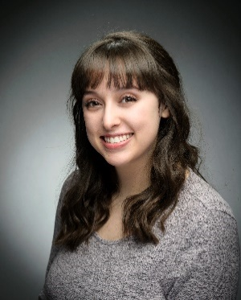
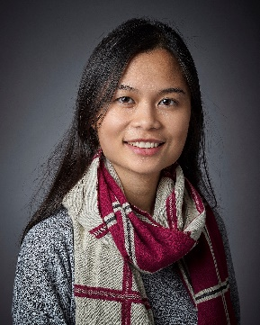
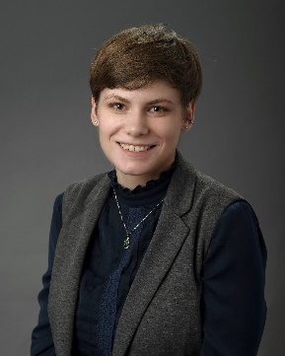
Meet our team International Recruitment & Admissions
Erin Boyd
International Admissions Coordinator
406-994-7252
erin.boyd1@montana.edu
Que Vo
International Student Recruiter
406-994-7418
que.vo01@montana.edu
Katelen Bennett
International Credential Evaluator
406-994-7181
katelen.bennett@montana.edu

Slide 3
Table of Contents
Why Bozeman, Montana
Why Montana State University
Academic Programs Overview
Undergraduate Admissions Requirement and Process
Graduate Admissions Requirement and Process
Tuition and Fees
Undergraduate Scholarship
International Students Spotlight

Slide 4
BOZEMAN- MONTANA Home of Montana State University

Slide 5
Source: https://www.youtube.com/watch?v=tT8Xj7HVGNQ&list=RDQMK-5fSrdaDgA&start_radio=1

Slide 6
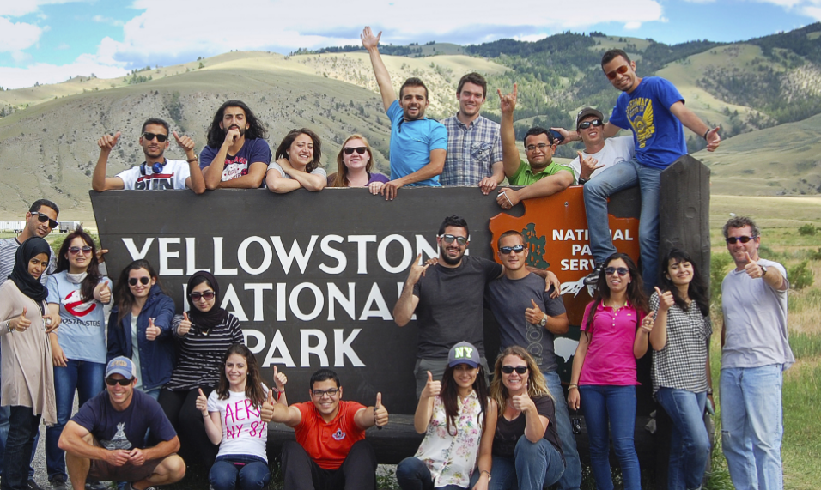
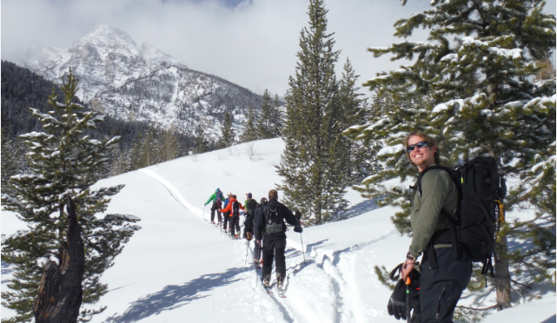
Why Bozeman
Endless Outdoor Activities
Top 7 Trail Town with 30 trailheads within an hour’s drive (Trail Runner)
Top 5 Ski Town in the world (National Geographic)
1.8 million acres of nearby wilderness and Yellow Stone National Park

Slide 7
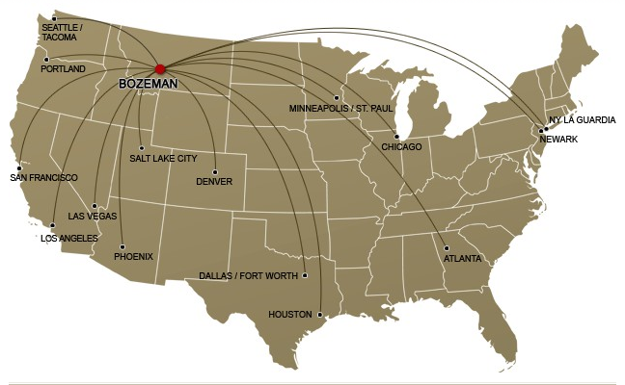
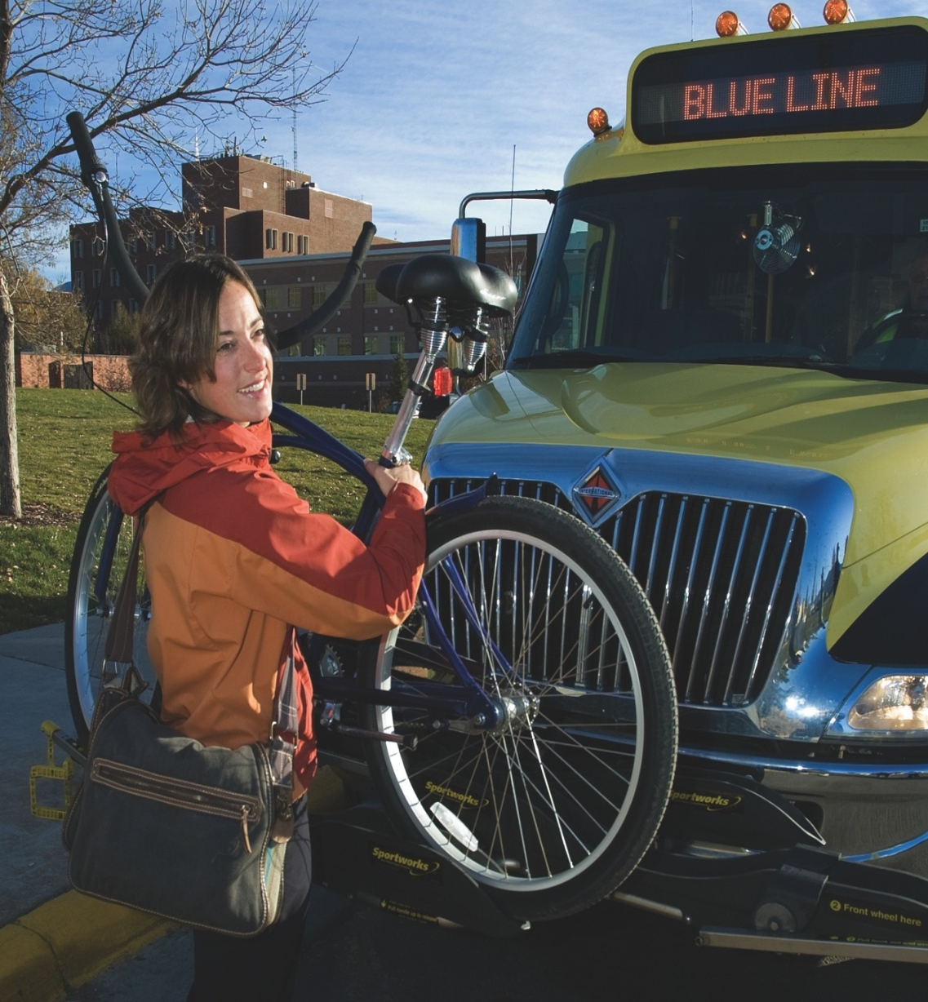
Why Bozeman
Safety and Convenience
#2 safest city in Montana (National Council for Home Safety and Security, 2019)
Free bus system
Direct flights from Bozeman Yellowstone International Airport to big cities like Chicago, Las Vegas, New York…
In less than 30 minute drive:
Shopping: Cosco, Walmart, Target, Macy…
Food and drink: Restaurants serve food from different countries

Slide 8
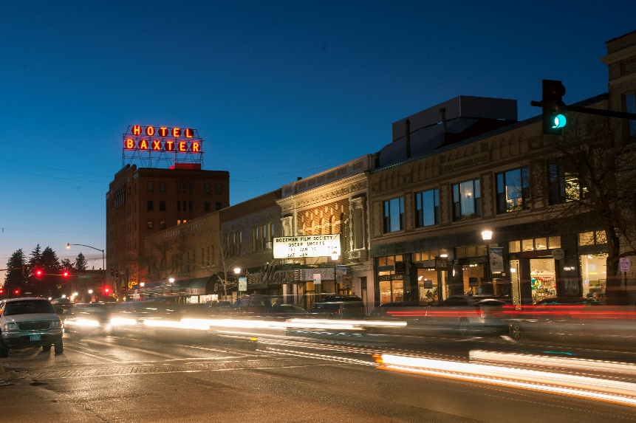
Why Bozeman
New Opportunities
#1 Strongest Micropolitan Areas (Policom, 2019)
#1 Best Places to Live in America (Money, 2017)

Slide 9
MONTANA STATE UNIVERSITY Home of the Bobcats

Slide 10
Welcome to Montana State University

Slide 11
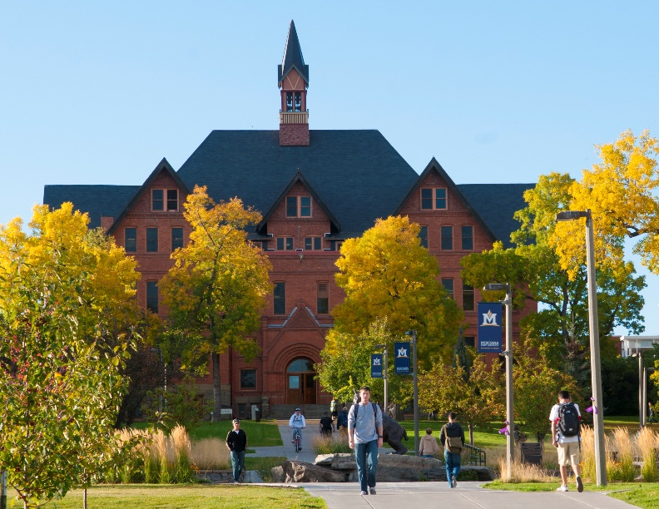
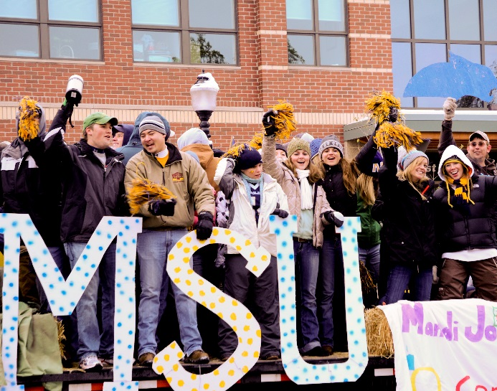
Montana State University
Quick Facts
National Public University
Established 1893
Land-grant institution
Largest institution in the state of Montana with 16,902 students
575 international students from 70+ countries.
Top 5 international student population at MSU: Saudi Arabia, Turkey, Kuwait, China, and India
Faculty to student ratio: 19:1

Slide 12
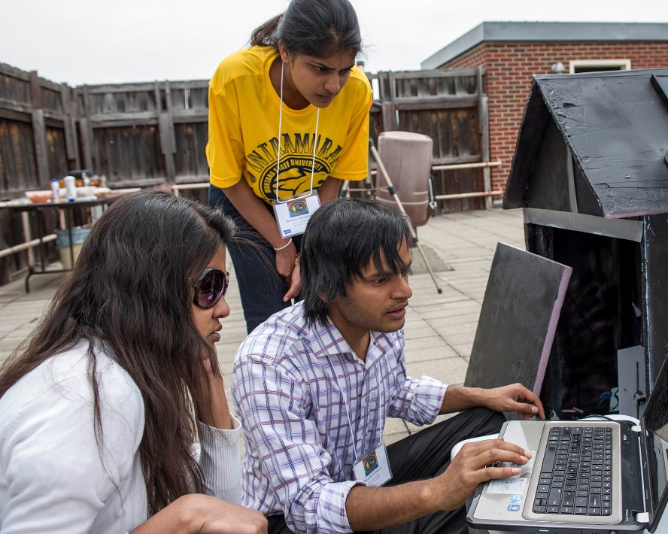
Why MSU
Active Research
Tier 1 – Very High Research University
One of only two universities with a Carnegie enrollment profile of “Very High Undergraduate”
Top 3% of the World’s Institution of Higher Education
$100 million Annual Research Expenditure
Research takes place in 44 research centers and more than 300 on-campus labs

Slide 13
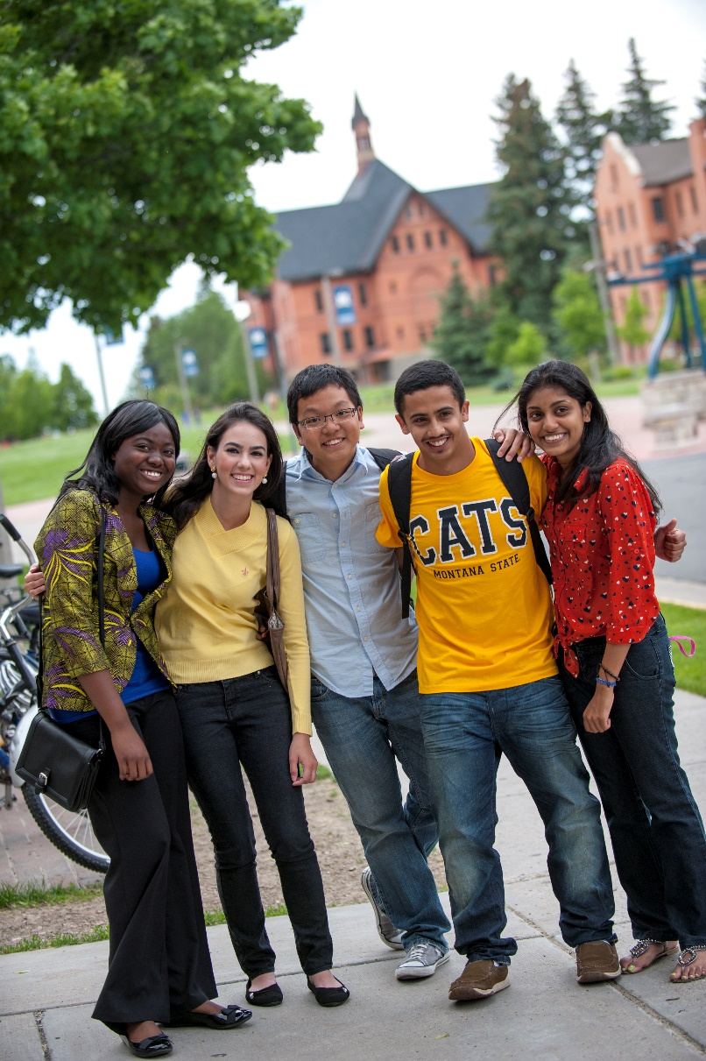
Why MSU Great Value
Top 10 Return on Investment for Public Universities in the Western Region (Best Values Schools, 2018)
#2 Great Affordable Colleges for Outdoor Enthusiasts (Great Values Colleges, 2019)

Slide 14
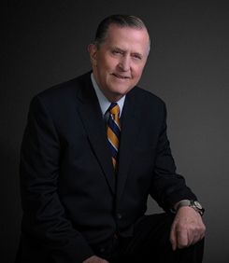
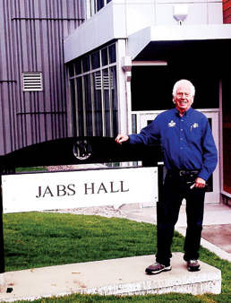
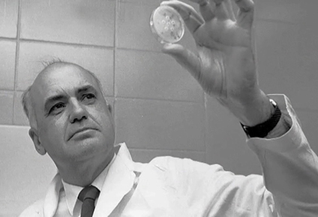
Why MSU Outstanding Alumni
Maurice Hilleman: Inventor of 8 life-saving vaccines (Chickenpox, Haemophilus influenza, Hepatitis A, Hepatitis B, Measles, Meningitis, Mumps, Pneumonia)
Norm Asbjornson: CEO, Chairman of the Board & Founder: AAON, Inc
Jake Jabs: President & CEO, American Furniture Warehouse

Slide 15
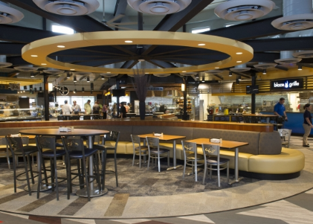
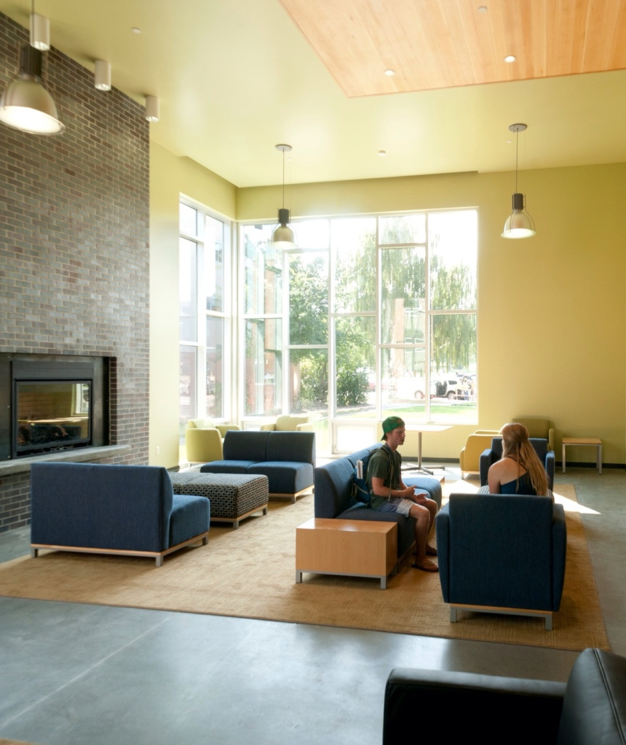
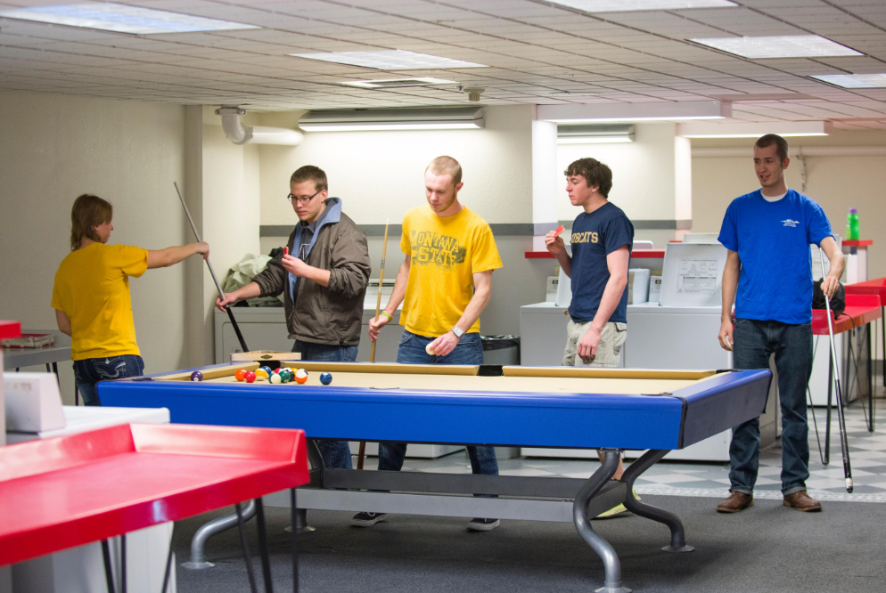
Why MSU
Your Home Away From Home
11 Residence Halls
Miller Dining Commons won the Grand Prize at the National Association of College and University Food Services’ awards.
Mixed gender of single gender housing options
Single or double occupancy
Each residence hall provides free cable service, free linen service, furnishing, and printing
Some residence halls also provide: outdoor patio with grills, common area kitchen, game room, and more
Notes:
11 Residence Halls
Miller Dining Commons won the Grand Prize at the National Association of College and University Food Services’ awards.
Each residence hall provides:
Free cable service
Free linen service
Furnishings
Printing
Some residence halls provide:
Outdoor patio with grills
Common area kitchen
Social lounges and quiet study lounges
Music practice room
Living Learning Community
Game room

Slide 16
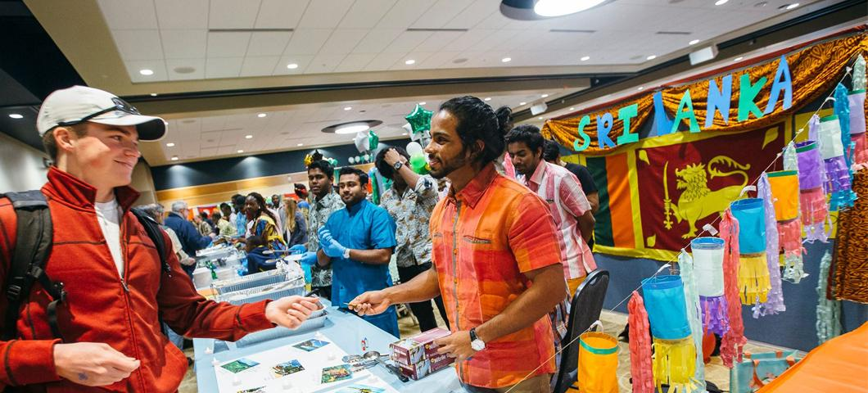
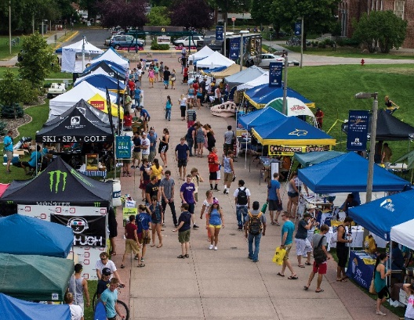
Why MSU
Welcoming Community
More than 575 international students from 70+ countries
International Events and Associations:
International Street Food Bazaar
Conversation Partners
International Education Week
…and countless cultural organizations!

Slide 17
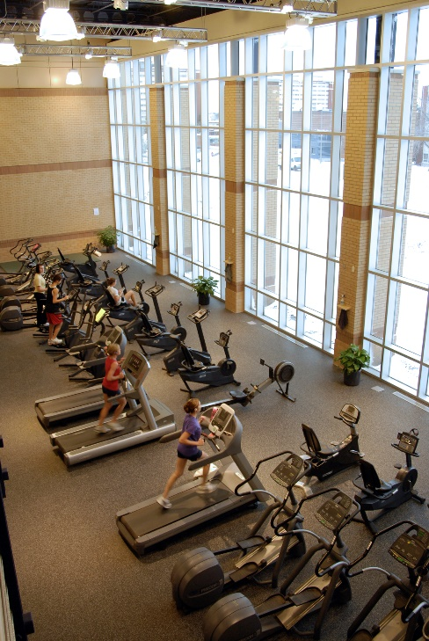
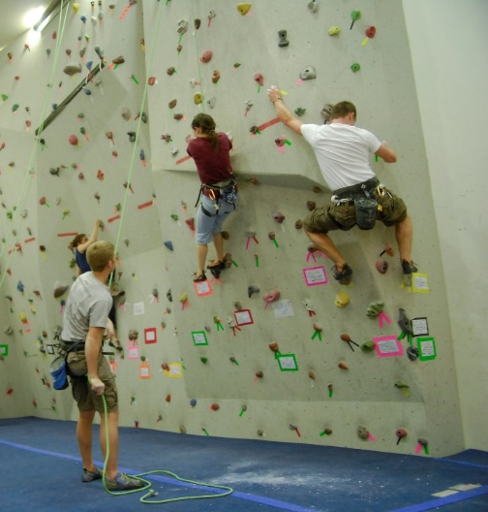
Why MSU
Active Lifestyle
#1 Best Colleges in the USA for outdoor sports and recreation (LendEDU, 2017)
MSU students can rent gear like rafts, fly rods, skis, tents, mountain bikes at MSU Outdoor Recreation
Other activities:
Personal fitness
Group exercise
Massage
Intramurals
Club sports

Slide 18
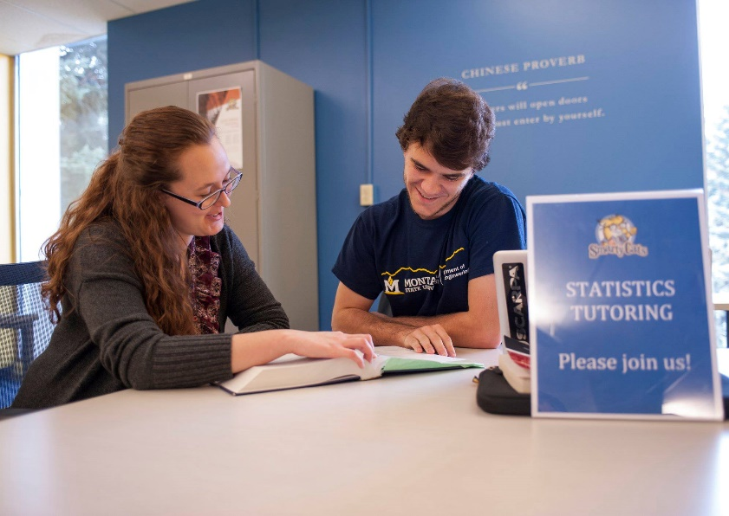
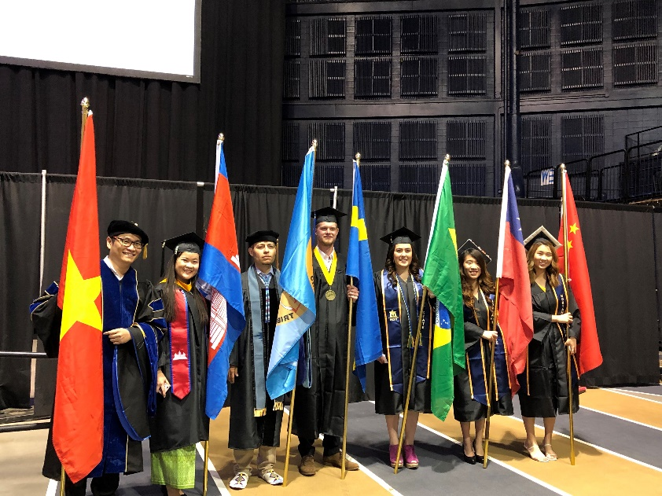
Why MSU
Prepare For Student’s Success
Allen Yarnell Center for Student Success
Career, Internship, & Student Employment Services
Help writing resumes and cover letters
Interview training
Over 100 employers & organizations attend the bi-annual Career Fair
Boeing, Exxon-Mobil, Microsoft, PricewaterhouseCoopers, Eli Lilly, Kraft Foods
Optional Practical Training (OPT)
STEM-related graduates can stay and work for 2 years
All other graduates can stay and work for 1 year

Slide 19
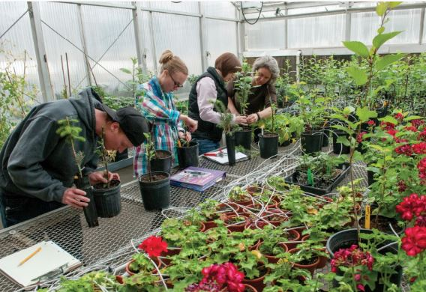
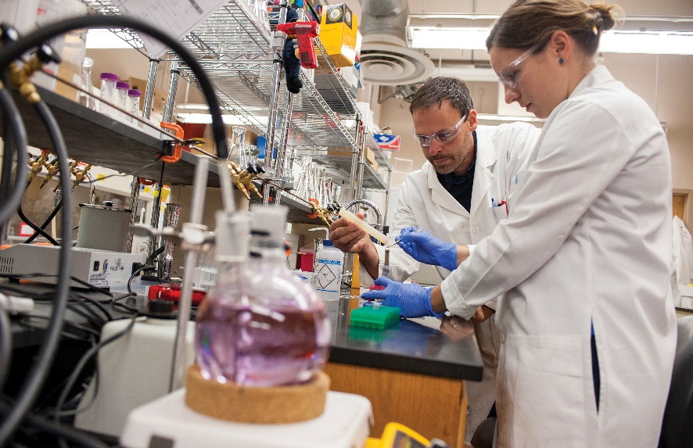
Why MSU
Strong Academic Programs
College of Agriculture
College of Arts & Architecture
College of Business & Entrepreneurship
College of Engineering
College of Education, Health, & Human Development
College of Letters (Humanities) & Sciences
College of Nursing

Slide 20
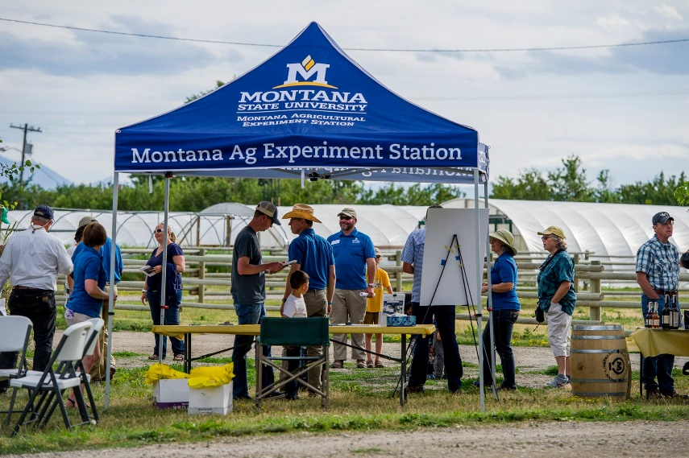
College of Agriculture
The Sustainable Food & Bioenergy Systems Program is in the Top 10 Environmental Programs in the US – Mother Nature Network
3 of the Top 5 departments at MSU in terms of research expenditures
The largest number of distinct scholarships awarded by any college at MSU.
Highlighted majors:
Agriculture Business
Environmental Science
Environmental Horticulture
Biotechnology
Plant Science

Slide 21
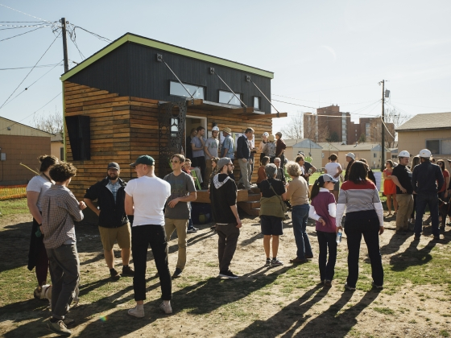
College of Arts and Architecture
The Architecture program is accredited by the National Council of Architecture (NAAB)
Home to the world’s only master’s degree in Science and Natural History Filmmaking
The nation’s first accredited five-year master’s of architecture program
Highlighted majors:
Architecture
Graphic Design
Film
Photography
Music Technology

Slide 22
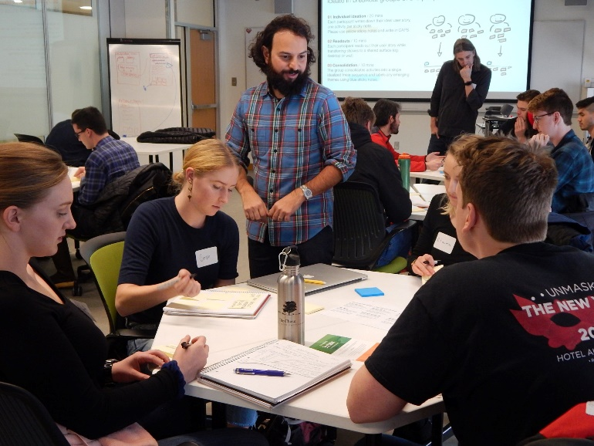
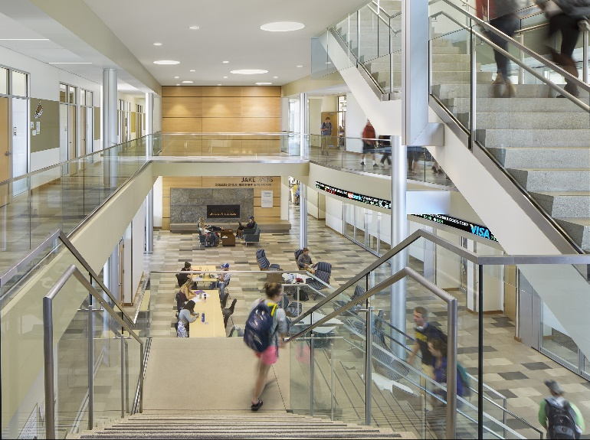
College of
Business and Entrepreneurship
AACSB Accredited
#1 Most affordable accounting master program 2018-2019 in Montana (AccountingEdu.org)
4+1 Master of Professional Accountancy
The MSU Blackstone LaunchPad which is housed under the college of business, is an entrepreneurial resource for students, alumni and faculty across the university and community
Highlighted majors:
Finance
Accounting
Management
Marketing

Slide 23
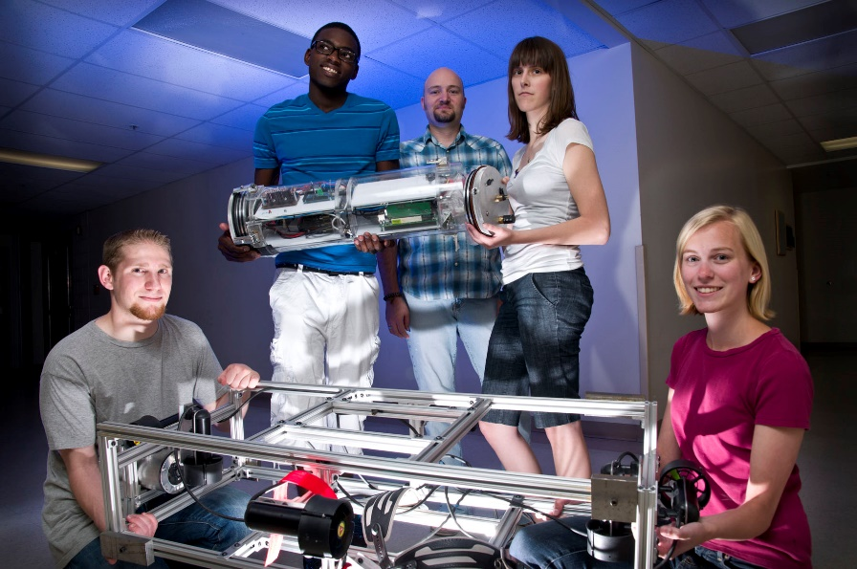
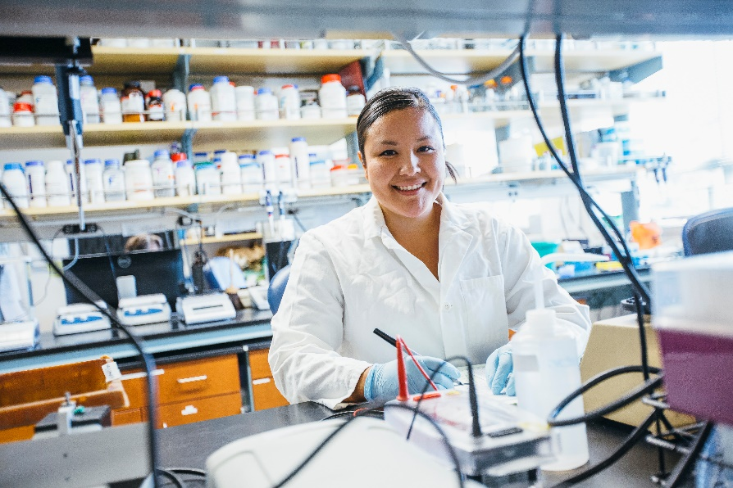
College of Engineering
ABET accredited
MSU Engineering students have helped send prototypes of new radiation-resistant computers into space with NASA funding
#5 on best American colleges for Mechanical Engineering (Schools.com, 2018)
Top employers include Boeing, Micron, Google
Highlighted majors:
Computer Science
Computer Engineering
Electrical Engineering
Mechanical Engineering
Industrial & Management System Engineering
Construction Engineering Technology
Notes:
The following engineering programs are accredited by the Engineering Accreditation Commission of the Accreditation Board for Engineering and Technology, Inc., known as ABET:
Chemical Engineering
Civil Engineering
Computer Engineering
Electrical Engineering
Industrial Engineering
Mechanical Engineering

Slide 24
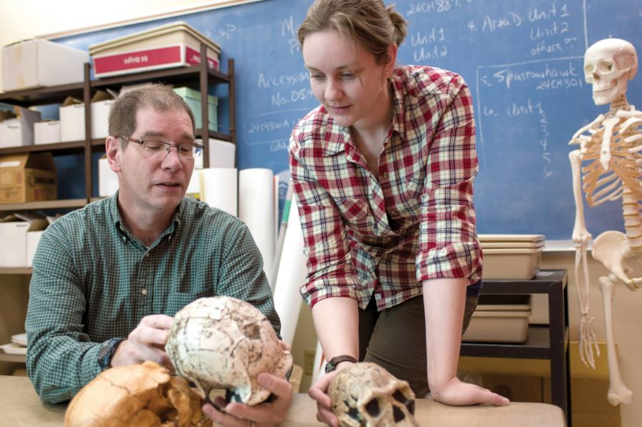
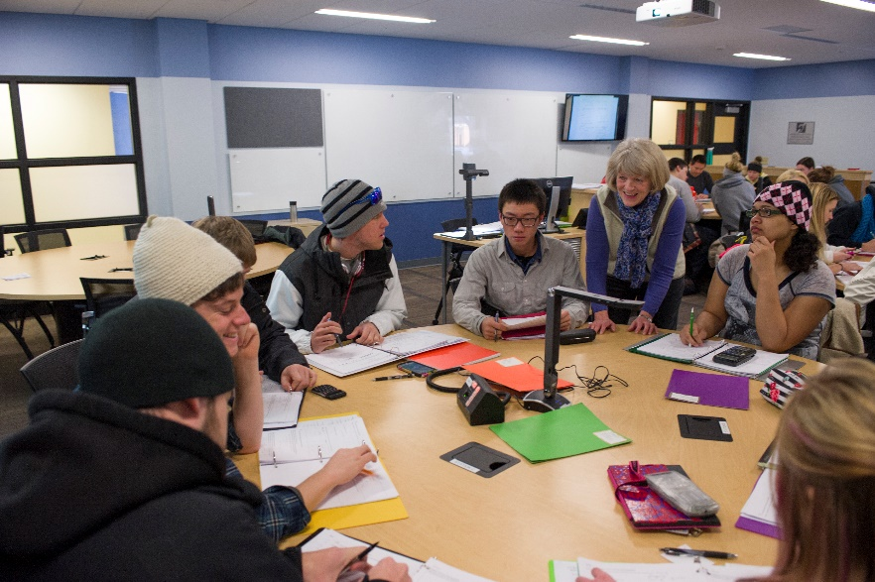
College of
Education, Health & Human
Development
The largest producer of certified teachers in the state of Montana
Pass rate for the Registered Dietitian examination is 90%, a rate well above the national average.
Highlighted majors:
Teaching: Elementary, Secondary
Technology Education
Food and Nutrition
Hospitality Management
Sustainable Food & Bioenergy Systems
Community Health

Slide 25
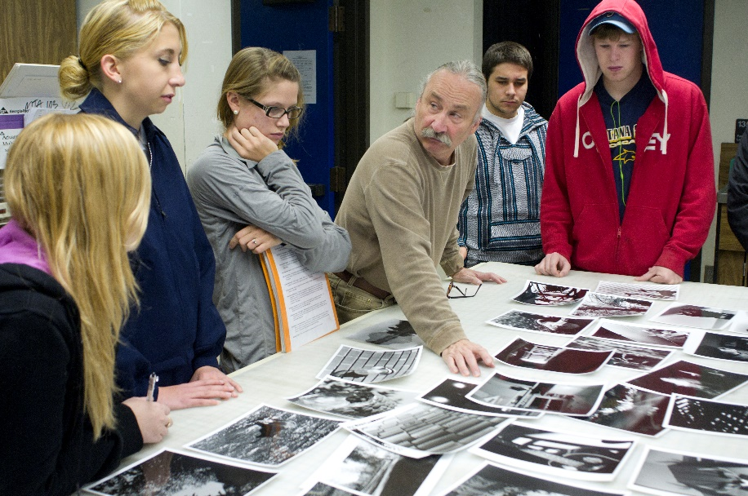
College of Letters and Science
The largest center for learning, teaching, and research at Montana State University.
In 2019, MSU is among the country’s top institution in the number of recipients for the Goldwater Scholarship, an award for excellence in math and science
Highlighted majors:
Economics
Chemistry/ Biochemistry
Cell Biology and Neuroscience
Psychology
Physics
Mathematics
Earth Science

Slide 26
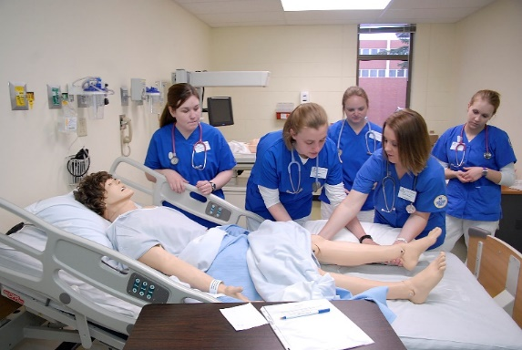
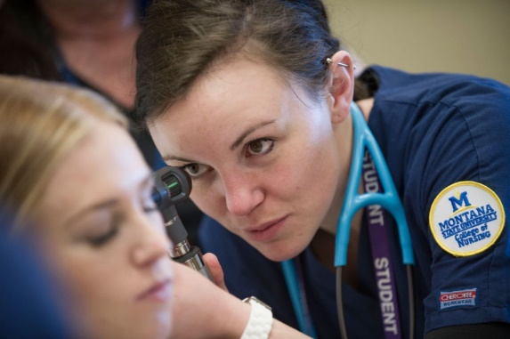
College of Nursing
CCNE accredited (Commission on Collegiate Nursing Education)
MSU offers the only masters and doctoral nursing programs in Montana
90% of recent MSU nursing graduates are enrolled in continuing education or employed. Their average annual salary is $54,374 (Bachelor of Science) and $85,000 (Doctor of Nursing Practice).
93% of MSU nursing grads who took the N-CLEX licensure exam passed on their first attempt.

Slide 27
Undergraduate Admissions Requirements
 | Freshman | Transfer students
Academic | GPA 2.5+/4.0 | GPA 2.0+/4.0
English | TOEFL iBT 71 or IELTS 6.0 or PTE Academic 48 or Completion of an approved intensive English program | TOEFL iBT 71 or IELTS 6.0 or PTE Academic 48 or An association degree from a US Community College or Completion of an approved intensive English program
SAT/ACT | Required for students graduated from US/Canadian high schools

Slide 28
Undergraduate Admissions Process
Submit
Online application form https://www.msuadmissions.org/international/index.cfm?isndsl
Application fee online $38 as part of the online application form or pay at www.msuadmissions.org/appfee
Highschool transcripts and diploma (local language and translated if not in English)
Previous college transcript for transfer students (local language and translated if not in English)
Proof of English Proficiency (or enroll in the Interlink program)
Official SAT/ACT scores (for merit based scholarship consideration and to apply to the Honors College)
Receive I-20 by submitting
Copy of student’s passport
Financial certificate (provided by our admissions team)
Bank statement with minimum fund $36,150
Apply for a student visa
Apply for housing
Start packing!
Deadlines:
Fall – July 1
Spring – Nov 1
Summer – March 15

Slide 29
Graduate Admissions Requirements
 | Graduate
Academic | GPA 3.0+/4.0
English | TOEFL iBT 80 or TOEFL PBT 550 or IELTS 6.5 or PTE Academic 54 or Completion of a post-secondary degree in the US or other countries where English is the native and official language
GRE | Varies by departments
Note | Competitive process Decentralized Graduate School Teaching and Research Assistantships are available in some departments for top applicants **Requirements vary depending on department. Always check department’s website for detailed information**

Slide 30
Graduate Admissions Process
Submit
$60 application fee
Transcript of all post secondary coursework completion (in local language and translation)
Proof of English proficiency
GMAT or GRE (score varies by department)
Essay / Statement of Purpose
Three letters of recommendation
Receive I-20 by submitting
Copy of student’s passport
Financial certificate (provided by our admissions team)
Bank statement with minimum fund $26,498
Apply for a student visa
Apply for housing
Start packing!
Deadlines:
Fall – May 13
Spring – Oct 1
**Deadlines may vary by department. Please
check your
department's
webpage to verify
the deadline**

Slide 31
Undergraduate and Graduate Tuition and Fee
 | UNDERGRADUATE | GRADUATE
Tuition/Fees | $25,850 | $16,198
Room and Board | $10,300 | $10,300
Total amount of required funds listed on form I-20 | $36,150 | $26,498
Note: Tuition and Fees is subject to change

Slide 32
Undergraduate Scholarships
INTERNATIONAL UNDERGRADUATE SCHOLARSHIP | VALUE
Freshman Scholarship- No SAT/ACT Freshman students without SAT/ACT and have a GPA at least 3.0/4.0^{(*)} | Up to $5,000
Transfer Scholarship - No SAT/ACT Transfer applicants without SAT or ACT and have a GPA at least 3.0/4.0^{(*)} | Up to $8,000
Merit based scholarship with SAT/ACT Applied to both freshmen and transfer applicants with GPA at least 3.0/4.0 and minimum SAT 1130/ACT 23^{(*)} | Up to $15,000
International Bobcat Alumni Scholarship Applied to both freshman and transfer who have had immediate family members (parents or siblings) graduate from MSU or who are currently enrolled at MSU. One-time offer for the first semester. | $2,000
Presidential Scholarship For top students who have been admitted. Full tuition waiver & stipend for four years. Separate application required & must be submitted by November 30. | Up to $25,000
Students are automatically considered for scholarships without a separate application
(*) Scholarship can be renewed annually if the student maintains a 3.0 GPA on a 4.0 scale, maintains full-time student status, and remains a non-resident student.

Slide 33
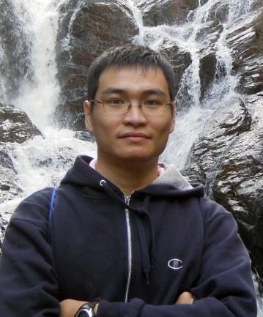
Tan Tran Graduate Statistics Vietnam
International Student Spotlight
I’m Tan Tran. This is my fifth year at MSU-Bozeman as a Ph.D. student in Statistics. In 2012, I started my education at MSU from a professor who visited Vietnam for a research project, and I have not regretted since then. For numerous Vietnamese students, Montana is not a well-known US state with a large Vietnamese community. However, people in Bozeman, especially MSU professors, staff, and students, are very helpful and I blended into a new environment without much difficulty.
The first snowfall experience is unforgettable. MSU has beautiful four seasons and a variety of fun outdoors activities, so I can always find precious time relaxing between my studying. I will never forget those remarkable moments when I am at MSU.

Slide 34
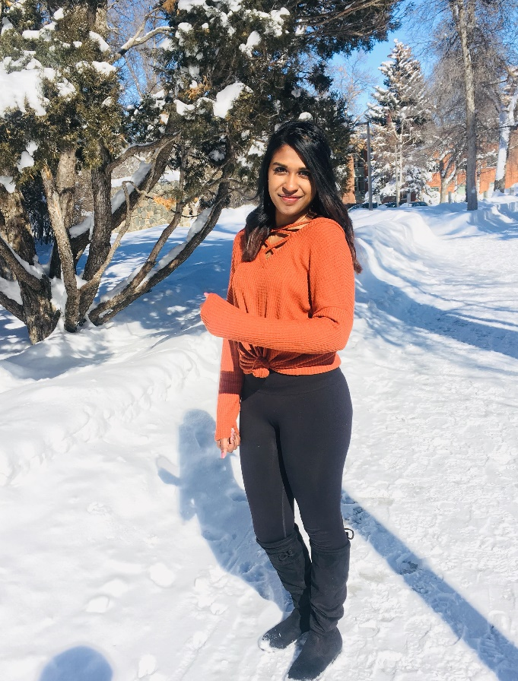
Juliana Rajamohan Undergraduate Human Development and Family Science Sri Lanka
International Student Spotlight
I have always wanted to find a balance between studying and experiencing the college life. I can positively say that coming to MSU has given me the opportunity to find where my interests lay and create a strong foundation to ensure a path of success.
Being an international student, there comes a great change when you move away from your country, your family and starting a new life. However, the transition from high school to college seemed fairly easy and enjoyable to me. I had a great time making new friends, establishing my identity and overall grow as an individual.
MSU has given me the platform to develop independence, have lifelong friendships and increase self-esteem with a feeling of accomplishment and personal satisfaction.

Slide 35
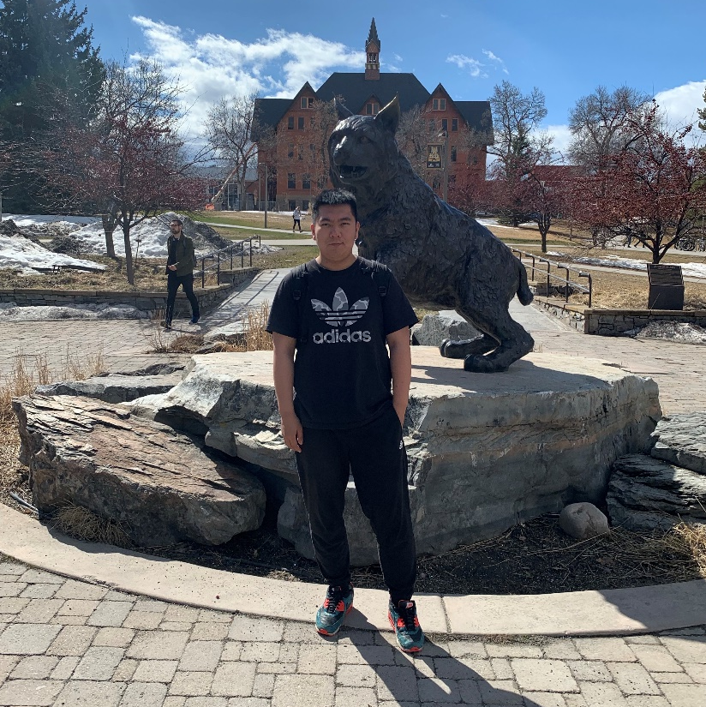
Meng Liang Undergraduate Environmental Horticulture China
International Student Spotlight
I've been at the Montana State University for two and a half years. I met many good people here. There are my best friends and my beloved teacher. The students here are very friendly, the teachers are very enthusiastic and professional.
The city where the university is located is also perfect. It's very close to Yellowstone Park and Glacier Park. Also has many outdoor activities, such as skiing and snowmobiles in winter, floating and mountain bike in summer, hunting in the fall which attract me deeply. All in all, I like here. It's like my second home.

Slide 36
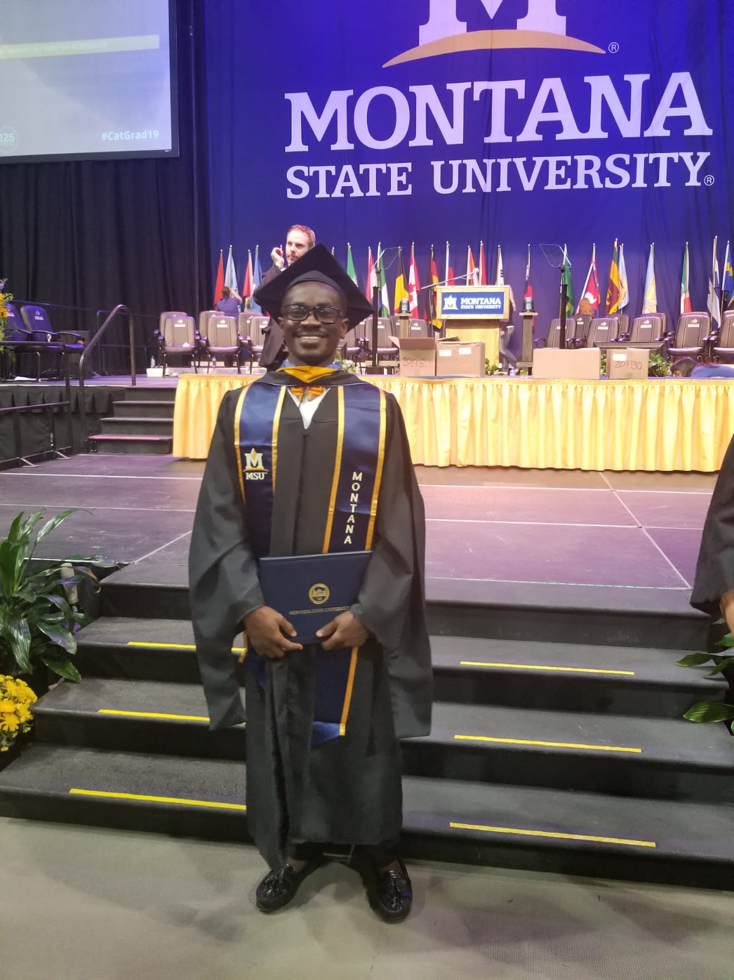
Bright Osuwu Graduate Statistics Ghana
International Student Spotlight
As a graduate from Kwame Nkrumah University of Science and Technology (KNUST-GHANA) with a first class honors in Mathematics, I decided to further pursue Statistics and its applications to real life problems. I got into the graduate Statistics program in Montana State University-Bozeman in the fall of 2016. The motivations behind choosing MSU was based on its excellent education through its programs structure which involve applications and skills development of what is taught in the classroom. The funding and teaching opportunities for international students is exceptional.
Further research drew my attention to the college’s location and its surroundings open to a lot of outdoor recreational activities. The mountains were beautiful which I anticipated to be excited for hiking, biking and skiing. The college community appeared more diverse with students from around the world. These opportunities filled me with much enthusiasm to be part of MSU.

Slide 37
Office of International Programs Units and Services
Recruitment and Admissions
International Student Services
Study Abroad
International Training Programs
International Travel Compliance
Office of International Programs

Slide 38
Thank you so much!
Please contact Que (que.vo01@montana.edu) if you wish to schedule a live Q&A session.
Stay connected with us:
globalstudy@montana.edu
www.montana.edu/international/admissions

