Slide 1
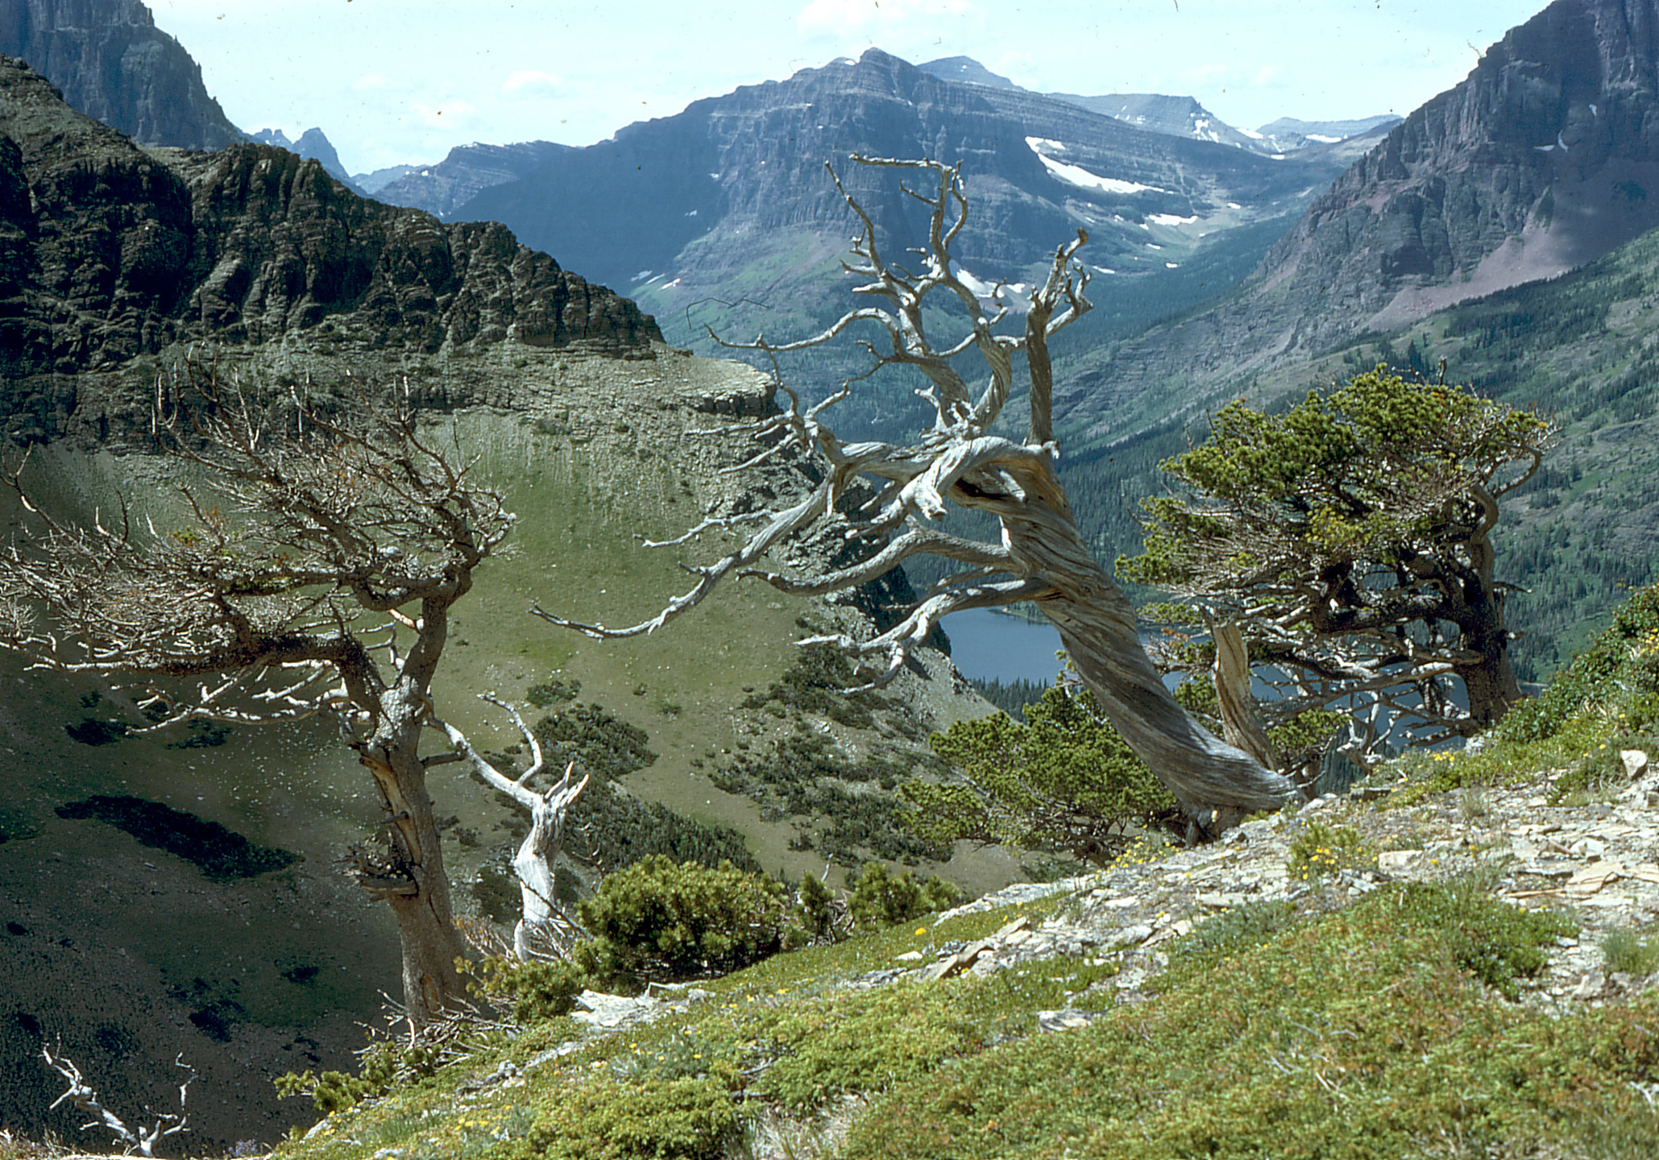
Paleoecology of whitebark pine over the last 20,000 years
Photo: M. Kaufmann 2004
Cathy Whitlock & Virginia Iglesias

Slide 2
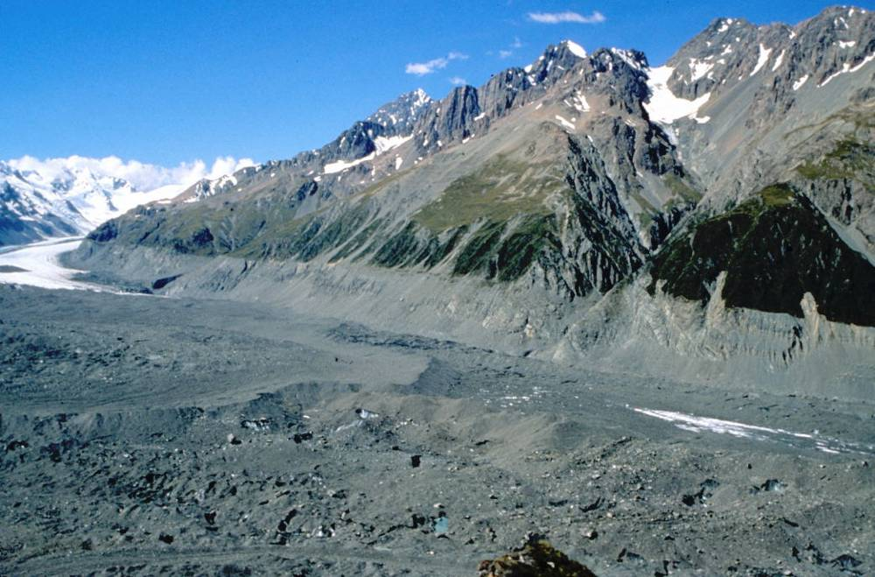
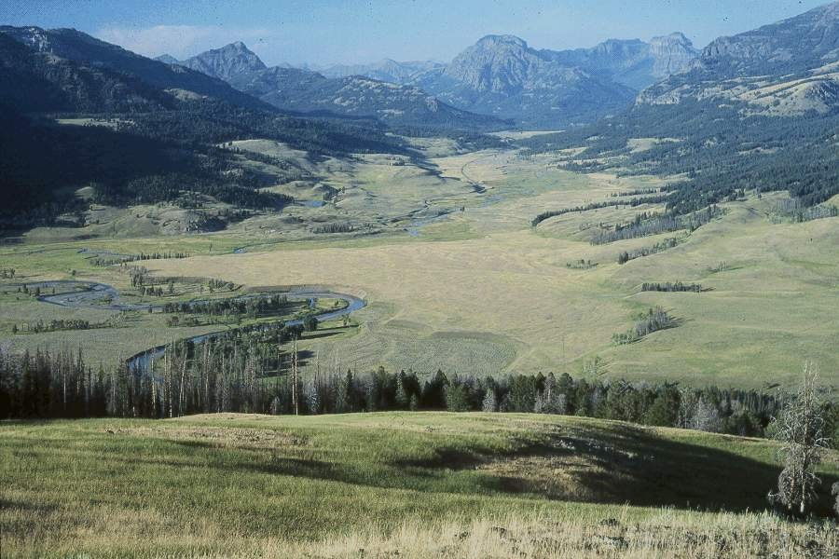
GYE vegetation history
GYE ~17,000 years ago
GYE today

Slide 3
GYE vegetation history
Vegetation history along a transect: comparing three records
T. Krause, PhD research

Slide 4
GYE Vegetation History
T. Krause, PhD research

Slide 5
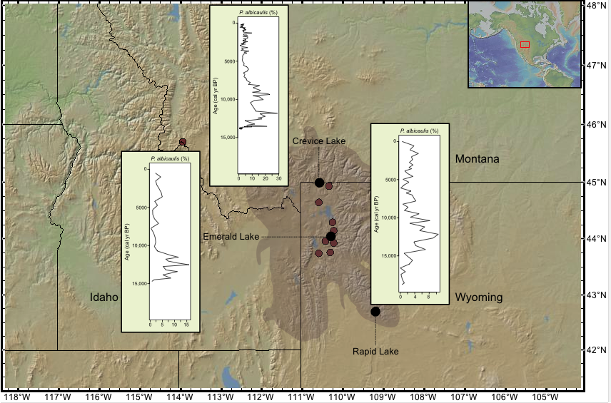
GYE Vegetation History
Crevice Lk
Emerald Lk
Rapid Lk

Slide 6
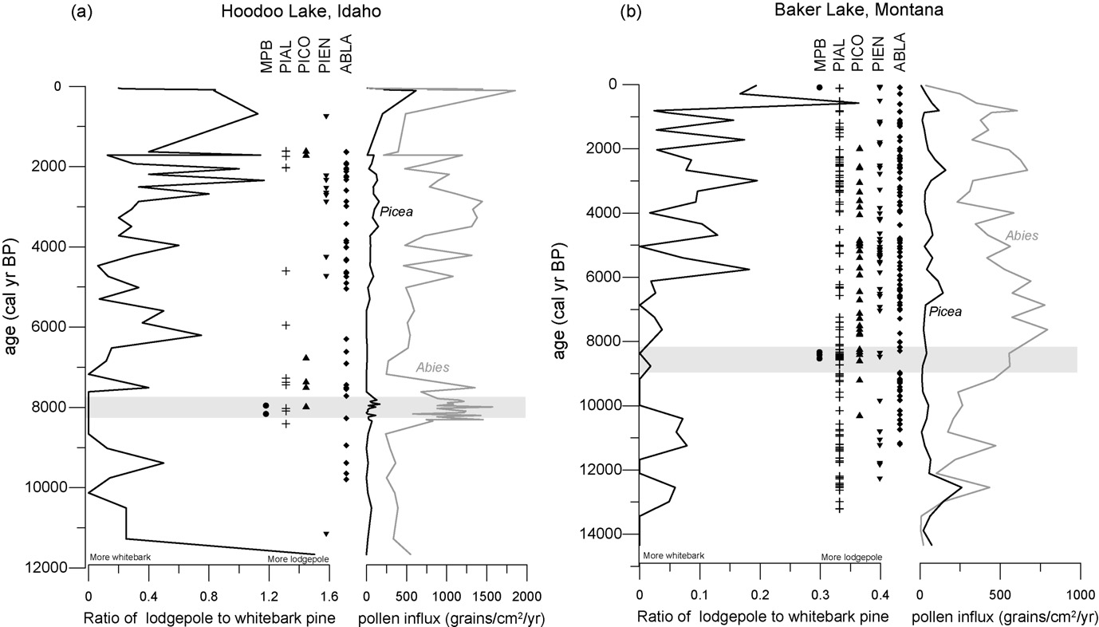
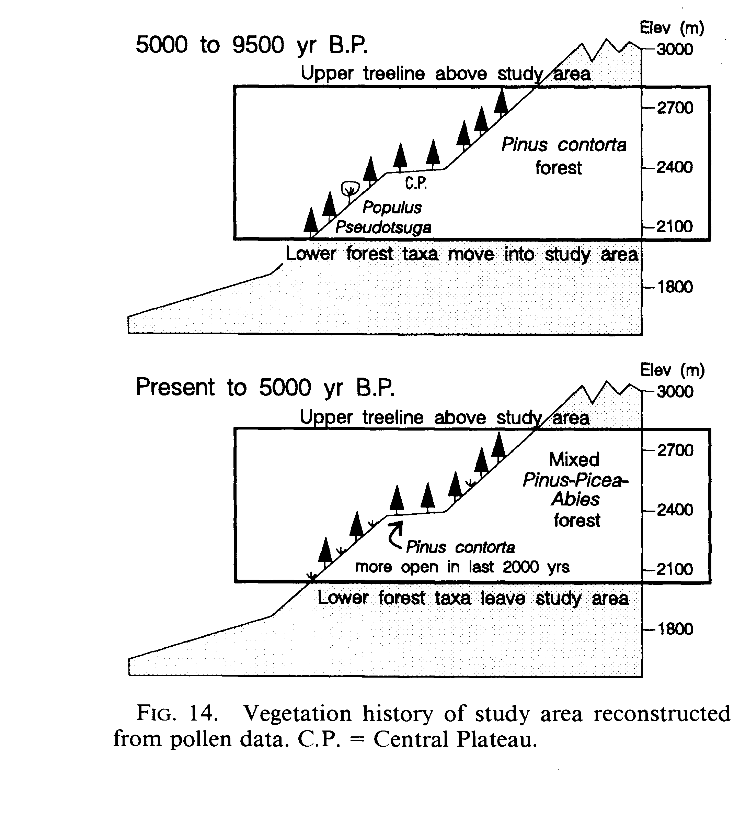
WBP & MPB
Past outbreaks associated with cool, effectively wet conditions
5.7-10.7 ka
12.2-13.4 ka
Last 5.7 kyr
10.7-12.2 ka
Brunelle et al., 2008

Slide 7
What do we not know?
Information gaps
Better understanding of WBP history and environmental change
WBP distribution during past warm periods: MCA (800-1200 AD) or the early Holocene
Rates/nature of WBP response to past climate change
Long-term linkages between WBP and fire
Synergistic disturbances in the past

Slide 8
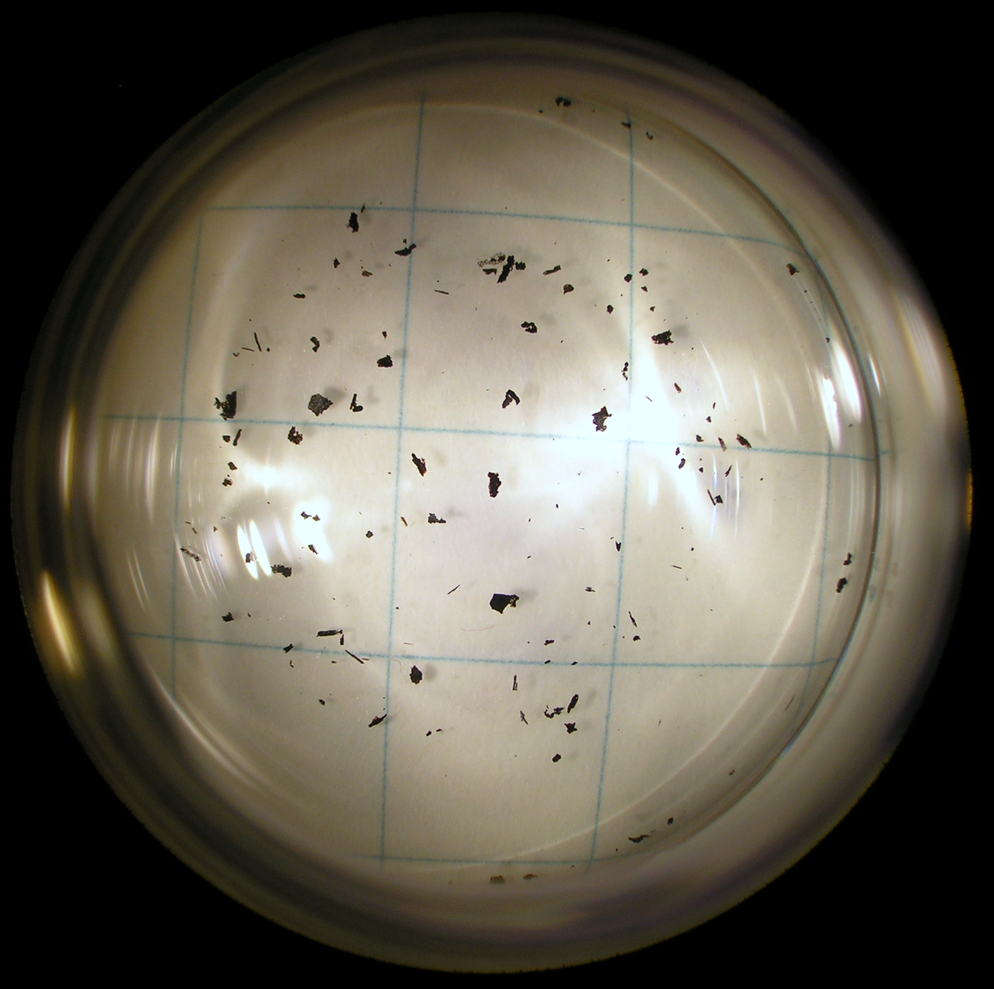
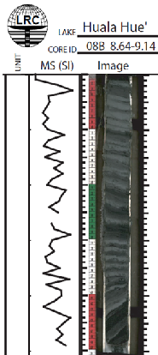



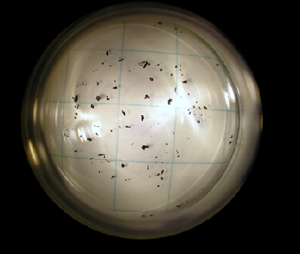
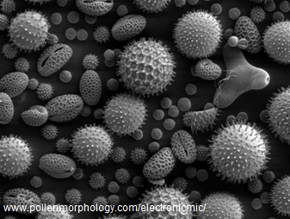
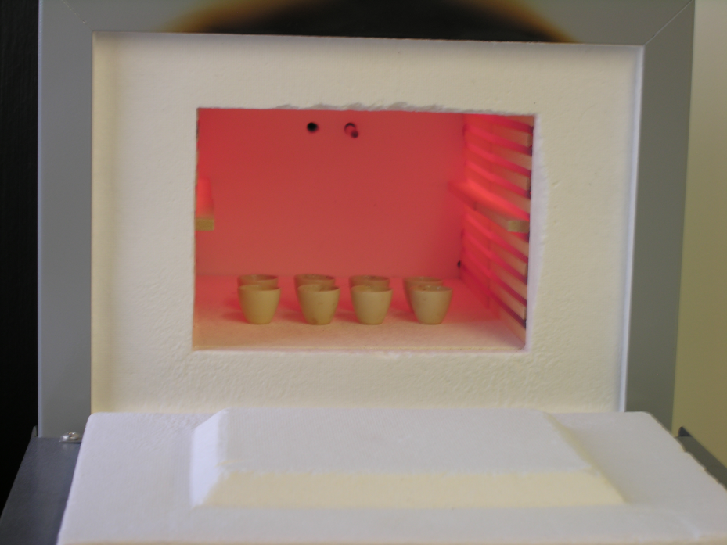
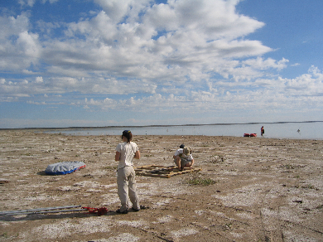
NC CSC Paleoenvironmental database
file://localhost/Users/virginia/Desktop/Database/example/Database.kmz

Slide 10
