Slide 1
An analysis of spatial trends within past to present climate trajectories in the Greater Yellowstone Ecosystem
Tony Chang and Andrew J. Hansen
Department of Ecology
Montana State University

Slide 2
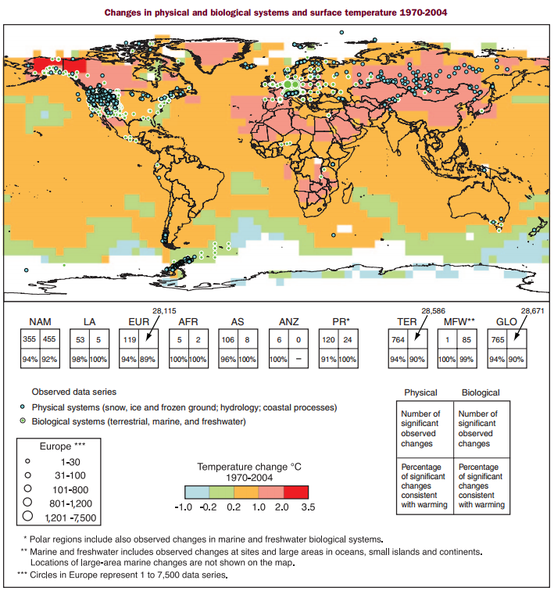
- Present day recorded changes in temperature at a global scale are not homogeneous across the landscape
IPCC 2007

Slide 3
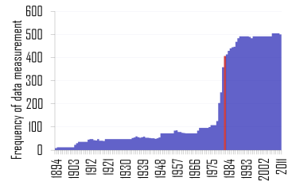
- ~700 observation locations in the GYE from 1894-2011
- Selection of 42 stations for analysis in an elevation gradient of 5280-9865 ft

Slide 4
Significant trends in minimum and maximum temperature changes across GYE

Slide 5
Maximum temperature rates of change with time are do not display a significant trend ubiquitously across GYE

Slide 6
Minimum temperature rates of change with time display a significant trend
GYE experiencing milder winter
lows

Slide 7
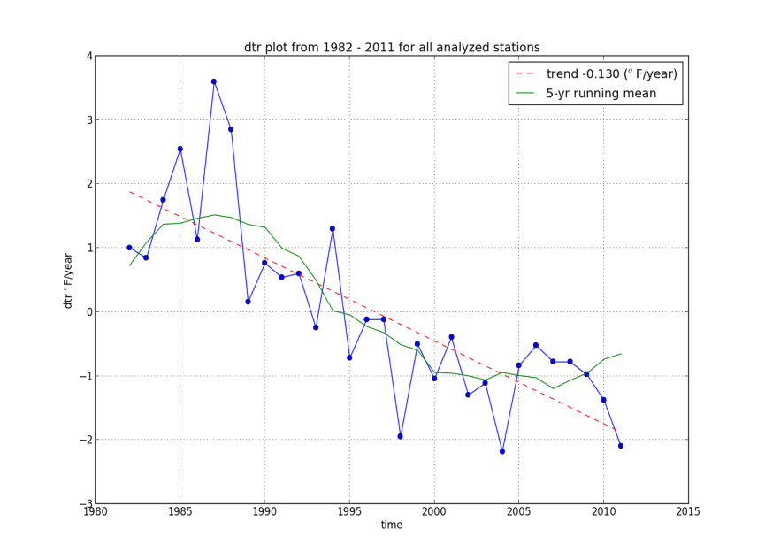
Significant diurnal temperature range contraction signal
R² ⁼ 0.634, p-value = 1.44 x10⁻⁷

Slide 8
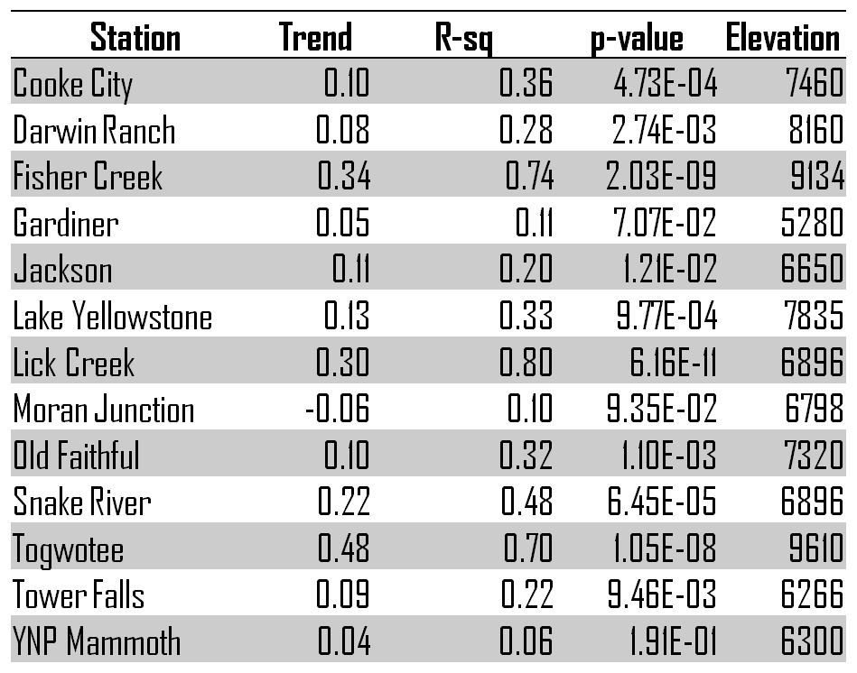
Minimum temperature rates of change display association with elevation

Slide 9
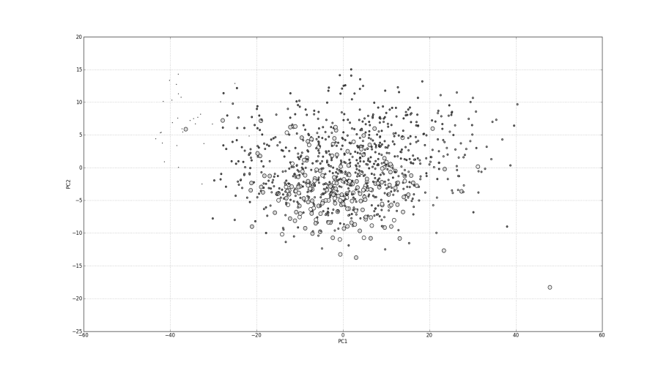
Principal component analysis display clustering of minimum temperature trends with elevation gradient
Eigenvalues = [205.67, 28.26, 27.12, 22.07, 16.72, 12.04, 9.23, 6.24, 4.32, 4.03, 2.81, 1.82]
Eigenvector 1 = [-0.373, -0.408, 0.425, 0.088, -0.62 , 0.254, 0.115, 0.127, -0.062, -0.024, 0.129, 0.085]
Eigenvector 2 =[-0.36 , 0.036, -0.184, 0.819, 0.183, -0.168, 0.268, 0.081, -0.12 , 0.002, -0.082, 0.051]

Slide 10
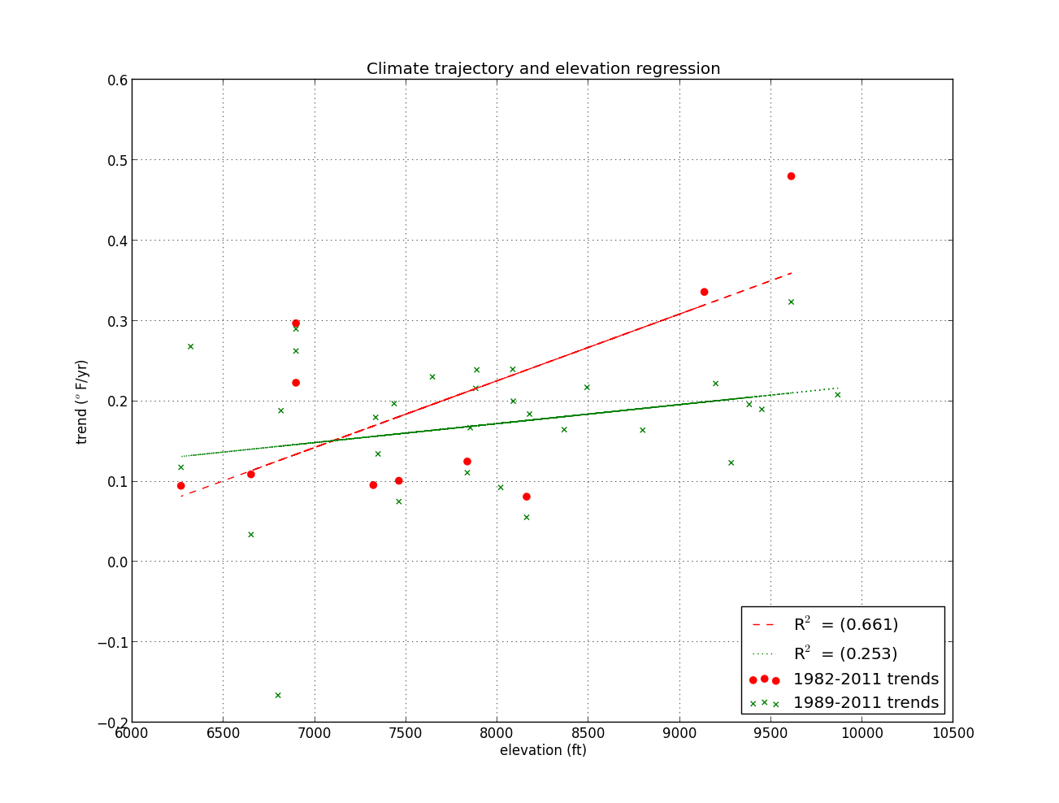
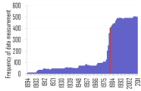
Significant positive correlation between minimum temperature trend and elevation
-- Slope: 0.016 (deg F/year/ 1000ft)

Slide 11
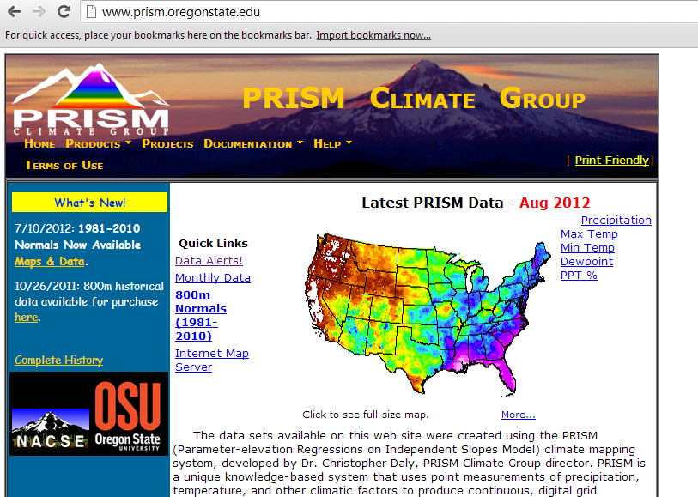
PRISM interpolation for regional climate assessment
-weighted regression of elevation
-weighting factors include:
*station spacing
*terrain induced climate transition areas (rain shadow)
*cold air drainage
(inversion areas)
* coastal zone

Slide 13
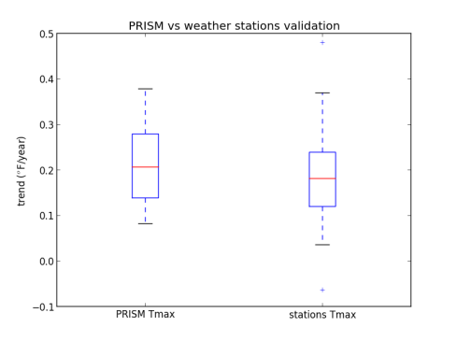
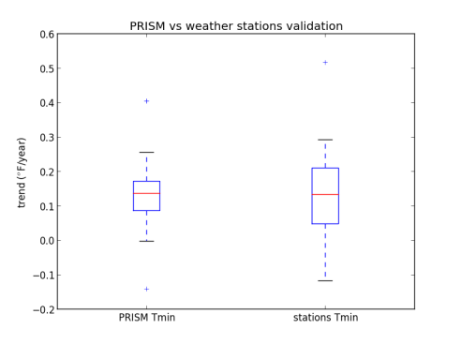
PRISM displays filtering of variation for minimum temperature trends across GYE
-No significant difference in mean trends

Slide 14
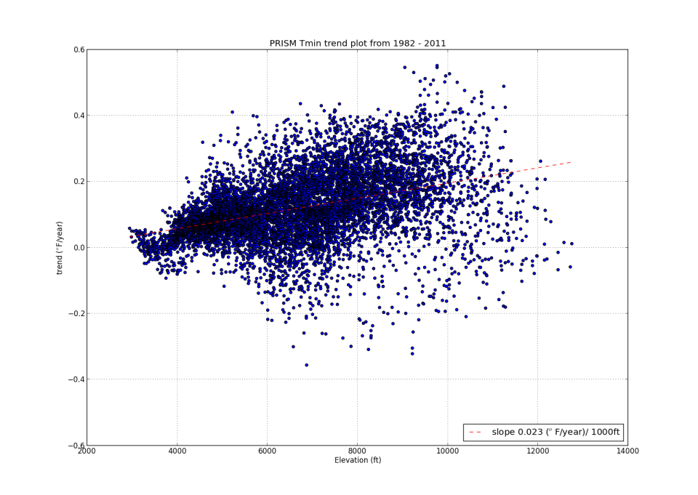
High variability at >10000 ft possibly due to PRISM interpolation method and limited station data at those elevations.

Slide 15
Implications and future research
-Greater Yellowstone Ecosystem experiencing a diurnal temperature range contraction from 1982-2011 (Easterling et al 1997)
-Greatest increases of temperature trends occurring in the sub-alpine/alpine mountain regions
-Consistent with findings in Europe and Asia
(Diaz and Bradley 1997)

Slide 16
Implications and future research
Potential mechanisms include:
cloudiness, humidity, land cover changes, and increased atmospheric CO2 levels
-Likely the number of days where average temperature cross the zero ºC freeze/thaw isotherm (days of snowmelt)
(Pederson 2010)
-Increased of snowmelt positive feedback, reduces albedo

Slide 17
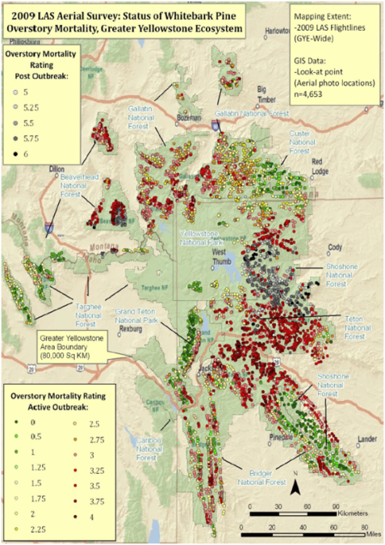
MacFarlane et al 2010

Slide 18
Preliminary analysis display strong association of mortality with minimum temperature trends.

Slide 19
Implications and future research
-Temperature trends imply increased exposure of climatic change for alpine species such as whitebark pine
-Variation in snow melt timing, results in changes of water resource availability and phenological response periods
-Climate/ecosystem forecast model application for active management of climate change

Slide 20
Questions?
Appreciation of support

Slide 21
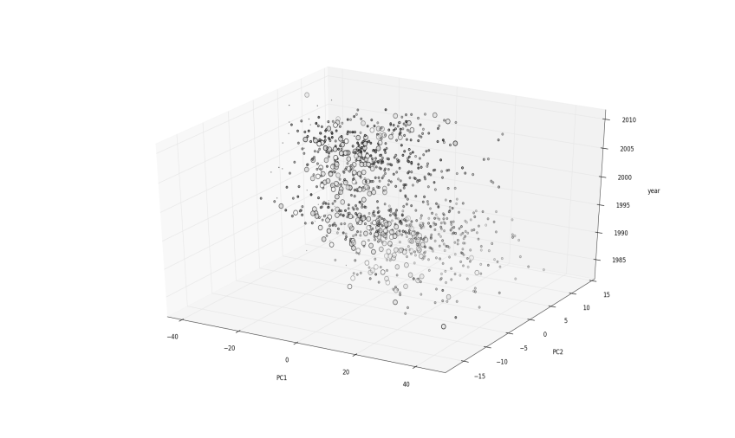
Principal component analysis display clustering of minimum temperature trends with elevation gradient

Slide 22
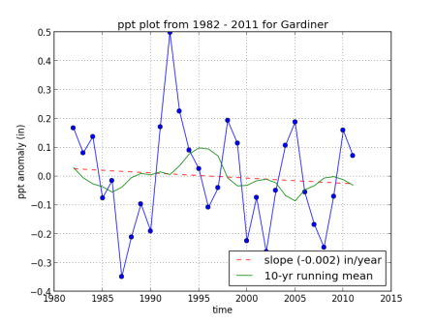
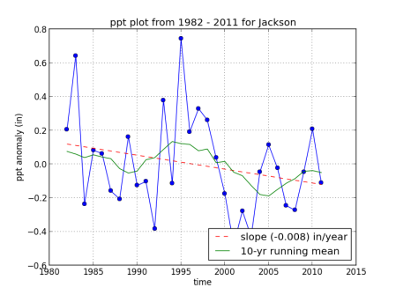
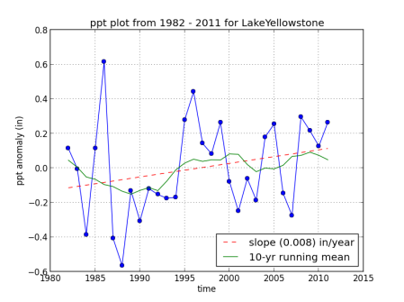
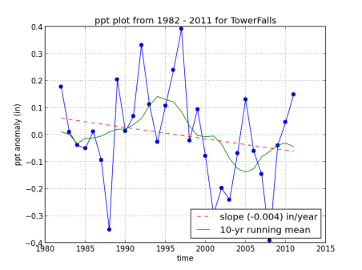
No significant trend in precipitation

