Slide 1
Estimating future suitable bioclimatic habitats for whitebark pine in the Greater Yellowstone Ecosystem under projected climates
Tony Chang, Andrew Hansen, Nathan Piekielek
Montana State University
Notes:
Good afternoon, my name is Tony Chang and today I will be speaking about my current research on estimating future suitable bioclimatic habitats for WBP in the GYE under projected climates.

Slide 2
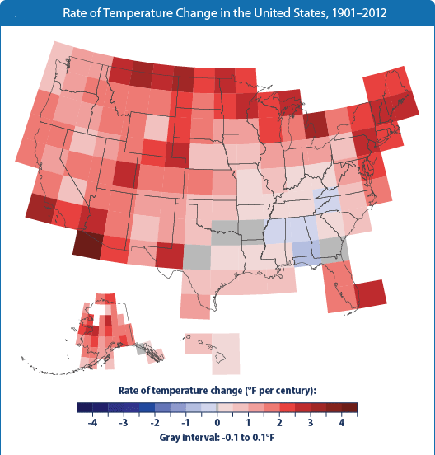
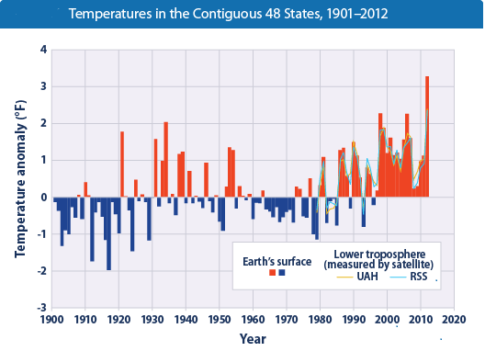
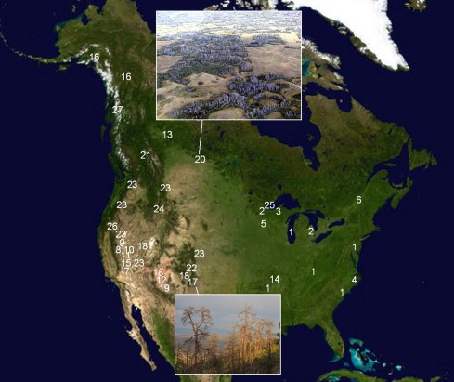
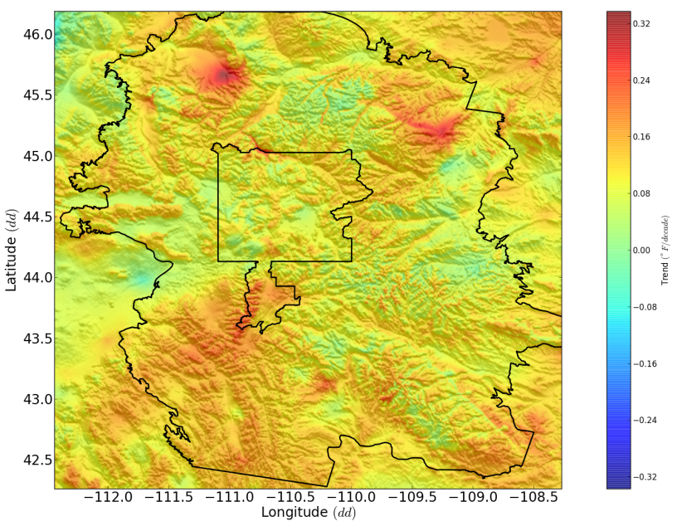
Heterogeneous change in climate
Notes:
Over the next century, it is expected that most of the conterminous US will experience climate changes. From present day temperature records, the US has already seen a temperature increase of up to 3.2 º F from the hundred year average, with most of this change occurring within the last 30 years. More importantly though, climatic changes across the landscape are not homogeneous, meaning that future conditions will experience temperature cooling or warming at regional and local scales, leading to shifts of temperature/moisture regimes to that may be mesic, xeric, or even hydric habitat conditions as you can see from this figure from the EPA.
This pattern continues at even higher resolutions. As can be demonstrated by examining the Greater Yellowstone Ecosystem where we can see some regions warming or cooling relative to the 1900-2010 average, due to complex topographies. This fact becomes important when we consider the impacts of climate on individual species at the local scale.

Slide 3
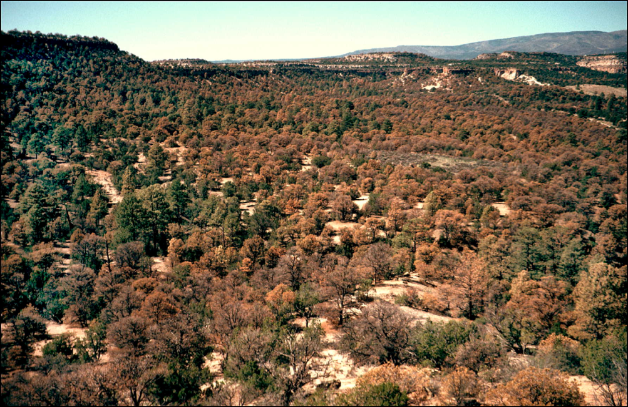
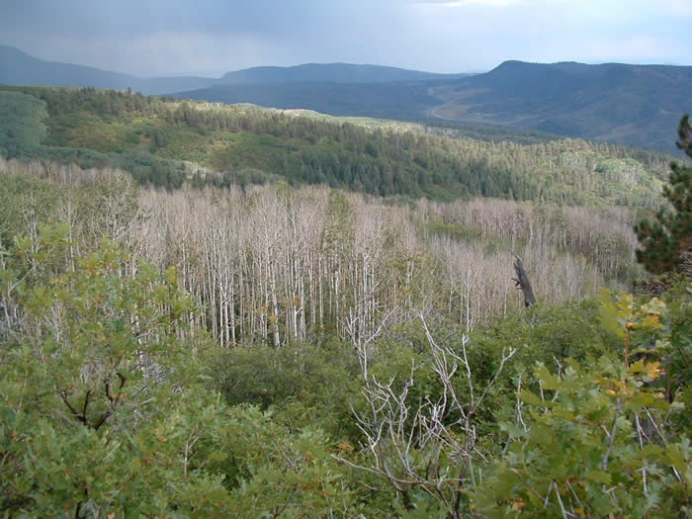
Vegetation response to climate
Regional Pinus edulis and Populus tremuloides die-off in the Southwest in response to a global change type drought (Breshears et al. 2005, Anderegg et al. 2011)
A review by Walther et al. (2002) observed upwards elevational shifts of treeline and alpine plants
Photo credit: Craig Allen/USGS
Notes:
Such climate changes are expected to influence the ecosystem. Evidence of climate related impacts have been observed by large dieoff events and elevational shifts.
Although episodic mortality occurs in the absence of climate change, a review study by Allen et al 2010 suggested that some of the world’s forested ecosystems already may be responding to climate change when physical conditions such as available moisture and temperature shift beyond the tolerance of the species.
This raises concern on determining where forests may be exposed to conditions outside of their classic environmental conditions
Aspen (populus tremuloides) in Alberta Canada, and Ponderosa Pine in Jemez Mountains, New Mexico.
Craig Allen on of the first to not rapid landscape response to climate variation
To better understand the effects of climate change on an ecosystem, we need to consider the variability of climate at a finer spatial resolution
David Breshears et al 2005 reported regional pinus edulis die-off in response to a global change type drought, meaning it was warmer than typical droughts.
Walther et al 2002 Ecological responses to recent climate change
In regions under the influence of El Nino/Southern Oscillation (ENSO), for example, change mayhappen rapidly during warm episodes, with `setbacks' during cool periods. In addition, climatic extremes related to natural oscillations and underlying long-term trends are also important in driving the present range changes.
Jesse Logan modeled mountain pine beetle increase with temperature

Slide 4
Whitebark pine mortality
Keystone species
80% mortality rate within the adult population (MacFarlane et al. 2013)
Listed candidate species
Notes:
One such forest species of concern is WBP.
Whitebark pine (Pinus albicaulis) (WBP) is a native conifer of the Western U.S. that is considered a keystone species in the sub-alpine environment, whose nuts provide a food source for Clark’s nutcracker, red squirrels, and grizzley bears. It also serves the ecosystem funcitons of stabilizing soil, moderating snow melt and runoff, and facilitating establishment for other species.
Whitebark pine has experienced a notable decline in the past two decades within the U.S. Northern Rockies (especially the GYE) due to high rates of infestation from the mountain pine beetle (Dendroctonus ponderosae) and white pine blister rust, whose activity is linked to increased temperatures and precipitation, resulting in an 80% mortality rate within the adult population. Furthermore, a meta-analysis by Hansen and Philips 2014 on projected tree species climate suitability across the Northern Rockies identified WBP as most vulnerable to climate change.
These declines make WBP an ideal species to examine for response to climate change in the future

Slide 5
Bioclimate envelope modeling
Niche modeling concept (Hutchinson 1957)
Correlative model of abiotic variables and species occurrence
No claims of projecting species distributions, but models projected suitable climates.
Used to model W. North American suitable habitats for forest tree species from present to future (Rehfeldt et al 2006, Coops and Waring 2011)
Rehfeldt et al 2006
Notes:
One method of understanding a species response to climate change is through bioclimate niche modeling, which has become common practice for assessing potential vegetation shifts under climate change.
Ecological niche theory proposes there exists some niche of bioclimatic conditions within which a species can persist. This niche is modeled by empirical relationships between the presence or absence of a species and the associated abiotic, and sometimes biotic, variables that describe the niche space. This assumes that the current variable relationships with presence and absence reflect a species environmental preferences which may be retained into the future.
The example below, shows the modeled suitable climate habitat space for pinyon pine reducing within the southwest from present day to 2030, 2060, and 2090
At macro scales, this approach has been used to predict species distributions across much of the US for numerous forest tree species .
Rehfeldt
Waring
This approach does not predict where a species will actually occur in the future (realized niche), but rather it predicts locations where climatic conditions will be suitable for the species under future projections.
Hansen
Models for vegetation

Slide 6
Climate Change within the GYE
Temperature
Precipitation
Notes:
What we are seeing here are computed mean annual temperature and precipitation changes within the GYE under the historic records in blue and multiple GCMs under 2 climate change scenarios in the red and orange. There exists 46 different General Circulation Models under the latest phase 5 IPCC Coupled Model Intercomparison, where I have selected the 9 best representative models. The red RCP 8.5 presents a “business as usual” scenario, and the orange RCP 4.5 represents a moderate reduction of carbon emissions globally. Changes in temperature and precipitation for the GYE display increases of 2-9ºC and -50-250mm relatively , depending on the general circulation model. This raises interest in not only understanding the impacts of these projections on WBP tolerances, but also the effects of variability among GCMs on WBP.

Slide 7
Study objectives
How will the bioclimatic habitat envelope for whitebark pine respond to shifts in the GYE climate under multiple GCMs and scenarios?
What is the level of variability amongst the different habitat projections across the different GCMs?
Notes:
So given these tools and observations of climate change in the GYE, we determined two major study objectives:
How will the bioclimatic habitat envelope for WBP respond to shifts in the GYE climate
What is the level the variability amongst the different habitat projections (to explicitly address the uncertainty of GCMs)

Slide 8
The Greater Yellowstone Ecosystem
Bozeman
Jackson
Notes:
The GYE is one region of interest for study. The GYE provides a complex topography to study the effects of climate change within a landscape.
The GYE encompasses 150,700 km² with an elevational gradient from 522-4,206 m that represents 14 surrounding mountain ranges, 3 national parks, and a number of state and federally managed forests.
This region is the primary area of interest for 3 reasons
Evidence that the GYE WBP sub-population is genetically distinct from other regional populations with different climate tolerances (Maholovich 2011)
High regional investment in WBP conservation with the formation of the GYRN WBP subcommittee. Many cross-jurisdictional boundaries to overcome for species persistence
The high density of climate stations within the region

Slide 9
Methods (Response Data Sources)
Current model on “Adult” class trees (DBH≥20cm)
2,569 data points (936 presence, 1,633 absence)
Forest Inventory and Analysis (USFS)
Whitebark and Limber pine Information System (USFS)
Greater Yellowstone Network (NPS I&M)
Notes:
One of the largest and most complete WBP datasets in the GYE

Slide 10
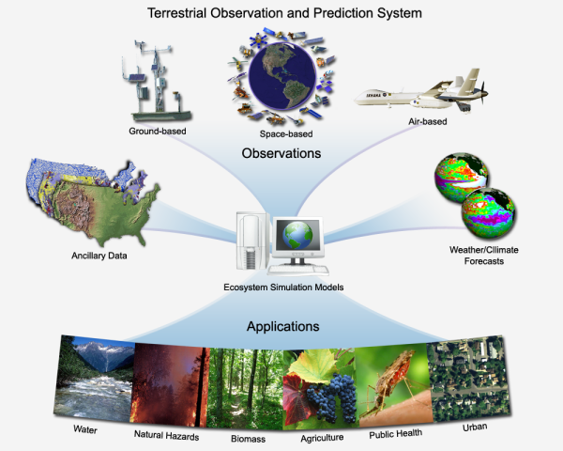
Methods (Predictor Data)
Historic Climate Data
PRISM 800m climate
(Daly et al. 2011)
(1900-2010) monthly
Projected Future Climate
(NASA TOPS)
CMIP5 Downscaled GCMs
(2010-2099) monthly
Notes:
Model the abiotic climate variables from PRISM and the NASA TOPS CMIP5 downscaled GCMs

Slide 11
Water Balance Modeling
Derived monthly water balance variables using Thornthwaite equation.
Provides 10 additional climate metrics
Notes:
Additionally, we used a dynamic Thornthwaite type equation to model the hydrological processes

Slide 12
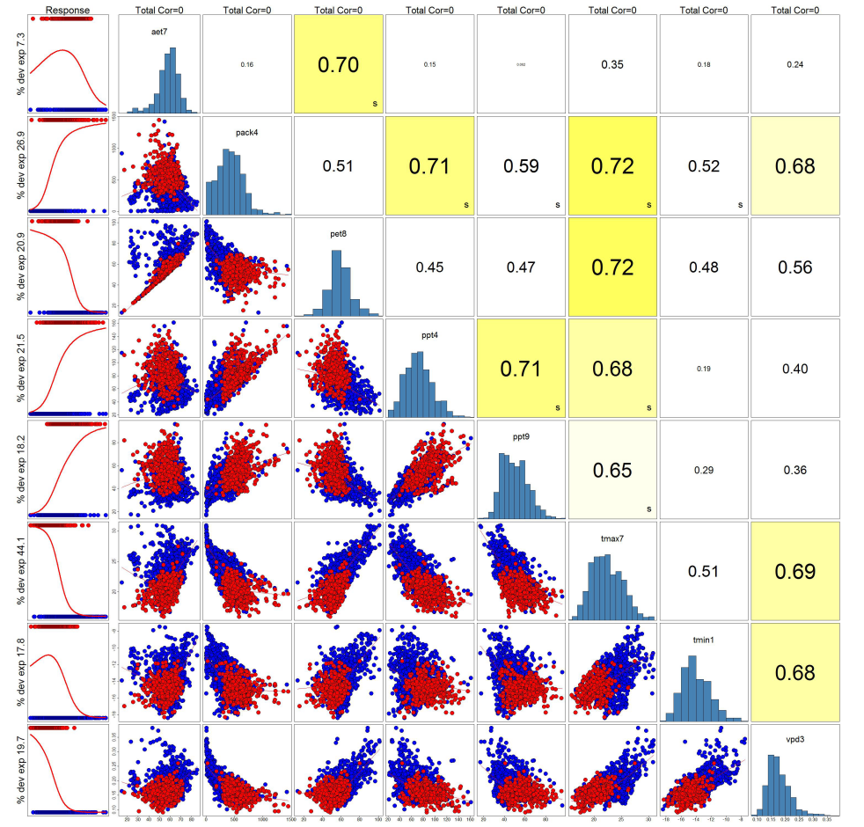
Predictor Variable Selection
Climate summarized using 1950-1980 means
122 predictor covariates
Suite considering ecologically meaningful predictors
Notes:
Selection for high deviance and reduction of collinearity below 0.75. We take these variables and use a Random Forest algorithm to model suitable bioclimatic habitat space for a subset of the WBP data (around 75% of the total data)

Slide 13
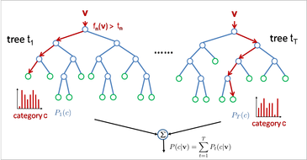
Random Forest
Decision tree method for classification
Subset of data withheld for validation
1000 random trees

Slide 14
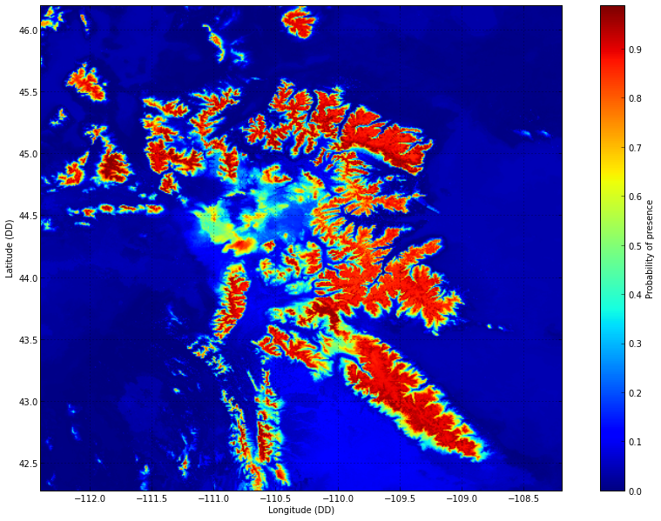
Results
Leading predictors:
Tmax7 and Pack4
Notes:
Using this Random Forest output, we can derive a spatially explicit map of present day WBP, where the highest probable suitable bioclimate habitat exist, which in this case dominate the upper elevational zones.

Slide 15
Diagnostics
Notes:
Using the withheld data, we can examine validate the model and find that it is performing well under the summarized results of sensitivity (true positive) and specificity (true negative)

Slide 16
Diagnostics

Slide 17
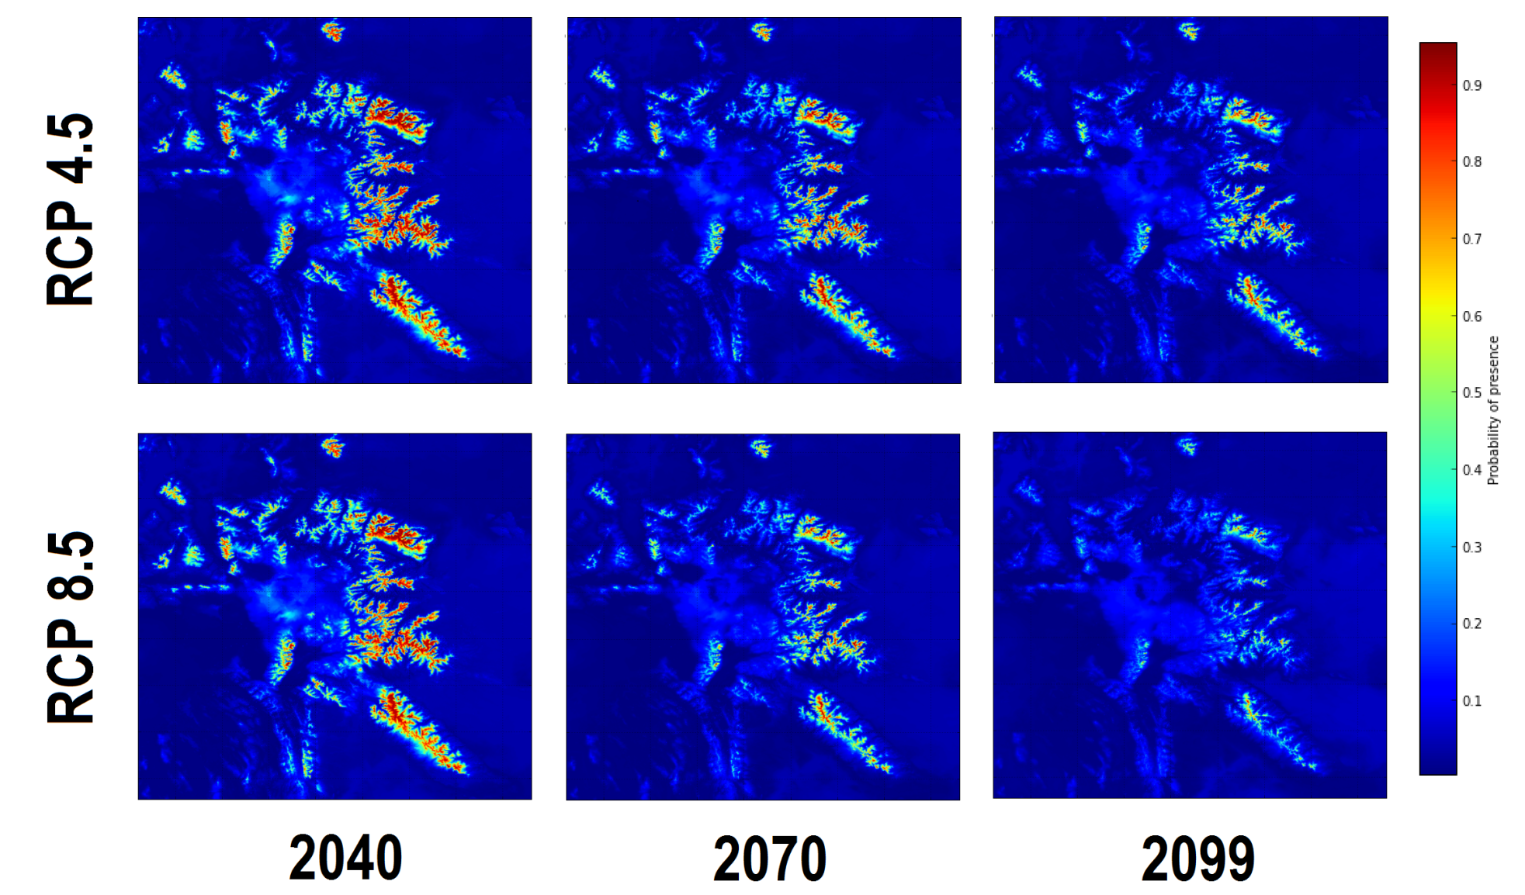
Future Projections
Notes:
Climate envelope shift towards higher elevations

Slide 18
Geographic properties of areas of suitable climate
Prob. Presence > 42.1% | Current | 2040 | 2070 | 2099
Area | 29,501 km² | 16,381 km² 15,746 km² | 9,151 km² 5,271 km² | 5,686 km² 960 km²
% suitable habitat area | 91.3 % | 51.1% 49.2 % | 28.6 % 16.5 % | 17.8 % 3.0 %
Mean elevation | 2,876 m | 3,020 m 3,022 m | 3,128 m 3,225 m | 3,218 m 3,470 m
Elevation Range (95% percentile) | 2,356 – 3,522 m | 2,494-3,603 m 2,492-3,606 m | 2,595-3,678 m 2,691-3,740 m | 2,692-3,735 m 3,002-3,909 m
RCP 4.5 ensemble
RCP 8.5 ensemble
Notes:
(65% reduction)
(79% reduction)
(86% reduction)
9500 ft mean
10,500 ft-11,500ft

Slide 19
Variability in Projections
Notes:
Low variability in the beginning and high variability at the middle decades.

Slide 20
Conclusions
Future suitable climate habitat centralized in the >3000m elevations of the GYE.
Suitable climate habitat for whitebark pine in GYE below 30% of the reference area for all climate models and scenarios.
Percent suitable climate area estimates ranged from 29-2% and 10-0.04% by 2099 for RCP 4.5 and 8.5 respectively.

Slide 21
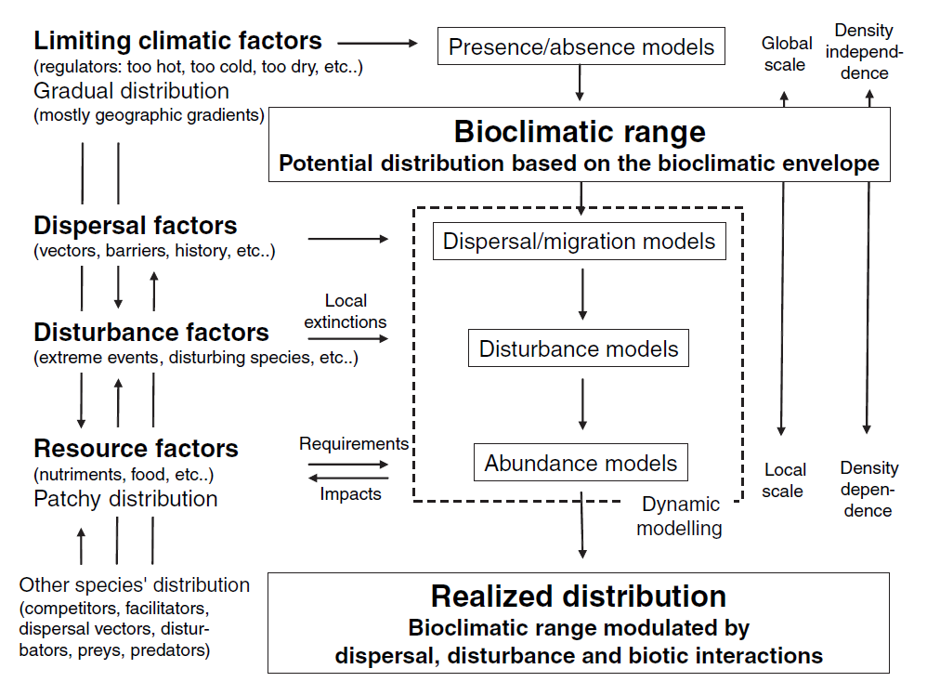
Caveats
Bioclimate niche models do not account for dispersal, disturbance, or competition effects
Landscape scale analysis of suitable habitat
Acknowledge the existence of micro-climate refugia
Future climate model science improving with technology
Inform active management options such as assisted migration or competition reduction.

Slide 22
Next Steps…
Envelope analysis to reveal climatic suitable areas for other life history stages
Sub-adult classes
Application to vulnerability assessment to determine management strategies/priorities
Inclusion of disturbance/competition/dispersal models

Slide 23
Summary – climate adaptation planning means spanning boundaries
 | Conceptual | Technical | Coordination
Challenges | Management goals differ between the many land units that include ownership of NPS, USFS, BLM, and state/counties. | Suitable climate habitat for WBP resides almost exclusively in wilderness areas where options are limited. | Restoration of WBP not equal between land units, despite cross border ecosystem benefits.
Opportunities | Regional concern for the persistence of WBP shared by all agencies. | Listing of WBP as a Threatened species may allow greater flexibility for adaptation actions | Formation of the GYCC and LCC allows communication between units.
Notes:
Climate adaptation here would be planting and controlling competition

Slide 24
Acknowledgements
NASA Applied Sciences Program (Grant 10-BIOCLIM10-0034)
NASA Land Cover Land Use Change Program
North Central Climate Sciences Center
NSF EPSCoR Track-I EPS-1101342 (INSTEP 3)

Slide 25
Questions

Slide 26
Patch analysis
Habitat fragmentation pattern
Overall reduction of median patch size

