Slide 1
2. Geomorphological units (“landscape facets”)
Units (polygons) on the landscape that are defined by geological and physiographic variables
Offer one way to identify potential habitat refugia
Means to “downscale” coarser-scale results to make relevant for management decisions?

Slide 2
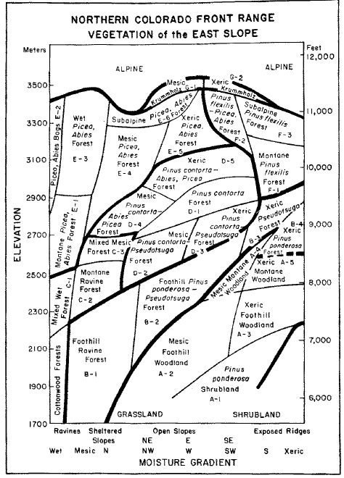

Slide 3
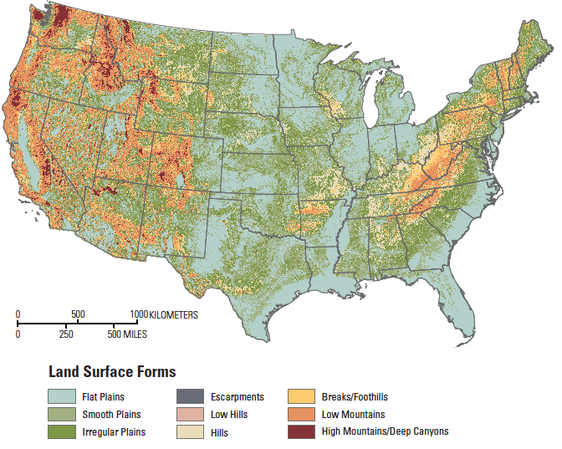

Slide 4
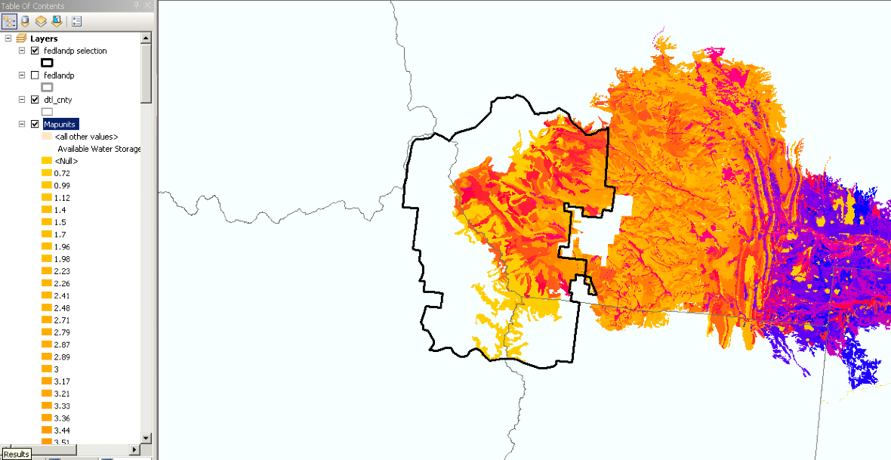
SSURGO AWC (Esri package)

Slide 5
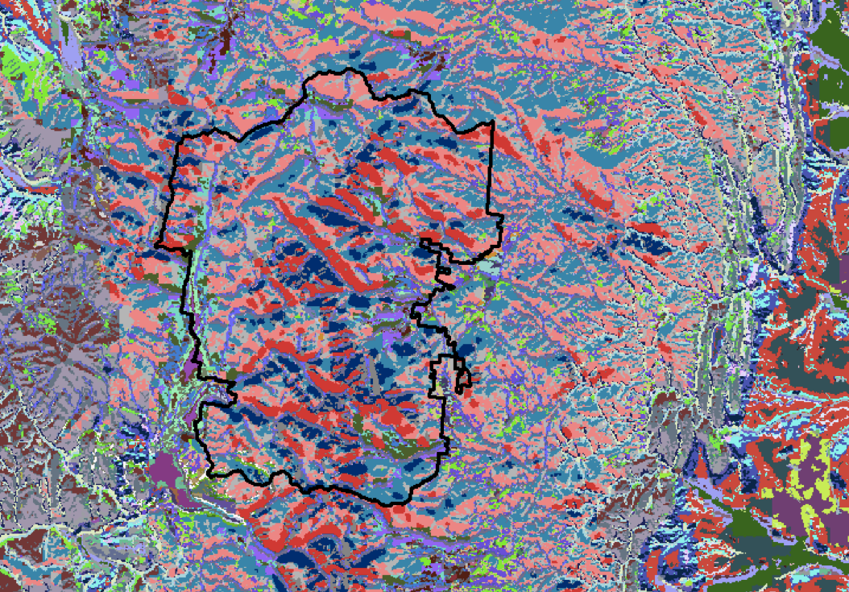

Slide 6
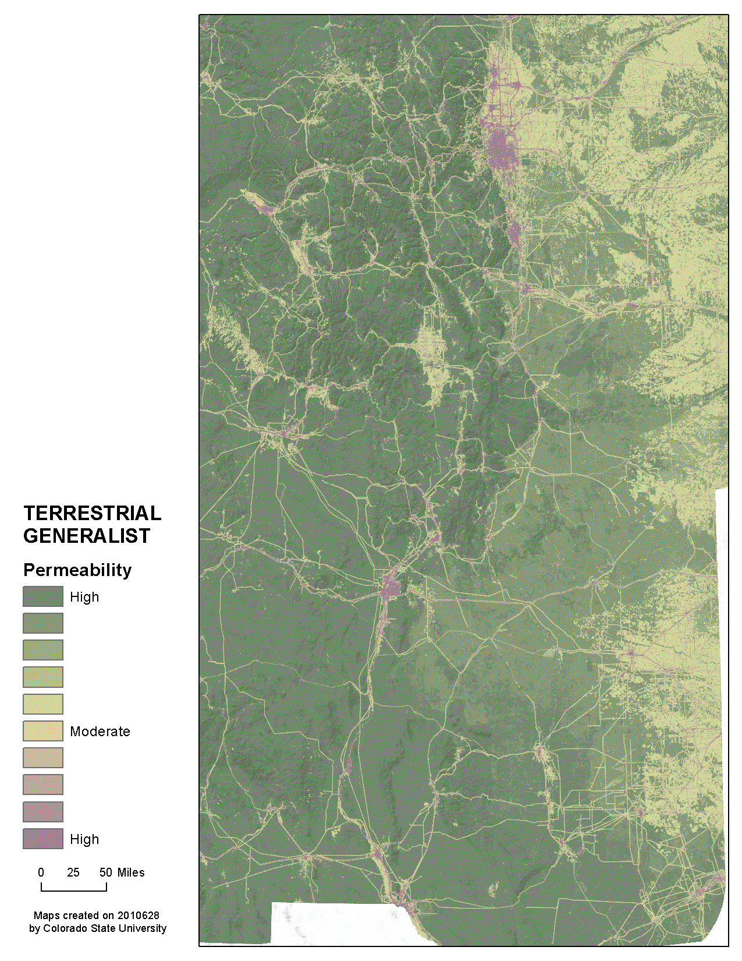

Slide 7
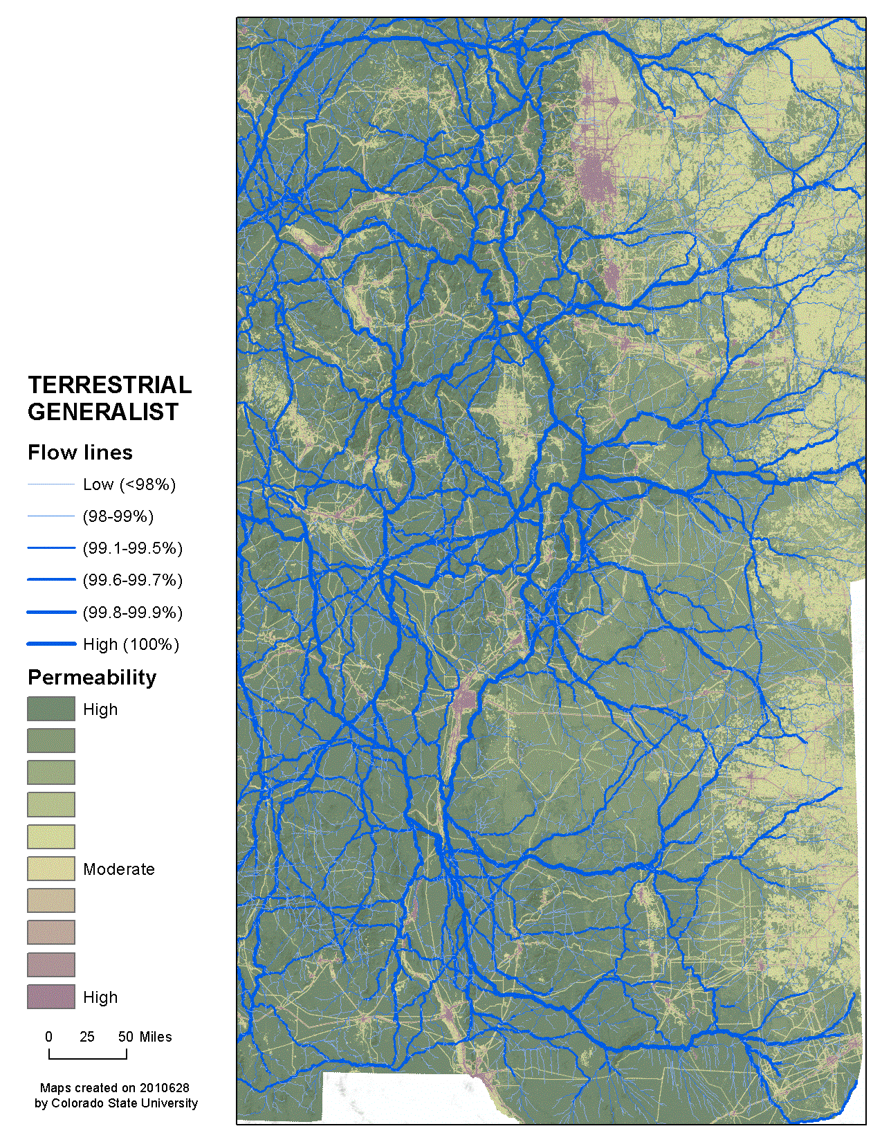

Slide 8
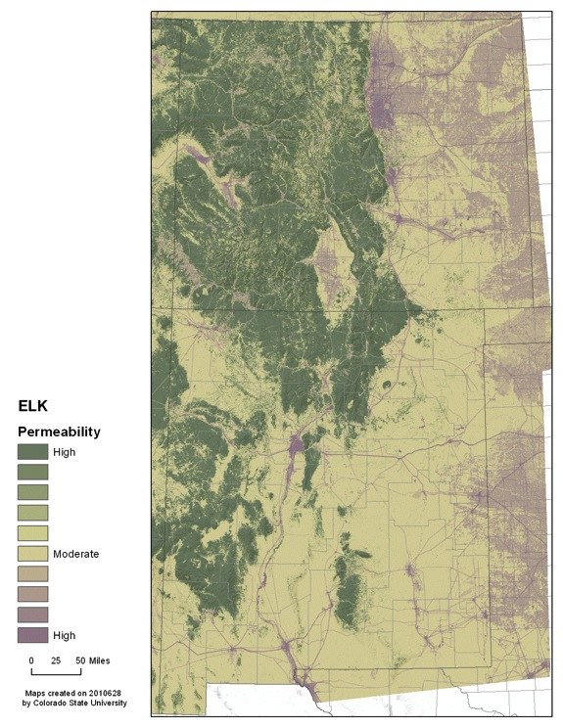

Slide 9
