Slide 1
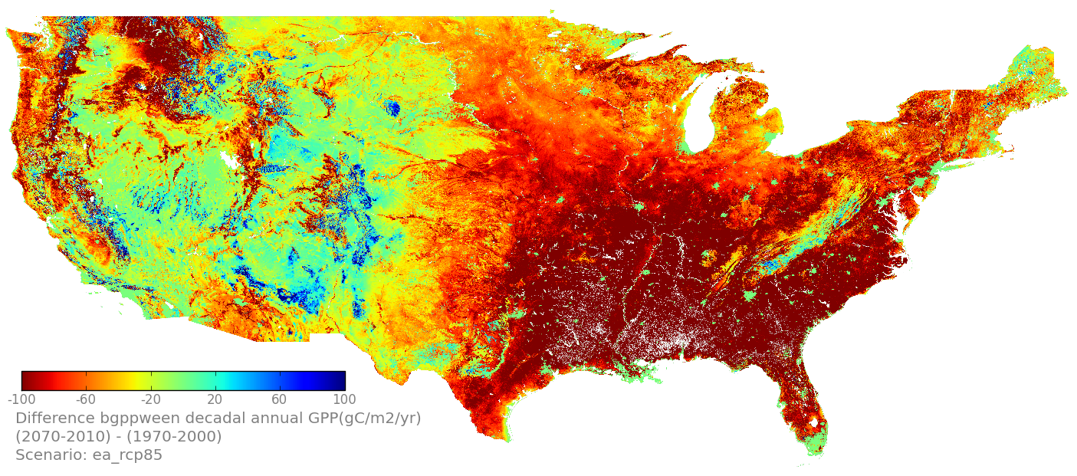
Modeling Impacts of Climate and Land Use Change on Ecosystem Processes to Quantify Exposure in two LCCS
Change in annual average GPP (gC/m²/yr)
(2071-2100) vs (19771-2000)
RCP 8.5, ensemble avg.
Forrest Melton^{1,2}, Jun Xiong³, Weile Wang^{1,2}, Cristina Milesi^{1,2}, Alberto Guzman^{1,2}, David Theobald⁴, Patrick Jantz⁵, Scott Goetz⁵, Tony Chang⁷, John Gross⁶, Andrew Hansen⁷, William Monahan⁶, Tom Olliff⁶, Nathan Piekielek⁷
¹NASA Ames Research Center, Moffett Field, CA, ²California State University Monterey Bay, Seaside, CA, Arizona State University, Tuscon, AZ, ⁴Conservation Science Partners, Ft. Collins, CO, ⁵Woods Hole Research Center, Falmouth, MA, ⁶National Park Service, Ft. Collins, CO / Bozeman, MT, ⁷Montana State University, Missoula, MT
(2071-2100) – (1971-2000)
Support provided by the NASA Applied Sciences Program

Slide 2
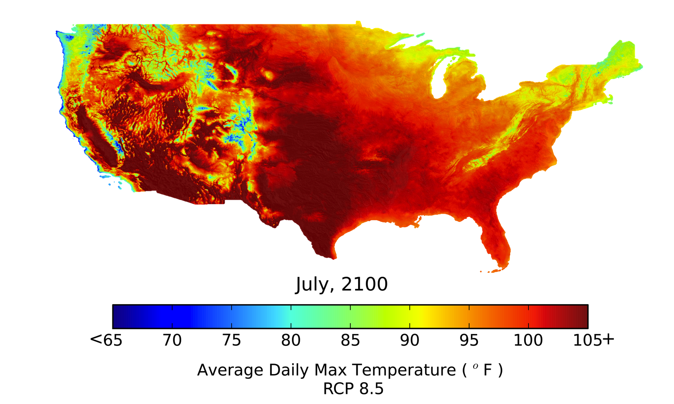
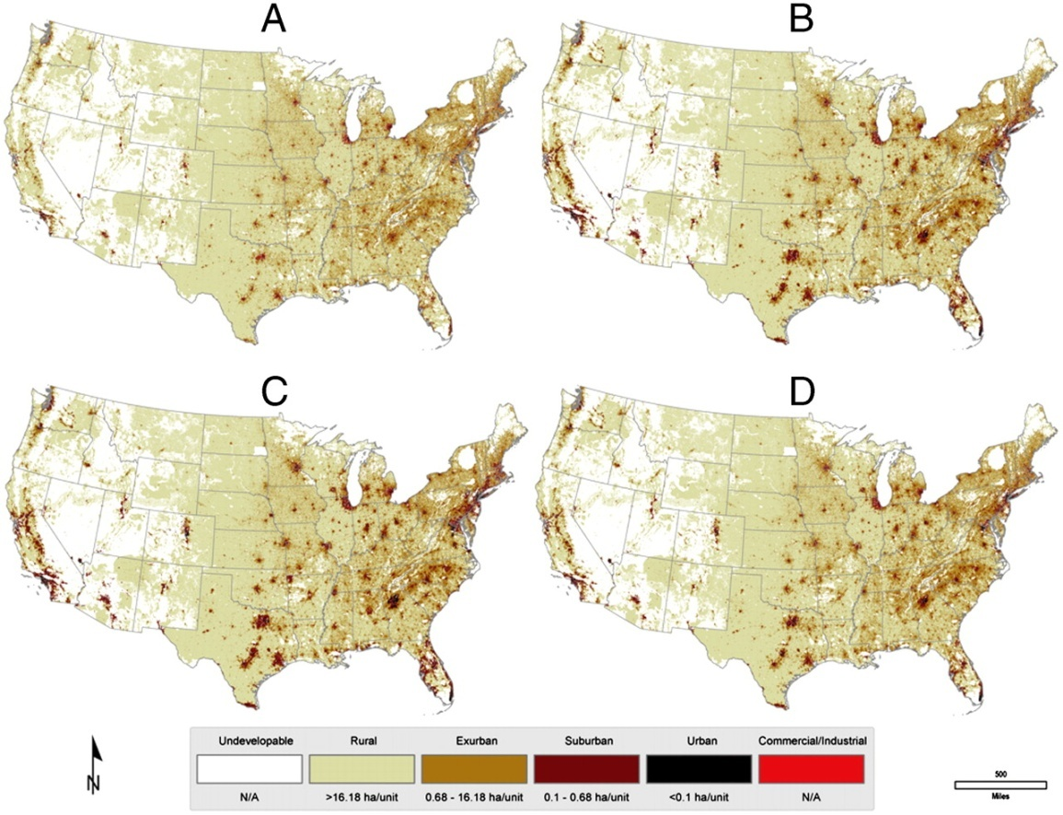
Motivation
Adaptation planning → Need for information on climate change impacts at local scales
Recent completion of ~1km resolution climate and land use projections for the U.S. creates an opportunity to assess combined impacts of climate and land use change
Use of the NASA Earth Exchange (NEX) to handle large data volumes and compute requirements (http://nex.nasa.gov)
Analysis is intended to complement hydrologic / ecosystem / niche modeling of individual watersheds and regions → model does not account for changes in spp. composition or disturbance regimes
NEX-DCP30 Climate Scenarios
SERGoM Housing Density
Notes:
402.84 at Mauna Loa on June 1

Slide 3
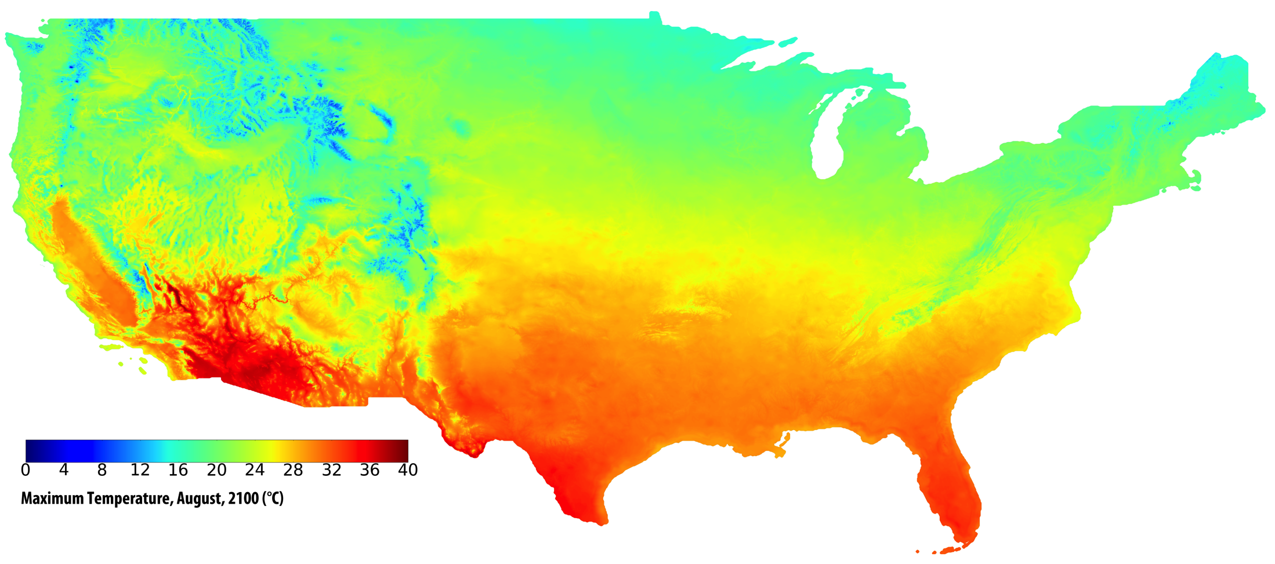
NEX-DCP30: NASA Earth Exchange Downscaled
Climate Projections for the U.S. at 30 arc-seconds
GCM Resolution: ~1 degree
30 arc-seconds / 800m / ~0.5 miles
CMIP5 archive downscaled using the Bias Correction and Spatial Disaggregation (BCSD) approach (Wood et al., 2002) and PRISM data (Daly et al., 1997)
Temperature and precipitation scenarios from 1950-2100
34 coupled General Circulation Models (global climate models)
4 Representative Concentration Pathways (RCPs)
17 TB of data
https://portal.nccs.nasa.gov/portal_home/published/NEX.html
Thrasher et al., 2013, Eos, Transactions AGU, vol 94(37):321–323
Notes:
Coupled Modeling Intercomparison Project Phase 5

Slide 4
SERGoM Impervious Surface Area
Spatially Explicit Regional Growth Model (SERGoM) Impervious Surface Area (ISA) Scenarios for 2000-2100; 4 SRES scenarios
SERGoM ISA scenarios are used to adjust the soil depth in TOPS on a decadal time step
Assumption: Decreases in soil water holding capacity are linearly proportional to increasing fractional ISA
Housing density for the conterminous United States shown as (A) actual housing density in 2000; (B) modeled housing density in 2100 for base case; (C) for scenario A2; and (D) for scenario B1.
Bierwagen et al., 2010, PNAS 107(49)
Notes:
Estimates are derived from census data, NLCD data and regional growth model (review paper)
SRES special report on emissions scenarios

Slide 5
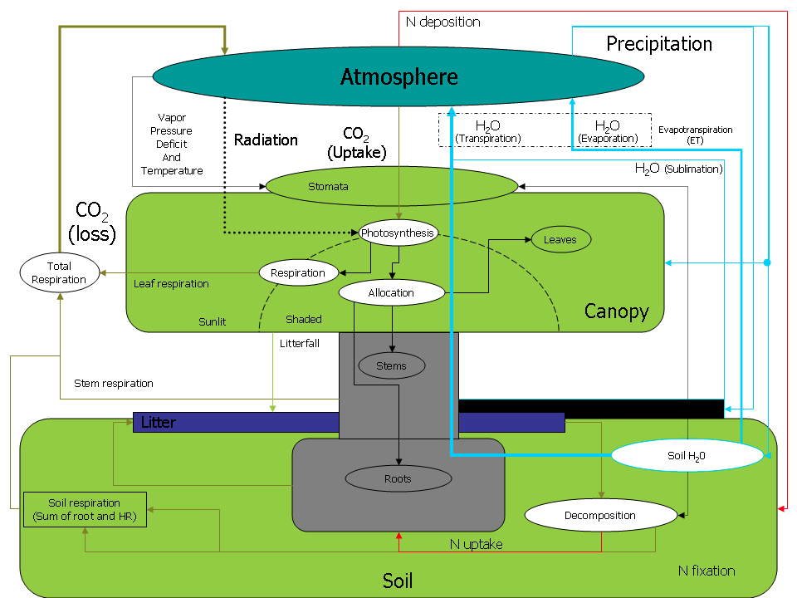
Biome-BGC
Widely used biogeochemical cycle model (Running et al., 1993)
Applied in modeling of energy, water, carbon and nitrogen fluxes from terrestrial ecosystems
Credit: Numerical Terradynamic Simulation Group, University of Montana
http://www.ntsg.umt.edu/biblio
Notes:
Process model that simulates:
New leaf growth and old leaf litterfall
Sunlight interception by leaves, and penetration to the ground
Precipitation routing to leaves and soil
Snow accumulation and melting
Drainage and runoff of soil water
Evaporation of water from soil and wet leaves
Transpiration of soil water through leaf stomata
Photosynthetic fixation of carbon from CO2 in the air
Uptake of nitrogen from the soil
Distribution of carbon and nitrogen to growing plant parts
Decomposition of fresh plant litter and old soil organic matter
Plant mortality
Fire

Slide 6
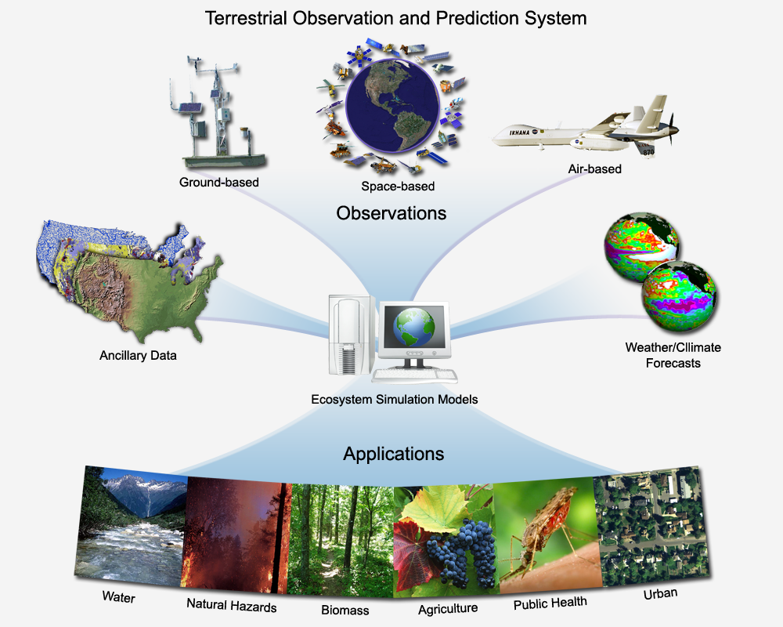
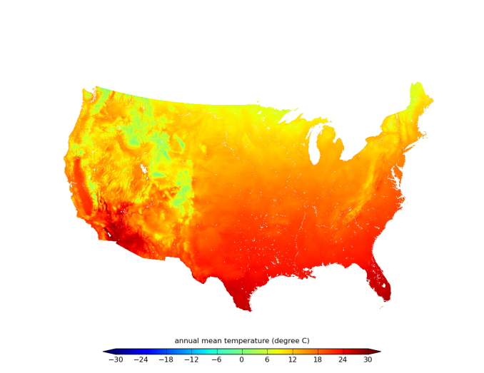
Approach
Inputs | United States (1km)
Impervious surface area | SERGoM + NLCD ISA (2000)
Climate (baseline run) | PRISM 800m Monthly Weather Surfaces
Climate (forecast) | NEX-DCP30 Downscaled CMIP5 800m Scenarios for RCP 2.6, 4.5, 6.0, 8.5
Elevation | National Elevation Dataset (resampled to 800m)
Leaf Area Index (baseline run) | MODIS MOD15A2 LAI (Myneni et al., 2000)
Leaf Area Index (forecast) | MODIS LAI Climatology
Soils | U.S. STATSGO2 database
Land Cover | MODIS MOD12Q1 Land cover (Friedl et al., 2002)
Generated 1km monthly Tave, Precip, VPD and solar radiation surfaces from downscaled WCRP CMIP3 scenarios (Maurer et al., 2007)
Nemani et al., 2009

Slide 7
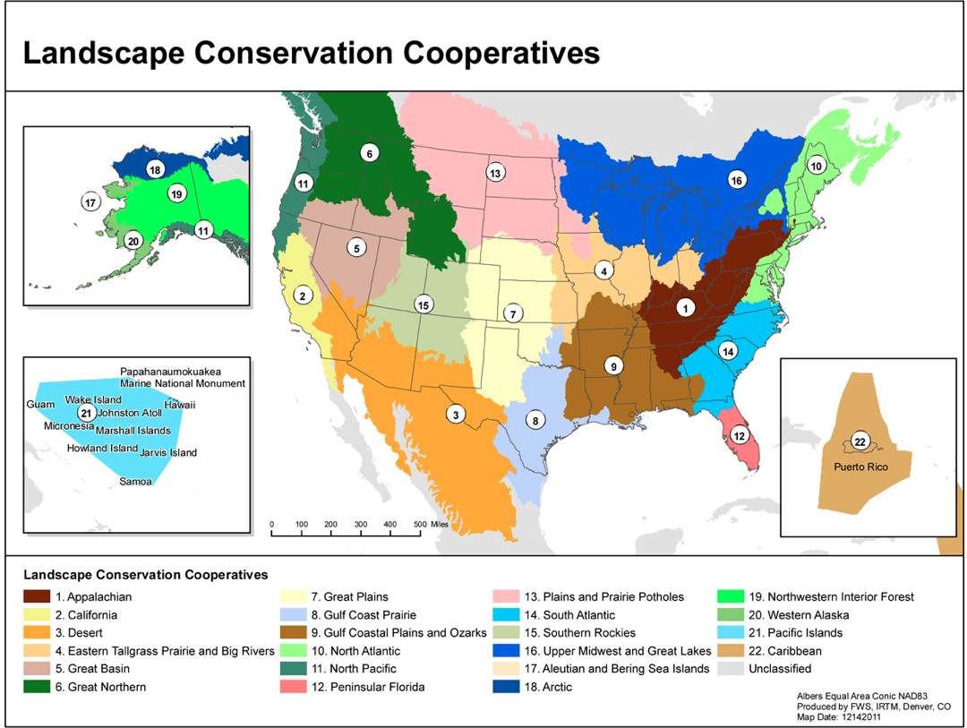
Great Northern LCC
Appalachian LCC

Slide 8
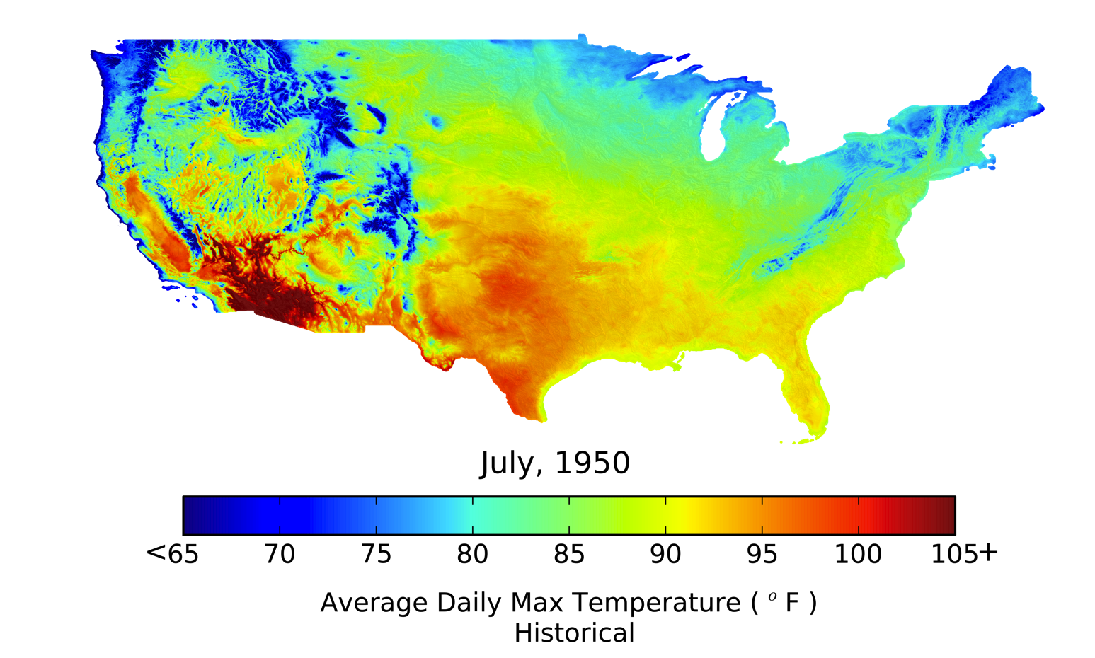
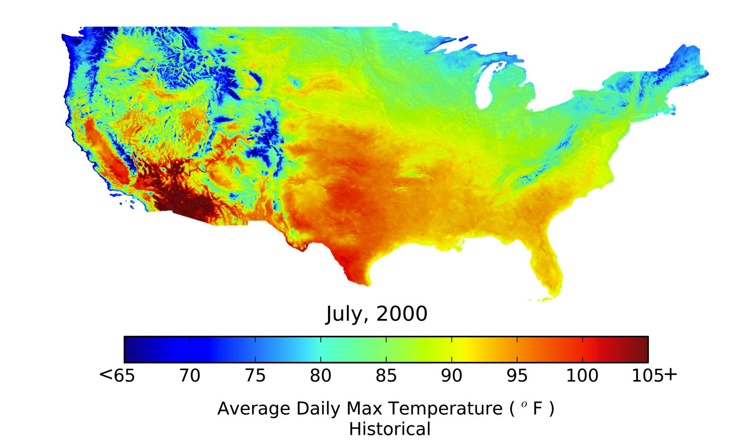
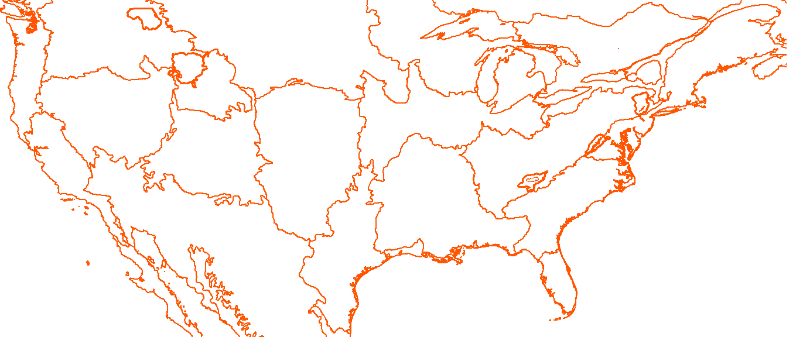
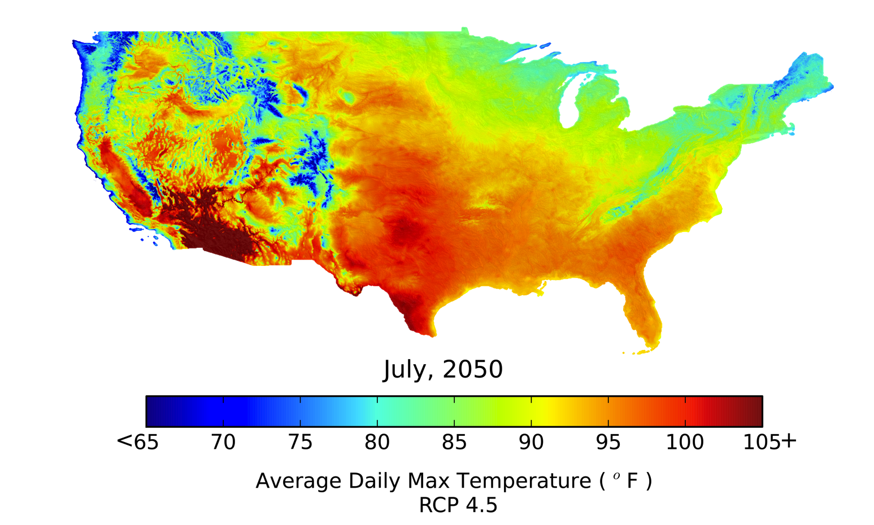
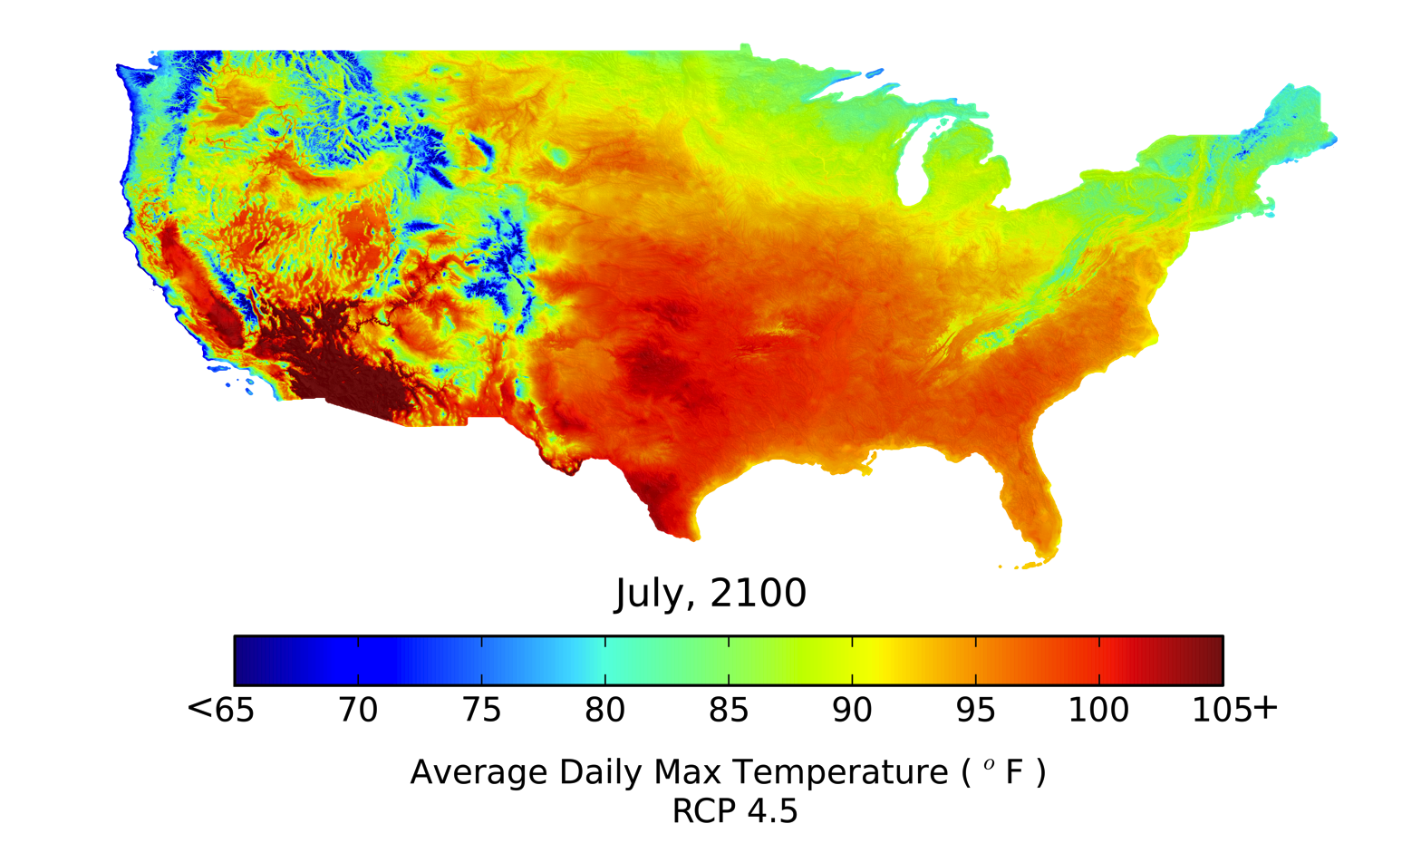
Downscaled CMIP5 (NEX-DCP30), RCP 4.5, Ensemble Avg.
Maximum Temperature
1950, PRISM
2000, PRISM
2050, RCP 4.5 EA (ensemble avg.)
2100, RCP 4.5 (ensemble avg.)
Notes:
Units are gC/m2/yr for GPP and mm/yr for ET and runoffs.
ALCC → GRSM (south), SHEN (middle), DEWA (north)

Slide 9
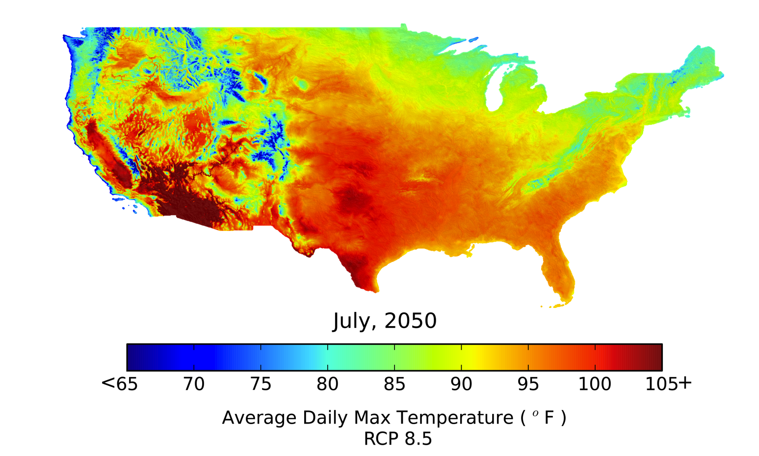
Downscaled CMIP5 (NEX-DCP30), RCP 8.5, Ensemble Avg.
Maximum Temperature
1950, PRISM
2000, PRISM
2050, RCP 8.5 (ensemble avg.)
2100, RCP 8.5 (ensemble avg.)
Notes:
Units are gC/m2/yr for GPP and mm/yr for ET and runoffs.
65F = 18C, 105F = 40.5C

Slide 10
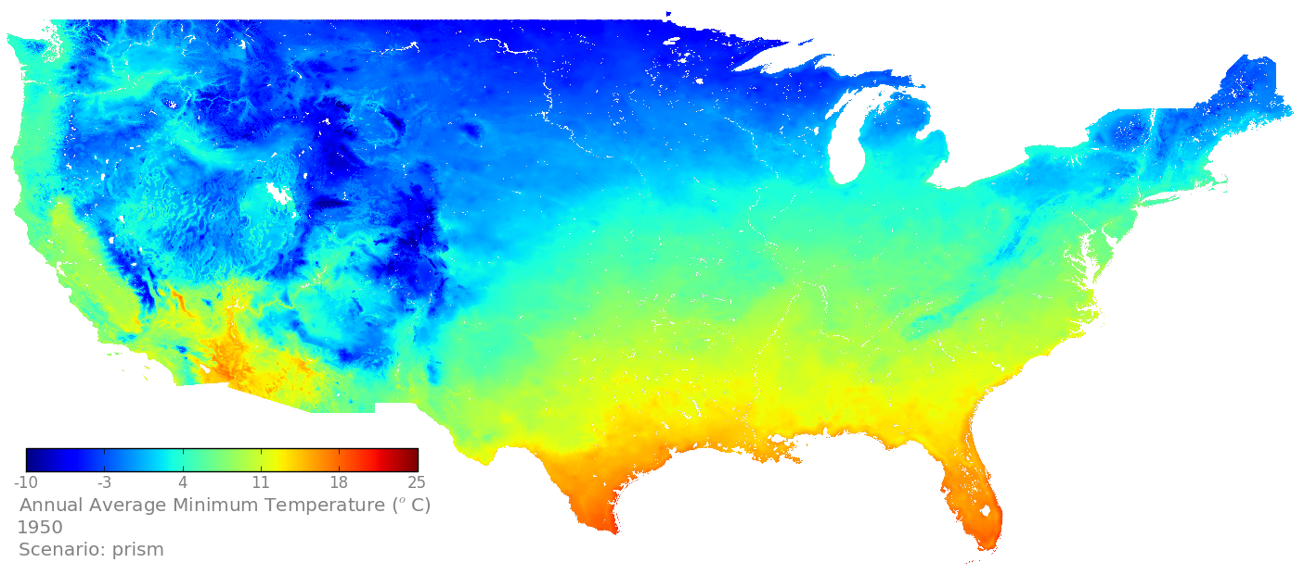
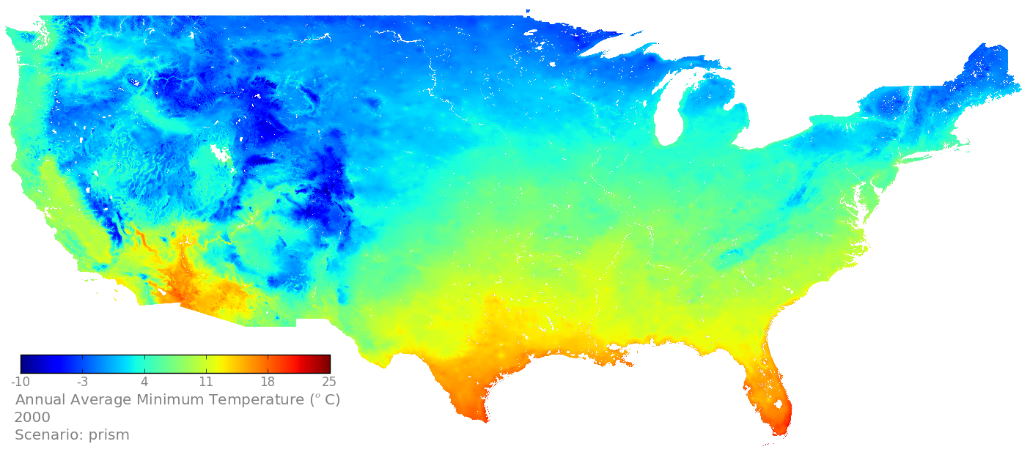
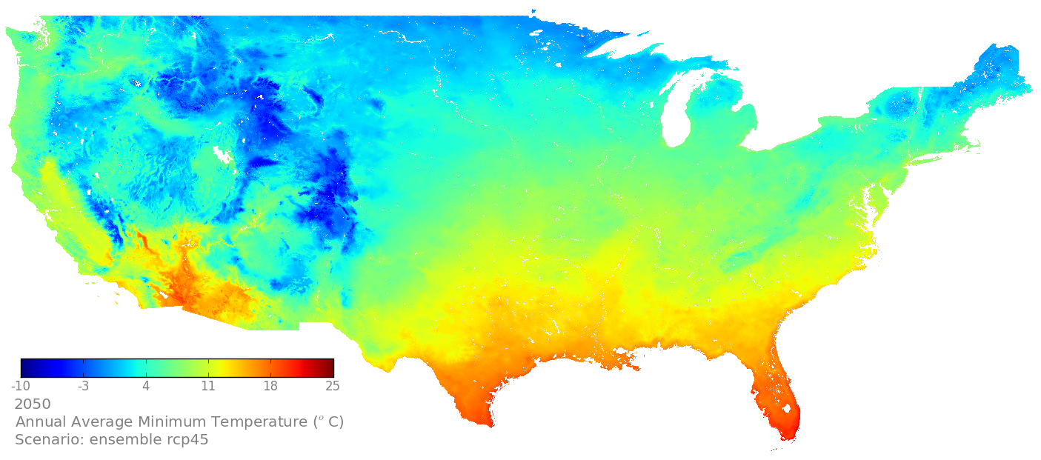
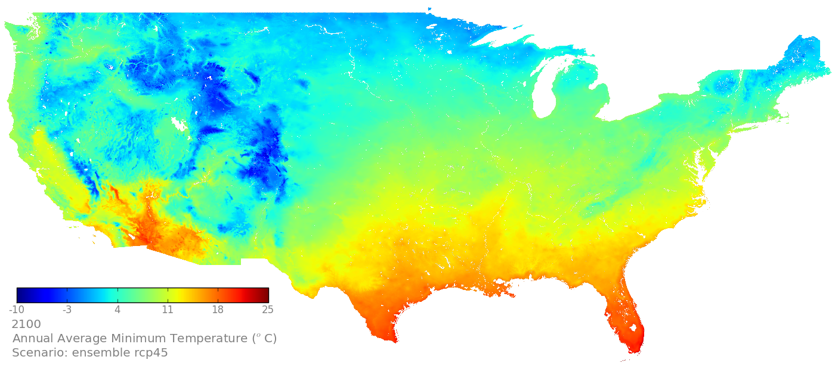
Downscaled CMIP5 (NEX-DCP30), RCP 4.5, Ensemble Avg.
Minimum Temperature
1950, PRISM
2000, PRISM
2050, RCP 4.5 EA
2100, RCP 4.5 EA
Notes:
Units are gC/m2/yr for GPP and mm/yr for ET and runoffs.
-20 = -4F, 25 = 77 F

Slide 11
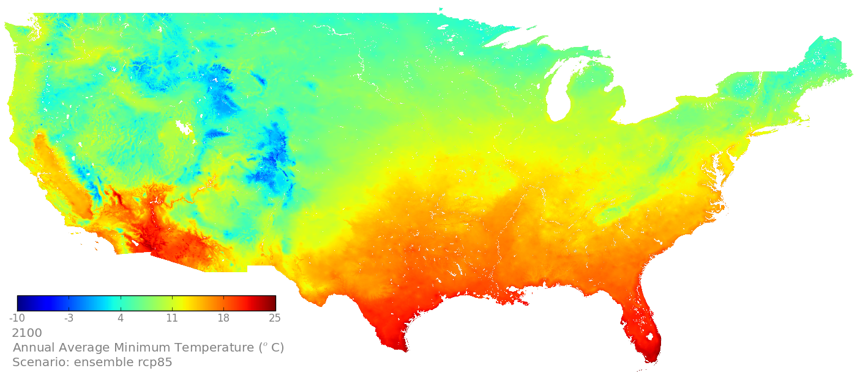
Downscaled CMIP5 (NEX-DCP30), RCP 8.5, Ensemble Avg.
Minimum Temperature
1950, PRISM
2000, PRISM
2050, RCP 8.5 EA
2100, RCP 8.5 EA
Notes:
Units are gC/m2/yr for GPP and mm/yr for ET and runoffs.

Slide 12
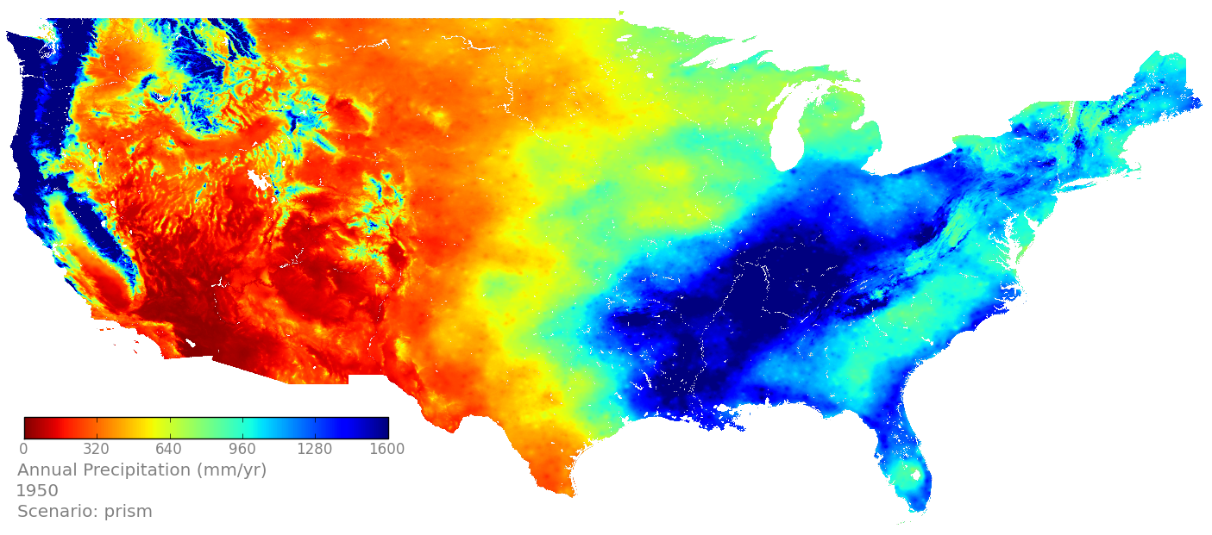
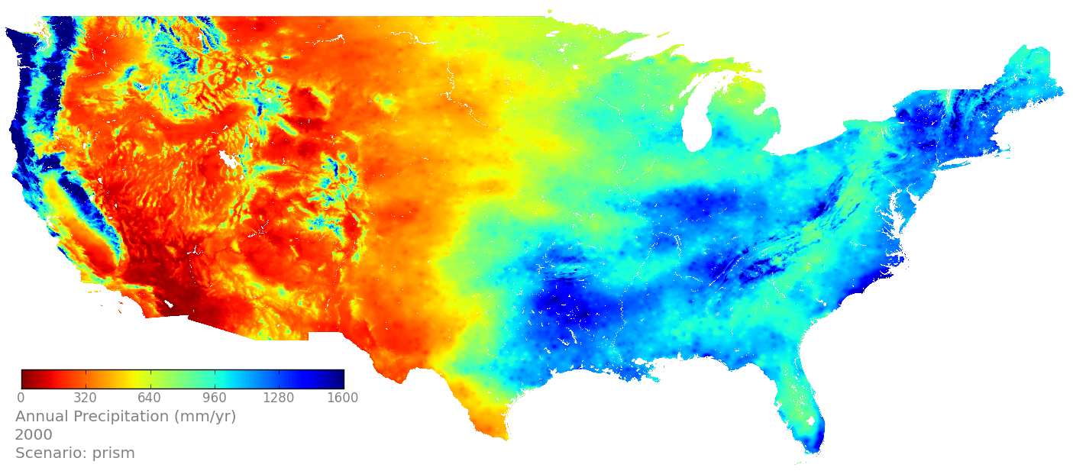
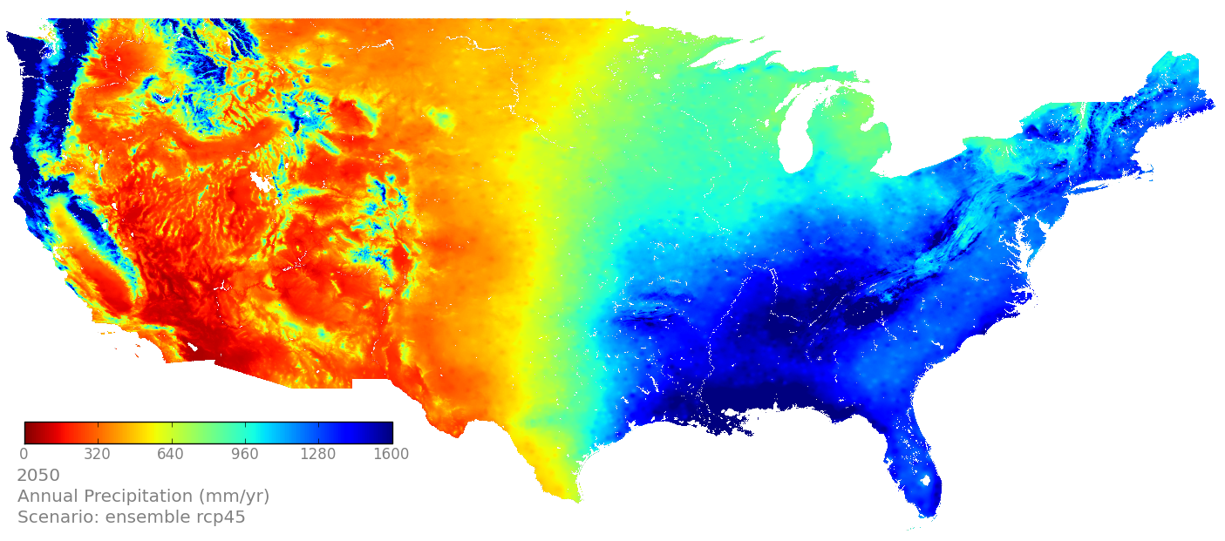
Downscaled CMIP5 (NEX-DCP30), RCP 4.5, Ensemble Avg.
Precipitation
1950, PRISM
2000, PRISM
2050, RCP 4.5 EA
2100, RCP 4.5 EA
Notes:
Units are gC/m2/yr for GPP and mm/yr for ET and runoffs.

Slide 13
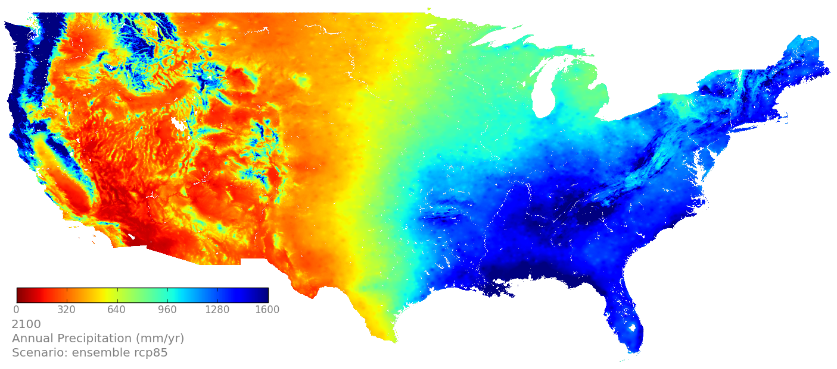
Downscaled CMIP5 (NEX-DCP30), RCP 8.5, Ensemble Avg.
Precipitation
1950, PRISM
2000, PRISM
2050, RCP 8.5 EA
2100, RCP 8.5 EA
Notes:
Units are gC/m2/yr for GPP and mm/yr for ET and runoffs.

Slide 14
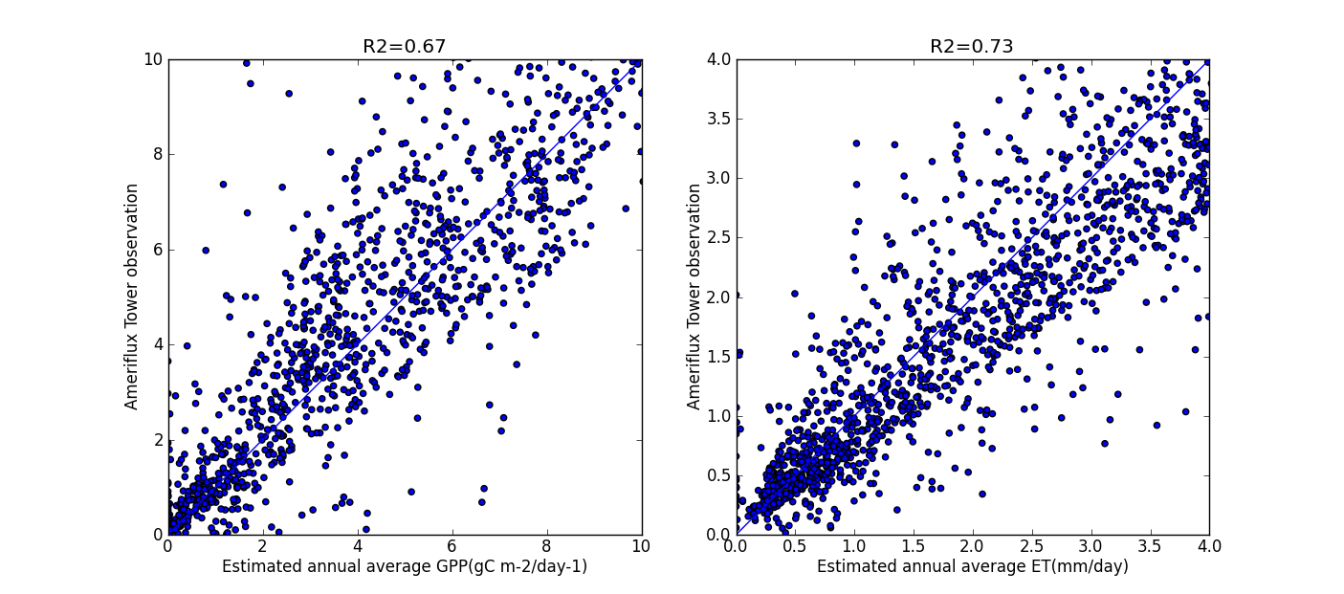
Model Verification: Comparison Against Ameriflux Tower Observations, 2001-2010
Gross Primary Production
Evapotranspiration

Slide 15
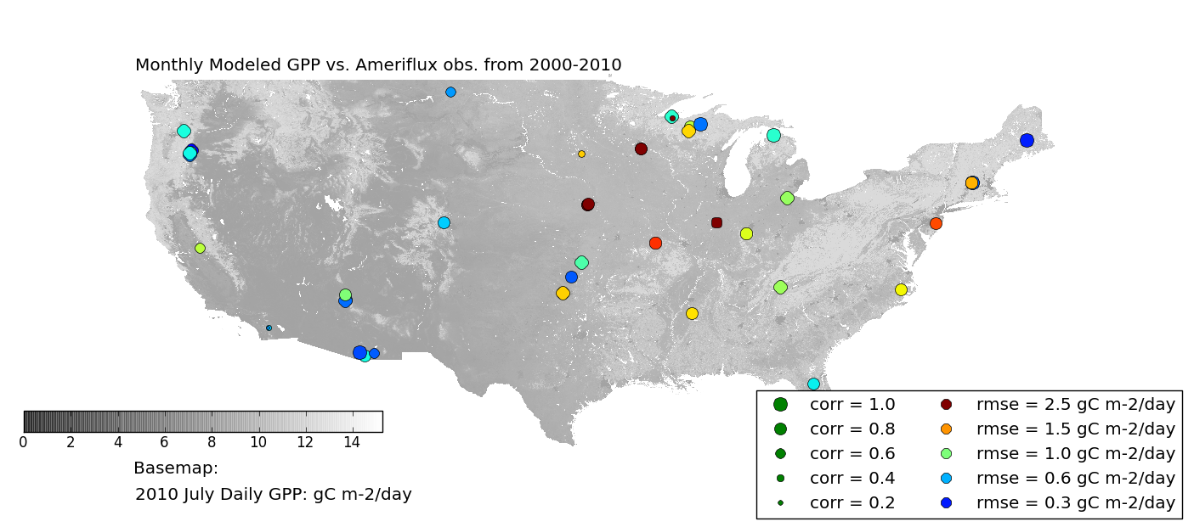
Model Verification: Gross Primary Production (GPP)

Slide 16
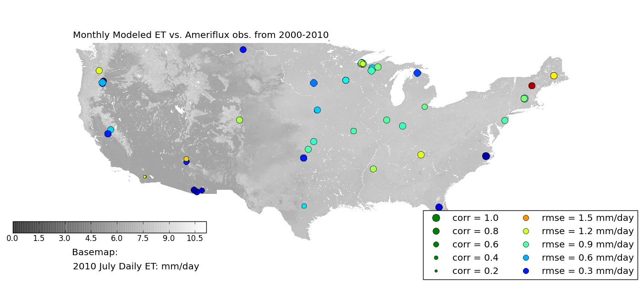
Model Verification: Evapotranspiration

Slide 17
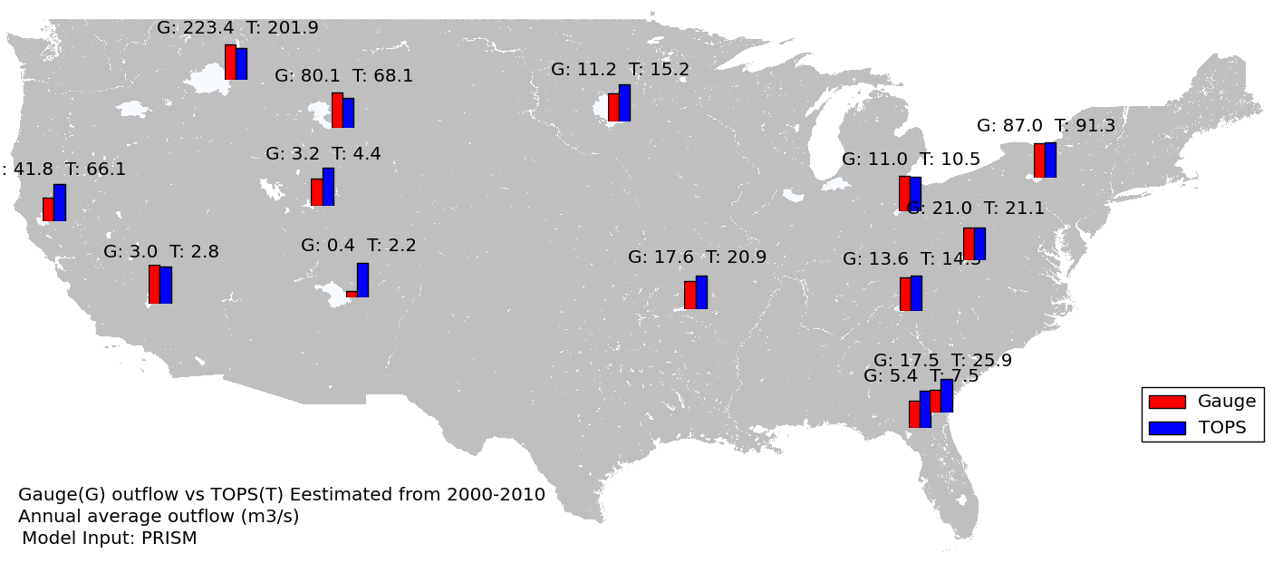
Model Verification: Runoff
Discharge from Gauge (G) vs TOPS (T), 2000-2010, annual average outflow (m³/s)
Notes:
Problem spot is Chinle Creek, AZ with deeply incised channel in desert region

Slide 18
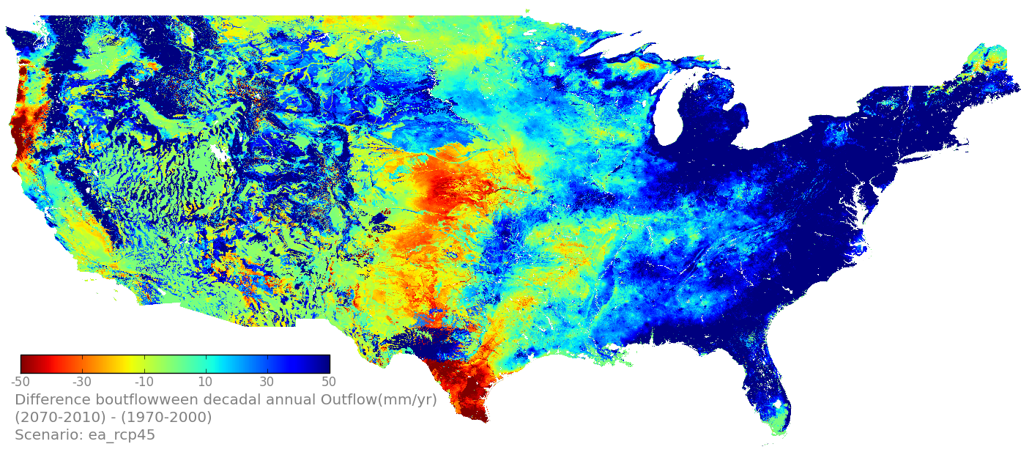
Results: Runoff
RCP 4.5 EA, AVG(2071-2100) – AVG(1971-2000)
Change in runoff (mm/yr)
(2071-2100) – (1971-2000)
RCP 4.5, Ensemble Avg.
(2071-2100) – (1971-2000)
Preliminary Results
Notes:
Units are gC/m2/yr for GPP and mm/yr for ET and runoffs.
Edwards Plateau

Slide 19
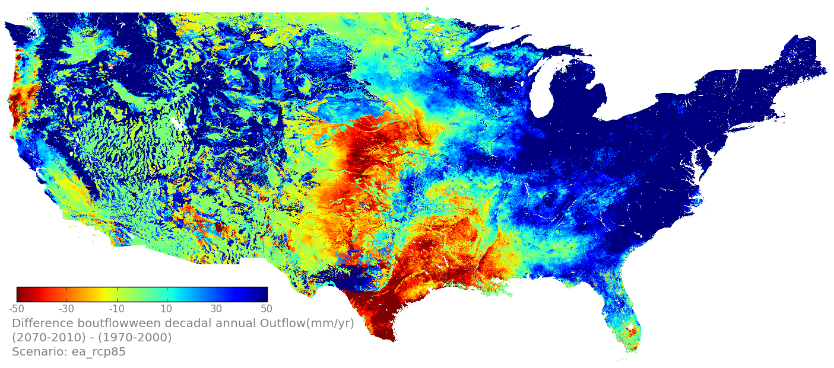
Results: Runoff
RCP 8.5 EA, AVG(2071-2100) – AVG(1971-2000)
Change in runoff (mm/yr)
(2071-2100) – (1971-2000)
RCP 8.5, Ensemble Avg.
(2071-2100) – (1971-2000)
Preliminary Results
Notes:
Units are gC/m2/yr for GPP and mm/yr for ET and runoffs.

Slide 20
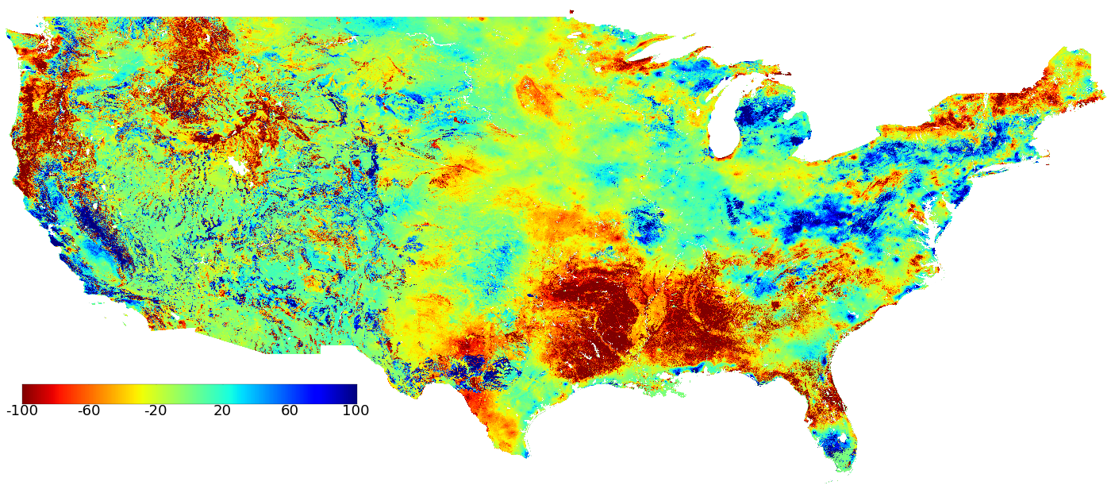
Results: Gross Primary Production
RCP 4.5 EA, AVG(2071-2100) – AVG(1971-2000)
(2071-2100) – (1971-2000)
Change in GPP (gC/m^2/yr)
(2071-2100) – (1971-2000)
RCP 4.5, Ensemble Avg.
Preliminary Results
Notes:
Units are gC/m2/yr for GPP and mm/yr for ET and runoffs.

Slide 21
Results: Gross Primary Production
RCP 8.5 EA, AVG(2071-2100) – AVG(1971-2000)
Change in GPP (gC/m^2/yr)
(2071-2100) – (1971-2000)
RCP 8.5, Ensemble Avg.
(2071-2100) – (1971-2000)
Preliminary Results
Notes:
Units are gC/m2/yr for GPP and mm/yr for ET and runoffs.

Slide 22
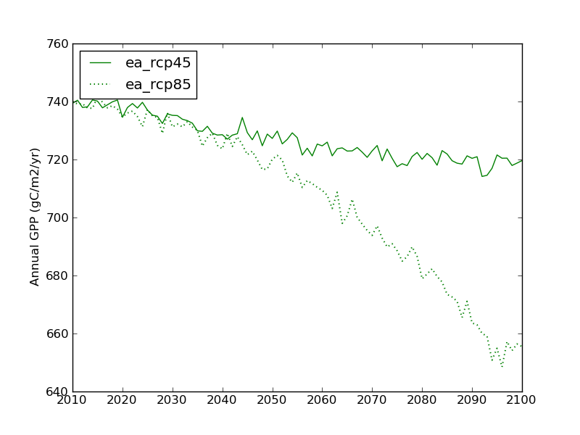
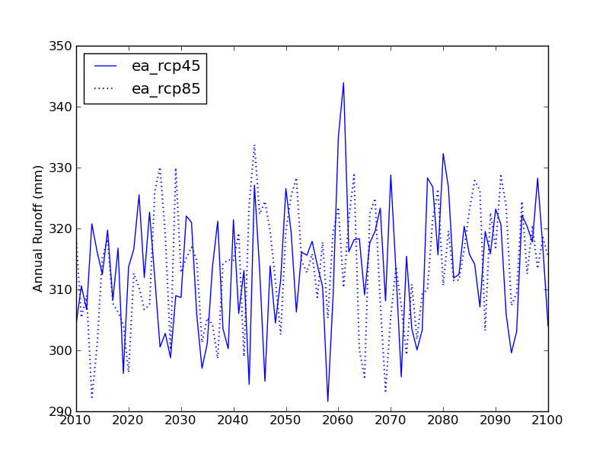
Results: Overall Trends for U.S.
Gross Primary Production
Runoff

Slide 23
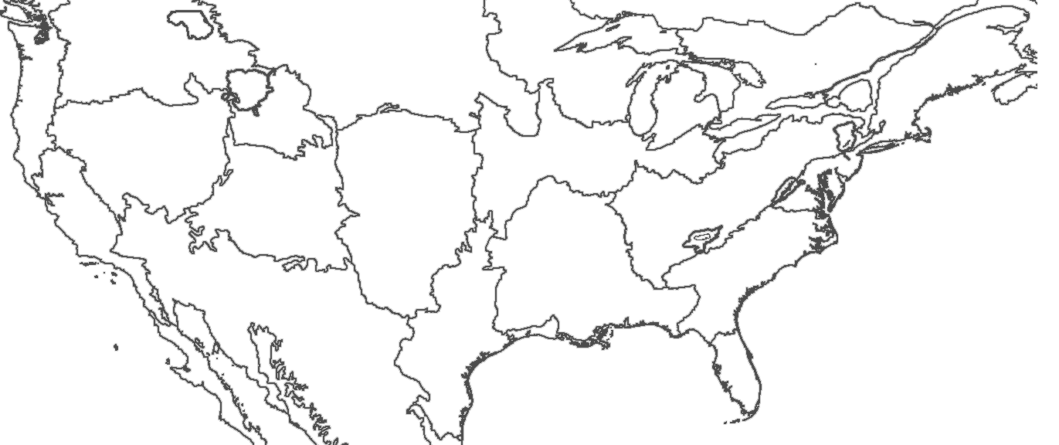
Results: Gross Primary Production
GYE PACE
RCP 8.5 EA, AVG(2071-2100) – AVG(1971-2000)
Change in GPP (gC/m^2/yr)
(2071-2100) – (1971-2000)
RCP 8.5, Ensemble Avg.
(2071-2100) – (1971-2000)
Preliminary Results
Notes:
Units are gC/m2/yr for GPP and mm/yr for ET and runoffs.
Greater Yellowstone (Yellowstone and Grand Tetons)

Slide 24
Example: Greater Yellowstone Ecosystem (GYE) PACE
Gross Primary Production (GPP)

Slide 25
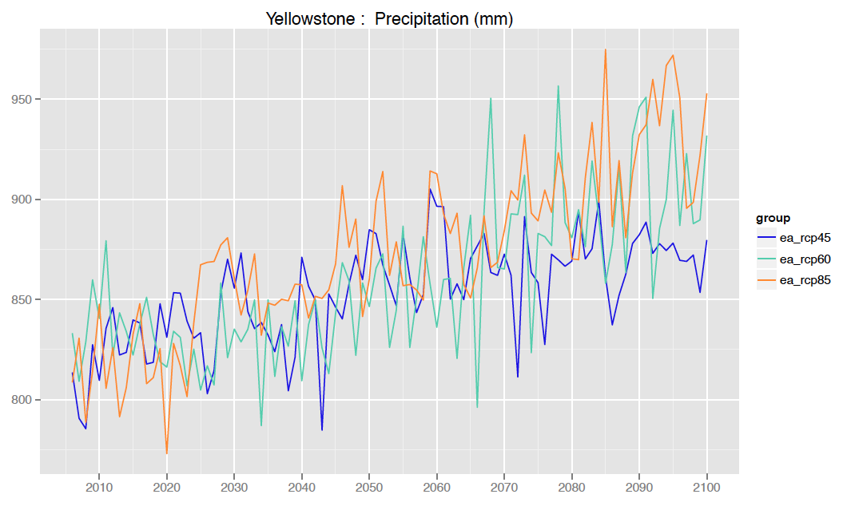
Example: GYE PACE

Slide 26
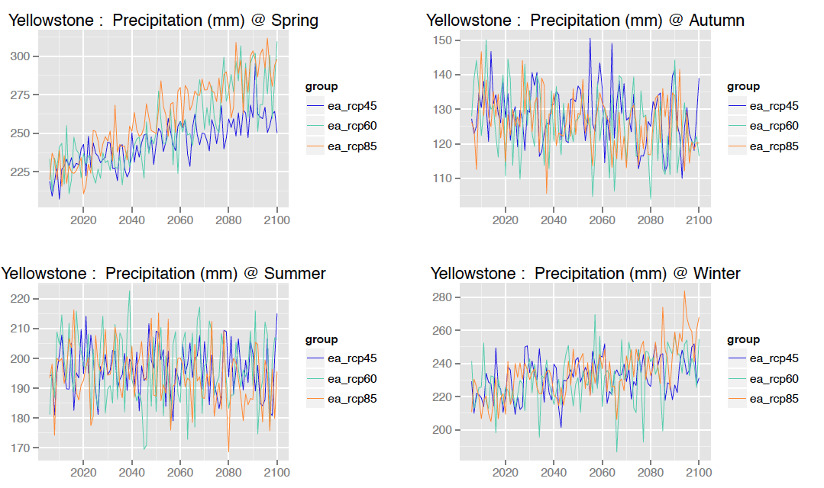
Example: GYE PACE

Slide 27
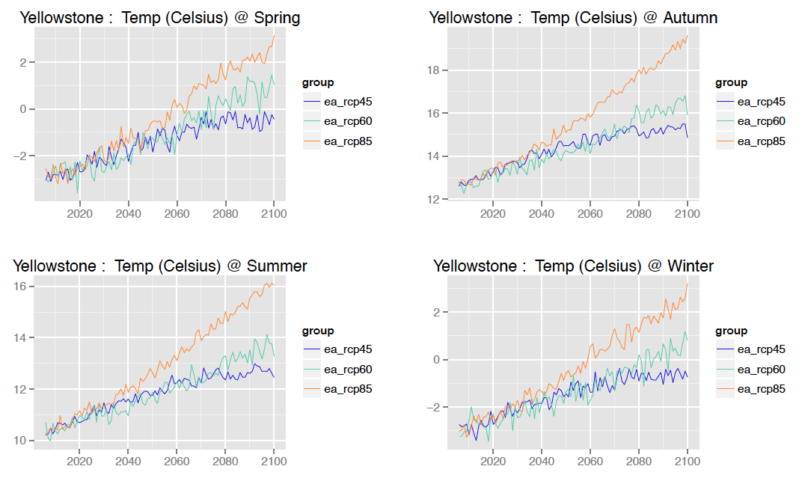
Example: GYE PACE

Slide 28
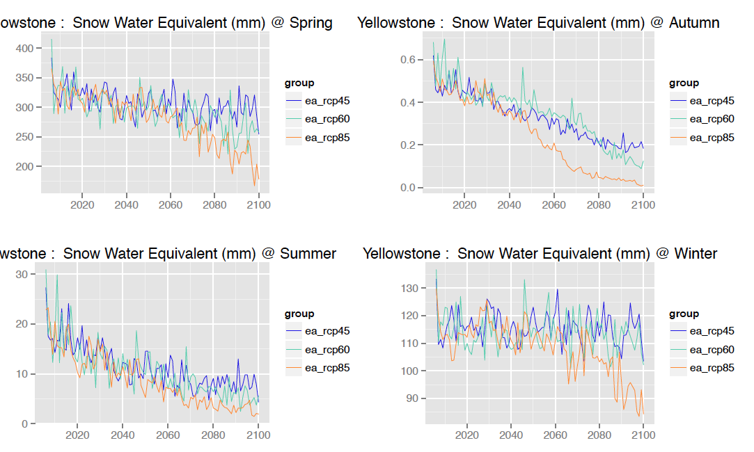
Example: GYE PACE

Slide 29
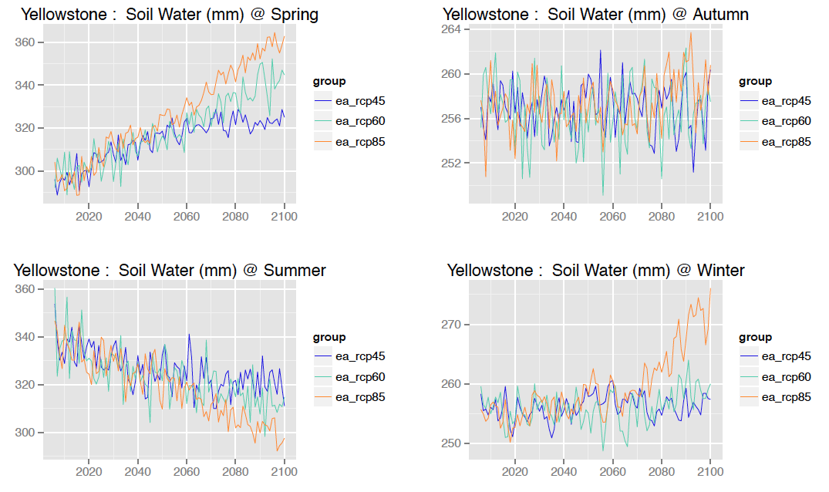
Example: GYE PACE

Slide 30
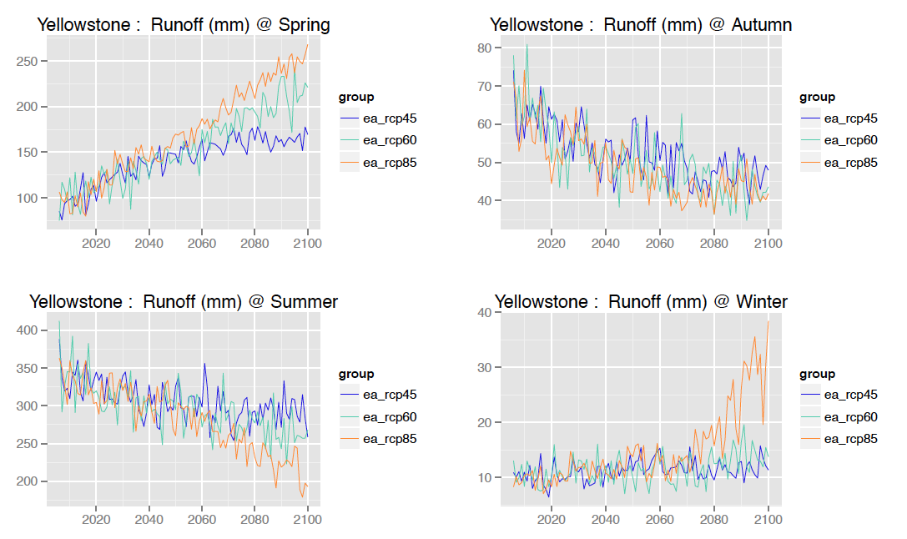
Example: GYE PACE

Slide 31
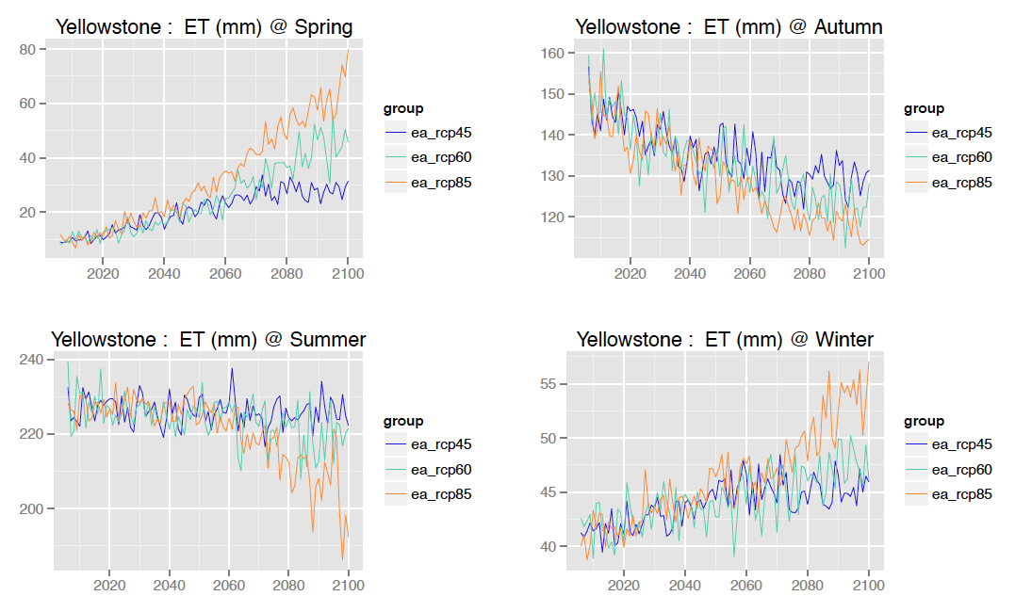
Example: GYE PACE
Evapotranspiration (ET)

Slide 32
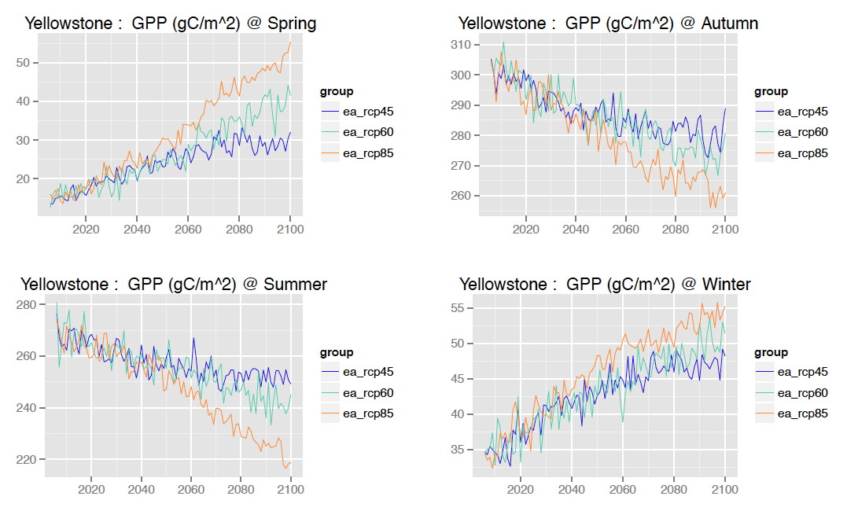
Example: GYE PACE
Gross Primary Production (GPP)

Slide 33
Summary
High resolution climate and land use scenarios used to drive Biome-BGC ecosystem model
Results capture interactions of climate, land use, soils and topography at 1km resolution
Results to date indicate substantial changes in GPP under RCP 8.5
Net changes in runoff are more subtle for U.S. on average, though seasonal and regional changes in runoff for can be dramatic and important
Next steps focused on additional runs with subset of individual models (e.g, CNRM-CM5, HadCM3, GFDL-ESM2M, per Sheffield et al., 2013; Rupp et al., 2013); regional analysis of impacts of land use change vs climate forcing

