Slide 1
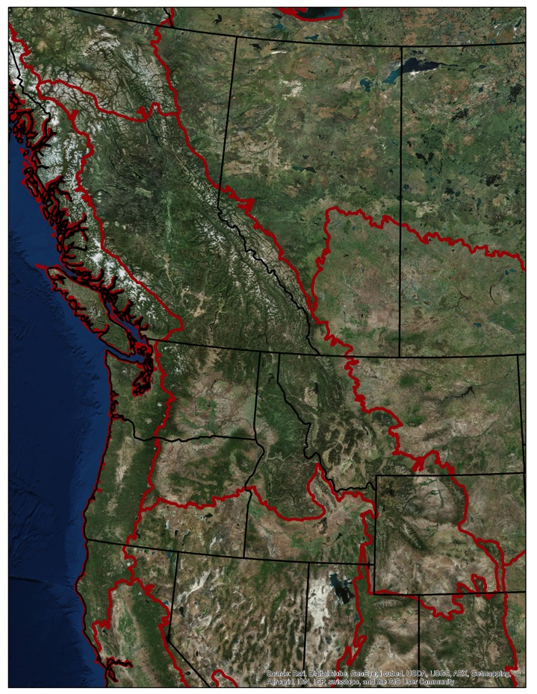
Mapping trans-boundary riparian climate-corridors: Overcoming data limitations to inform large-scale climate adaptation for North America
David M. Theobald^{1,2} and Meade Krosby³
¹Conservation Science Partners
²Department of Fish, Wildlife, and Conservation Biology, Colorado State University
³Climate Impacts Group, University of Washington

Slide 2
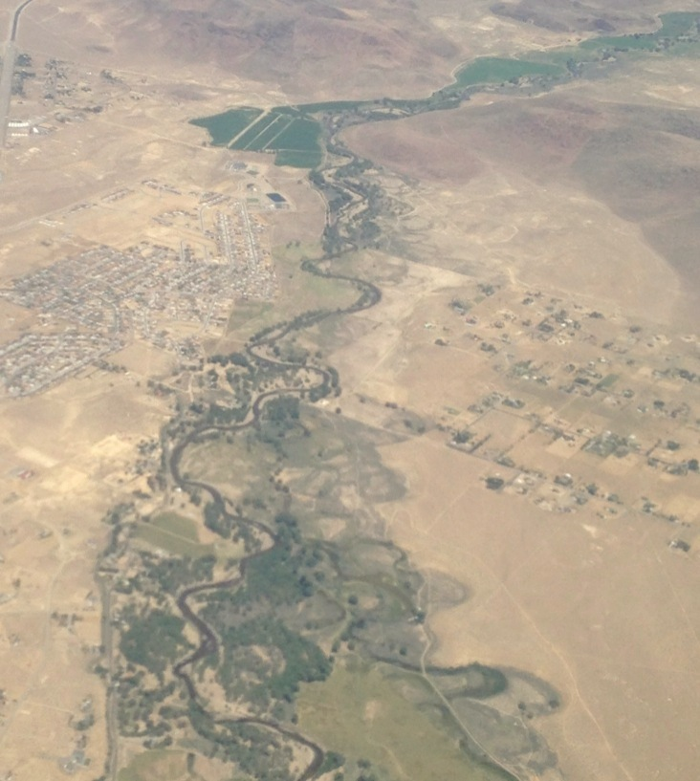
Why are riparian areas important for adaptation to climate change?
Span climatic gradients
Act as dispersal corridors
Contain cool, moist microclimates
Feature high species richness
Expected to facilitate range shifts and provide refugia from warming

Slide 3
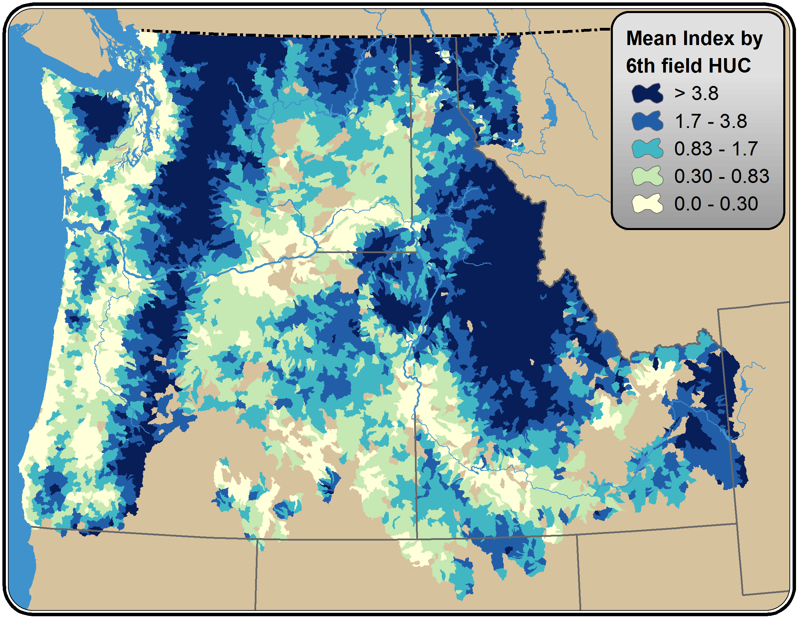
Goals
Create a method to identify RCC that transcend political boundaries to recognize natural processes
(Align with vulnerability assessment framework)
Practical way to scale up to broaden the geography

Slide 4
Which potential riparian areas (watersheds) are vulnerable to climate change?
Temperature 2070
Insolation
(Canopy cover)
Human modification
Exposure
Sensitivity
Potential Impact
Adaptive Capacity
Vulnerability
Notes:
Vulnerability frameworks (Williams et al. 2008; Stein et al. 2010) typically structure the analysis of vulnerability as a function of impact, mediated by adaptive capacity. Impact in turn is a function of exposure and sensitivity (Stein et al. 2010). Sensitivity can be thought of as a function of the ecology or in terms of factors intrinsic to species such as physiological tolerance or life-history characteristics. Adaptive capacity includes ecological function, as well as extrinsic factors such human management activities (Williams et al. 2008; Klausmeyer et al. 2011). Similar to past studies, we consider both climate and land use change as our exposure variables. However, we framed our analysis of vulnerability to consider connectivity as a component of sensitivity (rather than adaptive capacity), leaving adaptive capacity to be composed of human management actions would be extrinsic to the ecological dynamics. Pragmatically, this opens the model to have an explicit and clear policy lever with which to understand various adaptation strategies, as a function of management actions.

Slide 5
Exposure
Temperature (T) from WorldClim (Bio1) for 2000, ~2070
Lower elevation ~ higher exposure
T in 2070 standardized by mean/STD of 2000 (100 km radius)
Z-score converted to probability (0→1)

Slide 6
Exposure
Missoula, MT
You are here
1 mile

Slide 7
Sensitivity
Calculated using inverse of insolation
Assume related to evapotranspiration process
- High insolation = high sensitivity
- Low insolation = low sensitivity
- calculated using HILLSHADE (south at equinox zenith, adj. by latitude)

Slide 8
Adaptive capacity
Calculated as inverse of human modification
Data from “Night lights” (VIIRS) and accessibility to urban areas along roads
- High modification = low adaptive capacity
- Low modification = high adaptive capacity

Slide 9
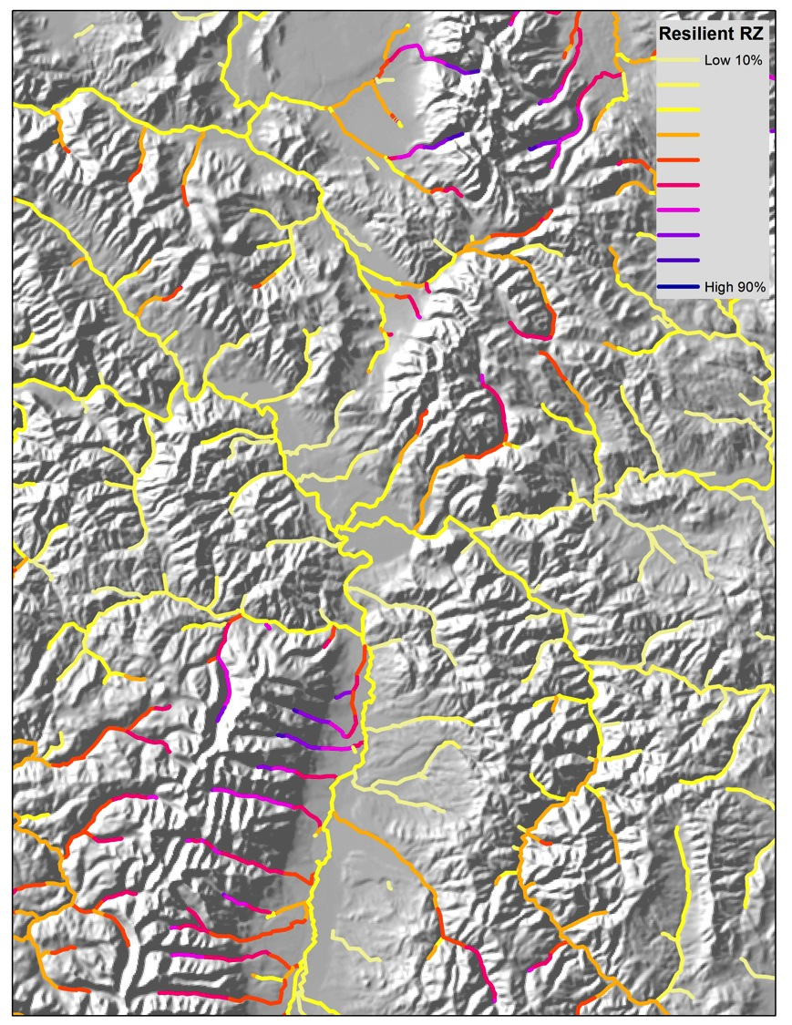
Vuln
Resilient riparian climate-corridors
Calculate “resilience” as inverse of vulnerability
V=1.0-((1-E) x (1-S) x (1-(1/A)))
R = 1-V
Assume spatial distribution dominated by watershed process (flow accumulation)
Average resilience from a location thru all locations above it (up to headwaters)
At 210 m resolution

Slide 10
Resilient riparian climate- corridors
Generally correspond to elevation
Mountain ranges more resilient, valleys less resilient

Slide 11
Resilient RCC (details)
Interesting mid-valley variations

Slide 12
Riparian climate-corridor quintiles – detailed approach

Slide 13
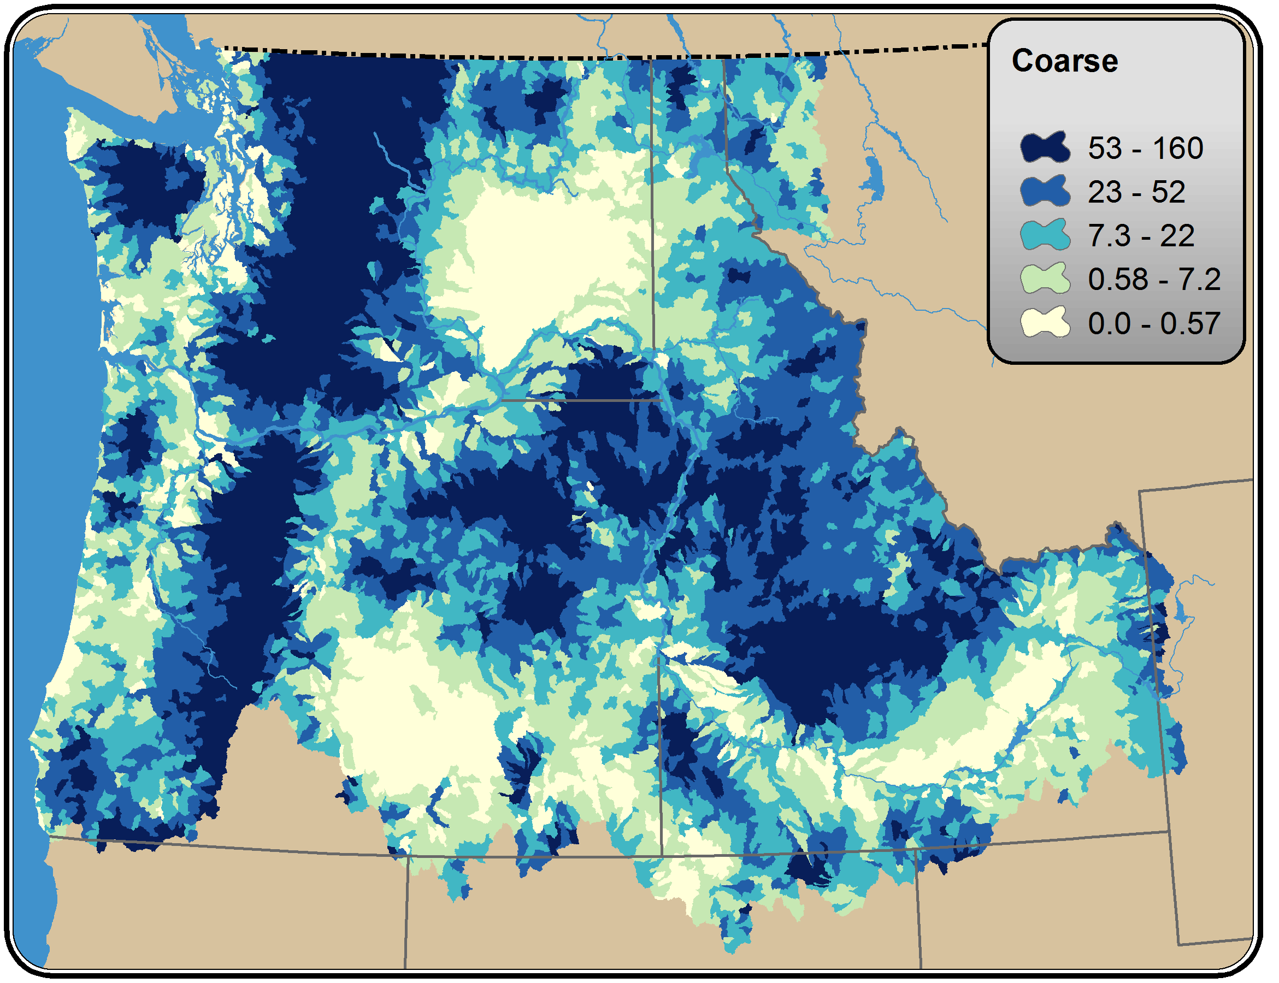
Riparian climate-corridor quintiles – coarse approach

Slide 14
Riparian climate-corridor quintiles – coarse approach

Slide 15
Summary – climate adaptation planning means transcending boundaries
 | Conceptual | Technical | Coordination
Challenges | Combining variables into meaningful measures, what are units of index? How far to link? Spanning ridgelines? | Boundaries (international, state/province, sector, etc.) Insolation Canopy cover? | Data issues, comparability, collaboration
Opportunities | Standardize (e.g., temperature to 0-1) Extend to landforms | Extend to Alaska as well, Mexico Scaling | High Divide, GNLCC, CMP, others Placing climate info on the ground

Slide 16
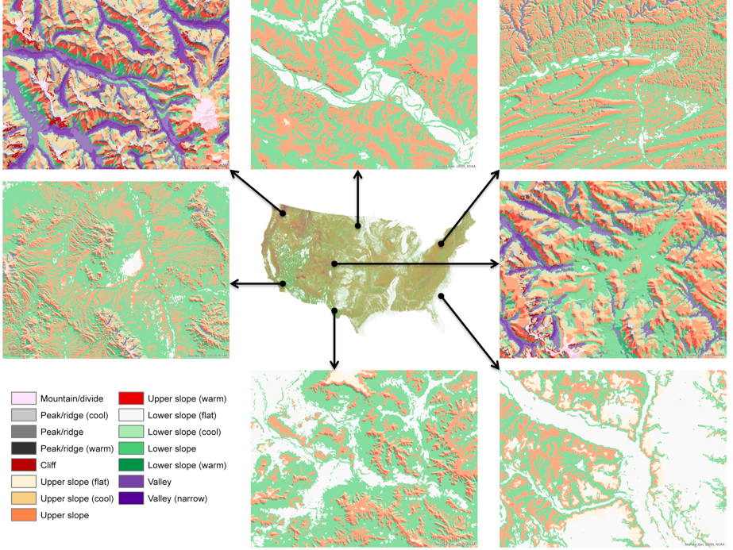
Climate neutral,
ecologically-relevant
land form classification

Slide 17
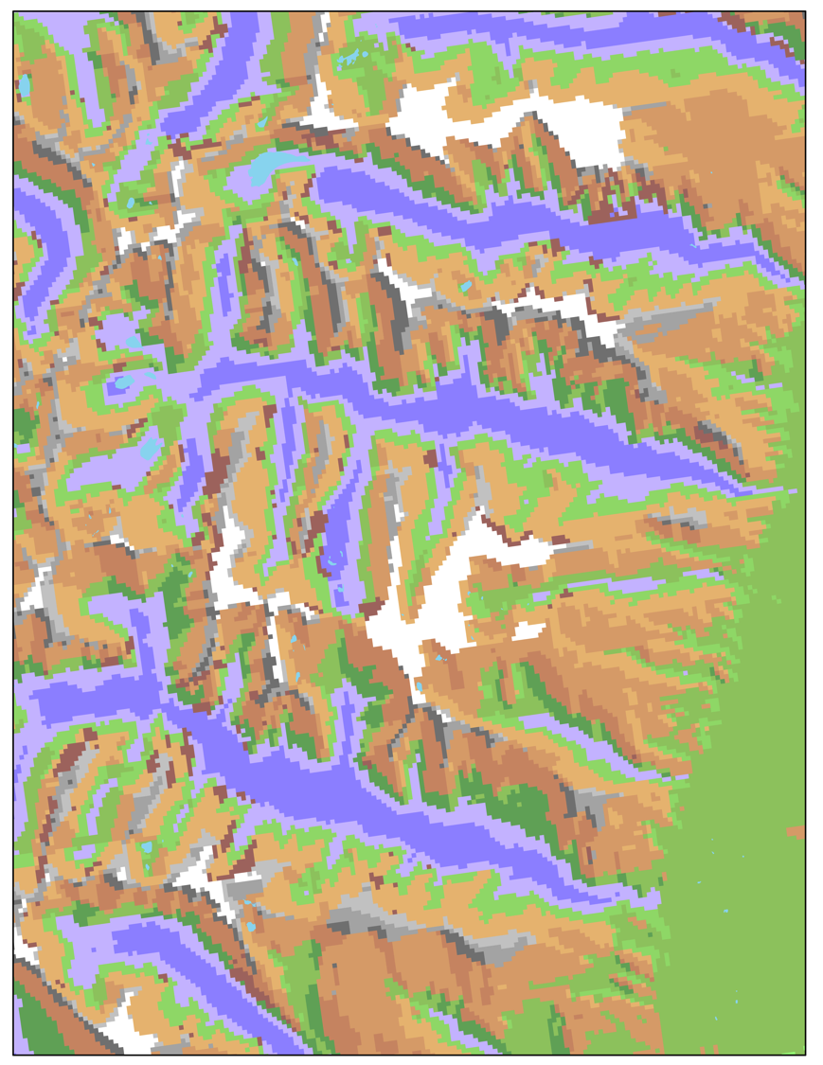
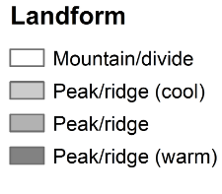
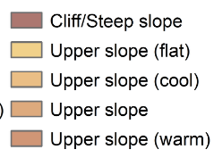
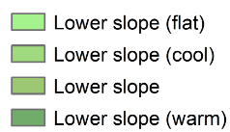
Landforms 90 m

Slide 18
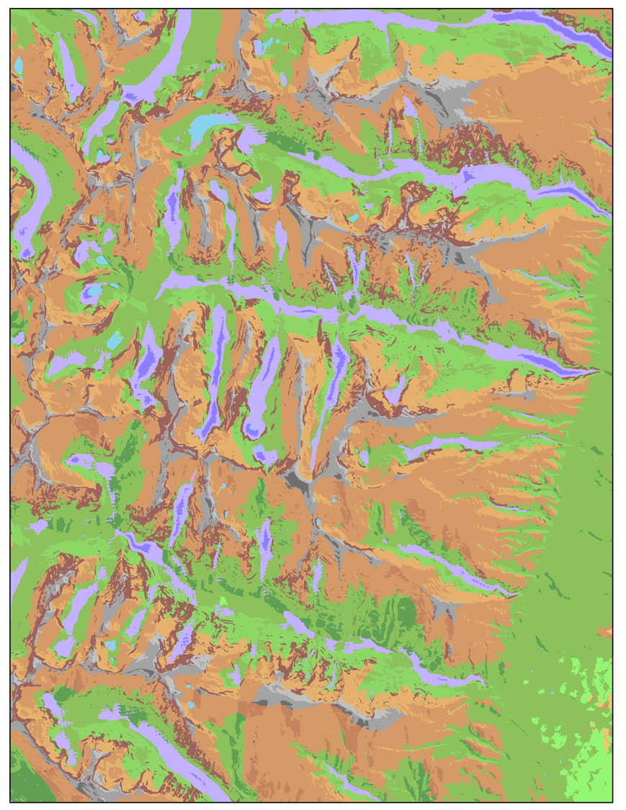
Technical – Scaling issues
Landforms 10 m

Slide 19
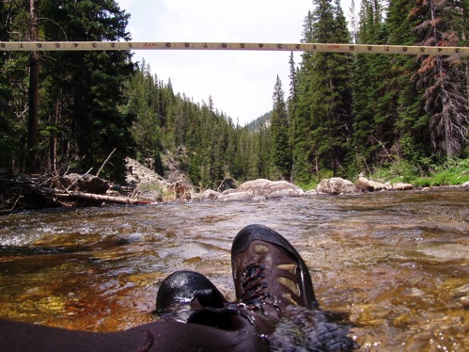
Thanks! Comments, questions?
Support from NASA, Wilburforce, Great Northern, North Pacific, and Southern Rockies LCCs
Feedback/questions: davet@csp-inc.org
Conservation Science Partners: www.csp-inc.org
Landscape & Climate Change Vulnerability Project: http://www.montana.edu/lccvp/

