Slide 1
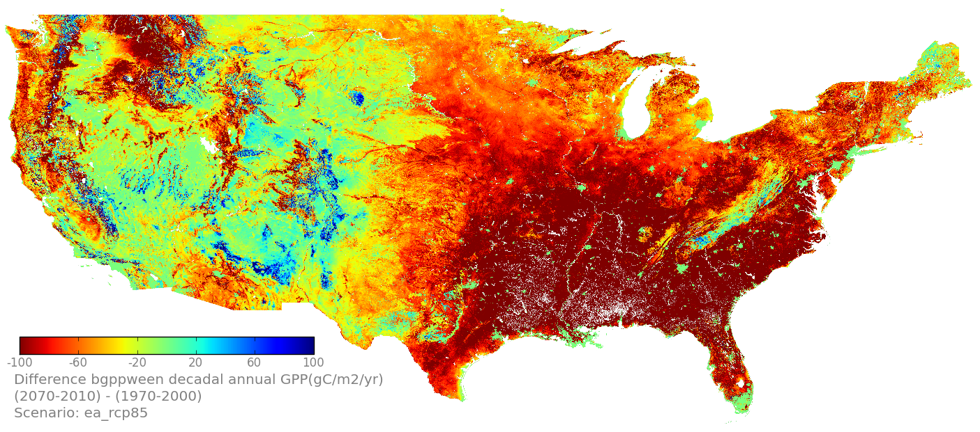
LCC-VP Project Update NASA ARC/CSU Monterey Bay
NASA/CSUMB Project Team
Forrest Melton, Jun Xiong, Weile Wang, Cristina Milesi, Alberto Guzman
Carolyn Rosevelt, Rama Nemani
Ecological Forecasting Lab
NASA Ames Research Center
May 21, 2013
(2071-2100) – (1971-2000)

Slide 2
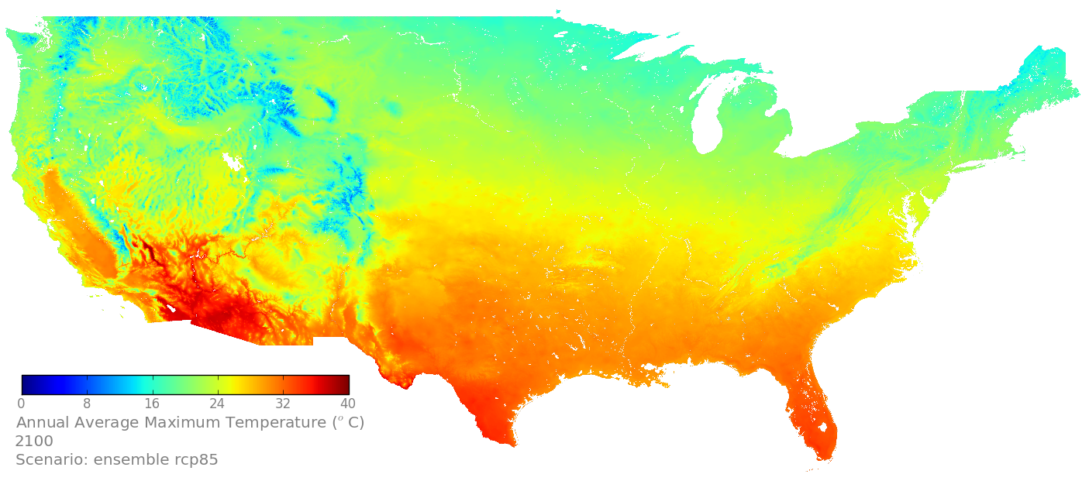
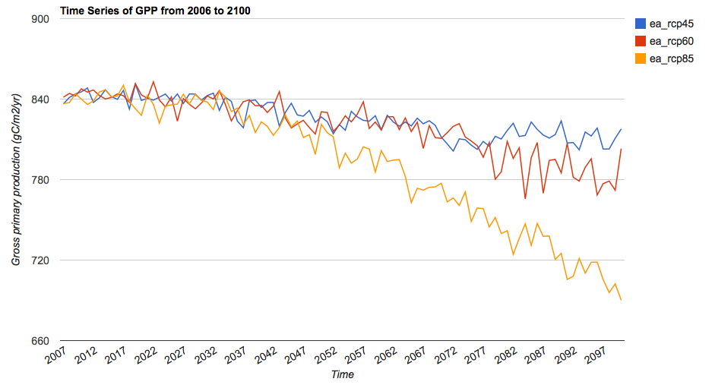
Status
Downscaled 30 arcsecond (~800m) CMIP5 scenarios completed (NEX DCP-30), Version 1.0 (in collaboration with Climate Analytics Group, Thrasher & Snyder); publication submitted to EOS; data publicly released via NCCS
Subsets delivered for ROMO, Great Northern LCC, and Appalachian LCC; SE BBS routes; posted via NCCS
TOPS runs complete for ensemble averages, CCSM-4
Summaries computed for all partner parks/PACEs / LCCs
Max Temp, 2100, RCP 8.5
Change in GPP, Glacier PACE

Slide 3
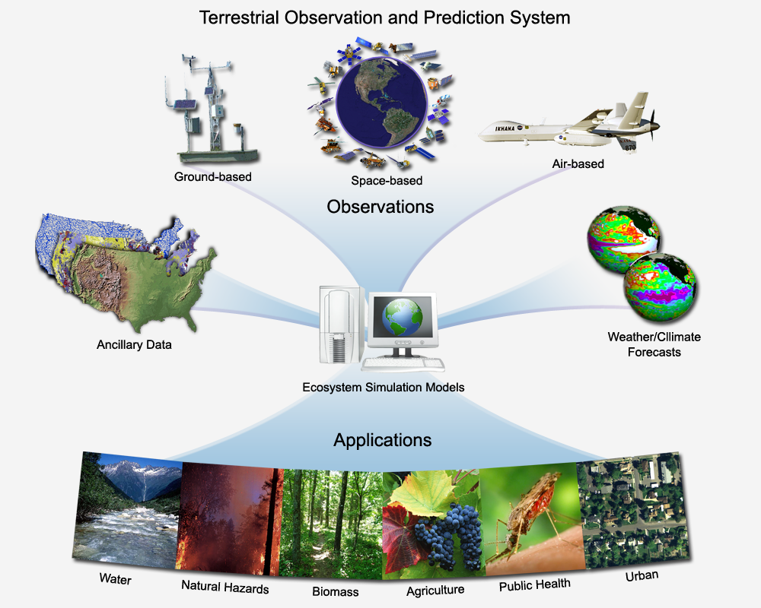
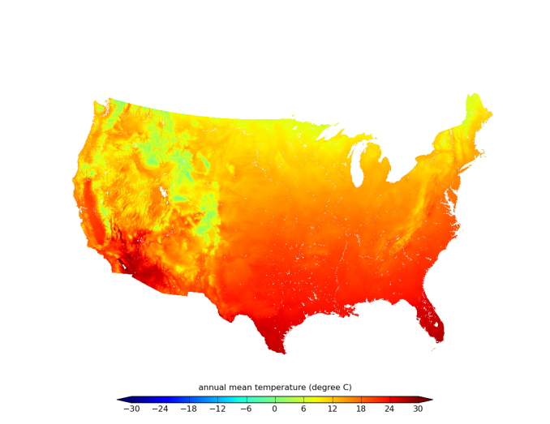
Methods: TOPS
Inputs | United States (1km)
Impervious surface area | SERGoM (Theobald et al., 2009) + NLCD ISA (2000)
Climate (baseline run) | PRISM 800m Monthly TOPOMET Weather Surfaces
Climate (forecast) | Downscaled CMIP5 Ensemble averages for RCP 2.6, 4.5, 6.0, 8.5 CCSM-4 scenario
Elevation | National Elevation Dataset (resampled to 800m)
Leaf Area Index (baseline run) | MODIS MOD15A2 LAI (Myneni et al., 2000)
Leaf Area Index (forecast) | MODIS LAI Climatology
Soils | U.S. STATSGO2 database
Land Cover | MODIS MOD12Q1 Land cover (Friedl et al., 2002) LPJ?
Generated 1km monthly Tave, Precip, VPD and solar radiation surfaces from downscaled WCRP CMIP3 scenarios (Maurer et al., 2007)

Slide 4
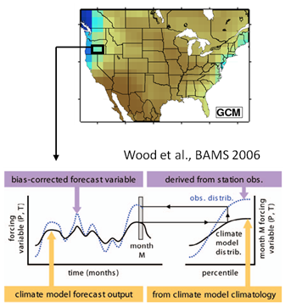
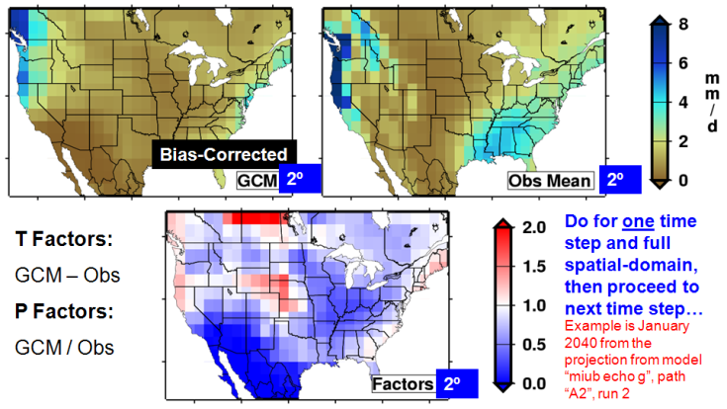
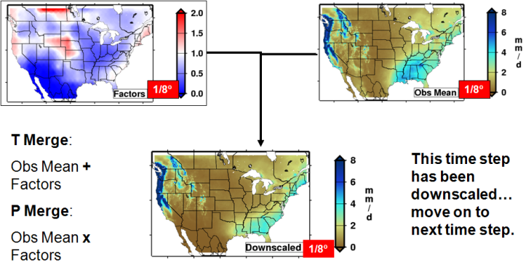
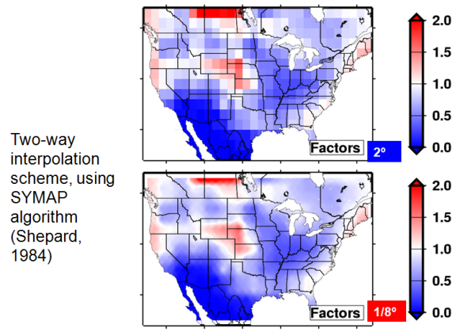
Methods: Climate Downscaling
Statistical downscaling: Bias-Correction Spatial Disaggregation (BCSD)
More info at: http://gdo-dcp.ucllnl.org/downscaled_cmip3_projections
Notes:
1st step: for each grid cell, adjust the mean and the variability of GCM-simulated variables so that their posterior cumulative distribution functions match those of corresponding observations;
2nd step: Aggregate the climatology of the finer-resolution observations to GCM resolutions so that they can be compared with the bias-corrected GCM variables to estimate T factors (offsets) or P-factors (scaling factors);
3rd step: interpolation of the T and the P factors to the finer resolution (of the observations);
4th step: Create downscaled GCM fields with the observed climatology and the calculated T/P factors.

Slide 5
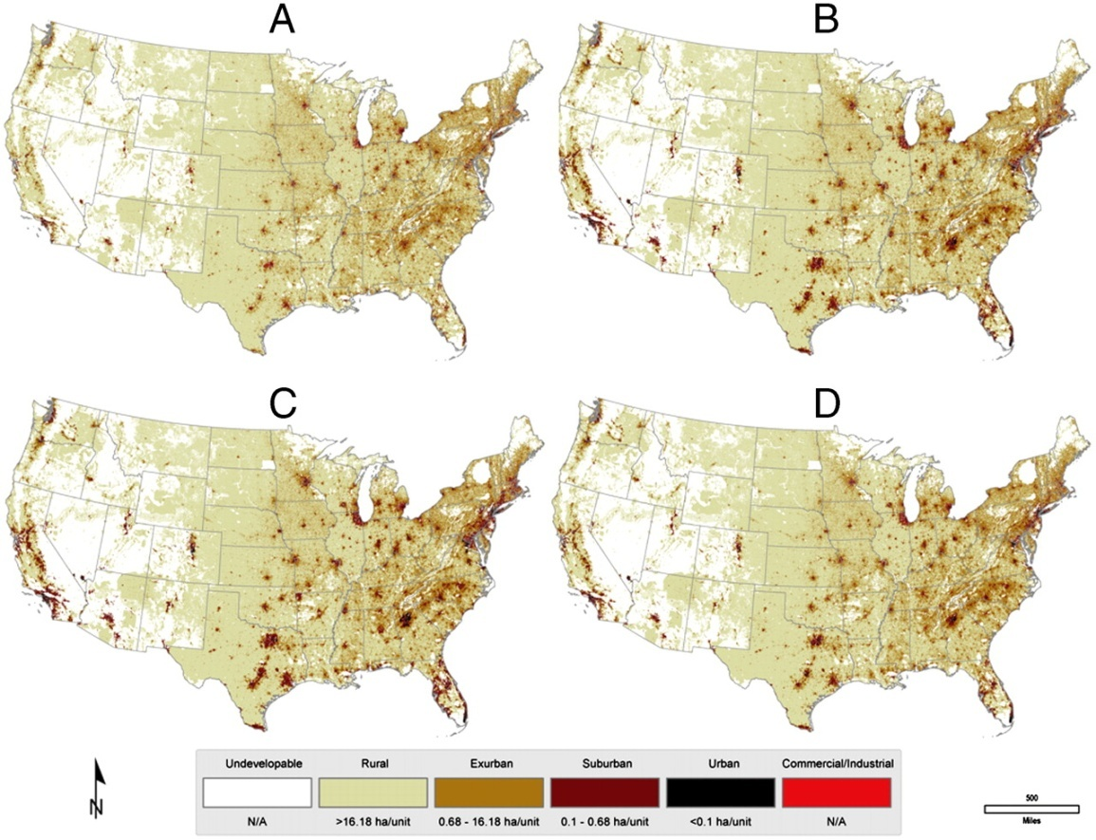
Methods: Integration of SERGoM Data
SERGoM ISA scenarios are used to adjust the soil depth in TOPS on a decadal time step
Assumption: Decreases in soil water holding capacity are linearly proportional to increasing fractional ISA
Approach worked well in Chesapeake and Delaware watersheds

Slide 6
TOPS Scenarios, 2000-2100
 | RCP 2.6 | RCP 4.5 (EA + CCSM4) | RCP 6.0 (EA + CCSM4) | RCP 8.5 (EA + CCSM4)
No LUC | 0 | 2 runs | 2 runs | 2 runs
SERGoM LUC | 0 | 2 runs | 2 runs | 2 runs
SERGoM + biome shifts? | 0 | 2 runs | 2 runs | 2 runs
SERGoM + BMPs | 0 | 2 runs | 2 runs | 2 runs
All runs complete, except for assimilation of biome-shift scenarios

Slide 7
TOPS Outputs
Climate
Maximum Temperature
Minimum Temperature
Average Temperature
Precipitation
Vapor Pressure Deficit
Shortwave Radiation
Vegetation
Water stress factor
Gross primary productivity
Net primary productivity
Respiration (Maintenance, Heterotrophic)
Hydrology
Outflow
Evapotranspiration
Soil water potential (another indicator of vegetation water stress)
Snow water equivalent
Soil moisture (VWC)
BGC Biome Types
Grasses Shrubs Savannah Broadleaf evergreen forest
Broadleaf deciduous forest Needleleaf evergreen forest
Needleleaf deciduous forest Unvegetated Urban (masked)

Slide 8
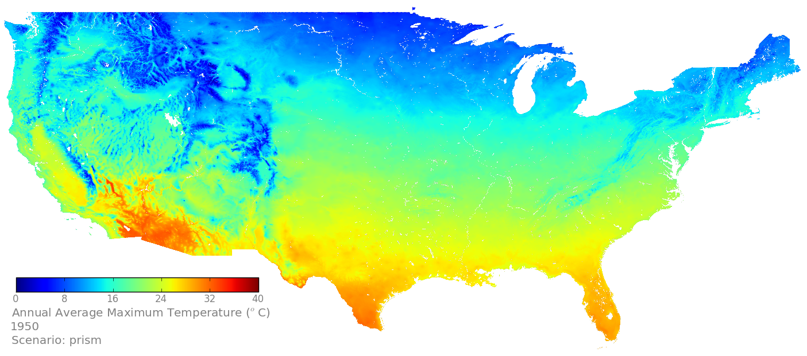
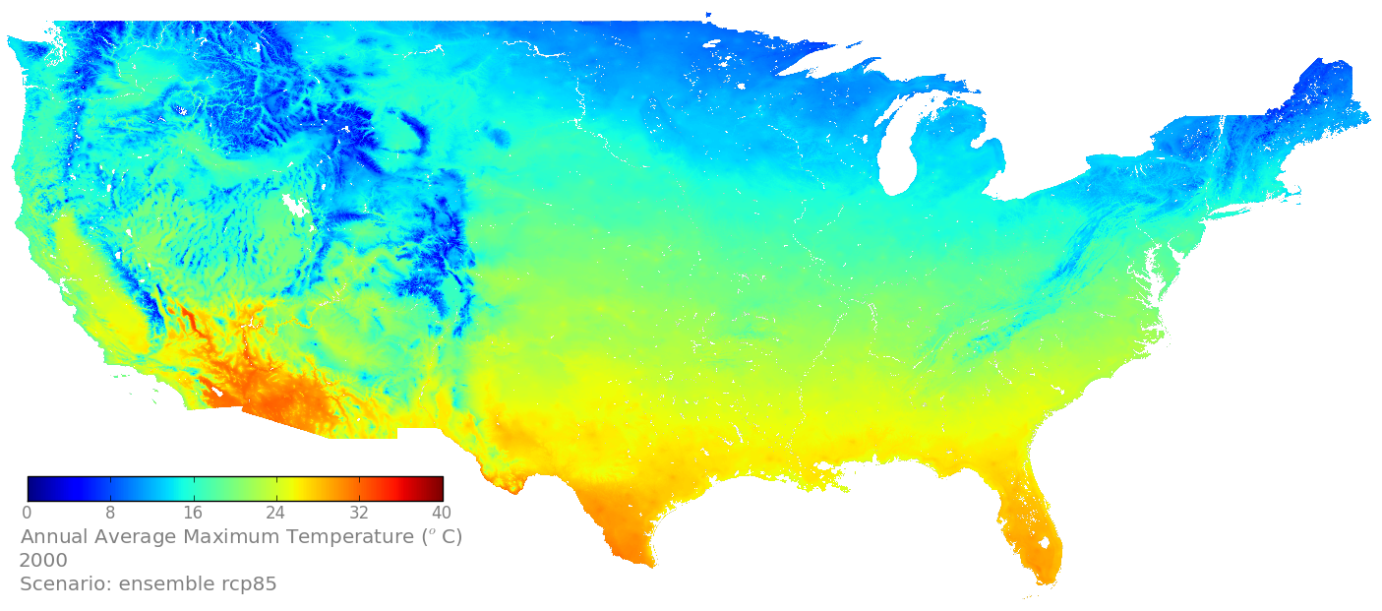
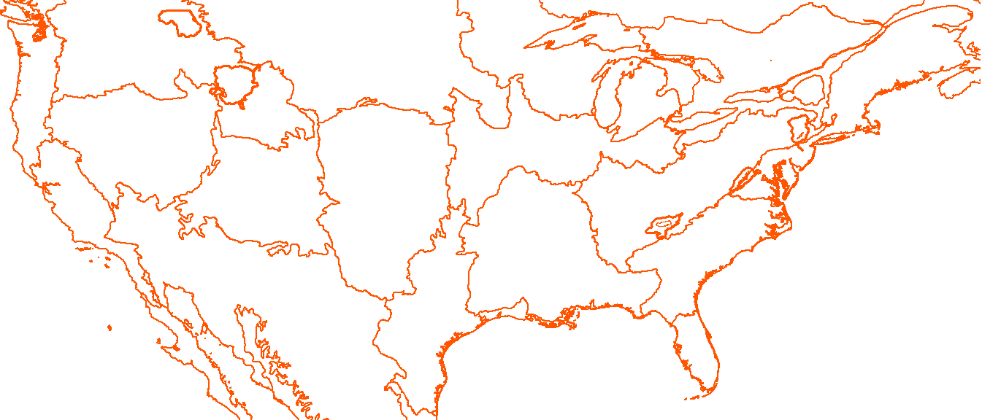
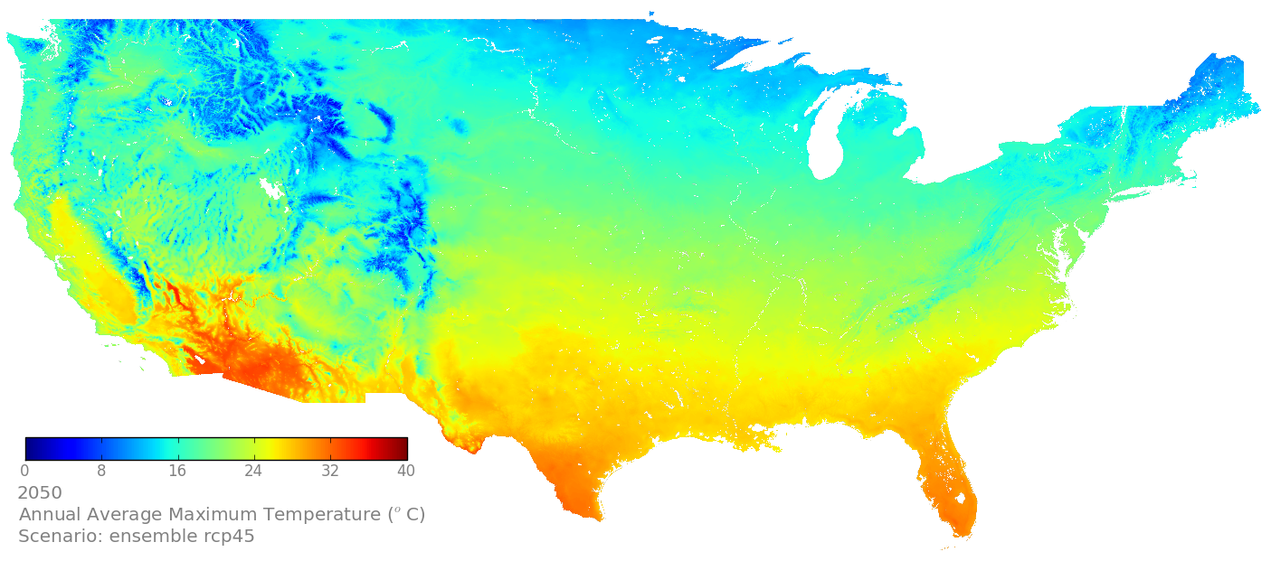
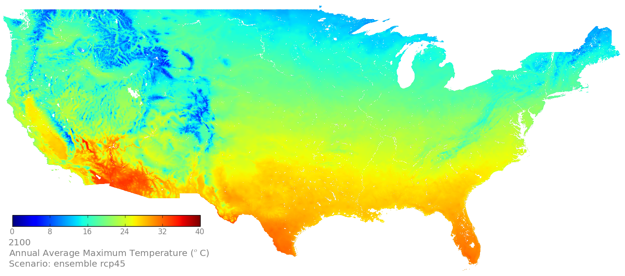
Downscaled CMIP5 (NEX-DCP30), RCP 4.5, Ensemble Avg.
Maximum Temperature
1950, PRISM
2000, PRISM
2050, RCP 4.5 EA
2100, RCP 4.5 EA
Notes:
Units are gC/m2/yr for GPP and mm/yr for ET and runoffs.

Slide 9
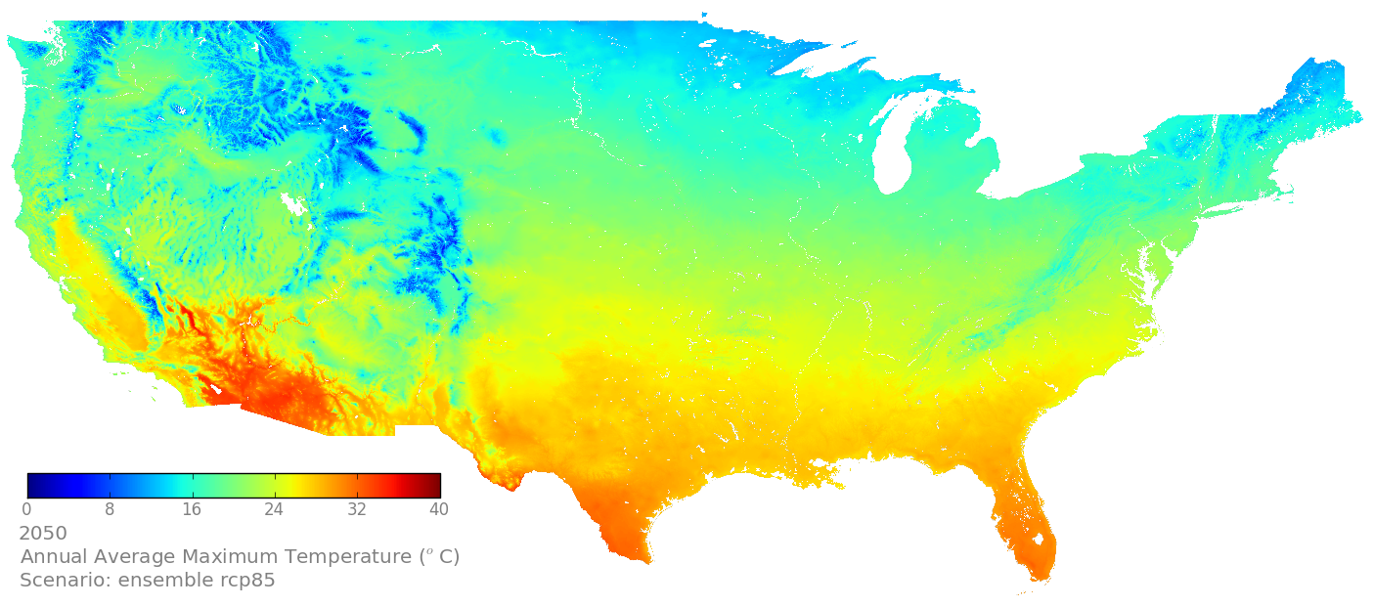
Downscaled CMIP5 (NEX-DCP30), RCP 8.5, Ensemble Avg.
Maximum Temperature
1950, PRISM
2000, PRISM
2050, RCP 8.5 EA
2100, RCP 8.5 EA
Notes:
Units are gC/m2/yr for GPP and mm/yr for ET and runoffs.

Slide 10
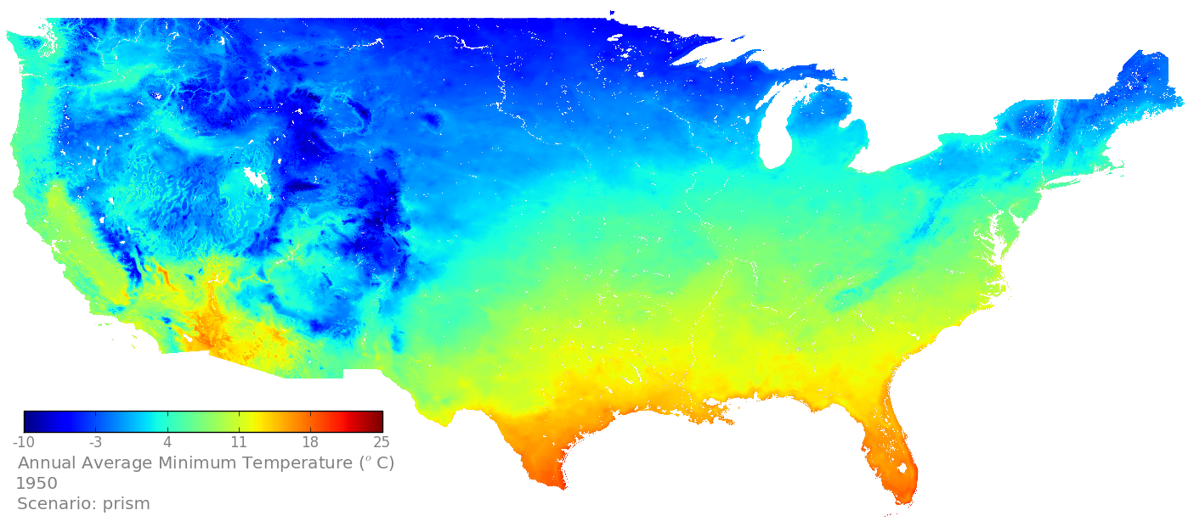
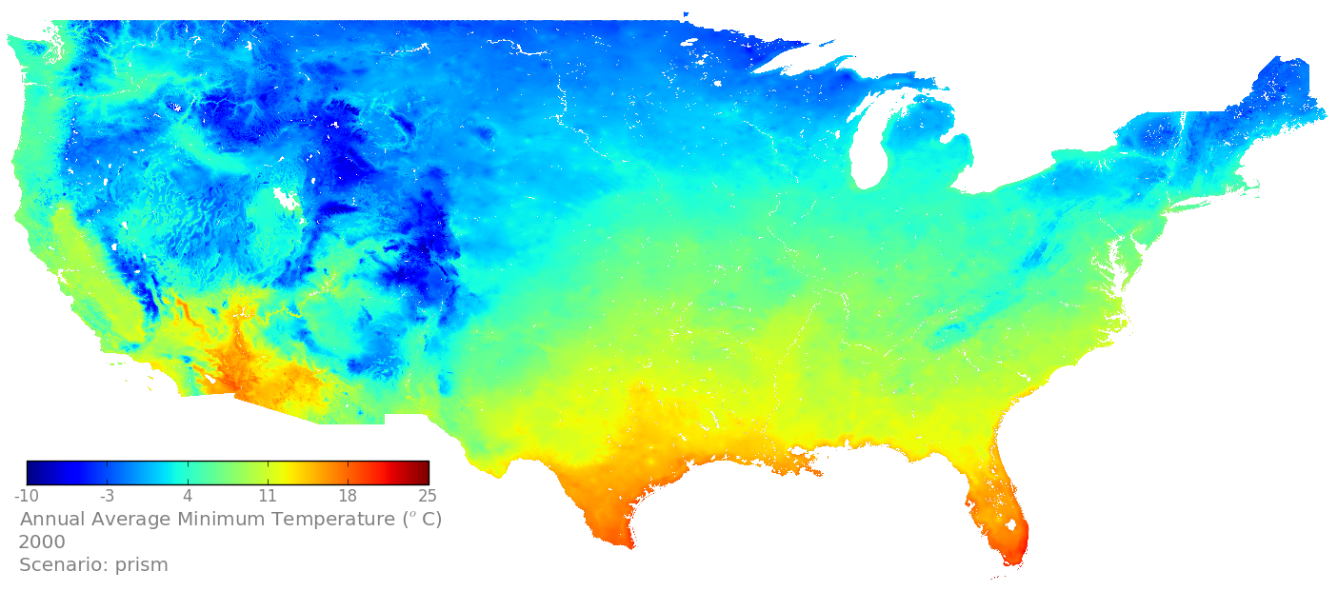
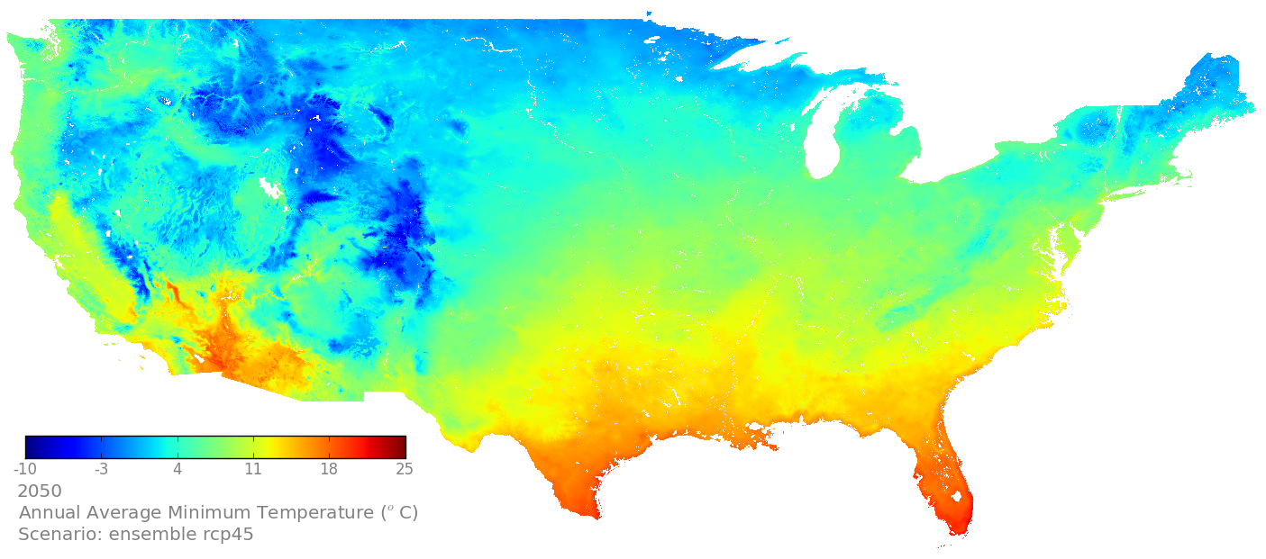
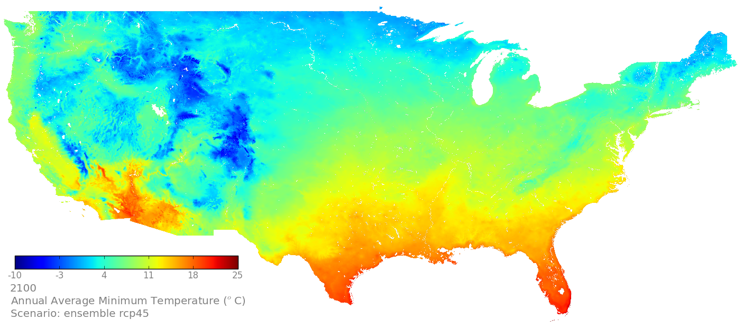
Downscaled CMIP5 (NEX-DCP30), RCP 4.5, Ensemble Avg.
Minimum Temperature
1950, PRISM
2000, PRISM
2050, RCP 4.5 EA
2100, RCP 4.5 EA
Notes:
Units are gC/m2/yr for GPP and mm/yr for ET and runoffs.

Slide 11
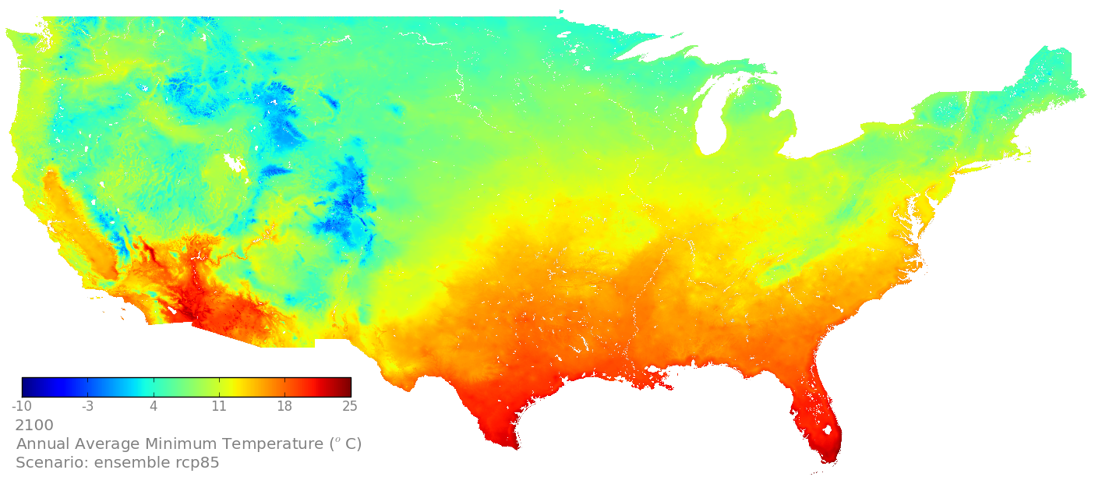
Downscaled CMIP5 (NEX-DCP30), RCP 8.5, Ensemble Avg.
Minimum Temperature
1950, PRISM
2000, PRISM
2050, RCP 8.5 EA
2100, RCP 8.5 EA
Notes:
Units are gC/m2/yr for GPP and mm/yr for ET and runoffs.

Slide 12
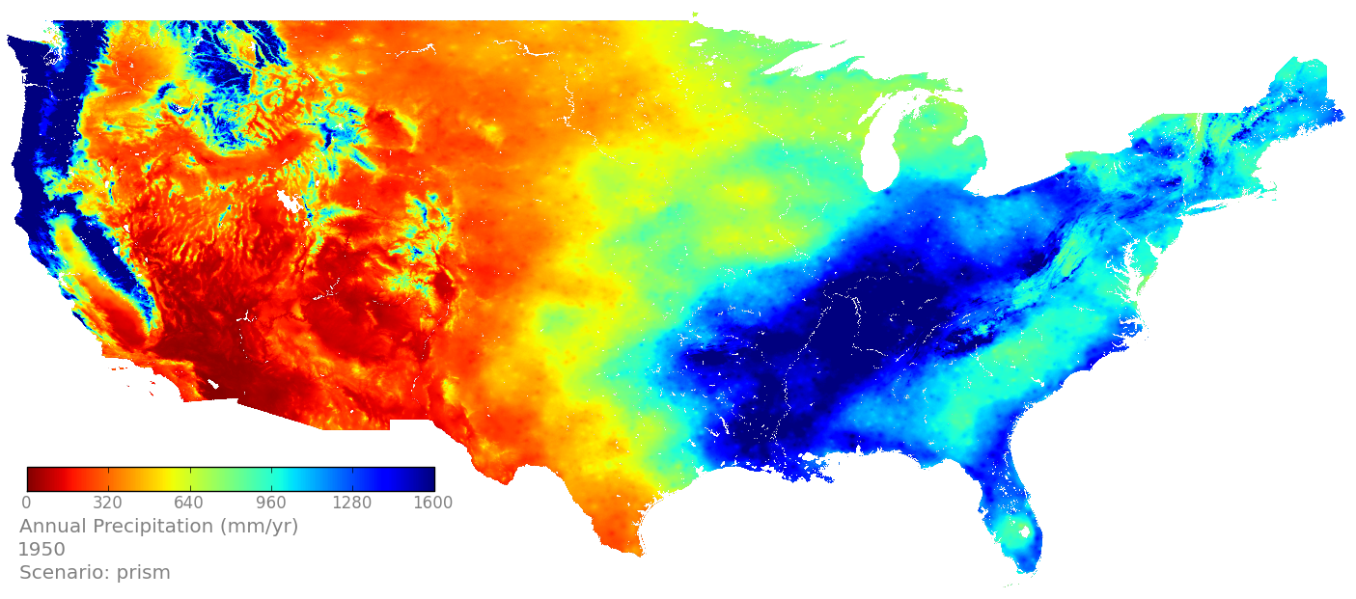
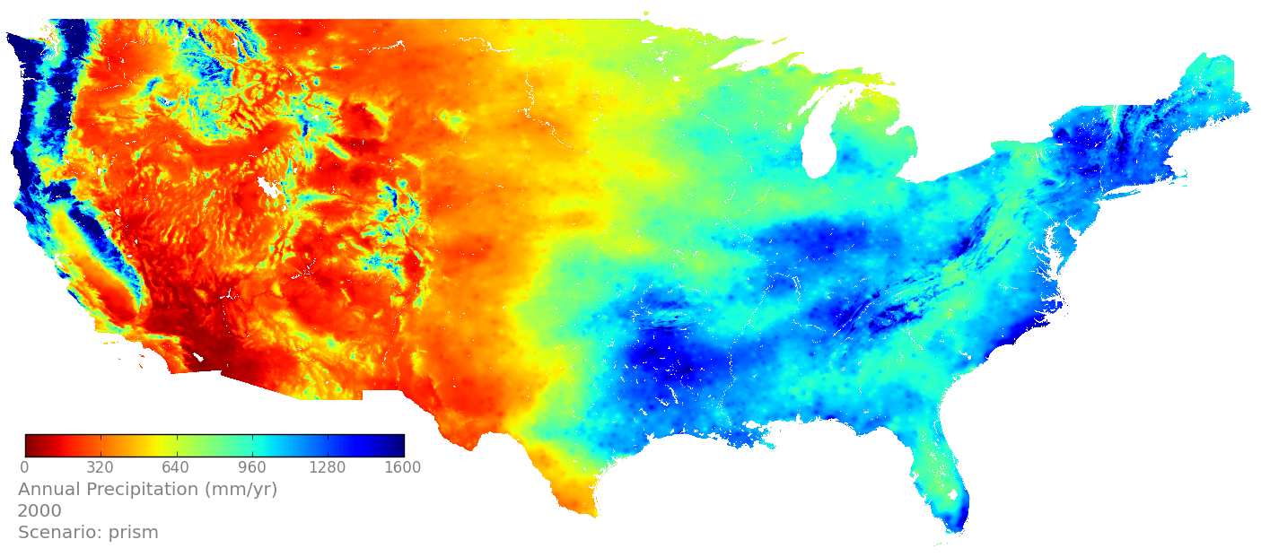
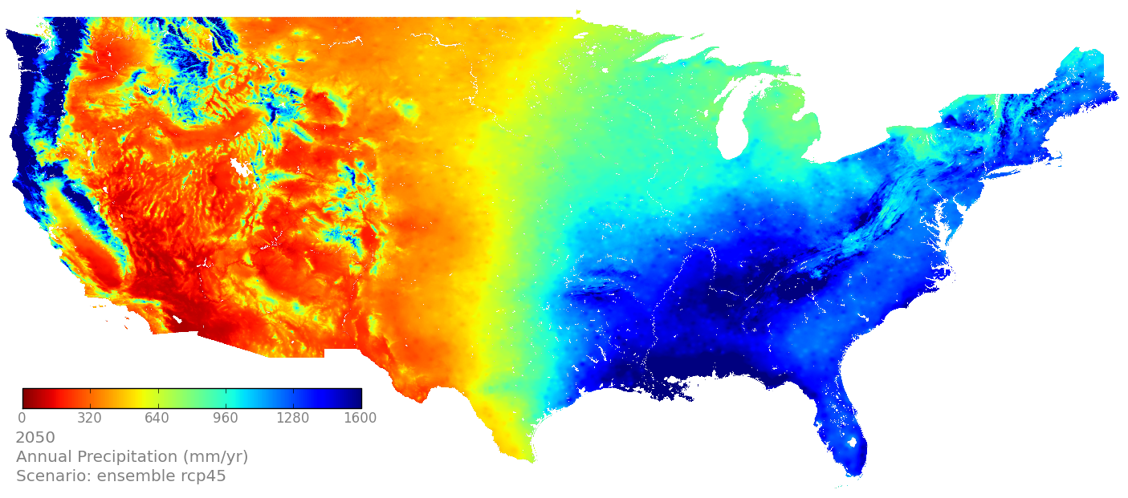
Downscaled CMIP5 (NEX-DCP30), RCP 4.5, Ensemble Avg.
Precipitation
1950, PRISM
2000, PRISM
2050, RCP 4.5 EA
2100, RCP 4.5 EA
Notes:
Units are gC/m2/yr for GPP and mm/yr for ET and runoffs.

Slide 13
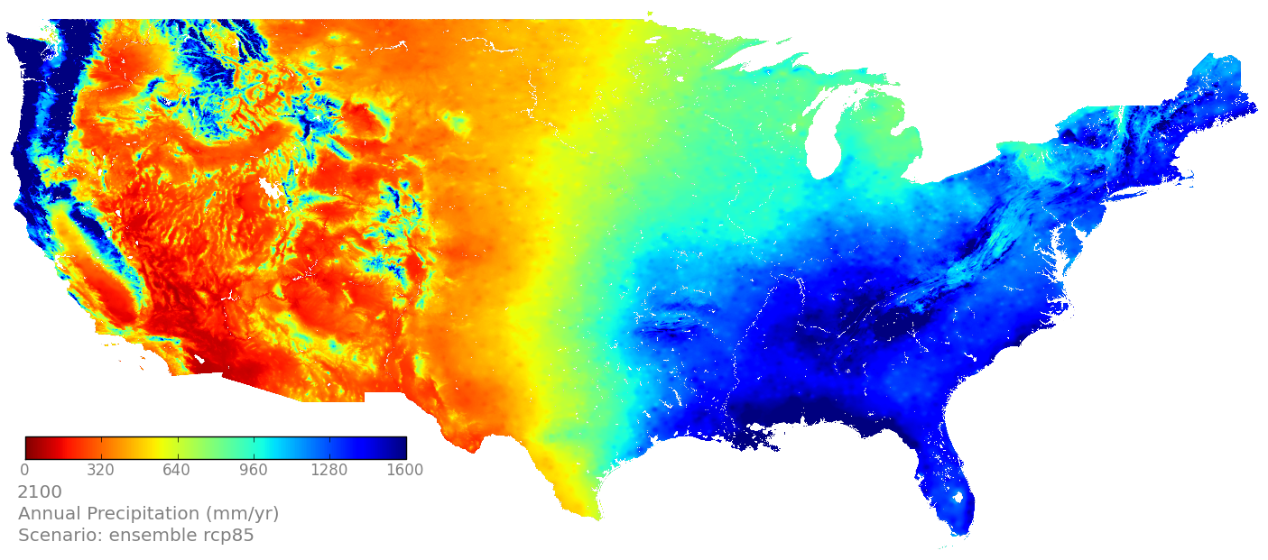
Downscaled CMIP5 (NEX-DCP30), RCP 8.5, Ensemble Avg.
Precipitation
1950, PRISM
2000, PRISM
2050, RCP 8.5 EA
2100, RCP 8.5 EA
Notes:
Units are gC/m2/yr for GPP and mm/yr for ET and runoffs.

Slide 14
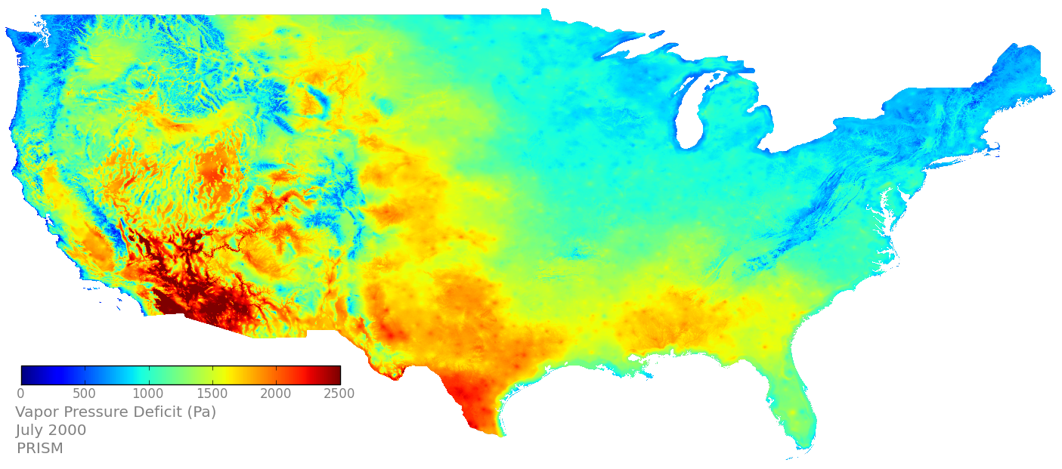
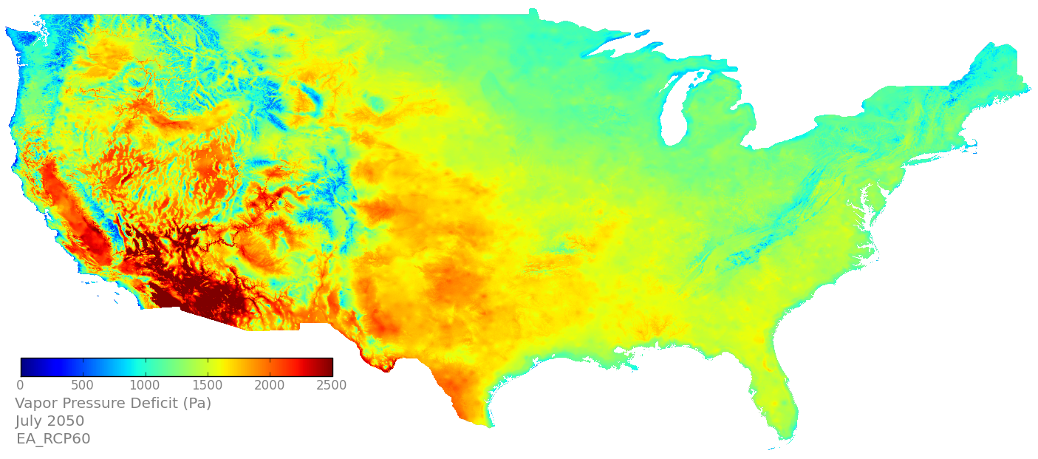
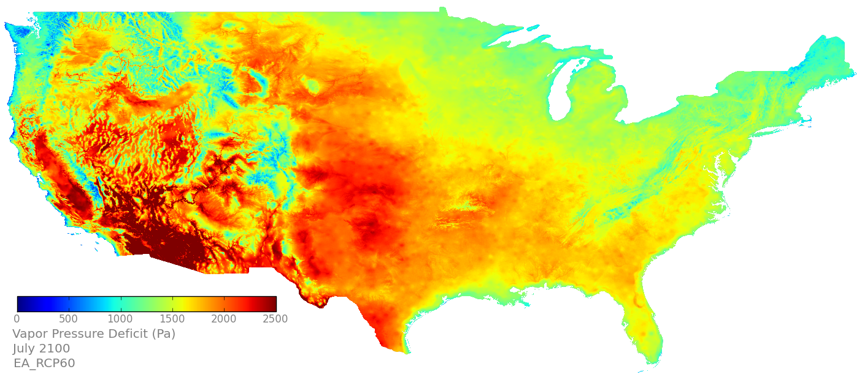
Downscaled CMIP5 + TOPS (VPD)
PRISM, 2000
RCP 6.0 EA, 2050
RCP 6.0 EA, 2100
Notes:
Units for the variables: mm/yr (precipitation), degrees Celsus (Tmax/Tmin), Watts/m2 (Srad), and Pascal (VPD)

Slide 15
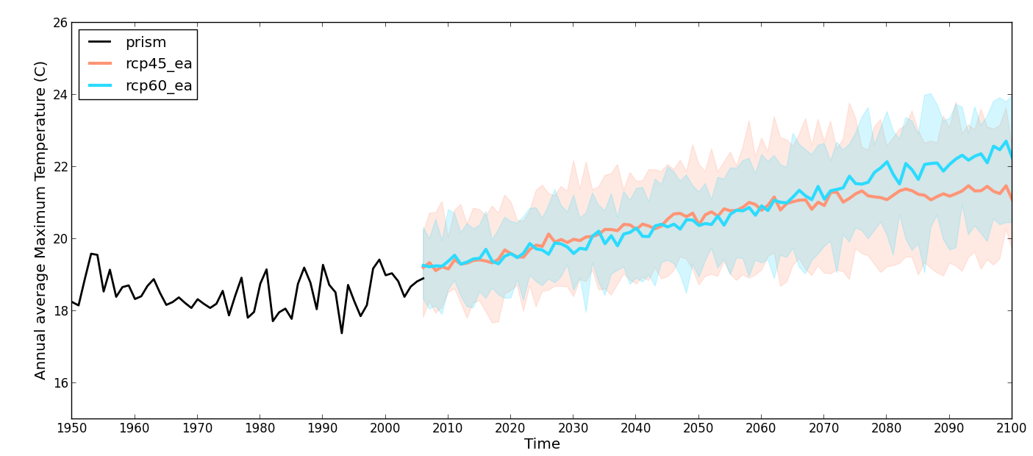
Ensemble Averages: Max Temp

Slide 16
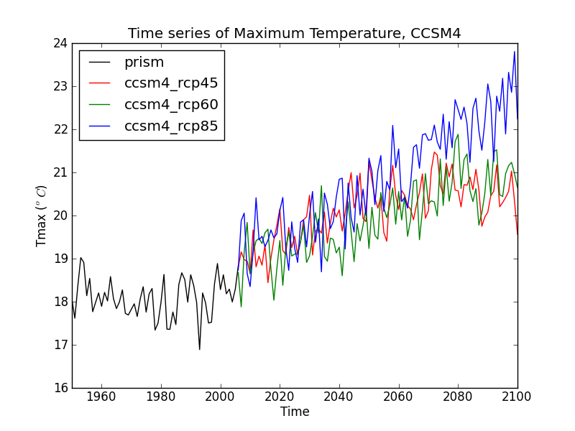
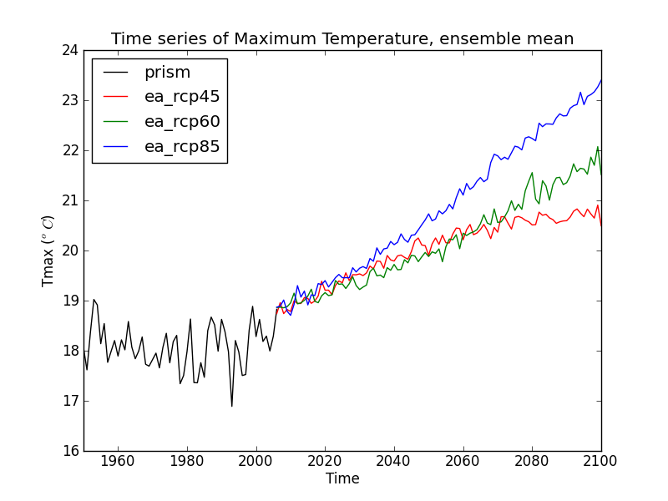
CCSM-4 vs Ensemble Averages: Max Temp

Slide 17
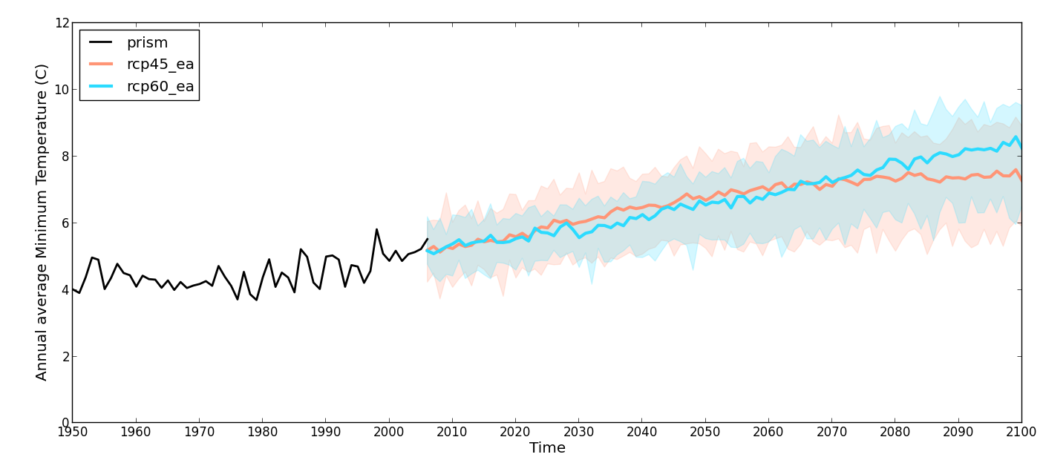
Ensemble Averages: Min Temp

Slide 18
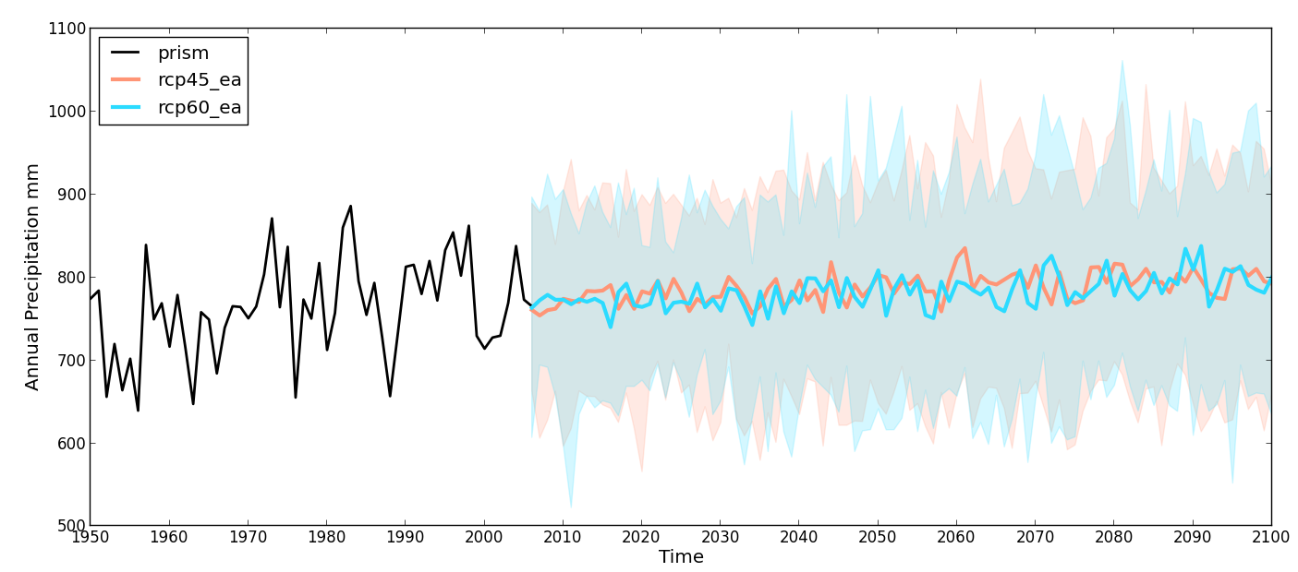
Ensemble Averages: Precip

Slide 19
CCSM-4 vs Ensemble Averages: Temperature

Slide 20
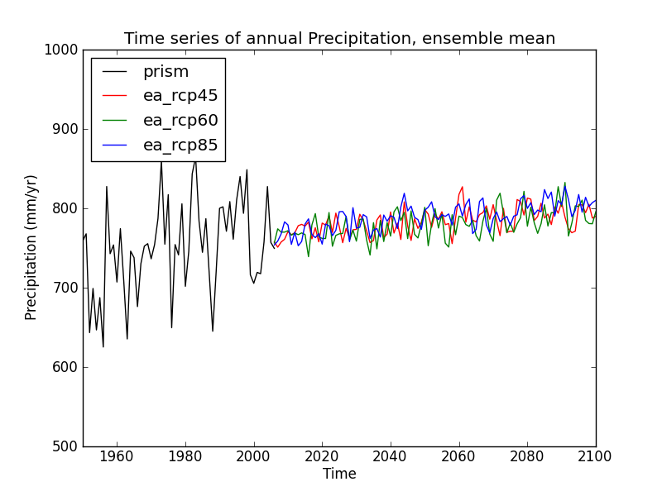
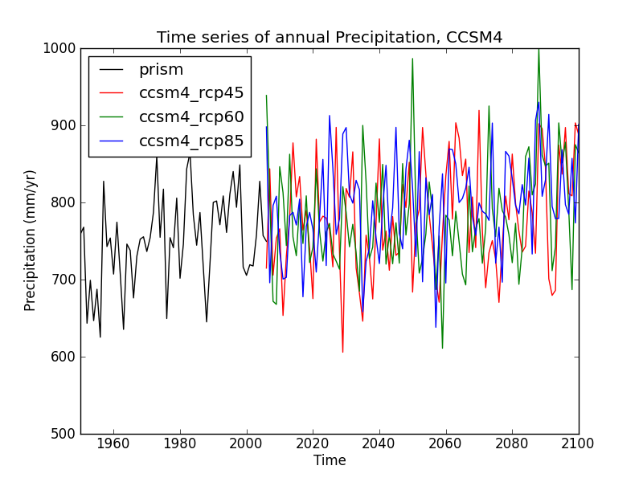
CCSM-4 vs Ensemble Averages: Precipitation

Slide 21
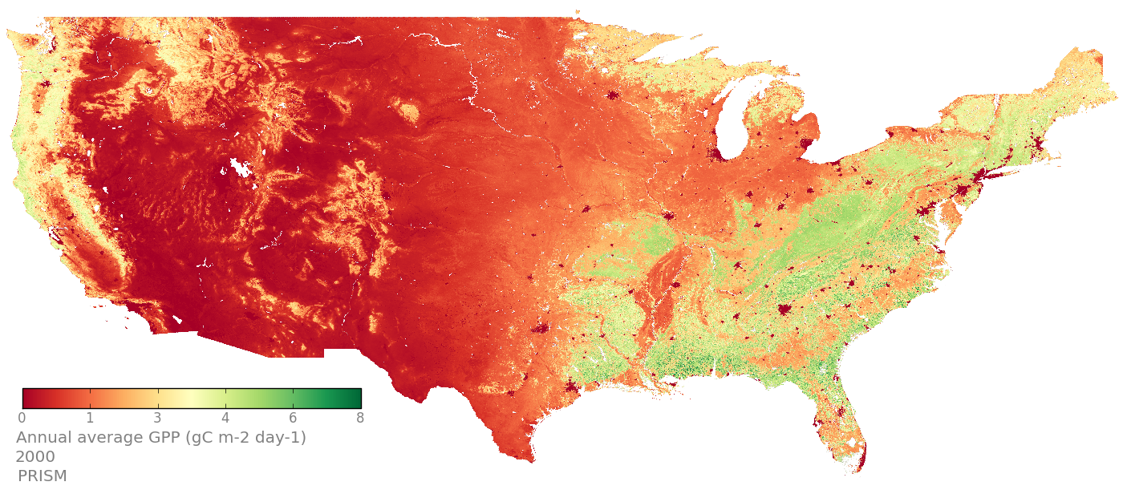
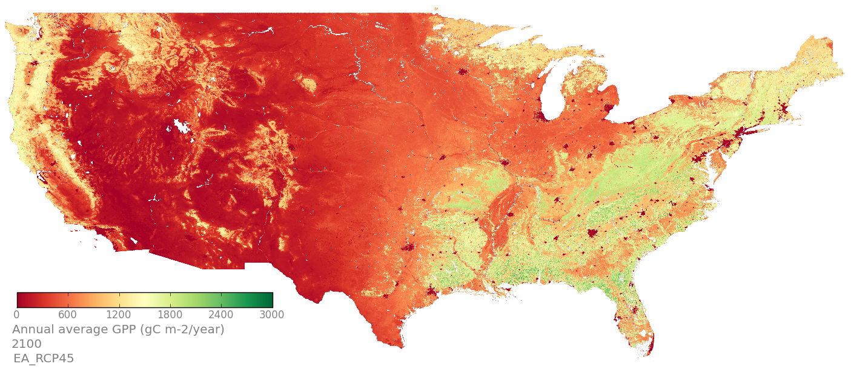
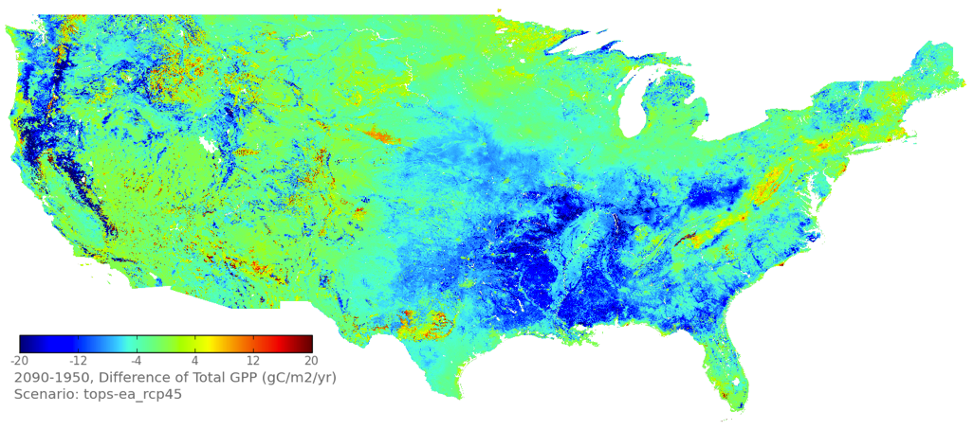
TOPS Results: Gross Primary Production
2000, PRISM
2100, RCP 4.5 EA
2050, RCP 4.5 EA
RCP 4.5, 2090s – 2000s
Notes:
Units are gC/m2/yr for GPP and mm/yr for ET and runoffs.

Slide 22
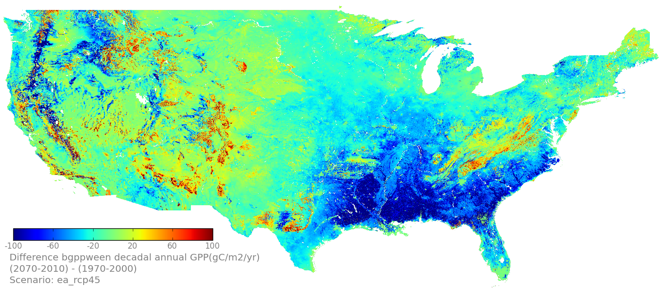
TOPS Results: Gross Primary Production
RCP 4.5 EA, AVG(2071-2100) – AVG(1971-2000)
(2071-2100) – (1971-2000)
Notes:
Units are gC/m2/yr for GPP and mm/yr for ET and runoffs.

Slide 23
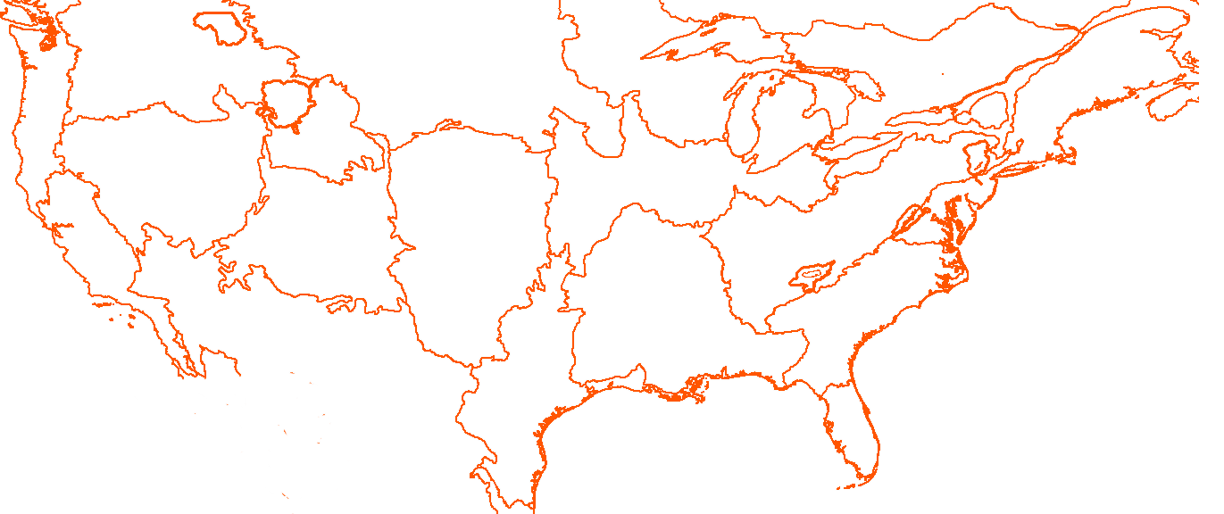
TOPS Results: Gross Primary Production
RCP 4.5 EA, AVG(2071-2100) – AVG(1971-2000)
(2071-2100) – (1971-2000)
Notes:
Units are gC/m2/yr for GPP and mm/yr for ET and runoffs.

Slide 24
TOPS Results: Gross Primary Production
RCP 8.5 EA, AVG(2071-2100) – AVG(1971-2000)
(2071-2100) – (1971-2000)
Notes:
Units are gC/m2/yr for GPP and mm/yr for ET and runoffs.

Slide 25
TOPS Results: Gross Primary Production
RCP 8.5 EA, AVG(2071-2100) – AVG(1971-2000)
(2071-2100) – (1971-2000)
Notes:
Units are gC/m2/yr for GPP and mm/yr for ET and runoffs.

Slide 26
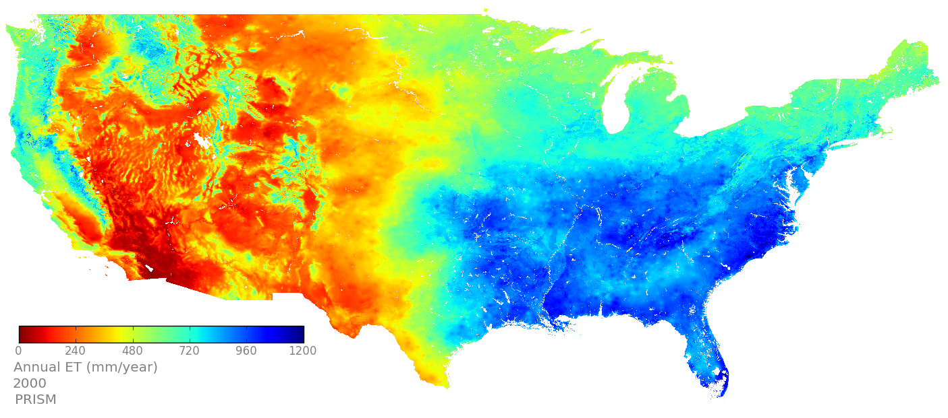
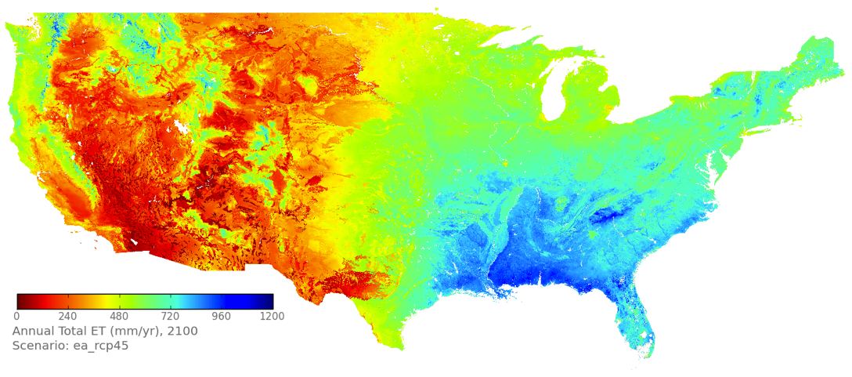
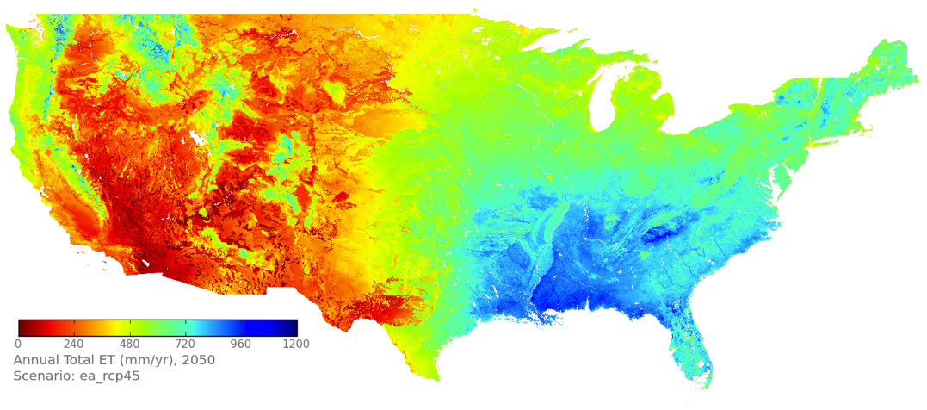
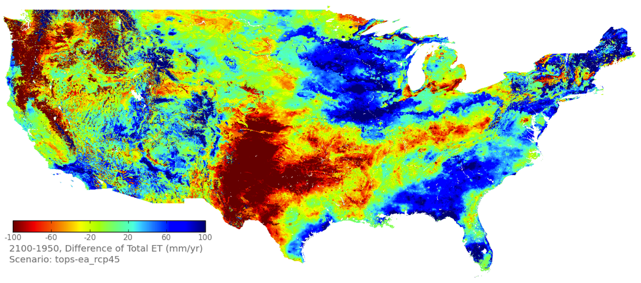
TOPS Results: Evapotranspiration
2000, PRISM
2100, RCP 4.5 EA
2050, RCP 4.5 EA
RCP 4.5 EA, 2100 - 1950
Notes:
Units are gC/m2/yr for GPP and mm/yr for ET and runoffs.

Slide 27
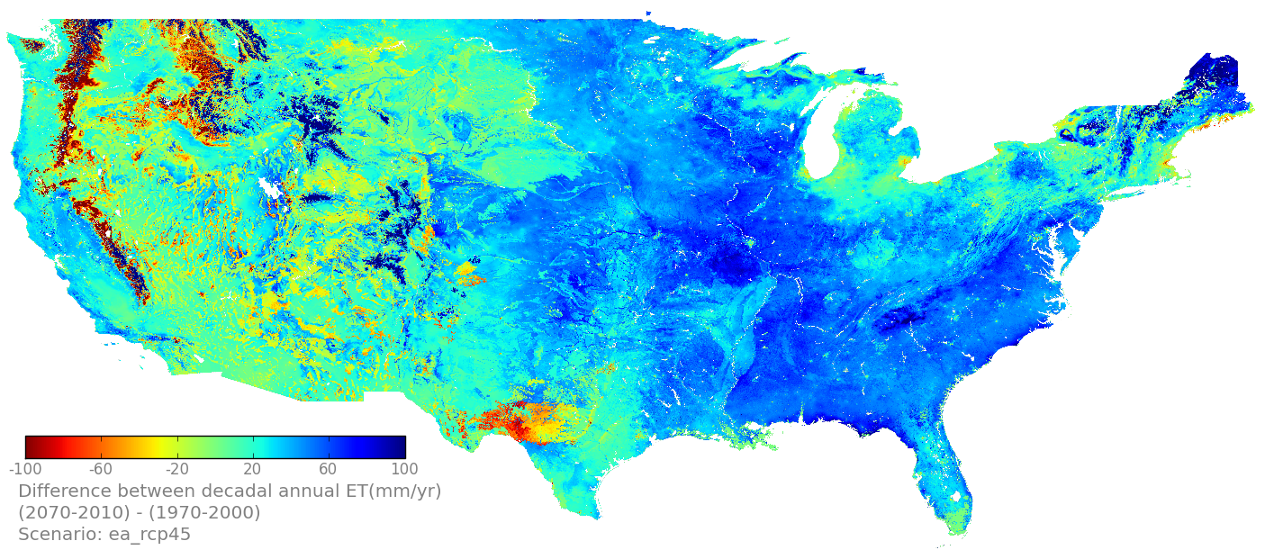
TOPS Results: Evapotranspiration
RCP 4.5 EA, AVG(2071-2100) – AVG(1971-2000)
(2071-2100) – (1971-2000)
Notes:
Units are gC/m2/yr for GPP and mm/yr for ET and runoffs.

Slide 28
TOPS Results: Evapotranspiration
RCP 4.5 EA, AVG(2071-2100) – AVG(1971-2000)
(2071-2100) – (1971-2000)
Notes:
Units are gC/m2/yr for GPP and mm/yr for ET and runoffs.

Slide 29
TOPS Results: Evapotranspiration
RCP 8.5 EA, AVG(2071-2100) – AVG(1971-2000)
(2071-2100) – (1971-2000)
(2071-2100) – (1971-2000)
Notes:
Units are gC/m2/yr for GPP and mm/yr for ET and runoffs.

Slide 30
TOPS Results: Evapotranspiration
RCP 8.5 EA, AVG(2071-2100) – AVG(1971-2000)
(2071-2100) – (1971-2000)
Notes:
Units are gC/m2/yr for GPP and mm/yr for ET and runoffs.

Slide 31
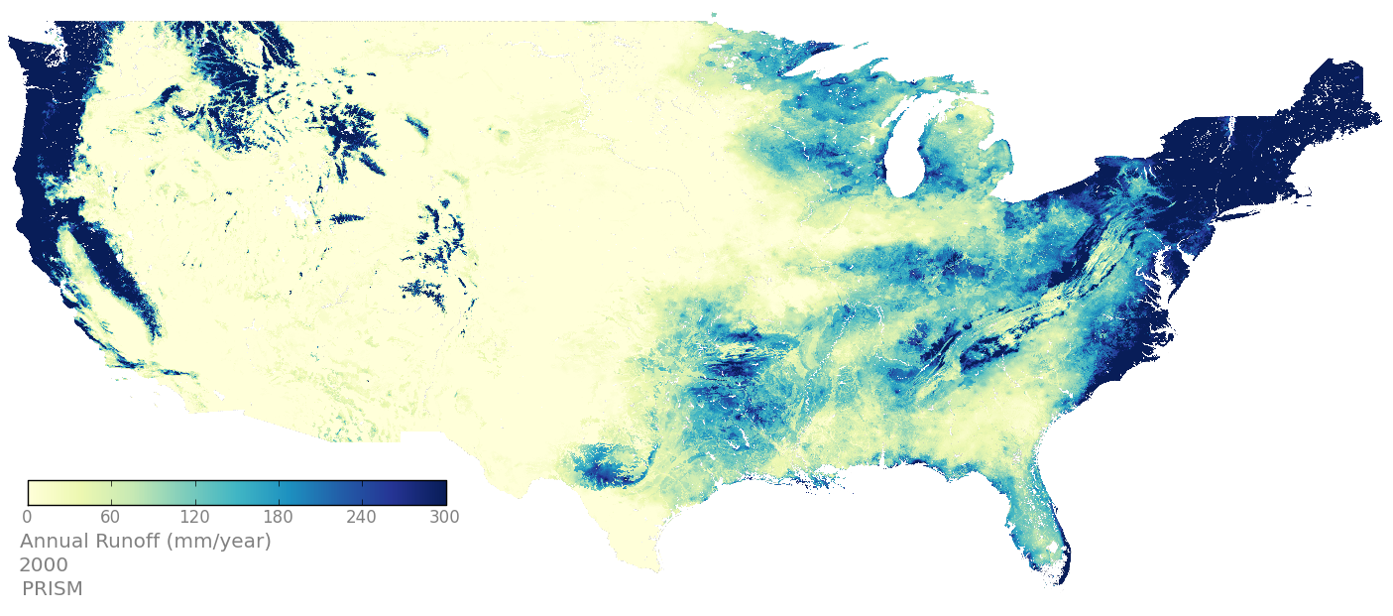
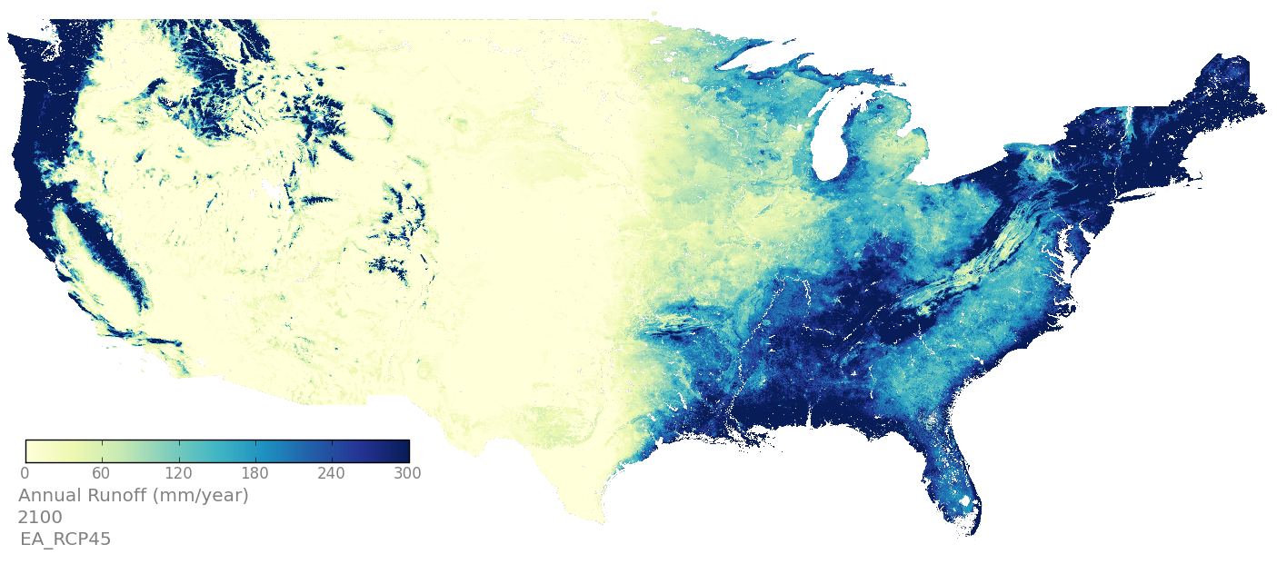
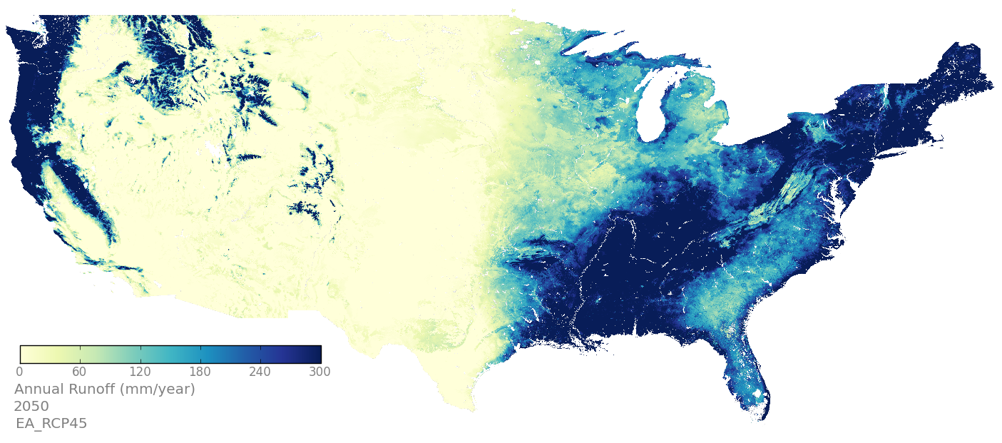
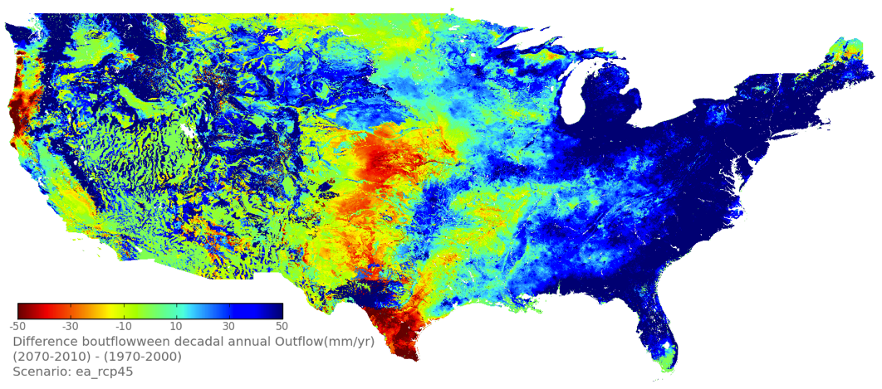
Sample TOPS Results: Runoff
2000, PRISM
2100, RCP 4.5 EA
2050, RCP 4.5 EA
RCP 4.5, AVG(2071-2100) – AVG(1971-2000)
Notes:
Units are gC/m2/yr for GPP and mm/yr for ET and runoffs.

Slide 32
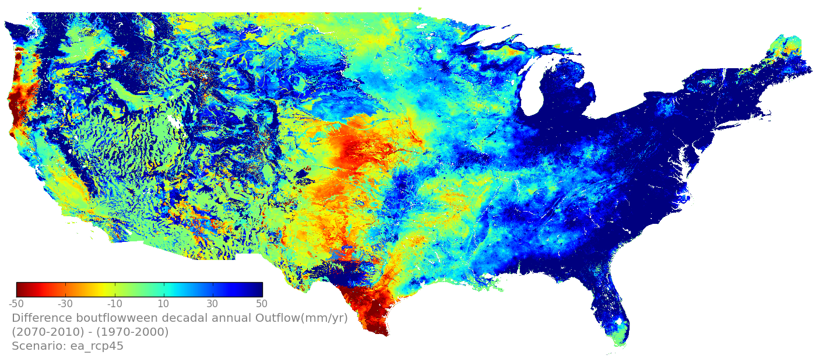
TOPS Results: Runoff
RCP 4.5 EA, AVG(2071-2100) – AVG(1971-2000)
(2071-2100) – (1971-2000)
Notes:
Units are gC/m2/yr for GPP and mm/yr for ET and runoffs.

Slide 33
TOPS Results: Runoff
RCP 4.5 EA, AVG(2071-2100) – AVG(1971-2000)
(2071-2100) – (1971-2000)
Notes:
Units are gC/m2/yr for GPP and mm/yr for ET and runoffs.

Slide 34
TOPS Results: Runoff
RCP 8.5 EA, AVG(2071-2100) – AVG(1971-2000)
(2071-2100) – (1971-2000)
Notes:
Units are gC/m2/yr for GPP and mm/yr for ET and runoffs.

Slide 35
TOPS Results: Runoff
RCP 8.5 EA, AVG(2071-2100) – AVG(1971-2000)
(2071-2100) – (1971-2000)
Notes:
Units are gC/m2/yr for GPP and mm/yr for ET and runoffs.

Slide 36
Changes in Mean Spring Temperature (32° F Isotherm)
Mean spring temperature (Mar-May) for 1950-2100 from PRISM + NEX-DCP30
Extent of the 32° F isotherm (decadal averages) from 1950-2100
Notes:
Fig.1 (a) Mean temperature for the springtime (March, April, May, 1950-2100) from hybrid downscaling product (800m) using BCSD methods. The downscaled climate dataset consists of two parts: historical (1950-2005, based on PRISM) and forecasting (2006-2100, based on CMIP5 ensemble mean). (b) Changes in regional areas (light purple) where decadal springtime mean air temperature is below 32F in west mountainous area. In 1950s, 55% of the area (350, 500 km2) of the three states (Washington, Oregon, and Idaho) has springtime mean air temperature below or equal to 32 F (0C). This area decreased to 43% (272, 300 km2) in 2000, and, by projection, will further decrease to 18% (118, 700 km2) in 2090s. This indicates a

Slide 37
Changes in Mean Spring Temperature (32° F Isotherm)
Mean spring temperature (Mar-May) for 1950 from PRISM
Mean spring temperature (Mar-May) for 2090-2099 from NEX-DCP30 ensemble average for RCP 4.5. Area with mean temperature <32°F shown in purple.
Notes:
Fig.1 Changes in springtime (March-April-May) mean temperature, T_{spring}, over the coterminous US from 1950 to 2100. The map at the upper-left corner shows the observed mean US T_{spring} in 1950s (based on PRSIM data), while the lower-right corner shows the corresponding T_{spring} in 2090s (as suggested by the ensemble mean of the NEX-DCP30 projections from the RCP4.5 scenario). The time series in the solid yellow line indicates that the changes of the aggregated T_{spring} for the coterminous US between 1950 and 2010, and the red line indicates the ensemble mean from 2006 to 2100. The blue bars shows the corresponding changes in the area where T_{spring} is below or equal to 0 ºC (i.e., indicated by the purple shades on the T_{spring} maps). The map in the background shows the 2090’s T_{spring} in the native resolution (~800m) over the South-West US, highlighting the spatial details of the downscaled climate projections that cannot be obtained from the original GCM outputs.

Slide 38
Glacier, Gross Primary Production
Ensemble Average
Spring
Summer
Fall
Annual

Slide 39
Glacier, Gross Primary Production, CCSM4
Spring
Summer
Fall
Annual

Slide 40
Glacier, Runoff, Ensemble Average
Spring
Summer
Fall
Annual

Slide 41
Glacier, Runoff, CCSM4
Spring
Summer
Fall
Annual

Slide 42
Glacier, Soil Water, Ensemble Average
Spring
Summer
Annual
Fall

Slide 43
Glacier, Soil Water, CCSM4
Spring
Summer
Annual
Fall

Slide 44
Glacier, Precipitation, Ensemble Average
Spring
Summer
Fall
Annual

Slide 45
Glacier, Precipitation, CCSM4
Spring
Summer
Fall
Annual

Slide 46
Glacier, SWE, Ensemble Average
Spring
Summer
Fall
Annual

Slide 47
Glacier, SWE, CCSM4
Spring
Summer
Fall
Annual

Slide 48
Glacier, Evapotranspiration, Ensemble Average
Spring
Summer
Fall
Annual

Slide 49
Glacier, Evapotranspiration, CCSM4
Spring
Summer
Fall
Annual

Slide 50
Yellowstone, Gross Primary Production
Ensemble Average, Summer

Slide 51
Yellowstone, Gross Primary Production, CCSM4, Summer

Slide 52
Yellowstone, Runoff, Ensemble Average, Summer

Slide 53
Yellowstone, Runoff, CCSM4, Summer

Slide 54
Yellowstone, Soil Water, Ensemble Average, Summer

Slide 55
Yellowstone, Soil Water, CCSM4, Summer

Slide 56
Yellowstone, Precipitation, Ensemble Average, Summer

Slide 57
Yellowstone, Precipitation, CCSM4, Summer

Slide 58
Yellowstone, SWE, Ensemble Average, Summer

Slide 59
Yellowstone, SWE, CCSM4, Summer

Slide 60
Model Verification: GPP & ET

Slide 61
Model Verification: GPP

Slide 62
Model Verification: ET

Slide 63
Model Verification: Runoff

Slide 64
Next Steps
Complete data analysis for model runs; complete preparation of manuscript(s)
Complete analyses for partner parks / LCCs
Complete documentation / metadata
Update national / regional summaries

Slide 65
Projected Impervious and Climate GFDL CM2.0 A1B and A2

Slide 66
TOPS Results: Coupled Climate and Land Use Change
SRES A1 vs A2 over US urban areas
Coupled climate and land use change impacts over urban areas
2100 Runoff
+110%
Impervious Area (km²)
+54%
+90%
Total Runoff (mm)
2100 GPP
+60%
Loss in GPP (kg C)
-25%
-40%

