Slide 1
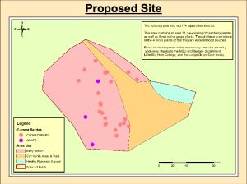
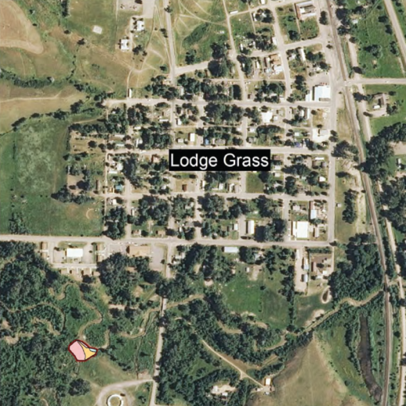
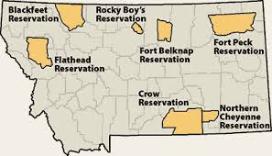
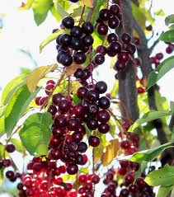
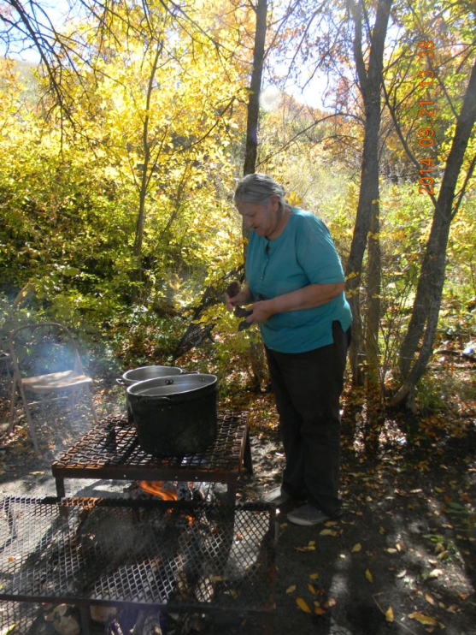
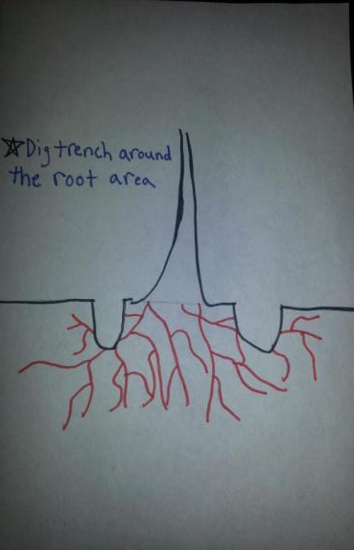
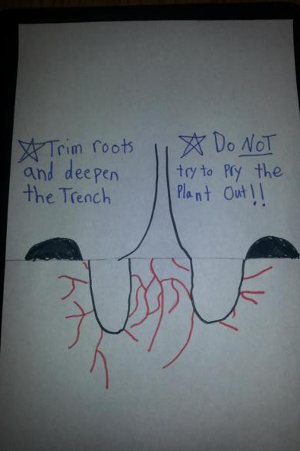
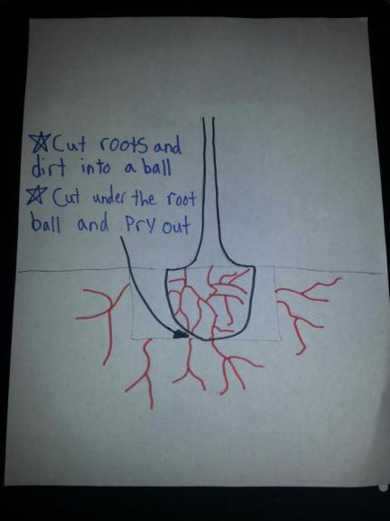
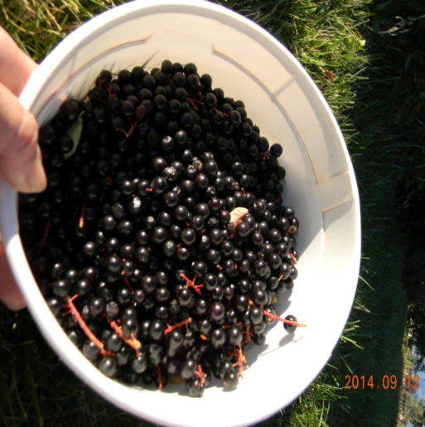
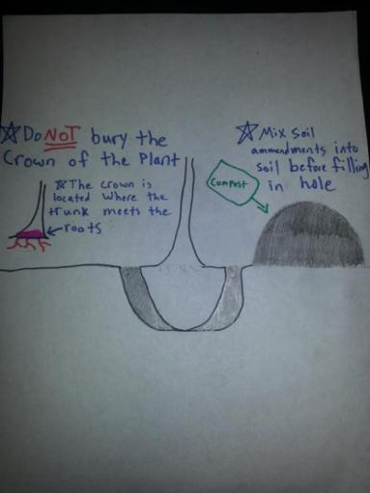
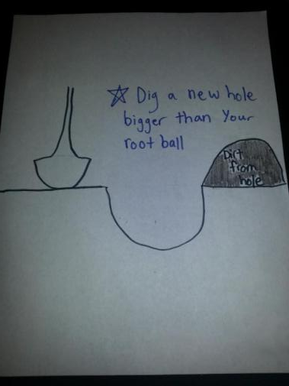
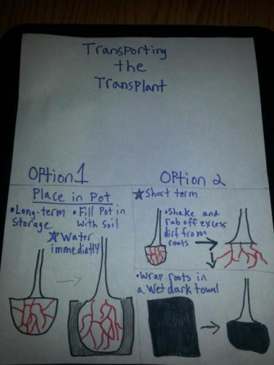
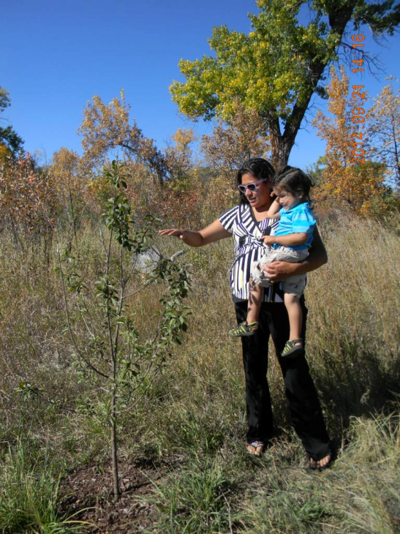
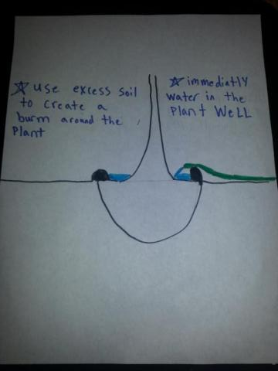
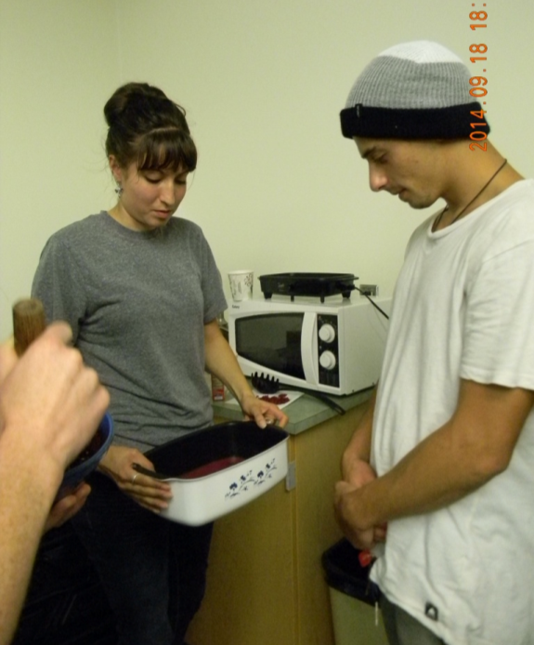
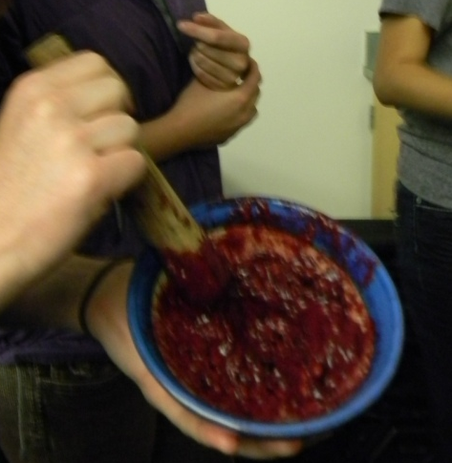
A Guide to transplanting Native Berries: Preserving Culture and Learning New Skills
Michael Logatto Environmental Horticulture, Jerad Hoy Computer Science, Tracie Small Liberal Studies (Quaternity), Florence Dunkel Plant Science and Plant Pathology, Montana State University-Bozeman
Introduction
Materials and Methods
Location of Berry site in Lodge Grass
The “Lets pick Berries” project began a few years back when Montana State Students started working with the Apsaalooke tribe with the goal of helping them preserve their culture. Tribal members consisting of elders and youth came to the conclusion that berries play a significant role in their culture. This was the spark that inspired the site, to be created. The berry site is supposed to serve as a recreational place that will bring the community closer and also have a native berries that can be gathered. After a failed attempt to transplant berries to the berry site, we decided it would be beneficial to create a simple transplant guide. The guide is intended to increase success of future transplants not only on the berry site but also else where on the Apsaalooke land.
After reviewing many transplanting guides on the internet, I took the main message from all of them and tried to create a simple guide. We are hoping that this guide will inspire more tribal members to make transplants of native berries and make native berries more available to the community.
Recommendations
Continue cultural rejuvenation through berry picking and planting
Don’t give up after a failed transplant
remember they must be cared for everyday until established!
Watering is key! Soil type will change water requirements (Sandy vs Silt vs Clay)
Food plays a big part in culture, eat traditionally and eat healthy
Baáchuutaale, chokecherries ,
Prunus virginiana
Hypothesis
Above is Carol Bulltail member Apsaalooke tribe. known to make excellent pemmican. Pemmican is healthy, traditional and can be a economic engine for Apsaalooke!
Informing the Apsaalooke community about how to transplant hardwood shrubs will increase the availability of native berries and thus increase cultural practices on the reservation.
Acknowledgements
I would like to thank Florence Dunkel who taught me how to learn about different cultures and for keeping me on track throughout the entire semester. Thank you Tracie Smalls for starting the berry project and being my mentor. Also big thanks to Valerie Smalls and everyone else who reviewed my planting guide
Results
Freshly picked choke cherries! Used to create a variety of delicious traditional foods such as pemmican.
Our original plan was to go to Lodge grass and teach the community how to properly transplant choke cherries and other native berries. Due to it being the wrong time of year to do transplants this could not be done. Secondary plan was to create a simple guide that is readily available to Apsaalooke. It will show them how to transplant and care for transplant afterwards.
Discussion
In the Apsaalooke community everything has meaning and purpose
Everything has a story which explains its purpose/meaning
Apsaalooke culture is oral not written
Stories are passed down from elders to youth
Outsiders should adapt to new culture when working with them
Created transplant guide from written guide, to a guide with more pictures and less words
Literature Cited
Adam, J. (2003, Oct). How to move a large shrub: Woody plants don't like being moved while in leaf, so wait until your shrub starts to snooze. Canadian Gardening, 14, 30-32.
Stead, S., & Post, R. L. (1989). Western chokecherry (prunus virginiana). Fact Sheet - College of Agriculture, University of Nevada-Reno, Nevada Cooperative Extension., (89-72)
Fountain, W. M., Kaiser, C. A., Witt, M. L., & Hartman, J. R. (1988). Transplanting trees and shrubs. ID - University of Kentucky, Cooperative Extension Service., (80)
Plumb, H. 2009. Plant fact sheet for black chokecherry
(Prunus virginiana L. var. melanocarpa (A. Nelson)
Sarg).. USDA-Natural Resources Conservation Service,
Upper Colorado Environmental Plant Center, Meeker, CO
81641.
Choke cherries being used to make pudding! Easy and tasty can be served with many dishes
Tracie Smalls checking on a wild plum tree that has Italian plums grafted on to the tree as well!

