Slide 1
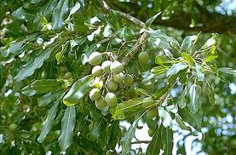
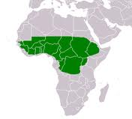
Hypothesis tested
Since shea butter is locally made by village women from shea nuts owned by village women and wild-collected by them from village shea trees, Vitellaria paradoxa (= Butyrospermum parkii ), and since shea butter is traditionally used in cooking cowpeas, shea butter is a good candidate for organic protection of cowpeas against its main storage pest, C. maculatus.

Slide 2
Materials and Methods
Organic cowpeas, Vigna vinculata
C. maculatus from cowpeas harvested in village of Sanambele, Mali
Environmental chamber 55+/-3% R.H.; photoperiod 12:12::light:dark; 28º C

Slide 3
Bioassay Procedures
Organic shea butter from Sanambele (Mali) women’s cooperative
Treatments: control (no shea butter); 0.01g; 0.05g; 0.50g; 1.0g warmed shea butter per 50g cowpeas.
50 intact cowpeas randomly selected
10 female C. maculatus per bioassay container
Post-adult emergence age specific 0-24 hrs, 24-48 hrs, 48-72 hrs
4 replicates
Behavioral observations 1 hr, 15 da, 20 da, 25 da
Embryo development observations

Slide 4
Results

Slide 5
C. maculatus Oviposition

Slide 6
C. maculatus Eggs Hatched

Slide 7
Adult C. maculatus Emergence

Slide 8
Discussion
Why will adoption of shea butter to preserve cowpeas postharvest be easy for village women?
What does this mean for the children of this remote village?
Is this sustainable?
Are there risks to mothers or children?
What is the take-away message?

Slide 9
Conclusion
As long as cowpeas are protected against C. maculatus, native villagers may safely store cowpeas and serve them, from harvest to harvest, to their children to prevent kwashiorkor.
Shea butter is a local, “at-home”, no-cost, safe, protection method for cowpeas in Malian villages, and throughout Sub-Saharan.

Slide 10
Postscript
Lesson #1 – Transdisciplinarity
Lesson #2 – Know the community

