Slide 1
Ways to Bridge The G A P
Stop, LISTEN to Subsistence Farmers, Other First Peoples
Family Farmers
Use Participatory, Holistic Processes
Appreciate Cultural Values
Engage in First-People-Driven, Family Farmer Collaborative Research

Slide 2
Planners ^{versus} Searchers
William Easterly. 2006. Whiteman’s Burden: Why the West’s efforts to aid the rest have done so much ill and so little good. Penguin Press. NY.
“The right plan is to have no plan.”

Slide 3
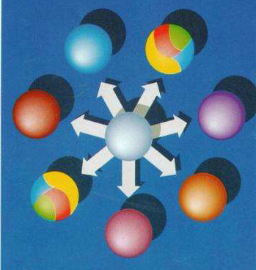
Holistic Management - Savory and Butterfield 1999

Slide 4
Holistic Circle of Life Processes
The Holistic
Process
Quality of
Life
Current
Resources
Future
Resources
Needed
Forms of
Production
Savory and Butterfield 1999.
Holistic Thought and Management

Slide 5
Expansive Collaboration
Dunkel et al. 2011

Slide 6
The Real Take-Home Message
As members of NC213, you are demonstrating and teaching important lessons to young scientists, engineers, and industry peers.
I hope you continue practicing your effective transdisciplinary interaction, and learn to appreciate the value of, and formally use, the holistic process with the communities you serve; become better Searchers.

Slide 7
Acknowledgements
National Institutes of Health (NIH) Grant Number 5R25GM063983-07 BRIDGING Tribal Colleges to Montana State University and MSU American Indian Research Opportunities (AIRO Program) (M. OldHorn, P.I.).
Montana Agricultural Experiment Station 91161 (F. Dunkel, P.I.)
USDA-National Institute of Food and Agriculture, Higher Education Challenge Grant Program “New paradigm for discovery-based learning: Create base for bottom-up development by listening to farmers’ needs while engaging them in participatory holistic thinking.”(F. Dunkel, P.I.)

Slide 8
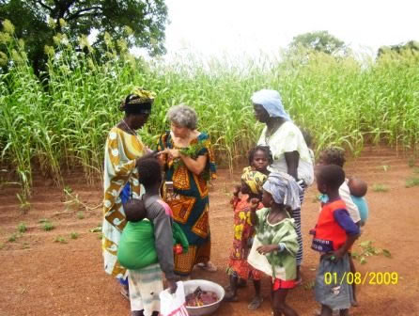
THANK YOU

