Slide 1
Qualitative Methodology II
Using Qualitative Data in Engineering Education
Christine Rogers Stanton, Ph.D.
christine.rogers1@montana.edu

Slide 2
Qualitative Design
Identify problem, purpose, & question(s)
Select methodology & methods
Analyze data
Report results
Notes:
2 min

Slide 3
Overview & Objectives
Explore areas of theory relevant to analysis of qualitative data
Practice analyzing data
Highlight opportunities for rigorous & innovative qualitative research in engineering education
Discuss recommendations for publication, grant proposal preparation, & presentation
Notes:
2 min

Slide 4
What is Qualitative Research?
 | Quantitative | Qualitative
Purpose | WHAT is happening? Goal is to quantify results & generalize to larger population | WHY is this happening? Goal is to gain deeper understanding of social phenomena
Sample | Large sample (generalizable) | Small # of participants, cases, etc. (not typically generalizable)
Data | Focused on numerical data (e.g. surveys, assessment scores, etc.) | Focused on observational & linguistic data (e.g. observations, interviews)
Analysis | Statistical, Linear, & Positivist | Interpretive, Iterative, & Theory-Driven
Notes:
2 min

Slide 5
Theory
Pragmatism (“truth” depends upon practical outcome)
Constructivism (“truth” is socially constructed)
Situated Learning Theory
Activity Theory
Critical Theory (“truth” is shaped by power structures)
Feminism
Critical Indigenous Research
Notes:
2 min

Slide 6
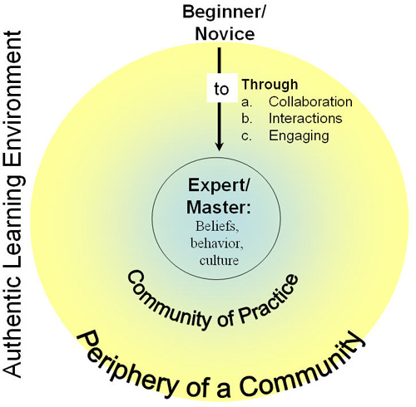
Situated Learning Theory
Zone of Proximal Development (Vygotsky)
“Legitimate peripheral participation”
Newcomers & old timers
Communities of practice
Apprenticeship/Teaching
http://neamathisi.com/new-learning/chapter-6-the-nature-of-learning/lave-and-wenger-on-situated-learning
Notes:
5 min

Slide 7
Feminism
“…as Borrego (2007a) and Koro-Ljungberg and Douglas (2008) have demonstrated, much engineering education scholarship is still characterized by a lack of explicit and consistent theoretical engagement. Specific to research on women in engineering, Jawitz and Case argue that ‘feminist perspectives have much to offer in providing an explanation of women’s experiences in engineering and the resistance of the status quo to substantial change’ (2002, p. 390), and Nelson and Pawley recommend the inclusion and testing of more gender theories in engineering education research (2010).” (Beddoes et al, 2011)
Notes:
5 min

Slide 8
Data Sources
Interviews
Structured, Un-Structured, Semi-Structured
In-depth
Individual, Focus Group
Observations
Field Notes
Recording (audio and/or video)
Journaling & Memoing
Think-Aloud or Stimulated Recall
Content
Artifacts
STANDOUT TIP: Go beyond single interviews or observations
Notes:
5 min

Slide 9
Analysis
Revisit problem, purpose, & research question(s)
Develop a systematic process
Step 1: Open Coding (review data, line by line, identify descriptions)
Step 2: Organize & Categorize Codes (synthesize open codes, look for similarities & differences, note frequency & magnitude)
Step 3: Focused Coding (refine codes/categories, connect to theory/research literature)
Emergent Themes (throughout process)
Constant Comparative Analysis (seek patterns & “saturation”)
Notes:
5 min

Slide 10
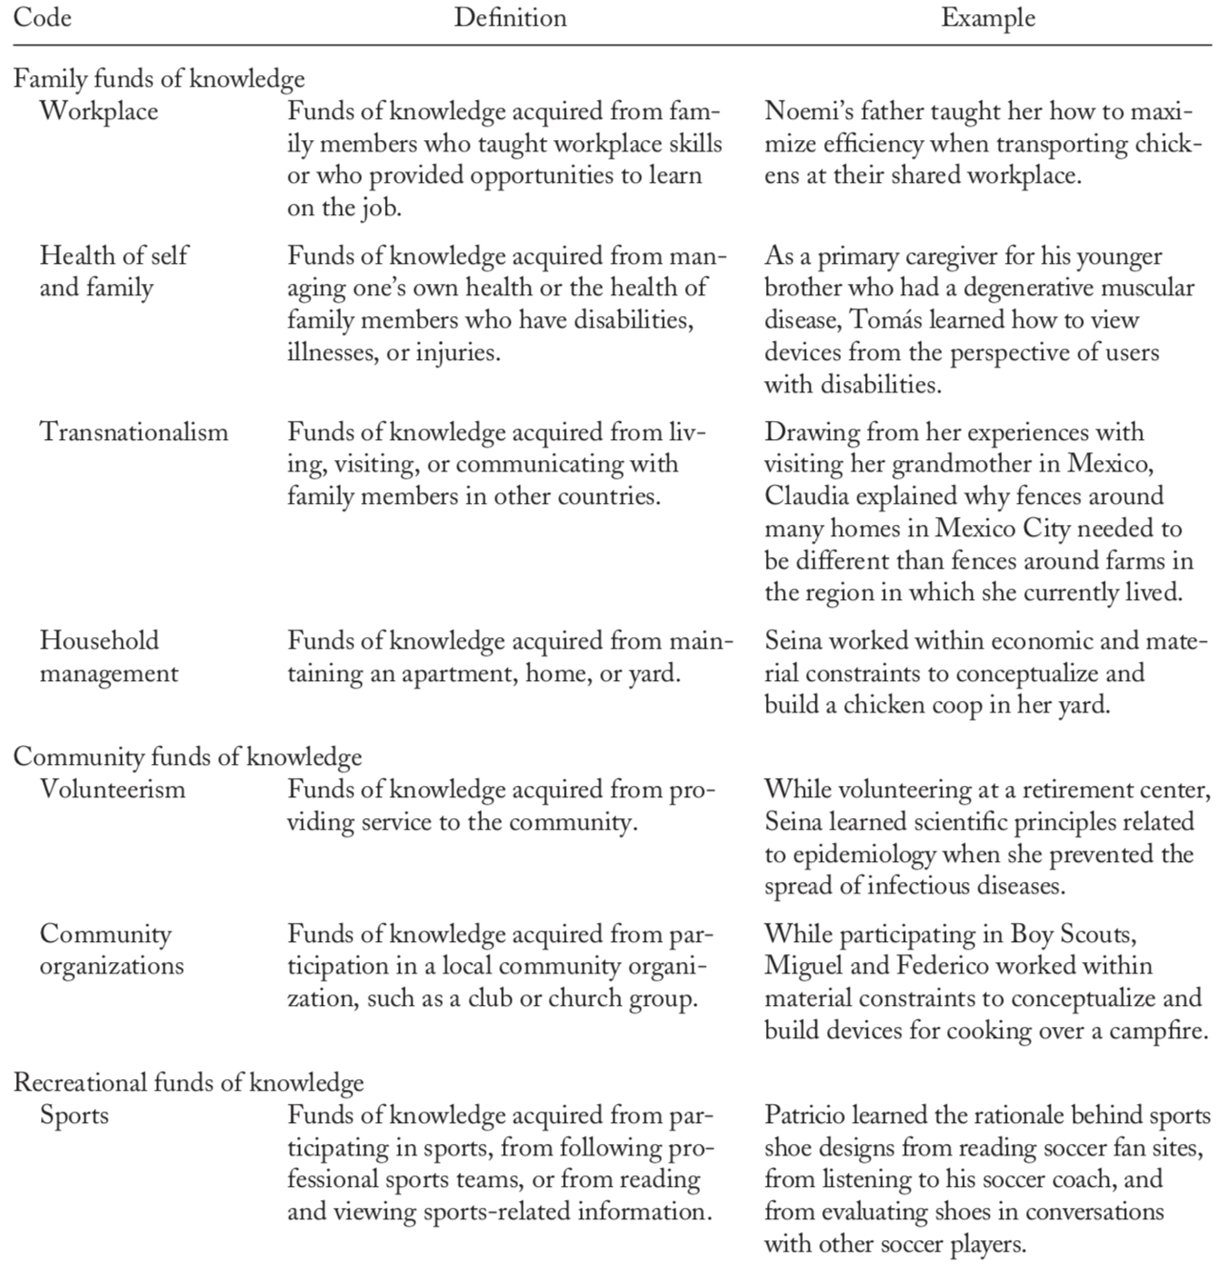
JEE Example: Focused Codes
Notes:
2 min

Slide 11
Interviews: Example
References childhood
Personal Motivation
“Growing up, I always wanted to make things, but all of my friends wanted to play with Barbies. It wasn’t a ‘girlie’ thing to do to actually do something.”
(Ann)
Peer/Social norms
“Doing” isn’t for girls
Notes:
Example explanation: 5 min

Slide 12
Interviews: Practice
Notes:
Try w/ the interview or own interview data: 10 min

Slide 13
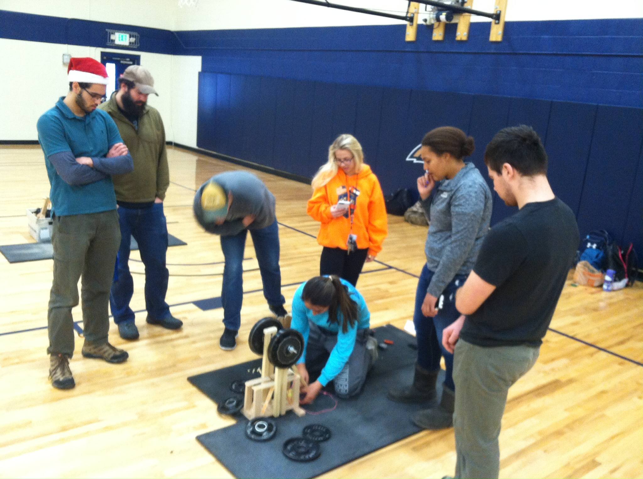
Observation: Example
Notes:
5 min

Slide 14
Observations: Practice
Time/Location & Observed Data | Analysis, Memo
Notes:
Cups activity and practice: 10 min

Slide 15
Content: Examples
Draw an engineer
Notes:
5 min

Slide 16
“Engineer” (First 4 Google Images)
Notes:
2 min

Slide 17
“Engineer” (next 4 Google images)
Notes:
2 min

Slide 18
Content: Practice
Your drawings
Notes:
5 min

Slide 19
Grants, Presentations, & Publications
Apply theory with integrity (especially critical theory)
Use diverse & robust data sources
Develop & describe systematic analysis procedures (codebooks?)
Include examples (not just summaries, frequencies, etc.) from data
Expand trustworthiness through member checks, multiple researchers, etc.
Create research teams with expertise in research methodology & teaching pedagogy
Read examples of quality qualitative and educational research (AERA journals, Qualitative Inquiry, & Qualitative Research)
Others?
Notes:
10 min

Slide 20
Suggested Resources
Bazeley, P. (2009). Analysing qualitative data: More than ‘identifying themes,’ The Malaysian Journal of Qualitative Research, 2, 1-18.
Creswell, J.W. (2013). Qualitative inquiry & research design: Choosing among five approaches (3rd ed.). Thousand Oaks, CA: SAGE Publications.
Daly, S., McGowan, A., & Papalambros, P. (2013). Using qualitative research methods in engineering design research. Paper presented at International Conference on Engineering Design, Seoul, Korea. Available at: https://m.designsociety.org/download-publication/34891/using_qualitative_research_methods_in_engineering_design_research
Hewitt-Taylor J (2001) Use of constant comparative analysis in qualitative research. Nursing Standard. 15, 42, 39-42. Date of acceptance: March 19 2001.
Koro-Ljungberg, M. & Douglas, E.P. (2008). State of qualitative research in engineering education: Meta-Analysis of JEE articles 2005-2006. Journal of Engineering Education, 97(2), 163-175.
Lave, J. & Wenger, E. (1991). Situated learning: Legitimate peripheral participation. Cambridge, UK: Cambridge University Press.

Slide 21
Suggested Resources, cont.
Maxwell, J.A. (2013). Qualitative research design: An interactive approach (3rd ed.). Applied social science research methods series (Vol. 41). Thousand Oaks, CA: SAGE Publications.
Merriam, S.B., & Tisdell, E.J. (2015). Qualitative research: A guide to design and implementation (4th ed.). San Francisco, CA: Jossey-Bass.
Miles, M.B., Huberman, A.M., & Saldaña, J. (2014). Qualitative data analysis: A methods sourcebook (3rd ed.). Thousand Oaks, CA: SAGE Publications.
Patton, M.Q. (2015). Qualitative research & evaluation methods (4th ed.). Thousand Oaks, CA: SAGE.
Saldana, J. (2012). The coding manual for qualitative researchers. Thousand Oaks, CA: SAGE. Summary available at: http://salmapatel.co.uk/academia/coding-qualitative-research
Savin-Baden, M., & Major, C. H. (2013). Chapter 5: Personal stance positionality and reflexivity. Qualitative Research: The Essential Guide to Theory and Practice. London: Routledge.
Van Note Chismm, N., Douglas, E., & Hilson, W.J. (2008). Qualitative research basics: A guide for engineering educators. Rigorous Research in Engineering Education, NSF. Available at: https://crlte.engin.umich.edu/wp-content/uploads/sites/7/2013/06/Chism-Douglas-Hilson-Qualitative-Research-Basics-A-Guide-for-Engineering-Educators.pdf

