Slide 1
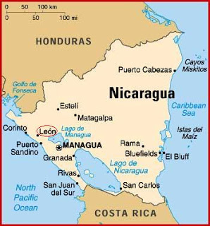
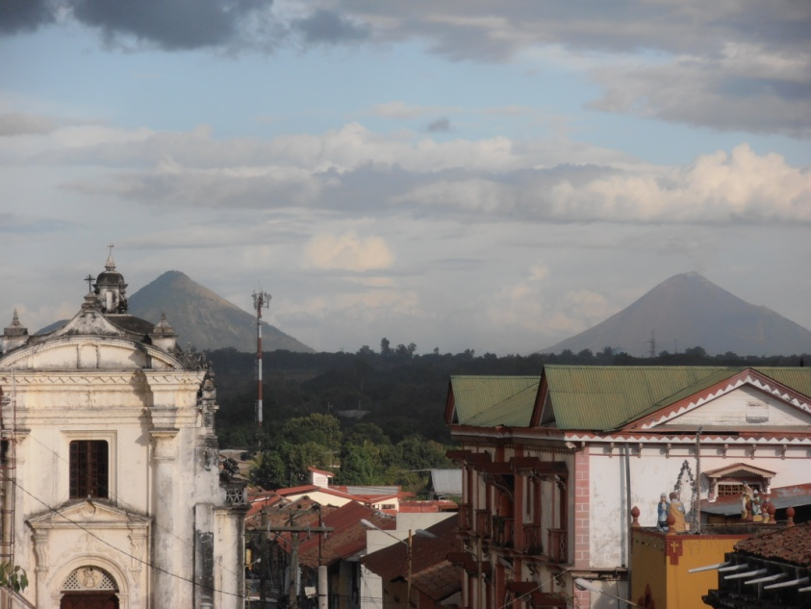
Summer program in León, Nicaragua

Slide 2
Two options to earn six credits in six weeks:
Option 1 90 hours of one–on–one courses
Option 2 45 hours of one–on–one courses
45 hours of volunteering at Las Tías

Slide 3
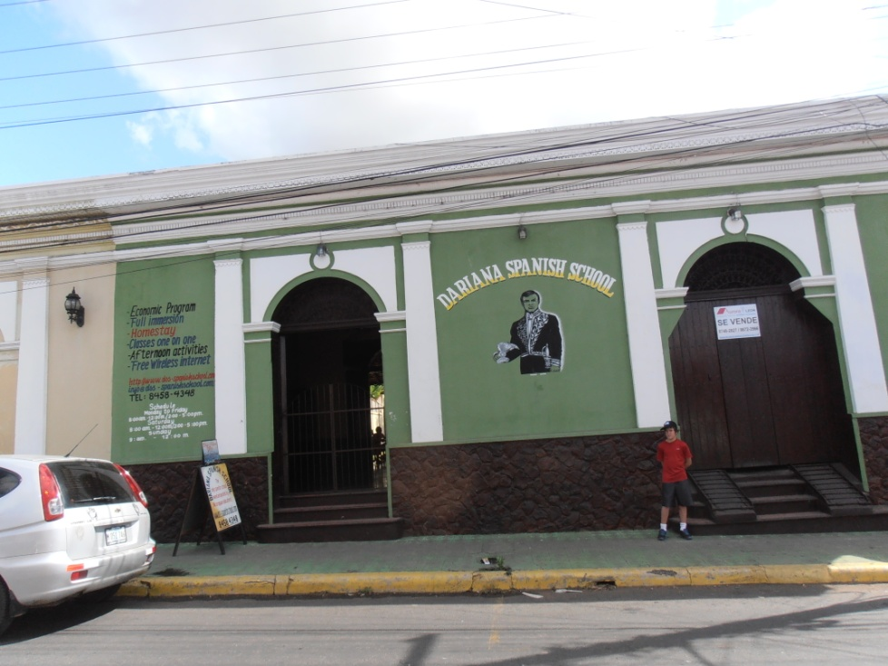
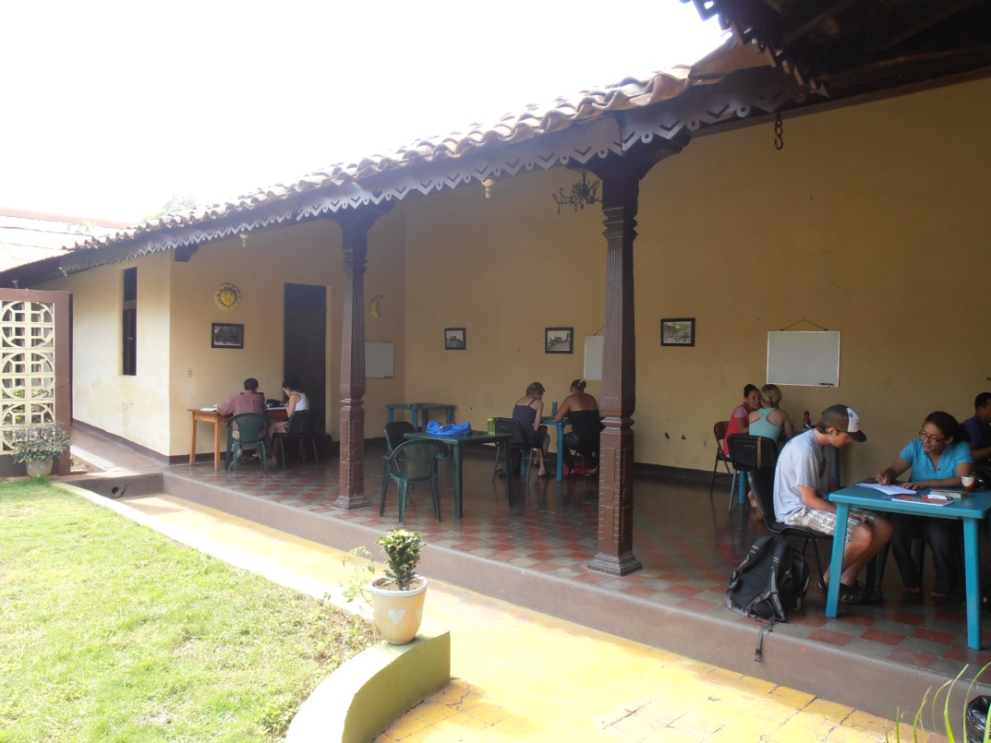
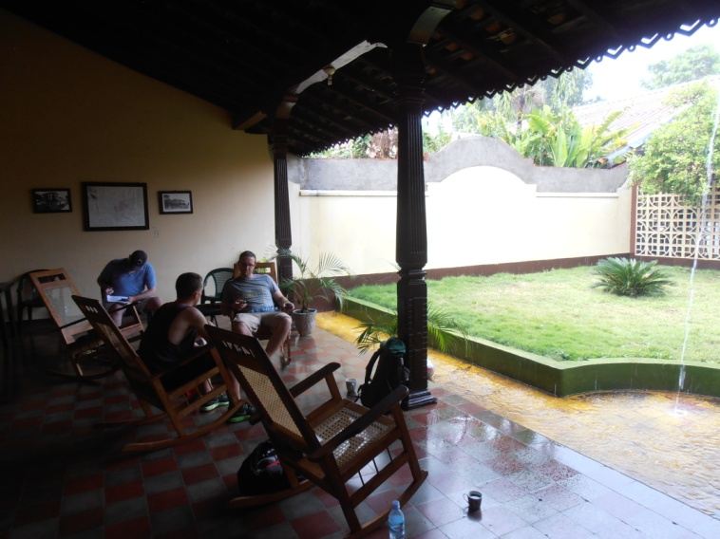
At our host school Dariana, you will get:
Personalized attention
plus coffee, wifi, and a place to relax

Slide 4
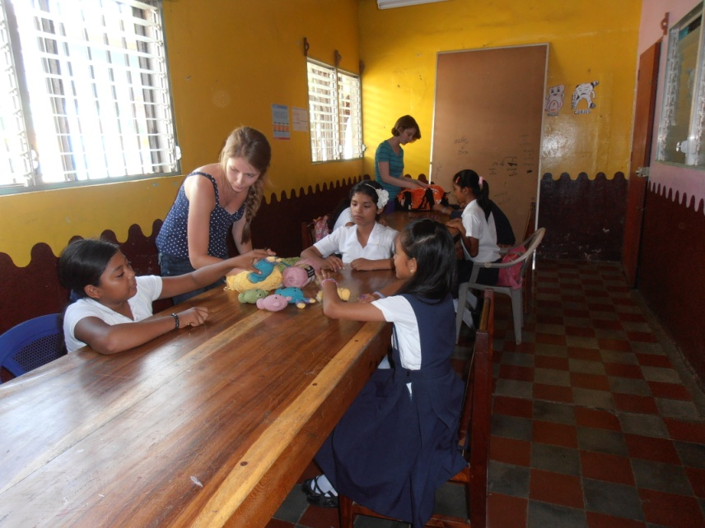
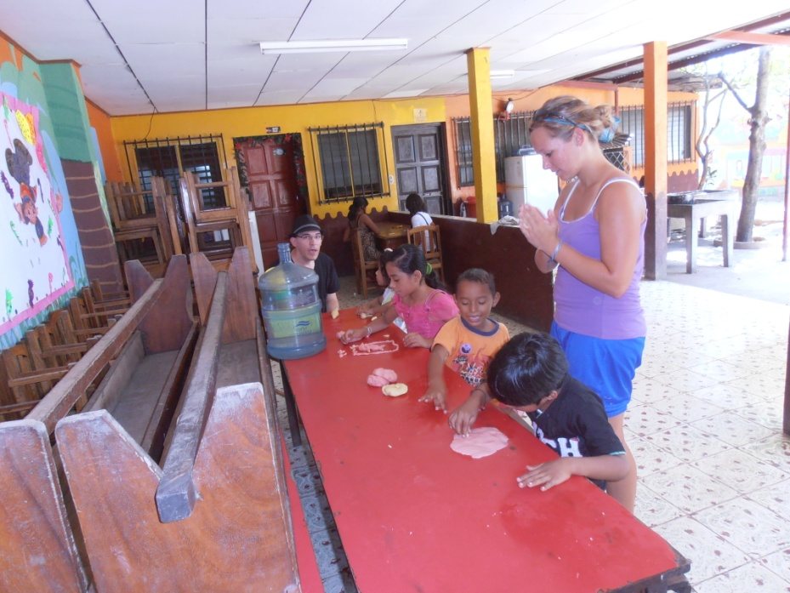
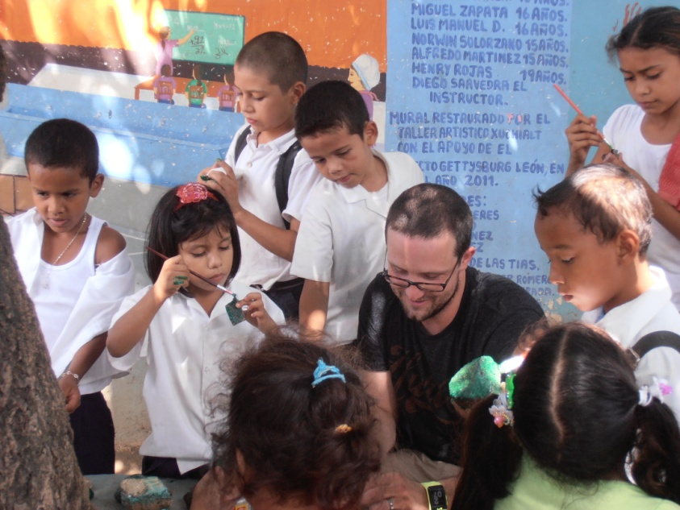
Volunteer at
Las Tías

Slide 5
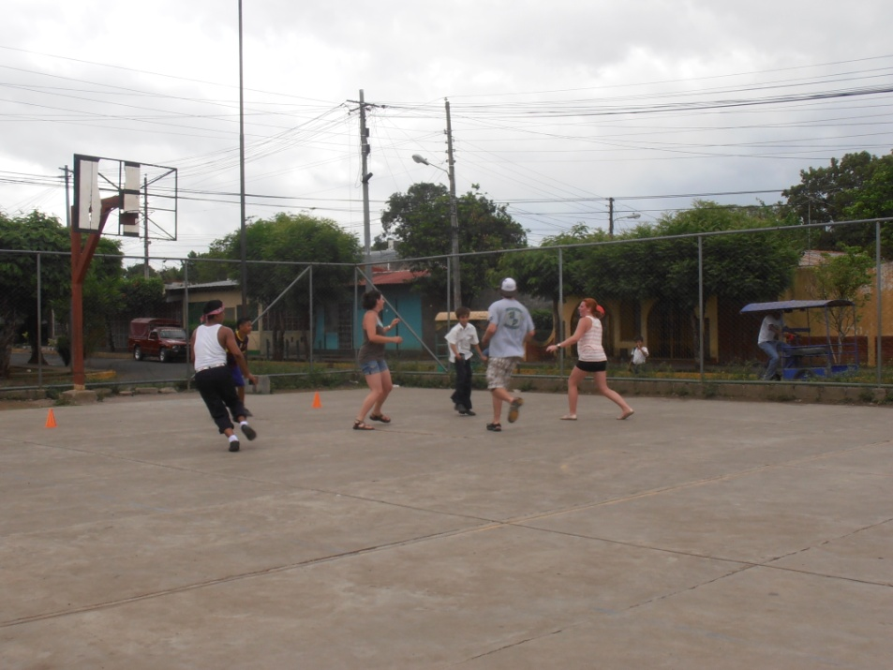
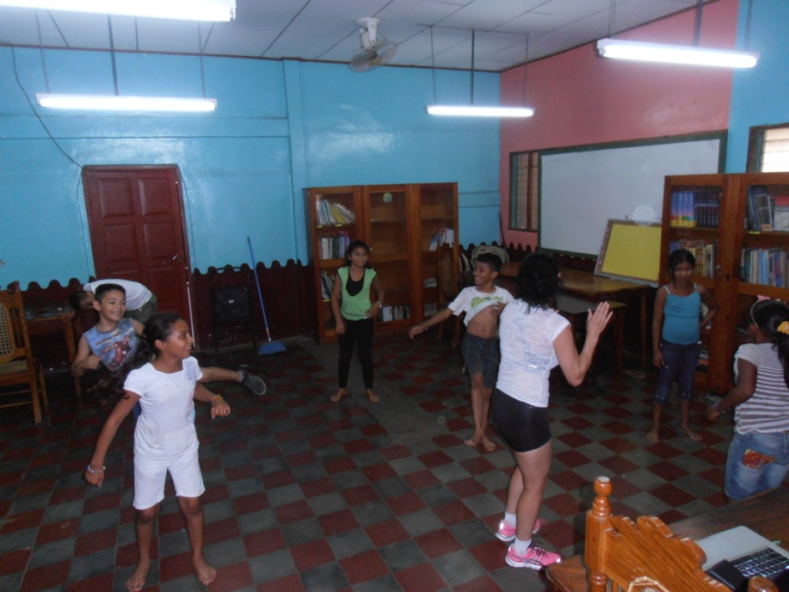
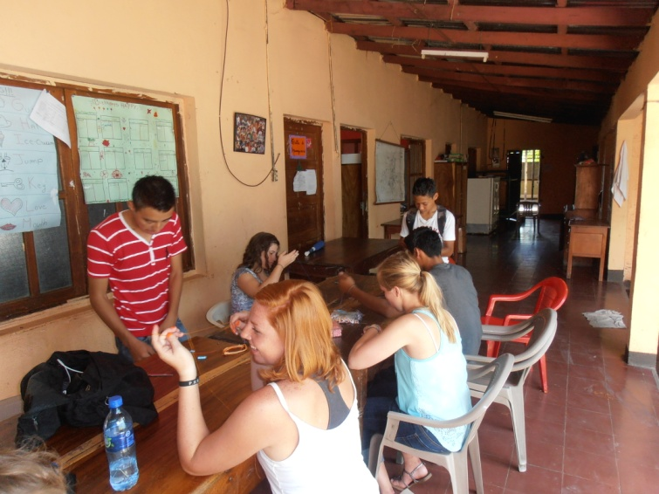
Share your time and passion with Nicaraguan children

Slide 6
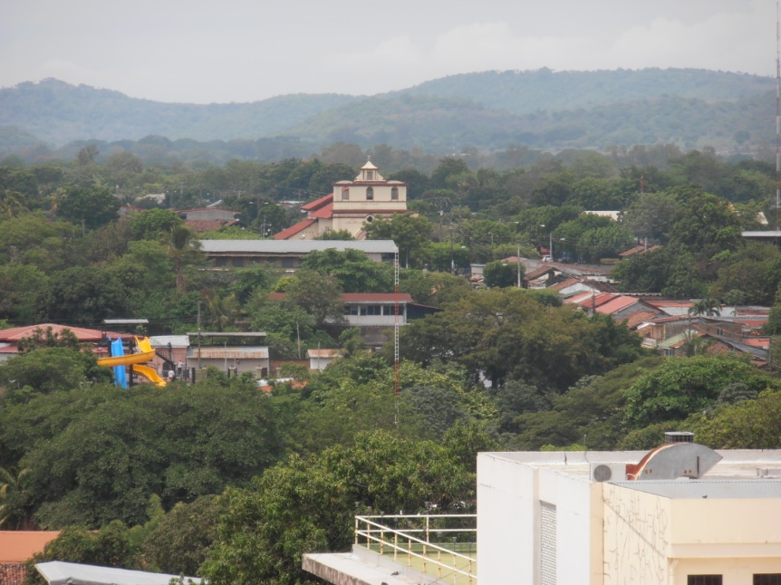
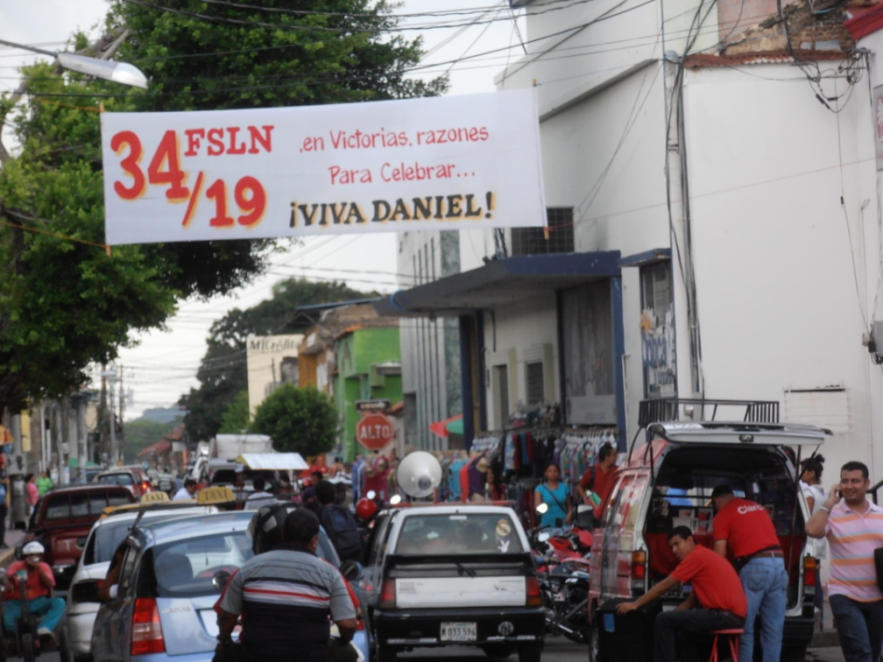
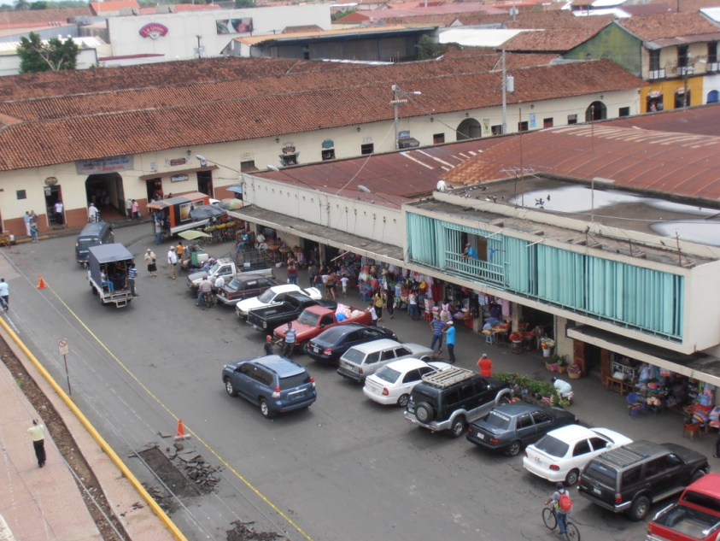
Experience the
beautiful and bustling town of León

Slide 7
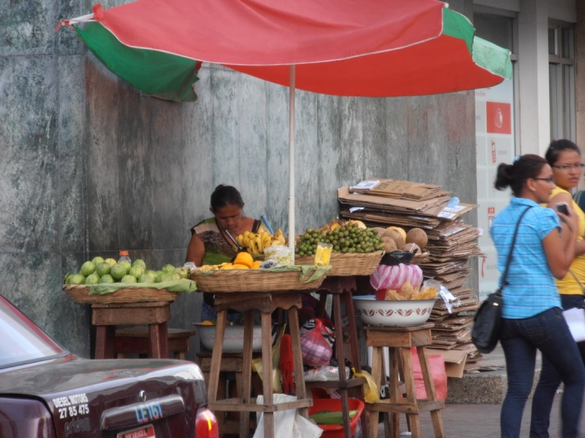
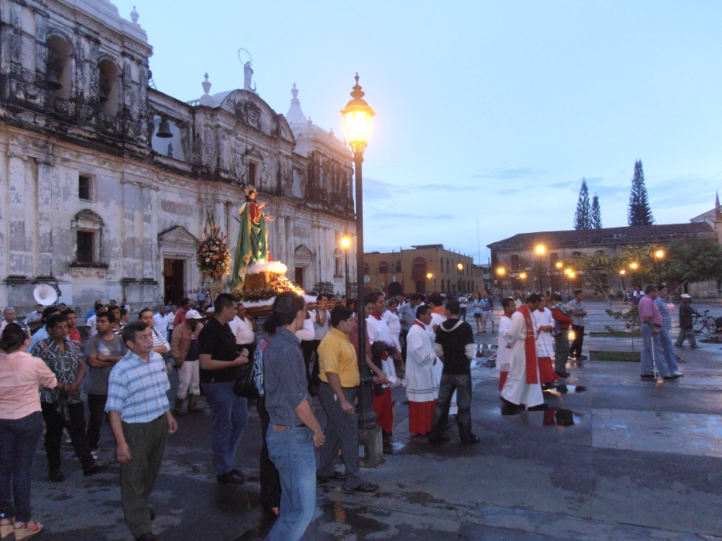
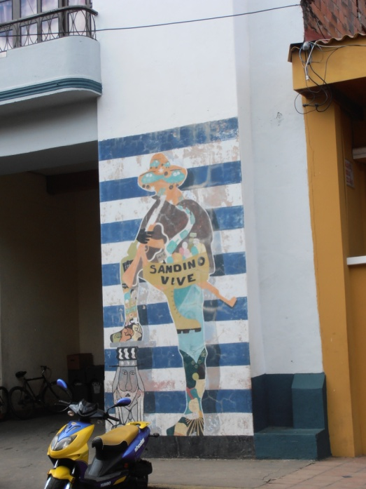
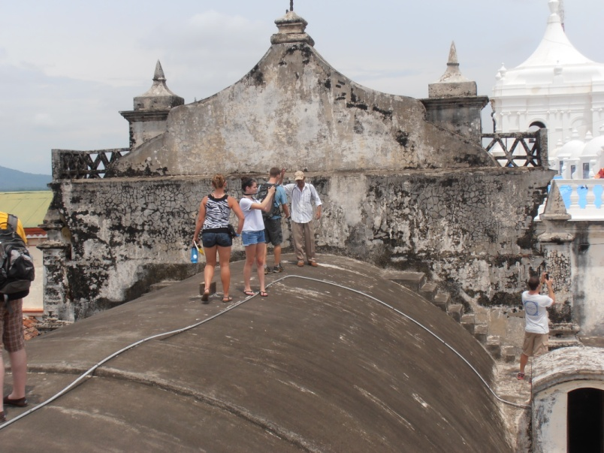
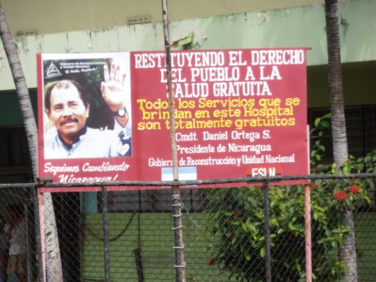
A city full of
history
culture
politics
and life!

Slide 8
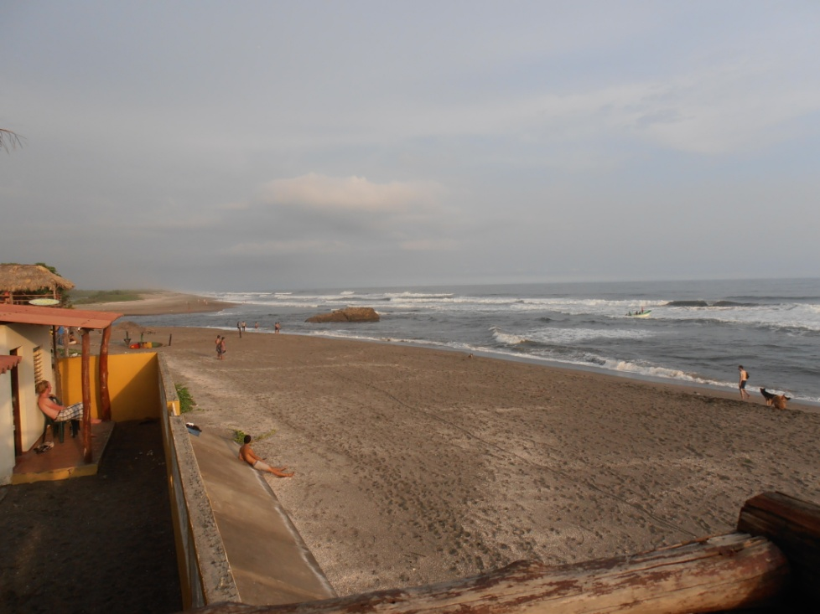
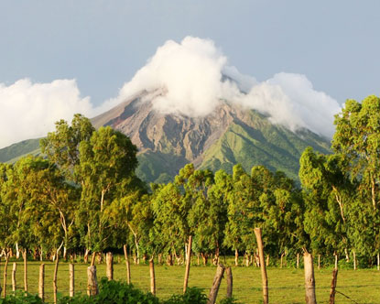
The beach is 30 minutes away!
Volcanoes and other attractions are also close by

Slide 9
Don’t miss this opportunity!
The cost of the program includes:
6 credits
Homestay with three meals a day
Health insurance
Optional weekend excursions
Pickup from and to airport
The cost of the program for summer 2013 was about $3,000

Slide 10
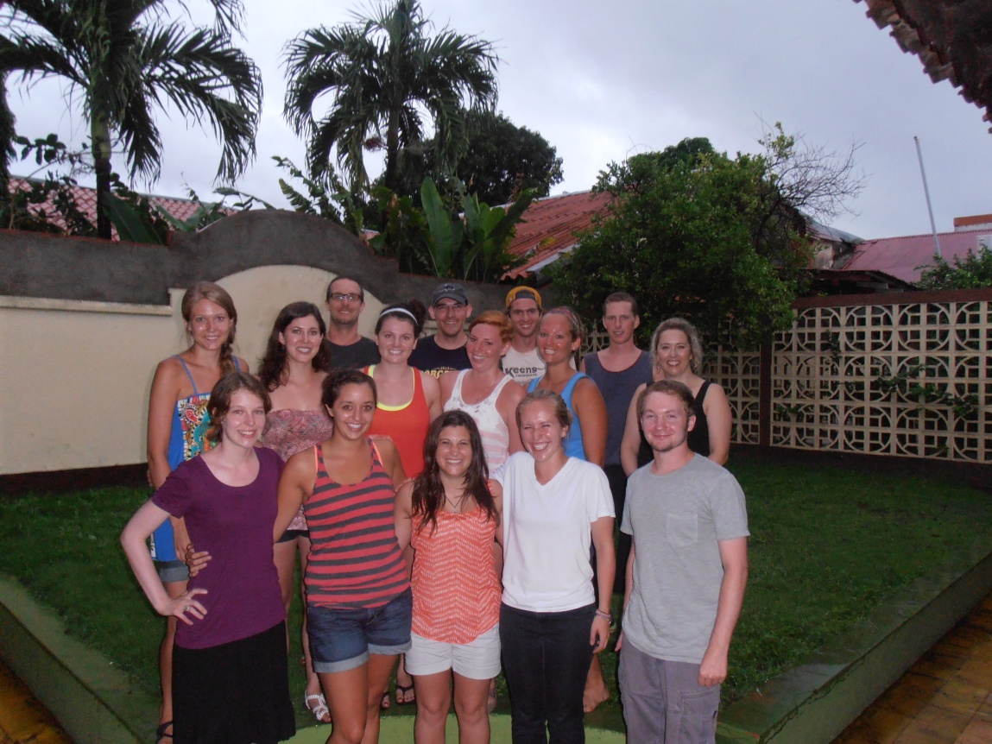
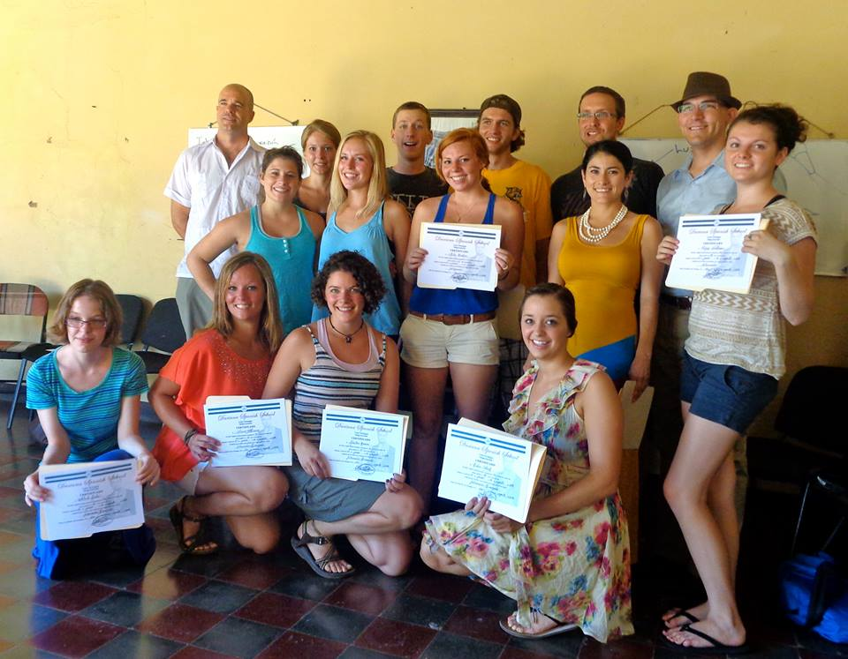
For more information contact professors
Patricia Catoira pcatoira@montana.edu or
James Martin jameswm@montana.edu
Our summer 2013 class

