Slide 1
March 26th-28th, 2020
Thank you for volunteering!

Slide 2
March 26th-28th, 2020
More than 4,000 students from across the nation and around the world
No MSU Classes on Thursday 26th and Friday the 27th
All MSU students, faculty and staff are invited to attend sessions
Social and informational events showcasing MSU research and opportunities
Conference Schedule Overview
Sunday 22nd | Monday 23rd | Tuesday 24th | Weds 25th | Thursday 26th | Friday 27th | Saturday 28th
 |  |  | Conference Shuttles Registration | Presentations, Poster Sessions, Performing Arts Opening Ceremony No MSU Classes | Presentations, Poster Sessions, Performing Arts Keynote Speaker No MSU Classes | Presentations, Poster Sessions, Performing Arts Keynote Speaker Excursions
For more schedule information go to: http://www.montana.edu/ncur2020/NCUR2020_Schedule.html

Slide 3
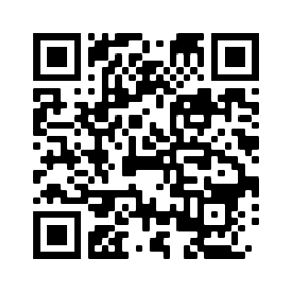
Nearly 2,000 volunteer shifts!
To sign up for shifts, scan the QR code or visit:
https://bit.ly/2VK9TGt
Attendant Registration
Event Assistant
Catering Assistant
Greeter
Shuttle Manager
Transportation Assistant
Luggage Support
Info Tent
Art Exhibit Assistant
Culinary Sanitation Assistant
Opening Ceremony Support
Presentation Assistant
…and more!
Pre and Post Conference volunteer shifts will also include set up and clean up opportunities.

Slide 4
NCUR 2020 Website
http://www.montana.edu/ncur2020/

Slide 5
NCUR Mobile App
https://eventmobi.com/ncur2020/

Slide 6
Be Great Hosts
MISSION:
Register, guide, support, serve, transport, and problem solve
How to prepare:
Sign up for volunteer shifts
Invite your friends, colleagues, and students to volunteer too
Review the NCUR 2020 website http://www.montana.edu/ncur2020/
PRO TIP: Check out the Frequently Asked Questions!
Download the App https://eventmobi.com/ncur2020/
Brush up on your campus navigation skills: https://www.montana.edu/campusmap/#!/

Slide 7
Volunteer Headquarters Strand Union Building 235
Check in at SUB 235 for every shift
please be on time
Headquarters Hotline Coming Soon!

Slide 8
Campus Navigation How would you help?
Which building is the Fieldhouse?
How do I get to the Fieldhouse through all this construction?
Where is Wilson Hall?
How do I find a specific room in Wilson Hall (its confusing!)
How do I get to Cheever Hall?
Where is the Shroyer Gym?
What is the ADA route to…?
Where are the gender inclusive restrooms?

Slide 9
When You Need Help
Volunteer Venue Info Packets pick up at SUB 235 when you check in for your volunteer shift
“Shift Change” Transitions
Volunteer Headquarters in Strand Union Building 235
Volunteer Headquarters Hotline coming soon
Email engagement@montana.edu
Call in the “Super Team”

Slide 10
Questions?

