Slide 1
MSU Bobcat Parent & Family Program
Off Campus Living Webinar

Slide 2
The purpose of the Good Neighbor Committee (GNC) is to improve the quality of life for all MSU students and Bozeman neighbors.
The Committee is comprised of members from the City Manager’s Office, City Police, Fire & Code Compliance, MSU Dean of Students, Office of Activities and Engagement, Residence Life, Police, Sorority Life, Fraternity Life, Bozeman businesses, community members, and a rental property management company.
The Good Neighbor Committee is a partnership between MSU and the City of Bozeman Neighborhoods Program.
Contact Tanya Andreasen, Neighborhoods Program Coordinator
(406) 582-2274 tandreasen@bozeman.net

Slide 3
Amy Kanuch & Jessica Johnson
MSU: Community Relations and Marketing
City of Bozeman: Neighborhood Coordinator
Co-Chairs of The Good Neighbor Committee
Amy Kanuch: amy.kanuch@montana.edu or (406) 994-7462
Jessica Johnson: jjohnson@bozeman.net or (406) 582-2274

Slide 4
James Tobin
Assistant Director of Residence Life
MSU Residence Life
Resident and good neighbor of
Bozeman since 2007

Slide 5
Residence Life
Provide supportive and convenient
on-campus housing for MSU students
+
Provide resources and advice to MSU students regarding their housing options, on and off-campus

Slide 6
On-Campus Housing
Students have many options including:
Residence halls and apartments
Double and single rooms (as available)
Single gender, mixed gender and co-ed environments
Living options available: Creative Arts, Business, Engineering, Honors, Global Village, Mixed Gender Housing, Well-Being and Emerging Leaders
Students are able to move rooms, floors, and buildings throughout the semester. If a student would like to move, they can discuss options with their Residence Hall front desk.

Slide 7
Sophomore & Above Options
MSU has great on-campus options for returning students:
Residence Life Apartments
Headwaters Complex
Roskie Hall 10th and 11th floor, Deluxe Singles
Housing Priority Selection (January – February) allows returning students to secure their room for next year.
Returning students who have signed-up for 2018-19 housing have until March 30 to cancel with no cancellation penalty.

Slide 8
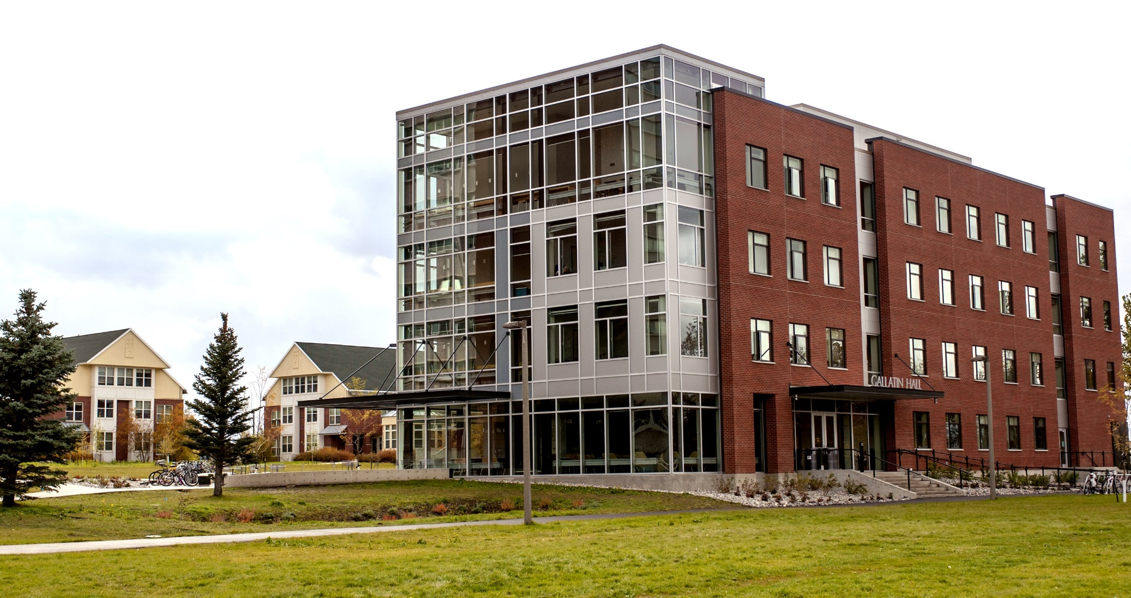
Gallatin Hall
North Hedges Suite 3

Slide 9
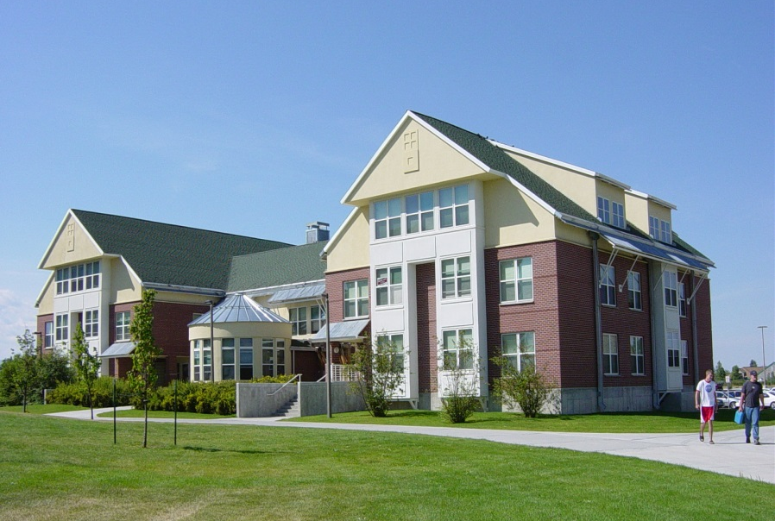

Slide 10
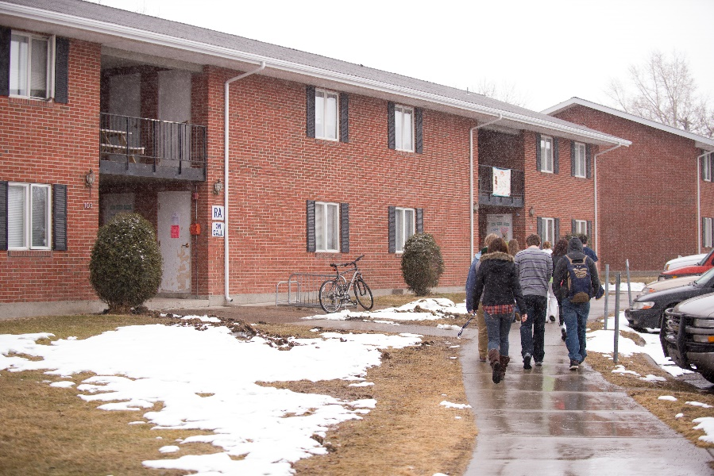
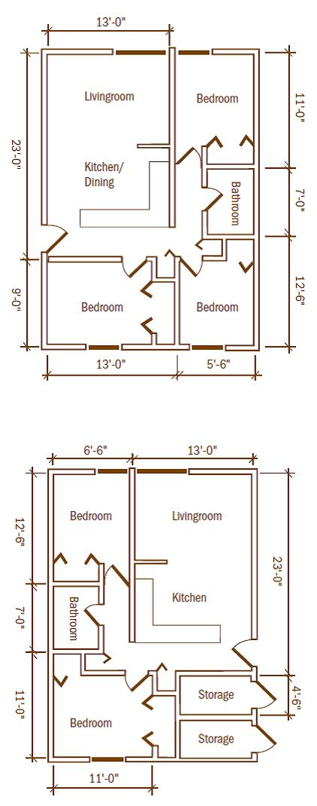
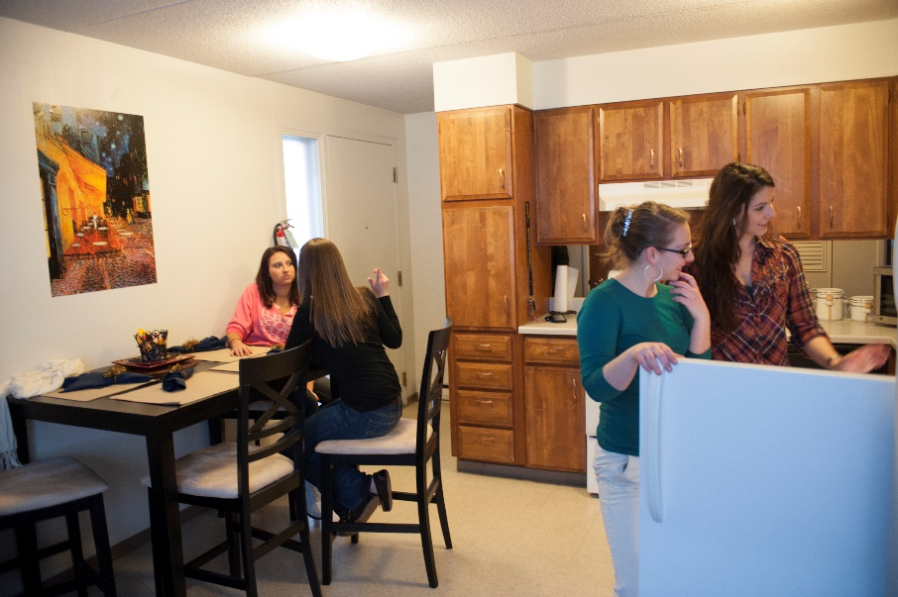

Slide 11
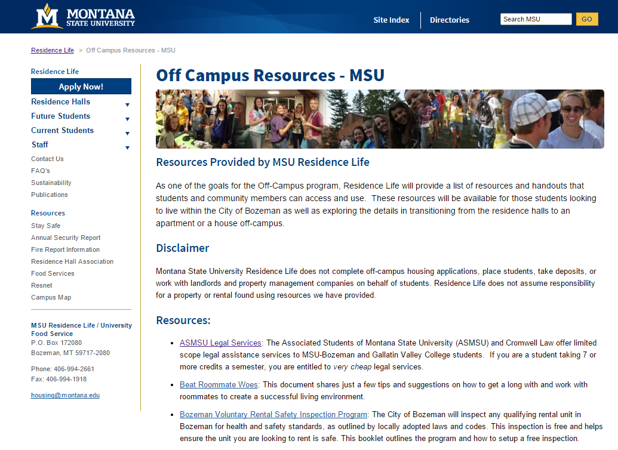
Off-Campus Resources Webpage

Slide 12
Off-Campus Housing
Residence Life provides resources to any student considering off-campus housing.
Resources we can provide:
Off-Campus Housing Guide, available online
Housing staff to meet with students
General information on leases, housing contracts, where to look

Slide 13
Common Questions
When is a good time for my student to move off-campus?
On-Campus vs. Off-Campus. Which is cheaper?
Are there meal plans for off-campus students?

Slide 14
Contact Us
Residence Life
406-994-2661
housing@montana.edu
Family and Graduate Housing
406-994-3730
fgho@montana.edu

Slide 15
Peak Property Management
Kevin O’Brien
Owner
MSU Grad
Bozeman native (by marriage)
Licensed MT Realtor
www.rentbozeman.com
kevin@rentbozeman.com
406-585-7776

Slide 16
Search Criteria
Time frame is from Jan 2013 to Jan 2018 Class is 'Residential'
Type is 'Condominium'
Area Major is 'Bozeman City Limits'
Results calculated from 1,545 listings

Slide 17
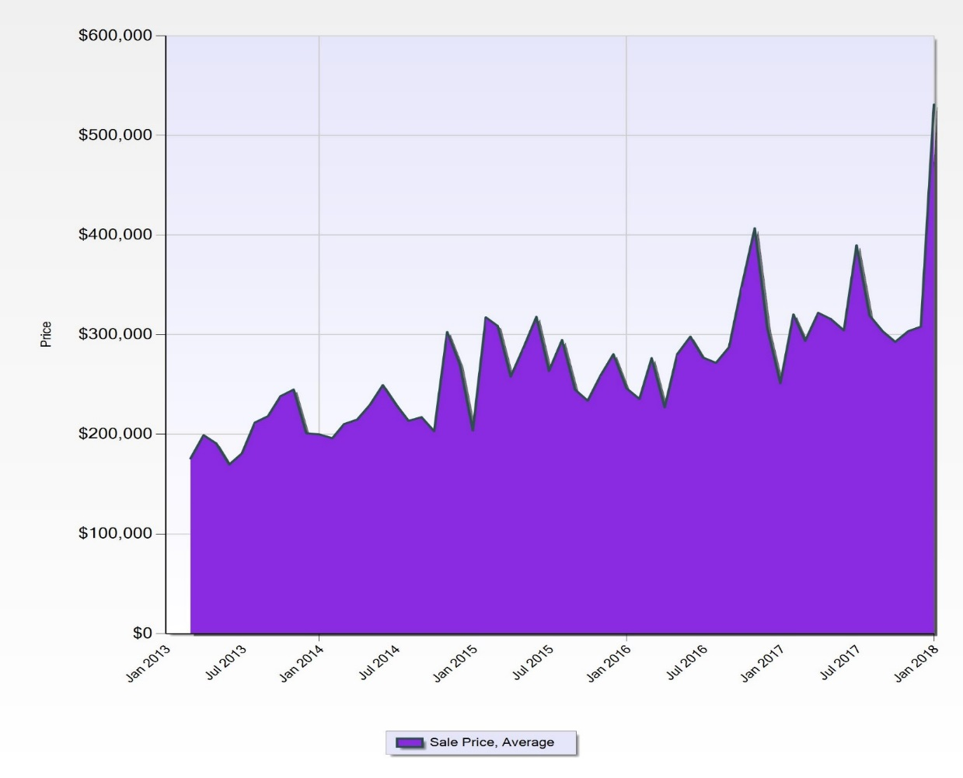
Search Criteria
Time frame is from Jan 2013 to Jan 2018 Class is 'Residential'
Type is 'Townhouse'
Area Major is 'Bozeman City Limits'
Results calculated from 530 listings

Slide 18
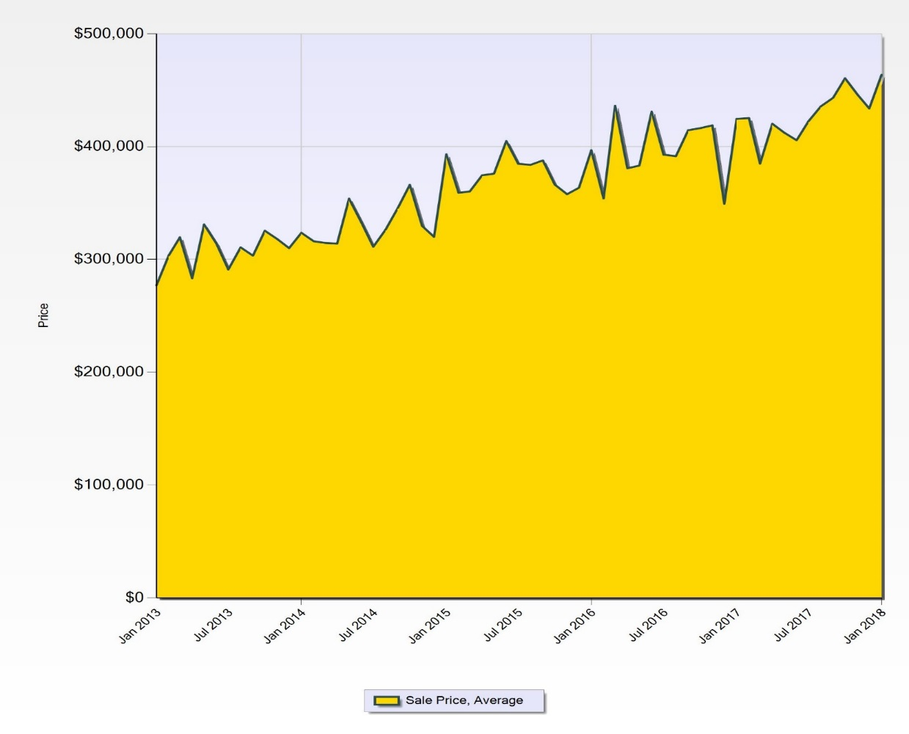
Search Criteria
Time frame is from Jan 2013 to Jan 2018 Class is 'Residential'
Type is 'Single Family'
Area Major is 'Bozeman City Limits'
Results calculated from 2,771 listings

Slide 19
Shopping for a rental:
Never rent a property, sight unseen
Be aware of safety issues
Smoke alarms and carbon monoxide alarms (or combo alarm)
Egress windows
Exposed wiring
Evidence of water damage
Do not become desperate
Look early and often, many places not advertised until 30 day notice is given.
rentbozeman.com, craigslist, newspaper, eavesdropping, message boards
Market has softened slightly
Rent amounts will be influenced by:
Age of property
Amenities
Amount invested by owner
Location
Still highly competitive
An application will be required;
will verify credit,
income,
background
rental history
If an area is deficient, a co-signer will be required. The co-signer will need to apply and undergo a credit check.
Peak Property Management’s policy for applications, (other companies will vary)
The applicant is applying with Peak, not the property owner
An approved application allows applicant to choose from any available property we manage
The application is good for six months
Avg Rent
1B $800-1000
2B $1000-1300
3B $1300-1700

Slide 20
Rental Agreement
(per Peak Property Management)
Also referred to as a lease
Some simple, some complex…borne from experience.
Should have clear definitions regarding rent amount, length of lease, security deposit, etc.
Length of lease can vary:
Month to month (either party can terminate lease with 30 days notice)
Annual…most typical lease
It is possible to get a shorter term lease when circumstances allow, most often when it brings lease back into a summer schedule (sign a 9 month lease in September, for example)
You can expect to pay rent through the summer
Holding a property is very unlikely
Sub-letting is only allowed with written permission from landlord (state law)
Read and understand the agreement before you sign it. It is a legally binding contract, which is held “jointly and severally”, meaning each person on the lease is 100% responsible, as are any co-signers.
Understand that there are “protected classes” of society to prevent discrimination. Age, race, religion, disability, etc. Montana has more protected classes than federal level.

Slide 21
Roommates
(per Peak Property Management)
CHOOSE ROOMMATES CAREFULLY. A bad roommate can affect your credit, finances and future housing opportunities.
One of the biggest challenges is finding suitable roommates.
Beware of roommates that you do not know or those that you do know.
High school best friend may not make a great roommate
Roommate switches are common, but require proper documentation, i.e. application, departure form, etc.
To be removed from a lease, you must be “signed off” by all parties (roommates) named on the lease.
Roommates should be treated as business partners and a written agreement, between roommates, is an effective tool.
“Jointly and severally” binds roommates together
Landlords don’t care if one person can’t pay, the others need to make up the difference.
A single person can’t be evicted from the lease, the roommates must complete appropriate documentation for a roommate switch/removal
It will come up later, but no one can predict how freedom or lack of structure will affect an individual.
People will do what they are going to do

Slide 22
Security Deposit
(per Peak Property Management)
Security Deposits held in a “trust account”, required by the state
Security Deposits remain with the property until the lease is terminated
Roommate switches will not result in any portion of the Sec Dep being returned
Security Deposits are held for the protection of the property owner.
Common misconception that security deposit money is kept by management company.
All security deposits are processed in accordance with Montana law. The money is accounted for in unpaid rent, utilities, repairs or returns and a copy of the register is sent to past tenant(s).
Security deposits are returned within 30 days if cleaning/repairs is/are necessary. 10 days if nothing needs to be done and all rent/utilities are paid. A notification letter will be sent regarding the status of the security deposit if the repairs take longer than 30 days.
When it is necessary to involve a sub-contractor, repair times can be longer.
The property move-in report is the key to maximizing your deposit return.

Slide 23
Move-In & Move-Out
(per Peak Property Management)
Upon signing rental agreement and prior to moving in, you should receive a COP (condition of premises), a property inspection report.
COP is for you to complete and is an evaluation of the condition of the property at the time you move in
Be thorough. Take pictures, take video, be specific.
When you move out, the COP will be examined and any damage not noted on the COP will be your responsibility, along with the co-signer.
Make note of walls, floors, doors, stains, dings, dents, dirty windows, missing screens… test the function of the garbage disposal, ceiling fans… be thorough.
Moving out will require a written 30 day notice, typically.
If you move out prior to lease ending, you will be assessed a lease break fee and be responsible for rent, utilities and ad fees until property is re-rented.

Slide 24
Rental Reality
Investment (rental) property is a business
Investment properties are not held for the benefit of the tenant
Owners have no personal involvement, they only see monthly statement
Tenants are living in someone’s retirement fund
Management companies are highly regulated
To manage property, a person must have a PM license or a RE license.
Management companies are, typically, more rigid and unlikely to make exceptions.
It is critical that everyone be treated the same, therefore changes to leases, applications, etc are unlikely.
A management company could be responsible for a collection of properties worth $100,000,000
Private owners
Individual landlords are not regulated by the state
Are a good option if you have really bad credit, evictions, judgments, etc.
RENTING IS A PRIVILEGE – NOT A RIGHT
Landlord has right to inspect property with 24 hour notice or in case of emergency
Landlord is there to protect property values, while preserving “quiet enjoyment” for tenants and neighbors
Renters get into the most trouble…
Having an unauthorized pet
Having an unauthorized tenant
Noise complaints, parties
Not paying rent
Not maintaining property

Slide 25
More Rental Reality
Obtain renters insurance!!!
Will cover fire, explosion and smoke, nothing to do with flooding…found out about both the hard way.
Insurance companies don’t follow “jointly and severally”
They seek to assign individual responsibility
We require $300,000 (see charts for average cost of property in Bozeman) liability and to be named as additional interest
Still very reasonably priced
Being named as additional interest means that we will be notified if the policy is cancelled
Hard to believe, but some people cancel the policy as soon as they show proof of insurance
Freedom changes people
No way to predict reaction
Pressures of school, rent, relationships
Parents are the last to know
Been screamed at by plenty of parents whose student forgot to inform them of key details (numerous police calls, shut the heat off during winter break, haven’t sent in necessary paperwork yet)
Remember, “Jointly and Severally”
Each person is 100% responsible, along with any co-signers.
A deadbeat roommate will cost you money
Damages from a party run amok are yours to pay, even if you weren’t there
Getting fed up and storming out the front door does not remove you from the lease, you have to be “signed off” of the lease.
Chapter 70, Section 24 of Montana Code Annotated is the Montana Landlord/Tenant Act

Slide 26
Questions
Thank you for participating in our webinar.
If you have any further questions please contact the Parent and Family Hotline at (406) 994-7359 or email us at parents@montana.edu

