Slide 1
Martha Potvin
Provost and VP Academic Affairs

Slide 2
Academic Affairs Financial Investments
Notes:
On KPI the “expenditures” for academic units went from $39.4M to $54.3M AY 03 to 12 , a 38% increase. Your graphs show, through AY14 increases of 59% (blue) and 50% (red).
It may be useful to know what these data are as compared to what is on the OPA website.
SCH wert form 320k to 360k in the same time interval, a 12.5% increase. Headcount was 03 was 12077; in AY 12 14431 – a 19.5% increase. This year will be 15350 – 27% up.
Overall, funding appears to increasing at twice the rate of student enrollment. That is a bit odd, actually.

Slide 3
Instructional FTE
Notes:
Can’t we get FY 14 data for faculty?

Slide 4
Student Faculty Ratios
Notes:
Here again FY 14 numbers would be helpful.

Slide 5
Financial Investment in Graduate Education
BASE OTO
FY 12 $40K $258K
FY 13 $45K $163K
FY 14 $216K $667K
TOTAL = $1.4M
Includes: Strategic Investment Proposals
PhD Enhancement Support
Graduate Enhancement Recruitment
Meritorious Fellowships (VPR)
Sloan Scholars Match

Slide 6
Enrollment and Classroom Use
TEAL Classrooms
(Technology Enhanced Active Learning)
Evening Sections
Space Management Software
(Ad Astra)
Notes:
See details that Marilyn emailed to you yesterday on TEAL
We have scheduled a CFE discussion to assess success of evening classes. CFE people will be interviewing students/faculty on why they took/gave class at that time. We will comparatively asses student outcomes.
Astra Schedule:
First: comprehensive and current inventory of space use. Inventory and characterization of all spaces suitable for instruction. Where to go to find a room of the type, size that you need.
Second: assistance in optimization of scheduling.
Later: Analytics – improved prediction of seats/ class, and, with solid course cap information, numbers of sections.

Slide 7
Northwest Commission on Colleges and Universities
Standard Two: Resources and Capacity
Governance & Governing Board
Leadership and Management
Policies and Procedures
  Academics
  Students
  Human Resources
  Institutional Integrity
  Academic Freedom
  Finance
Human Resources
Education Resources
  Undergraduate Programs
  Graduate Programs
  Continuing Education and Non-Credit Programs
Student Support Resources
Library and Information Resources
Financial Resources
Physical and Technological Infrastructure

Slide 8
Accreditation
Assessment of Learning Outcomes
  September for all courses
  October for all programs
    graduate and undergraduate
    majors, minors, certificates
  November for all assessment reports
Ron Larsen, Accreditation Liaison

Slide 9
Graduation Success Teams
Summer/ mini-courses/ J-term Ilsa Marie Lee, Diane Donnelly (mini-courses, J-term), David Singel (summer school)
Accelerated Masters Ken Bowers
Accelerated Degree Completion David Singel
Barrier/Gateway Courses Rob Maher
Dual Credit Ann Ellsworth and Stephanie Gray
On-line/EU- Seamless Model Kregg Aytes
Reports and Recommendations due: October 1, 2013
Summer Math Academy
Summer Gifted Program

Slide 10
Questions & Answers

Slide 11
Terry Leist
VP Administration and Finance

Slide 12
Financial Overview
MSU 4-Campus Total Revenues (Including State Allocation)
FY13 Actuals
Total Revenue = $ 644,330,184
Source: BoR Annual Operating Reports

Slide 13
Financial Overview
MSU-Bozeman Total Revenues & Transfers-In by Fund Type FY13 Actuals
Total Revenue = $ 477,721,269
Source: BoR Annual Operating Reports

Slide 14
Financial Overview
MSU-Bozeman General Operating Revenue By Source
FY13 Actual
Total Revenue = $ 154,230,200
Source: BoR Annual Operating Reports

Slide 15
Financial Overview
MSU-Bozeman General Operating Expenditures
By Program - FY13 Actual
Total FY13 Expenditures = $ 152,802,704
Note: Net of Tuition Waivers
Source: BoR Annual Operating Reports

Slide 16
Financial Overview
MSU-Bozeman General Operating Expenditures
By Category – FY13 Actual
Total FY13 Expenditures = $ 152,802,704
Source: BoR Annual Operating Reports

Slide 17
Enrollment (FTE)
MSU-Bozeman: FY09 - FY13
38%
39%
39%
39%
42%
<<< Fall Headcount Freshman NR %
27%
25%
25%
23%
23%
75%
73%
75%
77%
77%

Slide 18
Financial Overview
MSU-Bozeman General Fund Revenues

Slide 19
Financial Overview
MSU-Bozeman Expenditure Changes
FY08-FY10
Changes
$12,369,812
FY11-FY13
Changes
$16,339,306

Slide 20
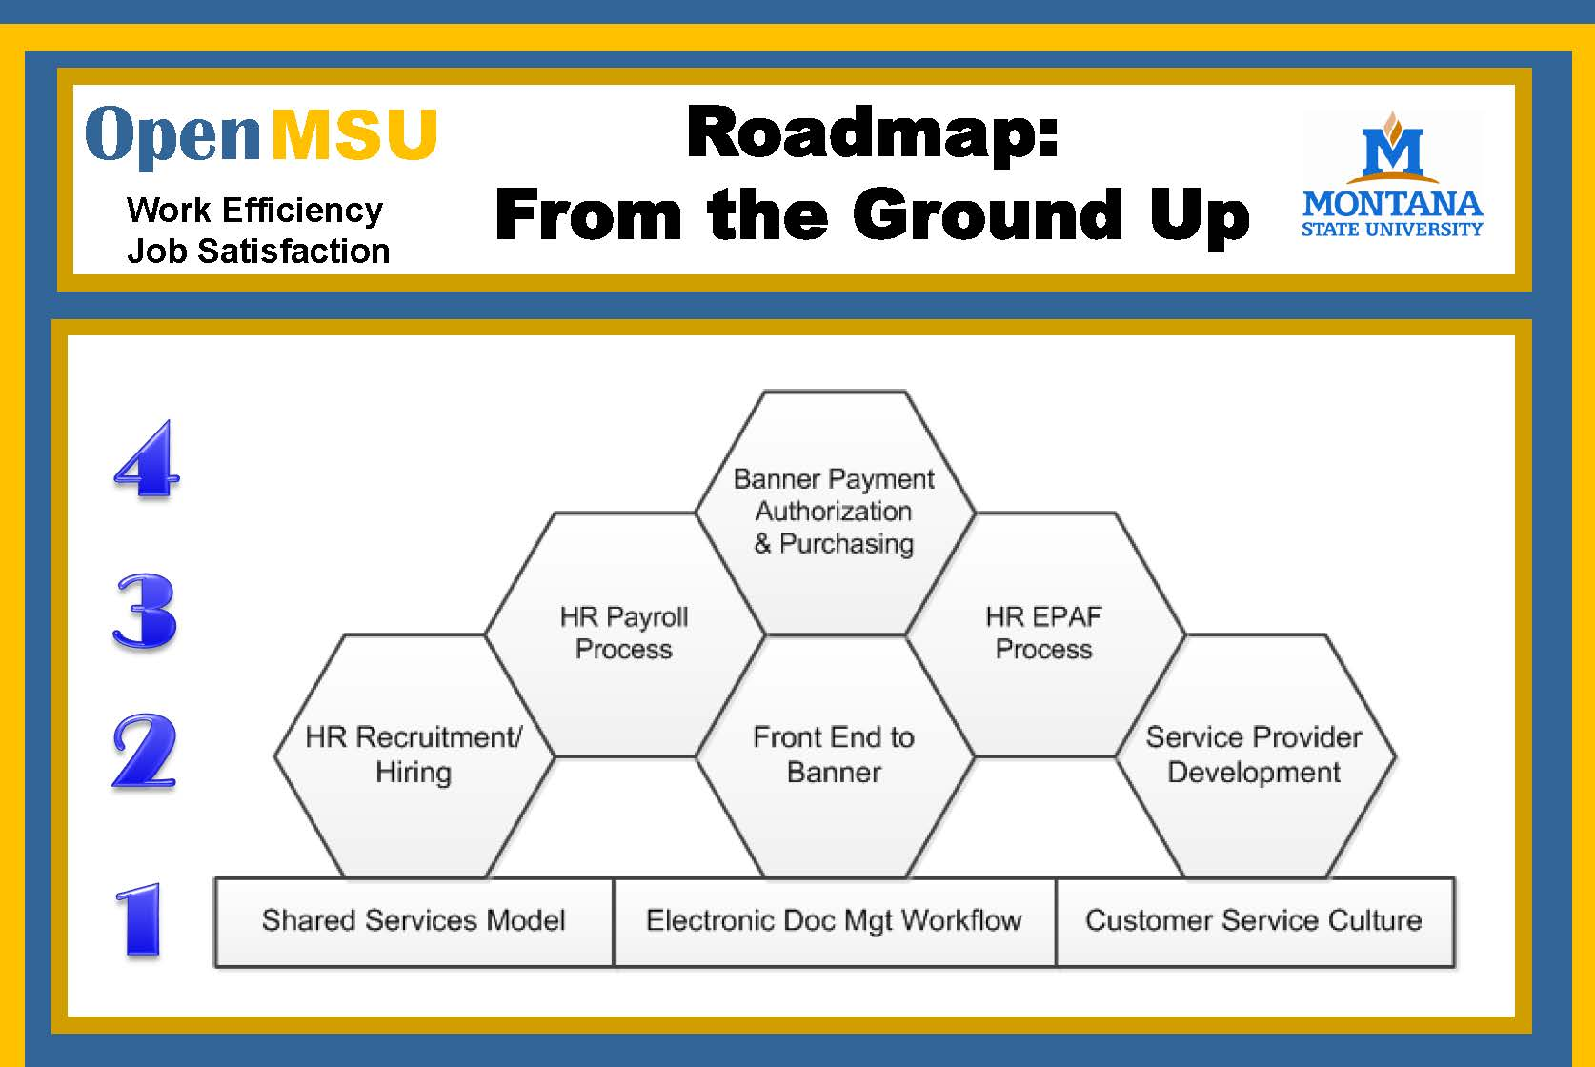
Website: www.montana.edu/openmsu

Slide 21
HR Reorganization Update
Human Resources
Chief Human
Resources Officer
Dennis Defa
HR Administration
(Support & Budget)
Talent
Management
Professional
Development
and Training
Faculty Affairs &
Employee Relations
HR
Operations
Tricia Wimbish
Betsy Webb
Deb Barkley & Susan Alt
Cathy Hasenpflug
Recruitment of all
employee types
Compensation
Diversity
Americans with
Disabilities
Act (ADA)
coordinator for
Faculty and staff
Professional
Development
and Training for
All employee
types
Faculty relations
and support, in
conjunction
with the Provost
Classified and
Professional
employee
relations
Collective Bargaining
Agreement (CBA)
Administration &
Support
HR Information
Systems (HRIS)
Payroll
Benefits
Retirement
Compliance for all
HR related areas
And responsibilities
Foreign Tax
Compliance

Slide 22
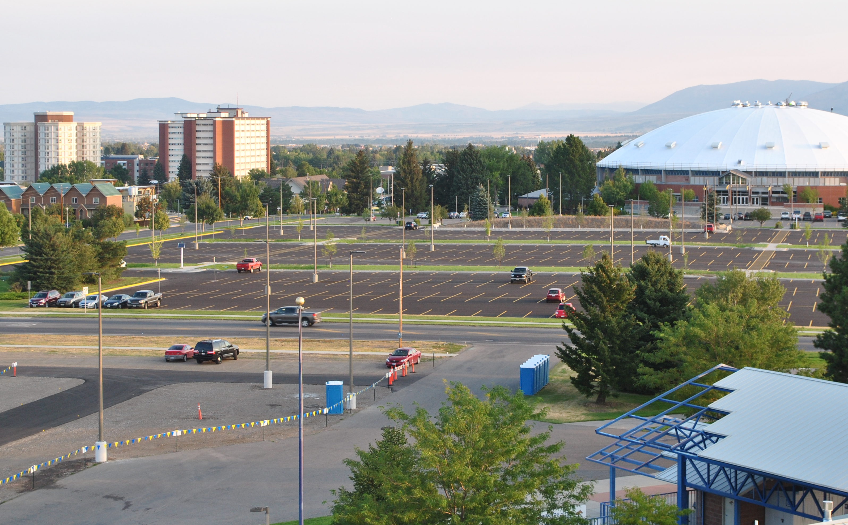
Parking Services - picture
Parking Improvements 2013

Slide 23
Parking Improvements 2013
Campus input last year
  Wanted: More capacity and parking for visitors/special events
  Summer Projects:
  S. Field House Lot: Paved, new lighting (+787 SB & D spaces)
  West Stadium F lot: ~ 500 spaces w/paved drive lanes, lighting and flashing crosswalk
  Enlarged Pay Lot: Added 71 spaces; total now 205. Visitors and special events better accommodated.
  Harrison Street: Repaved w/back-in parking and reconnected with 11th Ave for improved traffic flow

Slide 24
Motor Pool (Transportation Svcs)
MSU Motor Pool replaced by private vendors in August 2013.
  Benefits include lower rates, insurance coverage, increased vehicle choice, and newer vehicles.
Enterprise, National and Hertz (locally and nation-wide).
  Enterprise downtown delivers to the MSU Motor Pool lot
    24 hours notice for a sedan and 48 hours notice for an SUV
    You may park personal cars in the (Motor Pool) lot during rental
    Current pick-up and drop-off is done during business hours
    In late September, Enterprise key boxes will be installed to allow pick-up and drop-off at any time at the Motor Pool lot
Details at http://www.montana.edu/us/fs/motorpool/
    Airport service centers do not deliver to campus and additional fees apply for airport rentals.

Slide 25
Performance Funding
Begin FY15 based on FY13 results
  Two metrics: Completions and Retention Percentages
  Short Term (FY14-15 biennium) only
  $7.5M available (MUS), or ~5% of state allocation
  Long Term Process and Metrics
  Focus groups and surveys this fall
  Metric and process development next Spring
  Help from Complete College America
Website : http://mus.edu/CCM/performancefunding/PerformanceFunding

Slide 26
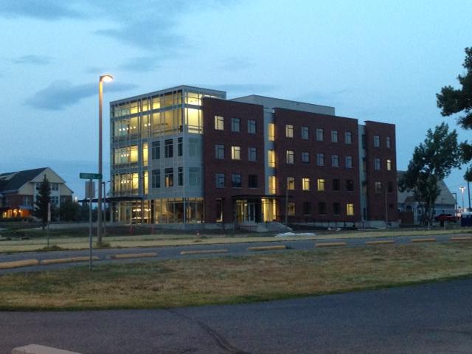
Auxiliary Services
Gallatin Hall
72 beds; Suite style housing
Opened in August 2013

Slide 27
Auxiliary Services
Housing
  Additional bed spaces – Gallatin Hall – 72, Quad F – 21
  Expansion of wireless in residence halls
  Upgraded security cameras
  Academic theme floors
  ADA enhancements to 7th floor South Hedges
Dining: Extend Late Night Bites to midnight
Energy Performance Contracts
  North Hedges Windows
  Expand underground irrigation system to Family/Graduate Housing quadrant

Slide 28
Jointly funded by ASMSU and MSU Administration and Finance, we foster a culture of stewardship and sustainability
Develop, coordinate, and promote campus sustainability goals, projects, and practices.
Support efforts to achieve MSU’s Strategic Plan and our commitment to the American College and University Presidents’ Climate Commitment (ACUPCC).
In collaboration with faculty, staff and students, initiatives include: sustainable food, energy efficiency, waste minimization, and alternative transportation.
Website: www.montana.edu/sustainability

Slide 29
Questions & Answers

Slide 30
Anne Camper
VP Research, Creativity and Technology Transfer

Slide 31
Incentive Program for Researchers
Opportunity for faculty to receive incentives for funded research beginning July 1, 2013
One-time, annual supplement to base salary in November
Write in appropriate effort on grant application for eligibility, at least 10% of effort
Incentive payments are 75% of net recovered salary not to exceed 25% of base salary
Balance of resources remain in the pool to fund researchers where the federal agency has restrictions on the amount of time/effort that can be charged to the grant
For more information, see
http://www.montana.edu/wwwvr/osp/

Slide 32
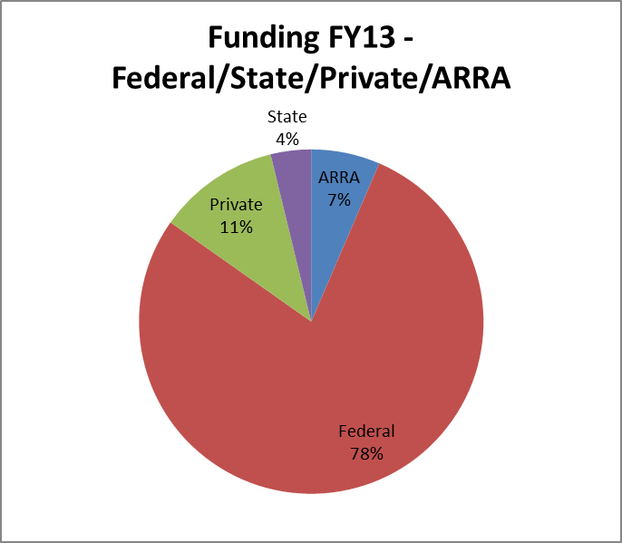

Slide 33
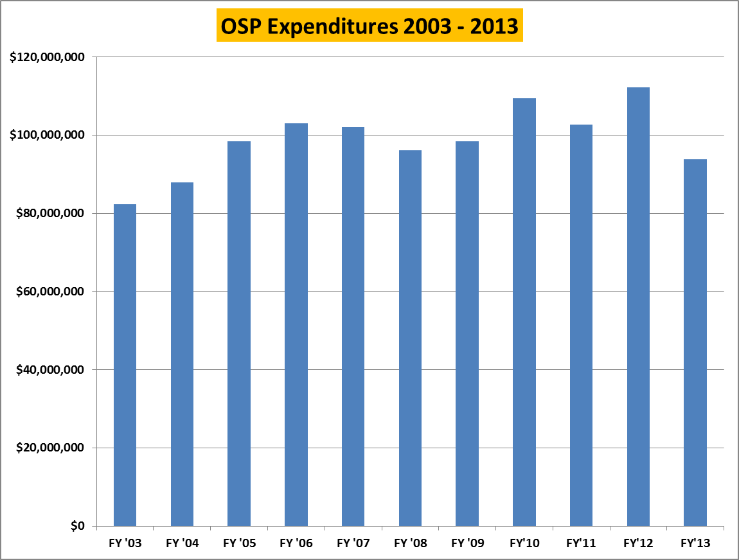

Slide 34
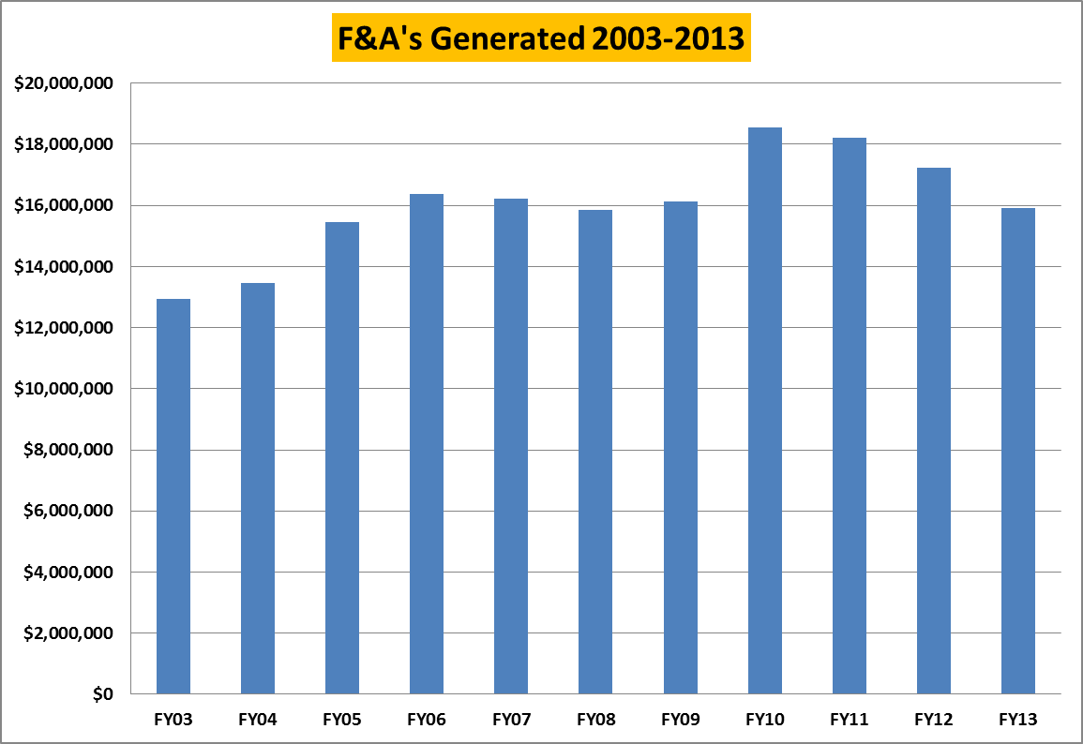

Slide 35
Sponsored Research Proposal and Award Data
’09 ’10 ’11 ’12 ‘13
Proposals 987 974 829 841 902
# PIs 416 397 382 375 369
Total $ 409,556,198 328,999,286 400,732,470 310,849,953 258,231,557
Average $ 414,950 337,782 483,393 369,619 286,288
New awards 353 550 440 454 452
Total new $ 61,868,922 91,192,636 52,220,022 72,272,049 47,295,350
Average award 175,266 165,805 118,682 159,630 104,636
Total expenditures 98,431,691 109,480,398 102,767,291 112,304,270 93,753,058

Slide 38
ADVANCE Project TRACS
The NSF funded ADVANCE Project TRACS was awarded to MSU to broaden the participation of women faculty in STEM and SBS fields at the university.
Approximately 82 MSU faculty involved in ADVANCE award (to date):
On Project Team (directors, co-directors, initiative leaders, teams): 63
Equity Advocates: 19
Over 287 MSU faculty have received assistance from ADVANCE:
Faculty provided assistance to under Research Capacity Initiative: 83
Assistance under Enhancing Work Life: over 130
Assistance under Cultural Attunement: over 74
Number of new faculty hires assisted by ADVANCE (to date):
21 search processes;
13 new STEM/SBS recruits.

Slide 39
WildFIRE-Partnerships in International Research and Education (PIRE)
MSU’s WildFIRE-PIRE project is an NSF funded, 5-year grant to study fire and climate change in sensitive forests in the U.S., Australia, and New Zealand.
At MSU, the WildFIRE PIRE project includes Bruce Maxwell, Dennis Aig, Dave McWethy and Cathy Whitlock, two post-docs, three PhD students, one MFA in the film program, and a large number of undergraduate interns. The WildFIRE PIRE project has included 14 undergrads in overseas internship experiences, including five students from Salish Kootenai College working with us in New Zealand, Australia, and Patagonia.
MSU’s WildFIREPIRE collaborators are from University of Colorado, University of Idaho, the Forest Service, University of Tasmania, Australian National University, Landcare Research (NZ), University of Auckland.

Slide 40
Big Sky Carbon Sequestration Partnership (BSCSP)
BSCSP is supported by the U.S. Department of Energy as one of seven regional carbon sequestration partnerships which engage key stakeholders to help determine or identify the best approaches for permanently storing regional carbon dioxide (CO2) emissions.
Year (MSU FY) | Institution | Faculty / Investigator | Undergrad | Graduate | Professional / Postdoc
2014 | MSU | 5 | 4 | 5 | 9
2013 | MSU | 6 | 9 | 5 | 13
2012 | MSU | 6 | 3 | 1 | 10
2011 | MSU | 2 | 1 | 0 | 6
2010 | MSU | 8 | 2 | 4 | 8
2009 | MSU | 9 | 7 | 4 | 8
2008 | MSU | 4 | 6 | 3 | 10
2007 | MSU | 5 | 9 | 2 | 12
2006 | MSU | 1 | 1 |  | 2
Cumulative/Unique | MSU | 46 / 16 | 42 / 31 | 24 / 13 | 78 / 25
 | Other | 31 | 18 | 17 | 3
Other institutions include LANL, INL, PNNL, LBNL, University of Wyoming, Washington State University, Columbia University, Idaho State University, Oregon State University, Vecta Oil & Gas and Schlumberger Carbon Services
Notes:
MSU numbers are taken from Banner counting personnel supported under project SL numbers so they should be very accurate. Cumulative / Unique gives total person-involvement years (sum of column) which counts an individual for each year they are involved / Unique individuals (e.g. if student x was supported in three years, she is only counted once). Identification of personnel type for other institutions is difficult, but these numbers should be close to correct.

Slide 41
Questions & Answers

Slide 42
Jill Martz
Director, Extension

Slide 43

MSU Extension
Across Generations, Across Montana
Role and Structure
Program Areas
Challenges and Opportunities

Slide 44
What is MSU Extension?
MSU Extension is a statewide educational outreach network that applies unbiased, research-based university resources to address community needs.
The Extension network connects researchers and educators on the MSU campus with local MSU faculty serving every county and reservation.

Slide 45
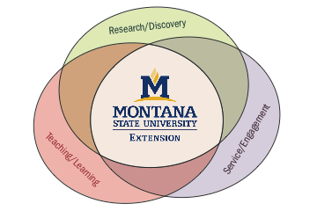
Extension and the Land Grant University
The U.S. Congress created Extension to share the knowledge of the university with the people.
Extension integrates learning, discovery and engagement through the work of campus and field faculty.

Slide 46
How is Extension Unique?
All land grant universities in the United States and its territories have an Extension program.
Extension is funded through federal, state and local governments.
Extension is focused on serving all people wherever they may live or work.

Slide 47
Program Areas
Agriculture and Natural Resources – increasing profits, reducing loss, a safe and sufficient food supply, environmentally sound and sustainable best practices
Community Development – local governance, strategic planning, leadership development, community foundation education, community health
Family and Consumer Sciences – family economics, food and nutrition, human development, consumer decision-making, housing and environmental health
4-H Youth Development – healthy living, science and citizenship through programming focused on life skill development, leadership and civic engagement

Slide 48
Challenges and Opportunities
Funders expect accountability and are asking for impact data to justify their decisions.
Approximately 40% of the faculty are eligible to retire and another 33% are early (< 5 years) in their career.
The demographics and industries of the state are changing and Extension must adapt to remain relevant and meet the needs of local communities.

Slide 49
How Can You Learn More?
Contact campus specialists or county and reservation Extension offices.
Take part in one of the many programs offered.
Like MSU Extension on facebook.
Go to the website (msuextension.org)
Explore the many publications and other resources available to you.

Slide 50

1914-2014
Join MSU Extension in celebrating
100 years of integrating
learning, discovery and engagement

Slide 51
Questions & Answers

Slide 52
Chris Fastnow
Director, Planning and Analysis

Slide 53
Planning
Strategic Plan
  Semi-monthly updates
  Year One Report
  Budget Alignment
Planning Council
  Assess coverage
  Monitor progress

Slide 54
Mountains & Minds:
Learners and Leaders
Montana State University, the state's land-grant institution, educates students, creates knowledge and art, and serves communities by integrating learning, discovery and engagement.
Learning
Discovery
Engagement
Integration
Access
Stewardship

Slide 55
Planning
Strategic Plan
  Semi-monthly updates
  Year One Report
  Budget Alignment
Planning Council
  Assess coverage
  Monitor progress

Slide 56
SP Goal Learning Metrics Update
Metric |  | 09-10 | 10-11 | 11-12 | 12-13 |  | Target |  | Progress
L.1.1 | Mastery of disciplinary knowledge as developed in departmental learning assessment plans | plans in place |  | plan improvement |  |  | Achieve targets |  | ↑
L.1.2 | University measures of undergraduate student mastery of critical thinking, oral communication, written communication, quantitative reasoning, understanding of diversity and understanding of contemporary issues in science will be developed by 2014. Targets set in learning assessment plans will be met by 2019. |  |  | Redefined outcomes, began assess |  |  | Develop measures by '14, meet targets by '19 |  | ↑
L.2.1 | Bachelor Graduation Rate (entering cohort from 6 years prior) | 48% | 47% | 51% | 49% |  | 65% |  | ↓
L.2.2 | Graduate Degrees Awarded (Summer, Fall, Spring) | 485 | 519 | 548 | 591 |  | 625 |  | ↑
 | Doctoral Degrees Awarded (Summer, Fall, Spring) | 45 | 45 | 56 | 53 |  | 80 |  | ↓
L.2.3 | Associate Degrees Awarded (Summer, Fall, Spring) |  |  | 9 | 31 |  | 70 |  | ↑
 | Workforce Certificates Awarded (Summer, Fall, Spring) |  |  | 13 | 20 |  | 65 |  | ↑
L.2.4 | FTFTF Retention Rate (entering cohort from prior Fall) | 72% | 74% | 74% | 74% |  | 82% |  | ↔
L.3.1 | Employed in Major Field or Position of Choice (one year post-grad) | 57% | 66% | 63% | 64% |  | 70% |  | ↑
L.3.2 | Graduate School Enrollment (one year post-grad) | 20% | 25% | 22% | 18% |  | 25% |  | ↓
Sources: MSU Office of Planning and Analysis, OCHE Student Data Warehouse, Career Services Career Destinations Survey, Provost's Office

Slide 57
Planning
Strategic Plan Progress
  Semi-monthly updates
  Year One Report
  Budget Alignment
Planning Council
  Assess coverage
  Monitor progress

Slide 58


Slide 59
Planning
Strategic Plan Progress
  Semi-monthly updates
  Year One Report
  Budget Alignment
Planning Council
  Assess coverage
  Monitor progress

Slide 60
Budget Alignment Examples
Learning Budget alignment (2012–13 investments unless otherwise noted)
$3.1 million in new tenure-track faculty lines in 2011–12 and 2012–13
$1.4 million for additional class sections to serve growing enrollment in 2011–12 and 2012–13
$25 million gift to fund construction of new Jake Jabs College of Business and Entrepreneurship and develop new College programs
$150,000 to support strategic investment proposals for math, statistics, and chemistry instructional redesign and enhancement
$455,000 for Office of Student Success programs like Smarty Cats tutoring, financial literacy, and career coaching
$1 million in renovated classroom and collaboration spaces

Slide 61
Budget Alignment Examples
Discovery Budget alignment (2012–13 investments unless otherwise noted)
$3.1 million in new tenure-track faculty lines since 2011 (also supports the Learning goal)
$1.5 million in additional salary and research support to retain MSU’s talented faculty
$6.3 million in new faculty startup packages
$325,000 allocated for 2013-14 for 18 new competitively awarded graduate assistantships, plus $170,000 awarded in strategic investment proposal process for enhanced graduate recruiting and 11 additional graduate assistantships in specific programs
$80,000 for Native American graduate students in science and engineering

Slide 62
Planning
Strategic Plan Progress
  Semi-monthly updates
  Year One Report
  Budget Alignment
Planning Council
  Assess coverage
  Monitor progress

Slide 63
…and Analysis
OPA Functions
  Maintain databases for official university reporting
    Data Governance
  Respond to Federal and State requirements, external requests
    Compliance
  Provide internal decision support
    Historic trends, comparisons, predictive modeling
Plans for this year
  Improved communication of available data
  Build on predictive analyses
  Additional data collection, mining, and modeling efforts

Slide 64
Questions & Answers

Slide 65
Lindsay Murdock
ASMSU President and
Lucas Smith
ASMSU Vice President

Slide 66
Who is ASMSU?
We are the Student Voice of Montana State
Admin Team
Senate
Programs

Slide 67
2013-2014 Initiatives
1. Inclusivity
  a. Equal Work/Equal Pay
  b. Mental Health Awarness
  Engagement
  a. Monday’s on the Mall
  b. Say Yes
  Sustainability
  a. Smart Building Intiative
  b. Financial Literacy

Slide 68
Thank You!
We’re looking forward to working with you!
Please contact us with any questions – our doors are always open
Lindsay
994-6861
asmsupres@msu.montana.edu
Lukas
994-6862
asmsuvp@msu.montana.edu

Slide 69
Questions & Answers

Slide 70
Robert Marley
Interim VP for Student Services

Slide 71
Outline
Where we have been
Where we are now
Where we are going
Share brief “stories of success”
Answer your questions

Slide 72
Division of Student Success
Circa 2011-12
Activities and Engagement
Admissions
Athletics
Auxiliary Services
Career, Internship & Student Employment Svcs.
Counseling & Psychological Services
Dean of Students
Disabled Student Services
Diversity Awareness Office
Family & Graduate Housing
Financial Aid Services
Fraternity & Sorority Life
Health Promotions
Office of Student Success
Rec’l Sports & Fitness
Re-entry Student Services
Registrar
Resident Life
Rodeo
Sports Facilities & Events

Slide 73
Division of Student Success
Circa 2011-12 (continued)
Strand Union Building
Student Health Services
TRIO Student Support
University Food Services
Veteran’s Services
VOICE Center
Women’s Center
Return-to-Learn
Smarty-Cats Tutoring
Champ-Change

Slide 74
Division of Student Success
Today—Where We Are
Admissions
Career, Internship & Student Employment Srvc.
Counseling & Psychological Services
Dean of Students
Disability, Re-entry & Veteran’s Services
Financial Aid Services
Registrar
Student Health Services
Bobcat Rodeo
Office of Student Success

Slide 75
Division of Student Success
“Stories of Success”
Consulting report to a major university regarding student recruitment (2012):
  Every university struggling to stay ahead of peers
    “bar” continually raised
  60% actively trying to grow size of 1st Year class
  60% want more academically talented students
  Want increase in retention and persistence rates
  Increase ethnic, gender and geographic diversity

Slide 76
Division of Student Success
“Stories of Success”
MSU Story in 2013-14:
  Largest historical enrollment
  Largest 1st year class
  Largest % of MT High School students
    MT resident enrollment grows overall
  Dominatingly large % of MUS scholarships
  Non-resident 1st year class continues to grow
    46 states and 19 countries (2013 entering)
    WA, CA, CO, and MN largest “feeder states”
  Average ACT of MSU students is 25.2

Slide 77
Division of Student Success
“Stories of Success”
MSU Story (continued):
  Total aid available to students at $120M
    Increase by $7M in 2 years
  Veterans expected to increase
  Under-represented minorities continue to grow
  Student participation in co-curricular and engagement activities continues to rise
  Retention and graduation rates expected to improve

Slide 78
Division of Student Success
“Stories of Success”
MSU has become that “University of Choice”
  Have set the bar for many of our peers
But, competitive environment continues to change
  Students applying to more institutions
  “double-booking” to maintain options while shopping for better scholarships, etc
  Ave Discount Rate nationally is 37%

Slide 79
Division of Student Success
“Stories of Success”
“I met you on the Montana schools tour a few summers ago. I wanted to give you a heads up that I am still so excited to convey to our CO students how excellent an opportunity Montana State is. I profile it as one of the ‘hidden gems’ relatively close to us in a college night break-out. Particularly for STEM-based students. I think your school is hard to beat.”
--Colorado HS Counselor to Ronda Russell
Sept 10, 2013

Slide 80
Division of Student Success
Where We Are Going
In addition to the competitive environment for students, increased concerns nationally and locally for:
  Improved retention
  Improved graduation rates
  Improved student welfare & safety
  Control or reduce indebtedness

Slide 81
Division of Student Success
Where We Are Going
Student welfare and safety
  New Associate Dean of Students for Student Welfare—Dr. Aaron Grusonik
Financial Welfare
  Increased scholarships and efficiencies in delivery
  Financial literacy program
Retention and graduation rates
  Multiple intervention programs
  Strategic Enrollment Management function

Slide 82
Division of Student Success
Where We Are Going
Pledge to work towards greater coordination of student affairs with academic affairs
Continue building Student Centered university
  Problem solving via student interests, not our convenience
Very skilled and dedicated professionals at your service

Slide 83
Division of Student Success
Where We Are Going
Student
Faculty
Student Success Professionals

Slide 84
Questions & Answers

Slide 85
Robert Mokwa
Chair, Faculty Senate
Michael Reidy
Chair – elect, Faculty Senate

Slide 86

Faculty Senate
Goals and plans for this year

Slide 87
Input from faculty…
All-Faculty Meeting: May 6, 2013
Carnegie Tier 1 status – sustain and enhance
Salary related issues
Strategies to address enrollment growth
Performance base funding
Transition from CBA to Faculty Handbook
Notes:
3 votes per attendee
264 votes total
176 in top 5, which is 67% of total votes
27 topics identified

Slide 88

How can we most effectively
address these critically
important issues on
our campus?

Slide 89
Shared Governance
We share in the planning and the decision-making process of the university.

Slide 90
Upcoming Activities and Topics
Financial planning in the office of research
Faculty Salaries
Metric S.1.2: “By 2019, increase the average MSU faculty and administrative salary to at least 80 percent of the representative peer market average.”

Slide 91
Activities and Topics - continued
Strategic planning: address growth and future direction of MSU
Academics: new courses and programs

Slide 92

Upcoming Topics - continued
Transition from union contract to a shared-governance relationship with administration and OCHE
Performance base funding, Complete College America, US President’s College Affordability Plan
Outcomes Based Funding

Slide 93
Thank You!

Slide 94
Policies Under Development
Expedited tenure review
Faculty pursuing a degree at MSU
Regents professor policy
Sabbatical process
Credit hour policy
Faculty Handbook Updates

Slide 95
Questions & Answers

Slide 96
Adam Edelman
Interim Chief Information Officer

Slide 97
New MSU Mobile Application
Integrated applications for students
Launched this Fall

Slide 98
New IT Service Desk
New location: 1st floor Renne Library
Improved Service

Slide 99
Login Simplification
Single Unique Username: NetID
Timeline

Slide 100
Email Upgrade
Office 365 Migration
Timeline

Slide 101
Stay Updated
www.montana.edu/mobile
www.montana.edu/loginsimplification
www.montana.edu/wifi
www.montana.edu/pmo

Slide 102
Questions & Answers

Slide 103
Leslie Taylor
University Legal Counsel

Slide 104
LEGAL COUNSEL REPORT
Recent OCR Guidance on Title IX and Pregnant Students and the Violence Against Women Act

Slide 105
Title IX and Pregnant Students
On June 25, 2013, the US Department of Education issued a “Dear Colleague Letter” addressing the academic success of pregnant and parenting students.

Slide 106
Title IX
Prohibition against discrimination; exceptions. No person in the United States shall, on the basis of sex, be excluded from participation in, be denied the benefits of, or be subjected to discrimination under any education program or activity receiving Federal financial assistance.

Slide 107
Title IX Regulations
Montana State University, as a recipient of federal funds:
shall not apply any rule concerning student's actual or potential parental, family, or marital status which treats students differently on the basis of sex.
Shall not require a physician certification that student is able to participate unless required of all students for all conditions requiring physician attention.

Slide 108
Title IX Regulations
shall not discriminate or exclude from program or activity on the basis of pregnancy, childbirth, false pregnancy, termination of pregnancy or recovery therefrom.
shall treat pregnancy, childbirth, false pregnancy, termination of pregnancy and recovery therefrom as justification for leave of absence for so long a period of time as is deemed medically necessary by the student's physician, at the conclusion of which student shall be reinstated to status held when leave began.

Slide 109
Violence Against Women Act [VAWA]
New reportable crimes under the Clery Act:
Dating violence
Domestic violence
Stalking

Slide 110
Written Notification to Victim
Importance of evidence preservation
Reporting Options available: Notify Police; Receive Assistance in Notifying Police; Decline to notify police
Victims rights to and information about protective and restraining orders, etc.
Counseling, victim advocacy, legal assistance

Slide 111
Reporting
Refer students to VOICE Center and
Report to Office of Institutional Equity
Will assure that students get required written notification.

Slide 112
Questions & Answers

Slide 113



2013 Legislative Overview
MSU Town Hall Presentation
September 11, 2013
Office of the Commissioner of Higher Education

Slide 114
College Affordability Plan (CAP)
An agreement between the Governor and the MUS to implement a resident-student tuition freeze for the 2014 and 2015 fiscal years.
Contingent upon funding from the MT Legislature
  HB 2, the state general fund appropriation act, provides an increase of $28.2 million in present law adjustments to MUS Education Units, Total = $34 million
  HB 13, the state employee pay plan, $5.3 million in FY 2014 and $13.4 million in FY 2015. Total = $18.7 million

Slide 117
Performance Funding
Addendum to the CAP agreement committing the MUS to allocating a portion of the state appropriation in the 2015 biennium based on progress made toward increasing college completions
  All nine members of the Joint Appropriations Subcommittee on Education also signed the addendum.
Allocation performance funds in the 2nd year of the biennium in an amount equal to 50% of the present law adjustment in FY 15 (approx. 5% of the base funding in HB 2 for that year equaling $7.5 million).
UPDATE: BOR approved a short-term performance model in May, for the allocation of funds in FY15.
    The MUS will spend 2013-14 engaging faculty and staff in the development of a longer-term model.
    Go to www.mus.edu/ccm for more information

Slide 118
System Initiatives
Total Funding = $7.5 million
Veterans Success - $1 million (OTO)
Workforce Development & 2-year Education: $1 million (OTO)
WWAMI Expansion: increase slots in WWAMI from 20 to 30. = $908,174 (biennial)
Veterinary Medicine: a joint program between MSU and WSU = $1 million (OTO)
Energy & Natural Resources Doctoral Program: collaborative Materials Science doctoral program with Montana Tech, UM, MSU = $600,000 (OTO)

Slide 119
System Initiatives (cont.)
Total Funding = $7.5 million
Medical Residency Expansion: = $400,000 (biennial)
Community College Workforce Development: = $1 million (OTO)
MSUN Bio-energy Research Center: = $400,000 (OTO)
Increase Tribal College Assistance: = $368,884 (OTO)
Extension Service-Local Government Center: = $200,000 (OTO)
Coal & Mine Data Records: = $600,000 (OTO)

Slide 120
Long-range Building Projects
Total Appropriation = $53.9 million
Authority Only = $51.5 million
Building Projects
Missoula College, UM Missoula, $29M
Health & Science Building Renovation, MSU Billings $10M
Automotive and Diesel Technology Building, MSU Northern, $4.9M
Main Hall Renovation, Phase 3, UM Western, $4M
Replace Roof and Other Renovations, Great Falls College MSU, $1M
Natural Resource Center Addition, MT Tech, $5M
Authority Only Projects
MSU, Jabs Hall, $20M
UM, Athlete Academic Center, $2.5M
UM, Gilkey Executive Education Center, $9.3M
UM, Mansfield Library Student Success, $3.2M

Slide 121
Other Legislation
SJ 13- Request MUS to study college completion (see Complete College Montana slides)
HB 286- Requests MUS to expand American Indian tuition waivers to include enrolled members of state or federally recognized Indian tribes in Montana, regardless of blood quantum.
HB 317 - Veterans’ Credit for Prior Learning
HB 377 & 454- Increase contributions and funding for TRS and PERS, Appropriates $1,554,530 to MUS for retirement benefits.
HB 240- Clarify constitutional provisions and law related to board of regents/u-system; a.k.a. Guns on Campus, VETOED

Slide 122
Complete College Montana
On August 19th, Governor Bullock committed Montana to the Complete College Montana initiative.
  This initiative is:
  Aimed at increasing the number of Montanans who earn college degrees and certificates.
  Designed to develop specific strategies that move Montana forward in reaching the goal the Governor established for increasing the percentage of Montanans’ with a higher education credential from 40% to 60%.
  Supported by Complete College America – a nationwide, non-profit effort involving an alliance of 34 of other states.

Slide 123
Complete College MT -- Strategies and Plans
Immediate Areas of Focus in Montana
Implement Performance Funding.
  FY 15 short-term model approved by the Board of Regents
  The MUS will use the 2013-14 academic year to engage faculty and staff in the development of a longer-term model.
  MUS Performance Funding Website
Reform Developmental Education.
  Developmental Education Taskforce studied remediation and brought recommendations for Board of Regents in May 2013
  The MUS will use the 2013-14 academic year to begin implementation of recommendations.

Slide 124
CCM Strategies and Plans
Immediate Areas of Focus in Montana
Increase Dual Enrollment Opportunities.
  Utilizing funding from the 2013 Legislature to grow dual enrollment opportunities.
  Market tuition reduction and elimination of fees incentive created by Board of Regents to improve student/parent awareness and participation.
Create Guided Pathways and Academic Maps.
  Expand on Big Sky Pathways
  Create articulated pathways from 2 year to 4 year campuses for specific majors.
  Degree Audit system

Slide 125
CCM Strategies and Plans
Immediate Areas of Focus in Montana
Measure Progress and Outcome Metrics.
  Utilize Complete College America metrics for SJ 13
  CCA metrics will be disaggregated by campus, full-time/part-time, age, race/ethnicity, gender, Pell status, remedial status, transfer students)
OUTCOME METRICS
Degree Production
Graduation Rates
Transfer (2yr to 4yr)
Credits/Time to Degree
PROGRESS METRICS
Enrollment in Remedial
Success in Remedial
Success in Gateways
Credit Accumulation
Retention Rates
Course Completion
CONTEXT METRICS
Enrollment
Completion Ratio

Slide 126
CCM State Team
State Liaison
Tyler Trevor, Associate Commissioner for Planning & Analysis
State Higher Ed Executive Officer
Clayton Christian, Commissioner of Higher Education
Governor's Education Policy Advisor
Shannon O’Brien
4-year Higher Ed. Representatives
Royce Engstrom, UM President; Waded Cruzado, MSU President
2-year Higher Ed. Representative
John Cech, Deputy Commissioner for 2-year Education
Legislator
Senator Taylor Brown

