Slide 1
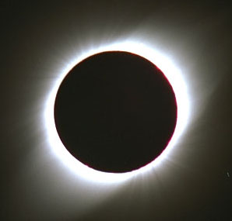
The story of Einstein, imagination, and the Eclipse Ballooning Project
OSP Round Table
April 11th, 2017
Notes:
And, But, Therefore
Conflict: 26% public
Heart: once in a lifetime; live
Narrative: perspective – make emotional
Arc: ordinary world, flawed protagonist, event, take stock, commit, stakes raised, learn, stop antagonist, achieve goal

Slide 2
What is solar physics?
Notes:
My background is solar physics. This background definitely influenced why I ended up leading a national eclipse project for NASA. I want to change your mental model about what the sun is. Won’t accomplish that well with a typical scientific presentation so show you a great video made by an MSU alum. The video has been viewed by over 5 million people. This is probably what the majority of you first picture when you think of the sun. Let’s change that.

Slide 3
Stories
Einstein
Eclipses
Eclipse ballooning
Where you can see the eclipse and why totality is totally the way to go
Notes:
Now that I’ve gotten off my soap box and hopefully changed your mental model of the sun, what I’d like to do today is tell you a few stories.

Slide 4
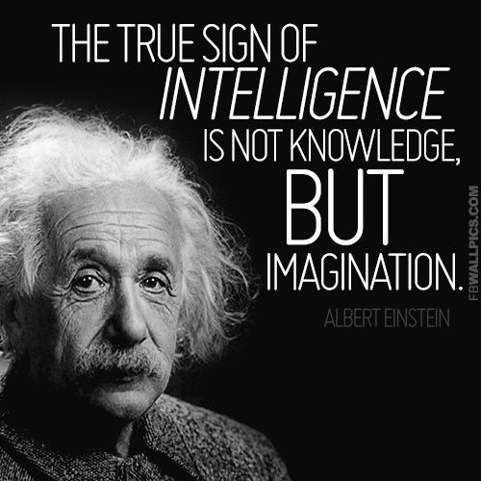
Notes:
Einstein was an incredibly creative thinker, innovator, hard worker.
But did you know that at first, everyone thought Einstein was crazy?

Slide 5
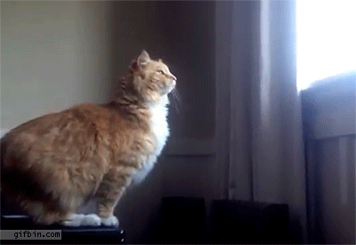
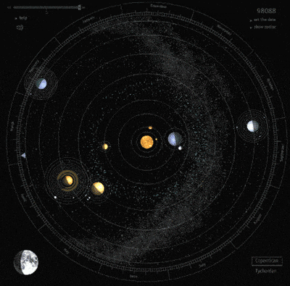
Famous eclipses: Einstein and General Relativity
Notes:
Einstein gave us a new way to think about gravity. What holds us firmly to the ground [CLICK], (or pulls us towards the ground as this cat is finding out), keeps our planets in orbit around our sun [CLICK} and our sun around the galaxy [CLICK] can all be described by warps and curves in the fabric of space (or spacetime). [CLICK]

Slide 6
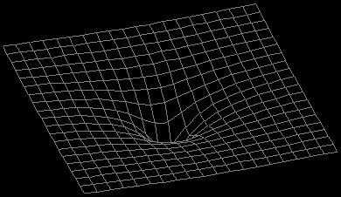
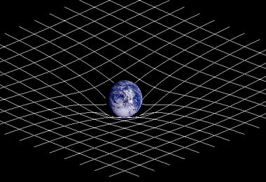
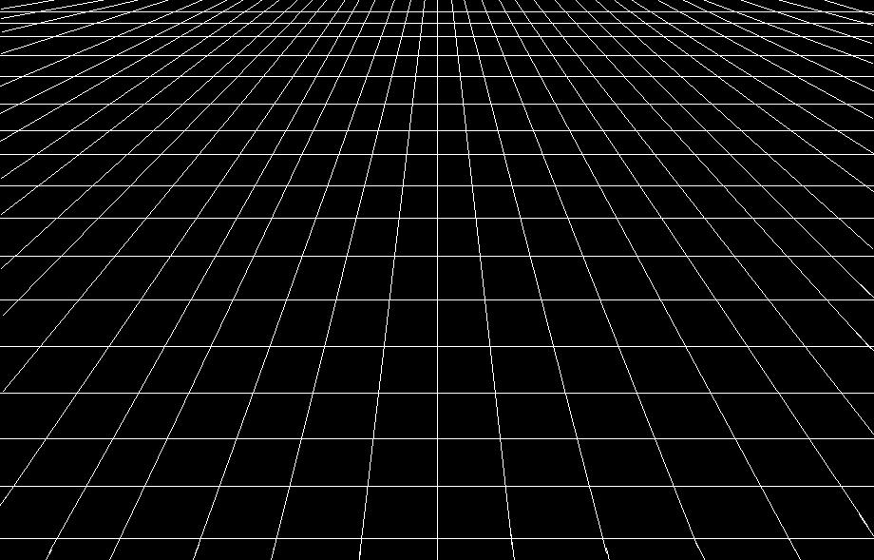
Einstein and General Relativity
Notes:
Einstein predicted that mass warps the “fabric” of space (spacetime), but how do you test something like the warping of space? [CLICK]
Light travels in straight lines, and what is a straight line on a warped surface? A curve! [CLICK] Einstein predicted that light would bend around massive objects as light follows a straight path within the curved space (spacetime)

Slide 7
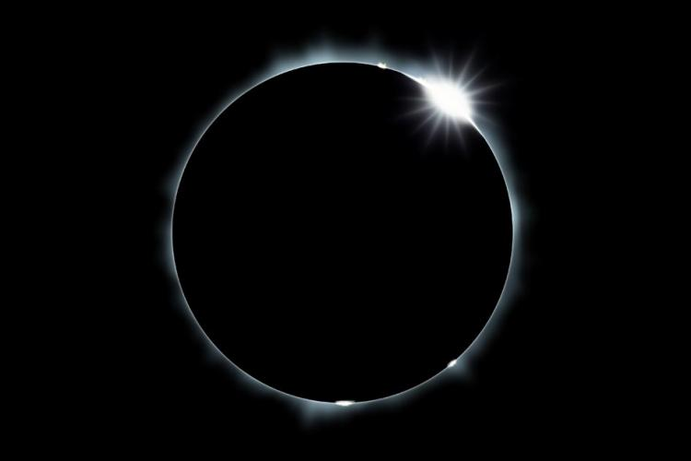
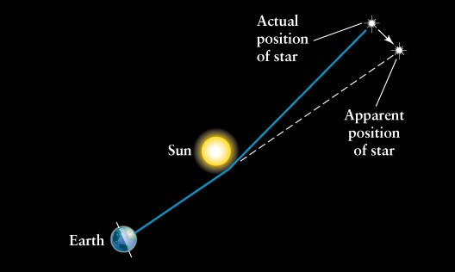
Testing General Relativity
Notes:
Gravitational lensing
In order to observe the change in the background stars apparent position, something about the Sun’s angular size must block the Sun’s light… Enter: Total Solar Eclipse

Slide 8
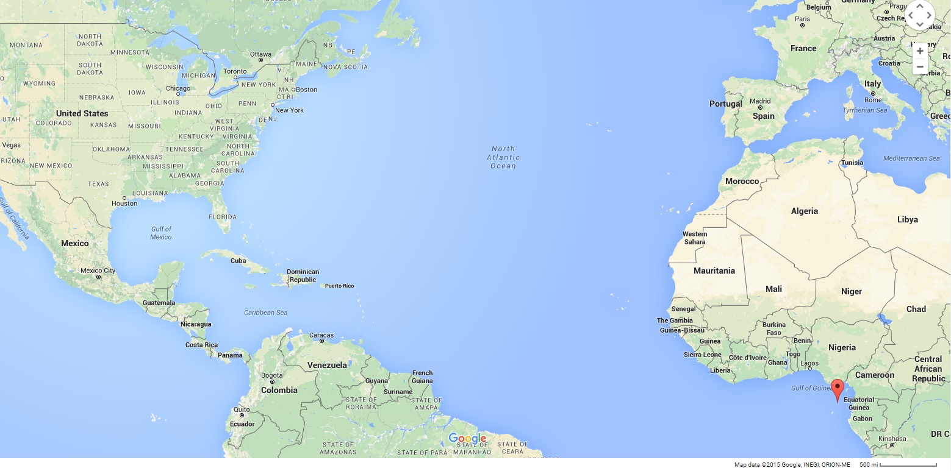
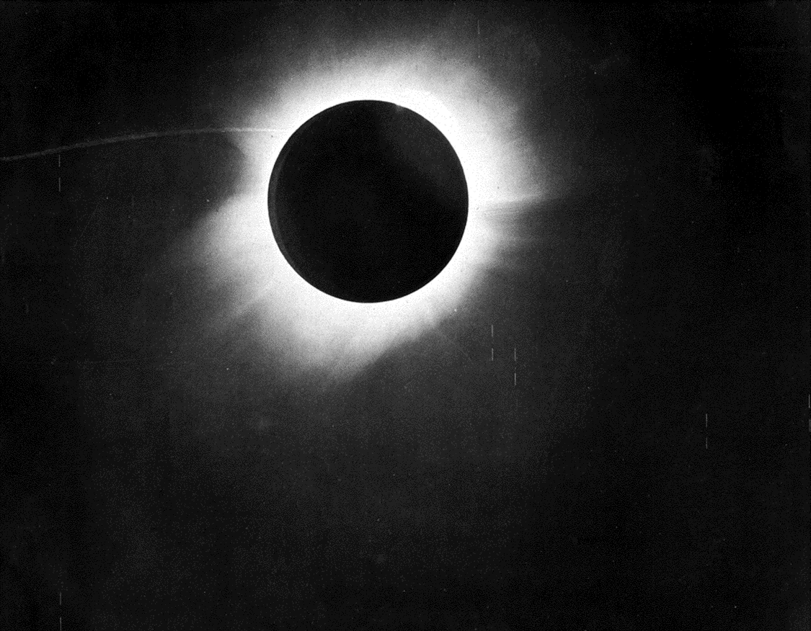
The African Island Principe, 5/29/1919
Notes:
The results of the experiment were consistent with Einstein’s theories about gravity and brought Einstein from a nobody into instant fame.

Slide 9
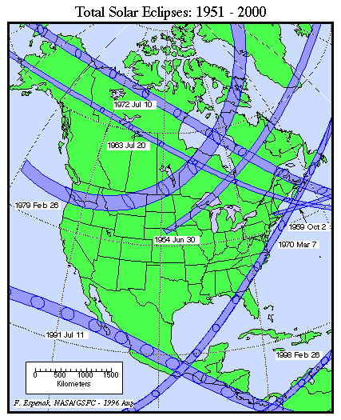
Notes:
That was 1919. Let’s move forward in history to the last total solar eclipse in the contenental US.
Raise your hand if you’ve seen a total solar eclipse in person. Keep raised if this had a profound impact on you. Last cross country in 1918. Last in continental US 1979. Think about the difference in our culture since then!

Slide 10
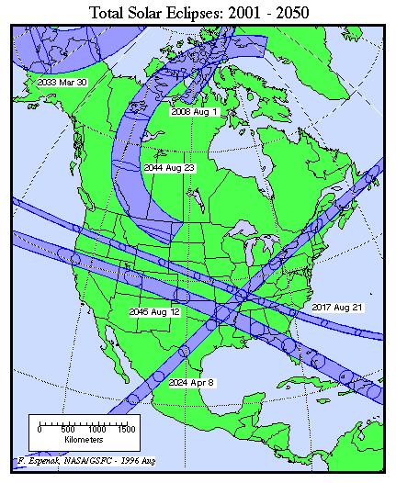
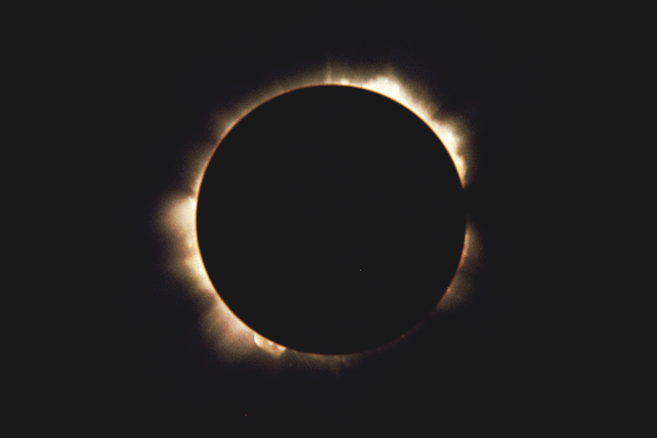
After nearly 4 decades
Notes:
Can see here the 2017 eclipse path
Also mention just 7 years later, US again!
Nearly 40 years; why so rare??

Slide 11
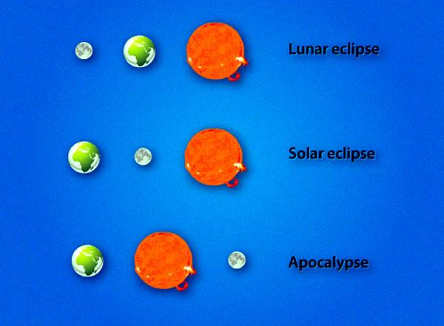
Notes:
Start with the basics.
But seriously – why ARE TSE so rare? When moon is between us and sun. Happens every new moon. Why not TSE every new moon? To explain, dance.

Slide 12
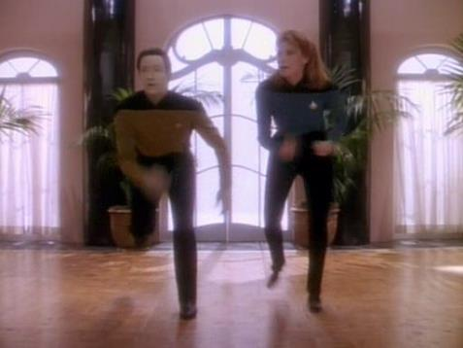
Sun, Earth, Moon dance
Notes:
Imagine beautiful E; Bozeman on chest; how long rotate once? Go direction. Not straight. Angle? North? Bend. Goofy – picture. Try again more accurate. Sit. Add Sun and Moon (flashlight). Thumbs up. Moon between. Phase? How long M around E? Direction? Orbit to opposite. Phase? To right. Phase? What side lit up? Orbit other side – what side lit? Cool piece of knowledge – could memorize. BUT could use mental model (IMAGINATION!) just created to figure out. Works to figure out many other things as well. Challenge? Stand back up. All facing sun, what time in Bozeman? Rotate until sun just sets. Where is full moon w/ respect to sun and E again? So Sun setting, Moon rising. Hand down. Rotate to midnight. What phase rising at about midnight? Waning half. Sit. Use model to get at why eclipses so rare. Sun, close one eye, block source of light w/ thumb. Move up 2 inches. Still? No. Main reason no eclipse every new moon.

Slide 13
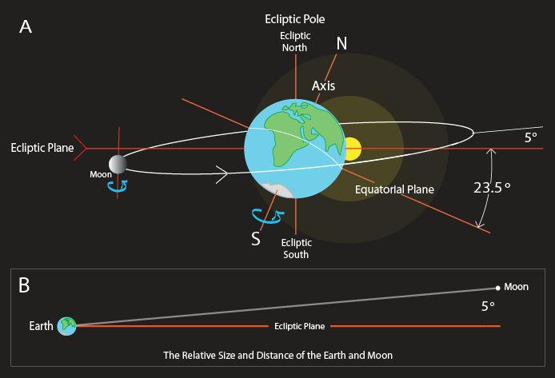
Notes:
Node ecliptic - orbit tilted angle 5%; The plane of the lunar orbit precesses in space and hence the lunar nodes precess around the ecliptic, completing a revolution in 18.6 years

Slide 14
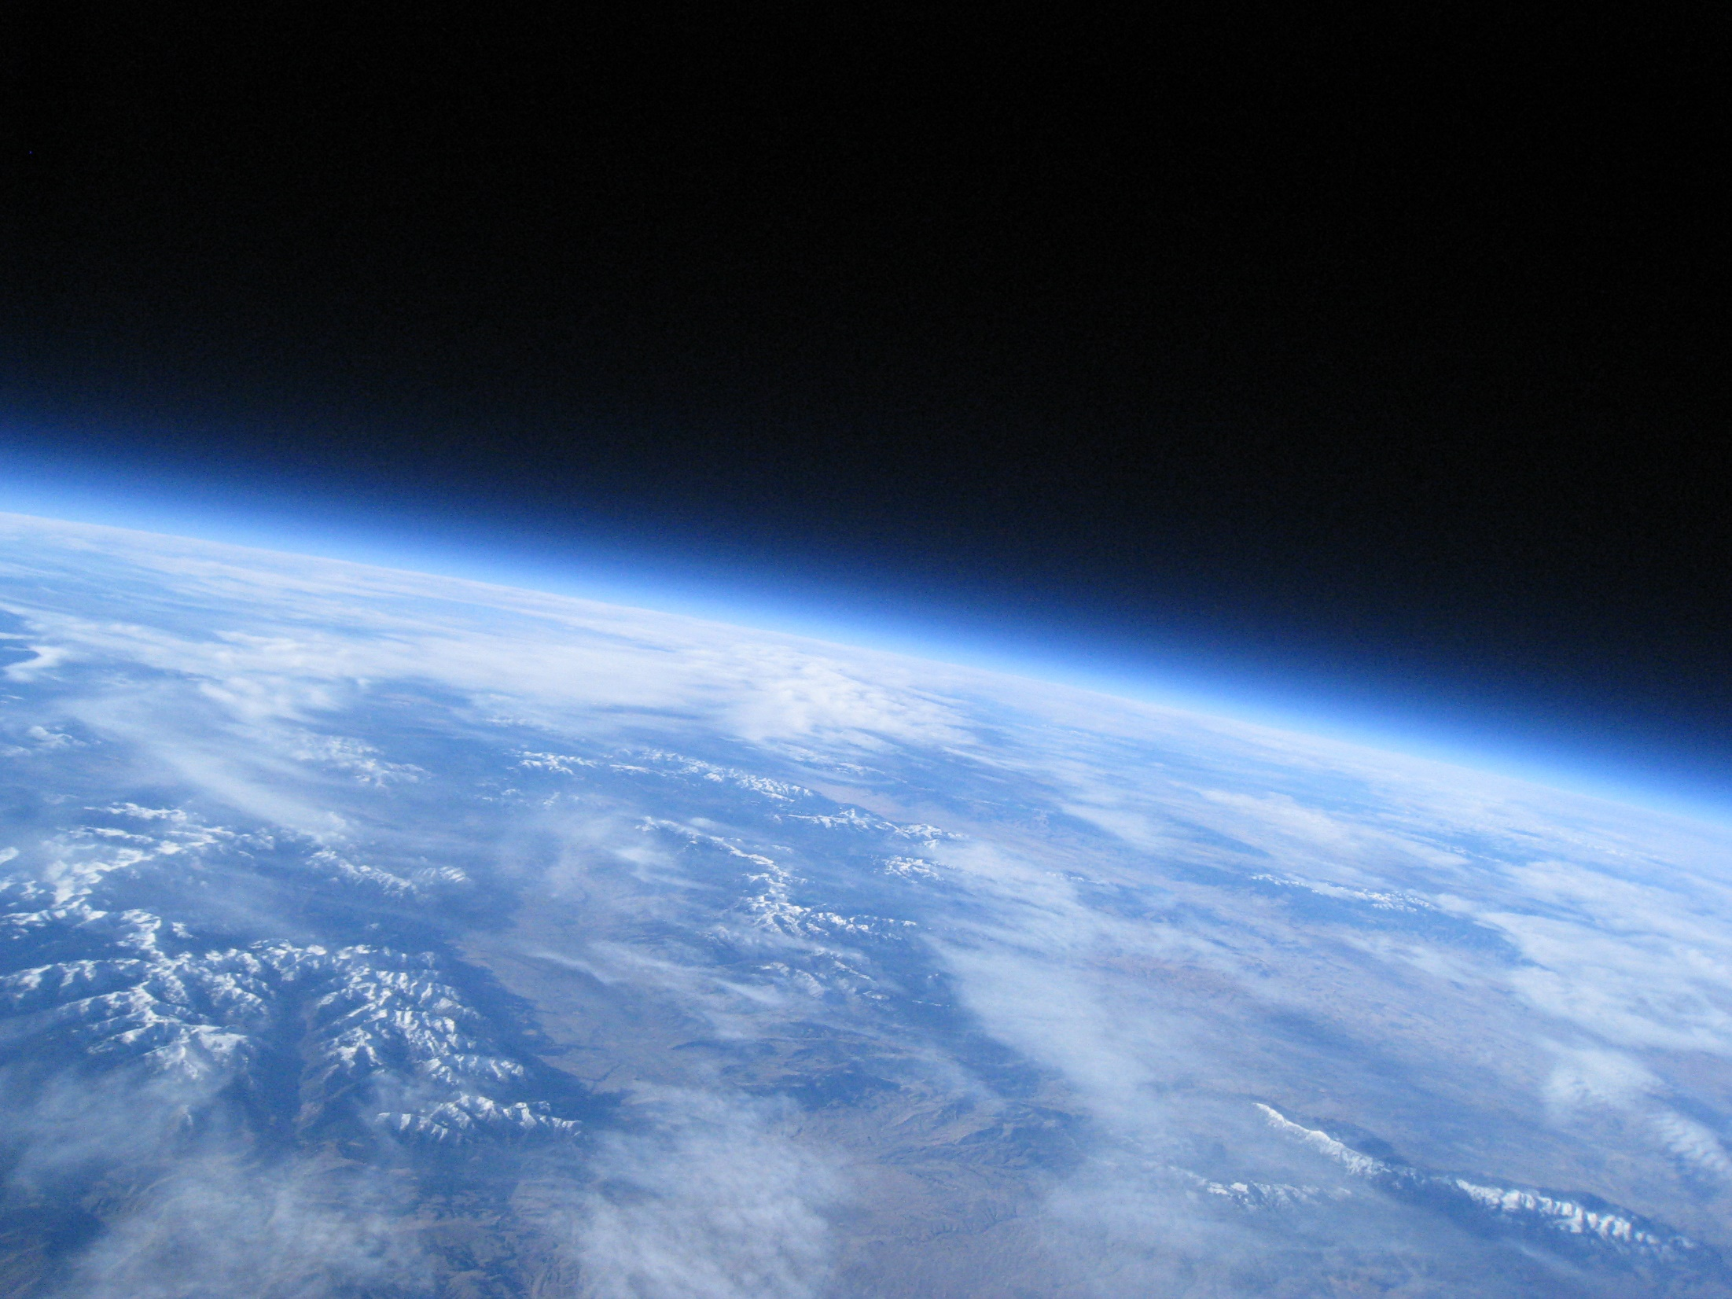
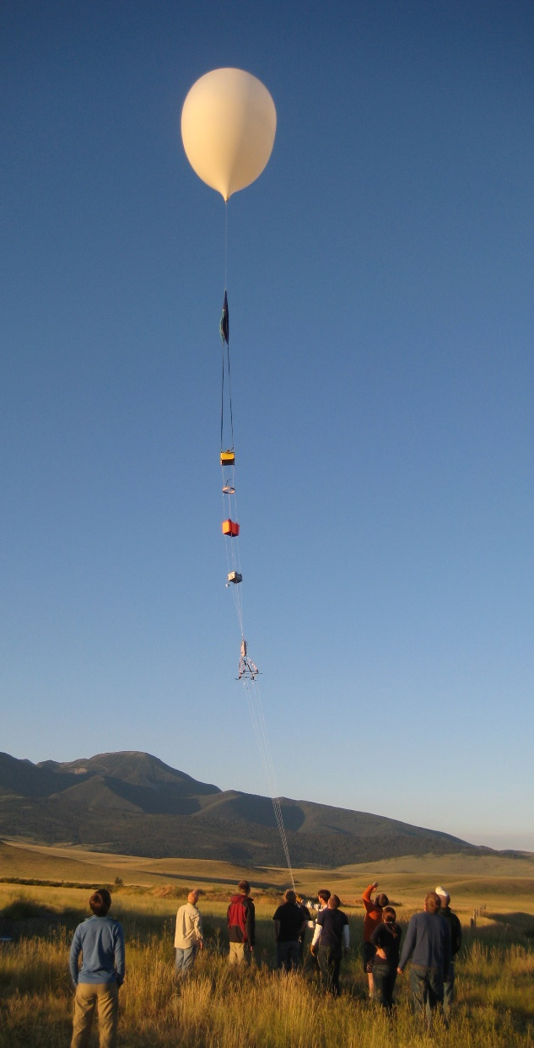

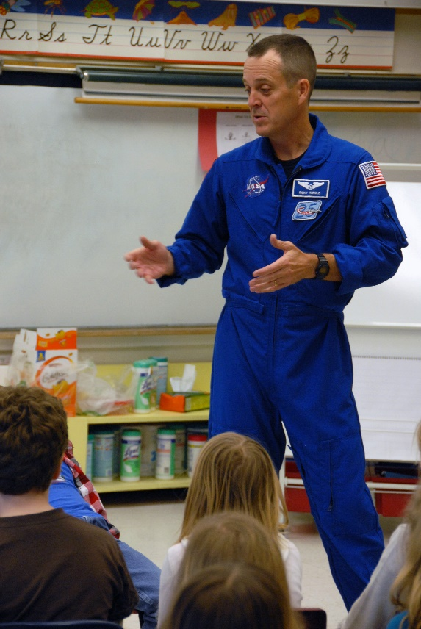
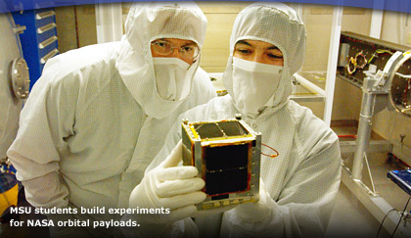
Montana Space Grant Consortium
Notes:
Space grant in every state

Slide 15
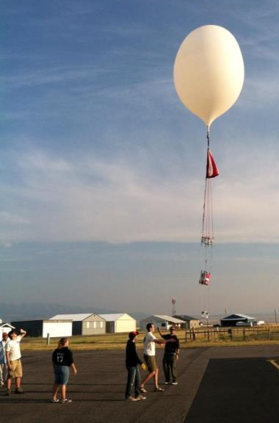
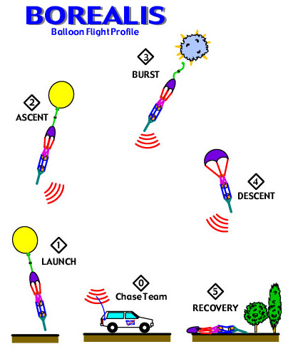
High Altitude Ballooning
Space-like environment
Mission-like
Multidisciplinary
100,000 feet up; flights last ~2 hours
Typical high altitude balloon flight
Notes:
If cool from a plane, what about from the edge of space?!
Had this thought because we’re all about high altitude ballooning here.
Anyone ever done it?
Yes, 2012 in Australia. GoPro video

Slide 16
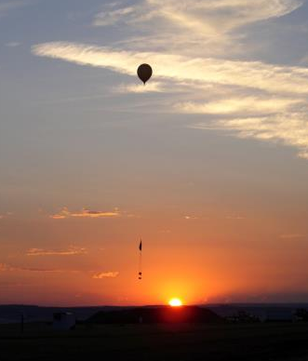
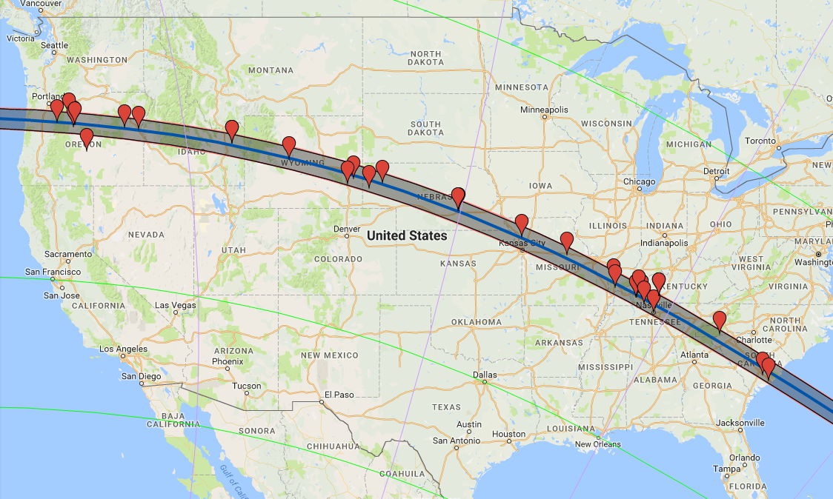

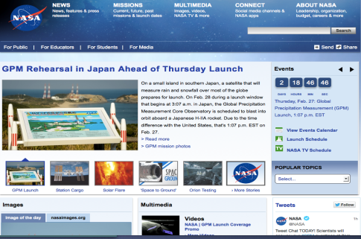
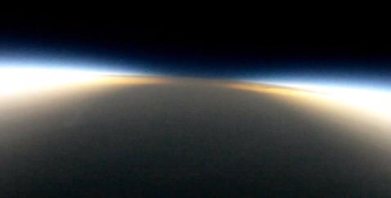
Eclipse Ballooning
Hundreds of millions
Notes:
Thought, hey we could totally do that; there’s the eclipse across the US in 2017 (that I’ve been looking forward to since middle school).
But in this culture, it would need to be live or would be too little too late. Sure, we could, right? Beam the data down no problem!
And get SGs – one in every state – to do flights as well – cover the whole US!
Turns out that there are multiple challenges –
technology (internet in the sky?),
Weight (had to weigh 6 lbs or less),
Cost (little financial resources),
Regulations (every flight capable vehicle in the air during those few minutes!),
Bureaucracy (don’t want to bore you with that but is the biggest challenge).
Will get into that in a bit but first talk a bit about why the passion for the project stuck despite the challenges.

Slide 17
Primary Challenges
Technology
Weight
Cost
Regulations
Bureaucracy
Massive collaboration
Time

Slide 18
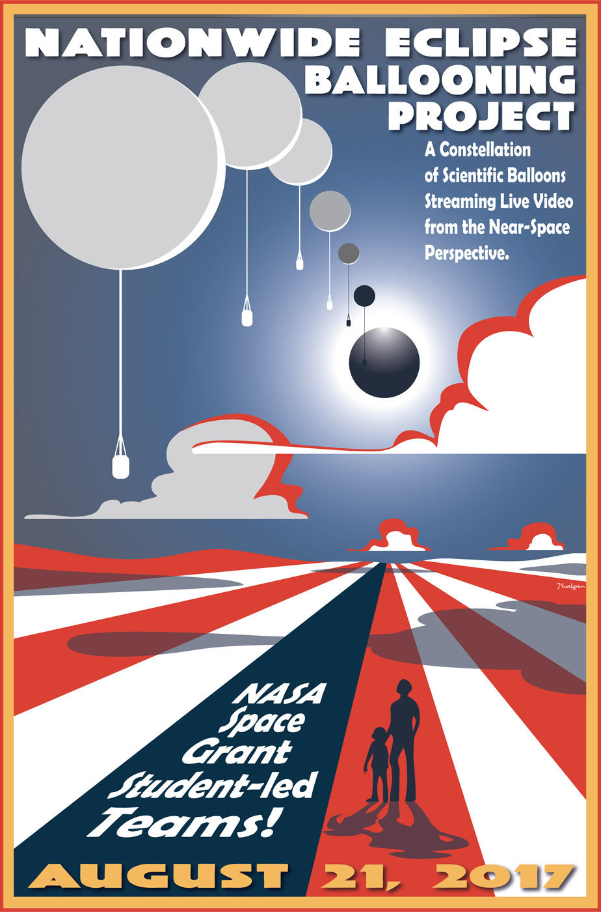


Slide 19
Let’s try to change this!
Notes:
conflict
2014 NSF survey
http://www.nsf.gov/statistics/seind14/index.cfm/chapter-7/tt07-08.htm
http://www.npr.org/sections/thetwo-way/2014/02/14/277058739/1-in-4-americans-think-the-sun-goes-around-the-earth-survey-says
Don’t blame them; what perspective tells them
Maybe between all the eclipse excitement in 2017 we can change this, even just a bit.
Eclipses have a long history of making an impact. For example in 1868, first element discovered off the earth.

Slide 20
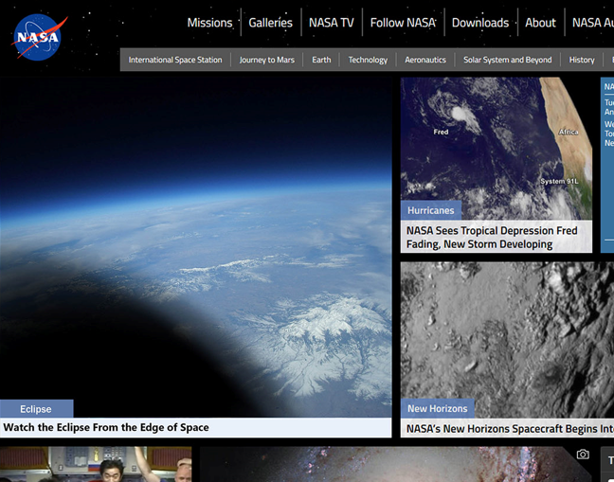
How it all works
terminate
Xbee
Xbee
900 MHz still
5.8 GHz video
Iridium Modem
Ground station antennas
Ground station computer
Ethernet
Data server
Web
Notes:
Learn
Starting in January 2014 set about convincing NASA to fund the project while still researching how we could do it (internet at 100,000 feet? Too early (Google Loon) or too expensive ($1M communication vans);
entered discussions with the FAA (every flight worthy vehicle in this 80 mile wide space in those few minutes!) to see if would even allow it,
Thinking about how we’d could handle 50 live HD video streams on a webpage with 50 – 500 million views (NASA estimate)
selling it to SGs to work on and pay for their student teams, started
Resolution
Turns out, with a lot of hard work, we could do it – radio modems; though have to build up all the systems selves; create tracking (Iridium), use local wireless commands (Xbee); each complete system costs about $3,700.
Have 47 teams from 31 states, have about $1M in NASA funds – half SMD, half SG
Still working on how to handle hits – NASA host or Google/Amazon donation

Slide 21
It’s all about perspective
Notes:
Example of video from Montana – imagine eclipse shadow coming over this kind of footage.
Personal
Great for general public, those who can’t go. BUT. We’re really close – you can be there in person AND watch online on phone!

Slide 22
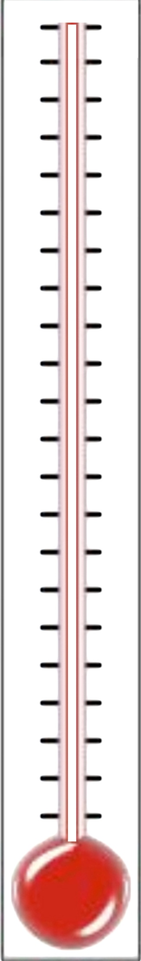
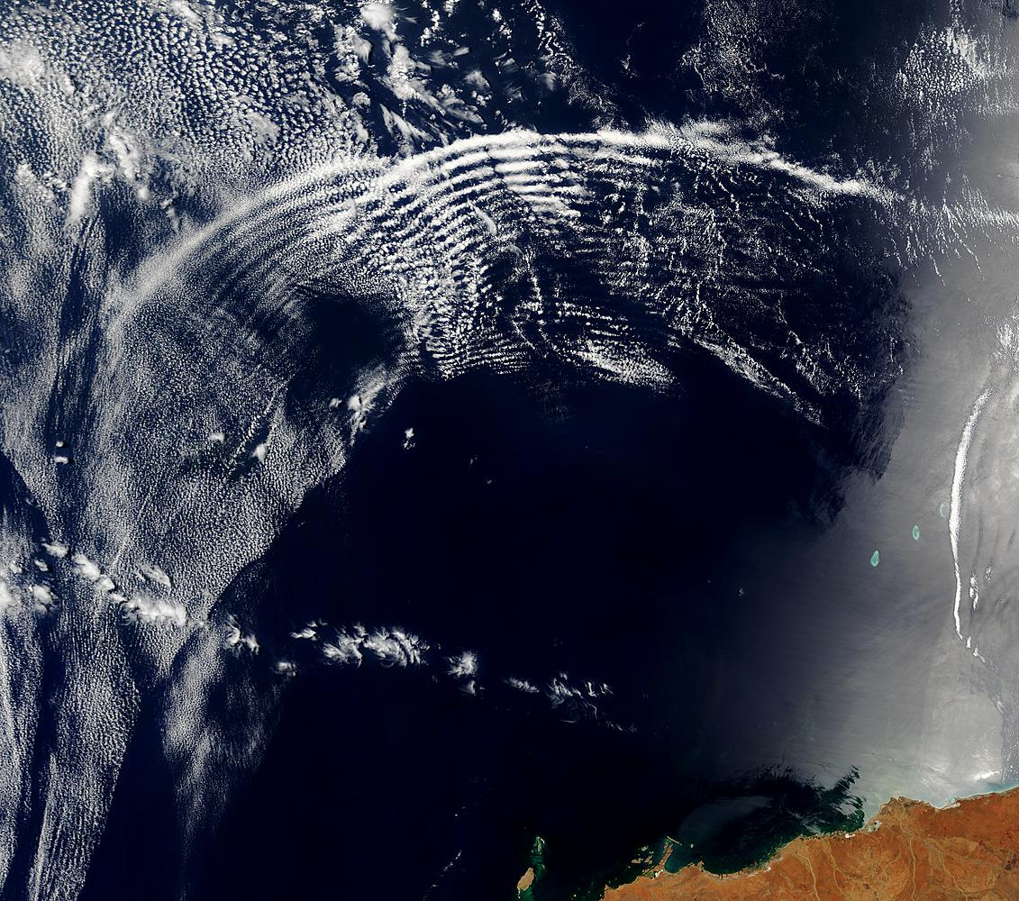
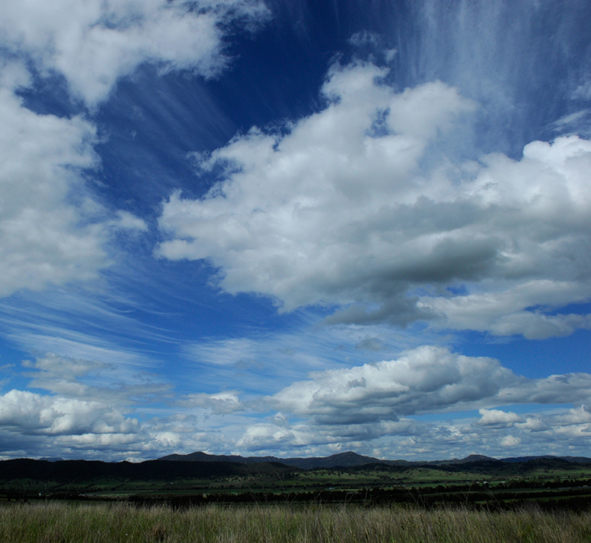
Eclipse Radiosonde Science
What happens in the atmosphere as the eclipse shadow blasts across 3,000 miles in 90 minutes?
How do we measure that?

Slide 23
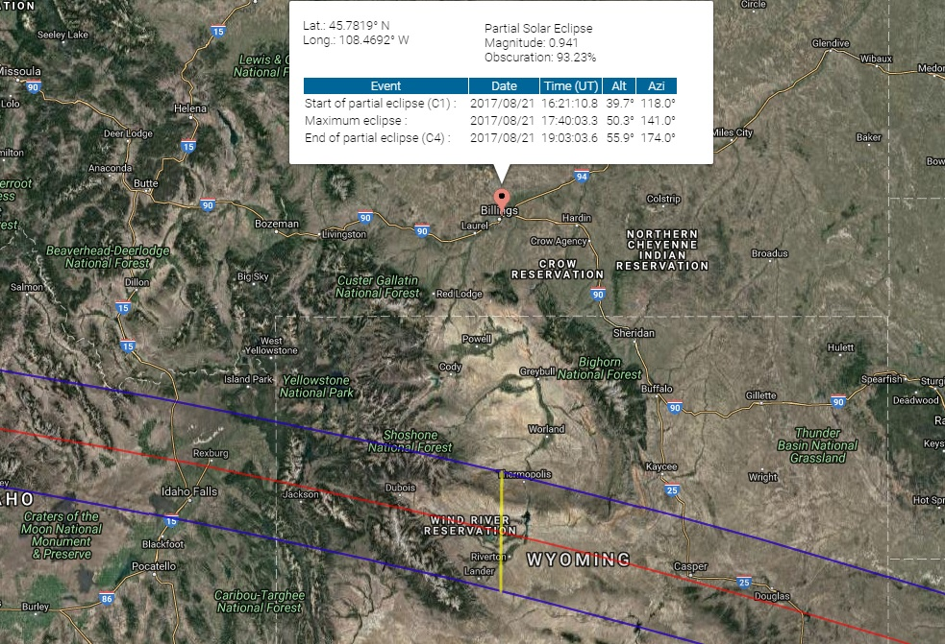
Your Local Eclipse
Bozeman, MT
95% Obscuration
Billings, MT
94% Obscuration
Casper is a 4 hour drive from Billings
Rexburg, ID
Path of
Totality
Casper, WY
Notes:
How much coverage at some local places to gauge how for they may want to travel… do they want to travel to see the total solar eclipse happen? Is 95% good enough? NOOOO!

Slide 24
August 21st, 2017
Where will you be?

Slide 25
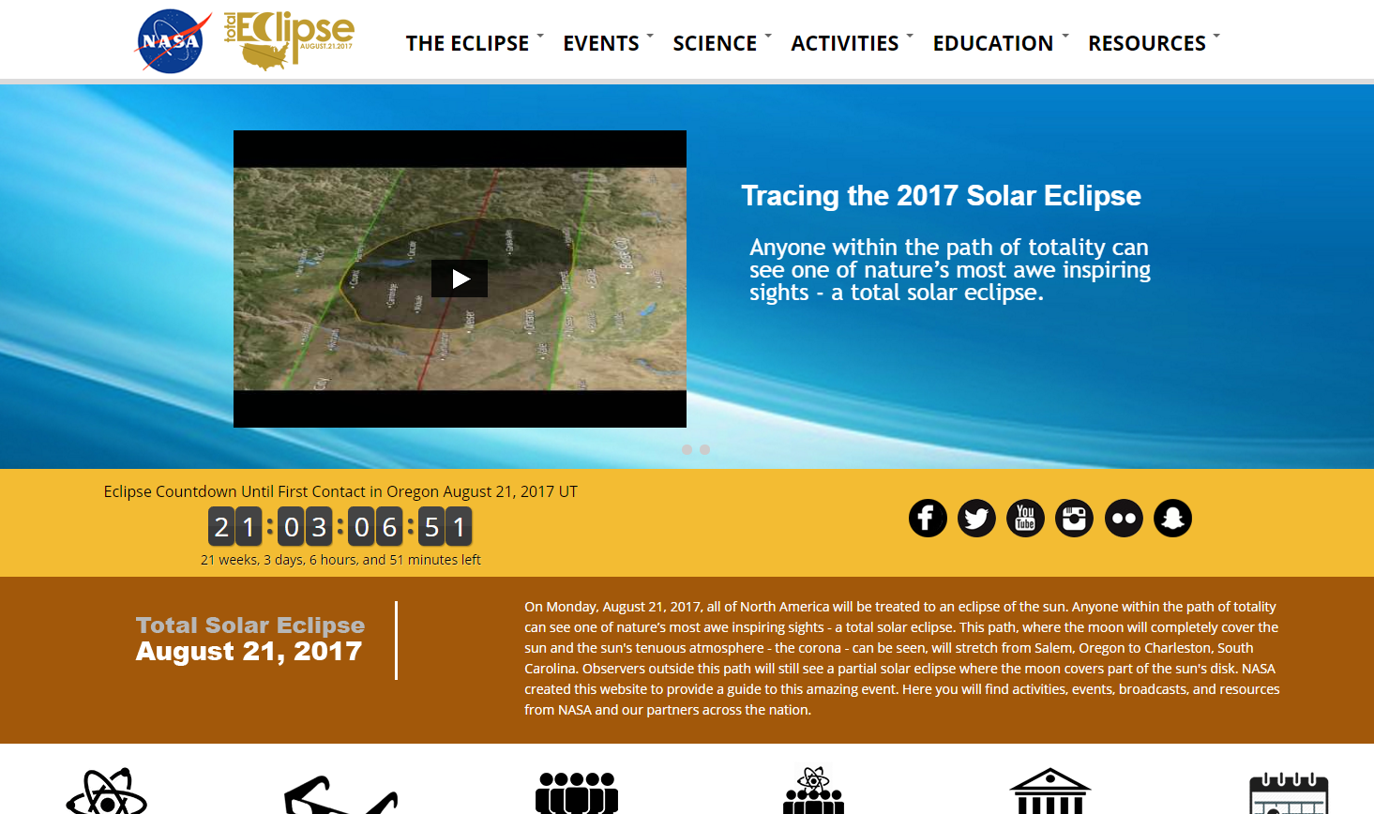
NASA’s eclipse website https://eclipse2017.nasa.gov/
Notes:
Can become an official NASA site. Subject matter expert: application coming soon.
https://eclipse2017.nasa.gov/2017-eclipse-subject-matter-expert-application

Slide 26
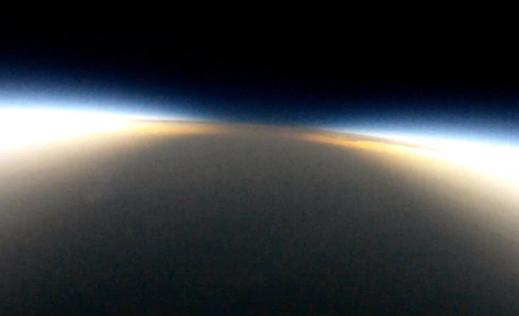
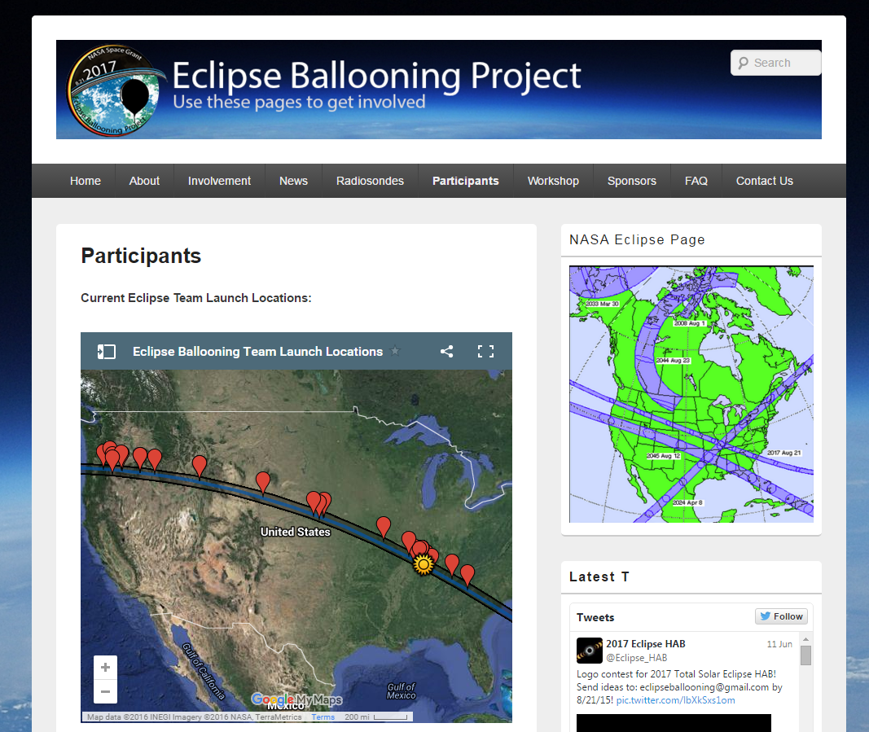
Watch live on NASA and StreamEclipse.live
*8-21-2017*
http://eclipse.montana.edu

