Slide 1
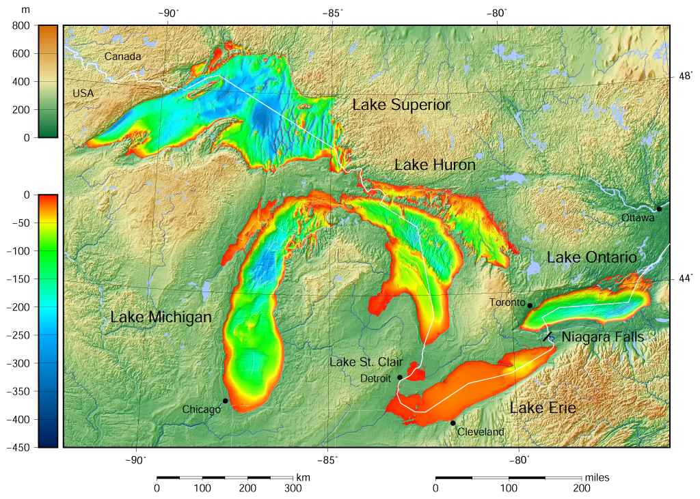

Slide 2
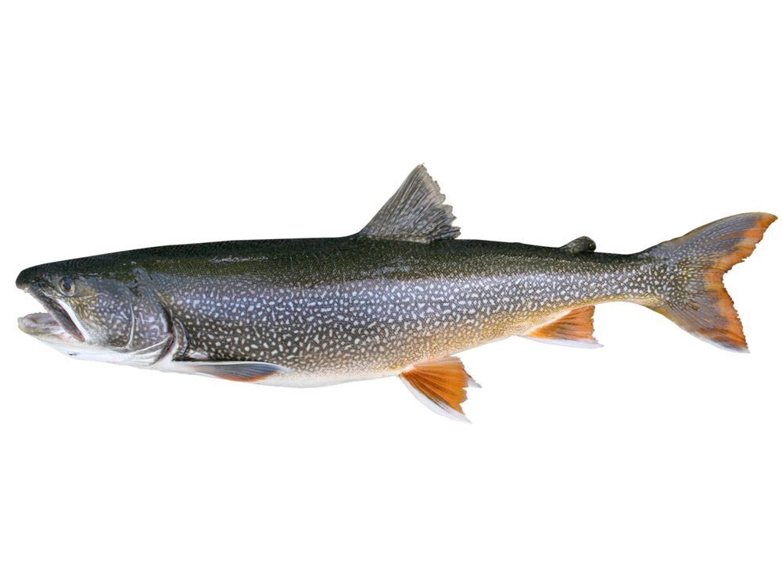
Lake trout Salvelinus namaycush
Native to the Great Lakes

Slide 3
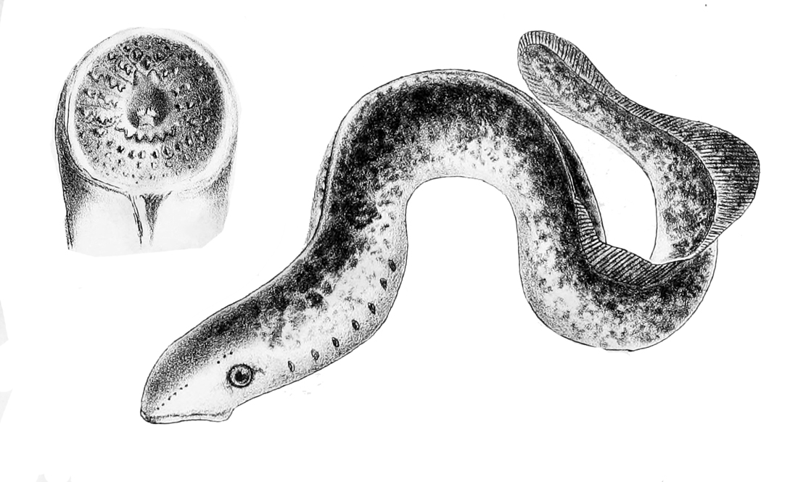
Sea lamprey Petromyzon marinus
Native to the Atlantic and Saint Lawrence River

Slide 4
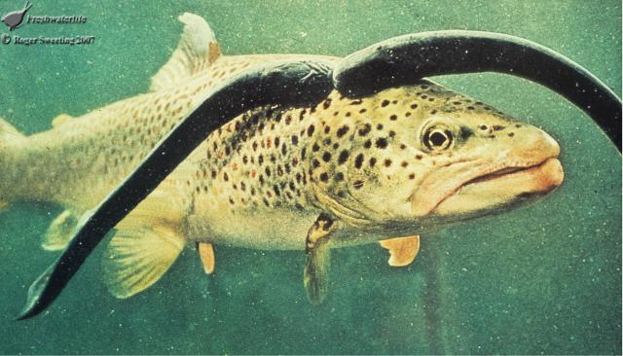

Slide 5
