Slide 1
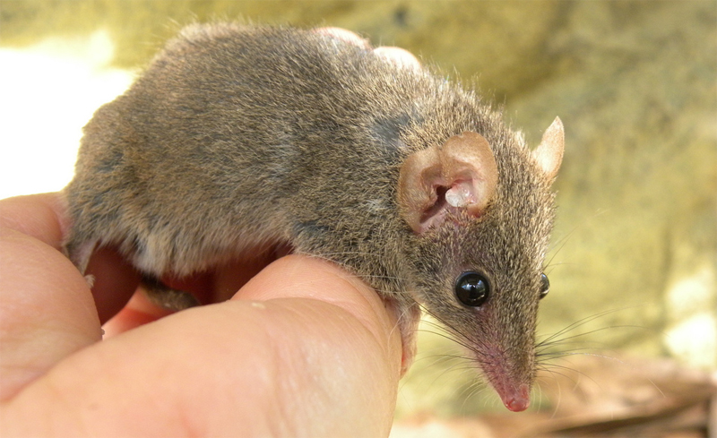
Introduction to POPULATION DYNAMICS and POPULATION GROWTH MODELS
Antechinus – a genus with uniquely simple population dynamics

Slide 2
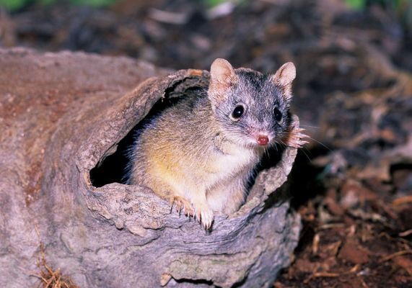

Slide 3
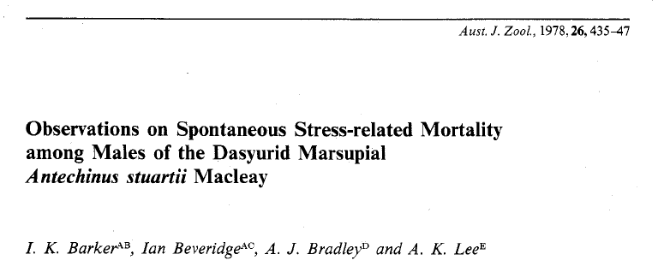

Slide 4
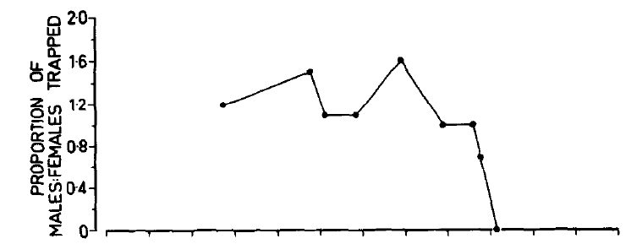

Slide 5
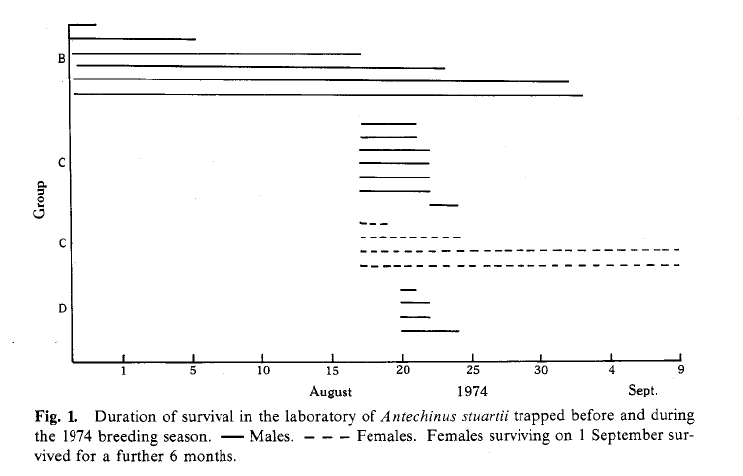

Slide 6
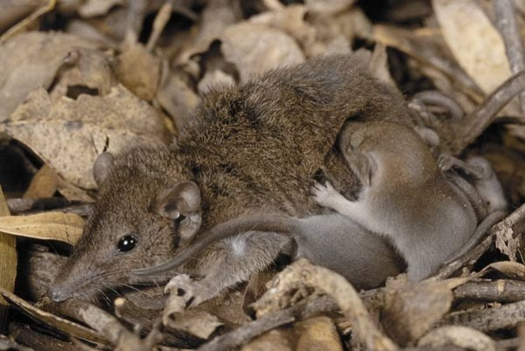

Slide 7
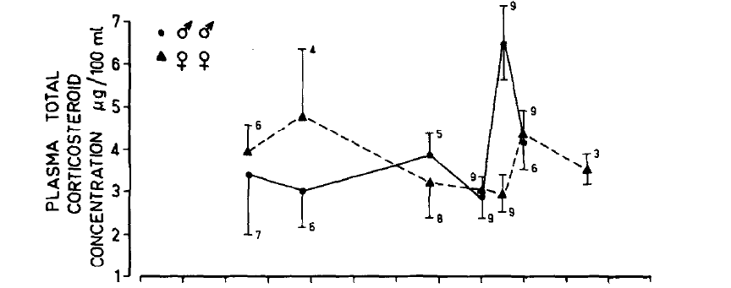

Slide 8
At the time of ‘programmed death’:
Between 73 and 77% of the total plasma corticosteroid is biologically active in males (3.15-4.29 pg per 100 ml), and only 28% is biologically active in females (0.83 pg per 100 ml). In other words, the concentration of biologically active corticosteroid in the plasma of males at this time is between four and five times that in females.
Males in August, just after mating
Immune suppression
Gastrointestinal ulcers
Pulmonary lesions due to pneumonia
Necrotic lesions in liver

Slide 9
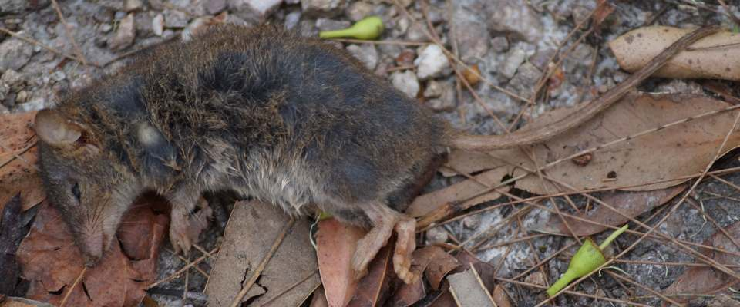
100% mortality among males in a 3 week window after mating season
Females die ~6 months later (after weaning)

Slide 10
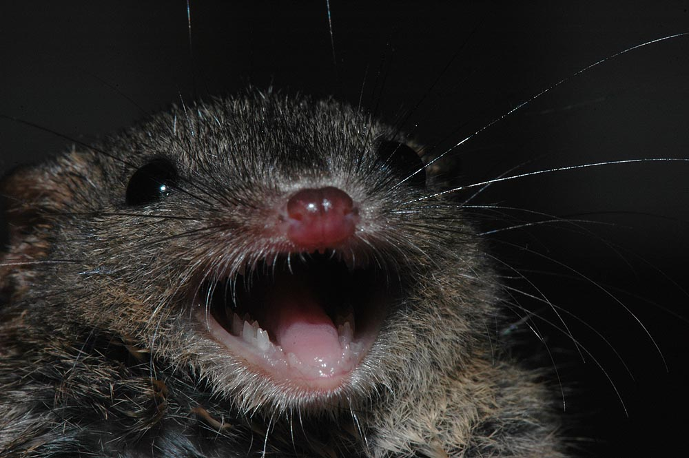

Slide 11
