Slide 1

Basic Procurement
Presented by
Procurement Services

Slide 2
Contact Information
Website: http://www.montana.edu/wwwbu/procurementservices/
Peggy Wallace
Procurement Associate
peggy.wallace1@montana.edu
994-3211
Brian O’Connor
Director
boconnor@montana.edu
Ramie Pederson
Procurement Officer
ramie.pederson@montana.edu
406-994-3213
Cheri Toeniskoetter
Procurement Officer
cheri.toeniskoetter@montana.edu
406-994-3212
Main Phone: 994-3211
Email: purchase@montana.edu
Office: Room 19, Montana Hall

Slide 3
Training Overview
Delegated Authority
Total Contract Value
Small, Medium, & Large Purchases
Independent Contractors
IT Procurement
Sole Source and Brand Name Justification
Term Contracts
Encumbrances
Reducing Encumbrances
Exemptions
Controlled Items

Slide 4
Delegated Authority
Procurement procedures are the law!
  Title 18 Montana Code Annotated (MCA)
  Montana Procurement Act
  Administrative Rules of Montana (ARM)
The State has granted MSU Procurement Services Level Two delegation; authorizing us to purchase non-controlled supplies up to $500,000.
Delegation is for two years and can be revoked
We further delegate to most departments to allow them to purchase non-controlled items up to $25,000 - if trained!
Department Delegation can be revoked or decreased if procurement procedures are not followed.
Notes:
The state procurement bureau gives Montana State University Procurement services delegation to purchase up to $500,000
We further delegate to allow departments to purchase up to $25,000 – if they are trained

Slide 5
TCV= Total Contract Value
The total contract value is the initial contract period, plus any options to renew, or the total potential purchase price of goods and/or services.
This includes shipping, handling, warranties, maintenance & support, convenience fees, reimbursable expenses, in short – ANY cost that the University will incur throughout the length of the contract
Total Contract Value is used to determine the proper procurement method.
TCV
= PURCHASE PRICE + ANY RENEWAL OPTIONS &
ALL OTHER FEES
Notes:
Refer to attachment FUA
Example: $4,999/yr for a contract of 3 years makes the TCV $14,997

Slide 6

Total Contract Value

Slide 7
“Small” Purchases
Total Contract Value of $5,000 or under.
Use the method that best meets your departments needs.
Shop around!
Use your P-Card to pay for goods whenever possible.
Departmental Purchase Order or Contracted Service Agreement recommended when appropriate, but not required.
Any time Services are required a CSA is a good idea to clearly outline what is expected
Notes:
At the discretion of the AGENCY Purchasing Director, such delegation may be revoked for failure to adhere to state purchasing regulations.

Slide 8
“Medium” Purchases
Total Contract Value of $5,000.01 through $25,000.00
MUST be competitively bid by Conducting a Limited Solicitation
  Obtain quotes from a minimum of three different vendors
  Phone bids ok, but email/fax preferred.
  Quotes should include any shipping
  Record prices on PD-20 – use “as attached” as necessary.
  Compare “apples to apples” and must award to low cost that meets specs.
  Contact us if you have rationale to consider other than low cost
Must be multiple brands. If specific brand is needed complete PD-13 Brand Name Justification form.
If only one source available, complete PD-14 Sole Source Justification form.
Approved at the Department Level, requestor signs to indicate correct info and no conflict of interest.
Notes:
At the discretion of the AGENCY Purchasing Director, such delegation may be revoked for failure to adhere to state purchasing regulations.

Slide 9
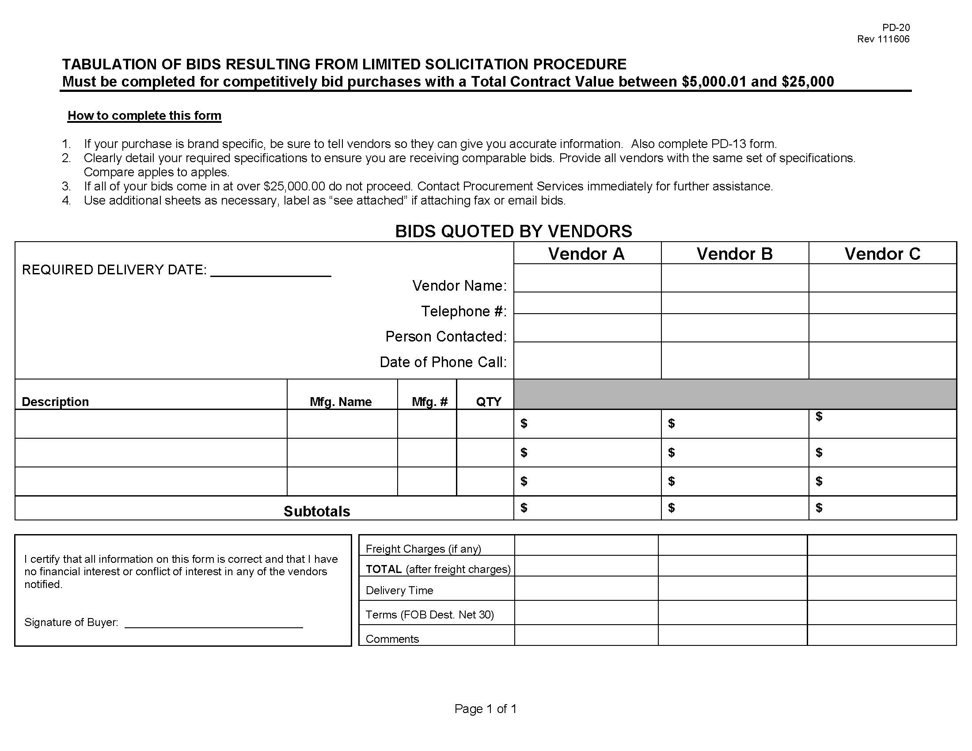
Notes:
You can email, call or fax vendors to get quotes.

Slide 10
Limited Solicitations
(continued)
Once lowest bidder is identified, issue Departmental Purchase Order (DPO, Form PD-12*) or use P-card if available.
For P-Card increase send email to purchase@montana.edu
If procuring services, issue Contracted Services Agreement (CSA*, Form PD-49) new form available with instructions embedded
  Stick to Boilerplate! Collect proof of workers compensation and insurance if applicable.
  If paying an individual, determine Independent Contractor status (contact UBS for help)
Appendix*
Procurement documentation must be submitted with BPA or P-Card report.

Slide 11
Drafting a CSA
Stick to the Boilerplate! Only a few section can be changed
Go to our website for the latest CSA template
Instructions are embedded
Remember to remove the instructions
Most important things to include Contract start date, end date, services to be performed and how and when Contractor will be paid

Slide 12
What are the most important things in a Contracted Service Agreement?

Slide 13
The most important Info on a CSA:
Contract Term (start and end dates)
Services
  Detailed description of work they will do
Consideration
  How much will they get paid and when

Slide 14
“Large” Purchases
Total Contract Value over $25,000
Complete a Purchase Requisition (Form PD-1*)
Include:
  Signatures up to VP level
  Specifications or Statement of Work
  Delivery Date and Delivery Location
  Suggested vendors including contact names and emails
  Funding information including index(es), account codes, and any funding splits
  Any supporting documentation that applies (PD-13 Brand Name Justification or PD-14 Sole Source Justification)
Submit Purchase Requisition to Procurement Services:
  Drop off, mail, fax or scan/email are all acceptable.
Procurement Services will work with department to issue:
  Contract or PO if Sole Source. If not:
MUST GO THROUGH PROCUREMENT SERVICES!!!!
Notes:
At the discretion of the AGENCY Purchasing Director, such delegation may be revoked for failure to adhere to state purchasing regulations.

Slide 15
“Large” Purchases
(continued)
  Procurement Services will issue a formal solicitation
  Invitation for Bid (IFB): Vendor awarded must meet all requirements and be lowest cost (takes about 3 – 4 weeks so plan accordingly.)
  Request For Proposal (RFP): Vendor awarded must be highest scoring offeror, combination of scored responses to requirements, offeror qualifications and cost (takes at least 8 weeks).
  Procurement will issue the PO or Contract as necessary

Slide 16
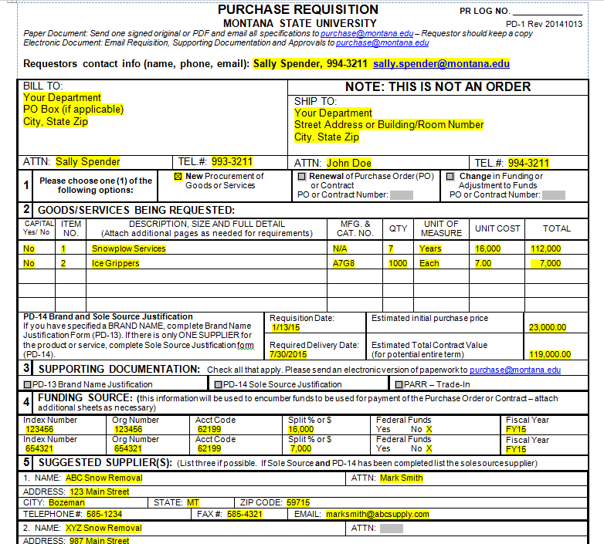
Filling out the PD-1
For accurate encumbrances, PD-1s must be filled out correctly.
Your PO Box
Your physical address
Estimated initial purchase price and estimated Total Contract Value should be stated
Index Number(s) & Account Codes including any breakdown should be stated - Designate FY
Notes:
Purchase Requisitions must be filled our correctly for encumbrances to be accurate
Important things to remember:
The Bill to Address should be YOUR PO box number – this is where the vendor will be sending invoices
The Ship to Address should be YOUR Physical Address – A Street Address or Room Number and Building should be used here so vendors know exactly where your purchase should be delivered
Unless your purchase is a sole source purchase and you already have a quote from the vendor, the totals will likely be estimates. You should estimate the initial purchase price and the estimated Total Contract Value (Total of contract including any renewal options)
The amount encumbered will be adjusted to the actual Purchase Price once the item has been awarded. If the amount is significantly more than the estimate, we will request a supplemental Purchase Requisition for the difference.
The Index Numbers and Account Codes Should be included - Remember to specify the breakdown if multiple indexes or account codes are used.
Fiscal Year should be stated

Slide 17
Be sure to define more than “sorta” what you want.

Slide 18
Independent Contractors vs. Employees
Can be difficult to determine status. Lots of compliance and tax implications.
If someone is an employee, they cannot also be an independent contractor for MSU. Any pay for additional duties must go through HR to be paid as additional comp. The IRS has very strict guidelines about a person being both an employee and an independent contractor and it is best to run everything through payroll.
There are also Conflict of Interest items to consider with Legal and on grants.
If you have a unique circumstance, please contact Katie Matzinger at X7508 or katie.matzinger@montana.edu otherwise, please work with HR directly to add to payroll as a One-Pay.

Slide 19
IT Procurement
Three important questions:
Will this product/service process, store, or require any faculty, staff, student, or research data?
Will this product/service be integrated with other systems at MSU?
Will this product/service be connected to the MSU network?
If you answered yes to any of these, contact the portfolio management office at pmo@montana.edu before you buy! The PMO will help you to be sure that your purchase isn’t responsible for a data breach or adversely affects other MSU systems.

Slide 20
Sole Source & Brand Specific Justifications
Use PD-13 Brand Name Justification, PD-14 Sole Source Justification*
  Brand Name Justification is for when a specific brand is required but it available from multiple suppliers
  Sole Source form is for when only one vendor can supply the good or service that you require
If exempt from competitive procurement identify exemption.
Describe clearly what you need to purchase including any special functionality, measurable size or performance ranges, etc. List all required (not desired) features.
Indicate if specifically identified in a grant, attach grant documentation.
Describe how you found this vendor or brand. List all other suppliers and detail what requirements they do not meet. Under $25,000 – approved at department level. Over $25,000 – approved at Procurement Services
Notes:
PD-13 is the Brand Name Justification Form
PD-14 is the Sole Source Justification Form
You can use one or the other depending on your purchase, but never both
Brand Name Justification is for when a specific brand is requried but it is available from multiple supplies (such as Motorola walkie talkies)
Sole Source is for when only one vendor can supply the good or service you require
Clearly describe what you need to purchase including any required features such special functionality, measurable size or performance range or space restrictions
Indicate if it is specifically identified in a grant. If so, attach grant documentation
Describe how you found this vendor or brand-
List all other suppliers and detail what requirements they don't meet
If under$25,000 – they can be approved at the department level by someone who has attended procurement training.
If you would prefer, Procurement Services can review them and/or approve them for you.
If Over $25,000 they must be apprived by Procurement Services

Slide 21
SSJ and Brand Justifications
(continued)
Sound rationale for a sole source purchase
  Compatibility with existing equipment or space restrictions
  Consistency of research
  Unique functionality that is required
Poor rationale for a sole source purchase
  “Industry Standard”
  “Quality Provider”
  History
  Cost
  Local
Notes:
Sole Source and Brand Name Justifications must have Sound Rationale
Examples would be objective reasoning (fact based) such as compatibility with existing equipment or space restrictions
Consistency of research
Unique functionality that is required
Poor Rationale for Sole Source and Brand Name Justifications is anything that is subjective (opinion based) such as
Industry Standard
Quality Provider
History with the vendor
Cost and being local are not justification for doing a sole source

Slide 22
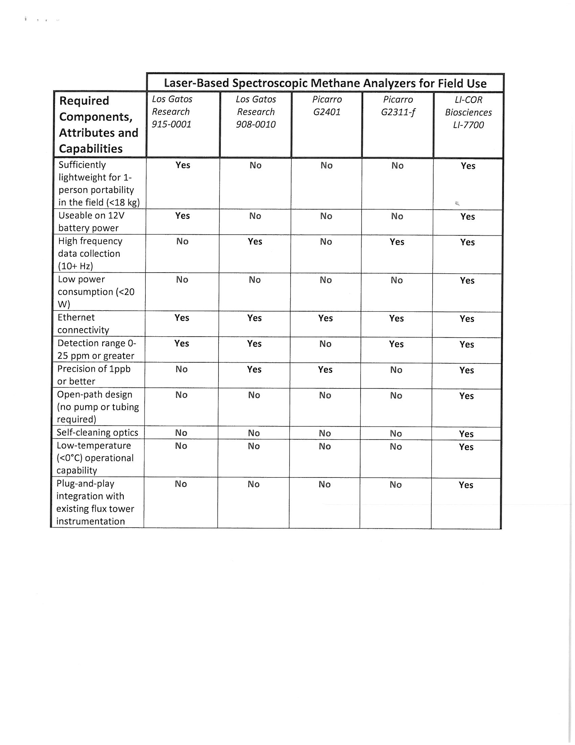
Notes:
Great example of a matrix someone from Land Resources provided with a SSJ
If it makes more sense to make a chart then to write 5 paragraphs to justify a purchase by all means do it
This matrix makes it very clear what required specifications the other items do not meet

Slide 23
Filling out A PD-14 Sole Source Justification form
Make sure you are using the most current form (1. should be Estimated TCV)
2. is rare
3. Should be the specifications you require NOT a list of features you got off the pamphlet or website
4. Name of Supplier
If Supplier was not named in a grant than 4 b) 1) thru 3) need to be completed
Notes:
Spend a minute going over filling out the PD-14 Sole Source form
The PD-13 Brand Name justification and PD-14Sole Source Justification are now two separate forms
Be sure you are using the most current form - (#1 should be Estimated Total Contract value)
Using #2 exemption is rare
#3 Should be the unique specifications you require nota list of features you got off the pamphlet or website
#4 Name of the Supplier
If the Supplier was not named in a grant than 4 b) 1) thru 4 b) 3) needs to be completed

Slide 24
PD-14 Continued
4)b)1) how you determined this was a sole source
4)b)2) a list of any other suppliers that have similar equipment
4)b)3) what each of the suppliers in 4)b)2) cannot do from #3.
For example: Brand XXXX Scanner does not have a detachable canopy,
Brand XXXXX only has a scanning bed size of 20 X 42 inches
Notes:
4) b) 1) How did you determine this was a sole source? What research did you do?
4) b) 2) List othersuppliers that have similar equipment
4) b) 3) Specify what each of thesuppliers in 4 b) 2) cannot do from #3
Example: Brand X Scanner does not have a detachable canopy
Brand Y scanner only has a scanning bed size of 20 X 42 inches

Slide 25
SSJ Approvals
2 signatures are required on all SSJ’s.
The first signature should be someone who can attest to the validity of the information on the form and verify they do not have a conflict of interest
For SSJ’s with a TCV under $25,000 the second signature should be the department procurement person who has attended training or PS staff
This is important as no one should make the determination by themselves
Over $25,000, must be approved by procurement

Slide 26

True or False?
Justification in a Sole Source needs to be Objective not Subjective

Slide 27
TRUE
All justification for a sole source needs to be objective and not subjective. Ratings, industry standard, and “quality” provider are considered subjective and are not sound rationale.
Objective reasoning such as compatibility with existing equipment, consistency of research and unique functionality are all sound rationale for SSJ.

Slide 28
True or False?
Low cost is good rationale for a Sole Source Justification

Slide 29
FALSE
LOW COST is never justification for a sole source.
If there are other vendors who can perform this work, then it is not a sole source even if the other vendors are more expensive
Do a limited solicitation and award to the low cost vendor

Slide 30

Encumbrances
https://youtu.be/pO_y3CSLLyk?t=31s

Slide 31
Identifying Encumbrances
When Procurement creates an encumbrance from your purchase requisition, we will provide you with a Contract Number or Purchase Order number.
This number should be indicated on all invoices, BPAs, P-card reports and correspondence with Procurement Services
Examples: P0002451, CS140015, K11-0012
Notes:
We will provide you with a Contract Number or a Purchase Order Number when we create an encumbrance from your Purchase Requisition
This number should be referenced on all Invoices from the vendor, BPAs, P-Cards reports and any correspondence with us regarding your Contract or PO
The numbers will either be P000XXXX for purchase orders, CSFY00XX for Contracts or KFY-0012 for contracts issued from RFPs

Slide 32
Which one is a Procurement Services encumbrance number?
A. 4W1523-FY16-06
B. CS110015
C. CSA FY2015
D. P0555555

Slide 33
How to Relieve Encumbrances?
Indicate the Purchase Order or Contract Number on your BPA when you make a payment against an encumbrance
Indicate on P-Card report when you make a payment against an encumbrance
Notify Procurement Services if encumbrance needs to be adjusted for any reason (spending less than committed, PO number not indicated on BPA, etc.)
Notes:
Relieving encumbrances
Three ways to accomplish this:
Indicate the Purchase Order or Contract Number on your BPA
Indicate the Purchase Order or Contract Number on your P-card report (this method will delay the encumbrance from being relieved since we don’t see the P-cards reports until several months after the payments are made
Notify us if you need an encumbrance adjusted
Spending less than committed
PO wasn’t indicated on BPA
P-card Payment you would like liquidated sooner

Slide 34
Notations
Communicate to Procurement on BPA or P-Card report how something was procured.
Provide supporting documentation for “medium” purchases (PD-20, DPO, CSA, SSJ, etc. if applicable)
Procurement Services has the supporting documentation for large purchases and you do not need need to attach it to BPAs, however for PO or contract issued by Procurement Services, use PO/ENC box and P/F on the BPA.
DO NOT use this box for departmental CSAs or term contract numbers.
This is only for Contracts and PO numbers issued by Procurement Services
Notes:
Make sure your BPAs and P-Cards communicate how something was procured
For any "medium" departmental purchases – attach supporting documentation such as the PD-20 Limited SOliciation form, DPO, CSA, SSJ, etc)
For large purchases we already have the supporting documentation on file so you don't need to attach it. However you should reference the PO or Contract numberin the PO/ENC box
And indicate wheather it Is a partial payment or final.
Do not use the PO/ENC box for departmental CSAs, DPOs, or term contract numbers. It is only for POs and Contracts issued by Procurement Services

Slide 35
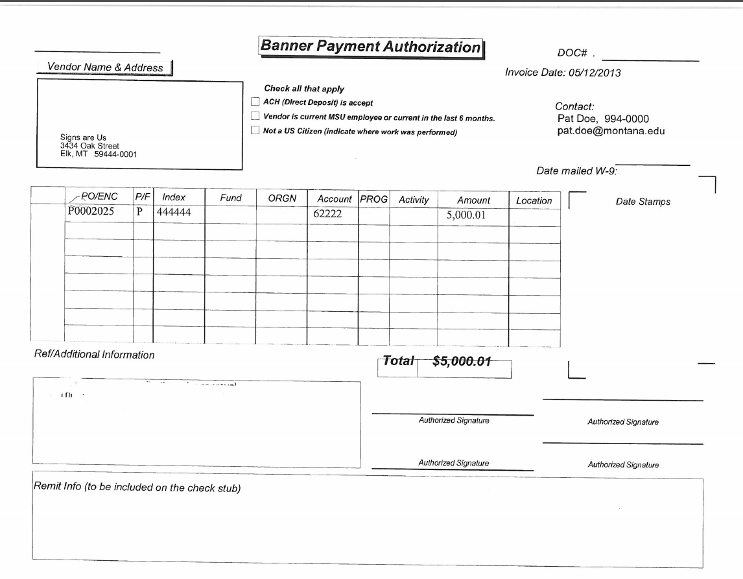
Reducing Encumbrance with BPA
Include your name,
phone number, and email address
Indicate Procurement Services PO or Contract number only
Make sure account code used for payment corresponds with indexes and account codes authorized for encumbrance on submitted PD-1
Indicate P for Partial payment or F for Final payment.
Only use F for final payments on encumbrances that will NOT be renewed. “F” completely closes out the encumbrance.

Slide 36
Notifications Continued
All other situations, indicate one of the following in ref/addtl information box of BPA:
  Procurement Documentation attached (Limited Solicitation/DPO/Sole Source/Brand Name Justification)
  Term Contract #_______________ (indicate number)
  Procurement Exempt _______________ (state reason)
This helps us ensure compliance and speedy processing.

Slide 37
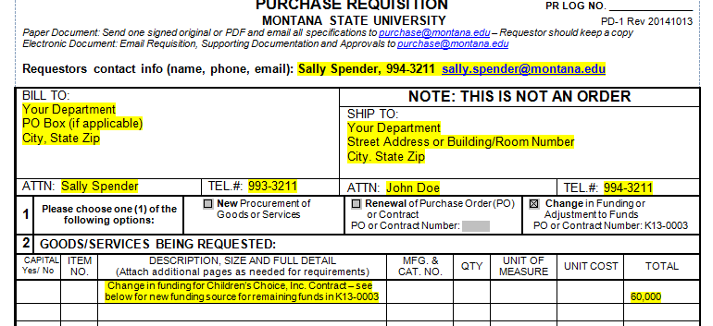
Changing Funding Source on
Existing Encumbrance
Submit a new PD-1 Purchase Requisition
Indicate encumbrance number
Add new Index(es) or change distribution of Funding Sources;
Obtain VP and OSP* signatures
Notes:
If you need to change the funding source to an exisiting encumbrance, we will need a new PD-1
We have recently revised our form to include a “Change in Funding or Adjustment to funds” box at the top
Indicate in the description box what you want done ex. “Change funding source for remaining funds”

Slide 38
How do you change the funds on a procurement encumbrance?

Slide 39
To change funds on an encumbrance, you need to submit a new PD-1
Check the box at the top of PD-1 indicating a change in funding
Reference the Contract or PO number
In the description add a note to clearly identify what you want done (move all remaining funds, add $20,000 to funds,etc)
Make sure to update funding source information and get VP and/or OSP signature

Slide 40
Direct Buy Opportunities: Term Contracts
List of all State term contracts available for agency use:
http://svc.mt.gov/gsd/apps/TermContractDefault.aspx
Does not require re-bidding. State has done the bidding for us.
Does not require DPO issuance or purchase requisition submittal.
Please order directly with vendor and indicate contract number on BPA or P-Card report
Notes:
Who utilizes term contracts?

Slide 41
Procurement Exemptions
Competition (bidding) not required for the following purchases:
  Training
  Travel
  Books and periodicals
  Employment of a registered professional engineer, surveyor, real estate appraiser, registered architect, physician, dentist, pharmacist or health care provider.
  Commission of art for a museum or public display
  Food produced in Montana
  Professional Licenses
  Renewal of software license agreements
  Purchase or renewal of maintenance agreements for software or hardware
  Advertising Placement (but not creation)
  Interagency agreements
  Legal Services
  NOT EXEMPT FROM CONTRACTING - JUST COMPETITION

Slide 42
Controlled Items
Neither Departments nor Procurement Services are authorized to purchase:
  New Vehicles*
  Purchasing and Fueling Card programs
  Bulk Fuel
  Motor Oil & Grease
  Bulk Propane
  *vehicles purchased on requisition time schedule, statewide bid put out in spring and fall. All others must be purchased off of exclusive agreements in place.

Slide 43
Copier Leases
Regardless of dollar amount ALL Copier Leases MUST go through Procurement Services
If you are in the market for a copier, contact Procurement Services right away to learn about an exciting new state Contract with Great rates!
Before entering any agreements, send the vendor’s quote to Procurement
We ensure you are getting the best rates and fair terms
We provide UBS info to properly record the lease; UBS will send you an amortization schedule
We will issue the DPO

Slide 44
Copier Maintenance Agreements
All Copier Maintenance Agreements MUST be reviewed by Procurement Services before you sign anything!

Slide 45
Vendor Agreements
Do NOT sign any vendor agreements before Procurement Services has reviewed the agreement
This applies to all dollar levels

Slide 46
Who can sign vendor agreements?
A. Anyone with a pen
B. Anyone who has attended Procurement training
C. Nobody that likes the Griz
D. Nobody until Procurement Services has reviewed the agreement

Slide 47
Correct Answer is D
Nobody can sign vendor agreements unless Procurement Services has reviewed the agreement.
Procurement often has to forward vendor agreements to Legal for further review
Any vendor agreement signed without Procurement review is an unauthorized agreement and subject to cancellation

Slide 48
Foreign Vendors
Minimize delays in paying foreign vendors
  As soon as a foreign payee is identified, contact Darcy Tickner in HR at dtickner@montana.edu
  Darcy will look up vendor; provide her with what vendor will be doing, company name and address
  Let her know if any services will be performed in the US
  First time payment for each year will need a new W-8
Notes:
As soon as you realize a vendor is foreign, notify Darcy Tickner in HR
Provide her with the company's name, address, what they will be doing and whether services will be performed in the US
First payment each year will need a new W-8

Slide 49
Who do you contact as soon as you realize you have a foreign vendor?

Slide 50
Darcy Tickner in HR

Slide 51
Resources
Procurement Policy and Procedures: http://www.montana.edu/policy/purchasing/
Forms http://www.montana.edu/policy/purchasing/purch1800.html#1800
  Purchasing Manual , Delegation Agreement Summary, FAQ’s, Training, Quick Reference Guide
State Procurement Bureau website http://sfsd.mt.gov/SPB
Purchasing ListServ (signup request to purchase@montana.edu)
Procurement Services Staff
Other MSU Colleagues
How Do I Buy… Webpage –is up and running!
http://www.montana.edu/buyingatmsu/index.html!

Slide 52
Questions?

Slide 53
Thanks for attending!
MSU Procurement Services
994-3211 purchase@montana.edu
Notes:
Who utilizes term contracts?

