Slide 1
EELE 414 – Introduction to VLSI Design
Module #1 – Introduction & Economy
Agenda
    Course Logistics
    Course Content
    Design Implementation Options
    VLSI Economy
Announcements
    Welcome
    All assignments are posted to the course website
    Please check your email regularly
    There is a digital circuit review at the end of these lecture notes
    Read Chapter 1

Slide 2
Course Overview
Office Hours: Check my website for most recent schedule.
Also available by email appointment
Requisites: Pre-requisite EE262, EE317
Grading: Homework - 40%
Exam #1 - 20%
Exam #2 - 20%
Exam #3 - 20%
- Homework Assignments will be posted on Tuesdays
- Homework Assignments are due at the beginning of class on the following Thursday.
(i.e., 1.5 weeks later)
- Late homework will be accepted for one week after the due date with a penalty of
50% point reduction. No credit will be given for assignments over one week late.
- No make up exams will be given. Plan on being available on the exam dates.
- Check website frequently for the most up to date schedule.

Slide 3
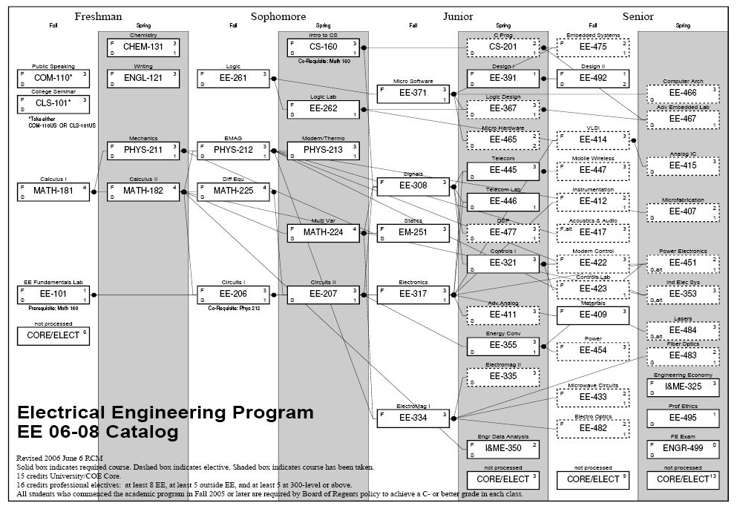
Course Overview
Where does this course fit into the Electrical Engineering curriculum?

Slide 4
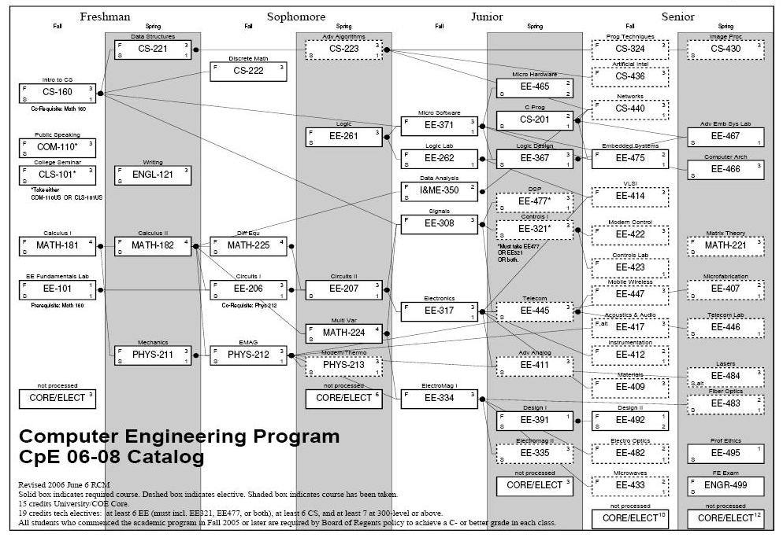
Course Overview
Where does this course fit into the Computer Engineering curriculum?

Slide 5
Course Content
What is this course?
- An introductory course into VLSI Circuit Design
- We will learn the transistor level implementation of the digital logic blocks used in VLSI designs
- We will learn the design and analysis, simulation, layout, and fabrication of these circuits
- We will learn to use modern CAD tools to design these circuits
What topics will be covered?
1) VLSI Implementation Options / Economy
2) MOSFET Characteristics
3) SPICE Modeling
4) Circuit Layout
5) CMOS Fabrication
6) Static Behavior of a MOS Inverter
7) Dynamic Behavior of a MOS Inverter
8) CMOS Logic Gates
9) Sequential Logic
10) SRAM
11) DRAM

Slide 6
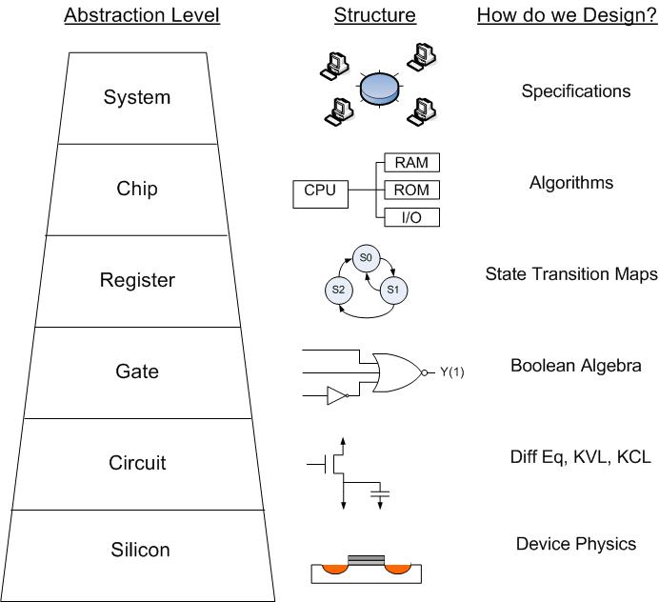
Course Content
At What level can we design?
- a level of abstraction allows
the description of larger and more
complex systems
- but we lose touch with the details
of the implementation
- as engineers, we want to have
experience in all levels of abstraction.

Slide 7
Course Content
What areas of VLSI do my EE/CpE courses cover?
EE367
EE261
EE414
EE317
You are here

Slide 8
Course Content
CAD / CAE Tools
- Modern designs are too large to be designed using manual techniques
- We rely on a set of CAD / CAE tools in order to manage the complexity of the designs
- We won't use all of the tools for a VLSI design in this course, but it is good to understand the basic
options and how they are used in a typical VLSI design
Analog Simulators - SPICE, Cadence Spectre
- Simulation Program for the Integrated Circuit Environment
- Numerical Solver that performs KVL, KCL, and Branch Equations
- Performs Numerical Integration for transient simulations
Advantages
- Real analog view of signals
Disadvantages
- long run time limits number of nodes that can be simulated
- typically used for 10's of transistors
- full VLSI designs can't be simulated using SPICE

Slide 9
Course Content
Digital Simulators - ModelSim, Xilinx, NC-Verilog
- only gives the state of the node (0,1,X,x,Z,z,…)
- this simplifies computation which reduces run time
- allows 1000's of nodes to be simulated simultaneously
Advantages
- many nodes can be simulated
- relevant for VLSI systems
Disadvantages
- only see the state, not the analog nature
Analog vs. Digital Simulation
- We use Analog simulation to verify the operation of basic building blocks (inverters, NANDs)
- From the analog results, we define specs used in the digital simulation (t_{rise}, t_{fall}, t_{prop}, fanout)
- the digital simulations then incorporate the specs of the block as timing delays

Slide 10
Course Content
Sel
Design Entry - Schematics
- Hardware Description Language (HDL)
Synthesis - Automatically generates the gate level netlist from an HDL
A
B
Out
if (Sel = 0)
Out = A
else
Out = B
Sel
if (Sel = 0)
Out = A
else
Out = B
Synthesis
A
B
Out

Slide 11
Course Content
Layout - Physical implementation of the circuitry
DRC / LVS - Design Rule Checker: Were manufacturing capabilities violated
- Layout versus Schematic Check
Side
Top

Slide 12
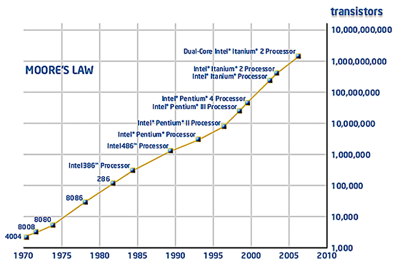
Course Content
VLSI Design Sizes
- more transistors are being integrated on chip
- this means we must rely more heavily on CAD/CAE

Slide 13
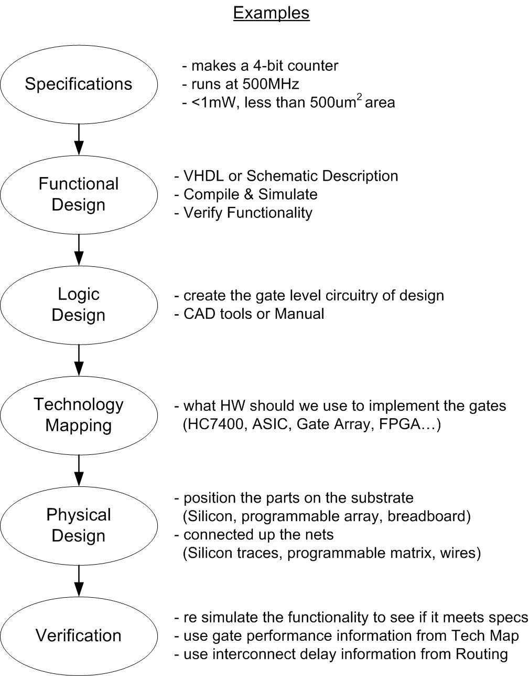
Course Content
VLSI Design Process

Slide 14
Required Text
“CMOS Digital Integrated Circuits” 3rd Edition.
Sung-Mo Kang and Yusuf Leblebici, McGraw Hill, 2003.
ISBN 0-07-246053-9
Notes:
14

Slide 15
Design Implementation Options
Implementations Options
- once a design is defined at the gate level, there are many options to implement the design
- each option is an engineering trade-off between
1) Cost : up-front, engineering time, per-piece
2) Schedule : how long does it take to get to market
3) Performance : does the final design meet spec (features, speed, power, area)
- VLSI designs are especially difficult due to the rapid progression of fabrication technology
- a new process is available every 18-36 months
- each process is faster, small, and takes less power
- product life cycles can also be short
- if development takes too long, a competitor can have a competing product in a better process
- the product may be obsolete before enough are sold to cover the investment

Slide 16
Design Implementation Options
Custom ASIC - "Application Specific Integrated Circuit"
- each gate is designed, laid out, and optimized by hand
Advantages
- Best circuit performance
- Best use of area on silicon
Disadvantages
- Long Design Cycle
- Full Custom Mask = More up-front $$$
- Takes skilled physical design engineers
Standard Cell - all of the gates and basic building blocks are designed
- each block has a spec sheet, layout, symbol, HDL instance, and simulation deck
- the designer combines the pre-existing blocks to form the new ASIC
- still considered an ASIC
Advantages
- faster development
- still relatively fast in performance
Disadvantages
- not as much optimization in performance, area, power as a custom ASIC

Slide 17
Design Implementation Options
Gate Array - transistors are already created but not connected
- the designer provides the interconnect design to implement the given functionality
aka
Advantages
"structured - faster development time
ASIC"
Disadvantages
- less performance
FPGA - Field Programmable Gate Array
- an array of programmable logic blocks are designed and packaged
- the designer creates a programming file to implement the given functionality
- user downloads the file and is running in hardware without any fab
Advantages
- fastest development
Disadvantages
- lowest performance

Slide 18
Design Implementation Options
Trade-offs
Up-Front Cost Development Time Per-Piece Cost
Custom ASIC
STD Cell ASIC
Gate Array
FPGA
most
most
least
least
least
most

Slide 19
VLSI Economy
Economy
- there are two general types of economy in VLSI
1) you are going to use the IC design in your own product you sell
2) you design and sell the individual IC
- both require a financial analysis that includes:
1) upfront cost
2) engineering development cost
3) per piece cost
4) predicted monthly volume
5) predicted life span of product
- items 1,2, and 3 are deterministic
- items 4 and 5 are marketing “best guesses” and probably the most difficult thing to predict in business

Slide 20
VLSI Economy
Economy Example of “Using your IC”
- your company is developing a product that will use a VLSI design. You are to choose which
implementation option is the best between a Custom ASIC, STD Cell ASIC, Gate Array, or FPGA
- in this case, all 4 of the implementation options meet the electrical specifications so it a simple matter
of economy in selecting the best option
- the product that this IC goes into will ship in 24 months regardless of the development time of your IC
(assuming it is done of course!)
- your marketing department thinks that you will sell 5,000 product per month and that the product
life cycle is 5 years (starting after the 24 months of development)
- you are given the following:
NRE Engineering Per-Piece Cost
Custom ASIC $500k 4 engineers, 24 months, $15k/engr/mo $5.00
STD Cell ASIC $300k 4 engineers, 18 months, $15k/engr/mo $8.00
Gate Array $200k 3 engineers, 12 months, $12k/engr/mo $11.00
FPGA $0k 2 engineers, 9 months, $10k/engr/mo $16.00

Slide 21
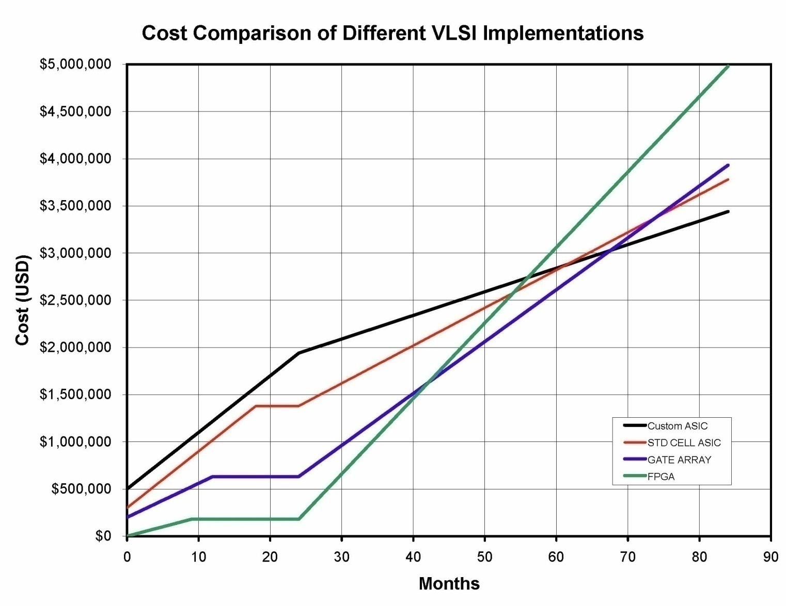
VLSI Economy
Economy Example

Slide 22
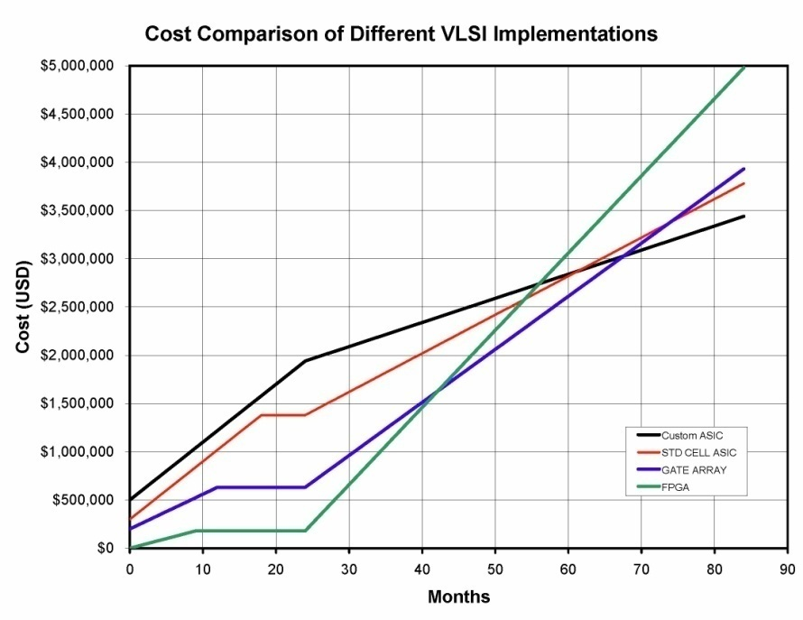
VLSI Economy
Economy Considerations
Quantitative considerations for this example….
Answer
- Which options takes the most development? ASIC
- If the product runs 5 years, which option is the most cost effective? ASIC
- What if the product only sells for 1 year? FPGA
- What if the product only sells for 2 years? Gate Array

Slide 23
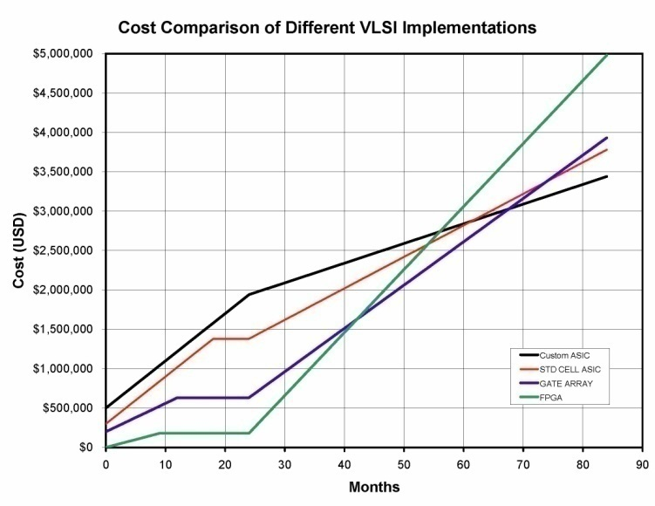
VLSI Economy
Economy Considerations
Qualitative considerations for this example….
Idea
- If performance mattered, how could you justify doing a Custom ASIC? You could charge more
for the product
- What if you are a small company and can’t afford the NRE? You might be forced to
use an FPGA
- What is the danger of doing an FPGA? It might not take long for
a competitor to develop
the same thing if they
see you are successful
selling your product

Slide 24
VLSI Economy
Economy of Selling your IC
- if you design and sell your IC, you need a similar analysis.
- But now you need to consider
1) Profit Margin - for each IC sold, how much of that is gross profit versus the cost of
simply making the IC
2) Break Even Point - you invest upfront NRE and engineering time. The gross profit
from the first x IC’s that you sell go toward paying off that investment.
The # of IC’s and the time it takes to reach that point is called
“Break Even”
- If the product doesn’t sell enough, you may not make enough to
pay for the initial development.
3) Opportunity Cost - if you only have 5 skilled IC designers, you want to make sure they
are working on the most profitable product. If they are working on
product A then they can’t be working on product B. If B is more
profitable, you are not using your resources effectively.

Slide 25
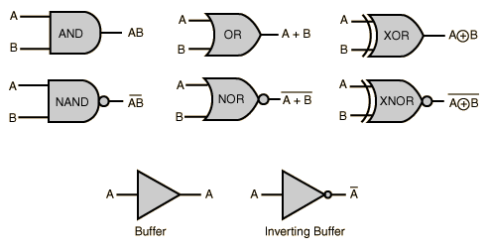
Digital Review
Combinational Logic
Combinational Logic Gates :
- Output depends on the logic value of the inputs
- no storage

Slide 26
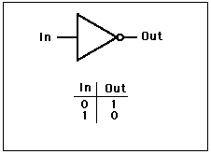
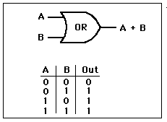
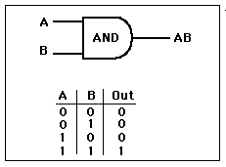
Digital Review
NOT out = in’ = in f(in) = in’ = in
OR out = a+b f(a,b) = a+b
AND out = a·b f(a,b) = a·b

Slide 27
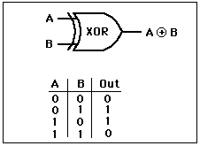
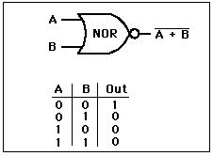
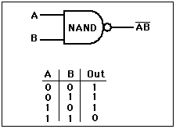
Digital Review
XOR out = a⊕b f(a,b) = a⊕b
NOR out = a+b f(a,b) = a+b
NAND out = a·b f(a,b) = a·b

Slide 28
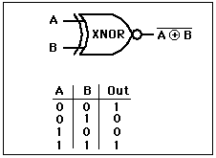
Digital Review
XNOR out = a⊕b f(a,b) = a⊕b
Also remember about XOR Gates:
f(a,b) = a⊕b = (a’b + b’a)
Also remember the priority of logic operations (without parenthesis) is:
NOT, AND, OR

Slide 29
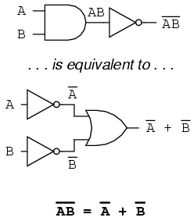
Digital Review
DeMorgan’s Theorems
Inverting the output of any gate results in the same function as the opposite
gate (AND/OR) with inverted inputs

Slide 30
Digital Review
DeMorgan’s Theorems
Graphically : breaking the bar changes the logic function (AND-OR) under the break
out = a+b
1) Break bar
out = a+b
2) Change + to · under break
out = a·b

Slide 31
Digital Review
Boolean Expressions Using SOP
Logic functions can be described using a Sum of Products techniques
Sum of Products (SOP) is the summation of all minterms resulting in the truth table
A minterm is the expression for an input configuration which yields a TRUE output
A minterm expression is the AND’ing of the input "1" signal configuration
Truth Table
a b out
0 0 0
0 1 1 minterm m1 = a’·b
1 0 1 minterm m2 = a·b’
1 1 0
SOP Expression : f(a,b) = a’·b + a·b’
Note : un-minimized Boolean expression

Slide 32
Digital Review
Boolean Expressions Using POS
Logic functions can be described using a Product of Sums techniques
Product of Sums (POS) is the multiplication of all maxterms resulting in the truth table
A maxterm is the expression for an input configuration which yields a FALSE output
A maxterm expression is the OR’ing of the input "0" signal configuration
Truth Table
a b out
0 0 0 maxterm m0 = a+b (input configuration of 0's)
0 1 1
1 0 1
1 1 0 maxterm m3 = a'+b' (input configuration of 0's)
POS Expression : f(a,b) = (a+b) · (a'+b')

Slide 33
Digital Review
Boolean Expressions Using SOP & POS
SOP and POS functions are equivalent
SOP Expression : f(a,b) = a’·b + a·b’
is equal to
POS Expression : f(a,b) = (a+b) · (a'+b')

Slide 34
Digital Review
Karnaugh Maps
K-maps provide a graphical method to find SOP/POS expressions
K-maps also provide a graphical method to perform logic minimization
K-map SOP Process
1) Circle minterms to create SOP
2) Circle in Horizontal & Vertical manner
3) Circle in groups with powers of 2 (1,2,4,8,…)
Truth Table
a b out
0 0 0
0 1 1
1 0 1
1 1 1
a
0 1
No dependency on b, minterm = a
b 0 1
0
1
No dependency on a, minterm = b
1
1
SOP expression : f(a,b) = a + b

Slide 35
Digital Review
Karnaugh Maps
K-maps provide a graphical method to find SOP/POS expressions
K-maps also provide a graphical method to perform logic minimization
K-map POS Process
1) Circle maxterms to create POS
2) Circle in Horizontal & Vertical manner
3) Circle in groups with powers of 2 (1,2,4,8,…)
Truth Table
a b out
0 0 0
0 1 1
1 0 1
1 1 1
a
0 1
Dependency on a' and b', maxterm = a+b
b 0 1
0
1
1
1
POS expression : f(a,b) = a + b

Slide 36
Digital Review
Sequential Logic
- Concept of “Storage Element”
- With Storage, logic functions can depend on current & past values of inputs
- Sequential State Machines can be created
D-Flip-Flop
- on timing event (i.e., edge of clock input), D input goes to Q output
CLK
D
Q
D
Q
Q
Q
tc2q

Slide 37
Digital Review
State Machines
- Moore : Outputs depend on present state
- Mealy : Outputs depend on present state and current inputs

Slide 38
Digital Review
State Machine Example : Design a 2-bit Gray Code Counter
1) Number of States? : 4
2) Number of bits to encode states? : 2^{n}=4, n=2
3) Moore or Mealy? : Moore
For this counter, we can make the outputs be the state codes
00
01
11
10

Slide 39
Digital Review
State Machine Example : Design a 2-bit Gray Code Counter
STATE
Current Next
Acur Bcur Anxt Bnxt
0 0 0 1
0 1 1 1
1 1 1 0
1 0 0 0
Anxt Logic
Bnxt Logic
00
Bcur
0 1
Bcur
0 1
01
Acur 0 1
0
1
Acur 0 1
1
1
0
1
0
0
11
Anxt = Bcur
Bnxt = Acur’
10
A
counter
output
B
D
Q
D
Q
A
B
Q
Q
CLK

