Slide 1
EELE 414 – Introduction to VLSI Design
Module #2 – MOSFET Operation
Agenda
    MOSFET Operation
    - Device Physics
    - MOSFET Structure
    - IV Characteristics
    - Scaling
    - Small Geometry Effects
    - Capacitance
Announcements
    Read Chapter 3

Slide 2
MOSFET Operation
MOSFET
- Metal Oxide Semiconductor Field Effect Transistor
- we need to understand the detailed operation of the MOSFET in order to use it to build
larger blocks such as Inverters, NAND gates, adders, etc…
- we will cover the theory of the device physics, energy bands, and circuit operation
- we will do homework to analyze the behavior by hand
- in the real world, we typically use SPICE simulations to quickly analyze the MOSFET behavior
- but we need to understand what SPICE is calculating or:
1) we won’t be able to understand performance problems
2) we won’t be able to troubleshoot (is it the tool, is it the circuit, is it the process?)

Slide 3
Semiconductors
Semiconductors
- a semiconductor is a solid material which acts as an insulator at absolute zero. As the temperature
increases, a semiconductor begins to conduct
- a single element can be a semiconductor:
Carbon (C), Silicon (Si)
- a compound material can also form a semiconductors
(i.e., two or more materials chemically bonded)
Gallium Arsenide (GaAs), Indium Phosphide (InP)
- an alloy material can also form semiconductors
(i.e., a mixture of elements of which one is a metal):
Silicon Germanium (SiGe), Aluminum Gallium Arsenide (AlGaAs)
- Silicon is the most widely used semiconductors for VLSI circuits due to:
- it is the 2nd most abundant element (25.7%) of the earth’s crust (after oxygen)
- it remains a semiconductor at a higher temperature
- it can be oxidized very easily

Slide 4
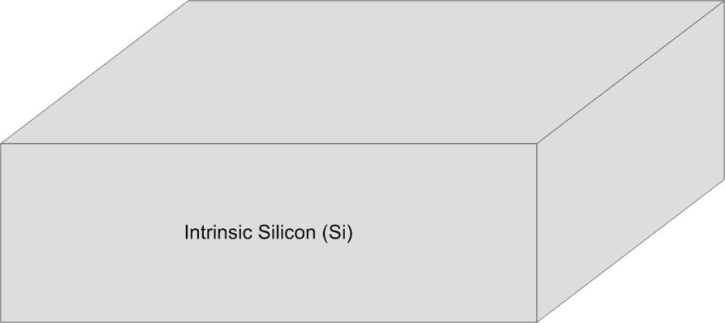
Semiconductors
Charge Carriers
- since we want to use Si to form electronics, we are interested in its ability to conduct current.
A good conductor has a high concentration of charge carriers.
- an electron can be a charge carrier.
- a hole (the absence of an electron) can be a charge carrier.
- “Intrinsic” Silicon means silicon that is pure or it has no impurities. We sometimes called this
i-typed Silicon
- Since there are no impurities, the number of charge carriers is determined by the properties
of the Silicon itself.
- We can define the Mobile Carrier Concentrations as:
n = the concentration of conducting electrons
p = the concentration of conducting holes
- these are defined per unit volume (1/cm³)

Slide 5
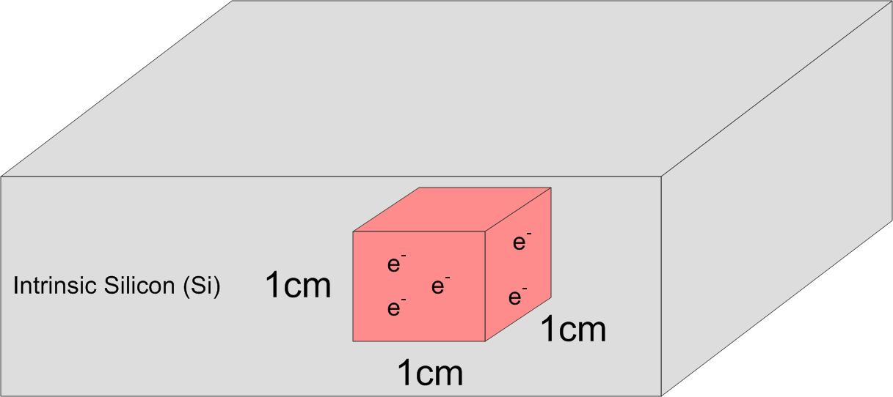
Semiconductors
Charge Carriers
- Intrinsic Silicon has a carrier concentration of :
n_{i} = 1.45 x 10¹⁰ cm-3
- notice the units are “carriers per cubic centimeter”
- notice that we give the subscript “i” to indicate “intrinsic”
- this value is dependant on temperature and is defined above at T=300 K (i.e., room temperature)
- there are about 5x10²² Atoms of Silicon per cubic centimeter in a perfect intrinsic lattice

Slide 6
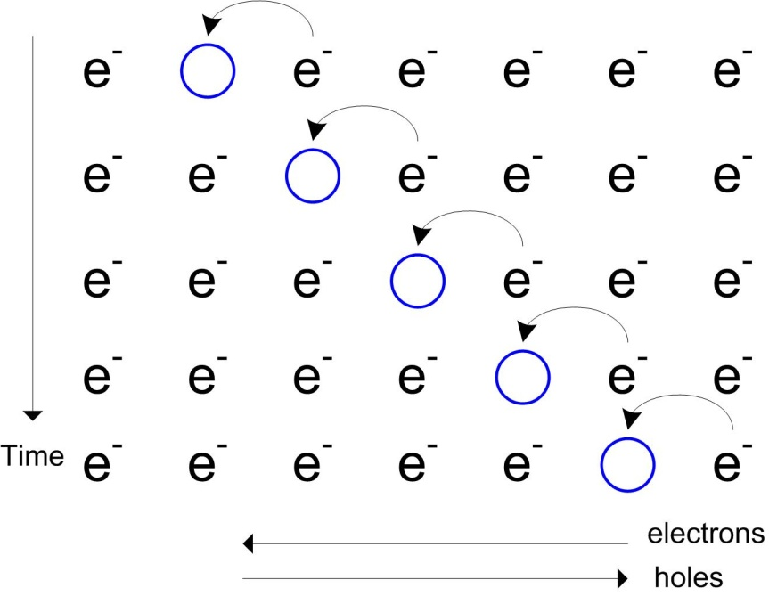
Semiconductors
Charge Carriers
- The equilibrium of the carriers in a semiconductor always follows the Mass Action Law
- this means there is an equal number of p and n charge carriers in intrinsic Silicon
Electrons vs. Holes
- electrons have a charge of q=-1.6x10⁻¹⁹ Coulomb (C)
- holes are the “absence” of electrons in an orbital
of an atom. When an electron moves out of an
orbital, it leaves a void (or hole). This hole
can “accept” another electron
- as electrons move from atom to atom, the holes
effectively move in the opposite direction and give
the impression of a positive charge moving

Slide 7
Energy Bands
Energy Bands
- the mobility of a semiconductor increases as its temperature increase.
- Increasing the mobility of a semiconductor eventually turns the material into a conductor.
- this is of interest to electronics because we can control the flow of current
- we can also cause conduction using an applied voltage to provide the energy
- we are interested in how much energy it takes to alter the behavior of the material
- Energy Band Diagrams are a graphical way to describe the energy needed to change the
behavior of a material.

Slide 8
Energy Bands
Energy Bands
- Quantum Mechanics created the concept of bands to represent the levels of energy that are
present at each “state” of an atom.
- the electrons on an atom occupy these energy states
- For a given number of electrons in an atom, we begin filling in the energy bands from
lowest to highest energy until all of the electrons have been used.
- electrons only exist in the bands. By convention, electrons are forbidden from existing in
between bands
- there is a finite amount of energy that exists to move an electron from one band to another
- if given enough energy (via heat or E-fields), electrons can receive enough energy to jump to
a higher energy band.

Slide 9
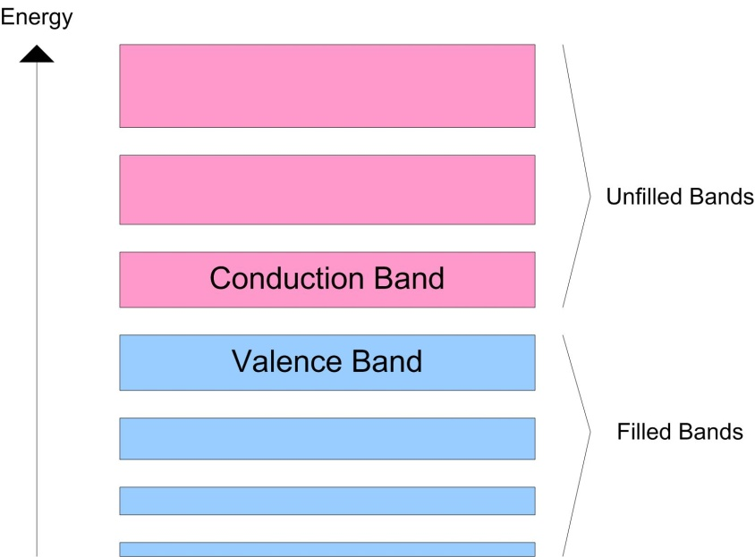
Energy Bands
Energy Bands
Valence Band : the highest range of electron energies where electrons are normally present
at absolute zero.
: this is the highest “filled” band
Conduction Band : the range of electron energy sufficient to make the electrons free to accelerate
under the influence of an applied electric field (i.e., current).
: this is the lowest “unfilled” band

Slide 10
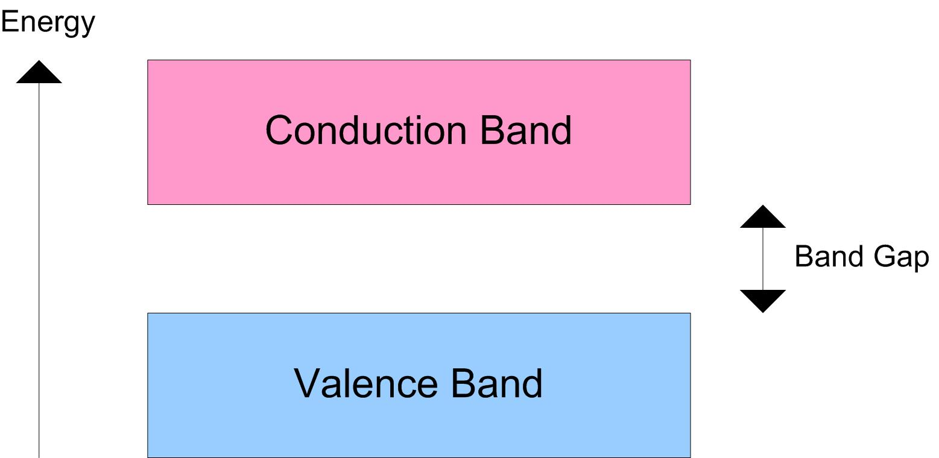
Energy Bands
Band Gap
- the band gap energy is the energy between the lowest level of the "conduction band" and the
top of the "valence band"
- this can be thought of as the amount of energy needed to release an electron for use as current
at absolute zero.

Slide 11
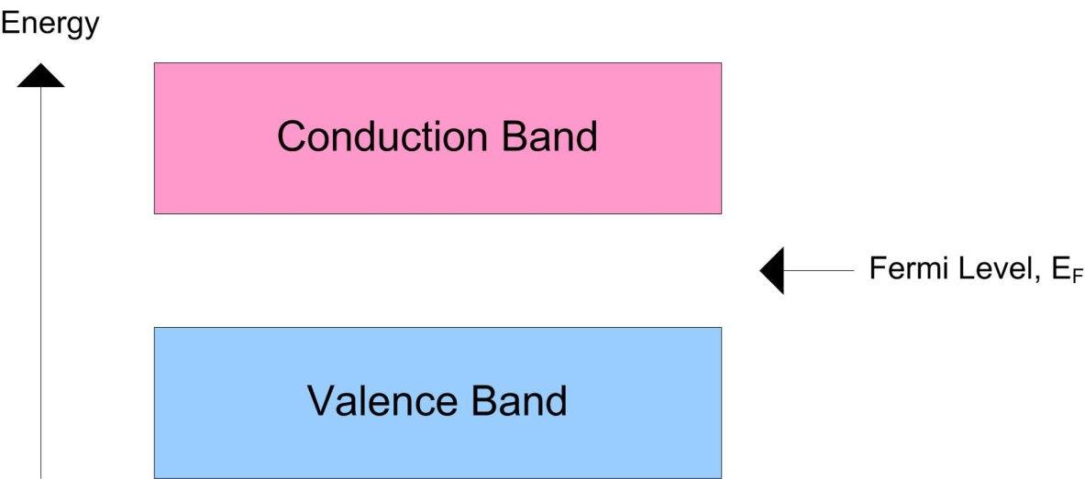
Energy Bands
Fermi Level
- the Fermi Level (or energy) represents an energy level that at absolute zero:
- all bands below this level are filled
- all bands above this level are unfilled
- the Fermi Level at room temperatures is the energy at which the probability of a state being occupied
has fallen to 0.5
- at higher temperatures, in order for an electron to be used as current, it needs to have
an energy level close to the Fermi Level
- this can also be thought of as
the equilibrium point of the material

Slide 12
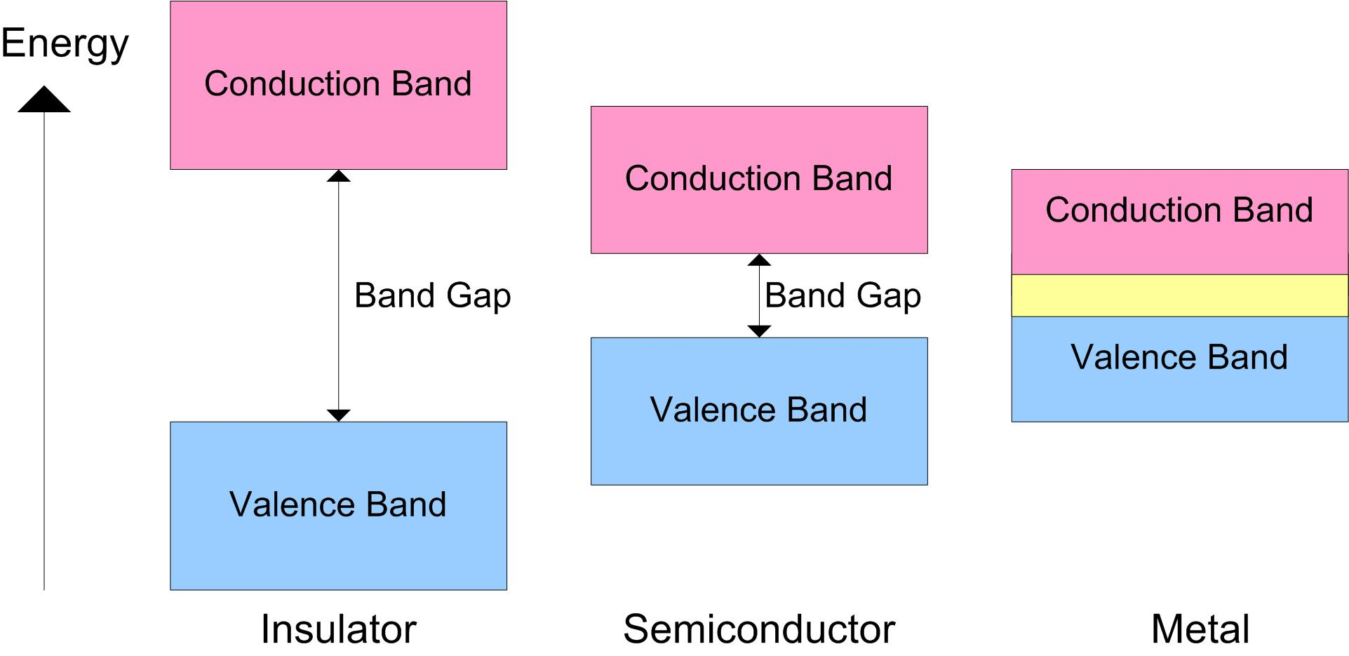
Energy Bands
Band Gap Comparisons
- the following shows the relationship of Band Gap energies between insulators, semiconductors,
and metals
- notice that the only difference between an insulator and a semiconductor is that the band gap
is smaller in a semiconductor.
- notice that there is an overlap between the conduction and valence bands in metals. This means
that metals are always capable of conducting current.

Slide 13
Energy Bands
Band Gap Comparisons
Insulator Band Gap : it is large enough so that at ordinary temperatures, no electrons reach
the conduction band
Semiconductor Band Gap : it is small enough so that at ordinary temperatures, thermal energy
can give an electron enough energy to jump to the conduction band
: we can also change the semiconductor into a conductor by introducing
impurities

Slide 14

Energy Bands
Band Gap Comparisons
- we typically describe the amount of energy to jump a band in terms of “Electron Volts” (eV)
- 1 eV is the amount of energy gained by an unbound electron when passed through an electrostatic
potential of 1 volt
- it is equal to (1 volt) x (unsigned charge of single electron)
- 1 Volt = (Joule / Coulomb)
- (V x C) = (J/C) x (C) = units of Joules
- 1eV = 1.6x10⁻¹⁹ Joules
- we call materials with a band gap of
~ 1eV a “semiconductor”
- we call materials with a band gap of
much greater than 1eV an “insulator”
- and if there isn’t a band gap, it is a “metal”

Slide 15
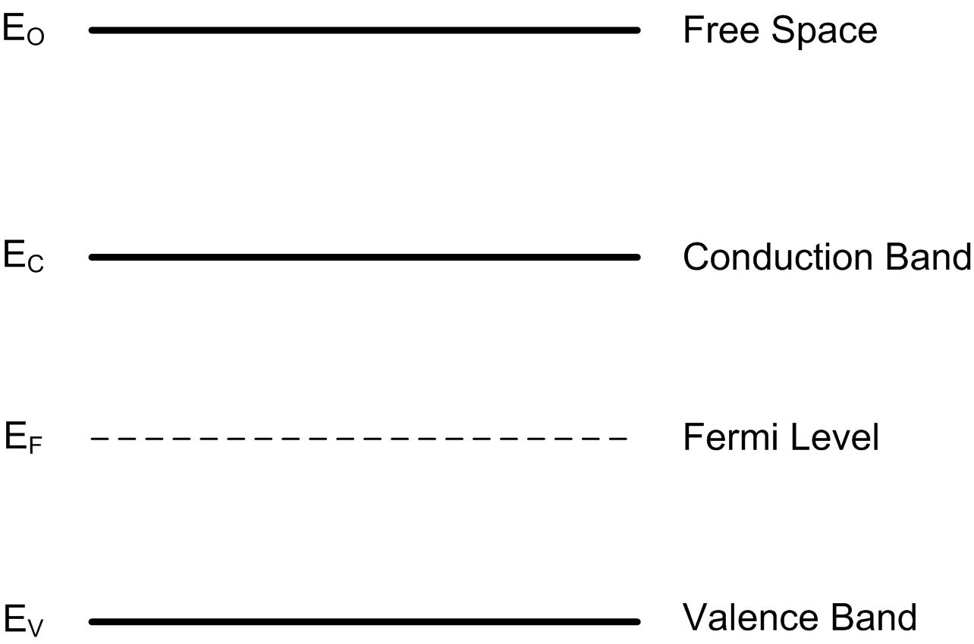
Energy Bands
Band Diagram
- in a band diagram, we tabulate the relative locations of important energy levels
- Note that E_{O} is where the electron has enough energy to leave the material all together
(an example would be a CRT monitor)
- as electrons get enough energy to reach near the Fermi level, conduction begins to occur

Slide 16
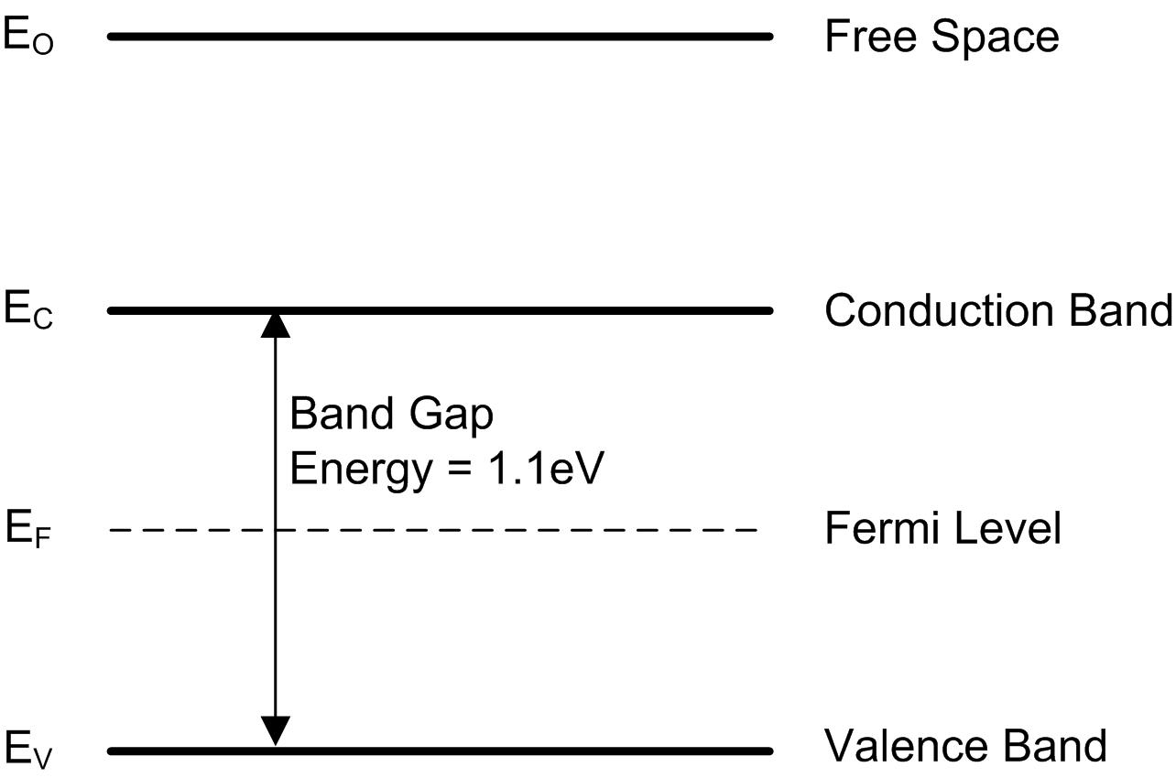
Energy Bands
Band Diagram of Intrinsic Silicon
- Intrinsic Silicon has a band gap energy of 1.1 eV
- @ 0 K, Eg=1.17 eV
- @ 300 K, Eg=1.14 eV

Slide 17
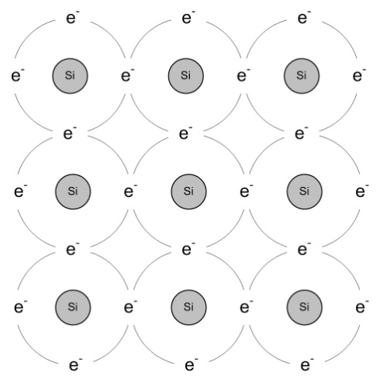
Doping
Doping
- the most exploitable characteristic of a semiconductor is that
impurities can be introduced to alter its conduction ability
- Silicon has a valence of 4 which allows it to form a perfect
lattice structure. This lattice can be broken in order to
accommodate impurities
- VLSI electronics use Silicon as the base material and then alter its properties to form:
1) n-type Silicon : material whose majority carriers are electrons
: introducing a valence-of-5 material increases the # of free
negative charge carriers
: Phosphorus (P) or Arsenic (As) are typically used (group V elements)
2) p-type Silicon : material whose majority carriers are holes
: introducing a valence-of-3 material increases the # of free
positive charge carriers
: Boron (B) is typically used (a group III element)
- when Silicon is doped, it is called “Extrinsic Silicon” due to the presence of impurities

Slide 18
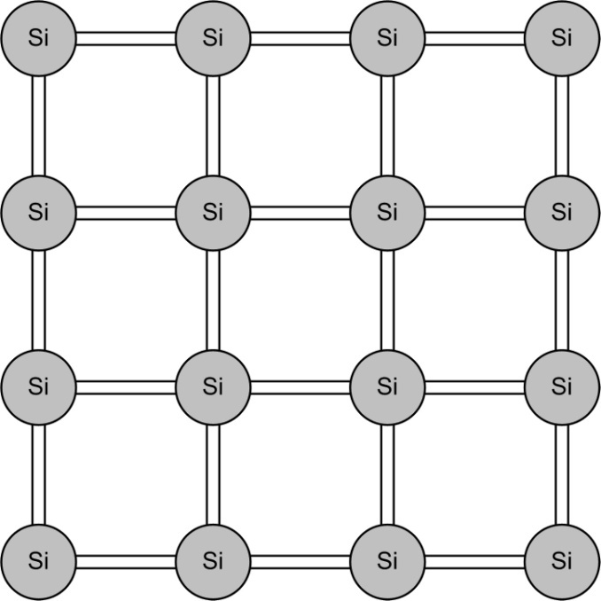
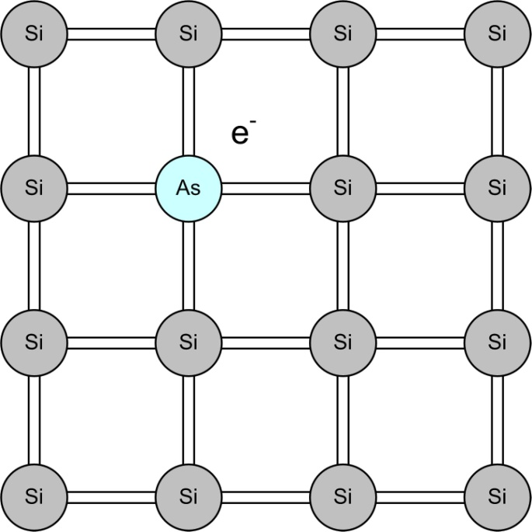
N-type Doping
N-type Doping
- a perfect Silicon lattice forms covalent bonds with neighbors on each side
- there is an equal number of p and n charge carriers (n∙p=n_{i}²)
- inserting an element into the lattice with a valence of 5 will form 4 covalent bonds PLUS
have an extra electron

Slide 19
N-type Doping
N-type Doping
- this extra electron increases the n-type charge carriers
- we call the additional element that provides the extra electron a Donor
- the concentration of donor charge carriers is now denoted as N_{D}
- we call N_{D} the doping concentration of an n-type material
- we can use the Mass Action Law to say:

Slide 20
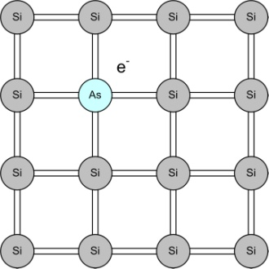
N-type Doping
N-type Doping
- Doping Silicon can achieve a Donor Carrier Concentration between 10¹³ cm⁻³ to 10¹⁸ cm⁻³
- Doping above 10¹⁸ cm⁻³ is considered degenerate (i.e., it starts to reduce the desired effect)
- We give postscripts to denote the levels of doping (normal, light, or heavy)
- Remember that Silicon has a density of ~10²¹ atoms per cm
Example:
n- : light doping : N_{D} = 10¹³ cm⁻³ : 1 in 100,000,000 atoms
n : normal doping : N_{D} = 10¹⁵ cm⁻³ : 1 in 1,000,000 atoms
n+ : heavy doping : N_{D} > 10¹⁷ cm⁻³ : 1 in 10,000 atoms

Slide 21
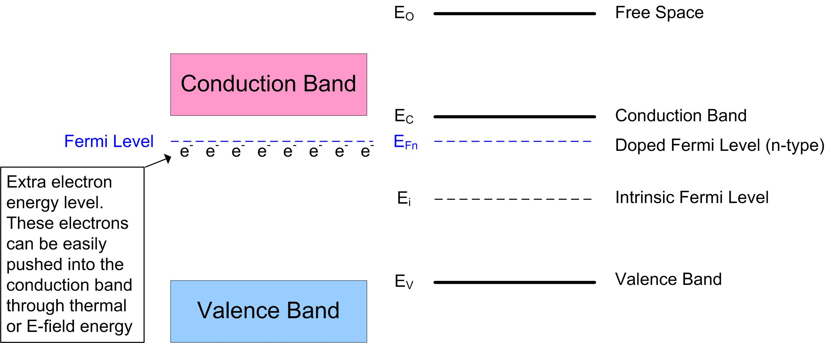
N-type Doping
Effect on the Band Structure
- by adding more electron charge carriers to a material, we create new energy states
- by adding more electrons to Silicon, we decrease the energy that it takes for an electron to reach
the conduction band
- this moves the Fermi Level (the highest filled energy state at equilibrium) closer
to the conduction band

Slide 22
N-type Doping
Effect on the Band Structure
- We can define the Fermi Potential (φ_{F}) as the difference between the intrinsic Fermi Level (E_{i})
and the new doped Fermi Level (E_{Fn})
- note: that φ_{Fn} has units of volts and is positive since E_{Fn}>E_{i},
- note: that E_{i} and E_{Fn} have units of eV, which we convert to volts by dividing by q
- note: we use q=1.6x10⁻¹⁹C, which is a positive quantity
- the Boltzmann approximation gives a relationship between the Fermi Level and the charge
carrier concentration of a material (a.k.a, the Quasi Fermi Energy).
- This expression relates the change in the Fermi Level (from intrinsic) to the additional charge
carriers due to n-type doping.
where, k_{B} = the Boltzmann Constant = 8.62x10⁻⁵ (eV/K)
or
= 1.38x10⁻²³ (J/K)
notice that the (E_{Fn} - E_{i}) term in the exponent represents a positive voltage since E_{Fn} > E_{i}

Slide 23
N-type Doping
Effect on the Band Structure
- if we rearrange terms and substitute n=N_{D}…
- since N_{D}>n_{i}, the natural log is
taken on a quantity that is
greater than one
- this makes φ_{Fn} POSITIVE
Then plug into the Fermi potential

Slide 24
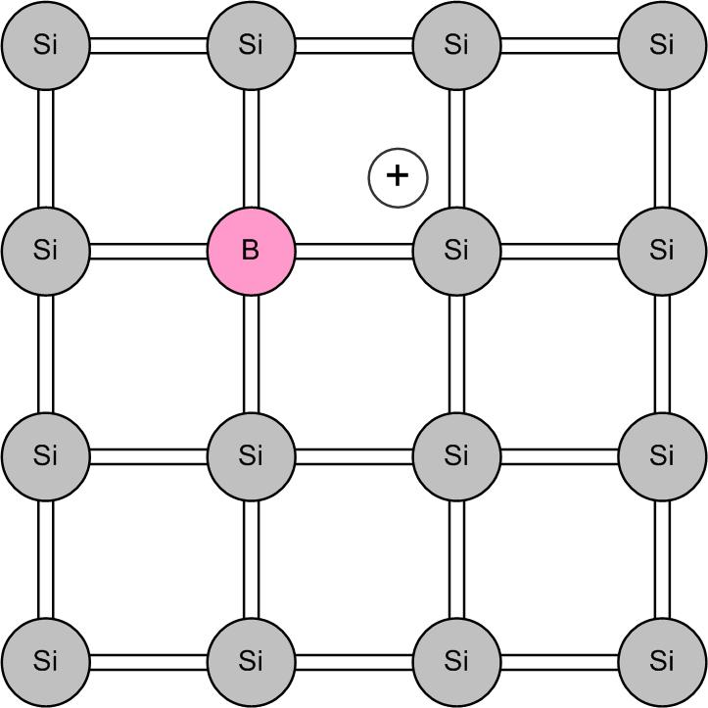
P-type Doping
P-type Doping
- inserting an element into the silicon lattice with a valence of 3 will form 3 covalent bonds but leave
one orbital empty
- this is called a hole and since it “attracts an electron”, it can be considered a positive charge with
a value of +1.6e⁻¹⁹ C

Slide 25
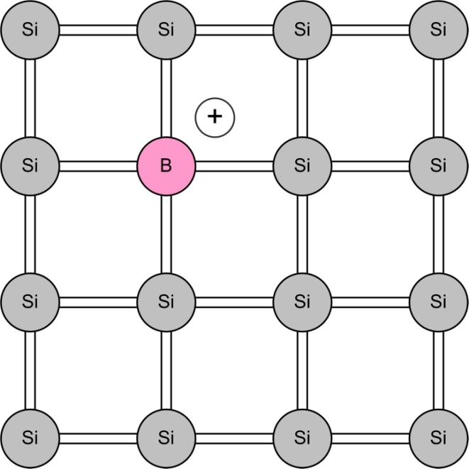
P-type Doping
P-type Doping
- this extra electron increases the p-type charge carriers
- we call this type of charge carrier an Acceptor since it provides a location for an electron to go
- the concentration of acceptor charge carriers is now denoted as N_{A}
- we call N_{A} the doping concentration of a p-type material
- we can use the Mass Action Law to say:

Slide 26
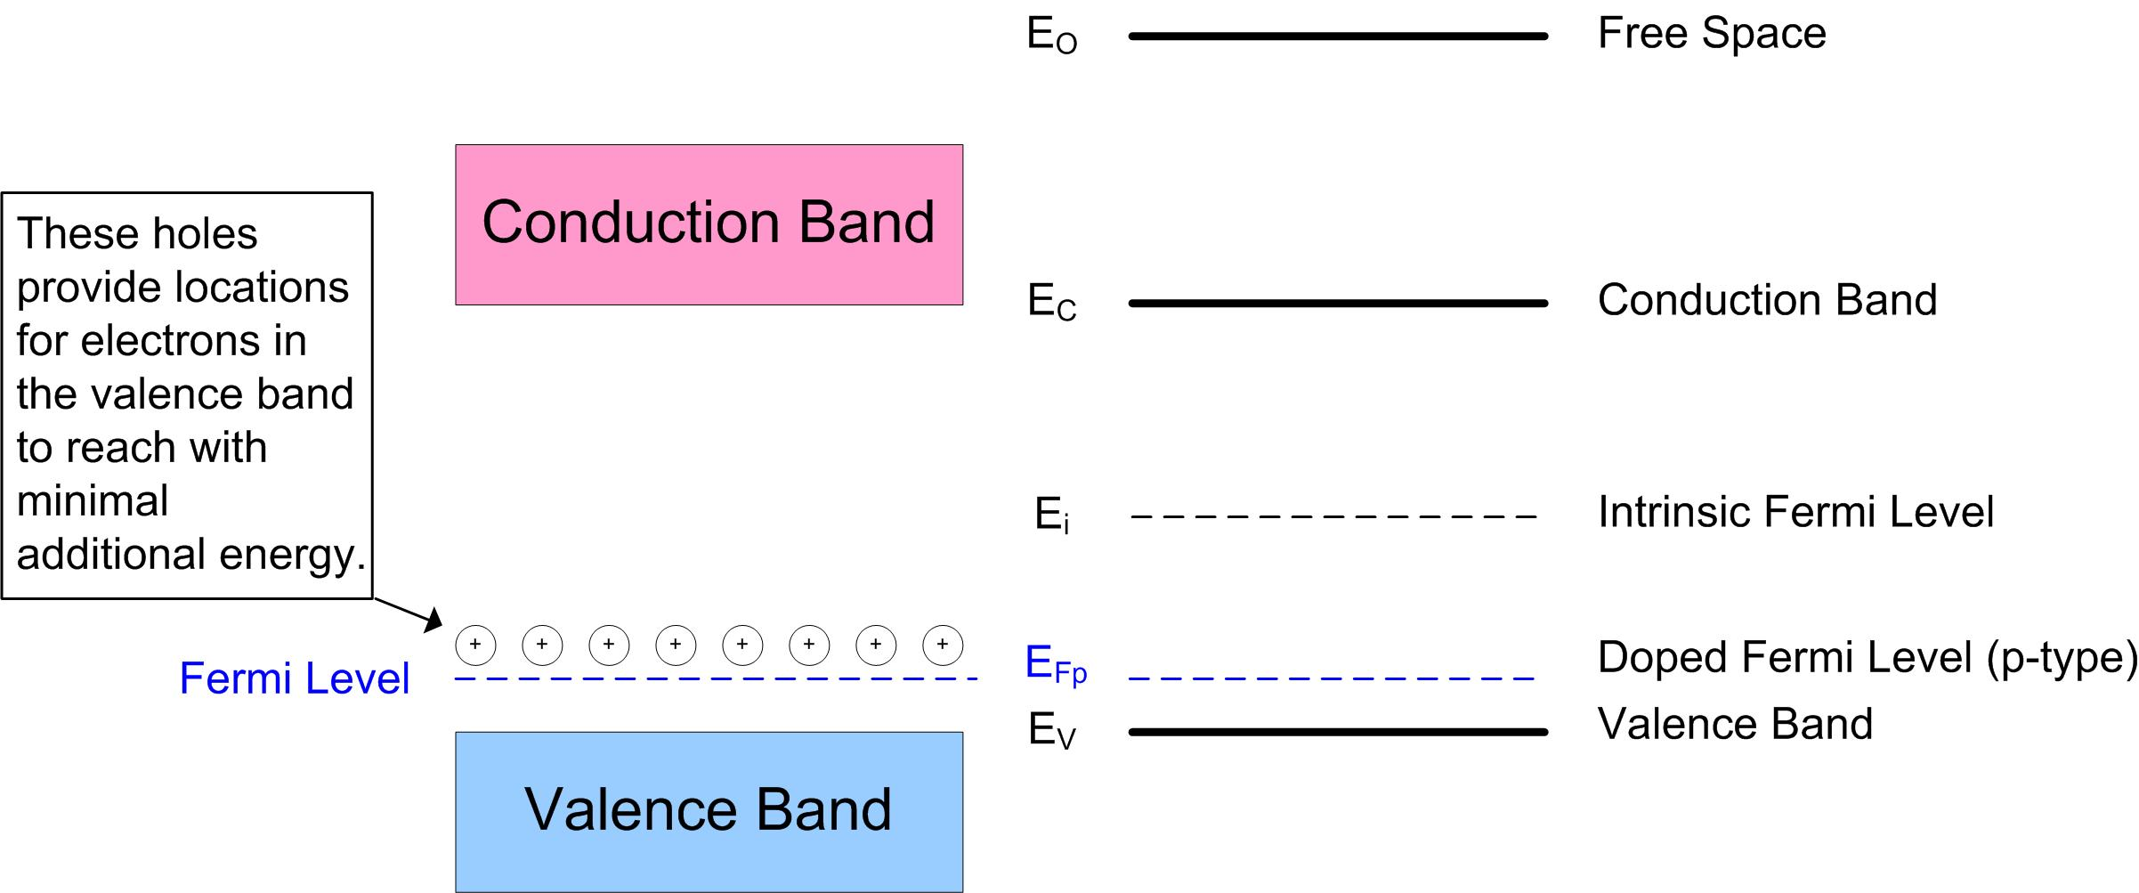
P-type Doping
Effect on the Band Structure
- by adding more hole charge carriers to a material, we also create new energy states
- holes create new “unfilled” energy states
- this moves the Fermi level down closer to the Valence band

Slide 27
P-type Doping
Effect on the Band Structure
- We again define the Fermi Potential (φ_{F}) as the difference between the intrinsic Fermi Level (E_{i})
and the new doped Fermi Level (E_{Fp})
- we again use the Boltzmann approximation, which gives a relationship between the
Fermi Level and the electron concentration of a material.
- notice that the (E_{Fp} - E_{i}) term yields a negative potential since E_{Fp} < E_{i}
- note that for the P-type doping the Fermi level moves down below the original Intrinsic level.
This original expression stated the increase in electron energy achieved by the doping.
So we need to swap the p and n_{i} terms to use this equation.
notice that the (E_{i} - E_{Fp}) term in the exponent represents a positive voltage since E_{i} > E_{Fp}

Slide 28
P-type Doping
Effect on the Band Structure
- if we rearrange terms and substitute p=N_{A}…
- since N_{A}>n_{i}, the natural log is
taken on a quantity that is
between 0 and 1
- this makes φ_{Fp} NEGATIVE
Then plug into the Fermi potential

Slide 29
Work Function
Electron Affinity & Work Function
- another metric of a material is the amount of energy it takes to move an electron into
Free Space (E₀)
Electron Affinity : the amount of energy to move an electron from the conduction band
into Free Space.
Work Function : the amount of energy to move an electron from the Fermi Level
into Free Space.

Slide 30
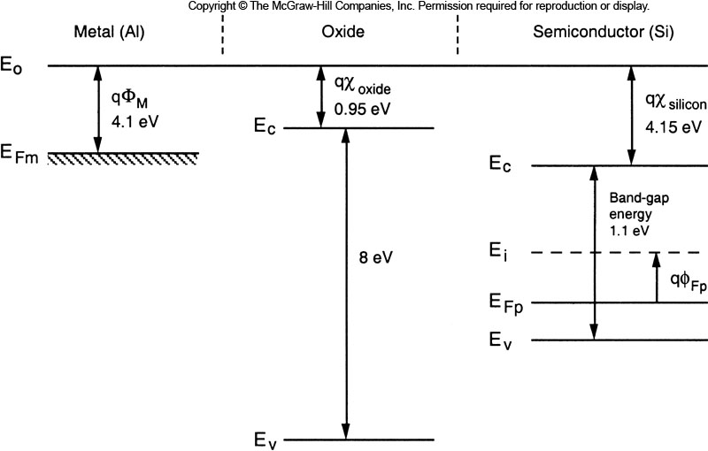
Work Function
Work Function of Different Materials
- When materials are separate, we can compare their band energies by lining up their
Free Space energies

Slide 31
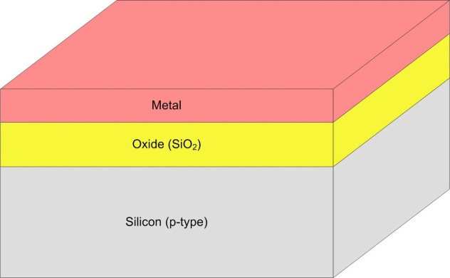
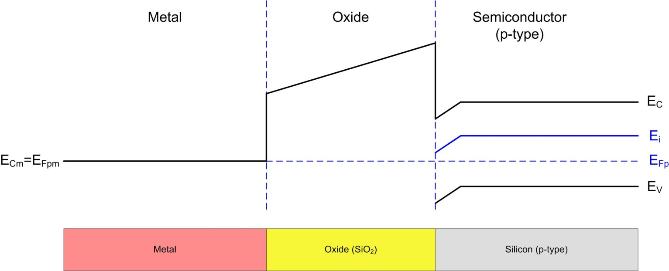
MOS Structure
MOS Structure
- When materials are bonded together, their Fermi Levels
in the band diagrams line up to reflect the
thermodynamic equilibrium.
- of special interest to VLSI is the combination of a
Metal Oxide Semiconductor (p-type) structure

Slide 32
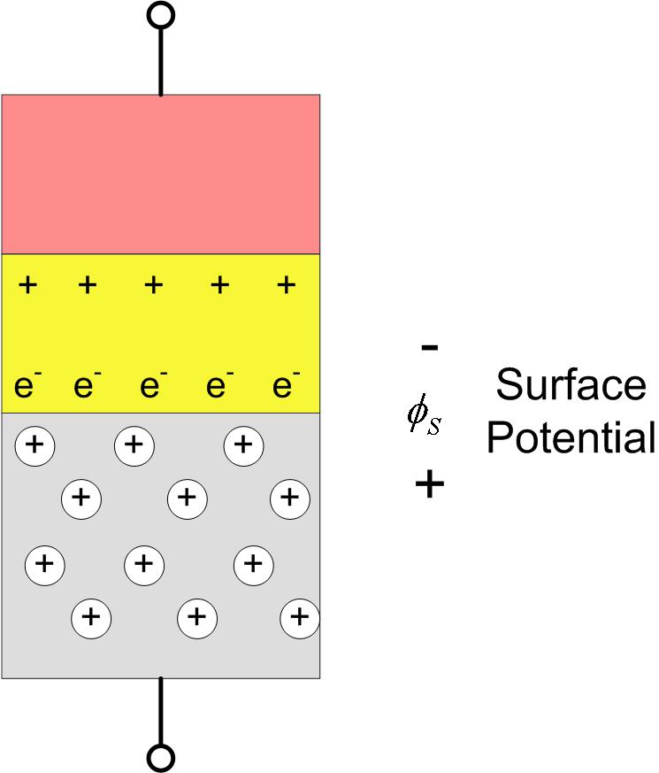

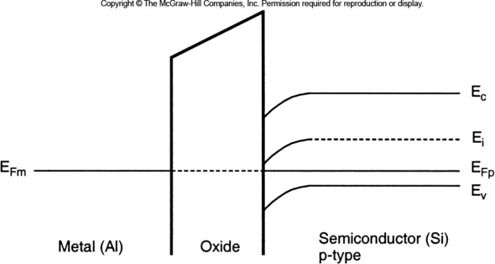
MOS Structure
Built-In Potential
- there is a built in potential due to the mismatches in work functions
that causes the bands to bend down at the oxide-semiconductor
junction
- this is due to the PN junction that forms due to the p-type Si and
the oxide. The oxide polarizes slightly at the surface

Slide 33
MOS Structure
Built-In Potential Example
- Example 3.1 in text. Given q∅_{Fp}=0.2eV, what is the built in potential in the following MOS structure?
Solution: We need to find the difference in work functions between the Silicon substrate and
the metal gate. We are given the metal gate work function (4.1eV) so we need to
find the Silicon work function:
Now we just subtract the Silicon work function from the Metal Gate work function:

Slide 34
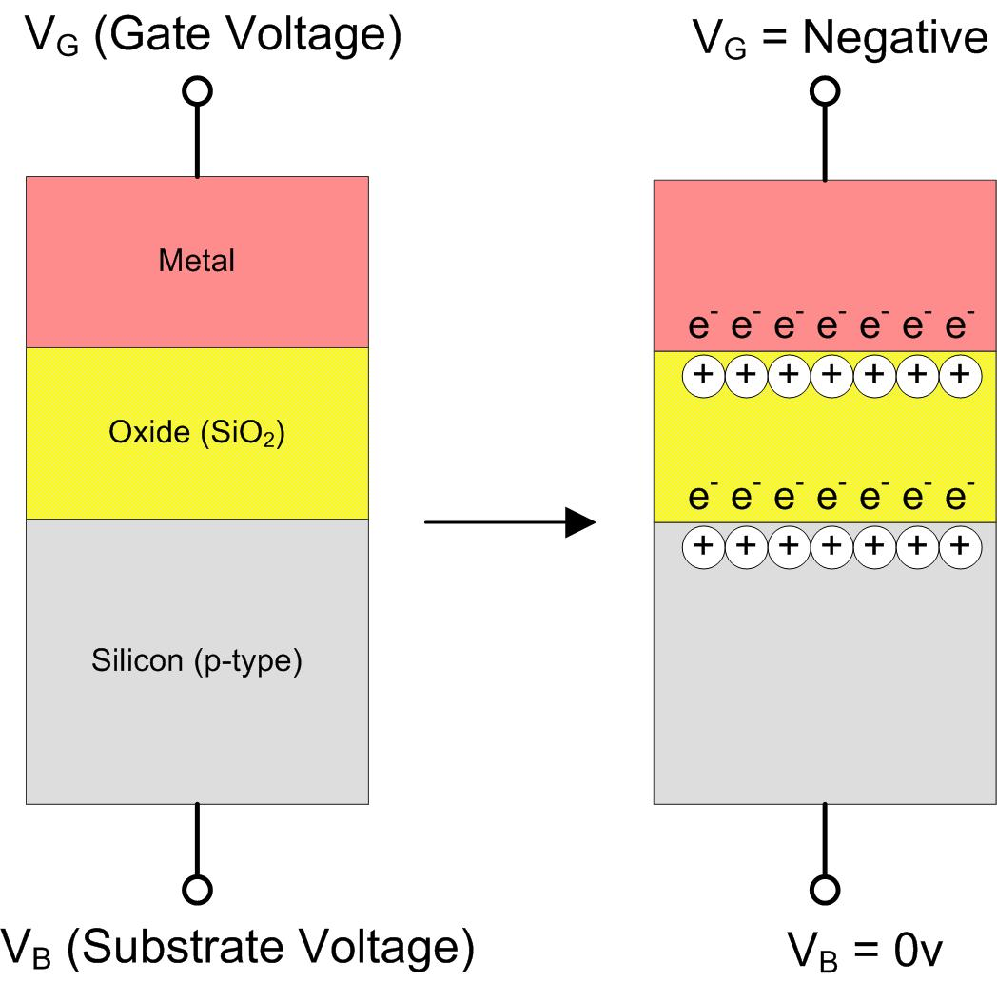
MOS Under Bias
MOS Accumulation
- If we apply an external bias voltage to the MOS, we can monitor how the charge carriers are affected
- assume a "body" voltage of 0v (V_{B}=0)
1) let's first apply a negative voltage to the "gate" (V_{G}=negative)
- the holes of the p-type semiconductor are
attracted to the Oxide surface
- this causes the concentration of charge
carriers at the surface to be greater
than that of the normal concentration (N_{A})
- this is called the Accumulation of
charge carriers in the semiconductor

Slide 35
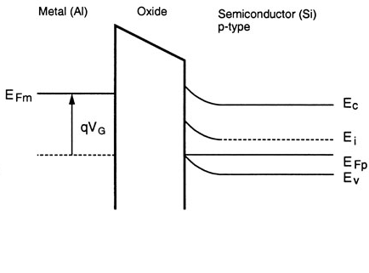
MOS Under Bias
MOS Accumulation
- applying a negative voltage to the metal raises its highest electron energy state by q·V_{G}
- the surface accumulation of energy can be reflected in the energy bands "bending up" near
the Oxide-Semiconductor surface
- note also that the minority carriers (electrons) in the p-type semiconductor are pushed away from
the oxide surface (not shown)

Slide 36
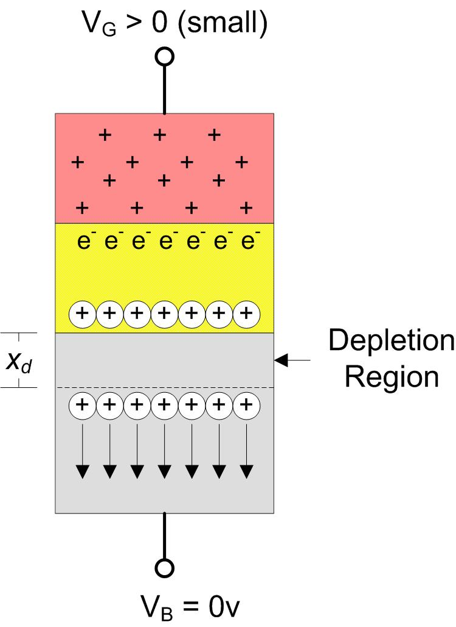
MOS Under Bias
MOS Depletion
2) now let's apply a small positive voltage to the gate
- the holes of the p-type semiconductor are repelled back away from the oxide surface
- as V_{G} increases, it will approach a level where there are no mobile carriers near the
Oxide-Semiconductor junction
- the region without mobile carriers is
called the Depletion Region

Slide 37
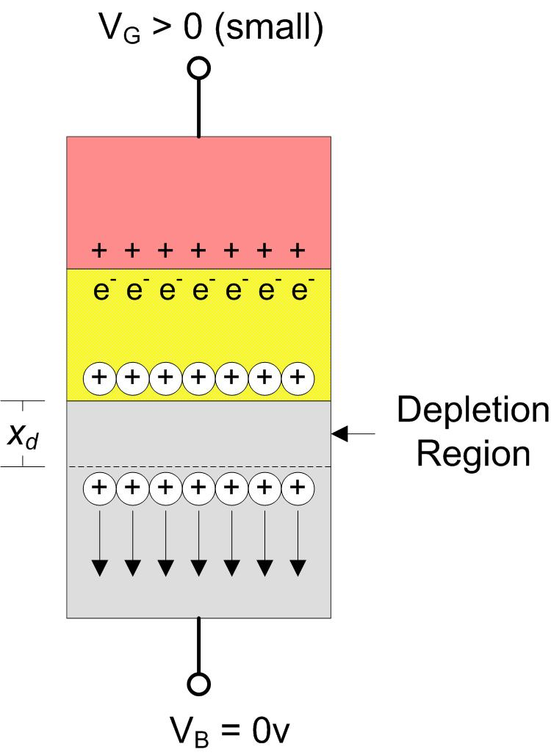
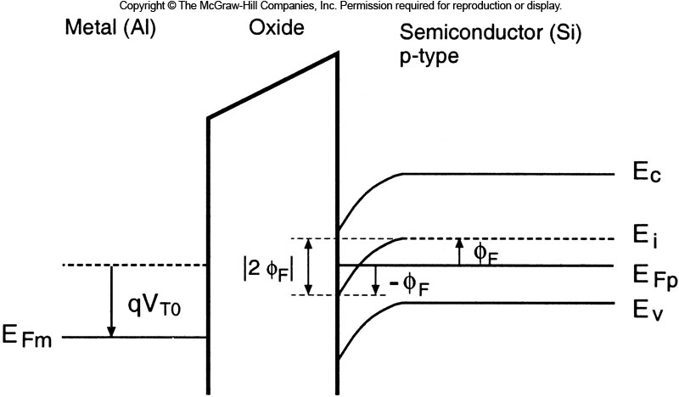
MOS Under Bias
MOS Depletion
- the positive voltage that develops at the Oxide-Semiconductor surface bends the energy bands
downward to reflect the decrease in electron energy in this region.
- the thickness of the depletion region is denoted as x_{d}

Slide 38
MOS Under Bias
MOS Depletion
- the depletion depth x_{d} is a function of the surface potential ∅_{S}
- if we model the holes as a sheet of charge parallel to the oxide surface, then the surface
potential (∅_{S}) to move the charge sheet a distance x_{d} away can be solved using
the Poisson equation.
- the solutions of interest are:
1) the depth of the depletion region:
2) the depletion region charge density:

Slide 39
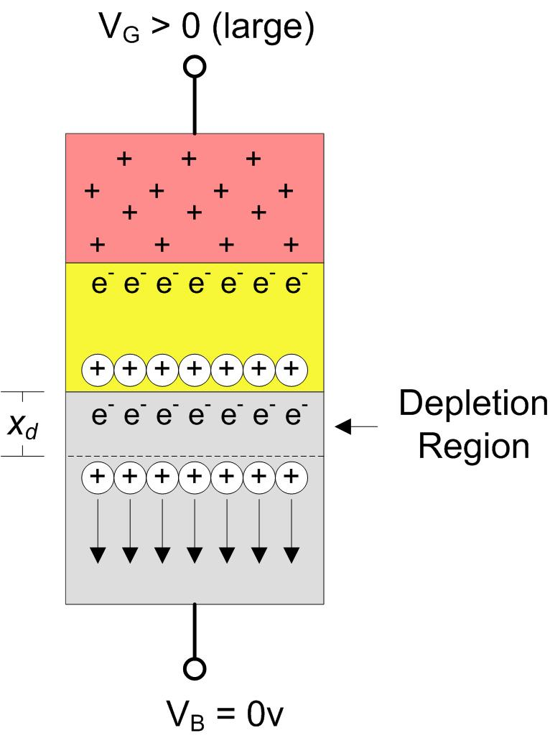
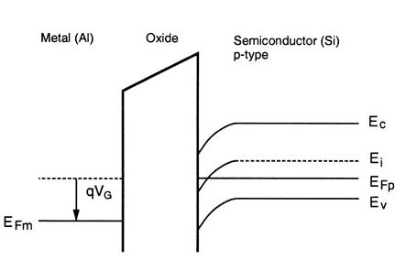
MOS Under Bias
MOS Inversion
3) now let's apply a larger positive voltage to the gate
- the positive surface charge in the Oxide is strong enough to pull the minority carrier
electrons to the surface.
- this can be seen in the band diagrams by “bending” the mid-gap (or E_{i}) energy at the surface
of the Oxide and semiconductor until it falls below the Fermi Level (E_{Fp})
- the n-type region created near the Oxide-Semiconductor
barrier is called the Inversion layer

Slide 40
MOS Under Bias
MOS Inversion
- this region has a higher density of minority carriers than majority carriers during inversion
- by definition, the region is said to be “inverted” when the density of mobile electrons
is equal to the density of mobile holes
- this requires that the surface potential has the same magnitude as the bulk Fermi potential,
- as we increase the Gate voltage beyond inversion, more minority carriers (electrons) will be pulled
to the surface and increase the carrier concentration
- however, the inversion depth does not increase past its depth at the onset of inversion:
- this means that the maximum depletion depth (x_{dm}) that can be achieved is given by:
- once an inversion layer is created, the electrons in the layer can be moved using an external E-field

Slide 41
MOSFET Operation
MOSFET Operation
- we saw last time that if we have a MOS structure, we can use V_{G} to alter the charge concentration
at the oxide-semiconductor surface:
1) Accumulation : V_{G} < 0
: when the majority carriers of the semiconductor
are pulled toward the oxide-Si junction
2) Depletion : V_{G} > 0 (small)
when the majority carriers of the Si
are pushed away from the oxide-Si
junction until there is a region with
no mobile charge carriers
3) Inversion : V_{G} > 0 (large)
: when V_{G} is large enough to attract the
minority carriers to the oxide-Si junction
forming an inversion layer

Slide 42
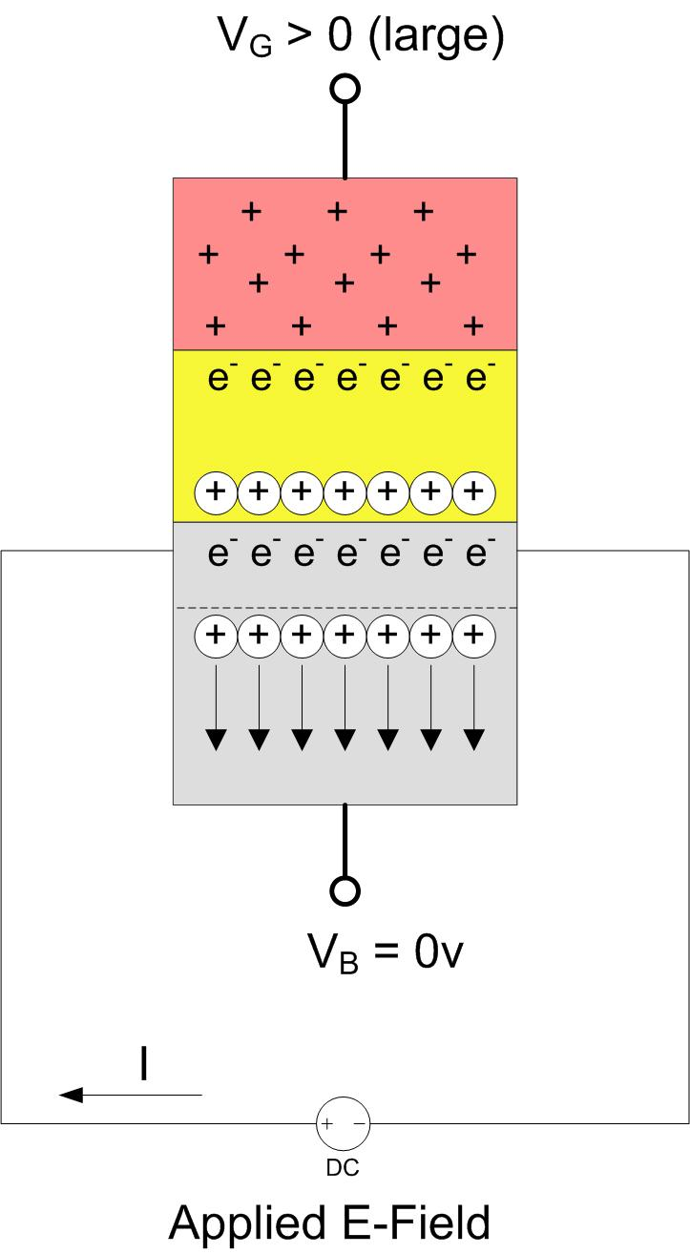
MOSFET Operation
MOSFET Operation (p-type substrate)
- Inversion is of special interest because we have
created a controllable n-type channel that can be
used to conduct current.
- these electrons have enough energy that they can
be moved by an electric field
- if we applied an E-field at both ends of this channel,
the electrons would move
NOTE: In a p-type material, the holes are also charge
carriers. But since they exist in all parts of the
Si, we can’t control where the current goes.
We use the minority charge carriers in inversion
because we can induce a channel using the
MOS structure.

Slide 43
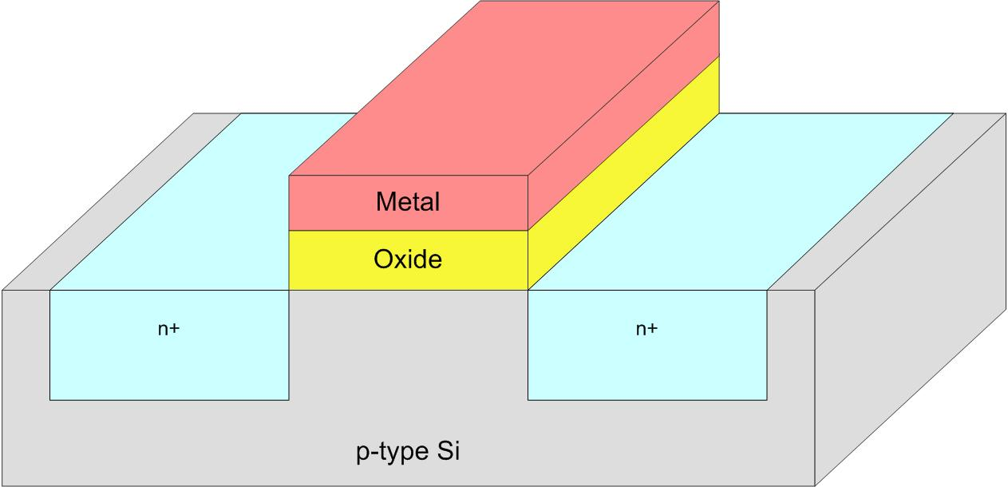
MOSFET Operation
MOSFET Operation (p-type substrate)
- in order to access the channel created by inversion, we add two
doped regions at either end of the MOS structure
- these doped regions are of the minority carrier type (i.e., n-type)
- current can flow between these terminals if an inversion is created in the p-type silicon by V_{G}
- since we are controlling the flow of current with a 3rd terminal, this becomes a “transistor”
- since we use an E-field to control the flow, this becomes the MOS Field Effect Transistor

Slide 44
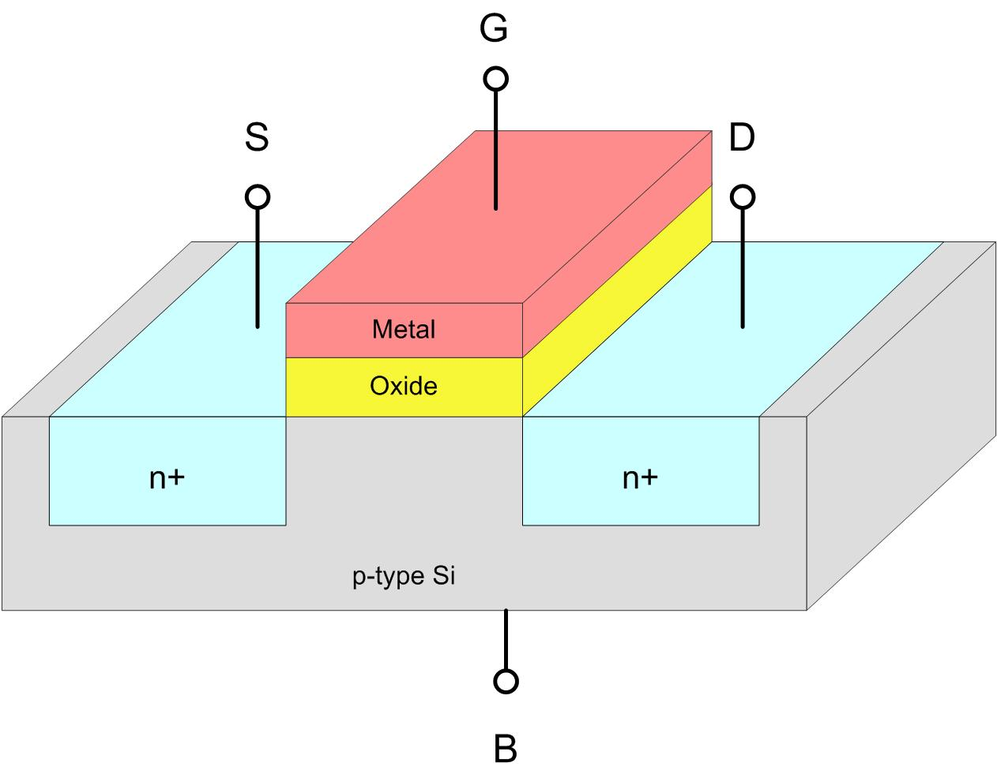
MOSFET Operation
Terminal Definition
Gate : The terminal attached to the metal of the MOS structure.
Source : One of the doped regions on either side of the MOS structure.
Defined as the terminal at the lower potential (vs. the Drain)
Drain : One of the doped regions on either side of the MOS structure.
Defined as the terminal at the higher potential (vs. the Source)
Body : The substrate
NOTE: we often don’t show the Body
connection

Slide 45
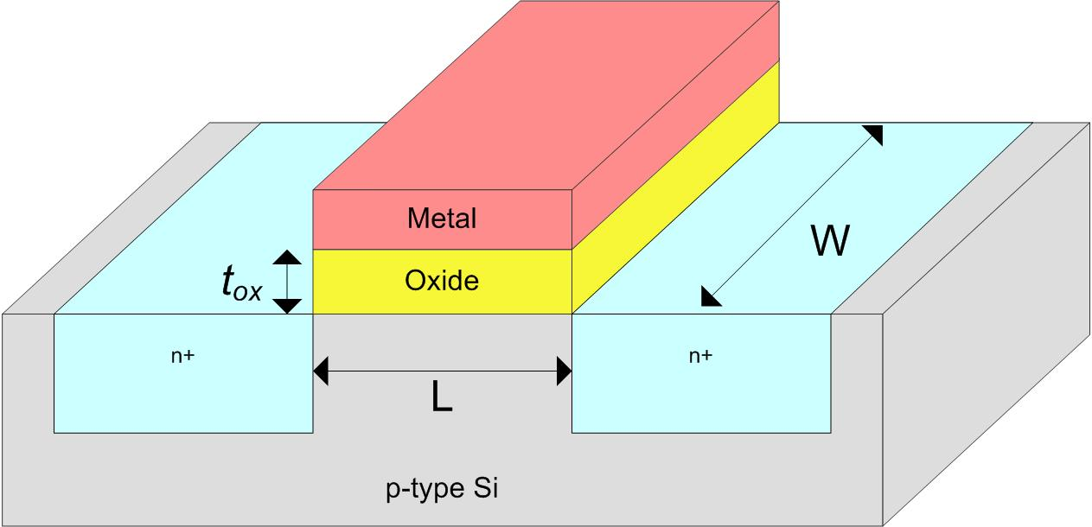
MOSFET Operation
MOSFET Dimensions
Length : the length of the channel. This is defined as the distance between the Source
and Drain diffusion regions
Width : the width of the channel. Notice that the metal, oxide, source, and drain
each run this distance
t_{ox} : the thickness of the oxide between the metal and semiconductor

Slide 46

MOSFET Operation
MOSFET Materials
Metal : Polysilicon. This is a silicon that has a heavy concentration of charge
carriers. This is put on using Chemical Vapor Deposition (CVD). It is
naturally conductive so it acts like a metal.
Oxide : Silicon-Oxide (SiO₂). This is an oxide that is grown by exposing the Silicon to
oxygen and then adding heat. The oxide will grow upwards on the Silicon
surface
Semiconductor : Silicon is the most widely used semiconductor.
P-type Silicon : Silicon doped with Boron
N-type Silicon : Silicon doped with either Phosphorus or Arsenic

Slide 47
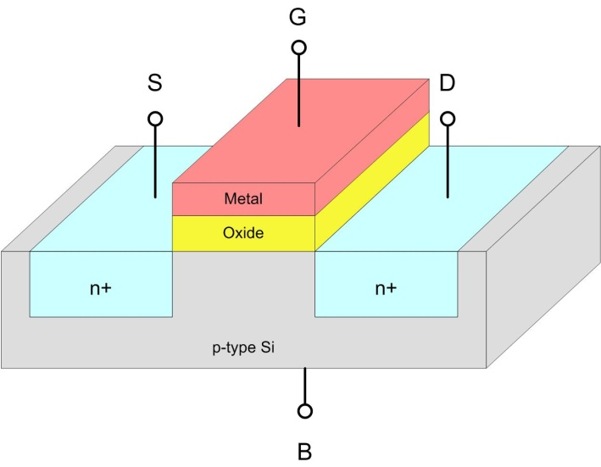
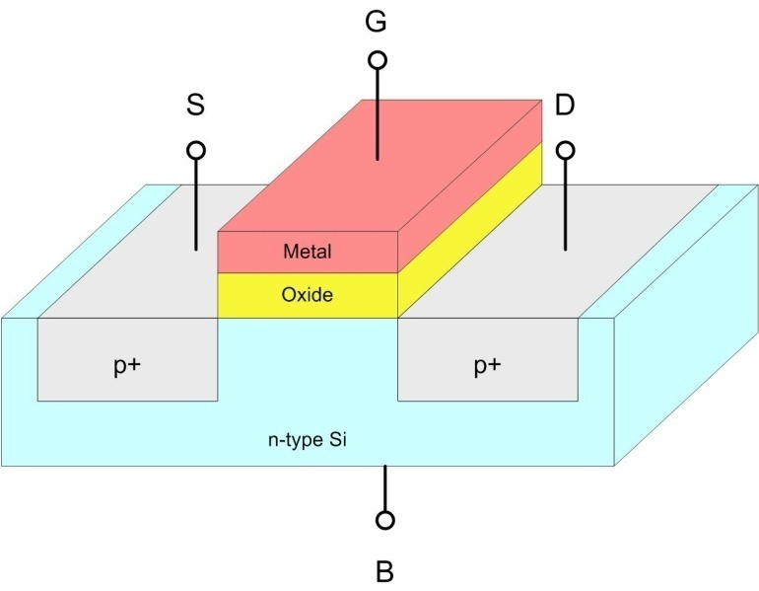
MOSFET Operation
MOSFET Type
- we can create a MOSFET using either a p-type or n-type substrate. We then can move current
between the source and drain using the minority carriers in inversion to form the conduction channel
- we describe the type of MOSFET by describing what material is used to form the channel
N-Channel MOSFET P-Channel MOSFET
- p-type Substrate - n-type Substrate
- n-type Source/Drain - p-type Source/Drain
- current carried in n-type channel - current carried in p-type channel

Slide 48
MOSFET Operation
Enhancement vs. Depletion MOSFETS
Enhancement Type : when a MOSFET has no conduction channel at V_{G}=0v
: also called enhancement-mode
: we apply a voltage at the gate to turn ON the channel
: this is used most frequently and what we will use to learn VLSI
Depletion Type : when a MOSFET does have a conducting channel at V_{G}=0v
: also called depletion-mode
: we apply a voltage at the gate to turn OFF the channel
: we won’t use this type of transistor for now
Note: We will learn VLSI circuits using enhancement-type, n-channel MOSFETS.
All of the principles apply directly to Depletion-type MOSFETs as well as
p-channel MOSFETs.

Slide 49
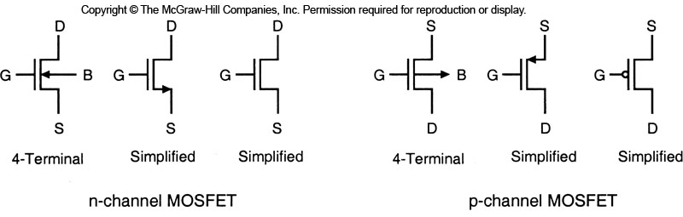
MOSFET Operation
MOSFET Symbols
- there are multiple symbols for enhancement-type MOSFETs that can be used

Slide 50

MOSFET Operation
Terminal Voltages
- all voltages in a MOSFET are defined relative to the Source terminal
V_{GS} : Gate to Source Voltage
V_{DS} : Drain to Source Voltage
V_{BS} : Body to Source Voltage

Slide 51
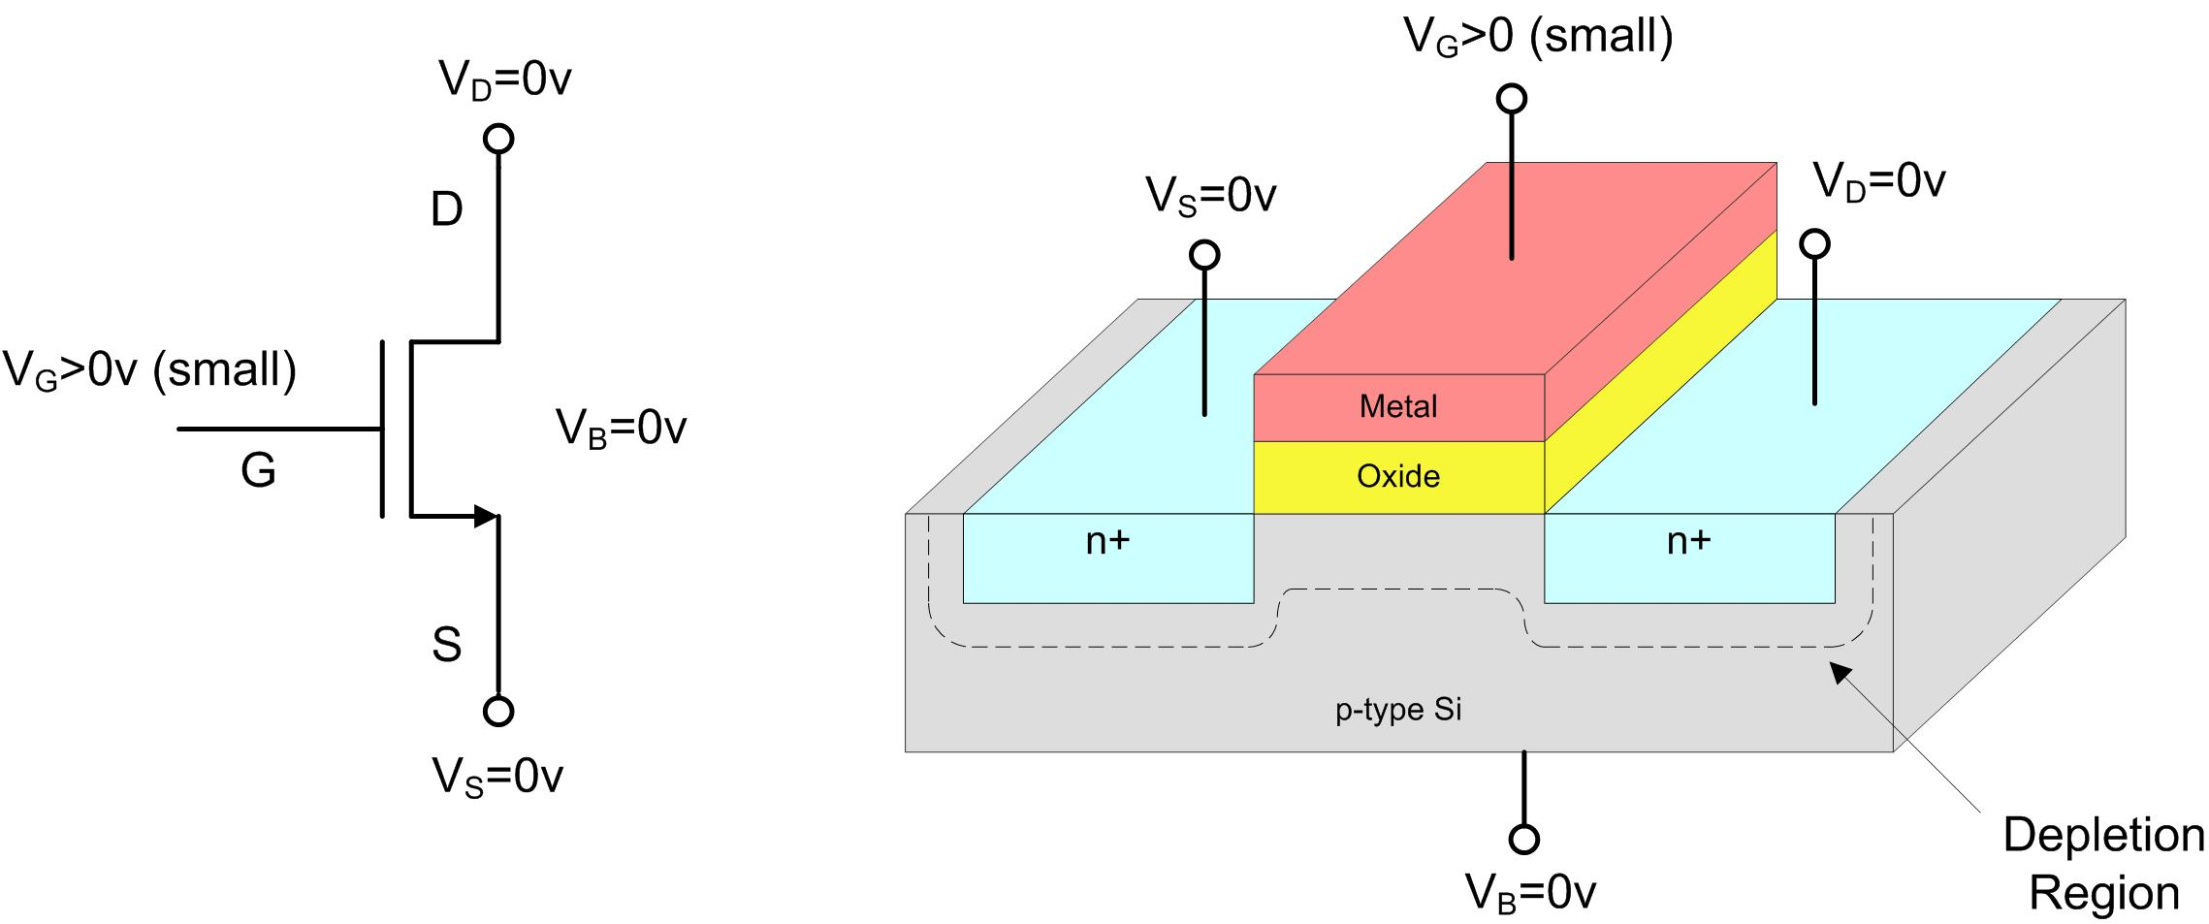
MOSFET Operation Under Bias
MOSFET under Bias (Depletion)
- let’s begin with an n-channel, enhancement-type MOSFET
- we bias the Source, Drain, and Body to 0v
- we apply a small positive voltage to the gate, V_{GS} > 0 (small)
- this creates a depletion region beneath the Gate, Source, and Drain that is void of all charge carriers

Slide 52
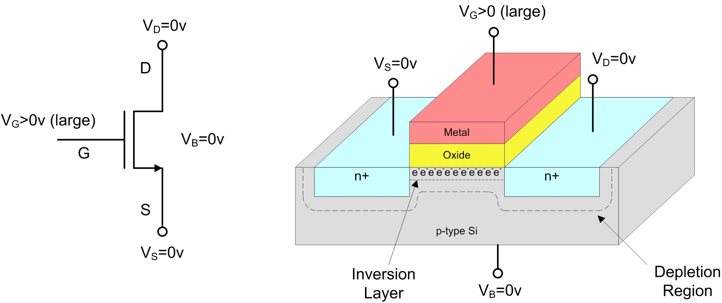
MOSFET Operation Under Bias
MOSFET under Bias (Inversion)
- as V_{GS} gets larger, it will form an inversion layer beneath the Gate oxide by attracting the minority
carriers in the substrate to the oxide-Si surface.
- when the surface potential of the gate reaches the bulk Fermi potential,
the surface inversion will be established and an n-channel will form
- this channel forms a path between the Source and Drain

Slide 53
Threshold Voltage
MOSFET under Bias (Inversion)
- as V_{GS} gets larger, it will form an inversion layer beneath the Gate oxide by attracting the minority
carriers in the substrate to the oxide-Si surface.
- when the surface potential of the gate reaches the bulk Fermi potential,
the surface inversion will be established and an n-channel will form
- this channel forms a path between the Source and Drain

Slide 54
Threshold Voltage
MOSFET under Bias (Inversion)
- we are very interested when an inversion channel forms because it represents when the
transistor is ON
- we define the Gate-Source voltage (V_{GS}) necessary to cause inversion the Threshold Voltage (V_{T0})
when V_{GS} < V_{T0} there is no channel so no current can flow between
the Source and Drain terminals
when V_{GS} > V_{T0} an inversion channel is formed so current can flow between
the Source and Drain terminals
NOTE: We are only establishing the channel for current to flow between the Drain and Source.
We still have not provided the necessary V_{DS} voltage in order to induce the current.
- just as in the MOS inversion, increasing V_{GS} beyond V_{TO} does not increase the surface potential
or depletion region depth beyond their values at the onset of inversion.
It does however increase the concentration of charge carriers in the inversion channel.

Slide 55
Threshold Voltage
Threshold Voltage
- the threshold voltage depends on the following:
1) the work function difference between the Gate and the Channel
2) the gate voltage necessary to change the surface potential
3) the gate voltage component to offset the depletion region charge
4) the gate voltage necessary to offset the fixed charges in the
Gate-Oxide and Si-Oxide junction
- putting this all together gives us the expression for the threshold voltage at Zero Substrate Voltage

Slide 56
Threshold Voltage
Threshold Voltage with Non-Zero Substrate Bias
- sometimes we can't guarantee that the substrate will be zero at all points of the IC:
- when a potential develops in the substrate, it pushes the Source terminal of the MOSFET to a
higher potential. We typically describe this as V_{SB} (instead of V_{BS})
- to predict the effect of a substrate bias voltage (V_{SB}), we must alter the expression
for the depletion charge density term:
- this changes the expression for the Threshold Voltage to:

Slide 57
Threshold Voltage
Threshold Voltage with Non-Zero Substrate Bias cont…
- V_{T0} is hard to predict due to uncertainties in the doping concentrations during fabrication.
As a result, V_{T0} is measured instead of calculated.
- this means for a typical transistor, it is a given quantity
- however, the non-zero Substrate Bias is a quantity that still must be considered.
- we want to get an expression for V_{T} that includes V_{T0} (a given)
- the depletion charge density is a function of the material and the substrate bias:

Slide 58
Threshold Voltage
Threshold Voltage with Non-Zero Substrate Bias cont…
- we can separate the material dependant term into its own parameter separate from V_{SB}
where is called the substrate-bias or body-effect coefficient
- this leaves our complete expression for threshold voltage as:
- a few notes on this expression:
1) in an n-channel, the following signs apply:
2) in a p-channel, the following signs apply

Slide 59
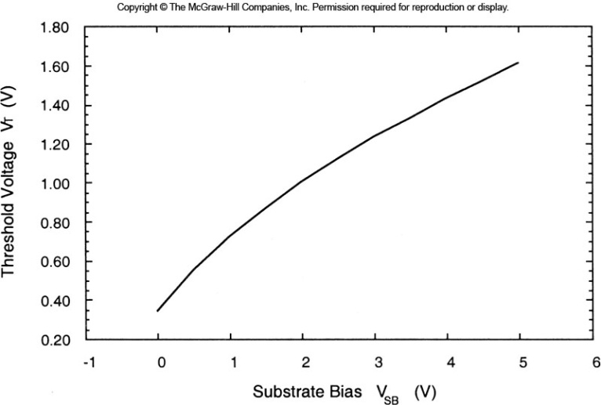
Threshold Voltage
Threshold Voltage with Non-Zero Substrate Bias cont…
- the following plot shows an example of threshold dependence on substrate bias for an
enhancement-type, n-channel MOSFET
- the threshold voltage increases with Substrate bias. This means as noise gets on the substrate, it
takes more energy to create the channel in the MOSFET. This is a BAD thing…

Slide 60
MOSFET I-V Characteristics
MOSFET I-V Characteristics
- we have seen how the Gate-to-Source voltage (V_{GS}) induces a channel between the Source and
Drain for current to flow through
- this current is denoted I_{DS}
- remember that this current doesn't flow unless a potential exists between V_{D} and V_{S}
- the voltage that controls the current flow is denoted as V_{DS}
- once again, we start by applying a small voltage and watching how I_{DS} responds
- notice that now we actually have two control variables that effect the current flow, V_{GS} and V_{DS}
- this is typical operating behavior for a 3-terminal device or transistor
- we can use an enhancement n-channel MOSFET to understand the IV characteristics and then
directly apply them to p-channel and depletion-type devices

Slide 61
MOSFET I-V Characteristics
MOSFET I-V Characteristics : Cutoff Region
- when V_{GS} < V_{T}, there is no channel formed between the Drain and Source and hence I_{DS}=0 A
- this region is called the Cutoff Region
- this region of operation is when the Transistor is OFF

Slide 62
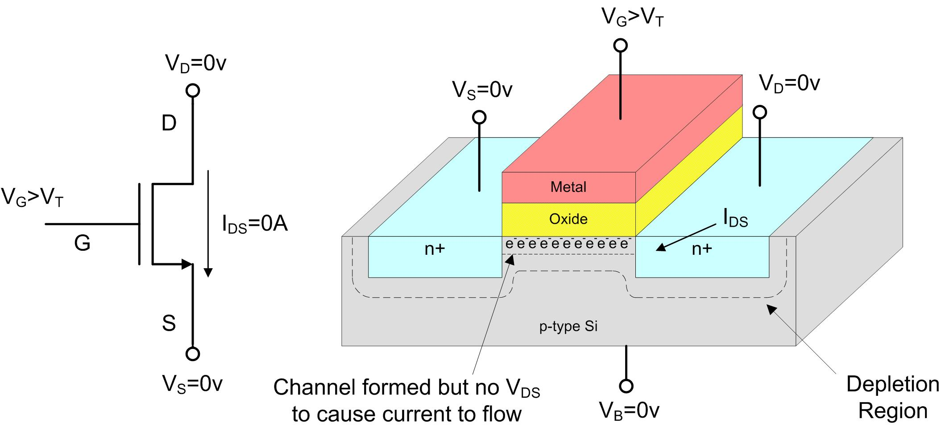
MOSFET I-V Characteristics
MOSFET I-V Characteristics : Linear Region
- When V_{GS} > V_{T}, a channel is formed. I_{DS} is dependant on the V_{DS} voltage
- When V_{DS} = 0v, no current flows

Slide 63
MOSFET I-V Characteristics
MOSFET I-V Characteristics : Linear Region
- If V_{GS} > V_{T} and V_{DS} > 0, then a current will flow from the Drain to Source (I_{DS})
- the MOSFET operates like a voltage controlled resistor which yields a linear relationship
between the applied voltage (V_{DS}) and the resulting current (I_{DS})
- for this reason, this mode of operation is called the Linear Region
- this region is also sometimes called the triode region (we'll use the term "linear")
- V_{DS} can increase up to a point where the current ceases to increase linearly (saturation)
- we denote the highest voltage that V_{DS} can reach and still yield a linear increase in current
as the saturation voltage or V_{DSAT}

Slide 64
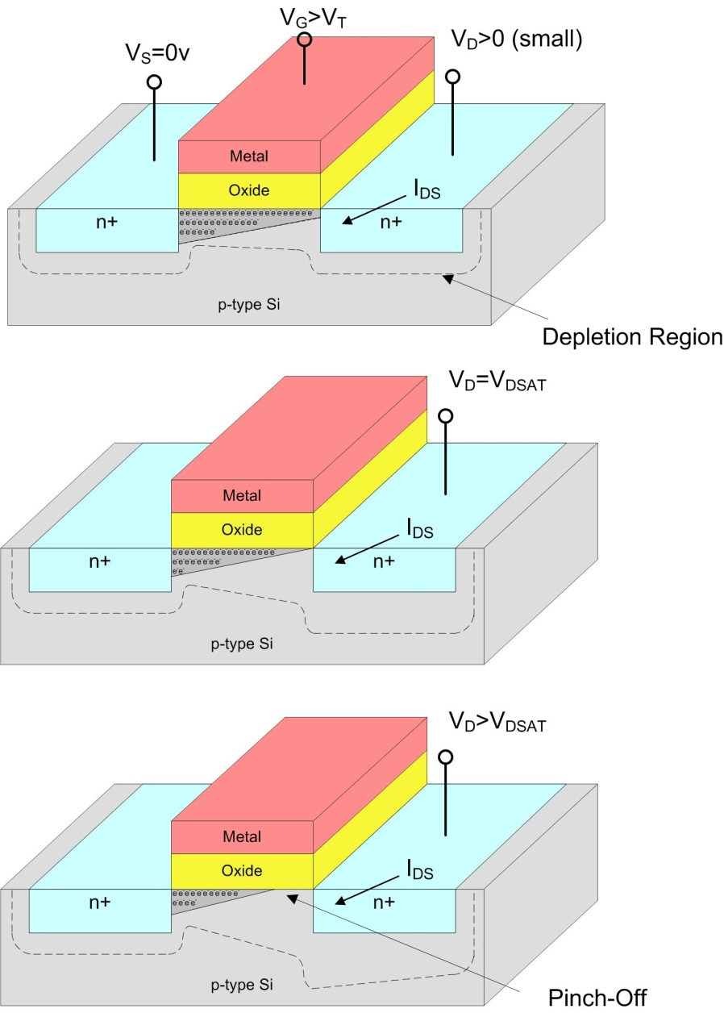
MOSFET I-V Characteristics
MOSFET I-V Characteristics : Linear Region
- when a voltage is applied at V_{D}, its positive charge
pushes the majority charge carriers (holes) that
exist at the edge of the depletion region further
from the Drain.
- as the depletion region increases, it becomes more
difficult for the Gate voltage to induce an inversion layer.
This results in the inversion layer depth decreasing
near the drain.
- as V_{D} increases further, it eventually causes the
inversion layer to be pinched-off and prevents the
current flow to increase any further.
- this point is defined as the saturation voltage (V_{DSAT})
- from this, we can define the linear region as:
V_{GS}>V_{T}
0 < V_{DS} < V_{DSAT}

Slide 65
MOSFET I-V Characteristics
MOSFET I-V Characteristics : Linear Region
- the Drain to Source current (I_{DS}) is given by the expression:
- where:
u_{n} = electron surface mobility (units in cm²/V·s)
C_{ox} = Unit Oxide Capacitance (units in F/cm²)
W = width of the gate
L = length of the gate
- remember this expression is only valid when :
V_{GS}>V_{T}
0 < V_{DS} < V_{DSAT}
A note on electron mobility (u_{n}):
u_{n} relates the drift velocity to the
applied E-field
Drift velocity is the average velocity
that an electron can attain due to an
E-field.
We are interested in Drift Velocity
because it tells us how fast the electron
can get from the Source to the Drain.
Since current is defined as I=∆Q/ ∆t, u_{n}
relates how much charge can move
in a given area per-time and per E-field

Slide 66
MOSFET I-V Characteristics
MOSFET I-V Characteristics : Linear Region
- what is linear about this equation?
- most of the parameters are constants during evaluation. They are sometimes lumped into single
parameters
or
- Notice that W and L are parameters that the designers have control over. Most of the other
parameters are defined by the fabrication process and are out of the control of the IC designer.

Slide 67
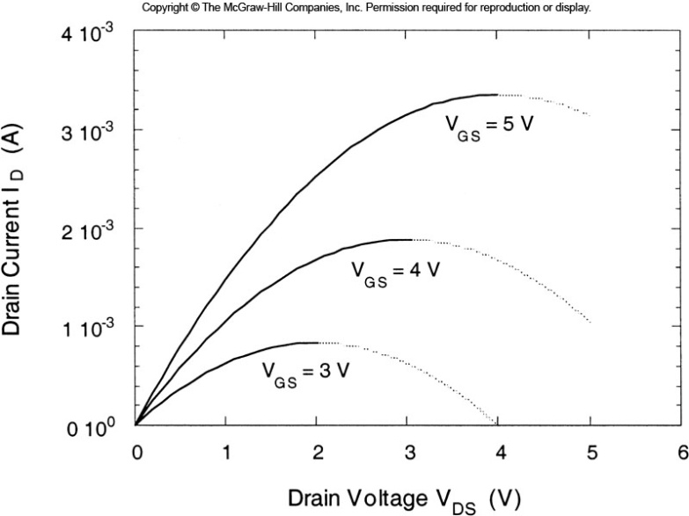
MOSFET I-V Characteristics
MOSFET I-V Characteristics : Linear Region
- what is linear about this equation?
- the -V_{DS}² term alters the function shape in the
linear region. As it becomes large enough
to significantly decrease I_{DS} in this function,
the transistor enters saturation and this
expression is no longer valid.
For a fixed V_{GS}, then
I_{DS} depends on V_{DS}
V_{DS}² has a smaller effect on I_{DS} at low values of V_{DS} since it is not multiplied by anything

Slide 68
MOSFET I-V Characteristics
MOSFET I-V Characteristics : Linear Region
- since we know what the current will not decrease as V_{DS} increases past V_{DSAT}, we can use
this expression to define V_{DSAT}:
- when V_{DS}>(V_{GS}-V_{T}), then I_{DS} in this expression
begins to decrease
- we can then define V_{DSAT} = (V_{GS}-V_{T})
- so now we have the formal limits on the linear
region and the validity of this expression:
Linear Region : V_{GS}>V_{T}
0 < V_{DS} < (V_{GS}-V_{T})

Slide 69
MOSFET I-V Characteristics
MOSFET I-V Characteristics : Saturation Region
- a MOSFET is defined as being in saturation when:
Saturation Region : V_{GS} > V_{T}
V_{DS} > (V_{GS}-V_{T})
- an increase in V_{DS} does not increase I_{DS} because the channel is pinched-off
- However, an increase in V_{GS} DOES increase I_{DS} by increasing the channel depth and hence
the amount of current that can be conducted.
- measurements on MOSFETS have shown that the dependence of I_{DS} on V_{GS} tends to
remain approximately constant around the peak value reached for V_{DS}=V_{DSAT}
- a substitution of V_{DS}=(V_{GS}-V_{T0}) yields:

Slide 70
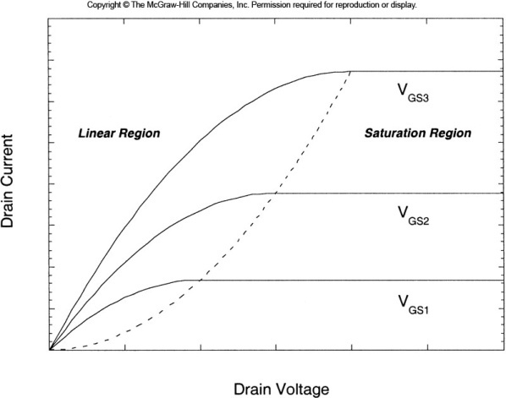
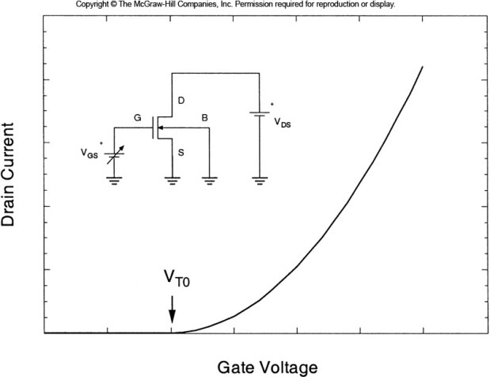
MOSFET I-V Characteristics
MOSFET I-V Characteristics : IV Curves
- now we have 1st order expressions for all three regions of operation for the MOSFET
Region Conditions IDS
Cutoff V_{GS} < V_{T}
Linear V_{GS} > V_{T}
V_{DS} < (V_{GS}-V_{T})
Saturation V_{GS} > V_{T}
V_{DS} > (V_{GS}-V_{T})

Slide 71
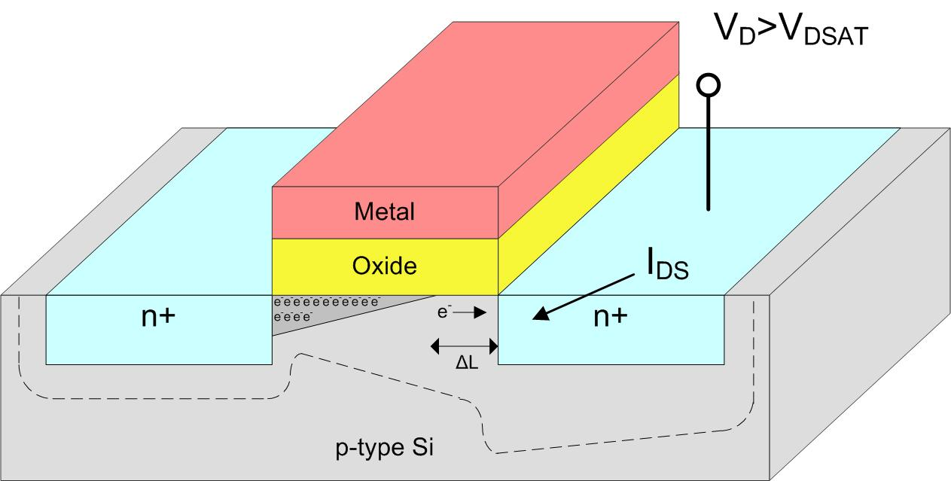
MOSFET I-V 2nd Order Effects
Channel Length Modulation
- the 1st order IV equations derived earlier are not 100% accurate. They are sufficient for 1st
order (gut-feel) hand calculations
- we can modify these IV equations to include other effects that alter the IV characteristics of a
MOSFET
- Channel Length Modulation refers to additional I_{DS} current that exists in the saturation mode
that is not modeled by the 1st order IV equations
- when the channel is pinched off in saturation
by a distance ΔL, a depletion region is created
next to the Drain that is ΔL wide
- given enough energy, electrons in the inversion
layer can move through this depletion region
and into the Drain thus adding additional
current to I_{DS}

Slide 72
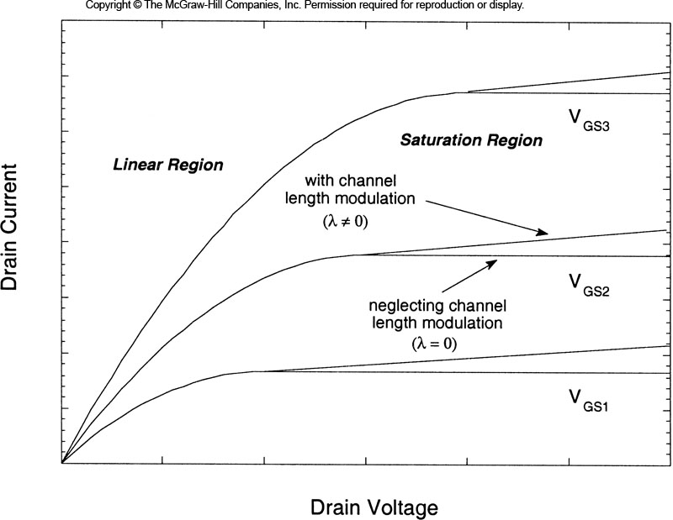
MOSFET I-V 2nd Order Effects
Channel Length Modulation
- we can model this additional saturation current by multiplying the I_{DS} expression by:
- λ is called the channel length modulation coefficient and is determined via empirical methods
- this term alters the I_{DSSAT} expression to be:

Slide 73
MOSFET I-V 2nd Order Effects
Substrate Bias Effect
- another effect that the 1st order IV equations don't model is substrate bias
- we have assumed that the Silicon substrate is at the same potential as the Source of the MOSFET
- if this is not the case, then the Threshold Voltage may increase and take more energy to induce
a channel
- we've already seen how we can model the change in threshold voltage due to substrate bias:
- for the IV equations to accurately model the substrate bias effect, we must use V_{T} instead of V_{T0}

Slide 74
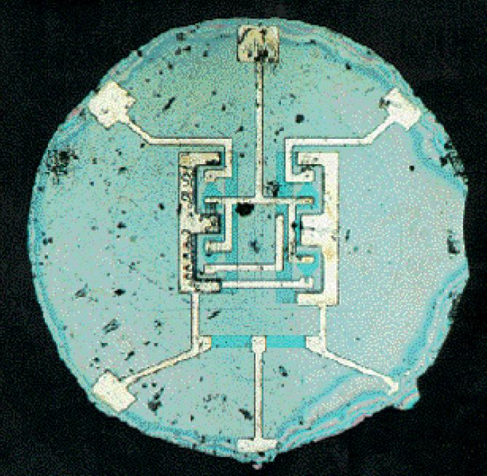
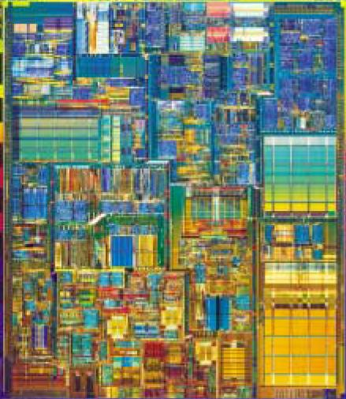
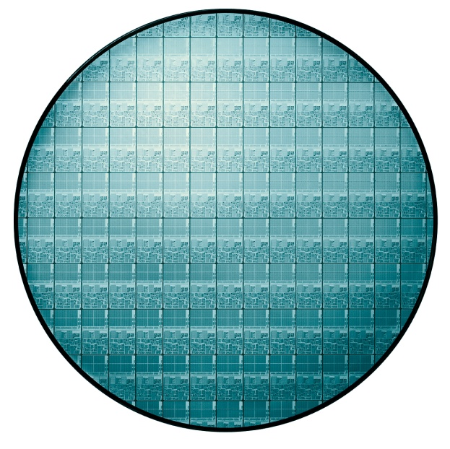
Scaling Theory
What is Scaling?
- Moving VLSI designs to new fabrication processes
- Shrinking the size of the circuitry
1961
First Planar Integrated Circuit
Two Transistors
2001
Pentium 4 Processor
42 Million Transistors
2006
Itanium 2 Dual Processor
1.7 Billion Transistors

Slide 75
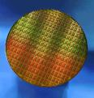
Scaling Theory
Why do we Scale?
1) Improve Performance
• More complex systems
2) Increase Transistor Density
• Reduce cost per transistor & size of system
3) Reduce Power
• Smaller transistors require less supply voltage
300mm wafer

Slide 76

Scaling Theory
Scaling Predictions
- In 1965, Gordon Moore of Intel predicted the exponential growth of
the number of transistors on an IC.
- Transistor count will doubled every 2-3 years
- Predicting >65,000 transistors in 1975
Moore’s Prediction
(1965)

Slide 77

Scaling Theory
More than just a prediction
- Transistor count has doubled every 26 months for the past 30 years
- Today this trend is used to target future process performance and prepare necessary infrastructure
(Design Tools, Test, Manufacturing, Engineering Skills, etc…)

Slide 78



Scaling Theory
• Timeline of Major Events
2006
Intel Ships 1st Billion Transistor uP
1971
1968
Intel Introduces the 4004, 1st single chip uP
(2300 transistors)
Noyce and Moore Form Intel
1958
First Integrated Circuit (Noyce/Fairchild & Kilby/Texas Instruments)
1947
First Transistor (Bell Labs)

Slide 79
Scaling Theory
How much can we shrink?
- Chip Area (A)
1
1
S
1
1
S
Chip Area for a Circuit (A) scales following : 1
S²
Note: In addition, the die sizes have increased steadily, allowing
more transistors per die

Slide 80

Full Scaling
Full Scaling (Constant-Field)
- Reduce physical size of structures by 30% in the subsequent process
W = Width of Gate
L = Length of Gate
t_{ox} = thickness of Oxide
x_{j} = depth of doping
- Reduce power supplies and thresholds by 30%
- we define: S ≡ Scaling Factor > 1
- Historically, S has come in between 1.2 and 1.5
for the past 30 years
- sometimes we use √2 = 1.4 for easy math

Slide 81

Full Scaling
Full Scaling (Constant Field)
- The following quantities are altered during fabrication
- we use a prime (‘) to denote the new scaled quantity
- Note that the doping concentration has to be increased to keep achieve the desired Fermi level
movement due to doping since the overall size of the junction is reduced
Before After
Quantity Scaling Scaling
Channel Length L L’ = L/S
Channel Width W W’ = W/S
Gate Oxide Thickness t_{ox} t_{ox}’ = t_{ox}/S
Junction depth x_{j} x_{j}’ = x_{j}/S
Power Supply Voltage V_{DD} V_{DD}’ = V_{DD}/S
Threshold Voltage V_{T0} V_{T0}’ = V_{T0}/S
Doping Densities N_{A} N_{A}’ = N_{A}•S

Slide 82
Full Scaling
Scaling Effect on Device Characteristics : Linear Region
- by scaling t_{ox}, we effect C_{ox} :
- since then
- The voltages V_{GS}, V_{TO}, and V_{DS} also scale down by S, which creates a1/S² in this expression:
- which results in:
I_{DSlin} scales down by S, this is what we wanted!!!
+
VDS
-
ID

Slide 83
Full Scaling
Scaling Effect on Device Characteristics : Saturation Region
- again, k effects I_{DS}
- which gives
I_{DSsat} scales down by S, this is what we wanted!!!
+
VDS
-
ID

Slide 84
Full Scaling
Scaling Effect on Device Characteristics : Power
- Static Power in the MOSFET can be described as:
- both quantities scale by 1/S
Power scales down by S², this is great!!!
+
VDS
-
ID

Slide 85
Full Scaling
Scaling Effect on Device Characteristics : Power Density
- Power Density is defined as the power consumed per area
- this is an important quantity because it shows how much heat
is generated in a small area, which can cause reliability problems
- Power scales by 1/S²
- Area scales by 1/S² (because W and L both scale by S and Area=W∙L)
- this means that the scaling cancels out and the Power Density remains constant
This is OK, but can lead to problems when IC’s get larger in size
and the net power consumption increase
+
VDS
-
ID

Slide 86
Constant-Voltage Scaling
Constant-Voltage Scaling
- sometimes it is impractical to scale the voltages
- this can be due to:
1) existing I/O interface levels
2) existing platform power supplies
3) complexity of integrating multiple
power supplies on chip
- Constant-Voltage Scaling refers to scaling the physical quantities (W,L,t_{ox},x_{j},N_{A}) but
leaving the voltages un-scaled (V_{T0}, V_{GS}, V_{DS})
- while this has some system advantages, it can lead to some unwanted increases in
MOSFET characteristics

Slide 87
Constant-Voltage Scaling
Scaling Effect on Device Characteristics : Linear Region
- we’ve seen that scaling t_{ox}, W, and L causes:
- if the voltages (V_{GS}, V_{T0}, and V_{DS}) aren’t scaled, then the I_{DS} expression
in the linear region becomes:
- which results in:
I_{DSlin} actually increases by S when we get smaller,
this is NOT what we wanted!!!
+
VDS
-
ID

Slide 88
Constant-Voltage Scaling
Scaling Effect on Device Characteristics : Saturation Region
- this is also true in the saturation region:
- which results in:
I_{DSSAT} also increases by S when we get smaller,
this is NOT what we wanted!!!
+
VDS
-
ID

Slide 89
Constant-Voltage Scaling
Scaling Effect on Device Characteristics : Power
- Instantaneous Power in the MOSFET can be described as:
- but in Constant-Voltage Scaling, I_{DS} increases by S and V_{DS} remains constant
Power increases by S as we get smaller,
this is not what we wanted!!!
+
VDS
-
ID

Slide 90
Constant-Voltage Scaling
Scaling Effect on Device Characteristics : Power Density
- Power Density is defined as the power consumed per area
- we’ve seen that Power increases by S in Constant-Voltage Scaling
- but area is still scaling by 1/S²
- This is a very bad thing because a lot of heat is being generated in a small area
+
VDS
-
ID

Slide 91
Scaling Choices
So Which One Do We Choose?
- Full Scaling is great, but sometimes impractical.
- Constant Voltage can actually be worse from a performance standpoint
- We actually see a hybrid approach. Dimensions tend to shrink each new generation. Then the
voltages steadily creep in subsequent designs until they are in balance. Then the dimensions
will shrink again.
- Why scale if it is such a pain?
- the increase in complexity per area is too irresistible.
- it also creates a lot of fun and high paying jobs.
Full Constant-V
Quantity Scaling Scaling
C_{ox}' S S
I_{DS}' 1/S S
Power' 1/S² S
Power Density' 1 S³

Slide 92
Scaling Trends
How Does Scaling Effect AC Performance?
- Assume Full Scaling
- Resistance (R)
+
VDD
-
Ids
Device Resistance (R) remains constant : 1
OK

Slide 93
Scaling Trends
How Does Scaling Effect AC Performance?
- Total Gate Capacitance (C)
Length
Width
tox
Gate Capacitance (C) scales following : 1
S
Good!

Slide 94
Scaling Trends
How Does Scaling Effect AC Performance?
- Gate Delay (τ)
Gate
Source
Drain
R
Vi
Vo
C
Gate Delay (τ) scales following : 1
S
Good!

Slide 95
Scaling Trends
How Does Scaling Effect AC Performance?
- Clock Frequency (τ)
Gate
Source
Drain
Clock Frequency (f) scales following : S
Good!

Slide 96
Scaling Trends
How Does Scaling Effect AC Performance?
- Dynamic Power Consumption (P)
VDD
Ip
In
Dynamic Power (P) scales following : 1
S²
Great!!!

Slide 97
Does Scaling Work?
How accurate are the predictions?
- For three decades, the scaling predictions have tracked well
Feature Sizes have been reduced by >30%

Slide 98
Does Scaling Work?
How accurate are the predictions?
Transistor Count has increased exponentially
Clock Rates have improved >43%

Slide 99

Can We Keep Scaling?
Why not just keep scaling?
- If it was easy, we wouldn’t have jobs!
- each time we get smaller, a couple new major problems arise.
- Over the years, we have a list of issues
that we call “Small Geometry Effects” that
have posed a barrier to future scaling.
- But until now, all of the problems have been
solved with creative engineering and we
continue on to the next process.
- You will need to solve the problems
in the next generation of process
sizes. Good luck!

Slide 100
Small Geometry Challenges
Short Channel Effects
- a MOSFET is called a short channel device when the channel length is close to the same size
as the depletion region thickness (L≈ x_{dm}). It can also be defined as when the effective channel
length L_{eff} is close to the same as the diffusion depth (L_{eff}≈ x_{j})
Velocity Saturation
- as the device gets smaller, the relative E-field energy tends to increase and the carriers in
the channel can reach higher and higher speeds.
- the long channel equations (i.e., the 1st order IV expressions) shows a linear relationship between
the E-field and the velocity of the carrier.
- however, at a point, the carriers will reach a maximum speed due to collisions with other electrons
and other particles in the Silicon
- At this point, there is no longer a linear relationship between the applied E-field (V_{DS}) and the
carrier velocity, which ultimately limits the increase in I_{DS}
- we can model this effect by altering the electron mobility term, u_{n}
where η is an empirical coefficient

Slide 101
Small Geometry Challenges
Subthreshold Leakage
- we’ve stated that when V_{GS}<V_{T}, there is no inversion in the channel and hence, no
charge carriers to carry current from the Drain to Source
- this transition from no-inversion to inversion doesn’t happen instantaneously
- there is a small amount of current that does flow when V_{GS}<V_{T}.
- we call this current Subthreshold leakage current.
- as devices get smaller, this current has become a non-negligible quantity.
- current in this region follows the relationship:
- lowering the V_{T0} makes this problem worse

Slide 102
Small Geometry Challenges
Oxide Breakdown
- the Oxide in a MOSFET serves as an insulator between the Gate electrode and the
induced channel in the semiconductor
- as t_{ox} gets thinner and thinner, it becomes difficult to grow a planar surface. The thin parts
of the non-planar oxide can be so thin that they will short out to the semiconductor
- another problem is that electrons can be excited enough in the Gate to have the energy
to jump through the oxide.
- this effectively shorts the Gate to the Source/Drain
e

Slide 103

Small Geometry Challenges
Hot Carrier Injection
- as geometries shrink and doping densities increase, electrons can be accelerated
fast enough to actually inject themselves into the oxide layer.
- this creates permanent damage to the oxide (effectively doping it to become a conductor)

Slide 104

Small Geometry Challenges
Electromigration
- when the metal interconnect gets smaller, its current density increases.
- the ions in the conductor will actually move due to the momentum of conducting electrons
and diffusion metal atoms
- this can leave holes in the metals
which lead to opens
- this can also build up regions of
unwanted metal that may short
to an adjacent trace
Leiterbahn Ausfallort

Slide 105
Small Geometry Challenges
Punch Through
- when the depletion regions around the Source and Drain get large enough to actually touch
- this is an extreme case of channel modulation
- this leads to a very large diffusion layer and causes a rapid increase in I_{DS} versus V_{DS}
- this limits the maximum operating voltage of the device in order to prevent damage due to the
high electron acceleration
e
depletion regions

Slide 106
Small Geometry Challenges
Drain Induced Barrier Lowering (DIBL)
- if the gate length is scaled without properly scaling the Source/Drain regions, the
Drain voltage will cause an un-proportionally large inversion layer
- this inversion interferes with the desired inversion layer being created by the Gate voltage
- this effectively lowers the Threshold voltage because it takes less energy to create inversion
since the Drain is providing some inversion itself.

Slide 107
Small Geometry : Interconnect
Interconnect
- Quantities altered during fabrication
Before After
Quantity Scaling Scaling
Width w w’ = w/S
Spacing s s’ = s/S
Thickness t t’ = t/S
Interlayer oxide height h h’ = h/S
w
s
t
h

Slide 108
Small Geometry : Interconnect
Scaling Effect on Interconnect
- Resistance, Capacitance, & Delay
Resistance scales following : S²
Horrible!!!
h
t
Capacitance scales following : 1
h
OK
w
Delay scales following : S²
Horrible!!!

Slide 109

Small Geometry : Interconnect
Interconnect Delay
- Device delay scales following 1/S
- Interconnect delay scales following S²
Interconnect Delay Dominates below 0.25um

Slide 110

Small Geometry : Interconnect
Interconnect Delay
- DSM Interconnect doesn’t full scale due to resistance:
- Interconnect structures are becoming “tall”
- Moving up the Z-axis decreases density

Slide 111

Small Geometry : Interconnect
Interconnect Delay
- Repeaters are used to make the “delay vs. length” linear
- Repeaters take power
- Repeaters require diffusion layer access

Slide 112

Small Geometry : Interconnect
On-Chip vs. Off-Chip Performance Mismatch
- On-Chip and Off-Chip Features are not scaling at the same rate
On-Chip
- f > 4GHz
- signal count scales exponentially
- Cheap
Off-Chip
- f < 2GHz
- signal count scales linearly (if that!)
- Expensive

Slide 113

Small Geometry : Interconnect
On-Chip vs. Off-Chip Performance Mismatch
- Getting data off-chip is the system bottleneck

Slide 114


Small Geometry : Power
Power Consumption
- Dynamic Power scales at 1/S² under “Full Scaling”
but…
- Full Scaling is impractical so we don’t get full 1/S² scaling
- Die sizes are increasing ~25% per generation
2000 Prediction
Actual

Slide 115

Small Geometry : Power
Power Consumption
- Lowering V_{T0} and V_{DD} reduces dynamic power
but…
- Leakage current increases exponentially
Approaching 50% in DSM

Slide 116

Small Geometry : Power
Power Consumption
- We’re now breaking the 100W mark @ 40W/cm²
- Distribution and Cooling become very difficult (if not impractical)

Slide 117
MOSFET Capacitance
MOSFET Capacitance
- We have looked at device physics of the MOS structure
- We have also looked at the DC I-V characteristics of the MOS Transistors
- We have not looked at AC performance
- Capacitance is the dominating imaginary component on-chip
(i.e., we don't really have inductance)
- the Capacitances of a MOSFET are considered parasitic
- "parasitic" means unwanted or unintentional. They are unavoidable and a result of fabricating
the devices using physical materials.
- we can use the capacitances of the MOSFET to estimate factors such as rise time, delay,
fan-out, and propagation delay

Slide 118

MOSFET Capacitance
MOSFET Capacitance
- Capacitance = Charge / Volt = (C/V)
- as we've seen, the charge in a semiconductor is a complex, 3-dimensional, distribution due to the
materials, doping, and applied E-field
- we develop simple approximations for the MOSFET capacitances for use in hand calculations
- we define each of the following lumped capacitance
for an AC model of the transistors
- each capacitance will have multiple contributions and
different values depending on the state of
the transistor (i.e., cutoff, linear, saturation)

Slide 119

MOSFET Capacitance
MOSFET Dimensions
- We need to define the geometric parameters present in the MOSFET structure
Mask Length
- we draw a gate length during
fabrication
- we call this the Drawn Length, L_{M}
- in reality, the diffusion regions extend
slightly under the gate by a distance, L_{D}
- this is called overlap
- the actual gate length (L) is given by:

Slide 120
MOSFET Capacitance
MOSFET Dimensions
W = Channel Width
t_{ox} = Oxide thickness
x_{j} = diffusion region depth
Y = diffusion region length
Channel-Stop Implants
- in order to prevent the n+ diffusion regions
from adjacent MOSFETS from influencing
each other, we use "channel-stop implants"
- this is a heavily doped region of opposite
typed material (i.e., p+ for an n-type)
- these electrically isolate each transistor
from each other

Slide 121
MOSFET Capacitance
MOSFET Capacitance
- We group the various capacitances into two groups
1) Oxide Capacitances - capacitance due to the Gate oxide
2) Junction Capacitances - capacitance due to the Source/Drain diffusion regions
Oxide Capacitances
Junctions Capacitances

Slide 122
Oxide-Related Capacitance
Oxide-Capacitance
- Oxide Capacitance refers to capacitance which uses the gate oxide as the insulator between
the parallel plates of the capacitor
- as a result, these capacitances always use the Gate as one of the terminals of the capacitor
- we are concerned with the following capacitances:
C_{gb} = Gate to Body capacitance
C_{gd} = Gate to Drain capacitance
C_{gs} = Gate to Source capacitance
- again, each of these values will differ depending on the mode of operation of the MOSFET

Slide 123
Oxide-Related Capacitance
Overlap Capacitance
- capacitance from the Gate to the Source/Drain due to the overlap region (L_{D})
- this creates:
- where C_{ox} is the unit-area capacitance (i.e., multiply by area to find total capacitance, F/m² or F/um²)
- NOTE : this capacitance does NOT depend on the external bias of the MOSFET since the Gate
and the Source/Drain do not have their carrier density altered during bias.

Slide 124
Oxide-Related Capacitance
Gate-to-Channel Capacitance
- the gate-to-channel configuration results in 3 capacitances (C_{gb}, C_{gs}, C_{gb})
- these capacitances change as a result of external bias since in effect, the "bottom plate" of the
capacitor is being moved around during depletion/inversion

Slide 125
Oxide-Related Capacitance (Cut-Off)
Gate to Source Capacitance (C_{gs}) : Cut-Off
- During Cut-off, there is no channel beneath the Gate.
- since there is no channel that links the Gate to the Source (i.e., no ΔQ),
there is no Gate-to-Channel capacitance.
- this leaves the overlap capacitance as the only component to C_{gs} in cut-off:
No "bottom plate" in the channel region to connect to the Source n+ conductor

Slide 126
Oxide-Related Capacitance (Cut-Off)
Gate to Drain Capacitance (C_{gd}) : Cut-Off
- Just as C_{gs}, during Cut-off, there is no channel beneath the Gate.
- since there is no channel that links the Gate to the Drain (i.e., no ΔQ),
there is no Gate-to-Channel capacitance.
- this leaves the overlap capacitance as the only component to C_{gd} in cut-off:
No "bottom plate" in the channel region to connect to the Drain n+ conductor

Slide 127

Oxide-Related Capacitance (Cut-Off)
Gate to Body Capacitance (C_{gb}) : Cut-Off
- There is a capacitor between the Gate and Body
- The bottom plate is the conductor formed by the p-type silicon since it has majority
charge carriers and acts as a conductor
- we can describe the Gate-to-Body Capacitance as:
- remember that L = (L_{M}-2·L_{D})

Slide 128
Oxide-Related Capacitance (Linear)
Gate to Source Capacitance (C_{gs}) : Linear Region
- When operating in the linear region, a channel is present in the substrate.
- this can be thought of as a conductor (or metal plate) that contacts the Source and Drain
- this results in a capacitance between the Gate and the Source/Drain
- we split this capacitance between the Source and Drain for simplicity
- the Gate-to-Channel contribution to C_{GS} is (1/2)C_{ox}WL
- the total C_{GS} capacitance in the linear region includes the overlap capacitance:

Slide 129
Oxide-Related Capacitance (Linear)
Gate to Drain Capacitance (C_{gd}) : Linear Region
- The Gate-to-Drain Capacitance is identical to the Gate-to-Source Capacitance in the Linear region:

Slide 130
Oxide-Related Capacitance (Linear)
Gate to Body Capacitance (C_{gb}) : Linear Region
- Since the channel (inversion layer) looks like a metal plate to the gate, the Gate can't actually
see the substrate anymore
- this means that the capacitance between the Gate and Body is zero when a channel is present

Slide 131
Oxide-Related Capacitance (Saturation)
Gate to Source Capacitance (C_{gs}, C_{gd}, C_{gb}) : Saturation Region
- When operating in the saturation region, the channel is pinched off
- We can make the assumptions that:
1) There is no longer a link between the Gate and Drain
2) Roughly 2/3 of the channel is still present linking the Gate to the Source (2L/3)
3) The pinched off channel still effectively shields the gate from the body
- from these approximations, we can describe the capacitances in the saturation region

Slide 132
Oxide-Related Capacitance (Summary)
Summary of Oxide-Related Capacitance
Cut-off Linear Saturation

Slide 133
Oxide-Related Capacitance (Total)
Total of Oxide-Related Capacitance
- if we assume that these three capacitances are in parallel, then their total values add:
- the lowest oxide-related capacitance that is present is in the saturation region:
- the largest oxide-related capacitance that is present is in the cut-off & the linear regions:
- for quick hand-calculations, we can use the largest oxide capacitance to find a worst-case value

Slide 134
Junction Capacitance
Junction Capacitance
- Junction Capacitance refers to capacitance between the diffusion regions of the Source & Drain
to the doped substrate surrounding them.
- they are called "junction" because these capacitances are due to the PN junctions that are formed
between the two materials
- we are concerned with the following junction capacitances:
C_{sb} = Source to Body capacitance
C_{db} = Drain to Body capacitance
- these capacitances are highly dependant on the bias voltages since the effective distance between
plates is the depth of the built in depletion region that forms at the PN junction

Slide 135

Junction Capacitance
Junction Capacitance
- the Source and Drain regions will have similar geometries so we will start by describing
the PN junctions for only one region
- Consider the numbers in the following figures illustrating the PN junctions that exist
- Let's start with an N-type MOSFET and identify all of PN junctions

Slide 136
Junction Capacitance
Junction Capacitance
- remember that the MOSFET is surrounded by a channel-stop implant to prevent the diffusion
regions from coupling to other MOSFETs.
- This implant is heavily doped (p+), usually 10·N_{A.}
- These areas are also called sidewalls
- remember that the diffusion regions are heavily doped (n+)

Slide 137
Junction Capacitance
Junction Capacitance
1) n+ / p junction = diffusion region to substrate beneath gate
2) n+ / p+ junction = diffusion region to channel-stop implant in back (sidewall)
3) n+ / p+ junction = diffusion region to channel-stop implant on side (sidewall)
4) n+ / p+ junction = diffusion region to channel-stop implant in front (sidewall)
5) n+ / p junction = diffusion region to substrate underneath

Slide 138
Junction Capacitance
Junction Capacitance
- the capacitance will be proportional to the area of the junction
1) Area = W·x_{j}
2) Area = Y·x_{j}
3) Area = W·x_{j}
4) Area = Y·x_{j}
5) Area = W·Y

Slide 139

Junction Capacitance
Junction Capacitance
- first we need to express the capacitance for an abrupt, PN junction under reverse-bias
- we begin with finding the depletion region thickness
- this is similar to the expression for depletion thickness of a MOS structure, except that the
region will protrude into both materials instead of just the semiconductor as before.
- as a result, the carrier concentration of both materials is now described:
- the depletion thickness is given by:
- where the built in junction potential is given by:

Slide 140

Junction Capacitance
Junction Capacitance
- the depletion-region charge (Q_{j}) can be written as:
- substituting x_{dpn} and rearranging terms, we get:

Slide 141
Junction Capacitance
Junction Capacitance
- the capacitance of the junction is defined as:
- we can differentiate our expression for junction charge with respect to voltage to get
the capacitance as a function of junction voltage:

Slide 142
Junction Capacitance
Junction Capacitance
- from this expression, we can define the zero-bias junction capacitance per unit area:
- putting this back into a more generic expression for C_{j}(V), we get:
- remember that we are assuming an "abrupt" PN junction

Slide 143
Junction Capacitance
Junction Capacitance
- since the total capacitance depends on the external bias voltage, it can be a complicated
to find the equivalent capacitance when the bias voltage is a transient.
- we need to make an assumption to simplify the expression.
- let's assume that the voltage change across the junction is linear. Then we can find the equivalent
or average capacitance using:

Slide 144
Junction Capacitance
Junction Capacitance
- substituting in our expression for C_{j}(V), we get:
- which we can simplify even further by defining a dimensionless coefficient K_{eq}
- where K_{eq} is the voltage equivalence factor (0<K_{eq}<1):

Slide 145
Junction Capacitance
Junction Capacitance
- How do we use this?
- for a given diffusion region, we calculate C_{eq} for each of the 5 PN junctions
- note that there really are only two different regions (n+ / p and n+ / p+)
- the sidewalls (2,3,4) will have their own zero-bias junction capacitance since
they have a unique carrier concentration (i.e., n+ / p+).
- the inner and bottom junctions (1,5) will have their own zero-bias junction capacitance since they have a unique carrier concentration (i.e., n+ / p).
- when solving for the sidewall contribution, you can add the areas for 2,3,4 and
solve once
- when solving for the inner and bottom junction contributions, you can add the
areas for 1 and 5 and solve once
- since this is a reverse biased PN junction the voltages for V1 and V2 are actually
negative when plugged into the K_{eq} expression

Slide 146
Junction Capacitance
Junction Capacitance
- What's the difference between the Source and Drain?
- If the Source is grounded, then there is no voltage change across it. This means
its capacitance is simply the zero-bias capacitance
- you will still need to calculate the sidewall and inner/bottom C_{j0} capacitances separately
- the drain typically sees a voltage change (V_{DS}). However, one good thing is that
typically the source voltage is 0v, so the expression simplifies somewhat

Slide 147
Junction Capacitance
Junction Capacitance
- Doesn't this take a lot of time?
- Yes! And remember that we have made a lot of assumptions along the way
- For this reason, we typically rely on computer models of the capacitance
- We do the hand calculations to get a gut feel for what factors affect capacitance
- Gut Feel makes for good designers because design is about balancing trade-offs
- If you don’t have Gut Feel and rely totally on simulators, you will struggle when asked to
innovate and trouble-shoot.

