Slide 1
EELE 414 – Introduction to VLSI Design
Module #3 – SPICE Modeling
Agenda
SPICE Modeling
Announcements
Read Chapter 4

Slide 2
SPICE Modeling
SPICE Modeling - Simulation Program with Integrated Circuit Emphasis or Simulation Program for the Integrated Circuit Environment - Developed by UC Berkeley in the late 1970’s - SPICE is an electric circuit simulator (R,L,C,V,I,…) - Its main contribution at the time was the ability to support transistor Models - Today… - Berkeley SPICE is free for Unix/Linux. It is a text based program. - CAD vendors take the free SPICE engine and add features like graphical entry and additional components - The CAD vendors then sell it for big money (Mentor, Synopsis, Cadence,…)

Slide 3
SPICE Modeling
SPICE Modeling - How does SPICE work? - for a given circuit, KCL and KVL equations can be written - Just like in EE206, these equations can be solved using Matrix math - SPICE does the same thing, except on the front-end it is able to take the entered circuit and create the KCL/KVL equations for us

Slide 4
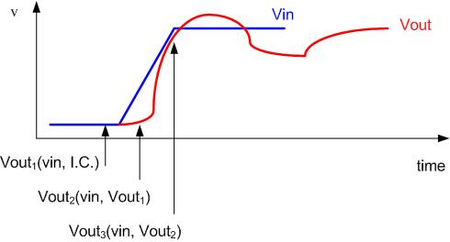
SPICE Modeling
SPICE Modeling - This can also be extended to AC analysis since the matrix math can handle Complex numbers - We can create Bode Plots by sweeping the frequency (i.e., running a simulation at each frequency)
- SPICE can also perform transient simulations by performing numerical integration

Slide 5
SPICE Modeling
SPICE Modeling - The source file for a SPICE simulation is called a DECK (from the days of punch cards… what is a punch card?... I’m not that old…) - The DECK can be thought of as a text netlist of the circuit. - Even when using a graphical entry tool for the schematic, the first thing the tool does when you click “simulate”, is create a text-based DECK that is plugged into the SPICE engine. - the first letter of a component instantiation in the DECK tells SPICE what the component is. - devices are then followed by the net names they connect to followed by their parameters
R1 n1 n2 VALUE=75 * resistor L1 n2 n3 VALUE=1n * inductor C1 n3 n4 VALUE=1p * capacitor V1 n4 n5 DC=1v * DC voltage source I1 n5 n6 ACmag=1 * AC current source

Slide 6
SPICE Modeling
SPICE Modeling - SPICE allows the use of MODELS to represent components with complex, non-linear responses such as Diodes and Transistors - Models are present in their own file (starting with the .MODEL keyword) - A component is instantiated in the DECK, but then references the MODEL to describe its behavior - MOSFETS are denoted with an “M” as their first letter
DECK
MODEL
M1 D G S B NMOD (L=1U W=10U)
.MODEL NMOD NMOS + KP=40 + VT0=0.55 + GAMMA=0.34 + PHI=0.3 + LAMBDA=0.2 : :
MOSFET
Terminal Connections
Model Name
Parameters
Device Parameters
Model Name
Model Type (NMOS or PMOS)

Slide 7
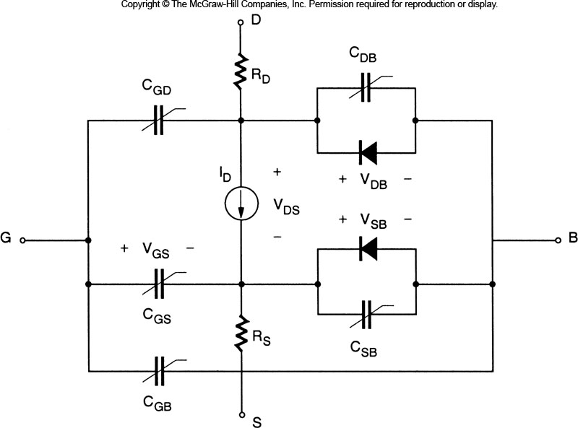
SPICE Modeling
SPICE Modeling (Level 1) - There are different levels of accuracy and complexity that a model can have. - We give these different types of models the description of Level (i.e., Level 1 model, Level 2 model..) - Increasing model accuracy increases simulation time - Let’s start by looking at the simplest model for a MOSFET, Level 1 - Level 1 uses the basic IV equations - it also includes: 1) Resistance of Source & Drain 2) Capacitance (bias dependant) 3) Reverse-Bias behavior of Junction Diodes

Slide 8
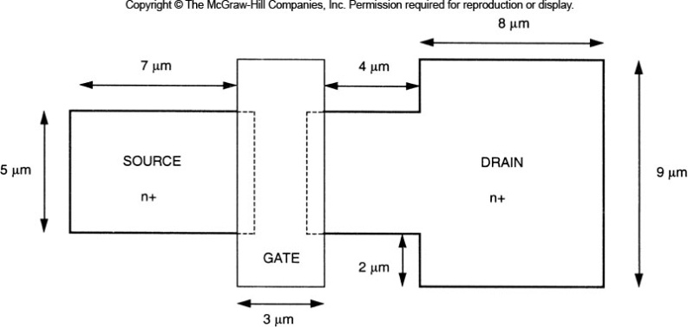
SPICE Modeling
SPICE Modeling (Level 1) - parameters can exist in the Model file. However, we can pass in parameters (i.e., override) the parameters by putting them in the Deck instantiation - there are different types of parameters for the model “Design Parameters” - these parameters are under the designer’s control - these sometimes have default values, but if we are doing design, this is what we change Parameter Description L length of channel (drawn) W width of channel AS / AD area of Source/Drain PS / PD perimeter of Source/Drain

Slide 9
SPICE Modeling
SPICE Modeling (Level 1) “Electrical Parameters” - there are 5 parameters that fully characterize the base model - these will have default values in the model based on the fab process - we can overwrite these from the DECK if we want to perform sensitivity analysis Parameter Description KP k’, transconductance VTO V_{T0}, zero substrate bias threshold GAMMA γ, substrate-bias coefficient PHI |2φ_{F}|, surface potential LAMBDA λ, channel length modulation coefficient

Slide 10
SPICE Modeling
SPICE Modeling (Level 1) “Physical Parameters” - there are parameters that describe the shape and material properties of the device Parameter Description U0 u_{n}, electron mobility TOX t_{ox}, oxide thickness NSUB N_{A}, doping concentration LD L_{D}, lateral diffusion - notice that these parameters are redundant with the Electrical parameters since these quantities are used to calculate k’, V_{T0}, γ, |2φ_{F}|, and λ - these allow you to get further into the details of the fabrication to see its effect on performance - however, the “Electrical Parameters” OVERRIDE the “Physical Parameters” - this means you wouldn’t supply both if you really want to see the effect of a physical parameters on the performance of the device. You would need to remove the electrical parameter.

Slide 11
SPICE Modeling
SPICE Modeling (Level 1) “Parasitic Parameters” - these are the capacitances and resistances of the material Parameter Description CJ C_{J0}, zero-bias bulk capacitance per area CJSW C_{J0sw}, zero-bias sidewall capacitance per area - there parameters scale with the size of the device provided by W,L,AS,AD,PS, and PD. - there are many more parameters in table 4.1 in the textbook, take a look and you’ll see why we need SPICE to properly predict the behavior of a transistor.

Slide 12
SPICE Modeling
SPICE Modeling (Level 2) - Level 2 adds the following behavior to the Level 1 model 1) Variation of the bulk depletion charge dependence on the channel voltage (we assumed it was constant in Level 1). 2) Variation of electron mobility (u_{n}) with the applied E-field 3) Variation of effective Channel Length in Saturation model 4) Carrier Velocity Saturation 5) Subthreshold Conduction - we also have the ability to indicate which level we want to use. For example, you can have a Level 2 model, but in the instantiation you say: M1 D G S B NMOD (Level=1 L=1U W=10U) this will tell the simulator to ignore all the parameters associated with Level 2 or higher accuracy. - we can also put the “Level=1” as the first parameters in the model

Slide 13
SPICE Modeling
SPICE Modeling (Level 3) - Level 3 was developed to specifically address small geometry effects. - instead of trying to come up with an expression for each and every bump and wiggle on the IV curve, Level 3 instead moves toward a more empirical approach. - curve-fitting parameters are added to the IV equations from Level 1 and Level 2. - these parameters are dialed-in based on measurement data from a test run of transistors.

Slide 14
SPICE Modeling
SPICE Modeling (BSIM) - Berkeley Short-Channel IGFET Model - what is an IGFET? - the term MOSFET implies a “metal” contact for the gate. Some say that is in not accurate for transistors that use polysilicon for the gate contact since polysilicon is not considered a true metal. Of course polysilicon is a conductor, just not a pure metal. - so the term “Insulated Gate FET” is used which describes any type of conducting gate used. - this is a totally empirical model which reduces the # of curve fitting parameters - this actually reduces simulation time over the Level 3 models, and sometimes over Level 2 due to moving away from IV equations with many coefficients. - there have been many versions of the BSIM models, but the most current is BSIM3 - this is the most commonly used model for accurate simulations.

Slide 15
SPICE Modeling
SPICE Modeling - Which Model should I use? - simulation is always a tradeoff of accuracy vs. simulation time - simulation time is a big problem. You’ll never ship if each simulation takes a month, (and they easily can!!!) - typically, we can use Level 1 models for quick, functional simulations ex) if I hook it up like this, does it do what I think it is supposed to? - then we move to BSIM3 models for accurate simulations which tell us speed, power, etc…

