Slide 1


Notes:
Hello everyone! This year our labs conducted a replication of our normative study in which we studies psychological experiences and restorative characteristics of nature and urban virtual images.

Slide 2
Introduction
Charbonneau et al. 2170
According to Attention Restoration Theory (ART) attention is restored while in nature (Kaplan,1995).
More restorative nature, as indicated by the mechanisms of ART, has many characteristics
  More mysterious, fascinating (Szolosi, Watson, & Ruddell, 2014), liked and produces less mind wandering (Charbonneau, et al., 2019)
  Associated with less anxiety and more resilience and mindfulness (Dzhambov, et al., 2019)
  All predicted effects were found in our study from last year (Charbonneau et al., 2020)
The purpose of the current study was to replicate the findings from Charbonneau et al. (2020) with resized urban images
Notes:
Attention restoration theory states that attention is restored while in nature.
Previous literature as well as our findings from our first study found that nature is found to be more fascinating, mysterious, and liked compared to urban environments. Also, nature produces less mind wandering and anxiety and promotes more feelings of resilience. We decided to run a replication to determine if we can find the same effects when our urban images were resized to match the nature images.

Slide 3
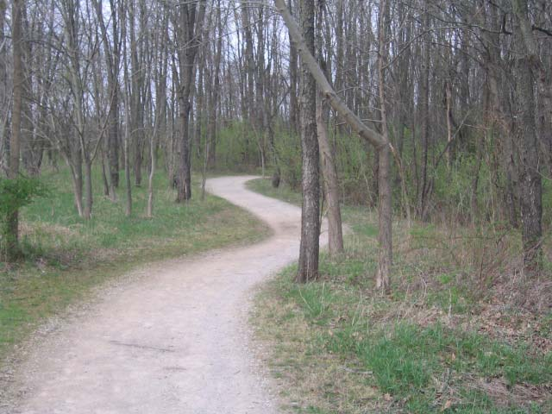
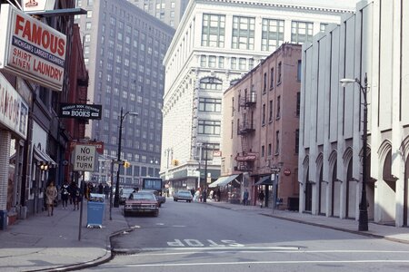
Methods
Charbonneau et al. 2170
Participants (N=207) saw 20 urban (Berman et al., 2008) and 20 (Szolosi et al., 2014) nature images and rated them on the following scales:
Fascination (0 not at all-6 very much so)
  This place has qualities that fascinate me.
  I would like to spend more time looking at the surroundings here.
  My attention is drawn to many interesting things here.
Mystery (0 not at all-6 very much so)
  Please indicate the extent to which the setting promises more to be seen if you could have walked deeper into the scene.
Likability (1 a strong dislike-7 a strong preference)
  To what extent do you like the image you have just seen?
Notes:
207 participants from Amazon Mechanical Turk rated 20 out of 40 nature images and 20 out of 40 urban images on the following scales. Each participant took about 40 minutes to complete the survey on Qualtrics and were compensated $1 for their time. Participants viewed each image for 5 seconds then rated each on image characteristics of fascination, mystery, and likability.

Slide 4
Methods
Charbonneau et al. 2170
Resilience (1 strongly disagree-5 strongly agree)
  After viewing the previous image, I feel as if I could make it through a stressful event.
  After viewing the previous image, I feel as if I could complete a challenging task.
Mindfulness (1 strongly disagree-5 strongly agree)
  While viewing the previous image I felt closely connected to the present moment.
  While viewing the previous image I actively explored my experience in the moment.
  While viewing the previous image I felt that I was experiencing the present moment fully.
  While viewing the previous image I noticed thoughts come and go.
Anxiety (0 not at all-4 very much so)
  Read each statement and select an answer to indicate how you felt when viewing the previous image. Do not spend too much time on any one statement but give the answer which seems to describe how you felt best when viewing the previous image.
    I felt calm, I was tense, I felt upset, I was relaxed, I felt content, I was worried.
Mind Wandering* (8 out of 40 trials)
  What were you just thinking about?
    The image, everyday stuff, current state of being, personal worries, daydreams, other.
Notes:
Participants also reported how resilient, anxious, and mindful each image made them feel. Also, on 8 out of the 40 trials of image rating thought probes were presented right after the image to measure mind wandering. Four trials were for nature images and 4 trials were for urban images.

Slide 5
Results
Charbonneau et al. 2170
Fascination: p < .001, d = .51
Mystery: p < .001, d = .47
Likability: p < .001, d =.47
Anxiety: p <.001, d = .53
Resilience: p <.001, d = .52
Mindfulness: p <.001, d = .40
Mind Wandering: p = .286
Notes:
The results revealed that nature images were significantly more fascinating, mysterious, and liked compared to urban images. Nature images also left participants feeling more resilient and mindful. These findings are in line with pervious literature. However, participants reported feeling more anxious when viewing nature images compared to urban images contrary to our previous study and previous literature. Also, mind wandering did not significantly differ between nature and urban images.

Slide 6
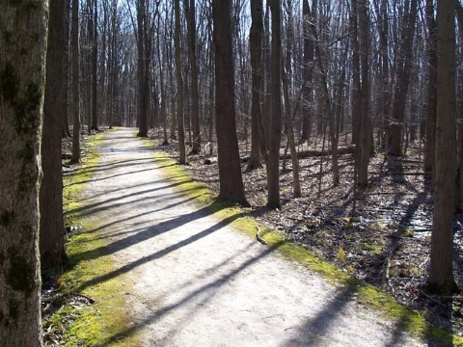
Conclusion
Charbonneau et al. 2170
Replicated Effects | Effects not Replicated
Fascination Mystery Likability Mindfulness Resilience | Anxiety (reversed) Mind Wandering (non-significant)
Notes:
The replicated effects of fascination, mystery, mindfulness, and resilience gives us confidence in our previous findings. However, the reversed effect of anxiety and null effect in mind wandering gives us pause. The only change from the pervious study to the replication was resizing the urban images therefore there is no theoretical reason why anxiety should reverse.
Two previous data sets from Mturk and Montana State University showed less anxiety when viewing nature images. Some explanations could be that outdoors may provoke more anxiety now that many are choosing to go back to socializing even though the pandemic is still ongoing. However, this anxiety would also be expected for the outdoors in urban areas as there are typically more people there. Future research will monitor how the relationship between nature and anxiety changes during the course of the pandemic.
Additionally, the null effect of mind wandering may be due to lack of observations, however, other studies in our lab have shown this effect to be unreliable and may not have a significant difference between nature and urban environments or mind wandering may differ based on the population. Add pupil explanation (Alex’s data), talk about Nature and health conference.
However, given the replicated effects we can now produce normative numbers for fascination, mystery, mindfulness, and resilience for these 40 images of nature and 40 images of urban scenes. These images sets may be useful for researchers interested in investigating which image properties underlie attention restoration by permitting researchers to select images along specific dimensions.
(difficulty replicating the priming intervention approach)

