Slide 1
Internal Control in Higher Education
Daniel Adams
Office of Audit Services

Slide 2
Audit Services’ Mission
To provide assurance and advisory services that are independent, objective and risk-based in order to protect Montana State University and to improve its operations.

Slide 3
Audit Services’ Responsibilities
Assurance services are objective examinations of evidence for the purpose of providing an independent assessment. Scope includes:
  Risks … are appropriately identified and managed;
  The means with which assets are safeguarded;
  Employees follow policies, procedures, applicable laws, regulations, contracts, and governance standards;
Source: Montana University System Internal Audit Charter

Slide 4
Audit Services’ Responsibilities
Advisory services: counsel, advice, facilitation, and training
Investigate suspected fiscal misconduct and review compliance hotline reports
Source: Montana University System Internal Audit Charter

Slide 5
3 Lines of Defense for Risk Management
(Institute of Internal Auditors Position Paper, January 2013)
Management and Personnel
Deans, Directors, Dept Heads, Faculty & Staff
Risk and Compliance
UBS, OSP, SRM, Info Security, Research Compliance
Internal Audit

Slide 6
Internal Control in Higher Ed Overview
5 components and 17 principles of internal control
Areas where internal control processes should commonly be implemented in higher ed
Tools for assessing and improving internal control processes in your unit

Slide 7
Office of Management and Budget (OMB) Circular A-81 §200.303 Internal controls.
The non-Federal entity must:
(a) Establish and maintain effective internal control over the Federal award that provides reasonable assurance that the non-Federal entity is managing the Federal award in compliance with Federal statutes, regulations, and the terms and conditions of the Federal award.

Slide 8
OMB Circular A-81
§200.303 Internal controls.
These internal controls should be in compliance with guidance in ‘‘Standards for Internal Control in the Federal Government’’ issued by the Comptroller General of the United States and the ‘‘Internal Control Integrated Framework’’, issued by the Committee of Sponsoring Organizations of the Treadway Commission (COSO).

Slide 9
COSO Internal Control–Integrated Framework
COSO (Committee of Sponsoring Organizations) of the Treadway Commission
  American Accounting Association (AAA)
  American Institute of Certified Public Accountants (AICPA)
  Financial Executives International (FEI)
  Institute of Management Accountants (IMA)
  The Institute of Internal Auditors (IIA)
Notes:
COSO was formed in 1985 to sponsor the National Commission on Fraudulent Financial Reporting (the Treadway Commission).
James Treadway http://www.coso.org/publications/ncffr.pdf

Slide 10
The Green Book
Standards for Internal Control in the Federal Government
  Government Accountability Office (GAO)
  Comptroller General of the United States
  “May also be adopted by state, local, and quasi-governmental entities as a framework for an internal control system”
Source: Standards for Internal Control in the Federal Government. GAO. September 2014.

Slide 11
Other Internal Control Frameworks
Canadian Institute of Chartered Accountants Control Framework
Control Objectives for Information and Related Technology (COBIT)
International Organization for Standardization (ISO)

Slide 12
Green Book Internal Control Definition
Internal control is a process effected by an entity’s oversight body, management, and other personnel that provides reasonable assurance that the objectives of an entity will be achieved.
Source: Standards for Internal Control in the Federal Government. GAO. September 2014.

Slide 13
Green Book Internal Control Definition
These objectives and related risks can be broadly classified into one or more of the following three categories:
Operations - Effectiveness and efficiency of operations
Reporting - Reliability of reporting for internal and external use
Compliance - Compliance with applicable laws and regulations
Source: Standards for Internal Control in the Federal Government. GAO. September 2014.

Slide 14
Green Book Internal Control Definition
Internal control comprises the plans, methods, policies, and procedures used to fulfill the mission, strategic plan, goals, and objectives of the entity.
Source: Standards for Internal Control in the Federal Government. GAO. September 2014.

Slide 15
Green Book Internal Control Definition
Internal control serves as the first line of defense in safeguarding assets.
Source: Standards for Internal Control in the Federal Government. GAO. September 2014.

Slide 16
Green Book Internal Control Definition
In short, internal control helps managers achieve desired results through effective stewardship of public resources.
Source: Standards for Internal Control in the Federal Government. GAO. September 2014.

Slide 17
Who do you think is responsible for internal control at MSU?

Slide 18
Green Book Internal Control Definition
People are what make internal control work. Management is responsible for an effective internal control system. However, personnel throughout an entity play important roles in implementing and operating an effective internal control system.
Source: Standards for Internal Control in the Federal Government. GAO. September 2014.

Slide 19
International Organization for Standardization (ISO) Control Definition
Administrative, managerial, technical or legal methods for managing risk, including policies, procedures, guidelines, practices or organizational structures
Source: ISO 27000 Information security management systems.

Slide 20
ISO Risk Definition
Combination of the probability (likelihood) of an event and its consequence (impact)
Source: ISO 27000 Information security management systems.
Notes:
See risk rating criteria
Inherent risk

Slide 21
OAS Risk Focus
Compliance (Legal and Liability)
Financial
Information Security
Operational
Reputational
Safety
Strategic
Source: http://www.montana.edu/audit/risk_rating_criteria.html
Notes:
Cross-functional processes

Slide 22
Characteristics of Higher Education
Large organizations
  Offices with functional expertise (e.g., finance, sponsored programs, human resources)
Decentralized
Partially taxpayer funded
Highly regulated
Some managers do not have prior business-type experience

Slide 23
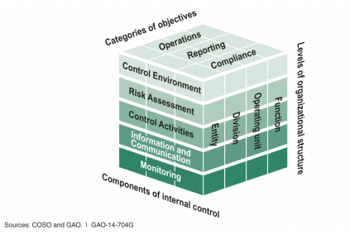
Five Components of Internal Control

Slide 24
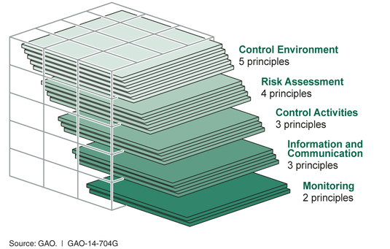
17 Principles Support the Five Components

Slide 25
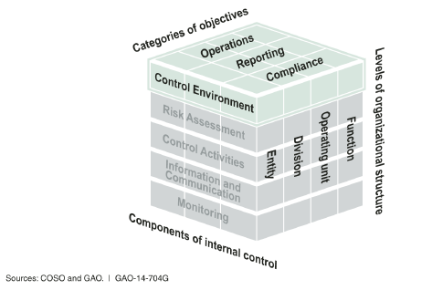
Control Environment
The oversight body and management establish and maintain an environment throughout the entity that sets a positive attitude toward internal control.
Source: Standards for Internal Control in the Federal Government. GAO. September 2014.

Slide 26
Control Environment - Principle 1
The oversight body and management demonstrate a commitment to integrity and ethical values.
  Tone at the Top
  Standards of Conduct
  Adherence to Standards of Conduct
Source: Standards for Internal Control in the Federal Government. GAO. September 2014.

Slide 27
State of Montana Code of Ethics
Gifts – You may not accept a substantial (> $50) gift or economic benefit
Self-Dealing – You may not perform an official act which directly and substantially provides an economic benefit to a business in which you have a substantial financial interest
https://hr.mt.gov/Portals/78/newdocs/guidesandforms/standardsofconductguide.pdf

Slide 28
State of Montana Code of Ethics
Unwarranted Privileges – You may not:
  Contract or be employed within six months of termination by someone who contracts with the state involving matters with which you were directly involved during your employment with the state
  Receive two salaries as a public employee for work during overlapping hours
https://hr.mt.gov/Portals/78/newdocs/guidesandforms/standardsofconductguide.pdf

Slide 29
State of Montana Code of Ethics
Public Property for Private Business Purposes – You may not use public time, facilities, equipment, supplies, personnel, or funds for private business purposes.
https://hr.mt.gov/Portals/78/newdocs/guidesandforms/standardsofconductguide.pdf

Slide 30
Control Environment - Principle 2
The oversight body should oversee the entity’s internal control system.
  Oversight Structure
  Oversight for the Internal Control System
  Input for Remediation of Deficiencies
Source: Standards for Internal Control in the Federal Government. GAO. September 2014.

Slide 31
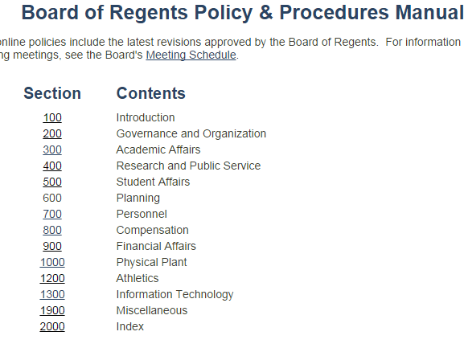
http://www.mus.edu/borpol/default.asp

Slide 32
Montana Code Annotated (MCA) 5-13-309.
Information from state agencies.
[…]
(3) The head of each state agency shall immediately notify both the attorney general and the legislative auditor in writing upon the discovery of any theft, actual or suspected, involving state money or property under that agency's control or for which the agency is responsible.
http://leg.mt.gov/bills/mca/title_0050/chapter_0130/part_0030/section_0090/0050-0130-0030-0090.html

Slide 33
Control Environment - Principle 3
Management should establish an organizational structure, assign responsibility, and delegate authority to achieve the entity’s objectives.
  Organizational Structure
  Assignment of Responsibility and Delegation of Authority
  Documentation of the Internal Control System
Source: Standards for Internal Control in the Federal Government. GAO. September 2014.

Slide 34
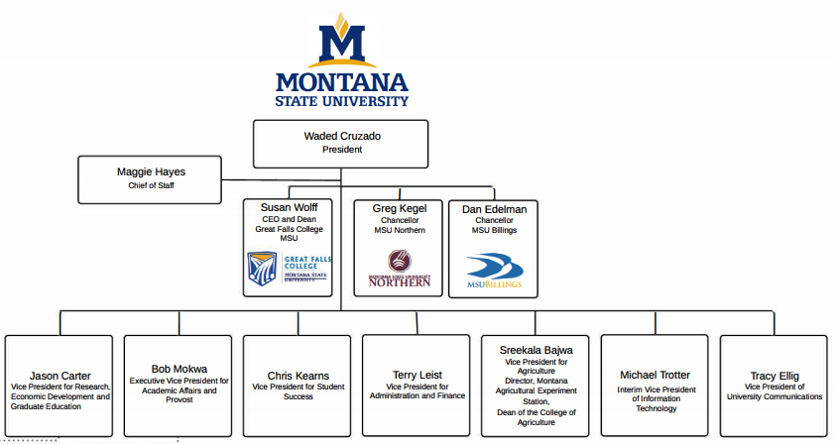
Organizational Structure

Slide 35
Do you think authority and responsibility are clearly assigned at MSU?

Slide 36
Principal Investigator Guide
1110.00 Responsibilities in Post-Award Administration
  Office of Sponsored Programs Post-Award Responsibilities
  PI Post-Award Responsibilities
  Departmental Accountant/Business Managers Post-Award Responsibilities
http://www.montana.edu/research/osp/documents/OSP_PI_Guide.pdf

Slide 37
Documentation of the Control System
Establishing and communicating who, what, when, where and why of internal control execution to personnel
Means to retain organizational knowledge that could be limited to a few personnel
Means to communicate effective control design to outside parties (e.g., auditors)
Source: Standards for Internal Control in the Federal Government. GAO. September 2014.

Slide 38
MSU Policies and Procedures
http://www.montana.edu/policy/
  https://www.montana.edu/policy/hr_policies/index.html
  http://www.montana.edu/policy/business_manual/
  http://www.montana.edu/policy/purchasing/
  http://www.montana.edu/policy/property/manual.html
  http://www.montana.edu/research/osp/piguide/index.html

Slide 39
Guidance on Adequate Documentation
  Departmental Revenue Collection Procedures Model
  This document can be used by departments as a guide for the development or enhancement of their revenue collection procedures and can be tailored to each department’s specific situation.
http://www.montana.edu/audit/guidance.html

Slide 40
Control Environment - Principle 4
Management should demonstrate a commitment to recruit, develop, and retain competent individuals.
  Expectations of Competence
  Recruitment, Development, and Retention of Individuals
  Succession and Contingency Plans and Preparation
Source: Standards for Internal Control in the Federal Government. GAO. September 2014.

Slide 41
How well do you think MSU does at developing and training its people?

Slide 42
Control Environment - Principle 5
Management should evaluate performance and hold individuals accountable for their internal control responsibilities.
  Enforcement of Accountability
  Consideration of Excessive Pressures
Source: Standards for Internal Control in the Federal Government. GAO. September 2014.

Slide 43
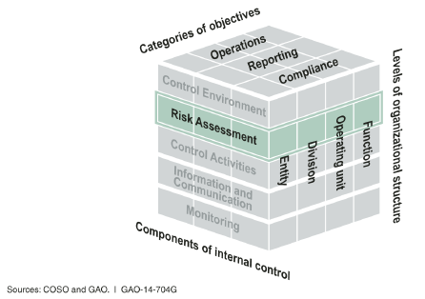
Risk Assessment
Management assesses the risks facing the entity as it seeks to achieve its objectives. This assessment provides the basis for developing appropriate risk
responses.
Source: Standards for Internal Control in the Federal Government. GAO. September 2014.

Slide 44
Risk Assessment - Principle 6
Management should define objectives clearly to enable the identification of risks and define risk tolerances.
  Definitions of Objectives
  Definitions of Risk Tolerances
Source: Standards for Internal Control in the Federal Government. GAO. September 2014.

Slide 45
Definitions of Objectives
For quantitative objectives, performance measures may be a targeted percentage or numerical value.
For qualitative objectives, management may need to design performance measures that indicate a level or degree of performance, such as milestones.
Source: Standards for Internal Control in the Federal Government. GAO. September 2014.

Slide 46
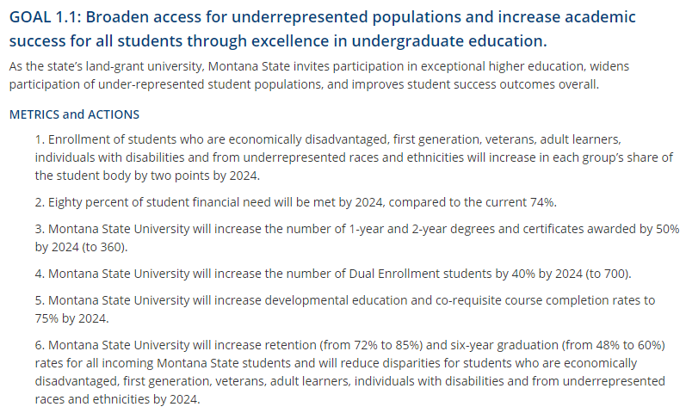
MSU Strategic Objectives

Slide 47
Definitions of Risk Tolerances
Risk tolerance is the acceptable level of variation in performance relative to the achievement of objectives.
  For financial reporting objectives, risk tolerance is typically expressed in terms of materiality.
Source: Standards for Internal Control in the Federal Government. GAO. September 2014.
Source: COSO Internal Control – Integrated Framework. May 2013.

Slide 48
Definitions of Risk Tolerances
Compliance objectives - Concept of risk tolerance does not apply. An entity is either compliant or not compliant.
Source: Standards for Internal Control in the Federal Government. GAO. September 2014.

Slide 49
Risk Assessment - Principle 7
Management should identify, analyze, and respond to risks related to achieving the defined objectives.
  Identification of Risks
  Analysis of Risks
  Response to Risks
Source: Standards for Internal Control in the Federal Government. GAO. September 2014.

Slide 50
Guidance on Risk Assessment
Internal Control Assessments
  These questionnaires were designed to make it easy for staff members to determine if their units have implemented many of the control activities that are commonly needed at MSU and are based on MSU and State of Montana policies and procedures and sound administrative practices.
http://www.montana.edu/audit/guidance.html

Slide 51
Accounting & Budgeting
Control Assessment (CA)
How do you ensure that all indexes are regularly monitored to know that you have adequate resources?
Do you use a subsidiary accounting system (e.g., CatBooks)? How is it used? Is it regularly reconciled to Banner (monthly)?
What reconciliations do you perform and at what frequency? What do you do if you detect errors or omissions?
http://www.montana.edu/audit/guidance.html

Slide 52
Human Resources CA
Are regular, extra (e.g., overtime) and exception time (e.g., leave) reviewed and approved?
Are termination checklists completed and properly approved when employees leave?
Are Conflict of Interest Disclosure Statements made annually by all applicable employees?
http://www.montana.edu/audit/guidance.html

Slide 53
Information Security CA
Are MSU information security policies and standards followed (e.g., MSU Enterprise Technology Management Policy)?
Has your area identified the types of data for which it is responsible and ensured that is stored in accordance with the MSU Enterprise Data Stewardship Policy?
Are information system access privileges for employees in your area periodically reviewed and accordingly changed or terminated?
http://www.montana.edu/audit/guidance.html

Slide 54
Information Security CA
Unit personnel do not download software from unknown sources or open attachments or links included in email without first thinking about the potential for resulting information security issues.
http://www.montana.edu/audit/guidance.html

Slide 55
OMB Circular A-81
§200.303 Internal controls.
(e) Take reasonable measures to safeguard protected personally identifiable information and other information the Federal awarding agency or pass-through entity designates as sensitive or the non-Federal entity considers sensitive consistent with applicable Federal, state and local laws regarding privacy and obligations of confidentiality.

Slide 56
Procurement & Disbursements CA
Purchases are not manipulated (e.g., two payments of $4,900 for a single item) to avoid following procurement procedures.
A written contracted services agreement exists for all purchased services from independent contractors that amount to $5,000 or more.
Prior to entering into a contract, the unit determines whether the relationship with the person or firm is an employment relationship or an independent contractor relationship.
http://www.montana.edu/audit/guidance.html

Slide 57
Property Management CA
The unit maintains capital and minor and sensitive equipment inventory listings.
Sensitive property includes items that possess a special risk of theft due to marketability and/or portability or that present a risk to safety.
Actual and suspected losses of assets are reported to MSU Property Management.
http://www.montana.edu/audit/guidance.html

Slide 58
Revenue Collection CA
Procedures must prevent skimming at the initial receipt of revenue. Records of initial receipt must be retained to prove that all revenue received was deposited.
The change fund is balanced each day it is in use (amount authorized for the change fund plus amount recorded as received that day equals amount on hand).
If there is insufficient staff for ideal separation of duties, procedures are in place that compensate for the lack of separation (e.g., supervisory review).
http://www.montana.edu/audit/guidance.html

Slide 59
Safety & Risk Management CA
Workers’ compensation issues are reported.
International travel is approved and reported.
Student travel is conducted in accordance with student travel policy (http://www2.montana.edu/policy/student_trips/)
http://www.montana.edu/audit/guidance.html

Slide 60
Sponsored Programs CA
Costs charged to sponsored programs are allowable.
Time and effort reporting is accurate, complete, timely and properly certified.
Cost transfers are minimized, properly approved, completed in a timely manner and reasonable in amount and frequency.
http://www.montana.edu/audit/guidance.html

Slide 61
Risk Assessment - Principle 8
Management should consider the potential for fraud when identifying, analyzing, and responding to risks.
  Types of Fraud
  Fraud Risk Factors
  Response to Fraud Risks
Source: Standards for Internal Control in the Federal Government. GAO. September 2014.

Slide 62
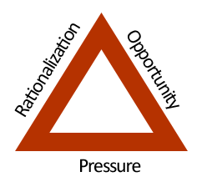
Fraud Risk Factors
Source: http://www.flawd.se/5percentfraud/. Retrieved October 17, 2014.

Slide 63
Fiscal Misconduct Policy
Any employee or student associated with the University who knows of, or suspects, fiscal misconduct should promptly notify his or her supervisor or one of the Responsible Officials for his or her campus [Director of Audit Services, Legal Counsel, or Director of University Police].
If a supervisor is notified of suspected fiscal misconduct, he or she will promptly notify a Responsible Official.
http://www.montana.edu/policy/fiscal_misconduct/

Slide 64
Fiscal Misconduct Definition
Examples include:
embezzlement;
misappropriation of goods, services, or resources;
diversion of assets;
conflict of interest situations,
violation of state or University fiscal policies and procedures and
use of University facilities and equipment for personal gain; and
any activity related to intentional wrongdoing and improper behavior related to state financial matters.
http://www.montana.edu/policy/fiscal_misconduct/

Slide 65
Where Fiscal Misconduct Typically Occurs in Higher Ed
Purchasing card
Revenue collection
Conflict of interest
Sponsored programs noncompliance
Property management

Slide 66
Purchasing card
Risk: Use of purchasing card for personal (or other unallowable) expenses
Controls:
Unit-level review of purchasing card reports
  Staff member could review most transactions
  Supervisor could review transactions conducted by report preparer
Purchasing card only used by cardholder

Slide 67
Revenue collection
Risk: Revenue collected is misappropriated
Controls:
Duties are segregated or compensating controls are implemented
  Segregate collection from daily balancing/ depositing
Records of initial receipt must be retained

Slide 68
Conflict of interest
Risk: Private interest negatively impacts an employee’s university activities
Controls:
Conflicts of interest are disclosed
Conflict management plans are developed and followed
http://www.montana.edu/policy/conflict_of_interest/

Slide 69
Sponsored programs noncompliance
Risk: Costs charged to sponsored programs are unallowable
Controls:
PIs are knowledgeable of grant rules
Grant accountants are empowered to question allowability of costs

Slide 70
Property management
Risk: Misappropriation of equipment
Controls:
Property Management Office is contacted for compliant disposition of property
Maintain listing of minor and sensitive equipment
Physical inventories of this listing are conducted every two years

Slide 71
Risk Assessment - Principle 9
Management should identify, analyze, and respond to significant changes that could impact the internal control system.
  Identification of Change
  Analysis of and Response to Change
Source: Standards for Internal Control in the Federal Government. GAO. September 2014.

Slide 72
What types of changes do you think could affect the internal control system?
Notes:
Regulation
Technology
Org Structure

Slide 73
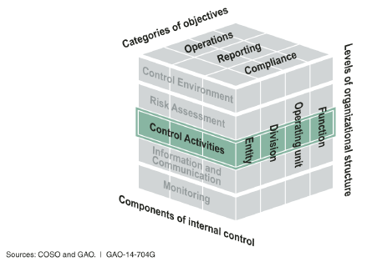
Control Activities
Control activities are the actions management establishes through policies and procedures to achieve objectives and respond to risks in the internal control system, which includes the entity’s information system.
Source: Standards for Internal Control in the Federal Government. GAO. September 2014.

Slide 74
Control Activities - Principle 10
Management should design control activities to achieve objectives and respond to risks.
  Response to Objectives and Risks
  Design of Appropriate Types of Control Activities
  Design of Control Activities at Various Levels
  Segregation of Duties
Source: Standards for Internal Control in the Federal Government. GAO. September 2014.

Slide 75
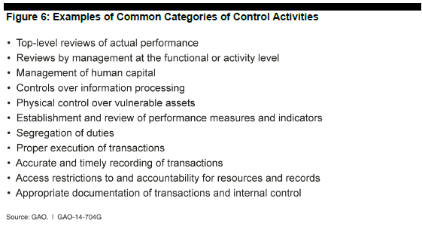
See pages 46-48.
Source: Standards for Internal Control in the Federal Government. GAO. September 2014.

Slide 76
Segregation of Duties
  Authority to execute transactions (e.g., can delete revenue transactions in software application)
  Custody of assets (e.g., cash and checks)
  Recording of transactions (e.g., preparation of bank deposit)
  Reviewing transactions (e.g., reconciling bank statement)
Source: Standards for Internal Control in the Federal Government. GAO. September 2014.

Slide 77
Guidance from the State
Montana Operations Manual (MOM) 399 Internal Control Guidebook (http://mom.mt.gov/ (Accounting category, page 2))
State Financial Services Division, Internal Control Documents (http://sfsd.mt.gov/SAB/internalcontrols)

Slide 78
Control Activities - Principle 11
Management should design the entity’s information system and related control activities to achieve objectives and respond to risks.
  Design of the Entity’s Information System
  Design of Appropriate Types of Control Activities
  Design of Information Technology Infrastructure
  Design of Security Management
  Design of Information Technology Acquisition, Development, and Maintenance
Source: Standards for Internal Control in the Federal Government. GAO. September 2014.

Slide 79
Information Processing Objectives
Completeness - Transactions that occur are recorded and not understated.
Accuracy - Transactions are recorded at the correct amount in the right account (and on a timely basis) at each stage of processing.
Validity - Recorded transactions represent economic events that actually occurred and were executed according to prescribed procedures.
Source: Standards for Internal Control in the Federal Government. GAO. September 2014.

Slide 80
Information Security Objectives
Confidentiality - Data, reports, and other outputs are safeguarded against unauthorized access.
Integrity - Information is safeguarded against improper modification or destruction, which includes ensuring information’s nonrepudiation and authenticity.
Availability - Data, reports, and other relevant information are readily available to users when needed.
Source: Standards for Internal Control in the Federal Government. GAO. September 2014.

Slide 81
Control Activities - Principle 12
Management should implement control activities through policies.
  Documentation of Responsibilities through Policies
  Periodic Review of Control Activities
Source: Standards for Internal Control in the Federal Government. GAO. September 2014.

Slide 82
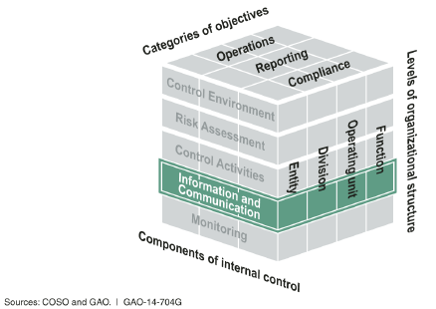
Information and Communication
Effective information and communication are vital for an entity to achieve its objectives. Entity management needs access to relevant and reliable communication related to internal as well as external events.
Source: Standards for Internal Control in the Federal Government. GAO. September 2014.

Slide 83
Information & Communication - Principle 13
Management should use quality information to achieve the entity’s objectives.
  Identification of Information Requirements
  Relevant Data from Reliable Sources
  Data Processed into Quality Information
Source: Standards for Internal Control in the Federal Government. GAO. September 2014.

Slide 84
Banner
Notes:
Regulation
Technology
Org Structure

Slide 85
Other Examples of Sources of Data
Office of Planning & Analysis
Web time entry system
OSP effort reporting system
Office of Commissioner of Higher Education (OCHE) Data and Reports

Slide 86
Information & Communication - Principle 14
Management should internally communicate the necessary quality information to achieve the entity’s objectives.
  Communication throughout the Entity
  Appropriate Methods of Communication
Source: Standards for Internal Control in the Federal Government. GAO. September 2014.

Slide 87
How effectively are changes that affect your job communicated?

Slide 88
Appropriate methods of communication
Written
  Formal document
  Email (Use the newspaper test)
Phone
Face-to-face

Slide 89
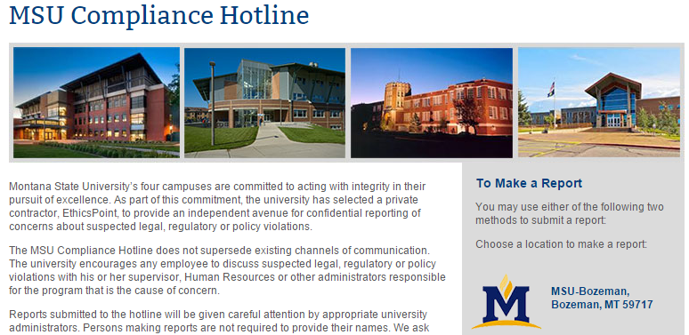

Slide 90
Reporting Suspected Legal, Regulatory and Policy Violations
Montana State University encourages all faculty, staff, students, and volunteers, acting in good faith, to report suspected legal, regulatory or policy violations. The university is committed to protecting individuals from retaliation for making a good faith report.
http://www.montana.edu/policy/reporting-violations/

Slide 91
Information & Communication - Principle 15
Management should externally communicate the necessary quality information to achieve the entity’s objectives.
  Communication with External Parties
  Appropriate Methods of Communication
Source: Standards for Internal Control in the Federal Government. GAO. September 2014.

Slide 92
Examples of Recipients of External Communications
State agencies
  Legislative Audit Division (LAD)
Federal agencies
The Integrated Postsecondary Education Data System (IPEDS)
Notes:
IPEDS National Center for Education Statistics

Slide 93
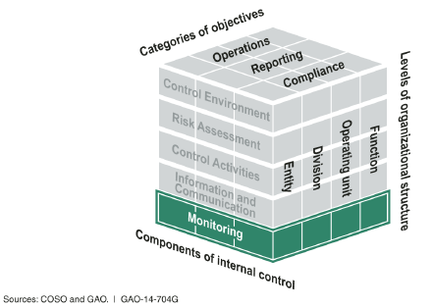
Monitoring
Internal control monitoring assesses the quality of performance over time and promptly resolves the findings of audits and other reviews. Corrective actions are a necessary complement to control activities in order to achieve objectives.
Source: Standards for Internal Control in the Federal Government. GAO. September 2014.

Slide 94
Monitoring - Principle 16
Management should establish and operate monitoring activities to monitor the internal control system and evaluate the results.
  Establishment of a Baseline
  Internal Control System Monitoring
  Evaluation of Results
Source: Standards for Internal Control in the Federal Government. GAO. September 2014.

Slide 95
Internal Control System Monitoring
Ongoing monitoring – regular management and supervisory activities, comparisons, reconciliations, and other routine actions
Separate evaluations – can be conducted by management or others such as internal auditors or management consultants

Slide 96
OMB Circular A-81
§200.303 Internal controls.
(c) Evaluate and monitor the non-Federal entity’s compliance with statute, regulations and the terms and conditions of Federal awards.

Slide 97
Monitoring - Principle 17
Management should remediate identified internal control deficiencies on a timely basis.
  Reporting of Issues
  Evaluation of Issues
  Corrective Actions
Source: Standards for Internal Control in the Federal Government. GAO. September 2014.

Slide 98
OMB Circular A-81
§200.303 Internal controls.
(d) Take prompt action when instances of noncompliance are identified including noncompliance identified in audit findings.

Slide 99
Five Components of Internal Control

Slide 100
Limitations of Internal Control
Human judgment
External events
Breakdowns
Management override
Collusion
Source: COSO Internal Control – Integrated Framework. May 2013.

Slide 101
Do you think MSU has established and maintained an effective internal control system?

Slide 102
Thanks!

