Slide 1
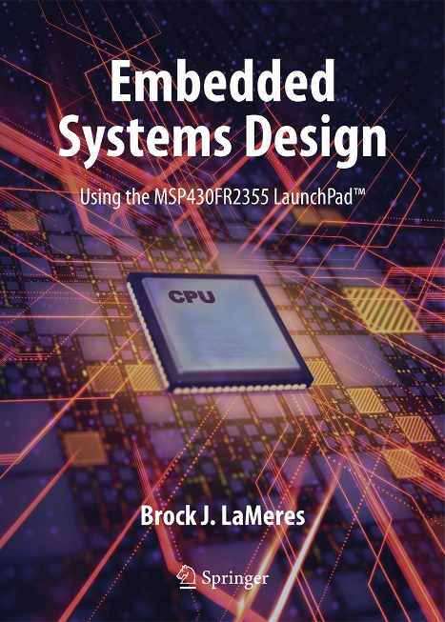
Embedded Systems Design
Chapter 14: Serial Communications in C
14.1 Serial Communications Overview
Brock J. LaMeres, Ph.D.

Slide 2
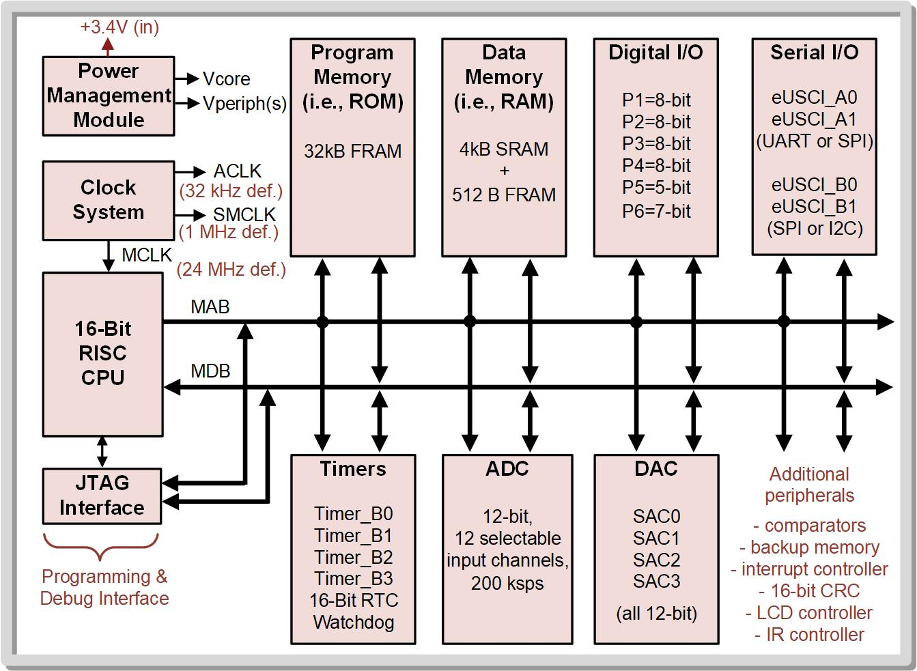
Ch. 14: Serial Communication in C
Parallel Communication – How we send information as a full word using the MCU ports. a full word.
14.1 Universal Asynchronous Receiver/Transmitter (UART) Operation

Slide 3
Ch. 14: Serial Communication in C
Serial Communication – uses a single wire to send information between a transmitter (Tx) and a receiver (Rx) as a sequence of bits.
Serial communication allows information to be transmitted using less pins compared to parallel communication, but at a slower overall information transmission rate due to only sending one bit at a time as opposed to a full word.
14.1 Universal Asynchronous Receiver/Transmitter (UART) Operation

Slide 4
Ch. 14: Serial Communication in C
Serial Communications on MCU’s
14.1 Universal Asynchronous Receiver/Transmitter (UART) Operation

Slide 5
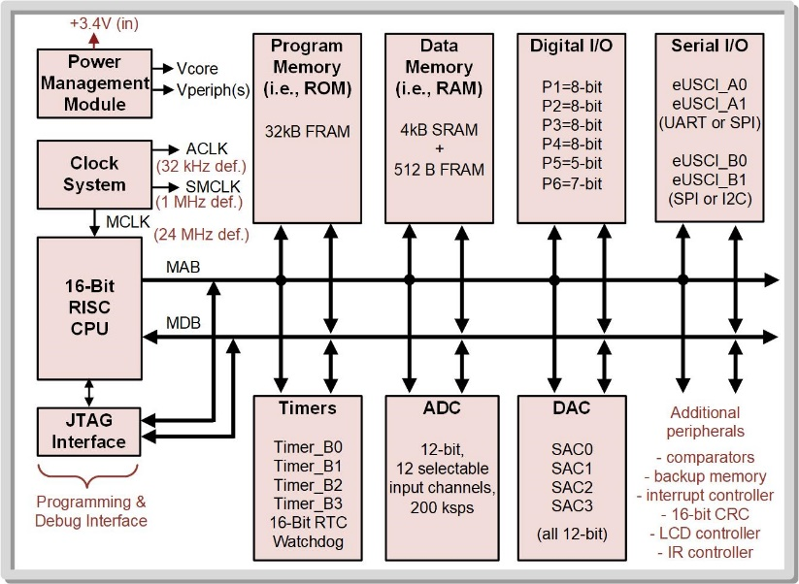
Ch. 14: Serial Communication in C
Serial Communications on MCU’s - Method 1 – “Bit Banging” - use BIC and BIS instructions to send the desired pattern out of a port pin. - Timer IRQs are used to set the data and clock periods.
14.1 Universal Asynchronous Receiver/Transmitter (UART) Operation

Slide 6
Ch. 14: Serial Communication in C
Serial Communications on MCU’s - Method 1 – “Bit Banging” - Method 2 – “Built in Serial Peripherals” - enhanced Universal Serial Communication Interfaces (eUSCI). - The MSP430FR2355 contains four eUSCI peripherals (eUSCI_A0, eUSCI_A1, eUSCI_B0, eUSCI_B1)
14.1 Universal Asynchronous Receiver/Transmitter (UART) Operation

Slide 7
Ch. 14: Serial Communication in C
MSP430FR2355 serial communication standards:
Universal Asynchronous Receiver/Transmitter (UART)
Serial Peripheral Interface (SPI)
Inter-integrated circuits (I2C) protocol
14.1 Universal Asynchronous Receiver/Transmitter (UART) Operation

Slide 8
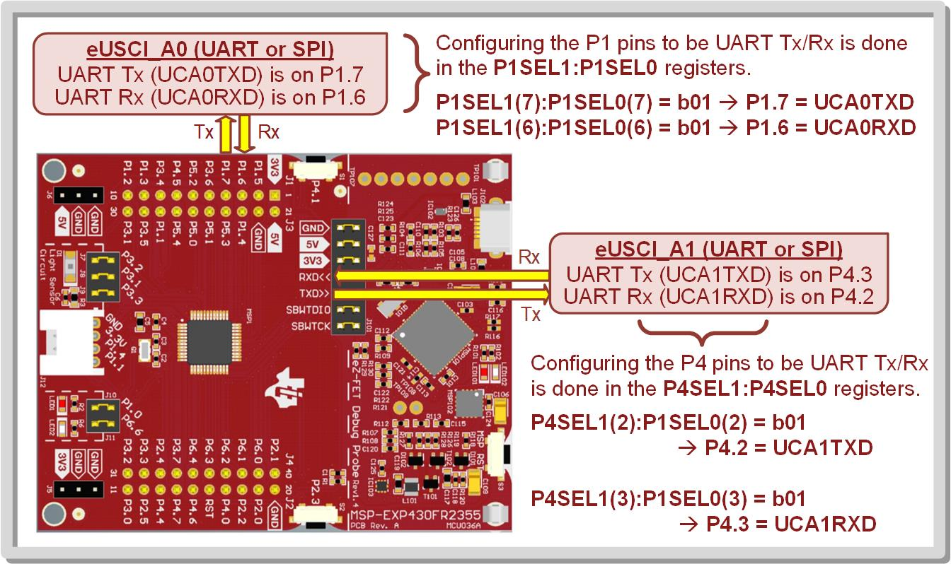
Ch. 14: Serial Communication in C
Serial Communications on MCU’s - Method 1 – “Bit Banging” - Method 2 – “Built in Serial Peripherals”
14.1 Universal Asynchronous Receiver/Transmitter (UART) Operation

Slide 9
Ch. 14: Serial Communication in C
Parallel-to-Serial Concept (Tx)
Parallel Register
Tx
Image Courtesy of https://neodem.wp.horizon.ac.uk/
Image Courtesy of
Recording Connection of Canada
Image Courtesy of
Recording Connection of Canada
Image Courtesy of
Recording Connection of Canada
Image Courtesy of
Recording Connection of Canada
Image Courtesy of
Recording Connection of Canada
Image Courtesy of
Recording Connection of Canada
14.1 Universal Asynchronous Receiver/Transmitter (UART) Operation

Slide 10
Ch. 14: Serial Communication in C
Serial-to-Parallel Concept (Tx)
Rx
Parallel Register
Image Courtesy of https://neodem.wp.horizon.ac.uk/
Image Courtesy of
Recording Connection of Canada
Image Courtesy of
Recording Connection of Canada
Image Courtesy of
Recording Connection of Canada
Image Courtesy of
Recording Connection of Canada
Image Courtesy of
Recording Connection of Canada
Image Courtesy of
Recording Connection of Canada
14.1 Universal Asynchronous Receiver/Transmitter (UART) Operation

Slide 11
Ch. 14: Serial Communication in C
Serial Communications on MCU’s - Learning…. Step 1 – you need to know the standard. Step 2 – decide whether to bit bang or use peripheral. We will use the peripherals. After you see the serial busses in action, bit banging will make more sense.
14.1 Universal Asynchronous Receiver/Transmitter (UART) Operation

Slide 12
Embedded Systems Design
Chapter 14: Serial Communications in C
14.1 Serial Communications Overview
www.youtube.com/c/DigitalLogicProgramming_LaMeres
Brock J. LaMeres, Ph.D.

Slide 13
Embedded Systems Design
Chapter 14: Serial Communications in C
14.1.1 The UART Standard
Brock J. LaMeres, Ph.D.

Slide 14
Ch. 14: Serial Communication in C
14.1.1 The UART Standard
Universal asynchronous receiver/transmitter – an approach to serial communication between two devices in which neither device shares a common clock.
Each device only uses lines for data.
Has a predefined protocol for how data is framed, how data packets start and stop, and how the receiver oversamples the incoming data to recover the information sent.
14.1 Universal Asynchronous Receiver/Transmitter (UART) Operation

Slide 15
Ch. 14: Serial Communication in C
14.1.1 The UART Standard
Baud rate (BR) – the common data rate between Tx and Rx; the fastest rate at which the data line changes states.
The baud rate and bit period (T_{B}) are related by BR = 1/T_{B}.
Baud rate must be set manually in both the Tx and Rx prior to data transmission (typical range is 9600 to 115200 baud).
14.1 Universal Asynchronous Receiver/Transmitter (UART) Operation

Slide 16
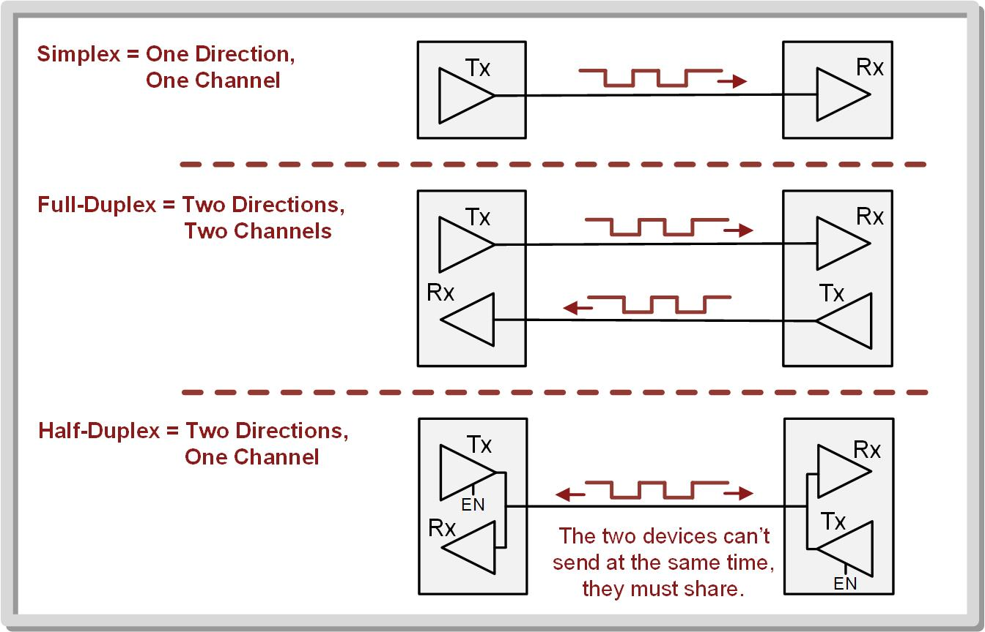
Ch. 14: Serial Communication in C
14.1.1 The UART Standard
Link – when two devices are connected together to transfer information.
14.1 Universal Asynchronous Receiver/Transmitter (UART) Operation

Slide 17
Ch. 14: Serial Communication in C
14.1.1 The UART Standard
Framing – the term used to describe how the bits are arranged in the UART serial bit sequence.
14.1 Universal Asynchronous Receiver/Transmitter (UART) Operation

Slide 18
Ch. 14: Serial Communication in C
14.1.1 The UART Standard
Framing – the term used to describe how the bits are arranged in the UART serial bit sequence.
Having the Tx drive a HIGH while not transmitting tells the Rx that it is still powered on.
14.1 Universal Asynchronous Receiver/Transmitter (UART) Operation

Slide 19
Ch. 14: Serial Communication in C
14.1.1 The UART Standard
Framing – the term used to describe how the bits are arranged in the UART serial bit sequence.
Start bit – initial symbol
To start a data transmission, the Tx drives the line LOW and holds it there for one T_{B}.
14.1 Universal Asynchronous Receiver/Transmitter (UART) Operation

Slide 20
Ch. 14: Serial Communication in C
14.1.1 The UART Standard
The data word is transmitted bit-by-bit, typically starting with the LSB.
14.1 Universal Asynchronous Receiver/Transmitter (UART) Operation

Slide 21
Ch. 14: Serial Communication in C
14.1.1 The UART Standard
Stop bit – last symbol
After the bits have been transmitted, the Tx drives the line HIGH for one T_{B} to represent the end of the sequence.
14.1 Universal Asynchronous Receiver/Transmitter (UART) Operation

Slide 22
Ch. 14: Serial Communication in C
14.1.1 The UART Standard
The most common options that are configurable on the MSP430 are swapping the order in which the bits are sent, changing the data size between 7-bits and 8-bits, adding on address bit (AD), adding a parity bit (PA), and adding a second stop bit.
14.1 Universal Asynchronous Receiver/Transmitter (UART) Operation

Slide 23
Ch. 14: Serial Communication in C
14.1.1 The UART Standard
When using a transmit address, two frames are sent, one for data and one for address.
The AD bit signifies whether the next frame is the address or data.
14.1 Universal Asynchronous Receiver/Transmitter (UART) Operation

Slide 24
Ch. 14: Serial Communication in C
14.1.1 The UART Standard
The addition of a second stop bit can be used to provide extra time between packets when running at higher baud rates in order to make the link more reliable.
14.1 Universal Asynchronous Receiver/Transmitter (UART) Operation

Slide 25
Ch. 14: Serial Communication in C
14.1.1 The UART Standard
Parity bit – used to detect transmission errors.
Even parity – the transmitter counts the number of 1’s in the data word and if the count is odd, it asserts the parity bit.
Odd parity – the transmitter counts the number of 1’s in the data word and if the count is even, it asserts the parity bit.
14.1 Universal Asynchronous Receiver/Transmitter (UART) Operation

Slide 26
Ch. 14: Serial Communication in C
14.1.1 The UART Standard
How does the receiver determine what logic is sent if it doesn’t have a clock?
Oversampling – using a receiver clock that is faster than the transmitter clock
Image Courtesy of https://neodem.wp.horizon.ac.uk/
Image Courtesy of
Recording Connection of Canada
Image Courtesy of
Recording Connection of Canada
Image Courtesy of
Recording Connection of Canada
Image Courtesy of
Recording Connection of Canada
Image Courtesy of
Recording Connection of Canada
Image Courtesy of
Recording Connection of Canada
14.1 Universal Asynchronous Receiver/Transmitter (UART) Operation

Slide 27
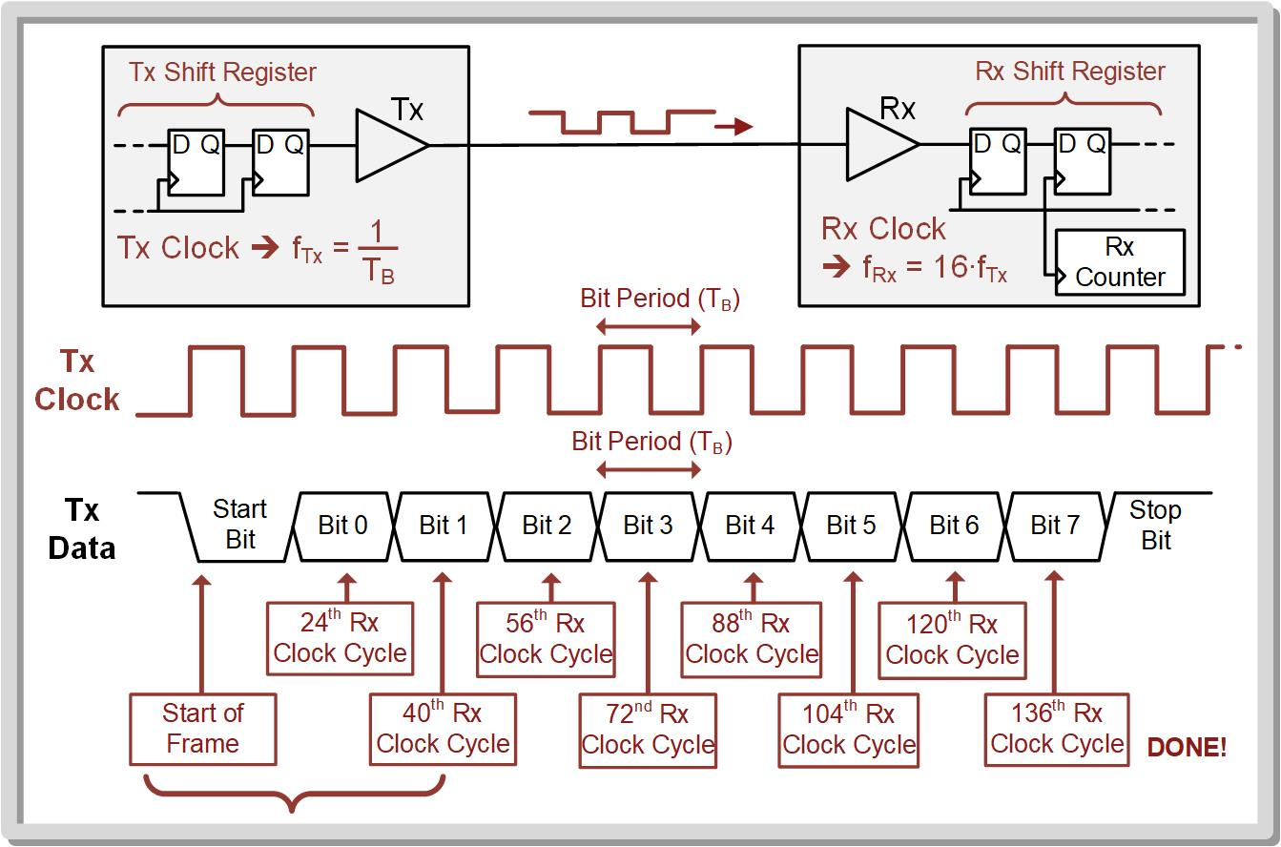
Ch. 14: Serial Communication in C
14.1.1 The UART Standard
14.1 Universal Asynchronous Receiver/Transmitter (UART) Operation

Slide 28
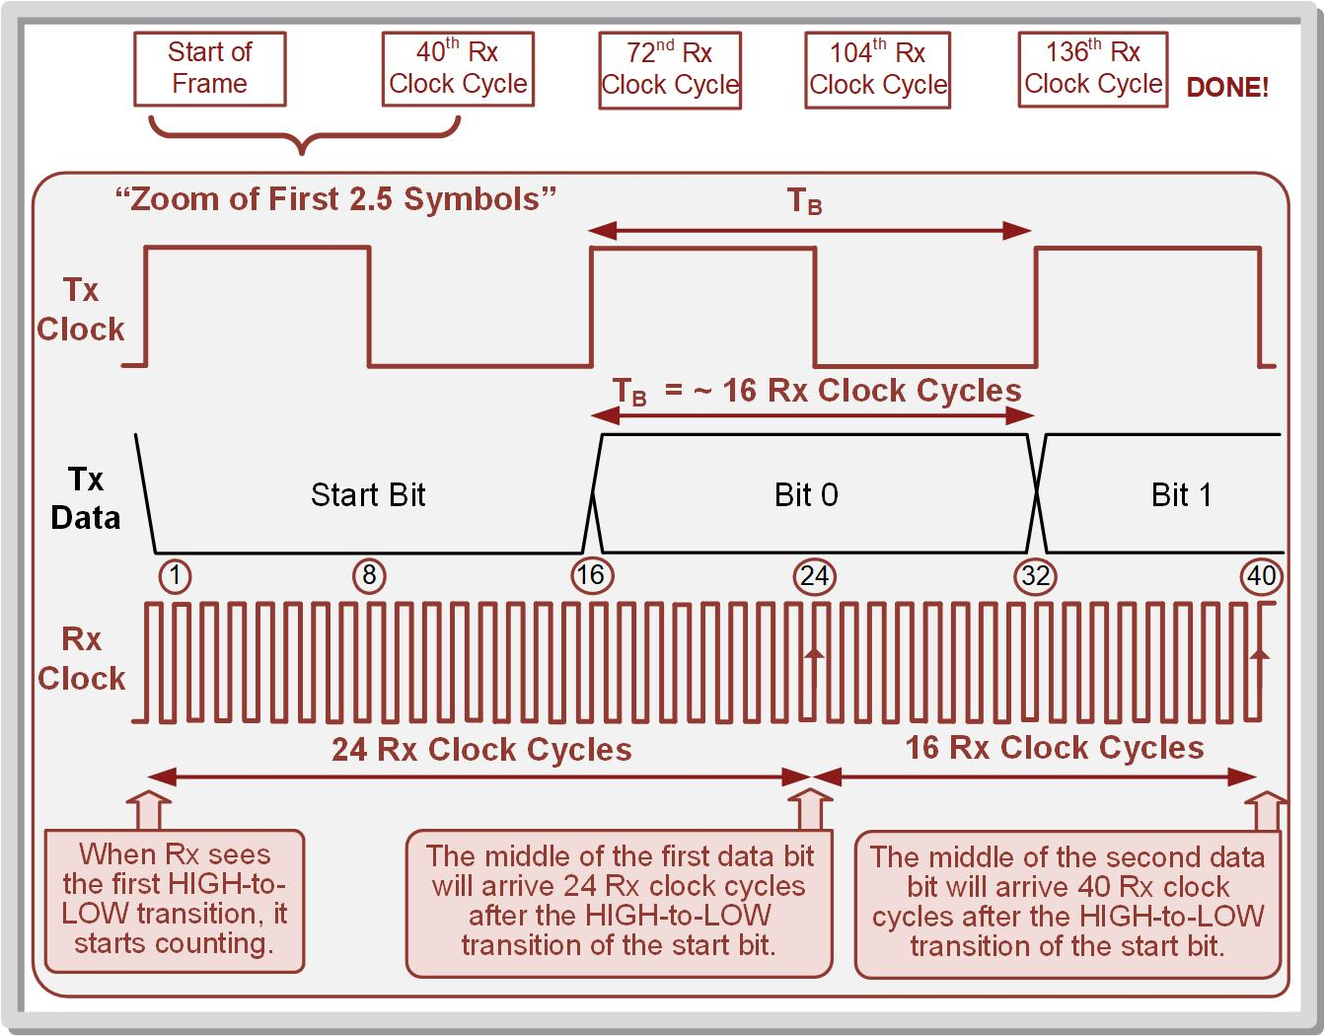
Ch. 14: Serial Communication in C
14.1.1 The UART Standard
14.1 Universal Asynchronous Receiver/Transmitter (UART) Operation

Slide 29
Ch. 14: Serial Communication in C
14.1.1 The UART Standard
Communication standard – when logic levels are assigned to the UART logic values.
As standard allows separate devices to communicate because both the logic levels and packet structure are known.
The term transistor-to-transistor logic (TTL) is used to describe a UART that transmits a HIGH as the power supply (Vcc) of the device and a LOW as the GND of the device.
MSP430FR2355 Specifications: Uses +3.4v TTL
Image Courtesy of https://neodem.wp.horizon.ac.uk/
Image Courtesy of
Recording Connection of Canada
Image Courtesy of
Recording Connection of Canada
Image Courtesy of
Recording Connection of Canada
Image Courtesy of
Recording Connection of Canada
Image Courtesy of
Recording Connection of Canada
Image Courtesy of
Recording Connection of Canada
14.1 Universal Asynchronous Receiver/Transmitter (UART) Operation

Slide 30
Ch. 14: Serial Communication in C
14.1.1 The UART Standard
14.1 Universal Asynchronous Receiver/Transmitter (UART) Operation

Slide 31
Embedded Systems Design
Chapter 14: Serial Communications in C
14.1.1 The UART Standard
www.youtube.com/c/DigitalLogicProgramming_LaMeres
Brock J. LaMeres, Ph.D.

Slide 32
Embedded Systems Design
Chapter 14: Serial Communications in C
14.1.2 UART Transmit on the MSP430FR2355 - Configuration
Brock J. LaMeres, Ph.D.

Slide 33
Ch. 14: Serial Communication in C
14.1.2 UART Transmit on the MSP430FR2355
The MSP430FR2355 contains two eUSCIs that support UARTs, eUSCI_A0 and eUSCI_A1.
14.1 Universal Asynchronous Receiver/Transmitter (UART) Operation

Slide 34
Ch. 14: Serial Communication in C
14.1.2 UART Transmit on the MSP430FR2355
The basic concept of operation of the UART system is to first configure its baud rate and frame characteristics.
14.1 Universal Asynchronous Receiver/Transmitter (UART) Operation

Slide 35
Ch. 14: Serial Communication in C
14.1.2 UART Transmit on the MSP430FR2355
We then store the data to be transmitted into a Tx buffer register, and a shift register will automatically send the data out over the Tx pin in a serial pattern.
14.1 Universal Asynchronous Receiver/Transmitter (UART) Operation

Slide 36
Ch. 14: Serial Communication in C
14.1.2 UART Transmit on the MSP430FR2355
The UART can also produce a variety of interrupts such as data received, transmit complete, and many others used for detecting transmission errors.
14.1 Universal Asynchronous Receiver/Transmitter (UART) Operation

Slide 37
Ch. 14: Serial Communication in C
14.1.2 UART Transmit on the MSP430FR2355
Steps to Configure the UART Peripheral:
Step 1: Set the UCSWRST bit in the UCAxCTLW0 configuration register to put the eUSCI_Ax peripheral into reset. Note that the default value for UCSWRST = 1 on system power-on or system reset, so the system is initially in software reset.
Step 2: Initialize all eUSCI_Ax configuration registers.
Step 3: Configure ports.
Step 4: Clear UCSWRST to take the eUSCI_Ax peripheral out of reset.
Step 5: Enable interrupts (optional) using the UCRXIE or UCTXIE bits int eh UCAxIE configuration register.
14.1 Universal Asynchronous Receiver/Transmitter (UART) Operation

Slide 38
Ch. 14: Serial Communication in C
14.1.2 UART Transmit on the MSP430FR2355
eUSCI_Ax Control Word 0 (UCAxCTLW0)
eUSCI_Ax Control Word 1 (UCAxCTLW1)
eUSCI_Ax Baud Rate Control Word (UCAxBRW)
eUSCI_Ax Modulation Control Word (UCAxMCTLW)
eUSCI_Ax Status (UCAxSTATW)
eUSCI_Ax Receive Buffer (UCAxRXBUF)
eUSCI_Ax Transmit Buffer (UCAxTXBUF)
eUSCI_Ax Auto Baud Rate Control (UCAxABCTL)
eUSCI_Ax IrDA Control (UCAxIRCTL)
eUSCI_Ax Interrupt Enable (UCAxIE)
eUSCI_Ax Interrupt Flag (UCAxIFG)
eUSCI_Ax Interrupt Vector (UCAxIV)
14.1 Universal Asynchronous Receiver/Transmitter (UART) Operation

Slide 39
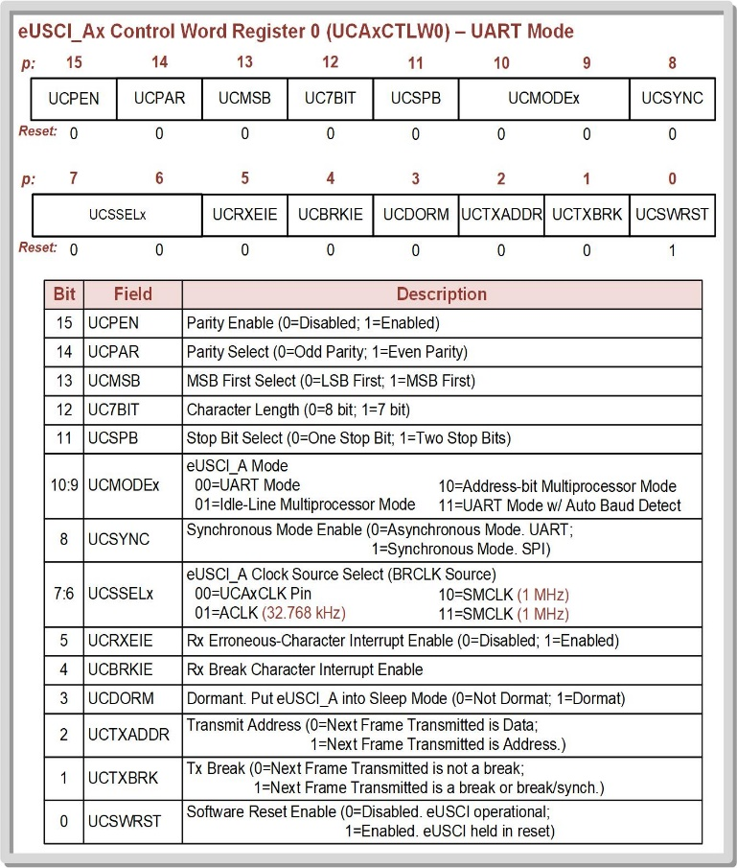
Ch. 14: Serial Communication in C
14.1.2 UART Transmit on the MSP430FR2355
We can start by just looking at the bare minimum to get the UART setup.
14.1 Universal Asynchronous Receiver/Transmitter (UART) Operation

Slide 40
Ch. 14: Serial Communication in C
14.1.2 UART Transmit on the MSP430FR2355
We can start by just looking at the bare minimum to get the UART setup.
The UCAxCTLW0 register has a LOT of our settings.
14.1 Universal Asynchronous Receiver/Transmitter (UART) Operation

Slide 41
Ch. 14: Serial Communication in C
14.1.2 UART Transmit on the MSP430FR2355
We can start by just looking at the bare minimum to get the UART setup.
The UCAxCTLW0 register has a LOT of our settings.
First, let’s consider what the default settings out of reset are:
14.1 Universal Asynchronous Receiver/Transmitter (UART) Operation

Slide 42
Ch. 14: Serial Communication in C
14.1.2 UART Transmit on the MSP430FR2355
We can start by just looking at the bare minimum to get the UART setup.
The UCAxCTLW0 register has a LOT of our settings.
First, let’s consider what the default settings out of reset are: - We’re by default in UART mode.
14.1 Universal Asynchronous Receiver/Transmitter (UART) Operation

Slide 43
Ch. 14: Serial Communication in C
14.1.2 UART Transmit on the MSP430FR2355
We can start by just looking at the bare minimum to get the UART setup.
The UCAxCTLW0 register has a LOT of our settings.
First, let’s consider what the default settings out of reset are: - We also have standard framing options.
14.1 Universal Asynchronous Receiver/Transmitter (UART) Operation

Slide 44
Ch. 14: Serial Communication in C
14.1.2 UART Transmit on the MSP430FR2355
We can start by just looking at the bare minimum to get the UART setup.
The UCAxCTLW0 register has a LOT of our settings.
First, let’s consider what the default settings out of reset are: - The UCSWRST bit is where we enable/disable the UART. - We need to put into Reset to configure the UART. - Note we “enable” a reset with UCSWRST=1
14.1 Universal Asynchronous Receiver/Transmitter (UART) Operation

Slide 45
Ch. 14: Serial Communication in C
14.1.2 UART Transmit on the MSP430FR2355
We can start by just looking at the bare minimum to get the UART setup.
The UCAxCTLW0 register has a LOT of our settings.
First, let’s consider what the default settings out of reset are: - We can choose our clock source using the UCSSELx bits. - We usually use ACLK or SMCLK.
14.1 Universal Asynchronous Receiver/Transmitter (UART) Operation

Slide 46
Ch. 14: Serial Communication in C
14.1.2 UART Transmit on the MSP430FR2355
We can start by just looking at the bare minimum to get the UART setup.
The UCAxCTLW0 register has a LOT of our settings.
First, let’s consider what the default settings out of reset are: - There are also options for error handling. - We won’t be using these.
14.1 Universal Asynchronous Receiver/Transmitter (UART) Operation

Slide 47
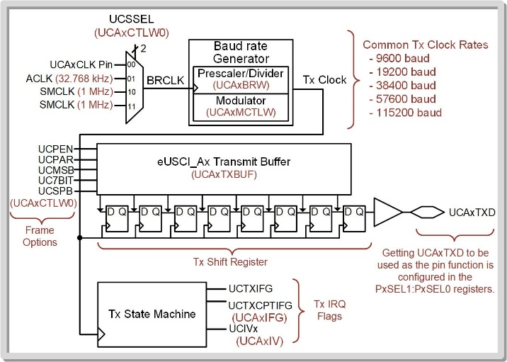
Ch. 14: Serial Communication in C
14.1.2 UART Transmit on the MSP430FR2355
The eUSCI_Ax peripheral has a baud rate generation circuit that can produce standard baud rates from nonstandard clock sources such as SMCLK (1MHz) and ACLK (32.768kHz).
The baud rate is set using two configuration registers, the eUSCI_Ax Baud Rate Control Word (UCAxBRW) and eUSCI_Ax Modulation Control Word (UCAxMCTLW) regsiters.
14.1 Universal Asynchronous Receiver/Transmitter (UART) Operation

Slide 48
Ch. 14: Serial Communication in C
14.1.2 UART Transmit on the MSP430FR2355
The eUSCI_Ax peripheral has a baud rate generation circuit that can produce standard baud rates from nonstandard clock sources such as SMCLK (1MHz) and ACLK (32.768kHz).
The baud rate is set using two configuration registers, the eUSCI_Ax Baud Rate Control Word (UCAxBRW) and eUSCI_Ax Modulation Control Word (UCAxMCTLW) regsiters.
Note: This is complicated enough that I will put into a separate video.
14.1 Universal Asynchronous Receiver/Transmitter (UART) Operation

Slide 49
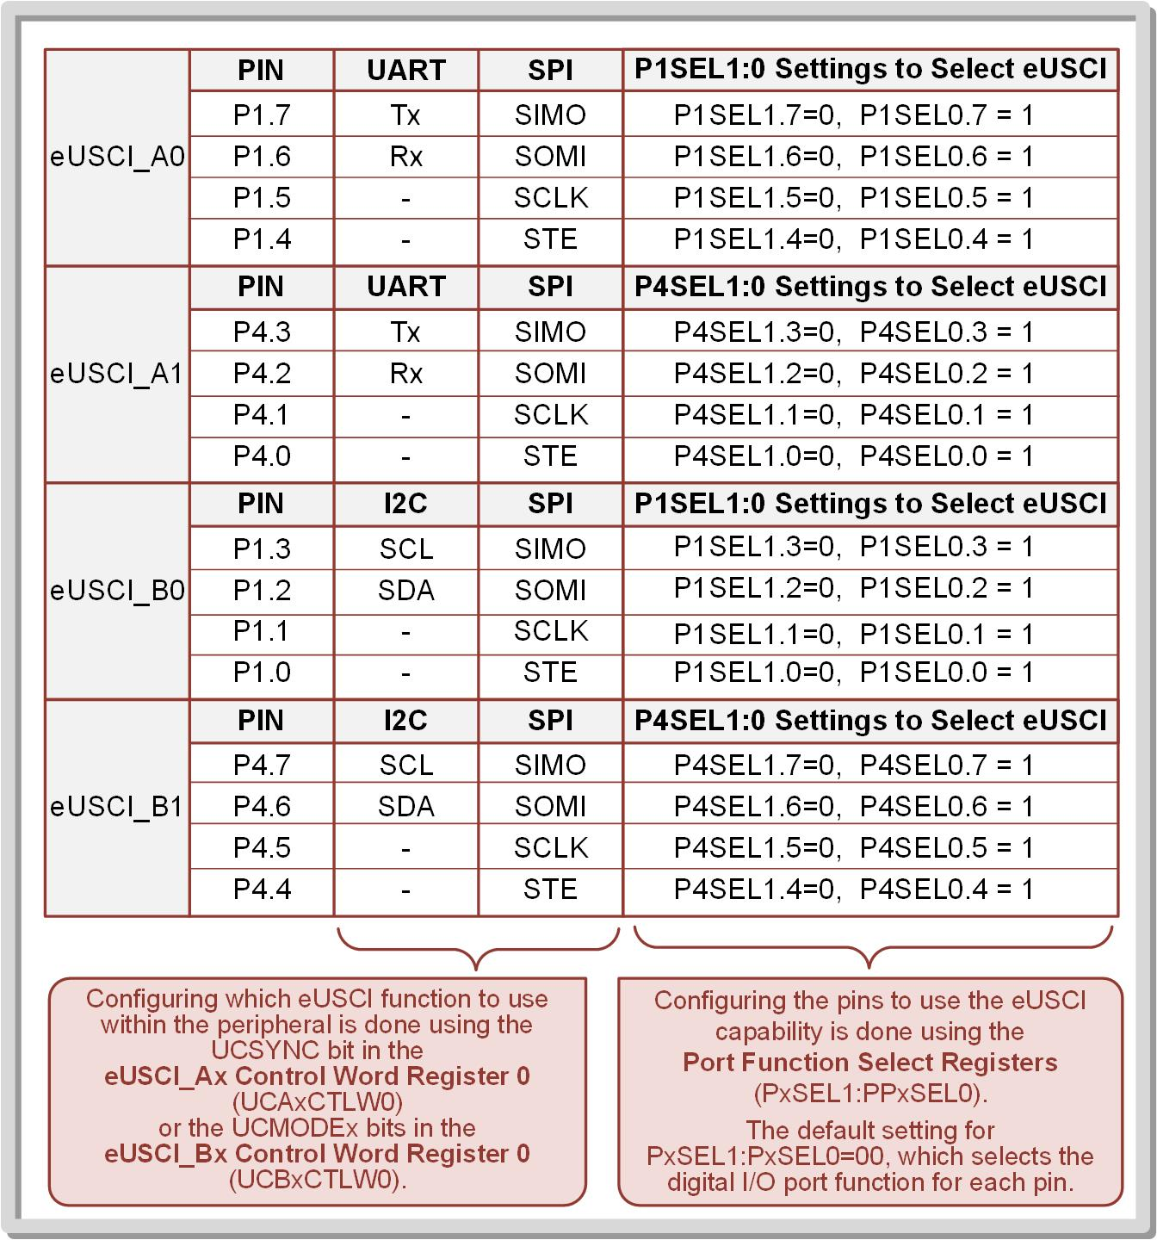
Ch. 14: Serial Communication in C
14.1.2 UART Transmit on the MSP430FR2355
To configure the Tx and Rx ports, use the PxSEL1 and PxSEL0 configuration registers.
14.1 Universal Asynchronous Receiver/Transmitter (UART) Operation

Slide 50
Ch. 14: Serial Communication in C
14.1.2 UART Transmit on the MSP430FR2355
Once taken out of software reset, the eUSCI_Ax module is enabled and will wait in an idle state until information is ready to be transmitted.
A Tx is initiated by writing a byte to the eUSCI_Ax Transmit Buffer (UCAxTXBUF).
The data in UCAxTXBUF is moved into the Tx shift
register and the baud rate generator beings producing clocks.
14.1 Universal Asynchronous Receiver/Transmitter (UART) Operation

Slide 51
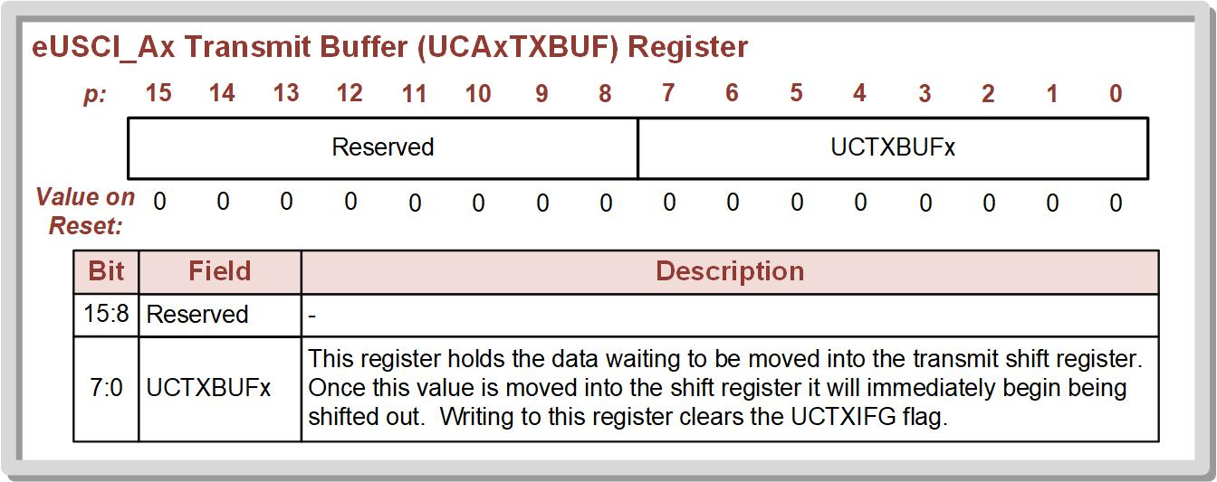
Ch. 14: Serial Communication in C
14.1.2 UART Transmit on the MSP430FR2355
The UCTXIFG (in UCAxIFG) flag provides the status of the transmission.
When UCTXIFG = 0, data is being shifted out and new data should not be written to the Tx buffer.
When UCTXIFG = 1, new data can be written to the Tx buffer
14.1 Universal Asynchronous Receiver/Transmitter (UART) Operation

Slide 52
Embedded Systems Design
Chapter 14: Serial Communications in C
14.1.2 UART Transmit on the MSP430FR2355 - Configuration
www.youtube.com/c/DigitalLogicProgramming_LaMeres
Brock J. LaMeres, Ph.D.

Slide 53
Embedded Systems Design
Chapter 14: Serial Communications in C
14.1.2 UART Transmit on the MSP430FR2355 – Setting Baud Rate
Brock J. LaMeres, Ph.D.

Slide 54
Ch. 14: Serial Communication in C
14.1.2 UART Transmit on the MSP430FR2355
The eUSCI_Ax peripheral has a baud rate generation circuit that can produce standard baud rates from nonstandard clock sources such as SMCLK (1MHz) and ACLK (32.768kHz).
The baud rate is set using two configuration registers, the eUSCI_Ax Baud Rate Control Word (UCAxBRW) and eUSCI_Ax Modulation Control Word (UCAxMCTLW) regsiters.
14.1 Universal Asynchronous Receiver/Transmitter (UART) Operation

Slide 55
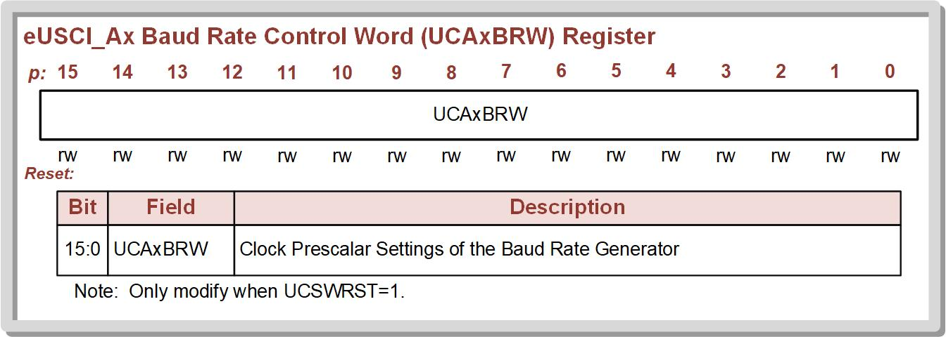
Ch. 14: Serial Communication in C
14.1.2 UART Transmit on the MSP430FR2355
14.1 Universal Asynchronous Receiver/Transmitter (UART) Operation

Slide 56
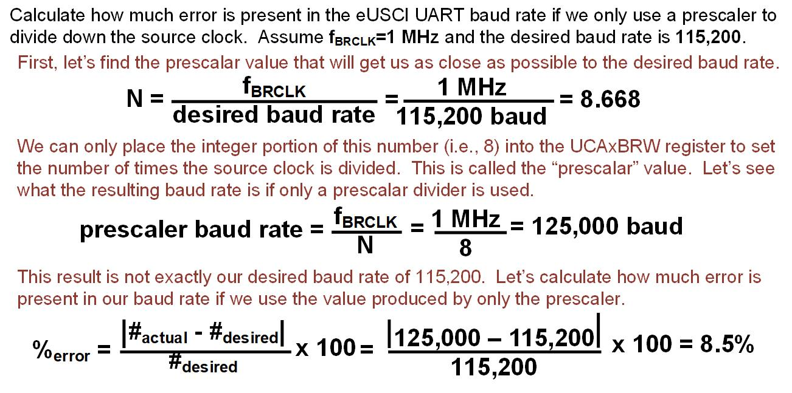
Ch. 14: Serial Communication in C
Ex: Calculating Error of eUSCI Prescaler Devision
14.1 Universal Asynchronous Receiver/Transmitter (UART) Operation

Slide 57
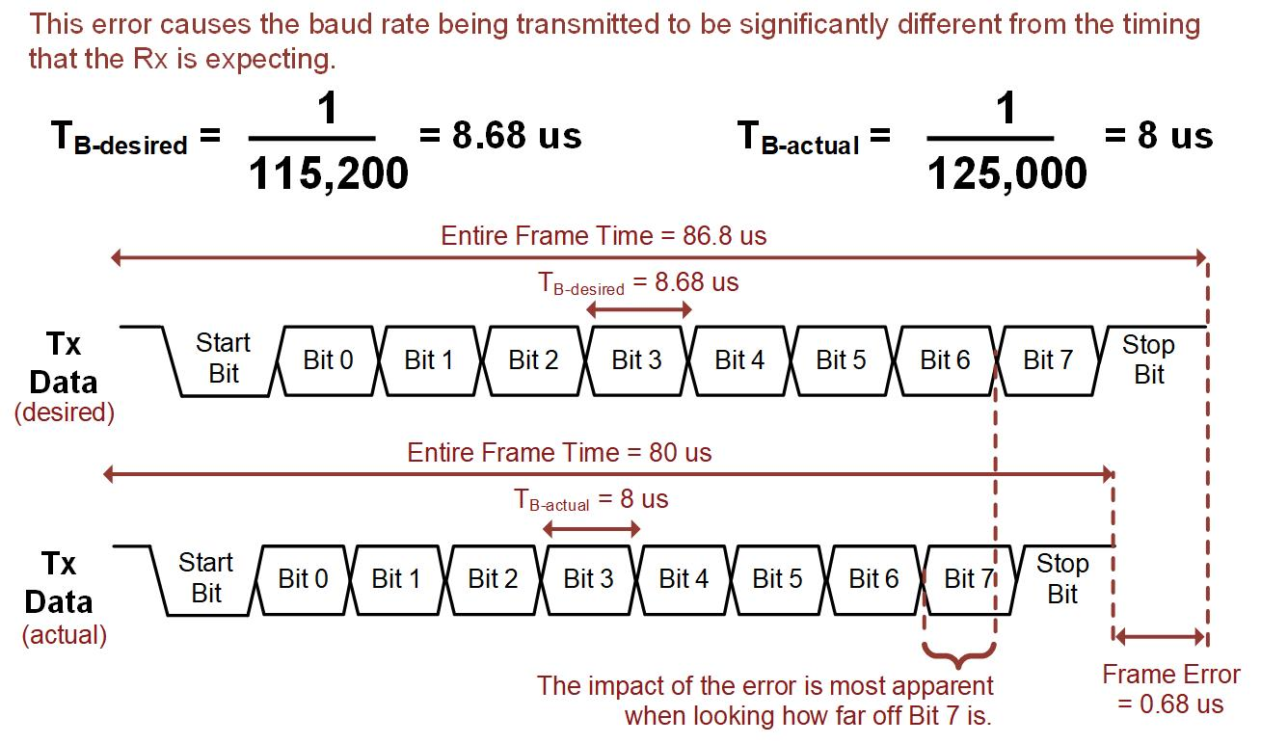
Ch. 14: Serial Communication in C
Ex: Calculating Error of eUSCI Prescaler Devision
14.1 Universal Asynchronous Receiver/Transmitter (UART) Operation

Slide 58
Ch. 14: Serial Communication in C
14.1.2 UART Transmit on the MSP430FR2355
Modulation circuits dynamically add and subtract BRCLK periods to the baud rate clock that drives the shift register.
By adding small amounts of time from the BRCLK clock period to the baud rate clock, the timing error can be reduced.
In low frequency mode, the baud rate generator uses the second modulation stage to create the desired baud rate.
Image Courtesy of https://neodem.wp.horizon.ac.uk/
Image Courtesy of
Recording Connection of Canada
Image Courtesy of
Recording Connection of Canada
Image Courtesy of
Recording Connection of Canada
Image Courtesy of
Recording Connection of Canada
Image Courtesy of
Recording Connection of Canada
Image Courtesy of
Recording Connection of Canada
14.1 Universal Asynchronous Receiver/Transmitter (UART) Operation

Slide 59
Ch. 14: Serial Communication in C
14.1.2 UART Transmit on the MSP430FR2355
14.1 Universal Asynchronous Receiver/Transmitter (UART) Operation

Slide 60
Ch. 14: Serial Communication in C
14.1.2 UART Transmit on the MSP430FR2355
Low frequency baud rate generation – used for baud rates that are less than or equal to 1/3 of BRCLK while the oversampling baud rate generation is used for higher ratios.
The UCSO16 bit in the UCAxMCTLW register controls the modulation mode with UCSO16 = 0 being for low frequency (default) and UCSO16 = 1 being for oversampling mode.
Image Courtesy of https://neodem.wp.horizon.ac.uk/
Image Courtesy of
Recording Connection of Canada
Image Courtesy of
Recording Connection of Canada
Image Courtesy of
Recording Connection of Canada
Image Courtesy of
Recording Connection of Canada
Image Courtesy of
Recording Connection of Canada
Image Courtesy of
Recording Connection of Canada
14.1 Universal Asynchronous Receiver/Transmitter (UART) Operation

Slide 61
Ch. 14: Serial Communication in C
14.1.2 UART Transmit on the MSP430FR2355
In oversampling baud rate mode, both the first and second modulation stages are used to reduce this timing error.
The first modulation stage is configured using the UCBRFx bits within the UCAxMCTLW register.
Image Courtesy of https://neodem.wp.horizon.ac.uk/
Image Courtesy of
Recording Connection of Canada
Image Courtesy of
Recording Connection of Canada
Image Courtesy of
Recording Connection of Canada
Image Courtesy of
Recording Connection of Canada
Image Courtesy of
Recording Connection of Canada
Image Courtesy of
Recording Connection of Canada
14.1 Universal Asynchronous Receiver/Transmitter (UART) Operation

Slide 62
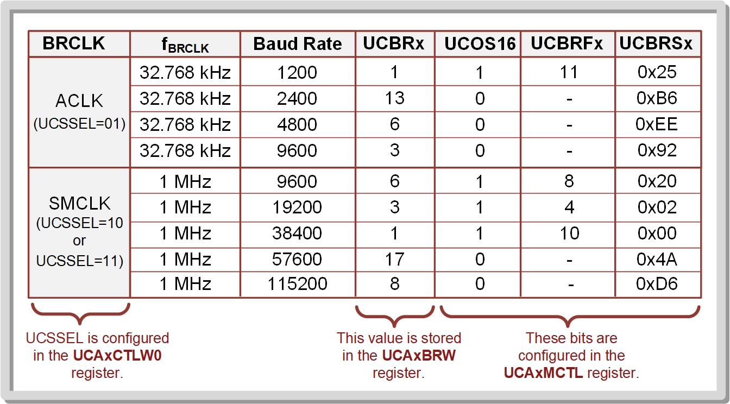
Ch. 14: Serial Communication in C
14.1.2 UART Transmit on the MSP430FR2355
14.1 Universal Asynchronous Receiver/Transmitter (UART) Operation

Slide 63
Embedded Systems Design
Chapter 14: Serial Communications in C
14.1.2 UART Transmit on the MSP430FR2355 – Setting Baud Rate
www.youtube.com/c/DigitalLogicProgramming_LaMeres
Brock J. LaMeres, Ph.D.

Slide 64
The Analog Discovery 2
Introduction to the AD2 + Installing Waveforms
Brock J. LaMeres, Ph.D.

Slide 65
Embedded Systems Design
Chapter 14: Serial Communications in C
14.1.2 UART Transmit on the MSP430FR2355 – Example: Transmitting a Byte over UART at 115,200 Baud
Brock J. LaMeres, Ph.D.

Slide 66
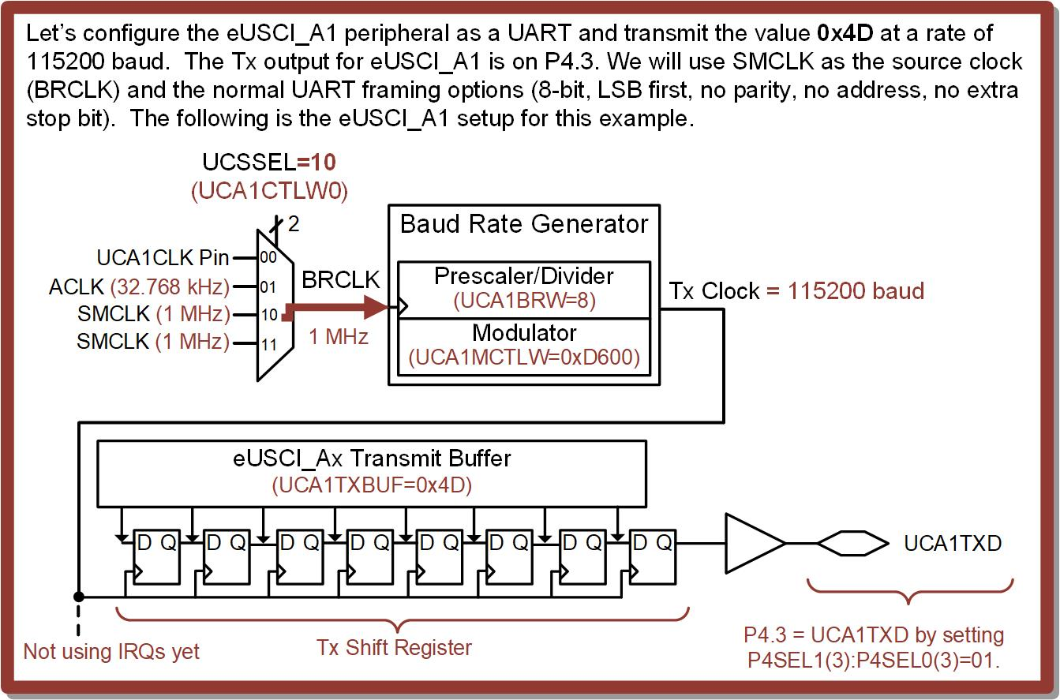
Ch. 14: Serial Communication in C
Ex: Transmitting a Byte Over UART at 115200 Baud
14.1 Universal Asynchronous Receiver/Transmitter (UART) Operation

Slide 67
Ch. 14: Serial Communication in C
Ex: Transmitting a Byte Over UART at 115200 Baud
To get to 115200, we need to use SMCLK
14.1 Universal Asynchronous Receiver/Transmitter (UART) Operation

Slide 68
Ch. 14: Serial Communication in C
Ex: Transmitting a Byte Over UART at 115200 Baud
14.1 Universal Asynchronous Receiver/Transmitter (UART) Operation

Slide 69
Ch. 14: Serial Communication in C
Ex: Transmitting a Byte Over UART at 115200 Baud
14.1 Universal Asynchronous Receiver/Transmitter (UART) Operation

Slide 70
Ch. 14: Serial Communication in C
Ex: Transmitting a Byte Over UART at 115200 Baud
Notice:
- The entire UCA1BRW register holds the prescalar value.
That’s why UCA1BRW = 8;
14.1 Universal Asynchronous Receiver/Transmitter (UART) Operation

Slide 71
Ch. 14: Serial Communication in C
Ex: Transmitting a Byte Over UART at 115200 Baud
Notice:
- The entire UCA1BRW register holds the prescalar value.
That’s why UCA1BRW = 8;
14.1 Universal Asynchronous Receiver/Transmitter (UART) Operation

Slide 72
Ch. 14: Serial Communication in C
Ex: Transmitting a Byte Over UART at 115200 Baud
14.1 Universal Asynchronous Receiver/Transmitter (UART) Operation

Slide 73
Ch. 14: Serial Communication in C
Ex: Transmitting a Byte Over UART at 115200 Baud
Notice:
- UCOS16 = 0 (low freq)
- UCBRFx = not used
- UCBRSx = xD6
That’s why
UCA1MCTLW = xD600
14.1 Universal Asynchronous Receiver/Transmitter (UART) Operation

Slide 74
Ch. 14: Serial Communication in C
Ex: Transmitting a Byte Over UART at 115200 Baud
Notice:
- UCOS16 = 0 (low freq)
- UCBRFx = not used
- UCBRSx = xD6
That’s why
UCA1MCTLW = xD600
14.1 Universal Asynchronous Receiver/Transmitter (UART) Operation

Slide 75
Ch. 14: Serial Communication in C
Ex: Transmitting a Byte Over UART at 115200 Baud
We will use many of the default framing options.
14.1 Universal Asynchronous Receiver/Transmitter (UART) Operation

Slide 76
Ch. 14: Serial Communication in C
Ex: Transmitting a Byte Over UART at 115200 Baud
The settings out of reset give us:
No parity
LSB First
8-Bit Length
1 Stop Bit
14.1 Universal Asynchronous Receiver/Transmitter (UART) Operation

Slide 77
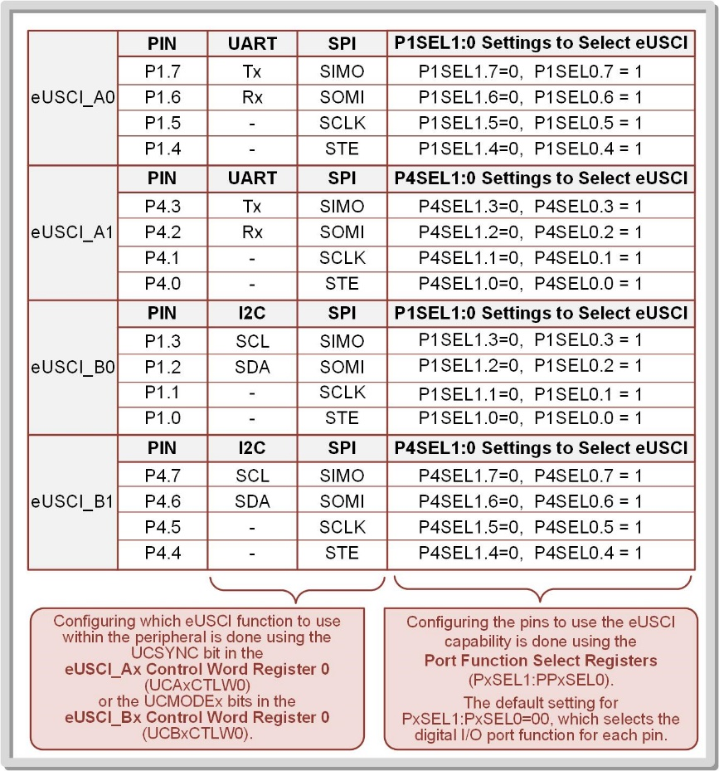
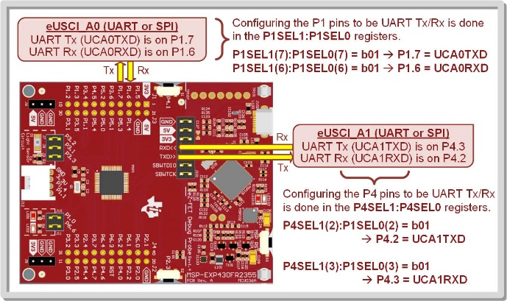
Ch. 14: Serial Communication in C
Ex: Transmitting a Byte Over UART at 115200 Baud
This pin is brought out to a pin on J101
14.1 Universal Asynchronous Receiver/Transmitter (UART) Operation

Slide 78
Ch. 14: Serial Communication in C
Ex: Transmitting a Byte Over UART at 115200 Baud
After the UART and Pin is setup, we can just write to the Tx Buffer and it will automatically shift out following the UART standard.
14.1 Universal Asynchronous Receiver/Transmitter (UART) Operation

Slide 79
Ch. 14: Serial Communication in C
Ex: Transmitting a Byte Over UART at 115200 Baud
Step 1: In CCS, create a new C/C++ Empty Project (with main.c) titled:
C_UART_Tx1_Sending_Byte_at_115200
Step 2: Type in the following code in main.c after the statement to stop the watchdog timer.
Image Courtesy of https://neodem.wp.horizon.ac.uk/
Image Courtesy of
Recording Connection of Canada
Image Courtesy of
Recording Connection of Canada
Image Courtesy of
Recording Connection of Canada
Image Courtesy of
Recording Connection of Canada
Image Courtesy of
Recording Connection of Canada
Image Courtesy of
Recording Connection of Canada
14.1 Universal Asynchronous Receiver/Transmitter (UART) Operation

Slide 80
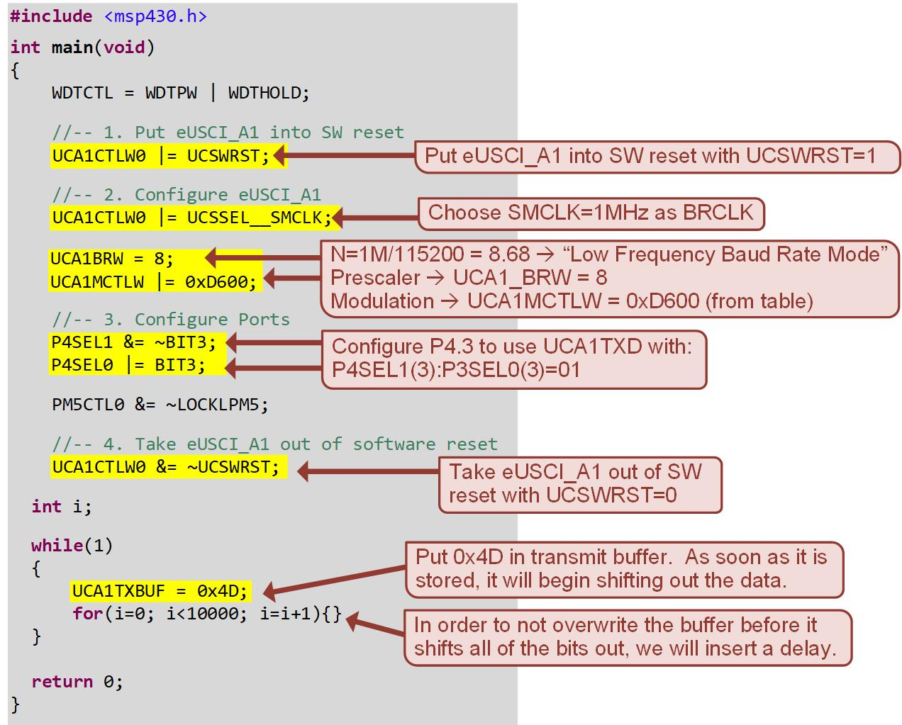
Ch. 14: Serial Communication in C
Ex: Transmitting a Byte Over UART at 115200 Baud
14.1 Universal Asynchronous Receiver/Transmitter (UART) Operation

Slide 81
Ch. 14: Serial Communication in C
Ex: Transmitting a Byte Over UART at 115200 Baud
Step 3: Debug your program and run it.
Note: We will first look at the Tx signal with an oscilloscope. If you don’t have an oscilloscope, we will look at the signal in a different way in a later example.
Image Courtesy of https://neodem.wp.horizon.ac.uk/
14.1 Universal Asynchronous Receiver/Transmitter (UART) Operation

Slide 82
Ch. 14: Serial Communication in C
Ex: Transmitting a Byte Over UART at 115200 Baud
Step 4: Observe the UART with an oscilloscope. Remove the jumper on the pins labeled “TXD>>” on the J101 header of the MSP430FR2355 board. Probe the pin nearest the MSP430 MCU (MSP1). This pin is being driven by UCA1TXD.
Step 5: Configure the oscilloscope waveform to center the UART frame. Measure the bit period of one of the short pulses.
Image Courtesy of https://neodem.wp.horizon.ac.uk/
14.1 Universal Asynchronous Receiver/Transmitter (UART) Operation

Slide 83
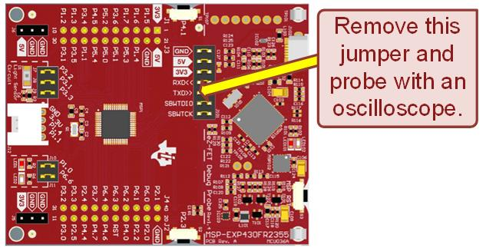
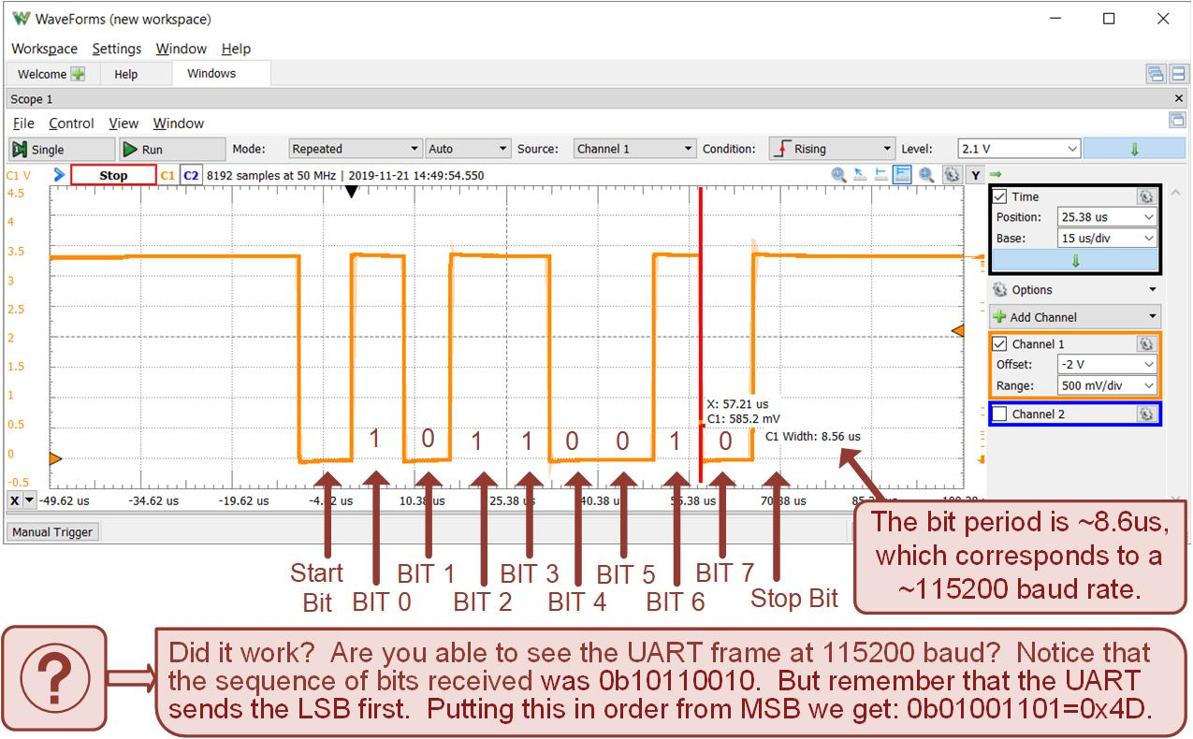
Ch. 14: Serial Communication in C
Ex: Transmitting a Byte Over UART at 115200 Baud
14.1 Universal Asynchronous Receiver/Transmitter (UART) Operation

Slide 84
Embedded Systems Design
Chapter 14: Serial Communications in C
14.1.2 UART Transmit on the MSP430FR2355 – Example: Transmitting a Byte over UART at 115,200 Baud
www.youtube.com/c/DigitalLogicProgramming_LaMeres
Brock J. LaMeres, Ph.D.

Slide 85
Embedded Systems Design
Chapter 14: Serial Communications in C
14.1.2 UART Transmit on the MSP430FR2355 – Example: Transmitting a Byte over UART at 9600 Baud
Brock J. LaMeres, Ph.D.

Slide 86
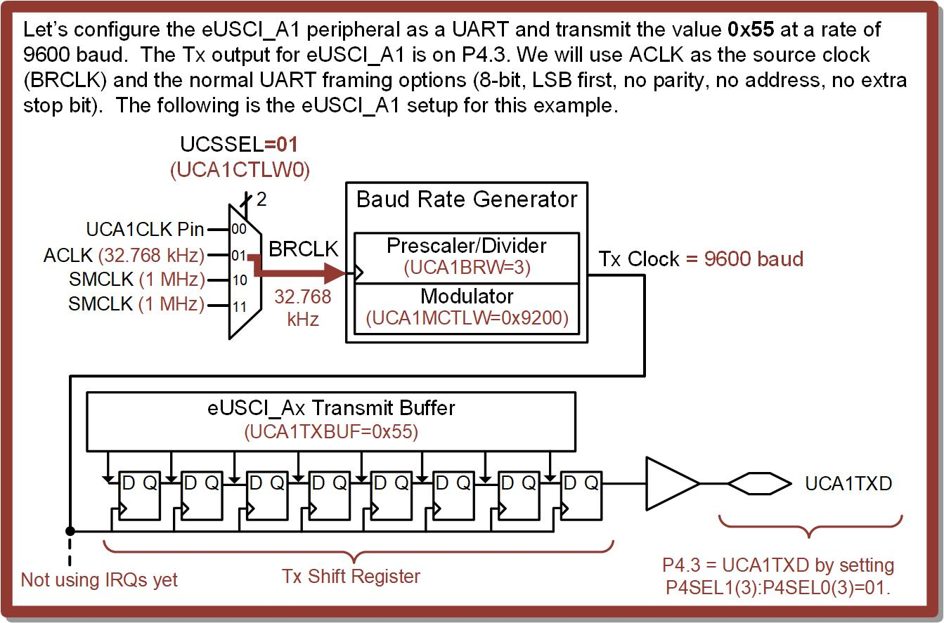
Ch. 14: Serial Communication in C
Ex: Transmitting a Byte Over UART at 9600 Baud
14.1 Universal Asynchronous Receiver/Transmitter (UART) Operation

Slide 87
Ch. 14: Serial Communication in C
Ex: Transmitting a Byte Over UART at 9600 Baud
14.1 Universal Asynchronous Receiver/Transmitter (UART) Operation

Slide 88
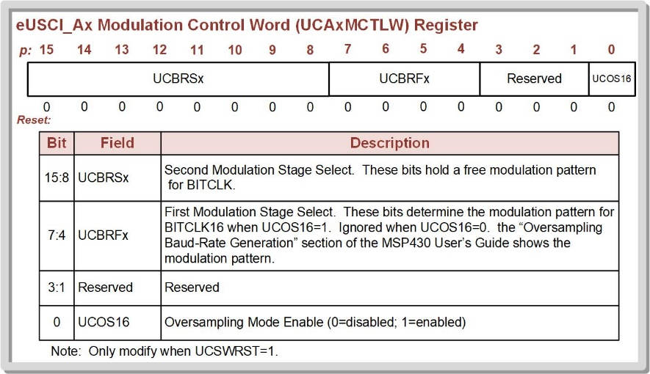
Ch. 14: Serial Communication in C
Ex: Transmitting a Byte Over UART at 9600 Baud
UCA1BRW = 3;
Notice:
- UCOS16 = 0 (low freq)
- UCBRFx = not used
- UCBRSx = x92
That’s why
UCA1MCTLW = x9200
14.1 Universal Asynchronous Receiver/Transmitter (UART) Operation

Slide 89
Ch. 14: Serial Communication in C
Ex: Transmitting a Byte Over UART at 9600 Baud
UCA1BRW = 8;
UCA1MCTLW = x9200
UCSSEL = UCSSEL__ACLK
14.1 Universal Asynchronous Receiver/Transmitter (UART) Operation

Slide 90
Ch. 14: Serial Communication in C
Ex: Transmitting a Byte Over UART at 9600 Baud
We will use many of the default framing options.
14.1 Universal Asynchronous Receiver/Transmitter (UART) Operation

Slide 91
Ch. 14: Serial Communication in C
Ex: Transmitting a Byte Over UART at 9600 Baud
The settings out of reset give us:
No parity
LSB First
8-Bit Length
1 Stop Bit
14.1 Universal Asynchronous Receiver/Transmitter (UART) Operation

Slide 92
Ch. 14: Serial Communication in C
Ex: Transmitting a Byte Over UART at 9600 Baud
A1 Tx is brought out to a pin on J101
14.1 Universal Asynchronous Receiver/Transmitter (UART) Operation

Slide 93
Ch. 14: Serial Communication in C
Ex: Transmitting a Byte Over UART at 9600 Baud
After the UART and Pin is setup, we can just write to the Tx Buffer and it will automatically shift out following the UART standard.
14.1 Universal Asynchronous Receiver/Transmitter (UART) Operation

Slide 94
Ch. 14: Serial Communication in C
Ex: Transmitting a Byte Over UART at 9600 Baud
Step 1: In CCS, create a new C/C++ Empty Project (with main.c) titled:
C_UART_Tx2_Sending_Byte_at_9600
Step 2: Type in the following code in main.c after the statement to stop the watchdog timer.
Image Courtesy of https://neodem.wp.horizon.ac.uk/
14.1 Universal Asynchronous Receiver/Transmitter (UART) Operation

Slide 95
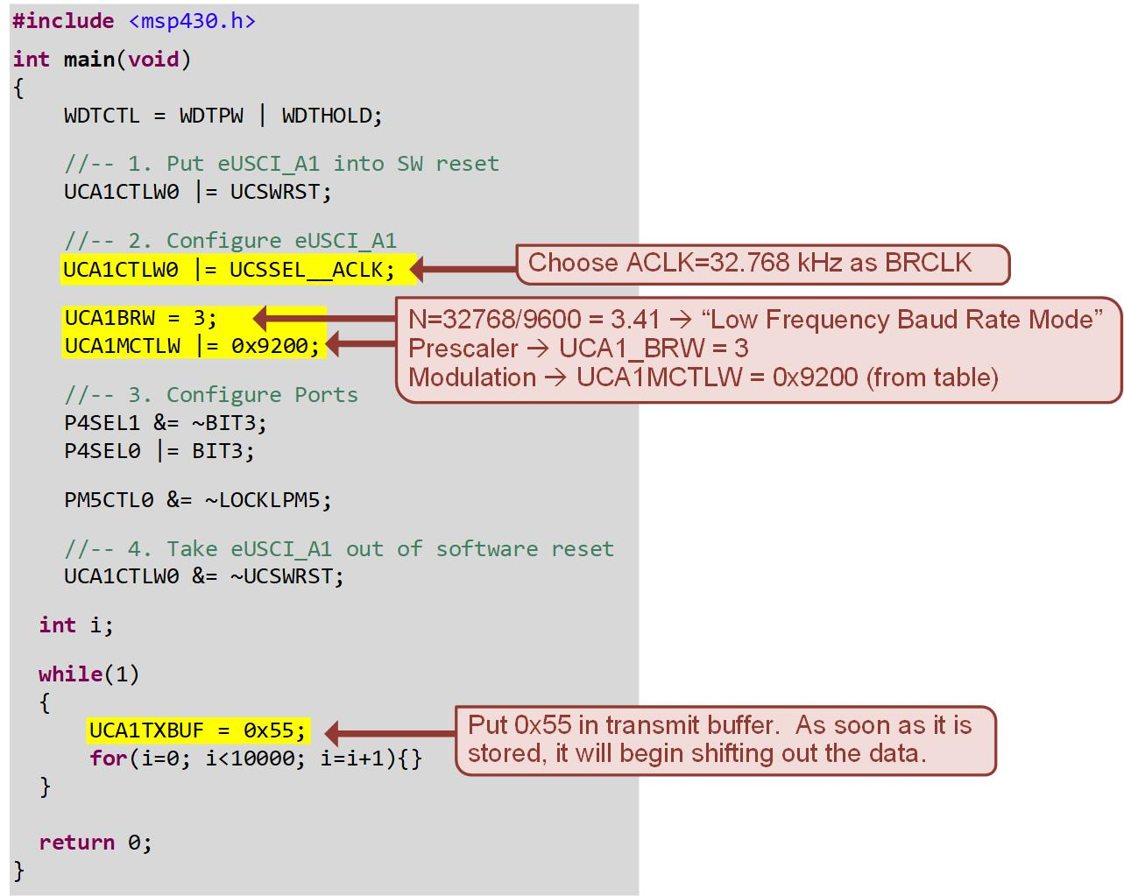
Ch. 14: Serial Communication in C
Ex: Transmitting a Byte Over UART at 9600 Baud
14.1 Universal Asynchronous Receiver/Transmitter (UART) Operation

Slide 96
Ch. 14: Serial Communication in C
Ex: Transmitting a Byte Over UART at 9600 Baud
Step 3: Debug your program and run it.
Note: We will first look at the Tx signal with an oscilloscope. If you don’t have an oscilloscope, we will look at the signal in a different way in a later example.
Image Courtesy of https://neodem.wp.horizon.ac.uk/
14.1 Universal Asynchronous Receiver/Transmitter (UART) Operation

Slide 97
Ch. 14: Serial Communication in C
Ex: Transmitting a Byte Over UART at 9600 Baud
Step 4: Observe the UART with an oscilloscope. Remove the jumper on the pins labeled “TXD>>” on the J101 header of the MSP430FR2355 board. Probe the pin nearest the MSP430 MCU (MSP1). This pin is being driven by UCA1TXD.
Step 5: Configure the oscilloscope waveform to center the UART frame. Measure the bit period of one of the short pulses.
Image Courtesy of https://neodem.wp.horizon.ac.uk/
14.1 Universal Asynchronous Receiver/Transmitter (UART) Operation

Slide 98
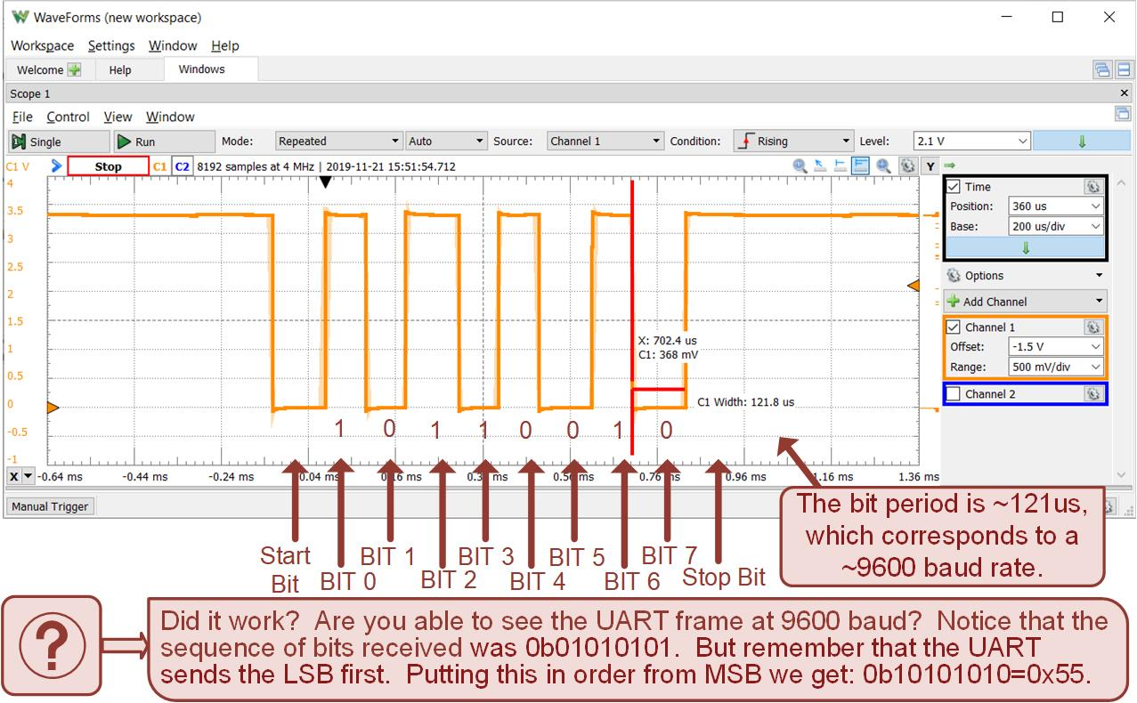
Ch. 14: Serial Communication in C
Ex: Transmitting a Byte Over UART at 9600 Baud
14.1 Universal Asynchronous Receiver/Transmitter (UART) Operation

Slide 99
Embedded Systems Design
Chapter 14: Serial Communications in C
14.1.2 UART Transmit on the MSP430FR2355 – Example: Transmitting a Byte over UART at 9600 Baud
www.youtube.com/c/DigitalLogicProgramming_LaMeres
Brock J. LaMeres, Ph.D.

Slide 100
Embedded Systems Design
Chapter 14: Serial Communications in C
14.1.2 UART Transmit on the MSP430FR2355 – Example: Sending ASCII Characters to a Terminal
Brock J. LaMeres, Ph.D.

Slide 101
Embedded Systems Design
Chapter 14: Serial Communications in C
14.1.2 UART Transmit on the MSP430FR2355 – Example: Sending ASCII Characters to a Terminal
Brock J. LaMeres, Ph.D.

Slide 102
Ch. 14: Serial Communication in C
14.1.2 UART Transmit on the MSP430FR2355
Terminal – a way to communicate with a device using standard I/O on a computer.
A terminal uses the UART interface to send and receive bytes through a serial port on a computer.
The CCS design environment contains a built-in terminal feature that can be used to view data coming from the MSP430FR2355 board and also send information to the MCU board.
Image Courtesy of https://neodem.wp.horizon.ac.uk/
14.1 Universal Asynchronous Receiver/Transmitter (UART) Operation

Slide 103
Ch. 14: Serial Communication in C
14.1.2 UART Transmit on the MSP430FR2355
The board contains a debug chip that handles downloading programs onto the MCU in addition to debugging programs.
When setting up a terminal connection to the MSP430FR2355 board, the com port number of the Application UART1 is used as the connection ID
Image Courtesy of https://neodem.wp.horizon.ac.uk/
14.1 Universal Asynchronous Receiver/Transmitter (UART) Operation

Slide 104
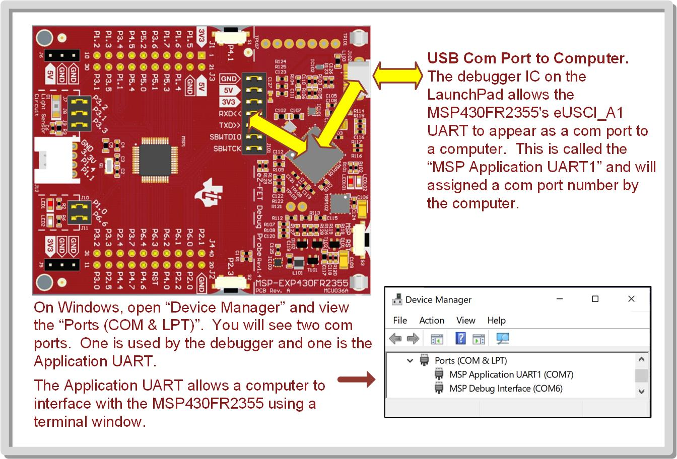
Ch. 14: Serial Communication in C
14.1.2 UART Transmit on the MSP430FR2355
14.1 Universal Asynchronous Receiver/Transmitter (UART) Operation

Slide 105
Ch. 14: Serial Communication in C
14.1.2 UART Transmit on the MSP430FR2355
ASCII – a coding scheme that uses terminal windows interface with the standard I/O of the computer
ASCII – American Standard Code for Information Interchange
This coding approach allows each button press on a computer’s keyboard to result in an 8-bit code being generated and understood by the computer’s CPU.
Image Courtesy of https://neodem.wp.horizon.ac.uk/
14.1 Universal Asynchronous Receiver/Transmitter (UART) Operation

Slide 106
Ch. 14: Serial Communication in C
14.1.2 UART Transmit on the MSP430FR2355
When writing a program, the data type “char” can be used to declare variable and store characters in ASCII.
In C, when a statement such as char Var1 = ‘A’; is used, it will assign the ASCII code for the symbol “A” into the 8-bit variable labeled “Var1.”
Using the char datatype allows us to create programs that can send and receive ASCII characters using a terminal.
Image Courtesy of https://neodem.wp.horizon.ac.uk/
14.1 Universal Asynchronous Receiver/Transmitter (UART) Operation

Slide 107
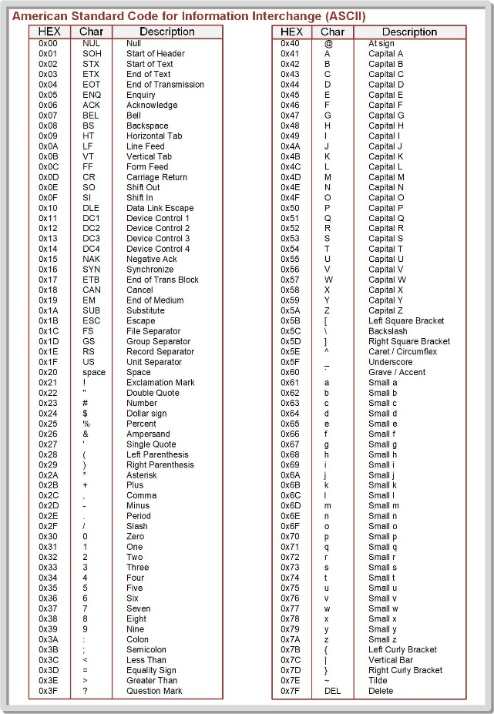
Ch. 14: Serial Communication in C
14.1.2 UART Transmit on the MSP430FR2355
14.1 Universal Asynchronous Receiver/Transmitter (UART) Operation

Slide 108
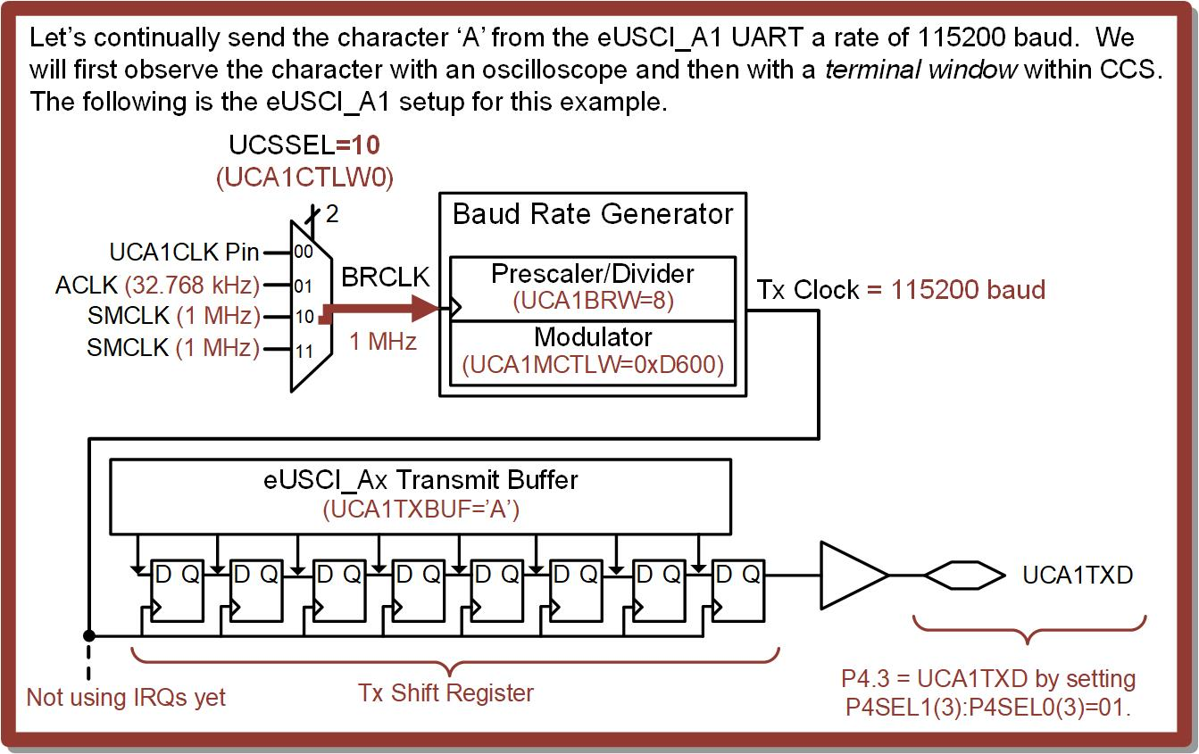
Ch. 14: Serial Communication in C
Ex: Transmitting a Character Over UART
14.1 Universal Asynchronous Receiver/Transmitter (UART) Operation

Slide 109
Ch. 14: Serial Communication in C
Ex: Transmitting a Character Over UART
Step 1: In CCS, create a new C/C++ Empty Project (with main.c) titled:
C_UART_Tx3_Sending_Char
Step 2: Type in the following code in main.c after the statement to stop the watchdog timer.
Image Courtesy of https://neodem.wp.horizon.ac.uk/
14.1 Universal Asynchronous Receiver/Transmitter (UART) Operation

Slide 110
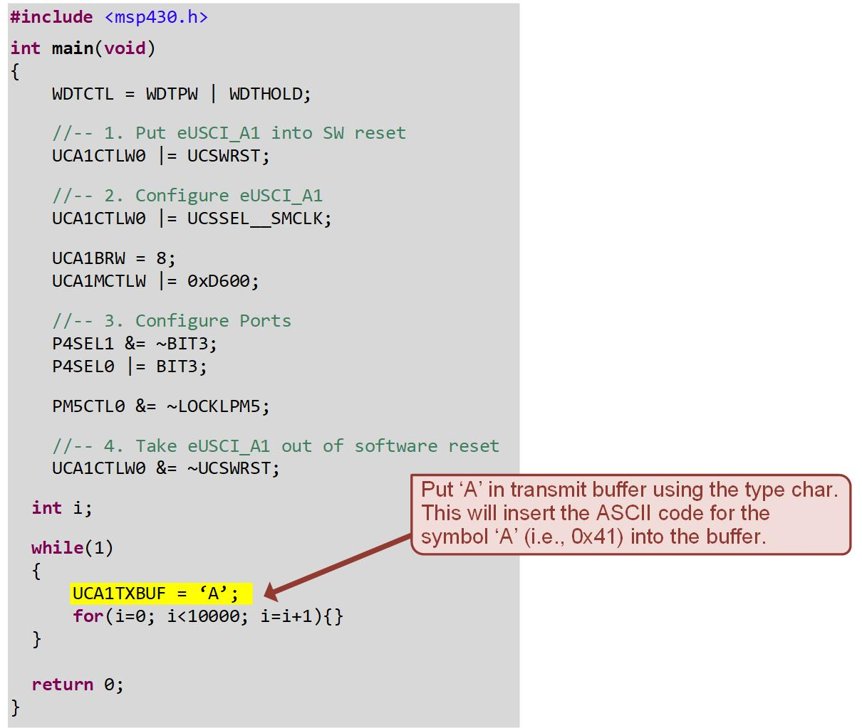
Ch. 14: Serial Communication in C
Ex: Transmitting a Character Over UART
14.1 Universal Asynchronous Receiver/Transmitter (UART) Operation

Slide 111
Ch. 14: Serial Communication in C
Ex: Transmitting a Character Over UART
Step 3: Debug your program and run it.
Note: We will first look at the Tx signal with an oscilloscope to view the ASCII code for ‘A’. We will then look at the character using a terminal window.
Image Courtesy of https://neodem.wp.horizon.ac.uk/
14.1 Universal Asynchronous Receiver/Transmitter (UART) Operation

Slide 112
Ch. 14: Serial Communication in C
Ex: Transmitting a Character Over UART
Step 4: Observe the UART with an oscilloscope. Remove the jumper on the pins labeled “TXD>>” on the J101 header of the MSP430FR2355 board. Probe the pin nearest the MSP430 MCU (MSP1). This pin is being driven by UCA1TXD.
Step 5: Configure the oscilloscope waveform to center the UART frame.
Image Courtesy of https://neodem.wp.horizon.ac.uk/
14.1 Universal Asynchronous Receiver/Transmitter (UART) Operation

Slide 113
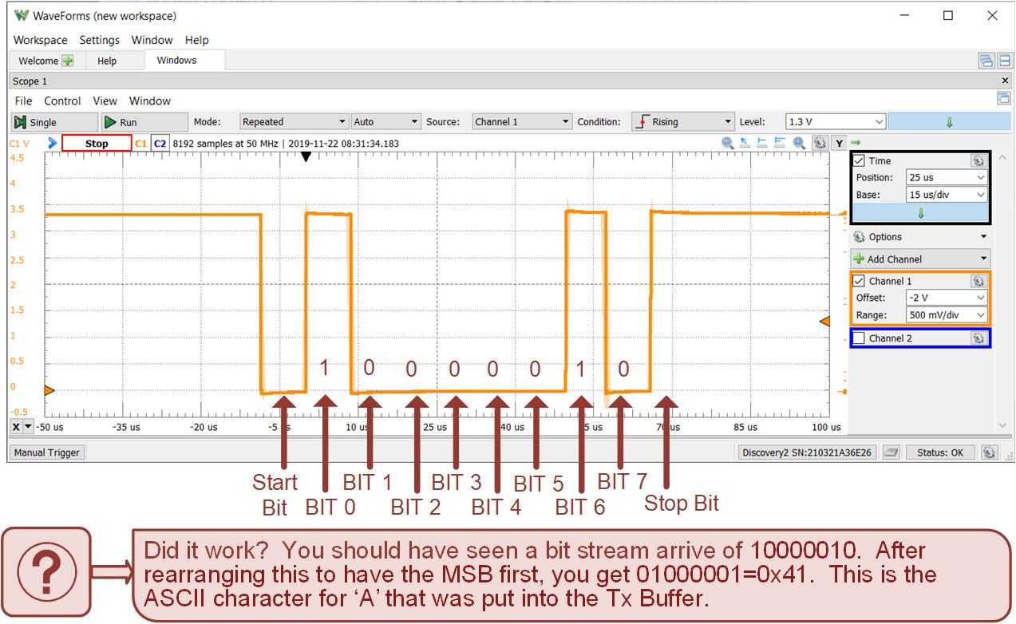
Ch. 14: Serial Communication in C
Ex: Transmitting a Character Over UART
14.1 Universal Asynchronous Receiver/Transmitter (UART) Operation

Slide 114
Ch. 14: Serial Communication in C
Ex: Transmitting a Character Over UART
Step 6: Now let’s launch a terminal within CCS and observe the ASCII character arrive. In CCS, use the pull down menu View → Terminal. A terminal tab will appear within CCS (usually in the lower right corner along with the “Problems” and “Advice” tabs).
Step 7: Configure the terminal window. Click on the “Open a Terminal” button on the terminal tab. This will bring up a configuration window. You will need to determine the Application UART1’s com port on your computer. On Windows, this can be found using “Device Manager → Ports (COM & LPT)”. Configure the terminal to use this com port number with a baud rate of 115200, a data size of 8, no parity, and 1 stop bit. Leave the encoding at its default value.
Image Courtesy of https://neodem.wp.horizon.ac.uk/
14.1 Universal Asynchronous Receiver/Transmitter (UART) Operation

Slide 115
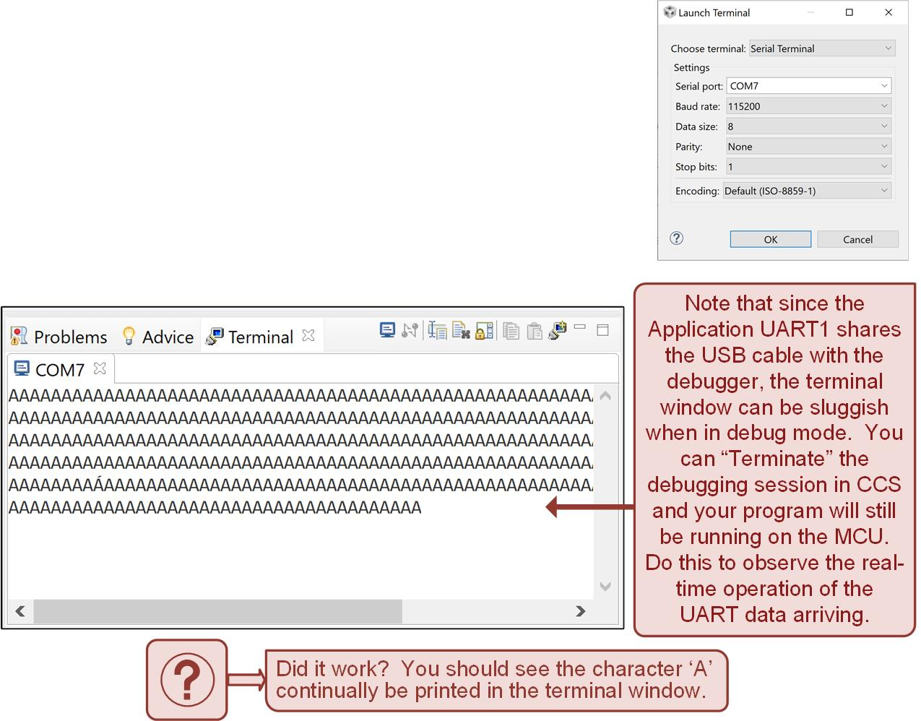
Ch. 14: Serial Communication in C
Ex: Transmitting a Character Over UART
Step 8: Plug your jumper back into the MSP430FR2355 board and observe the character ‘A’ arrive.
14.1 Universal Asynchronous Receiver/Transmitter (UART) Operation

Slide 116
Embedded Systems Design
Chapter 14: Serial Communications in C
14.1.2 UART Transmit on the MSP430FR2355 – Example: Sending ASCII Characters to a Terminal
www.youtube.com/c/DigitalLogicProgramming_LaMeres
Brock J. LaMeres, Ph.D.

Slide 117
Embedded Systems Design
Chapter 14: Serial Communications in C
14.1.2 UART Transmit on the MSP430FR2355 – Example: Sending a String to a Terminal
Brock J. LaMeres, Ph.D.

Slide 118
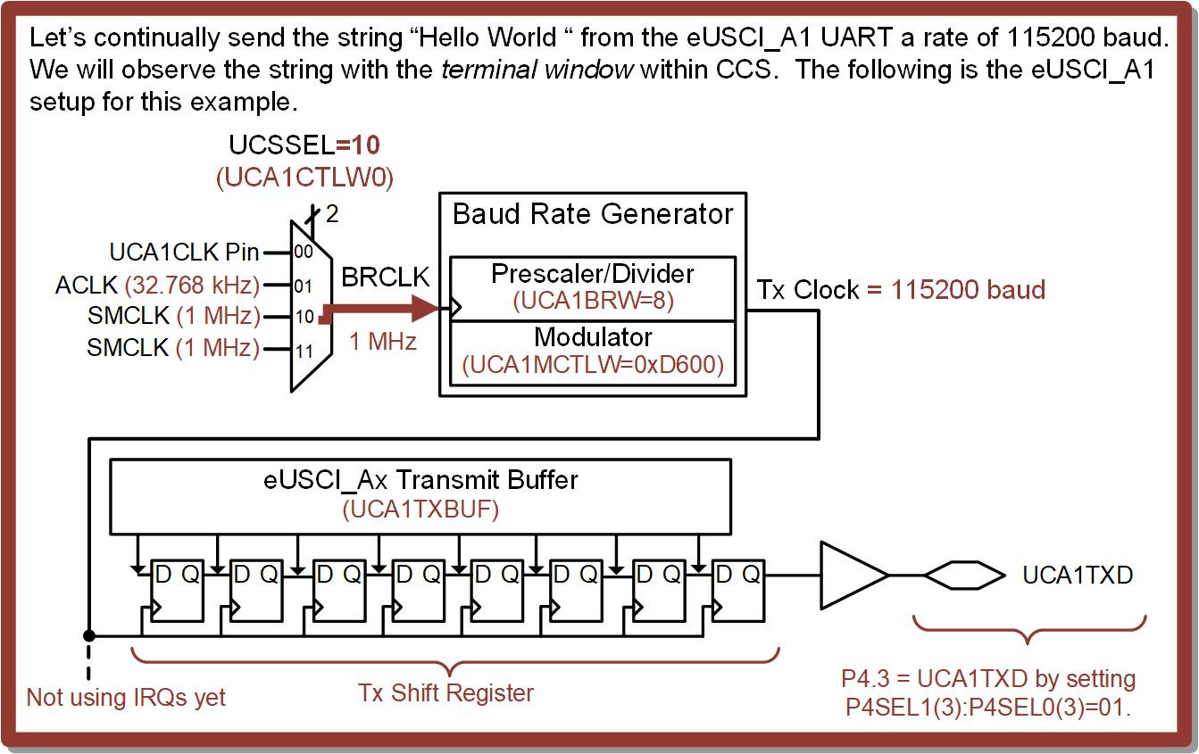
Ch. 14: Serial Communication in C
Ex: Transmitting a String Over UART
14.1 Universal Asynchronous Receiver/Transmitter (UART) Operation

Slide 119
Ch. 14: Serial Communication in C
Ex: Transmitting a String Over UART
Step 1: In CCS, create a new C/C++ Empty Project (with main.c) titled:
C_UART_Tx4_Sending_String
Step 2: Type in the following code in main.c after the statement to stop the watchdog timer.
Image Courtesy of https://neodem.wp.horizon.ac.uk/
14.1 Universal Asynchronous Receiver/Transmitter (UART) Operation

Slide 120
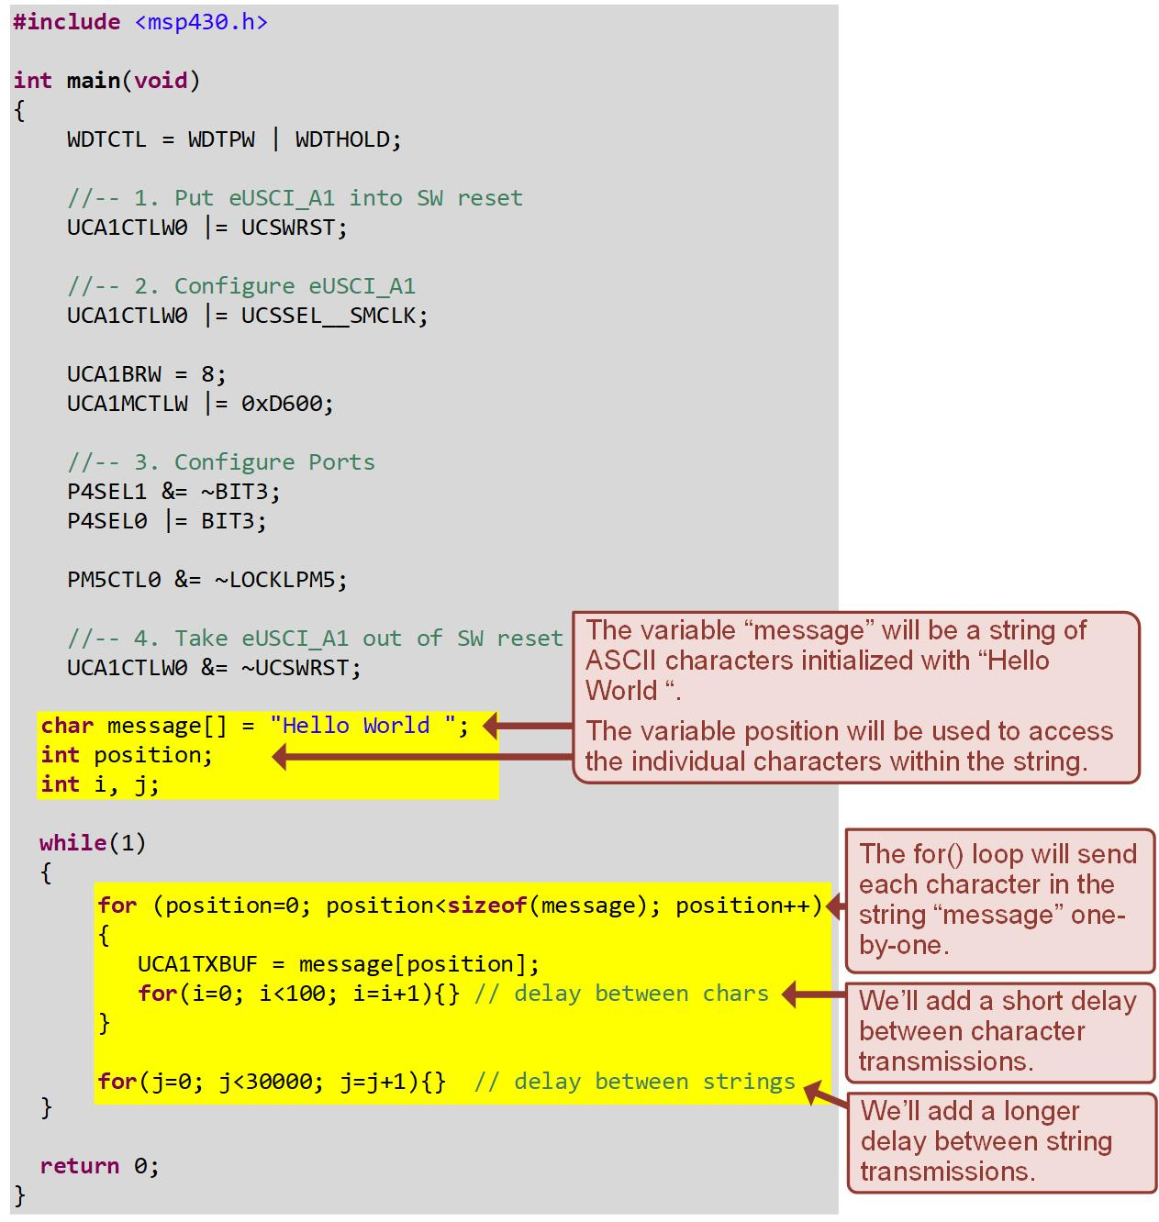
Ch. 14: Serial Communication in C
Ex: Transmitting a String Over UART
14.1 Universal Asynchronous Receiver/Transmitter (UART) Operation

Slide 121
Ch. 14: Serial Communication in C
Ex: Transmitting a String Over UART
Step 3: Debug your program and run it.
Note: We will first look at the Tx string using the terminal window within CCS.
Step 4: Launch a terminal within CCS and observe the string arrive continually. Configure the terminal to use the com port of the Application UART1 with a baud rate of 115200, a data size of 8, no parity, and 1 stop bit. Leave the encoding at its default value. You should see “Hello World” arrive continually on the terminal.
Image Courtesy of https://neodem.wp.horizon.ac.uk/
14.1 Universal Asynchronous Receiver/Transmitter (UART) Operation

Slide 122
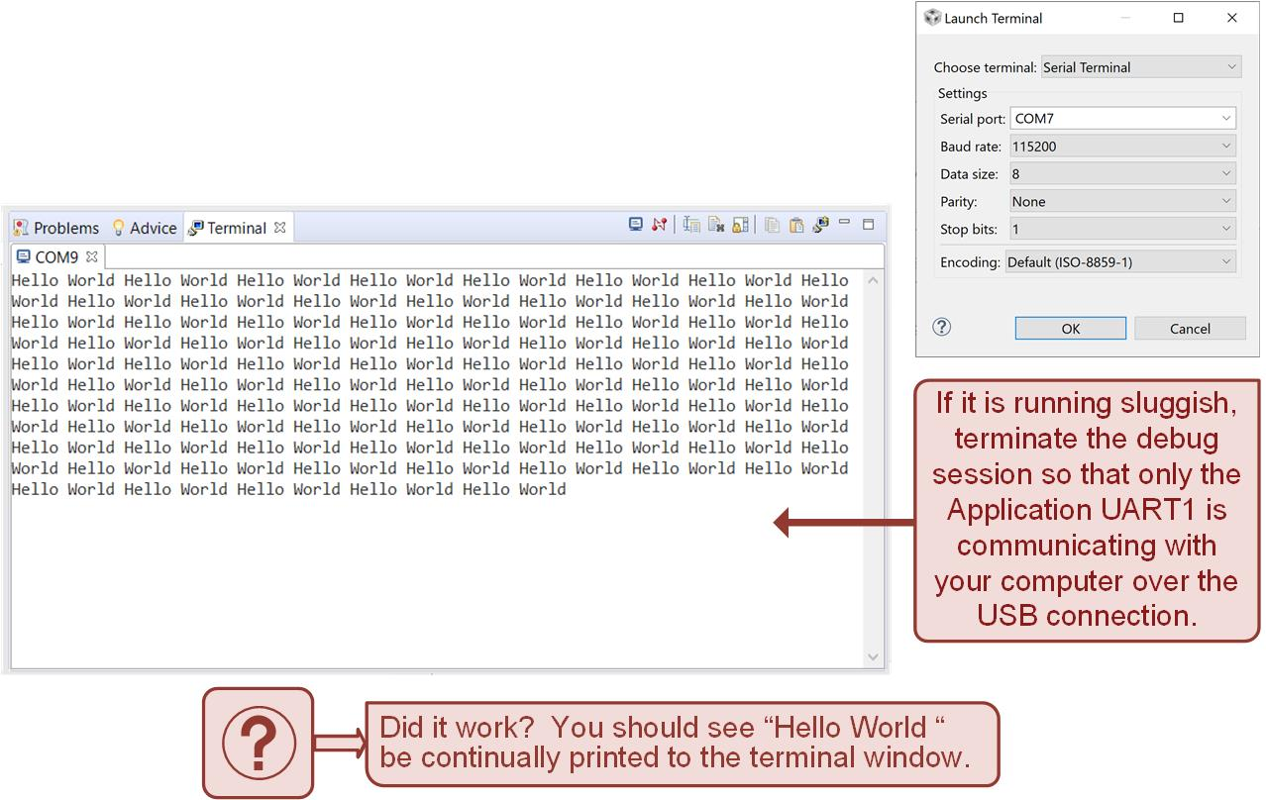
Ch. 14: Serial Communication in C
Ex: Transmitting a String Over UART
14.1 Universal Asynchronous Receiver/Transmitter (UART) Operation

Slide 123
Embedded Systems Design
Chapter 14: Serial Communications in C
14.1.2 UART Transmit on the MSP430FR2355 – Example: Sending a String to a Terminal
www.youtube.com/c/DigitalLogicProgramming_LaMeres
Brock J. LaMeres, Ph.D.

Slide 124
Embedded Systems Design
Chapter 14: Serial Communications in C
14.1.2 UART Transmit on the MSP430FR2355 – Example: Using Tx IRQs to Control UART Transmission
Brock J. LaMeres, Ph.D.

Slide 125
Ch. 14: Serial Communication in C
14.1.2 UART Transmit on the MSP430FR2355
One of the drawbacks of the prior examples was that delay loops were needed to space out when data was put into the Tx buffer.
The eUSCI UART contains a variety of flags that aid in monitoring the status of the link.
These flags can also trigger IRQs.
Image Courtesy of
Recording Connection of Canada
Image Courtesy of
Recording Connection of Canada
Image Courtesy of
Recording Connection of Canada
Image Courtesy of
Recording Connection of Canada
Image Courtesy of
Recording Connection of Canada
Image Courtesy of
Recording Connection of Canada
Image Courtesy of https://neodem.wp.horizon.ac.uk/
14.1 Universal Asynchronous Receiver/Transmitter (UART) Operation

Slide 126
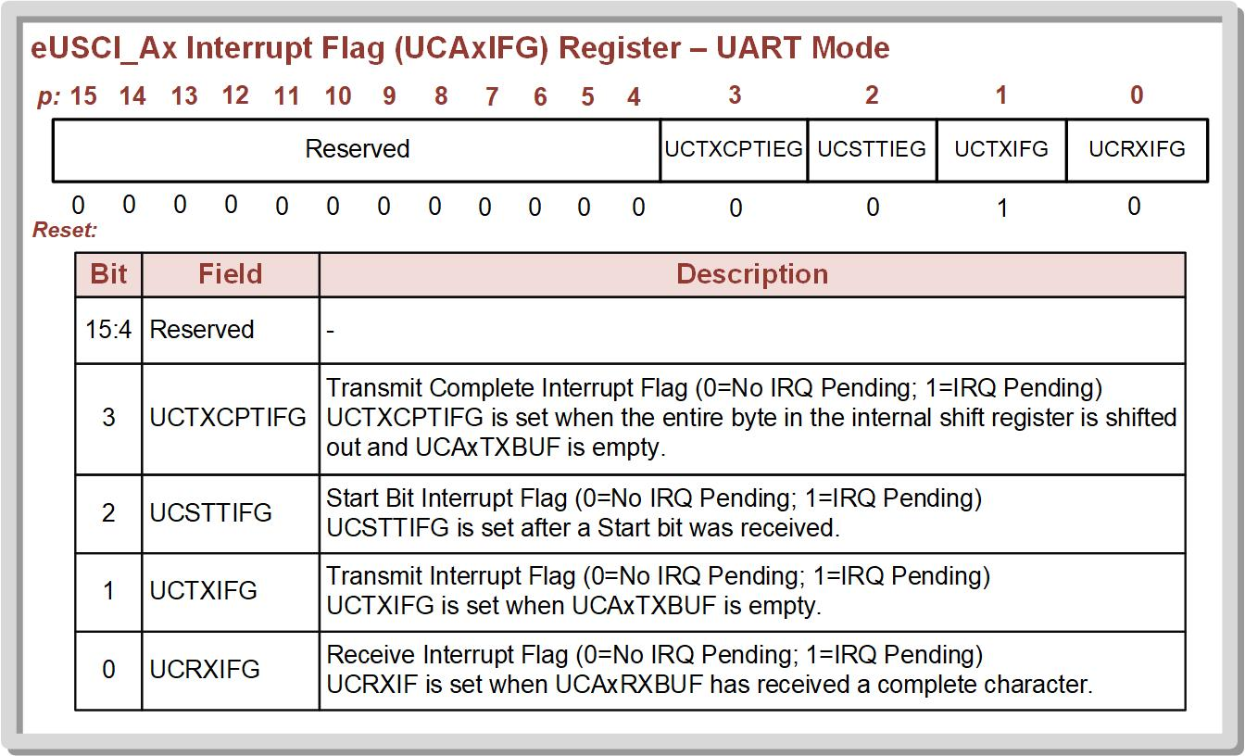
Ch. 14: Serial Communication in C
14.1.2 UART Transmit on the MSP430FR2355
14.1 Universal Asynchronous Receiver/Transmitter (UART) Operation

Slide 127
Ch. 14: Serial Communication in C
14.1.2 UART Transmit on the MSP430FR2355
Transmit Interrupt (UCTXIFG):
Flag is cleared when the Tx buffer data is written to.
Flag is set when the Tx buffer data has been moved to the shift register and the buffer is empty.
Only indicates that the Tx buffer is empty, not that the last character has been fully shifted out.
Image Courtesy of
Recording Connection of Canada
Image Courtesy of
Recording Connection of Canada
Image Courtesy of
Recording Connection of Canada
Image Courtesy of
Recording Connection of Canada
Image Courtesy of
Recording Connection of Canada
Image Courtesy of
Recording Connection of Canada
Image Courtesy of https://neodem.wp.horizon.ac.uk/
14.1 Universal Asynchronous Receiver/Transmitter (UART) Operation

Slide 128
Ch. 14: Serial Communication in C
14.1.2 UART Transmit on the MSP430FR2355
Transmit Complete Interrupt (UCTXCPTIFG):
Flag is set when the entire byte in in Tx shift register has been shifted out and it is ready for a new character.
The two Tx IRQs are enabled with the UCTXIE and UCTXCPTIE bits with in the UCAxIE
The eUSCI_Ax peripheral only contains one interrupt vector address for all the interrupts within the system.
Image Courtesy of https://neodem.wp.horizon.ac.uk/
14.1 Universal Asynchronous Receiver/Transmitter (UART) Operation

Slide 129
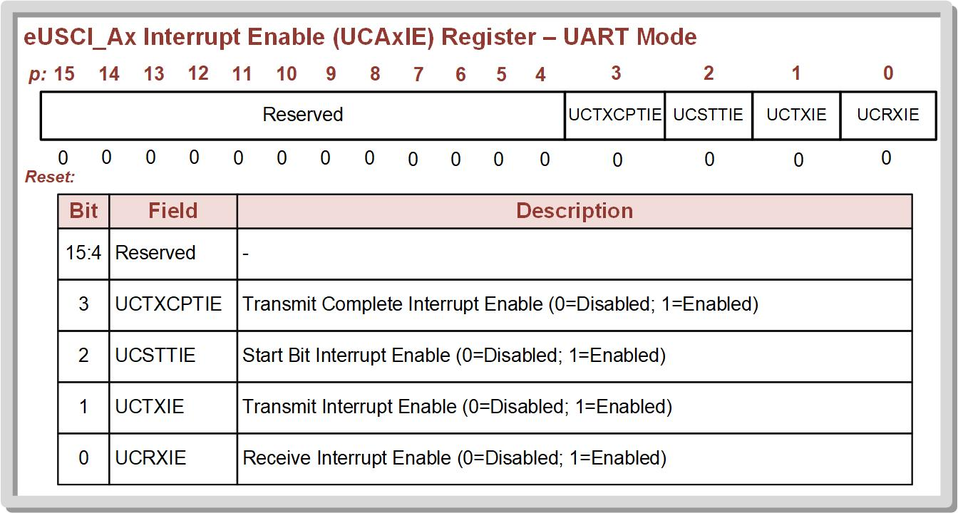
Ch. 14: Serial Communication in C
14.1.2 UART Transmit on the MSP430FR2355
14.1 Universal Asynchronous Receiver/Transmitter (UART) Operation

Slide 130
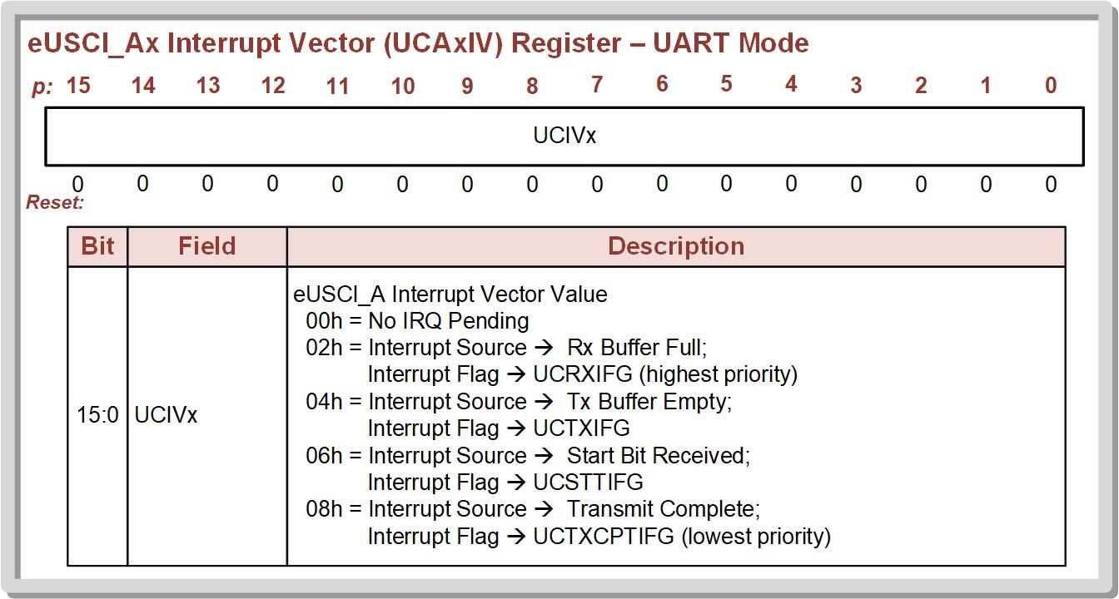
Ch. 14: Serial Communication in C
14.1.2 UART Transmit on the MSP430FR2355
14.1 Universal Asynchronous Receiver/Transmitter (UART) Operation

Slide 131
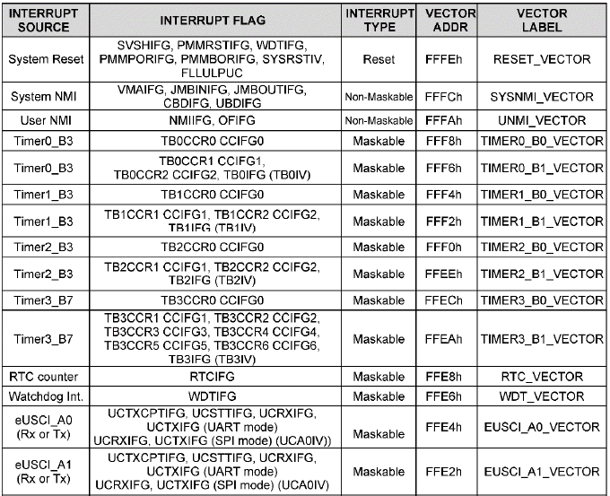
Ch. 14: Serial Communication in C
14.1.2 UART Transmit on the MSP430FR2355
Each of the 4x eUSCI systems have a dedicate interrupt vector.
14.1 Universal Asynchronous Receiver/Transmitter (UART) Operation

Slide 132
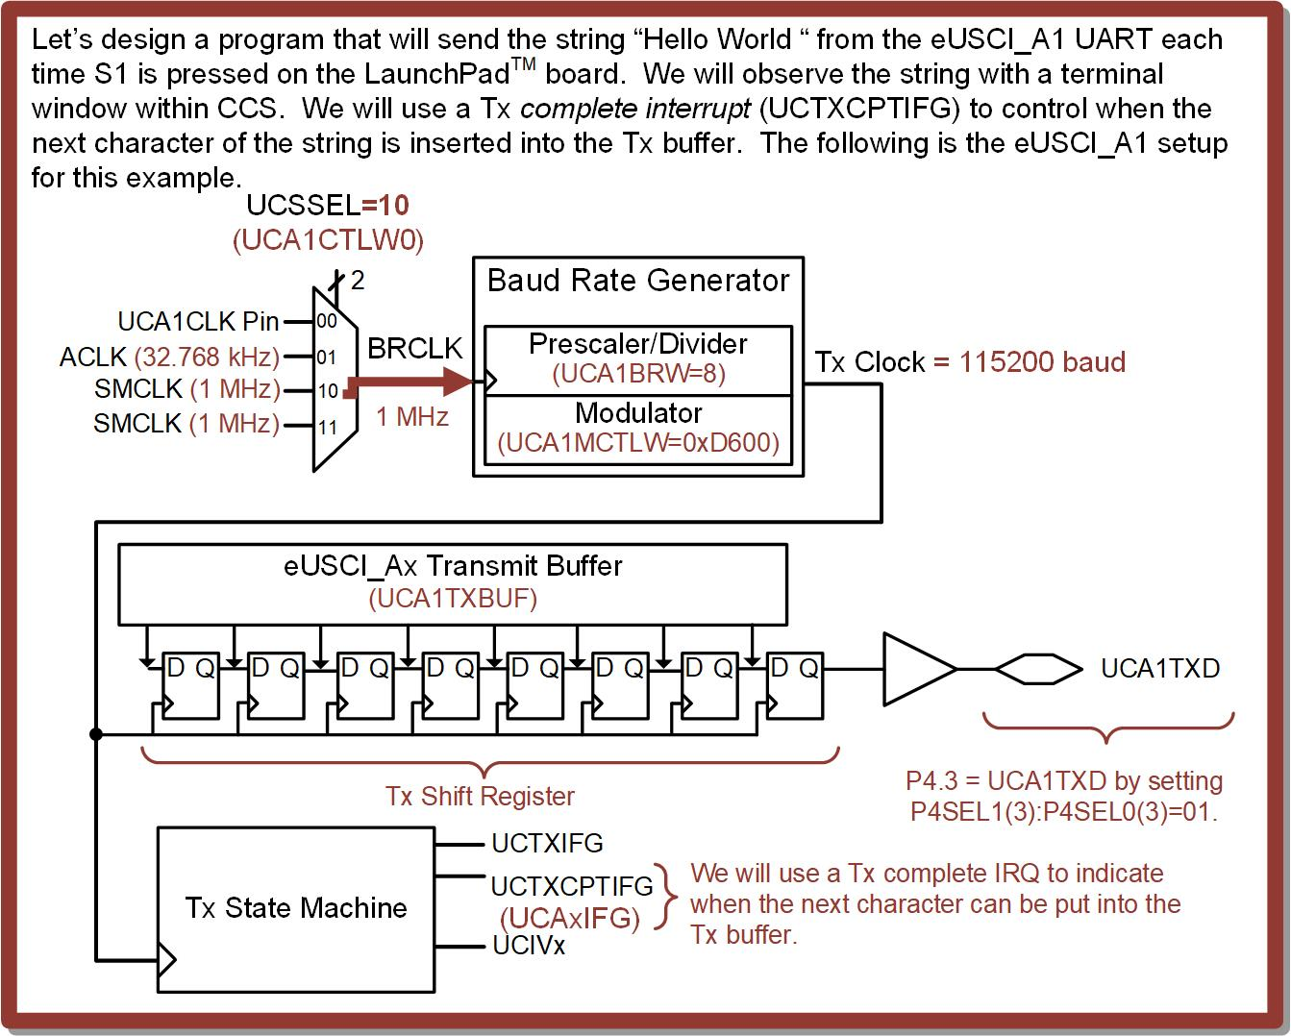
Ch. 14: Serial Communication in C
Ex: Controlling UART Transmission With Interrupts
14.1 Universal Asynchronous Receiver/Transmitter (UART) Operation

Slide 133
Ch. 14: Serial Communication in C
Ex: Controlling UART Transmission With Interrupts
Step 1: In CCS, create a new C/C++ Empty Project (with main.c) titled:
C_UART_Tx5_Sending_String_using_UCTXCPTIFG
Step 2: Type in the following code in main.c after the statement to stop the watchdog timer.
Image Courtesy of https://neodem.wp.horizon.ac.uk/
14.1 Universal Asynchronous Receiver/Transmitter (UART) Operation

Slide 134
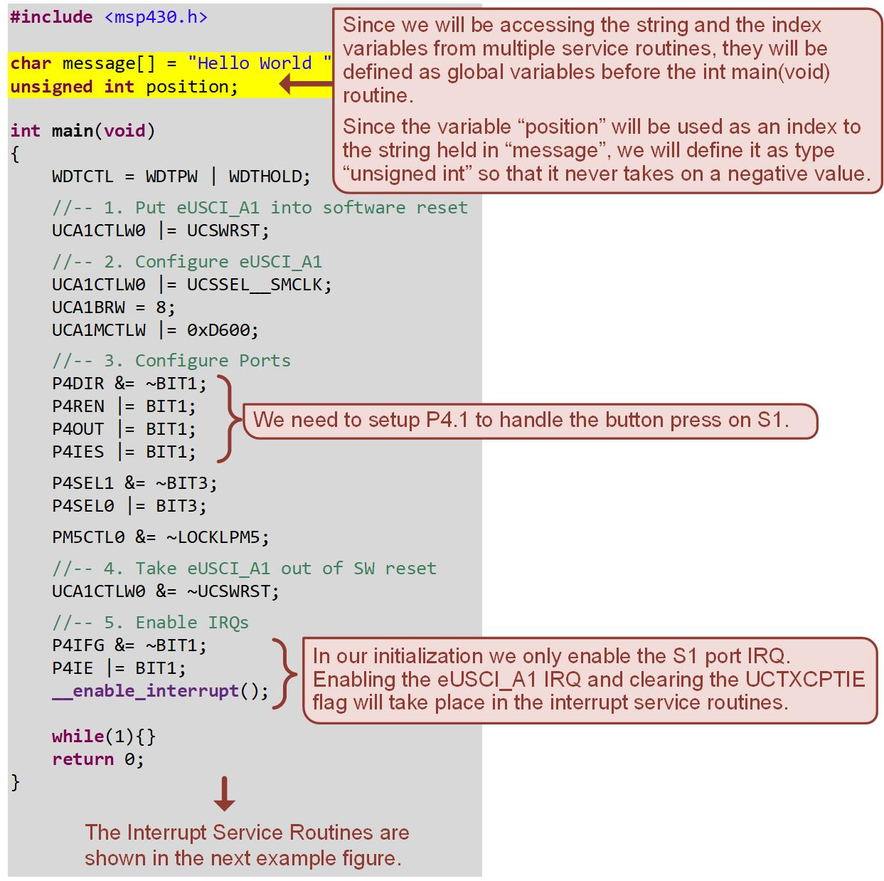
Ch. 14: Serial Communication in C
Ex: Controlling UART Transmission With Interrupts
14.1 Universal Asynchronous Receiver/Transmitter (UART) Operation

Slide 135
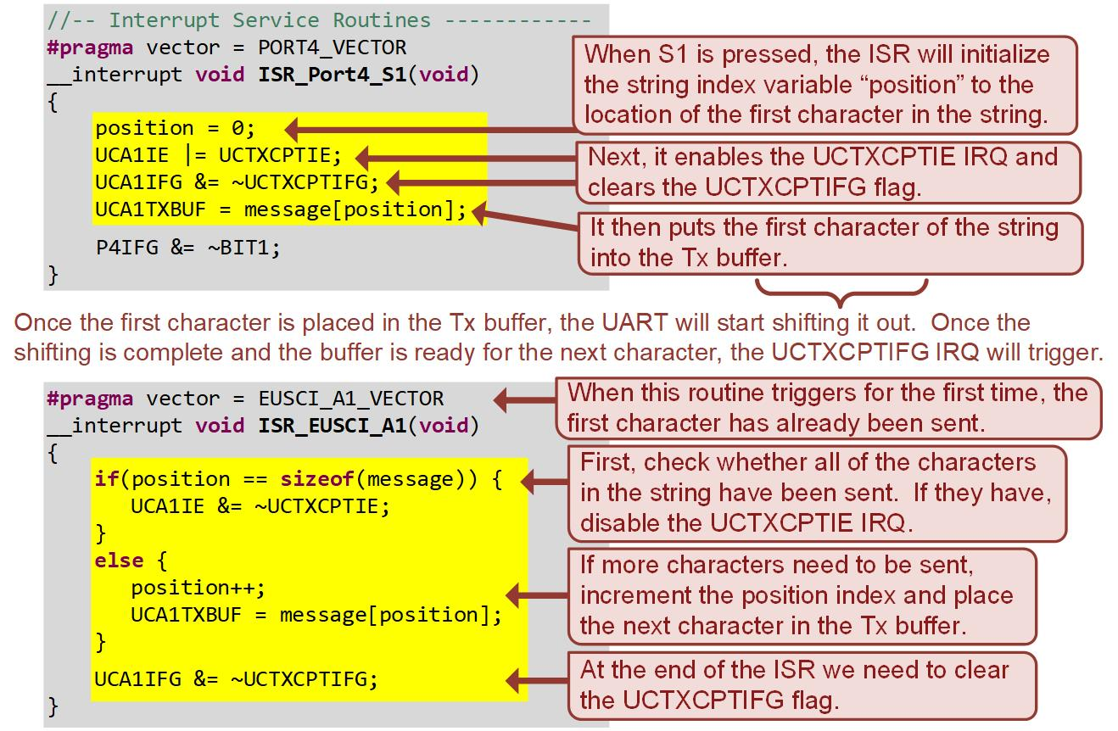
Ch. 14: Serial Communication in C
Ex: Controlling UART Transmission With Interrupts
14.1 Universal Asynchronous Receiver/Transmitter (UART) Operation

Slide 136
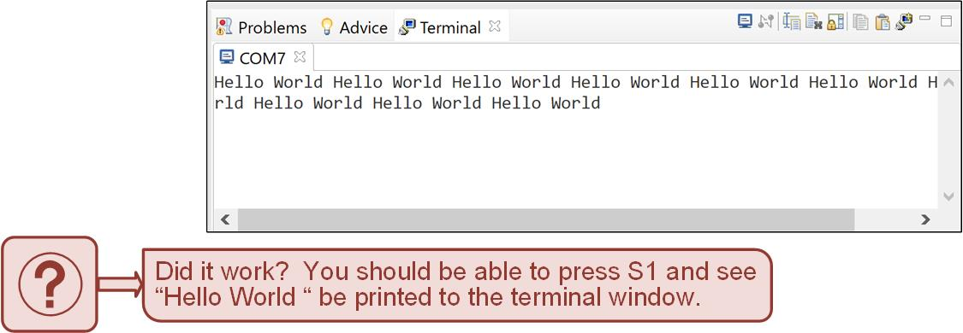
Ch. 14: Serial Communication in C
Ex: Controlling UART Transmission With Interrupts
Step 3: Save and debug your program. Run and then terminate your program. Your program will be running but CCS will not be sharing the USB connection between the debugger and Application UART1.
Step 4: Launch a terminal within CCS and configure it to communicate with the MSP430FR2355 board.
14.1 Universal Asynchronous Receiver/Transmitter (UART) Operation

Slide 137
Embedded Systems Design
Chapter 14: Serial Communications in C
14.1.2 UART Transmit on the MSP430FR2355 – Example: Using Tx IRQs to Control UART Transmission
www.youtube.com/c/DigitalLogicProgramming_LaMeres
Brock J. LaMeres, Ph.D.

Slide 138
Embedded Systems Design
Chapter 14: Serial Communications in C
14.1.3 UART Receive on the MSP430FR2355 – Overview
Brock J. LaMeres, Ph.D.

Slide 139
Ch. 14: Serial Communication in C
14.1.3 UART Receive on the MSP430FR2355
14.1 Universal Asynchronous Receiver/Transmitter (UART) Operation

Slide 140
Ch. 14: Serial Communication in C
14.1.3 UART Receive on the MSP430FR2355
The same clock generator is used for both the Tx and Rx circuits and is configured using the UCAxBRW and UCAxMCTLW registers.
The Rx baud rate generator is configured with the desired baud rate, and the system automatically handles creating the oversampling clock for the Rx shift register.
14.1 Universal Asynchronous Receiver/Transmitter (UART) Operation

Slide 141
Ch. 14: Serial Communication in C
14.1.3 UART Receive on the MSP430FR2355
The Rx system is very similar to the Tx system in that it contains a shift register that receives the serial data.
14.1 Universal Asynchronous Receiver/Transmitter (UART) Operation

Slide 142
Ch. 14: Serial Communication in C
14.1.3 UART Receive on the MSP430FR2355
Once the frame has been received, it is put into the Rx receiver buffer (UCAxRXBUF).
Notice the framing options have to be the same as how the Tx is setup.
14.1 Universal Asynchronous Receiver/Transmitter (UART) Operation

Slide 143
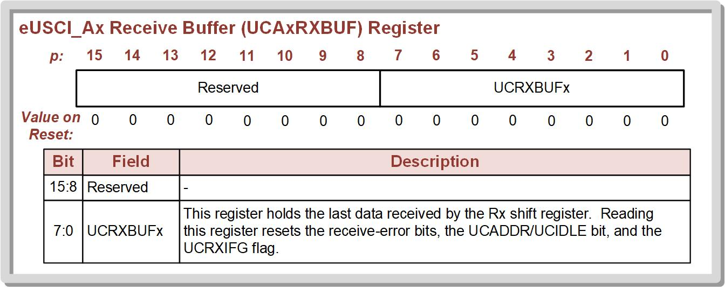
Ch. 14: Serial Communication in C
14.1.3 UART Receive on the MSP430FR2355
14.1 Universal Asynchronous Receiver/Transmitter (UART) Operation

Slide 144
Ch. 14: Serial Communication in C
14.1.3 UART Receive on the MSP430FR2355
The Rx system has a state machine that monitors the incoming data and creates status flags that can be used to generate interrupts.
You never know when data will come in, so you always use flags/IRQs for Rx.
14.1 Universal Asynchronous Receiver/Transmitter (UART) Operation

Slide 145
Ch. 14: Serial Communication in C
14.1.3 UART Receive on the MSP430FR2355
Receive interrupt (UCRXIFG):
Triggers when a new character has been received and the data is available in the Rx buffer.
Cleared when the Rx buffer is read.
UCRXIFG has its own flag and local IRQ enable.
14.1 Universal Asynchronous Receiver/Transmitter (UART) Operation

Slide 146
Ch. 14: Serial Communication in C
14.1.3 UART Receive on the MSP430FR2355
Start bit interrupt (UCSTTIFG)
Triggers when the system sees a HIGH-to-LOW transition on the Rx pin indicating a new frame is being received.
UCSTTIFG has its own flag and local IRQ enable.
14.1 Universal Asynchronous Receiver/Transmitter (UART) Operation

Slide 147
Ch. 14: Serial Communication in C
14.1.3 UART Receive on the MSP430FR2355
The Rx IRQs share the same eUSCI vector as the Tx IRQs.
14.1 Universal Asynchronous Receiver/Transmitter (UART) Operation

Slide 148
Ch. 14: Serial Communication in C
14.1.3 UART Receive on the MSP430FR2355
14.1 Universal Asynchronous Receiver/Transmitter (UART) Operation

Slide 149
Embedded Systems Design
Chapter 14: Serial Communications in C
14.1.3 UART Receive on the MSP430FR2355 – Overview
www.youtube.com/c/DigitalLogicProgramming_LaMeres
Brock J. LaMeres, Ph.D.

Slide 150
Embedded Systems Design
Chapter 14: Serial Communications in C
14.1.3 UART Receive on the MSP430FR2355 – Example: Toggling LED1 Based on Terminal Keystrokes
Brock J. LaMeres, Ph.D.

Slide 151
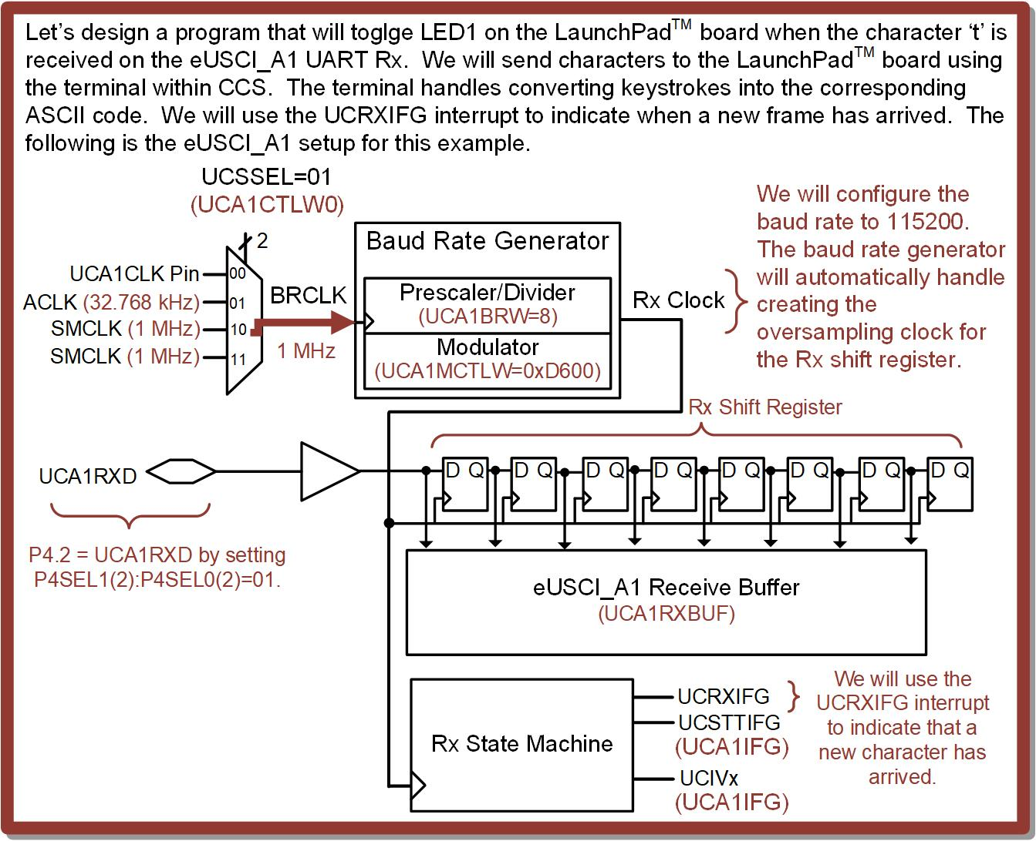
Ch. 14: Serial Communication in C
Ex: Receiving Characters on the eUSCI_A1 UART
14.1 Universal Asynchronous Receiver/Transmitter (UART) Operation

Slide 152
Ch. 14: Serial Communication in C
Ex: Receiving Characters on the eUSCI_A1 UART
Step 1: In CCS, create a new C/C++ Empty Project (with main.c) titled:
C_UART_Rx1_Toggling_LED1
Step 2: Type in the following code in main.c after the statement to stop the watchdog timer.
Image Courtesy of https://neodem.wp.horizon.ac.uk/
14.1 Universal Asynchronous Receiver/Transmitter (UART) Operation

Slide 153
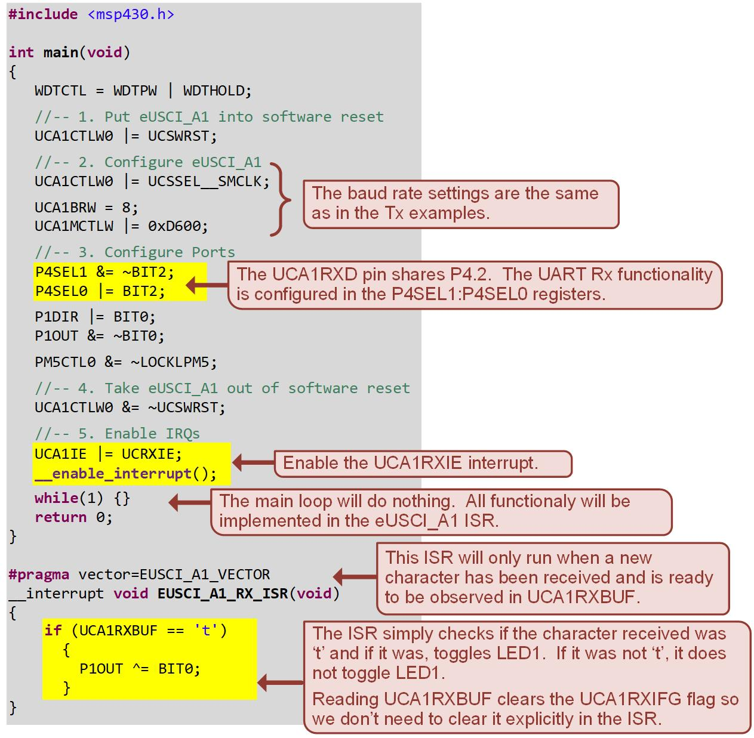
Ch. 14: Serial Communication in C
Ex: Receiving Characters on the eUSCI_A1 UART
14.1 Universal Asynchronous Receiver/Transmitter (UART) Operation

Slide 154
Ch. 14: Serial Communication in C
Ex: Receiving Characters on the eUSCI_A1 UART
Step 3: Save and debug your program. Run and then terminate your program. Your program will be running but CCS will not be sharing the USB connection between the debugger and Application UART1.
Step 4: Launch a terminal within CCS and configure it to communicate with the MSP430FR2355 board.
14.1 Universal Asynchronous Receiver/Transmitter (UART) Operation

Slide 155
Ch. 14: Serial Communication in C
Ex: Receiving Characters on the eUSCI_A1 UART
Can you see these ASCII codes in the debugger?
14.1 Universal Asynchronous Receiver/Transmitter (UART) Operation

Slide 156
Embedded Systems Design
Chapter 14: Serial Communications in C
14.1.3 UART Receive on the MSP430FR2355 – Example: Toggling LED1 Based on Terminal Keystrokes
www.youtube.com/c/DigitalLogicProgramming_LaMeres
Brock J. LaMeres, Ph.D.

