Slide 1
EELE 461/561 – Digital System Design
Module #2 – Interconnect Modeling with Lumped Elements
Topics
Modeling Techniques
Impedance of Resistors, Capacitors and Inductors
Textbook Reading Assignments
3.1-3.7
What you should be able to do after this module
Understand what a model is
Describe the impedance of a Resistor, Capacitor, and Inductor

Slide 2
Interconnect Modeling
Interconnect Modeling - All interconnect can be described using the fundamentals of electromagnetic wave propagation given by Maxwell’s equations. - However, it is impractical to use Maxwell’s equations in real designs due to the time associated with the solutions. - Instead, we try to Model the performance of the interconnect using our basic circuit elements. - We use the word Model to describe the schematic of a circuit that mimics the electrical behavior of a physical structure. - A model not only gives us a gut feel, but it can be simulated with SPICE. - Since simulators only operate on ideal components, we need to construct our equivalent circuit model using i.e., Resistors, Capacitors, Inductors, and Transmission Lines

Slide 3
Interconnect Modeling
Interconnect Modeling - The accuracy of a model can be increased by using more circuit elements. - However, more circuit elements cause the simulation to run slower. - As a result, we want a Model that is: 1) Accurate enough for our application 2) Not overly complex resulting in longer-than-necessary simulation times - A model is also be accurate over a finite frequency range. We call this the: “Bandwidth of the Model” - The model may be accurate over its bandwidth, but may give inaccurate results above its BW. - We need to make sure that our model has sufficient bandwidth to accurately predict the behavior for all spectral content in our system. - Again, the more circuit elements in the model, the higher range of frequency that the model can cover.

Slide 4
Interconnect Modeling
Interconnect Modeling - There are 4 ideal circuit elements that we use to describe a circuit’s behavior: Lumped Elements Distributed Elements Resistor (R) Transmission Line (T) Capacitor (C) Inductor (L) - “Lumped” means there is no propagation time through the element - “Distributed” means there IS propagation time through the element

Slide 5
Impedance
Impedance - In all cases, the most important electrical parameter of a system is its Impedance - Impedance is ALWAYS defined as: - At first glance, this looks just like a resistor, but Impedance is the generic expression that includes time & frequency dependence.

Slide 6
Impedance (R)
Z of a Resistor - Resistance is the Ratio of DC Voltage to DC Current - The fundamental expression that describes the performance of a resistor is Ohm’s Law: - substituting this into the definition for Impedance, we can find Z_{R} - this is obvious, but one important takeaway is that an ideal resistor element has a fixed impedance that is not dependant on frequency

Slide 7
Impedance (C)
Z of a Capacitor - Capacitance is the Ratio of Charge stored between two conducting nodes to the voltage across the same nodes: - Large Capacitance means that more charge can be stored with less voltage. - Physically, a capacitor is made of two plates separated by an insulating (dielectric) material. - Since the two plates are isolated, there is NO DC Current - if we inject charge suddenly on one of the capacitor nodes, the dielectric will polarize and cause charge to move on the opposite node. This instantaneous charge movement is AC or transient current.

Slide 8
Impedance (C)
Z of a Capacitor - If we look at the definition of Current, we can form a relationship for the behavior of a capacitor: - Let’s rearrange our capacitor definition and then differentiate with respect to time: - This is the fundamental expression that describes the behavior of a capacitor.

Slide 9
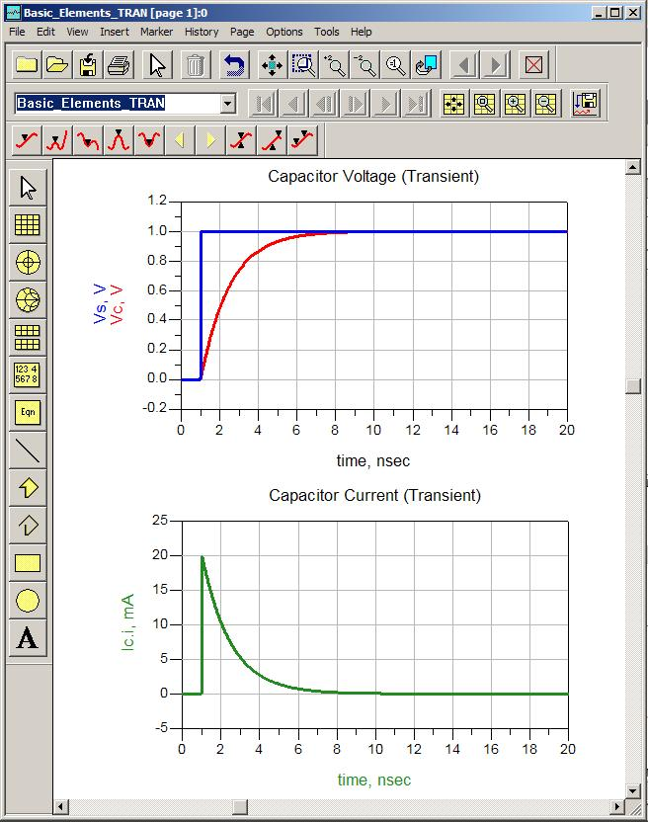
Impedance (C)
Z of a Capacitor - This expression says that voltage cannot change instantaneously but current can. - A small change in voltage will result in a large change in current.

Slide 10
Impedance (C)
Z of a Capacitor Time Domain - if we look at the impedance of a capacitor in the time domain, we first remember that impedance is always V/I - this expression that says: 1) when dV/dt is small (or DC), the capacitor impedance is HIGH 2) when dV/dt is large (or High Frequency), the capacitor impedance is LOW - we conceptually say: 1) At DC, a capacitor looks like an OPEN. 2) At High Frequency, a capacitor looks like a SHORT.

Slide 11
Impedance (C)
Z of a Capacitor Time Domain - let’s represent our voltage in the time domain using sine waves: - now let’s derive the current of a capacitor using this voltage: - Now plugging into our Impedance expression for capacitance, we get:

Slide 12
Impedance (C)
Z of a Capacitor Time Domain - This expression tells us two important things: 1) The magnitude of the Impedance is: 2) The phase of the Impedance is: - we say that the Voltage LAGS behind the Current in a capacitor by 90º, or “ICE”

Slide 13
Impedance (C)
Z of a Capacitor Frequency Domain - In the frequency domain, we only have sine waves with Magnitude, Frequency, and Phase. - We use a complex plane to represent the magnitude and phase with one complex quantity. - On the complex plane, we represent a -90º phase using a -j - Remember on the complex plane:
Im
Re

Slide 14
Impedance (C)
Z of a Capacitor Frequency Domain - The impedance of the capacitor can be expressed as: - Note that Impedance is a complex quantity and we define the Complex Frequency as s=jω - We call the Real part of Impedance Resistance and the Imaginary part Reactance. - Since a capacitor only has an imaginary component, we can say that the Reactance is equal to the Impedance.
Im
Re

Slide 15
Impedance (C)
Z of a Capacitor Frequency Domain - We typically get the most information from the magnitude of the impedance. - Note this shows an inverse relationship between Impedance and Frequency - This verifies what we saw in the Time Domain: 1) At DC, a capacitor looks like an OPEN. 2) At High Frequency, a capacitor looks like a SHORT.

Slide 16
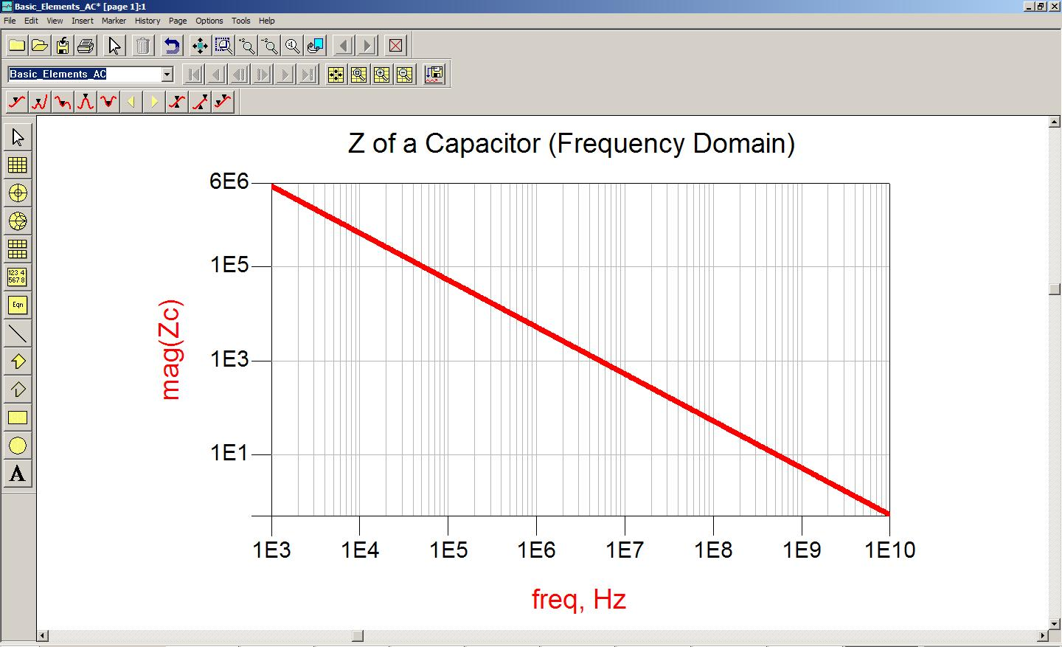
Impedance (C)
Z of a Capacitor Frequency Domain

Slide 17
Impedance (L)
Z of an Inductor - Inductance is the ratio of Magnetic Flux to Current - Magnetic Flux is the number of B-field Lines around the conductor (units are Webers, Wb) - Large Inductance means that more magnetic fields can be stored with less current. - Physically, an inductor is a structure or material that can temporarily hold Magnetic field lines ex) a coil, or Ferroelectric material

Slide 18
Impedance (L)
Z of an Inductor - Faraday’s Law of Induction states that the voltage induced from an inductor is: - Let’s rearrange our inductance definition and then differentiate with respect to time: - This is the fundamental expression that describes the behavior of an inductor.

Slide 19
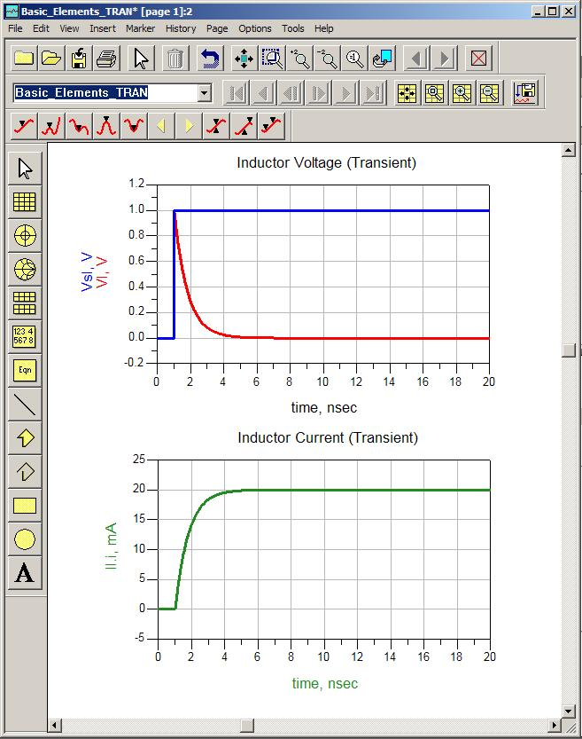
Impedance (L)
Z of an Inductor - This expression says that current cannot change instantaneously but voltage can. - A small change in current will result in a large change in voltage.

Slide 20
Impedance (L)
Z of an Inductor Time Domain - if we look at the impedance of an inductor in the time domain, we first remember that impedance is always V/I - this expression that says: 1) when dI/dt is small (or DC), the inductor impedance is LOW 2) when dI/dt is large (or High Frequency), the inductor impedance is HIGH - we conceptually say: 1) At DC, an inductor looks like a SHORT. 2) At High Frequency, an inductor looks like an OPEN.

Slide 21
Impedance (L)
Z of an Inductor Time Domain - let’s represent our current in the time domain using sine waves: - now let’s derive the voltage of an inductor using this current: - Now plugging into our Impedance expression for inductance, we get:

Slide 22
Impedance (L)
Z of an Inductor Time Domain - This expression tells us two important things: 1) The magnitude of the Impedance is: 2) The phase of the Impedance is: - we say that the Voltage LEADS the Current in an inductor by 90º, or “ELI”

Slide 23
Impedance (L)
Z of an Inductor Frequency Domain - In the frequency domain, we only have sine waves with Magnitude, Frequency, and Phase. - We use a complex plane to represent the magnitude and phase with one complex quantity. - On the complex plane, we represent a +90º phase using a +j - Remember on the complex plane:
Im
Re

Slide 24
Impedance (L)
Z of an Inductor Frequency Domain - The impedance of the inductor can be expressed as: - Again, we call the Real part of Impedance Resistance and the Imaginary part Reactance. - Since an inductor only has an imaginary component, we can say that the Reactance is equal to the Impedance.
Im
Re

Slide 25
Impedance (L)
Z of an Inductor Frequency Domain - In the Frequency Domain, the magnitude of the impedance is: - Note this shows a linear relationship between Impedance and Frequency - This verifies what we saw in the Time Domain: 1) At DC, an inductor looks like a SHORT. 2) At High Frequency, an inductor looks like an OPEN.

Slide 26
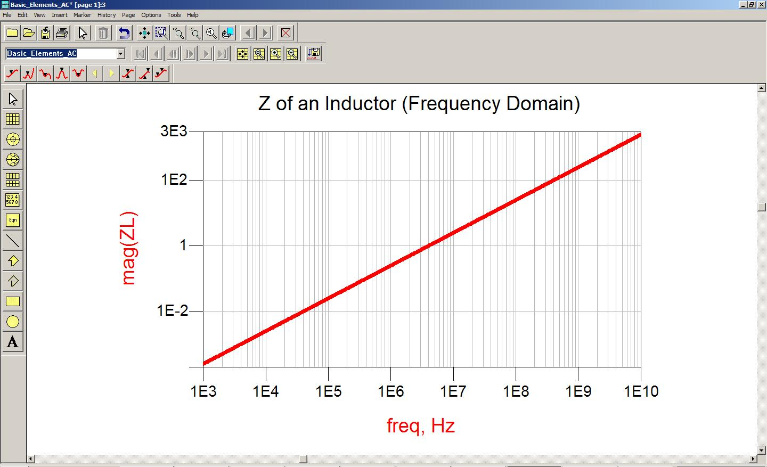
Impedance (L)
Z of an Inductor Frequency Domain

