Slide 1
Introduction to Matlab
Module #1 – Getting Started with Matlab
Topics
Starting a session
Entering commands & expressions in interactive mode
Working with variables (ans, assignment operator)
Arithmetic operations
Special variables and constants
Controlling the session (working directory, saving sessions, command history)
Arrays (index, size, operators)
Basic plotting
Script files (m files)
Help System
Textbook Reading Assignments
1.1 – 1.8
Practice Problems
Chapter 1 Problems: 2, 5, 12, 13, and 21

Slide 2
Course Overview
Instructor: Brock J. LaMeres Office : 533 Cobleigh Hall Phone : (406)-994-5987 Email : lameres@ece.montana.edu Web : www.coe.montana.edu/ee/lameres/
Time / Location: 625 Cobleigh 10:00am to 1:00pm
Textbook: “Introduction to Matlab 7 for Engineers", William J. Palm III McGraw-Hill, 2nd edition 2005 (Note: some tables in these notes are from the author’s lecture notes)
Website: http://www.coe.montana.edu/ee/lameres/courses/matlab_sum10/ - all handouts and exercises are found on the website

Slide 3
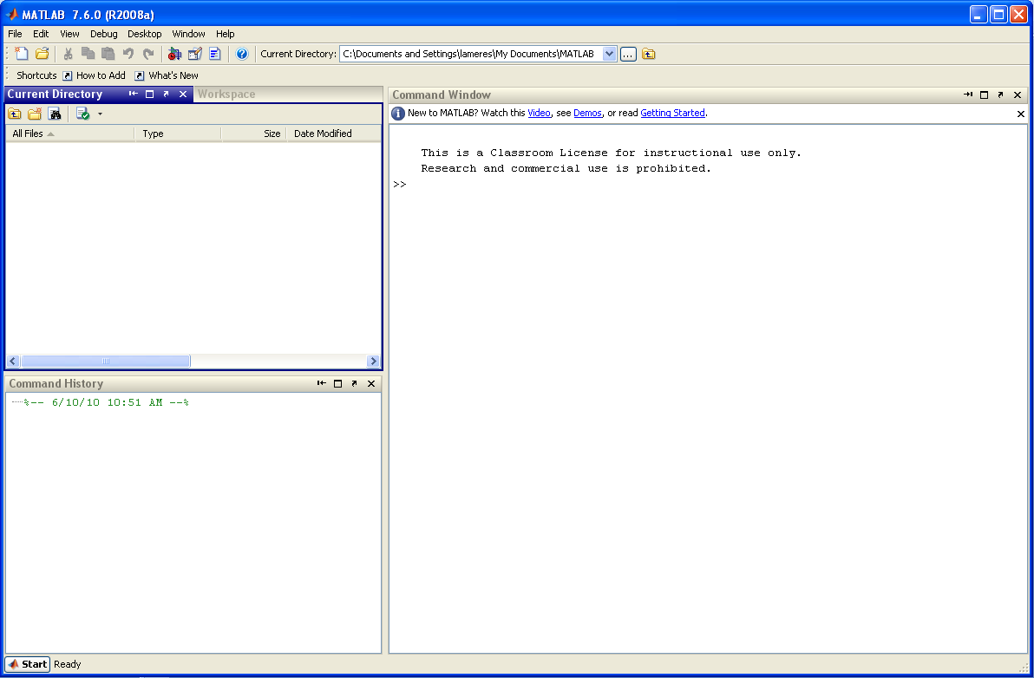
1) Starting a Session
Start a Matlab Session Start – Programs – Matlab – R2008a – Matlab 2008a

Slide 4
1) Starting a Session
Overview of windows
Workspace - a list of your current variables - need to click to bring to front
Command Window - where you enter expressions, commands and execute script files
Current Directory
Command History - a list of all of the commands you have entered

Slide 5
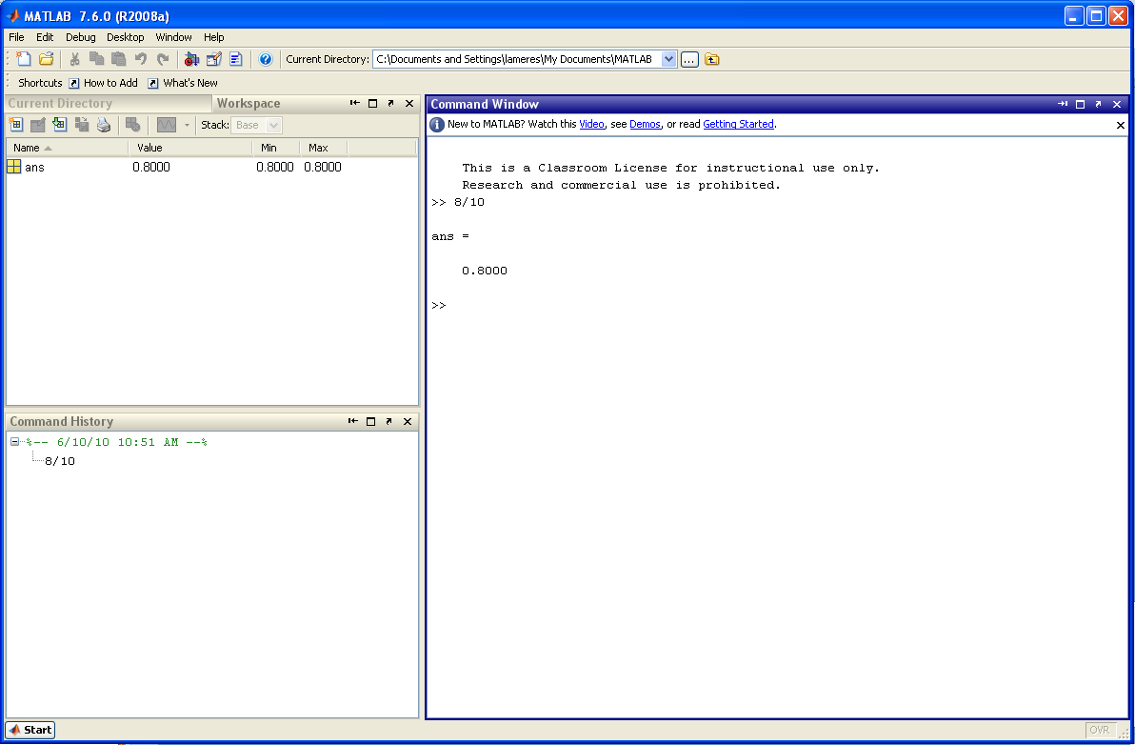
2) Entering Commands & Expressions
Enter >> 8/10 and let’s see what happens…
- Matlab evaluates the expression
- Matlab echoes back the name of a default variable (ans)
- Matlab echoes back the answer (0.8)
The Workspace now shows the variable “ans” and its current value (0.8)
The Command History window shows the command you just entered (8/10)

Slide 6
2) Entering Commands & Expressions
Interactive Session - “interactive” means that you are manually typing in commands and getting answers back. This this good for simple calculations and evaluations. As things get more complex, Matlab will allow you to put your commands in a file and then execute the file. This is called a script file (*.m) and is typically how things are done. Interactive mode is good to test things as you develop your script file. - there are a variety of commands and expression that can be entered in Matlab Mathematical Operations - actual computations (+, -, *, …) Systems Commands - configuring the Matlab session - changing directories - seeing values of variables, - changing the way numbers are displayed - clearing the command history, variable values, etc… Execution of Functions or Scripts - telling Matlab to run a pre-existing function - telling Matlab to run one of your scripts

Slide 7
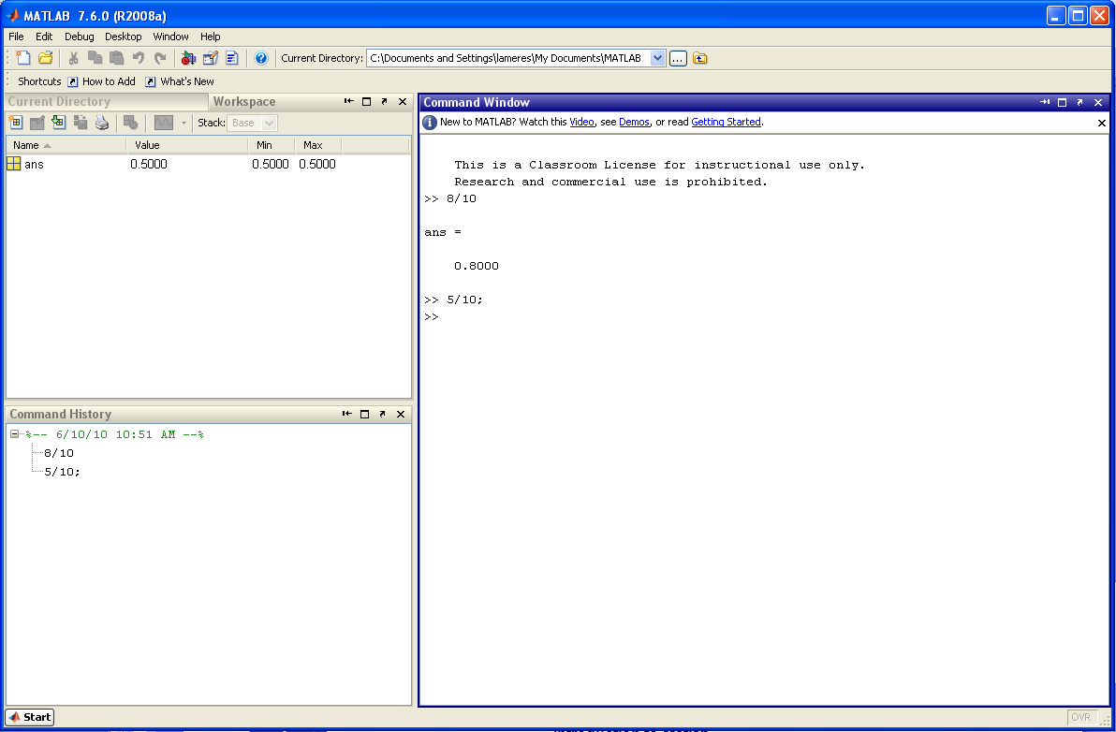
2) Entering Commands & Expressions
Interactive Session - If you put a “;” after your expression, Matlab will NOT echo back the answer. Matlab does however perform the evaluation.
- Matlab evaluates the expression but does NOT echo
The Workspace shows that the variable “ans” has been updated to 0.5
The Command History window shows the new command (5/10)

Slide 8
3) Working with Variables
Variables - every evaluation in Matlab is stored in a variable. - a variable is a symbol which holds a value and makes managing computations easier i.e., x = 8 (we use “x” to hold the current value) x = y+2
- if not specified, Matlab will store the current evaluation in a default variable called “ans”
- if not specified, each subsequent evaluation will be stored to ans and the previous value will be overridden. - you can create your own variables by putting a unique symbol and an assignment operation to the left of the expression. i.e.,: x = 8/10 (now x will be created and assigned 0.8) - to see the value of a variable, you can simply type is name >> x - to see if a variable exists, you can type: >> exists(‘name’). Matlab will return ‘1’ if the variable exists (true) and ‘0’ if it does not exist (false)

Slide 9
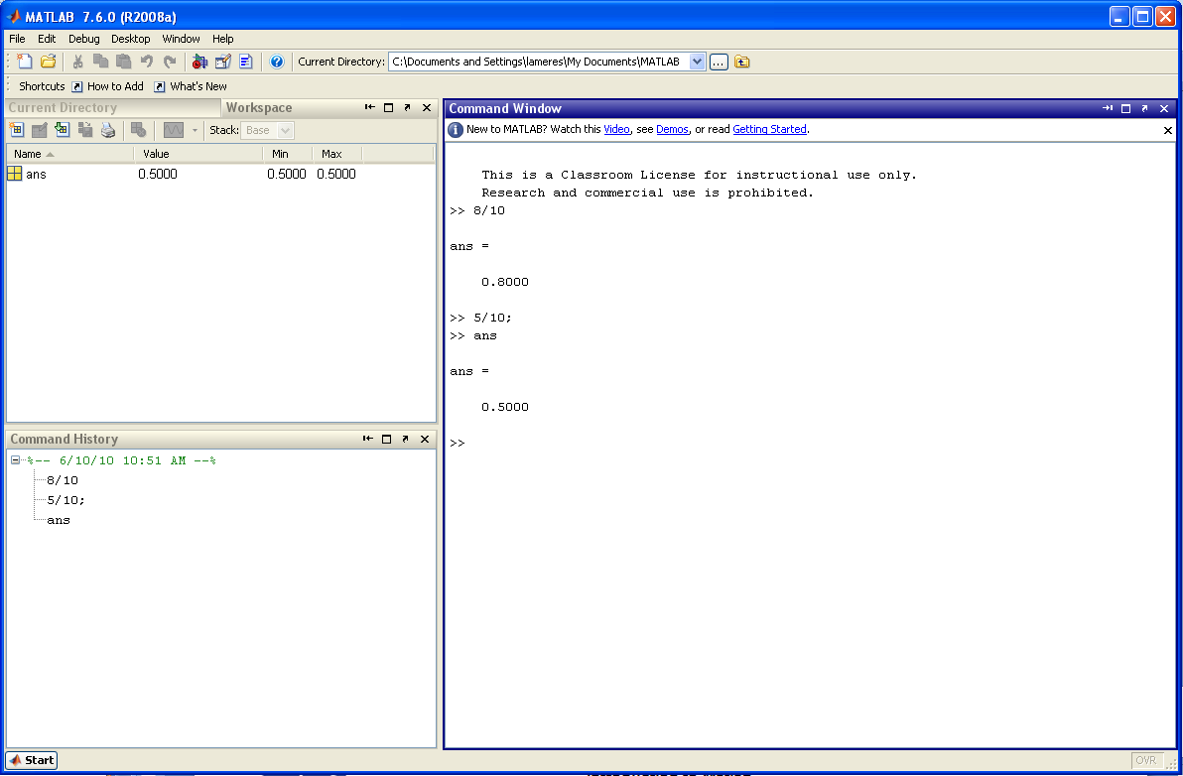
3) Working with Variables
See the current value of “ans” by typing its name at the prompt >> ans
- Matlab echoes the value currently in “ans”
The Command History window is updated

Slide 10
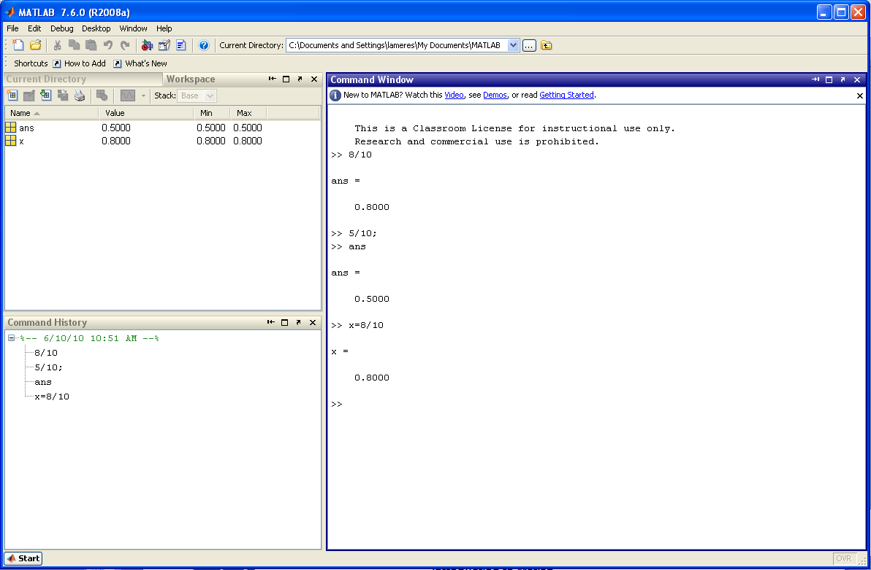
3) Working with Variables
Let’s create a new variable “x” and assign it 8/10 >> x = 8/10
By putting “x=“ on the left hand of the expression, a new variable is created and assigned the evaluation of the right-hand-side of the expression (RHS)
The Workspace shows that “x” has been created and has a current value of 0.8.
The Command History window is updated

Slide 11
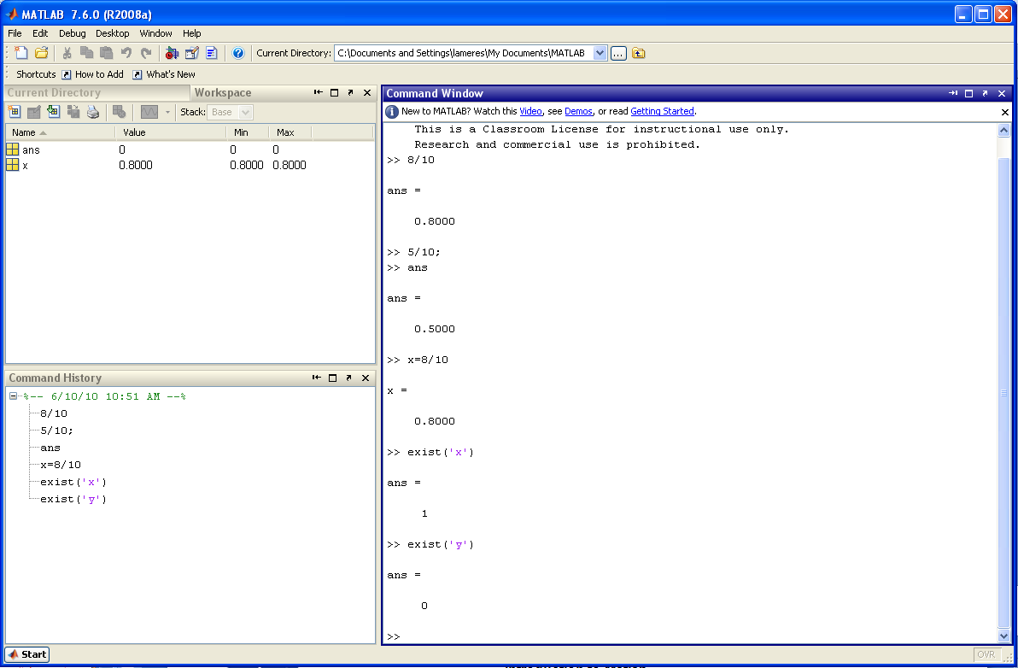
3) Working with Variables
Let’s see how to use the “exist” command >> exist (‘x’) >> exist (‘y’)
exist(‘x’) evaluates to a 1 since x was created by our previous command
exist(‘y’) evaluates to a 0 since it has not been created
Notice that the default variable “ans” is updated with the last evaluation (0)

Slide 12
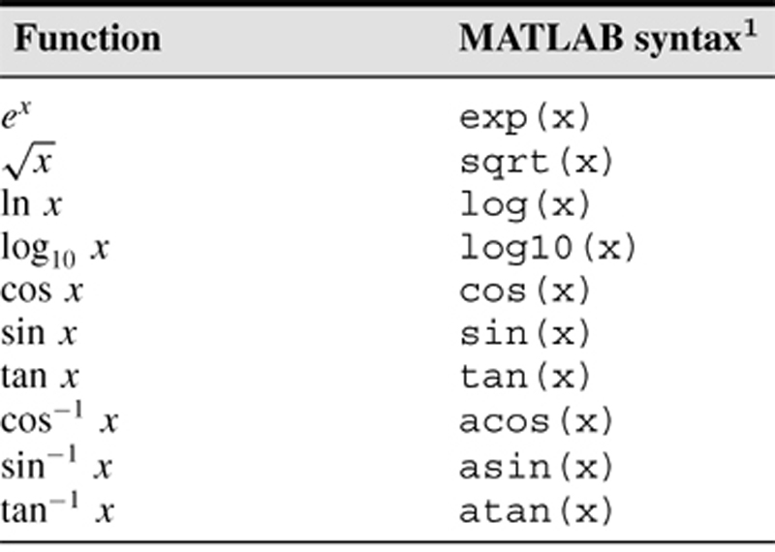
4) Arithmetic Operations
Arithmetic and Mathematical Functions

Slide 13
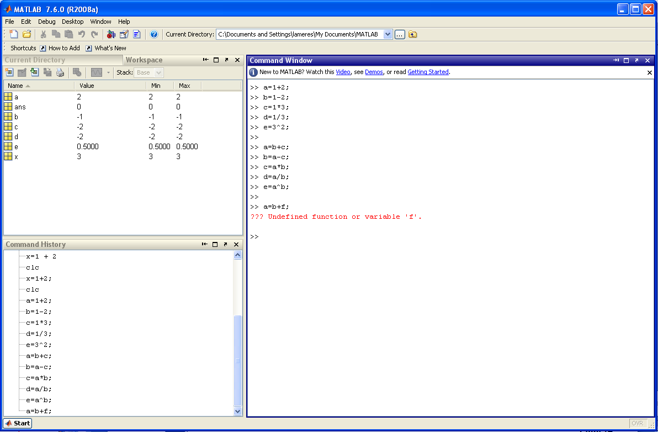
4) Arithmetic Operations
Examples
Syntax for arithmetic operations
New variables are created each time the “assignment operator” is used: a= b= c= d= e=
Existing variable can also be used in subsequent expressions
If the variables doesn’t exist, Matlab will give you an error message

Slide 14
4) Arithmetic Operations
Precedence - standard algebraic precedence holds in Matlab

Slide 15
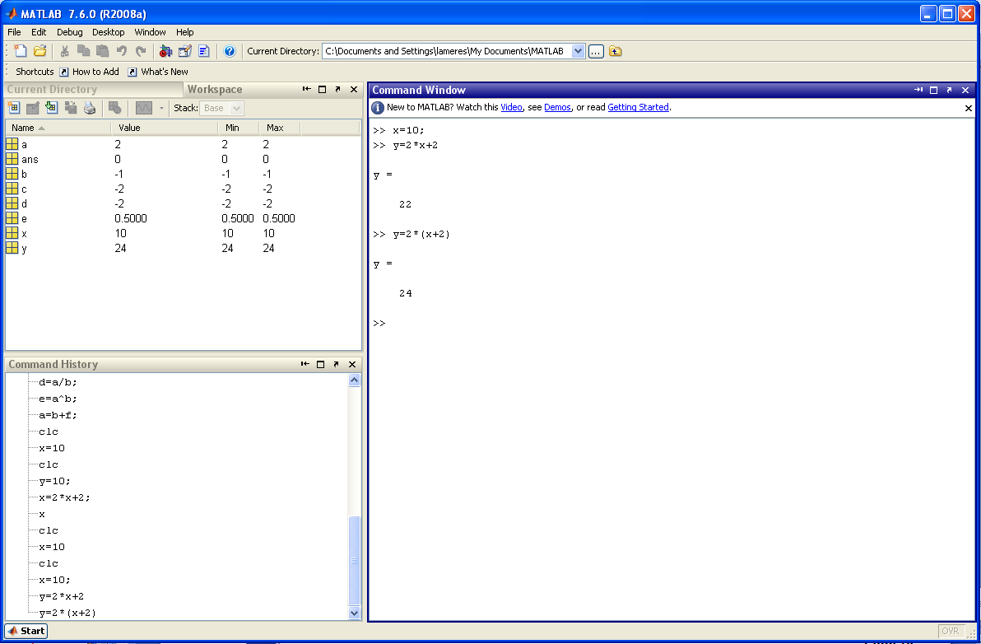
4) Arithmetic Operations
Precedence - Be careful, this can lead to a computational errors in your program i.e., y = 2*x+2 is not equal to y = 2*(x+2)
No parenthesis (y = 22)
With parenthesis (y=24)

Slide 16
5) Special Variables and Constants
There are a handful of built-in constants available in Matlab - NOTE: These can be overwritten so be careful!!! Ex) pi = 2 will actually set the variable to 2 for this session.

Slide 17
6) Controlling the Session
There are special commands in Matlab to setup and control your session Command History - Matlab saves previous keystrokes. You an use the up/down arrow to scroll through previous commands. Use the enter key to execute the command. - You can also drag/drop commands from the Command History window pane to the prompt in the Command Window.
Formatting (changes how Matlab displays numbers) >> format short 4 decimal digits (default) >> format long 16 digits (default) >> format short e 5 digits, 4 decimals plus exponent (default) >> format long e 5 digits, 4 decimals plus exponent (default) more formats available in Table 1.1-5

Slide 18
6) Controlling the Session
Managing the Work Session >> clc clears the command window >> clear removes all variables from memory. Will also reset built in constants such as eps, pi, etc… in case you overwrote them. >> clear v1 v2 … clears values of variables v1 v2 …. >> quit ends Matlab session >> who lists variables currently in memory >> whos lists variables currently in memory and their value and size
- You can save your current variables to a file (filename.mat) to be loaded in a new session later. The file will be stored in your current working directory (next page). >> save filename.mat saves current variables to a file called “filename.mat” >> load filename.mat loads current variables from a file called “filename.mat”

Slide 19
6) Controlling the Session
Working Directory - Matlab will place files in your current working directory. You set the working directory using a series of commands. This is similar to navigating up/down directories in My Computer but instead of double clicking on folders, you manually type in commands. This is also similar to Dos and Unix. - You should create a directory on your Z drive that will contain all of your practice and lab exercises. Consider creating a directory at: Z:\Matlab_Course\Lab01\ >> pwd lists your current directory (stands for present-working-directory) >> dir lists all of the files and subfolders in your current directory >> ls lists all of the files and subfolders in your current directory >> cd dirname changes directories to a subdirectory called “dirname”. Note that the subdirectory must exists below where you are. NOTE: You can use the TAB key to auto-complete the name of the subdirectory. This is VERY handy >> cd .. changes directories UP one level

Slide 20
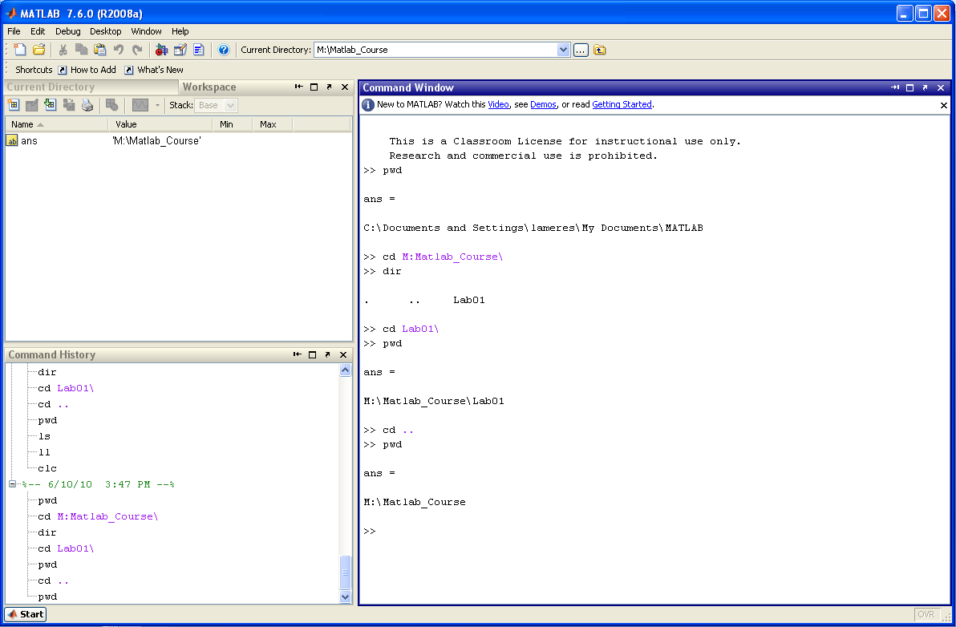
6) Controlling the Session
Working Directory Example - I’ve created two directories using “My Computer” (M:\Matlab_Course\Lab01) - I will now change into this directory after launching Matlab
pwd tells me where I’m currently at
cd changes to my Matlab_Course directory. Notice that you can include the drive letter (M or Z).
dir lists any subfolders. Notice that there is a subfolder called “Lab01”
pwd confirms I’m in the right spot
cd .. takes me up one directory
pwd confirms I moved up a level

Slide 21
6) Controlling the Session
Working Directory - You can lists only Matlab files in your present-working-directory also >> what lists only Matlab related files (*.m, *.mat) >> what dirname lists only Matlab related files (*.m, *.mat) in the directory specified
Search Paths - You can execute a script file or function by typing its name assuming the file resides in your present-working-directory. - If the file resides in a different directory, you can type in the full path name to execute it (i.e., >> M:\Matlab_Course\Functions\addthem.m) - If you’d like to be able to call files without providing the entire path each time, you can setup the location in Matlab’s search path. Then when you type in just the file name, Matlab will first look in the present-working-directory and if the file isn’t found, it will begin looking through the search path. >> path displays the current search path >> addpath dirname adds a directory path to the search path >> rmpath dirname adds a directory path to the search path >> pathtool launches the “Set Path Tool” which will graphically add paths

Slide 22
7) Arrays
Arrays (just a quick overview) - An array is a collection of numbers (as opposed to a scalar which is a single number) - Each of the numbers within the array has a specific location, called its index - Arrays are entered into Matlab using the square brackets with commas or spaces delimiting the entries >> y = [0, 2, -1, 5] - Indexes in Matlab start at 1 and increase by whole numbers >> y = [0, 2, -1, 5] index 1 2 3 4 - individual values of the array can be accessed using the index and parenthesis: ex) y(1) = 0 y(2) = 2 y(3) = -1 y(4) = 5

Slide 23
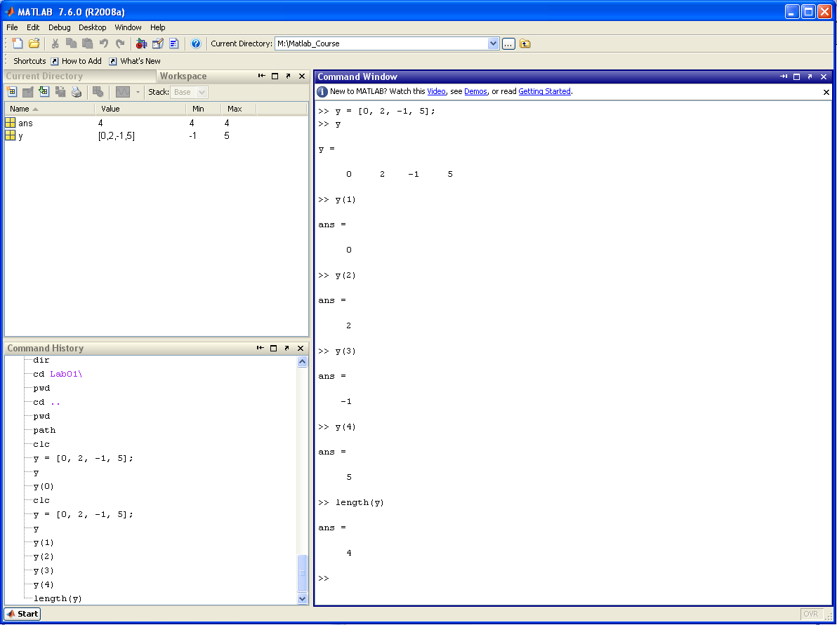
7) Arrays
Arrays (just a quick overview) - The size of an array is the number of entries and be found using the length command
Create a new 4 element array ‘y’
Echo the contents of y
Echo the contents of y(1)
Echo the contents of y(2)
Echo the contents of y(3)
Echo the contents of y(4)
Give the number of elements in the array

Slide 24
7) Arrays
Arrays (just a quick overview) - An array with equally spaced entries can be created using the “:” within the square brackets >> t = [0:1:10] start value step size end value - this is especially useful for creating an array to represent time

Slide 25
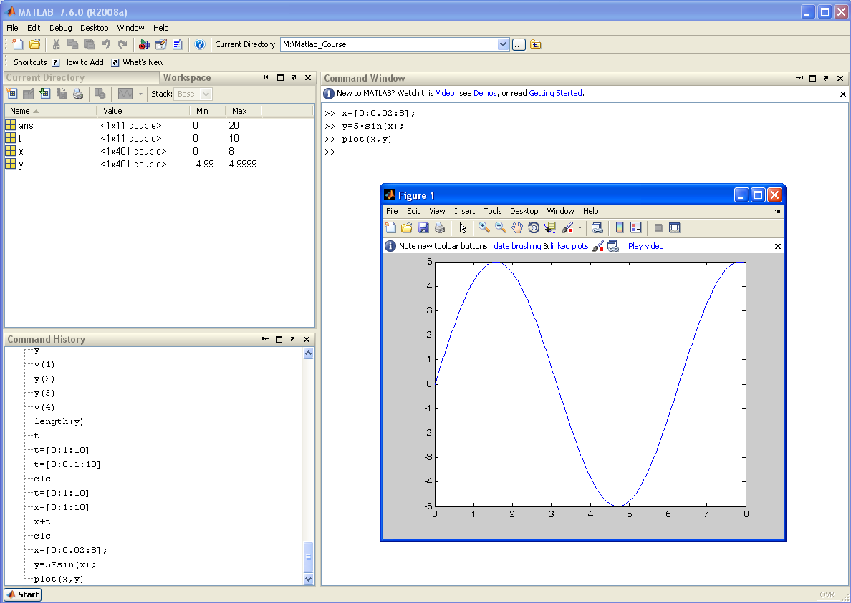
8) Basic Plotting
Plotting (just a quick overview) - Matlab can create a simple XY plot of two arrays using the plot function

Slide 26
8) Basic Plotting
Plotting (just a quick overview) - there are a variety of formatting commands that can make the plot easier to read. >> title(‘text’) puts the ‘text’ label along the top of the plot >> xlabel(‘text’) puts the ‘text’ label along the x-axis >> ylabel(‘text’) puts the ‘text’ label along the y-axis >> gtext(‘text’) will put the ‘text’ label wherever you click your mouse on the plot >> grid displays the grid >> hold on/off “hold off” will overwrite the current plot. “hold on” will plot onto an existing plot window. NOTE: multiple plotting commands can be put on the same line if separated by a comma >> plot(x,y), title(‘Example Plot’), xlabel(‘X-label’), ylabel(‘Y-label’), grid

Slide 27
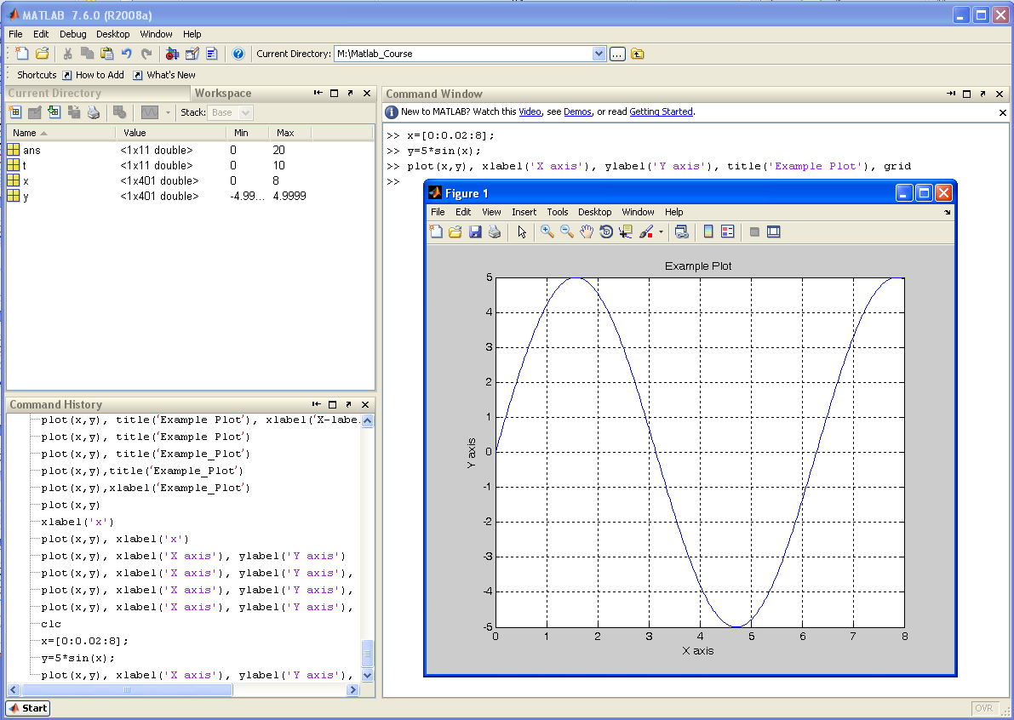
8) Basic Plotting
Plotting Example - Plotting x vs. y and including formatting options on the same line

Slide 28
9) Script Files
Script Files - When what you are trying to accomplish involves a series of commands, using Matlab in interactive mode can become difficult. - Using a script file (*.m) allows you to put all of your commands in a text file and then execute the file. - Script files also allow you to include basic programming constructs (loops, decisions statements) so your programs can become. - The command in the script file are executed sequentially just as if you typed you them in at the command line. - You execute script files by typing the name of the file at the prompt. Ex) if you created a script called lab01a.m, you would simply type >> lab01 - Matlab will look for the file in your pwd, then in your search path. - It is recommended that you create a folder for the project you are working in and then change into this directory for your session. All of your script files for that project should reside in that folder.

Slide 29
9) Script Files
Script Files - Comments in scripts files start with %. - Commends can be inserted at the beginning of a line or after commands
Ex) script file syntax - Matlab has a built in editor that you can use to create your script file. You can also use any other text editor you wish outside of Matlab. This color codes Matlab keywords which makes it easier to create programs.
% Filename: Practice01.m
% Author: Brock J. LaMeres
% Date: 6/14/10
% Description: This script file will plot the sine wave
% function y(t) = 2*sin(3t+2)
%%%%%%%%%%%%%%%%%%%%%%%%%%%%%%%
t = [0:0.1:5]; % generate a time step from 0s to 5s
x = 2*sin(3*t + 2); % calculate sine expression for each t
plot (t,x) % plot the sine wave function
title('Practice01 Plot')
xlabel('t')
ylabel('x')
grid

Slide 30
9) Script Files
Script File Example Ex) - Let’s create a script file called “Practice01.m”. First, create a directory that will contain this script file (M:\Matlab_Course\Lab01). - In Matlab, change your pwd into this directory. >> cd M:\Matlab_Course\Lab01 - Now launch the editor in Matlab using the pull-down menus: File → New → M-File - Type in the example code to plot a sine wave - Save the file with a name Practice01.m in your working directory (File – Save) - In Matlab you should be able to perform a dir and see this new file.

Slide 31
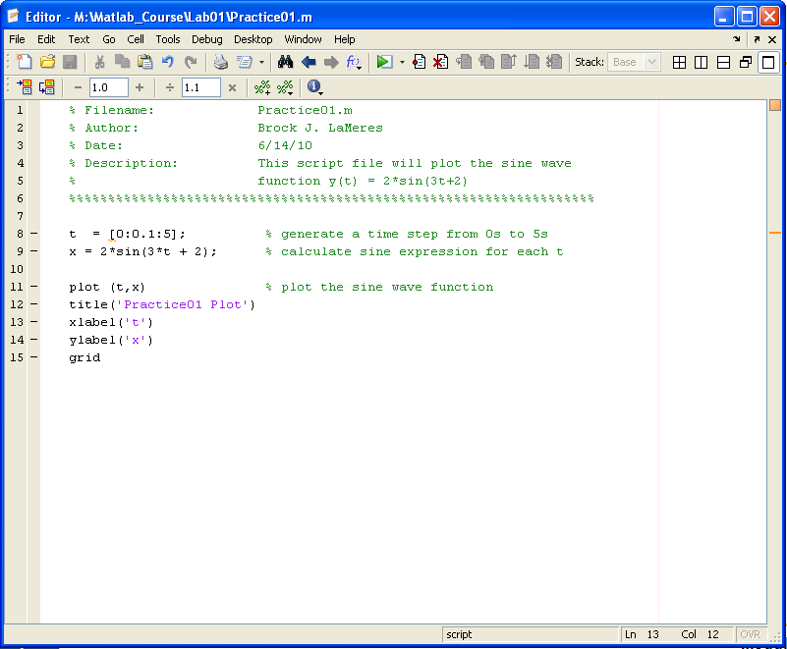
9) Script Files
Script File Example

Slide 32
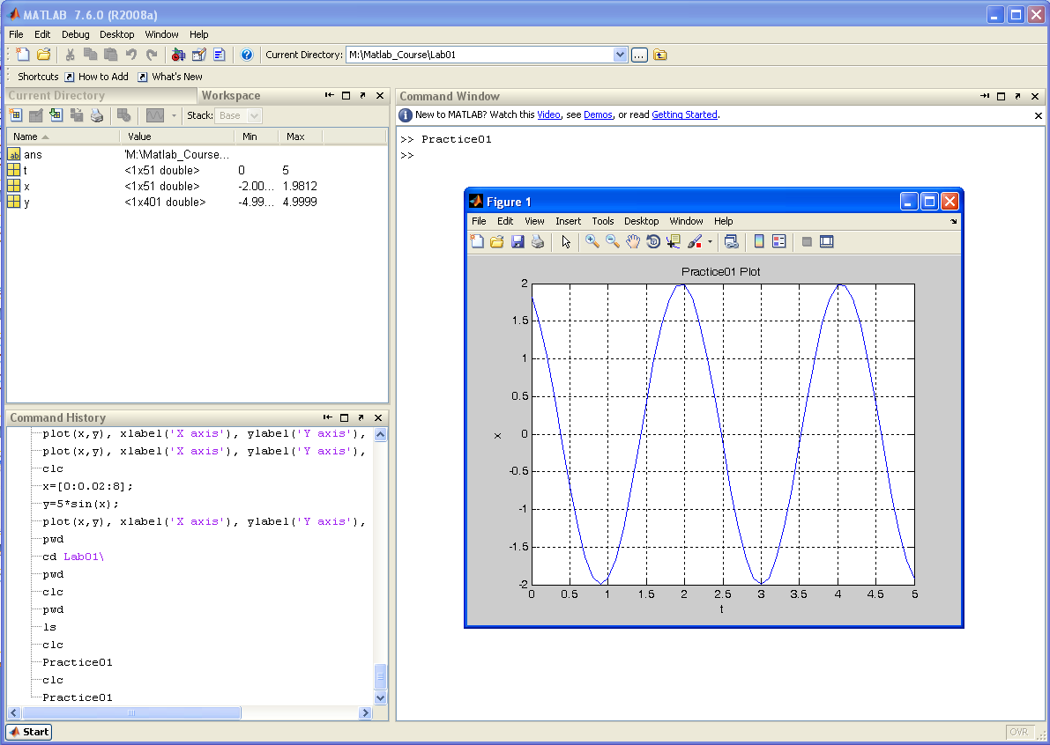
9) Script Files
Script File Example - Now execute the script file by typing “Practice01” at the prompt:

Slide 33
10) Help System
Matlab Help System - You can get help for Matlab in a variety of ways. 1) Help Browser - Launch using the pull-down menus (Help – Product Help) 2) Help Functions - you can type the commands help, lookfor, or doc at the command line to get help ex) >> help plot this will display information on the plot command >> lookfor plot this will display all help documents that contain the word “plot” >> doc plot this will bring up the Help Browser and search for information regarding plot.

Slide 34
Lab 1 Exercise Problems
For each of these exercises, you will create a script file. Your script file will perform the calculations and then display the answers to the workspace.
Create a directory on your Z drive called “Z:\Matlab_Course\Lab01”
Change your pwd to “Z:\Matlab_Course\Lab01” (>> cd Z:\Matlab_Course\Lab01)
Perform the following exercises: 1.2 - Create a script file called Lab01_1d2.m (the “d” stands for dot) - Write the code for each of the parts in this problem (a-d) - Remember that if you put a “;” after a line in your script, it will NOT be echoed to the screen. - Print a comment to the screen for each solution using the command disp. i.e., disp(‘The solution to 1.2(a) is:’) disp(var) 1.5 - Create a script file called Lab01_Prob1d5.m and print each solution to the screen
1.12 - Create a script file called Lab01_Prob1d12.m and print each solution to the screen 1.13 - Create a script file called Lab01_Prob1d13.m and print each solution to the screen 1.21 - Create a script file called Lab01_Prob1d21.m that creates the

