Slide 1
Introduction to Matlab
Module #4 – Programming
Topics
Programming Basics (fprintf, standard input)
Relational Operators
Logical Operators
Conditional Statements (if/then/else, case)
Loops (for, while)
Debugger
Textbook Reading Assignments
4.1-4.9
Practice Problems
Chapter 4 Problems: 17b, 20a, 21a, 23, 24a

Slide 2
1) Programming Basics
Programming in Matlab - Matlab is an interpreted language, which means it does not require compiling. Instead, when a program is executed, it is interpreted line-by-line on the fly. - All structured programs can be created with three main constructs: 1) Sequential Operations - individual tasks that are executed in order 2) Conditional Operations - decisions that are made in the code based on evaluation of variables. The flow of the code execution is altered depending on the evaluations 3) Iterative Operations - program loops that execute over and over or are terminated based on conditional operations. - Using functions for common tasks is a proven technique for making programs easier to develop and debug. - All code should be commented so that others can understand the functionality of your program. - Flow charts and pseudo-code are a good way to design a program.

Slide 3
1) Programming Basics
fprintf command - A more sophisticated technique for printing information is the fprintf command fprintf(‘text’, A, ….) - A set of codes can be used to insert special characters: \n % return \r % beginning of a new line \b % backspace \t % tab ‘’ % Apostrophe \\ % Backslash

Slide 4
1) Programming Basics
fprintf command - Formatted numbers can be printed the expression using the syntax %var - Number formats consists of: # of digits in front of the decimal point # of digits behind the decimal point # type of number format - The available number formats are: e Scientific format with lowercase e E Scientific format with uppercase E f Decimal format g %e or %f, whichever is shorter - Example of a number format for x=1.234567: %6.3f → 1.234 %2.2f → 1.23 - Variable names to be printed are listed in the fprintf statement after the ‘text’ statement and are comma delimited.

Slide 5
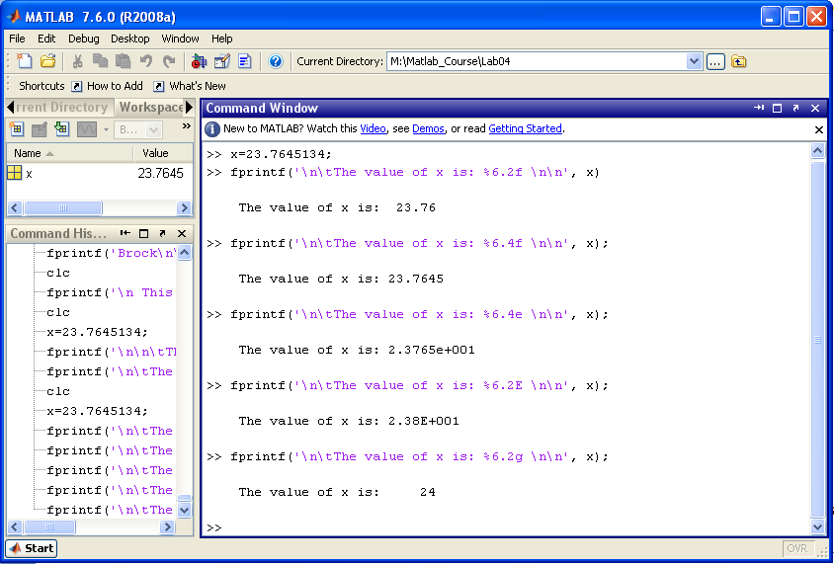
1) Programming Basics
fprintf command examples:

Slide 6
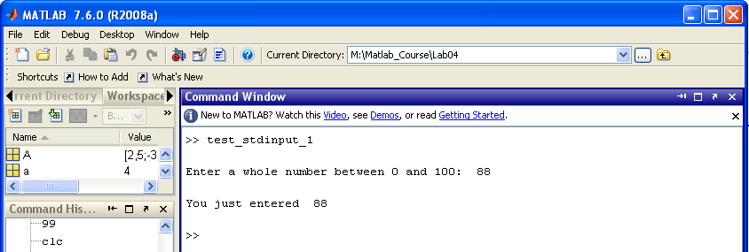
1) Programming Basics
Command line Inputs - Inputs from the command line can be assigned to variables using the input command
test_stdinput_1.m
response = input('\nEnter a whole number between 0 and 100: ');
fprintf('\nYou just entered %3.0f \n', response);

Slide 7
2) Relational Operators
Relational Operators - relational operators compare two values and return a TRUE or FALSE interpretation based on the chosen operator. - Matlab has 6 relational operators Operator Description < Less than <= Less than or equal to > Greater than >= Greater than or equal to == Equal to ~= Not equal to - A TRUE evaluation of these operators is returned as a ‘1’. A FLASE evaluation of these operators is returned as a ‘0’ - The 1’s and 0’s returned from these operators are of the data type logical. This is different from a numeric 1 or 0. - Arrays and Matrices are compared on an element-by-element basis

Slide 8
2) Relational Operators
Relational Operator Examples Scalars Vectors Less Than >> 4 < 6 ans = 1 >> [1,2,3] < [3,2,1] ans = 1 0 0 >> 6 < 4 ans = 0
Less than or equal >> 4 <= 5 ans = 1 >> [1,2,3] <= [3,2,1] ans = 1 1 0 >> 4 <= 4 ans = 1 >> 4 <= 3 ans = 0
Greater than >> 4 > 6 ans = 0 >> [1,2,3] > [3,2,1] ans = 0 0 1 >> 6 > 4 ans = 1
Greater than or equal >> 4 >= 5 ans = 0 >> [1,2,3] >= [3,2,1] ans = 0 1 1 >> 4 >= 4 ans = 1 >> 4 >= 3 ans = 1
Equal to >> 4 == 4 ans = 1 >> [1,2,3] == [3,2,1] ans = 0 1 0 >> 4 == 5 ans = 0 Not Equal to >> 4 ~= 4 ans = 0 >> [1,2,3] ~= [3,2,1] ans = 1 0 1 >> 4 ~= 5 ans = 1

Slide 9
3) Logical Operators
Logical Operators - logical operators perform Boolean operations on an element-by-element basis. - Matlab has 5 logical operators Operator Name Description ~ NOT % Inversion (0→1, 1→0), works on Matrices & AND % Logical AND of operands, works on Matrices | OR % Logical OR of operands, works on Matrices && Short-Circuit AND % Short-circuit AND of operands, only works on Scalars || Short-Circuit OR % Short-circuit OR of operands, only works on Scalars

Slide 10
3) Logical Operators
Logical Operator Examples NOT >> ~0 ans = 1 >> ~1 ans = 0
AND >> 0&0 ans = 0 >> 0&1 ans = 0 >> 1&0 ans = 0 >> 1&1 ans = 1
OR >> 0&0 ans = 0 >> 0&1 ans = 1 >> 1&0 ans = 1 >> 1&1 ans = 1

Slide 11
3) Logical Operators
The “find” function - the “find” function returns the indices of any non-zero elements within an array. Ex) >> y = [ 8 -1 0 3 ] >> find(y) → [ 1 2 4 ] this indicates that elements y(1), y(2), and y(4) are non-zero - this can be useful when using logical arrays
Ex) You wish to find which entries are TRUE and which are false in z = [1 0 0 0 1 ] >> z = [1 0 0 0 1 0] >> find(z) → [1 5] this tells which are 1’s and implies which entries are 0’s

Slide 12
4) Conditional Statements
If statements - these statements allow your program to either execute or skip a set of operations based on the evaluation of a statement. - these statements evaluate a Boolean expression and based on whether it is TRUE or FALSE, will execute specific code segments - the syntax for an if statement is: if logical expression statements % execute this code if the logical expression evaluates to TRUE end - if the “logical expression” evaluates TRUE, then the statements code will be executed. - If the “logical expression” evaluates FALSE, then the statements code will be skipped. - each “if” requires a corresponding “end”.

Slide 13
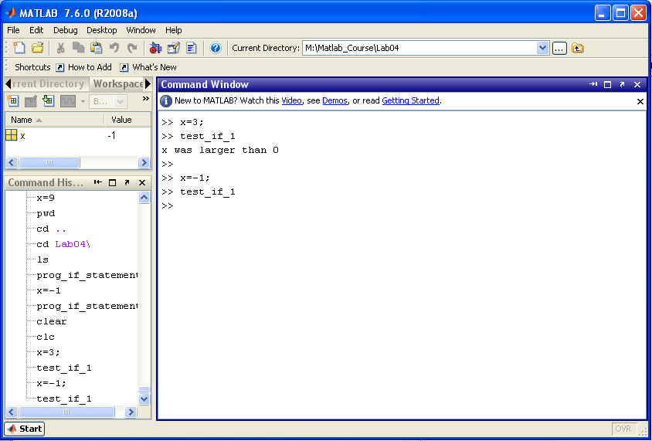
4) Conditional Statements
If statement example
test_if_1.m
if (x > 0)
disp('x was larger than 0');
end
x is initialized to 3. when the program is executed, the logical expression (x>0) evaluated TRUE so the subsequent code was executed.
x is initialized to -1. when the program is executed, the logical expression (x>0) evaluated FALSE so the subsequent code was skipped.

Slide 14
4) Conditional Statements
If-else statements - An “else” clause can be used in conjunction with an if-statement to allow your code to take an action if the first logical expression evaluates to FALSE. - the syntax for an if statement is: if logical expression statements % execute this code if the logical expression evaluates to TRUE else statements % execute this code if the logical expression evaluates to FALSE end - if the “logical expression” evaluates TRUE, then the if-statements code will be executed. - If the “logical expression” evaluates FALSE, then the else-statements code will be executed. - each “if” requires a corresponding “end”.

Slide 15
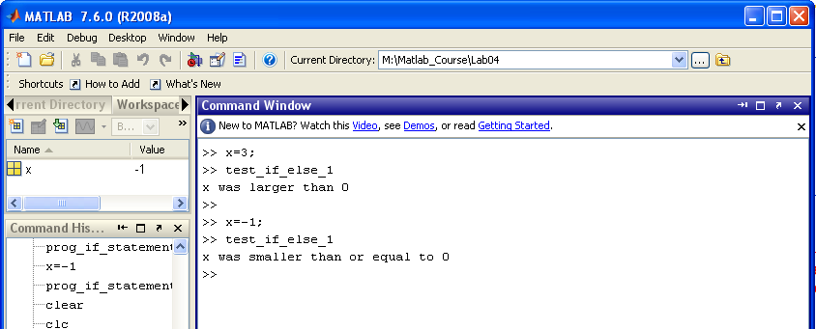
4) Conditional Statements
If-else statement example
test_if_else_1.m
if (x > 0)
disp('x was larger than 0');
else
disp('x was smaller than or equal to 0');
end
x is initialized to 3. when the program is executed, the logical expression (x>0) evaluated TRUE so the if-statement code was executed.
x is initialized to -1. when the program is executed, the logical expression (x>0) evaluated FALSE so the else-statement code was executed.

Slide 16
4) Conditional Statements
If-elseif statements - An “elseif” clause can also be included to give multiple logical evaluations within a single if-statement. - The if, elseif, … statements are evaluated in sequence. The first logical evaluation of TRUE will result in the corresponding code to be executed. All other code in the if-statement will be skipped. - the syntax for an if statement is: if logical expression statements % execute this code if the above logical expression evaluates to TRUE elseif logical expression statements % execute this code if the above logical expression evaluates to TRUE : : : else statements % execute this code if none of the above logical expressions evaluated to TRUE end

Slide 17
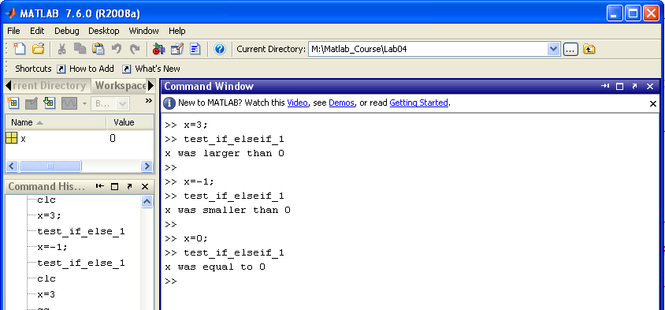
4) Conditional Statements
If-elseif statement example
test_if_elseif_1.m
if (x > 0)
disp('x was larger than 0');
elseif (x < 0)
disp('x was smaller than 0');
else
disp('x was smaller than or equal to 0');
end
x is initialized to 3. when the program is executed, the logical expression (x>0) evaluated TRUE so the if-statement code was executed.
x is initialized to -1. when the program is executed, the logical expression (x<0) evaluated TRUE so the elseif-statement code was executed.
x is initialized to 0. when the program is executed, neither the (x>0) or (x<0) logical expressions evaluated TRUE so the else-statement code was executed.

Slide 18
4) Conditional Statements
Case statements (or switch statements) - A Case statement is a list of logical expressions. - Each expression is evaluated in turn for a given input variable. - If an expression evaluates TRUE, the corresponding code statements will be executed. - the syntax for a case statement is: switch input expression case value1 statements % execute this code if the input is equal to this case case value2 statements % execute this code if the input is equal to this case : : otherwise statements % execute this code if none of the above cases evaluate to TRUE end

Slide 19
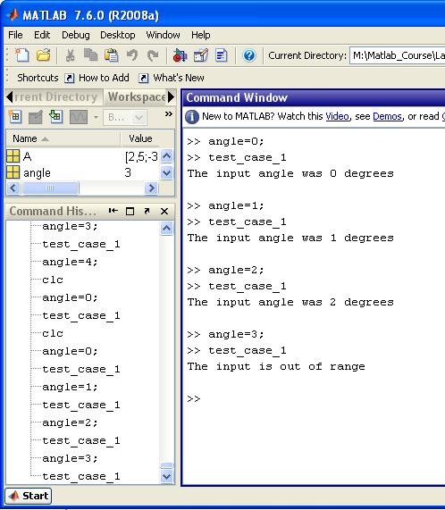
4) Conditional Statements
Case statement example
test_case_1.m
switch (angle)
case (0)
fprintf('The input angle was 0 degrees \n');
case (1)
fprintf('The input angle was 1 degrees \n');
case (2)
fprintf('The input angle was 2 degrees \n');
otherwise
fprintf('The input is out of range\n');
end

Slide 20
5) Loops
Program Loops - Program loops allow you to repeatedly execute a section of code. - There area different types of loops that have different functionality For Loop - executes a segment of code a predefined # of times While Loop - executes a segment of code while a logical expression is TRUE

Slide 21
5) Loops
For Loops - A for loop uses a loop variable to count the number of times it will execute. - You can specify the start, stop, and step size of the loop variable in addition to its name. - The loop variable will increment/decrement by the step-size each time the loop is executed. - The loop will continue to execute until the current loop variable reaches the stop value. Syntax: for loop_variable = m:s:n statements end - in this code: m = the initial value of the loop variable n = the final value of the loop variable s = the step size that the loop variable will increment by each time the loop is executed

Slide 22
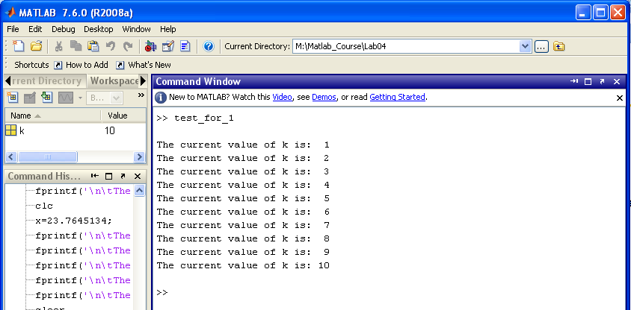
5) Loops
For Loop example - let’s create a loop variable called ‘k’ - let’s create a for loop that will start k at 1, increment it by 1, and loop until k reaches 10 (m:s:n = 1:1:10) - each time through the loop, let’s use the fprintf statement to print the value of the loop variable.
test_for_1.m
for (k = 1:1:10)
fprintf('The current value of k is: %2.0f \n', k);
end

Slide 23
5) Loops
For Loops - For loops are good for addressing arrays. - For loops can be nested to create two loop variables that can be used as the index for an array Syntax: for loop_variable1 = m:s:n for loop_variable2 = m:s:n statements end end

Slide 24
5) Loops
Nested For Loop example - let’s use two nested For loops to write the contents of a 3x2 array - let’s call the row variable m - let’s call the column variable n
n
m
test_for_nested_1.m
A = [2,5; -3,4; -7,1];
for (m = 1:1:3)
for (n = 1:1:2)
fprintf('The value of a%1.0f%1.0f is: %2.0f \n', m, n, A(m,n) );
end
end

Slide 25
5) Loops
While Loops - A while loop will continually execute as long as a logical expression evaluates TRUE Syntax: while logical_expression statements end - if the logical_expression evaluates TRUE, the loop will execute. - if the logical_expression evaluates FALASE, the loop will NOT execute.

Slide 26
5) Loops
While loop example - we will initialize x =2; - in our while loop, we square x and print the new value - we will continue this until the new value of x is greater than 500.
test_while_1.m
x = 2;
while (x < 500)
x = x^2;
fprintf('The value of x after squaring is: %3.0f \n', x);
end

Slide 27
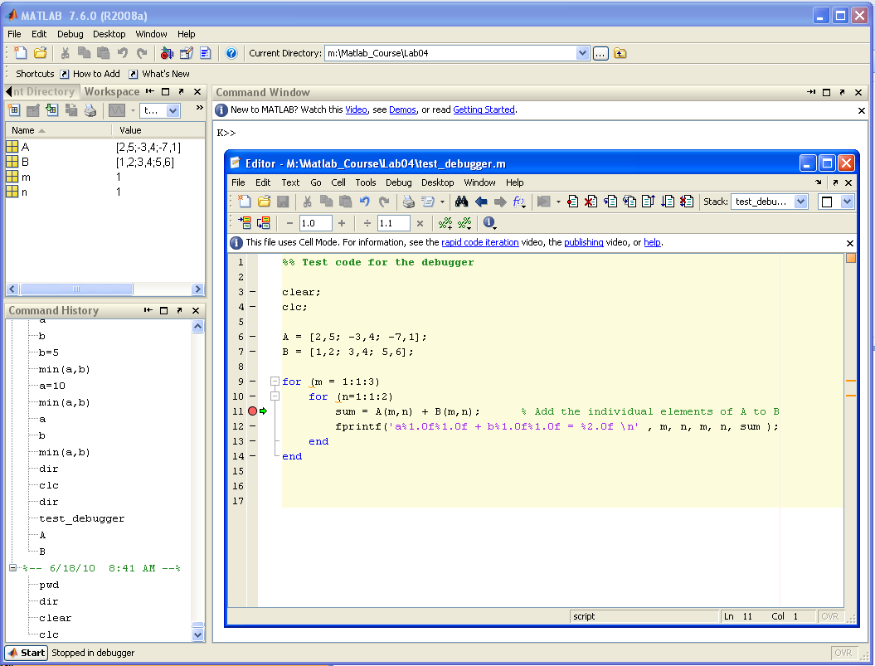
6) Debugger
Debugger - There is a built-in debugger in the Matlab text editor - A debugger allows you to set breakpoints and step through your code while you observe the contents of variables.
Current variable values are observed in the Workspace
The menu allows you to: - Set Breakpoints - Remove Breakpoints - Step - Step Into - Continue
Indicates location of Breakpoints
Indicates current location of code execution

Slide 28
Lab 4 Exercise Problems
For each of these exercises, you will create a script file. Your script file will perform the calculations and then display the answers to the workspace.
Create a directory on your Z drive called “Z:\Matlab_Course\Lab04”
Change your pwd to “Z:\Matlab_Course\Lab04” (>> cd Z:\Matlab_Course\Lab04)
Perform the following exercises: Ch4: 17b, 20a, 21a, 23, 24a

