Slide 1
Introduction to Matlab
Module #5 – Advanced Plotting
Topics
Plot Options (subplots, overlays, legends, datapoints)
Polar Plots
3D Plots (plot3, mesh)
Textbook Reading Assignments
5.1-5.9
Practice Problems
Chapter 5 Problems: 5.49

Slide 2
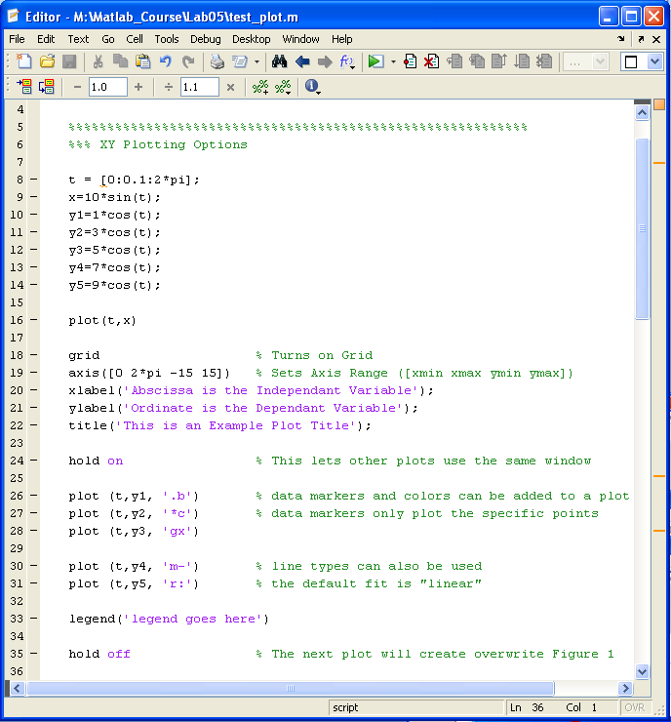
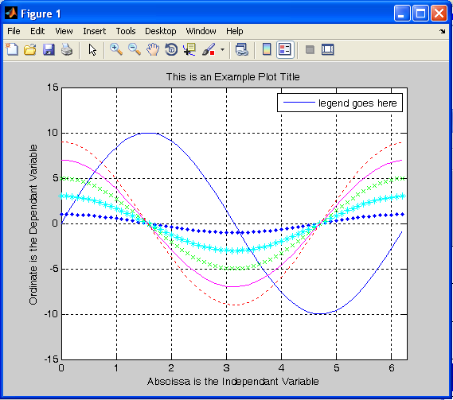
1) Plot Options
XY Plot Options

Slide 3
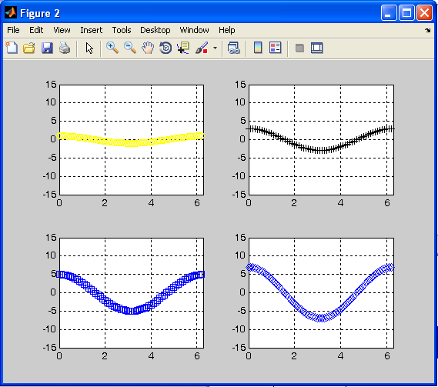
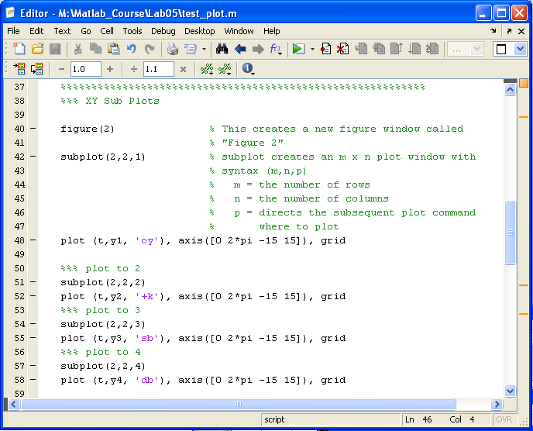
1) Plot Options
Sub Plots

Slide 4
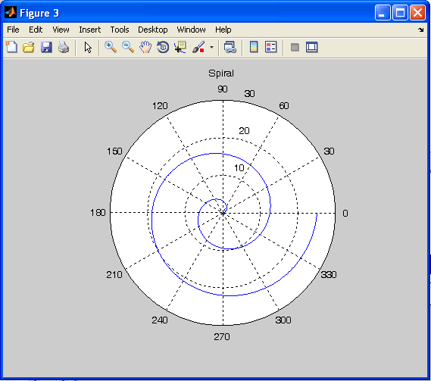
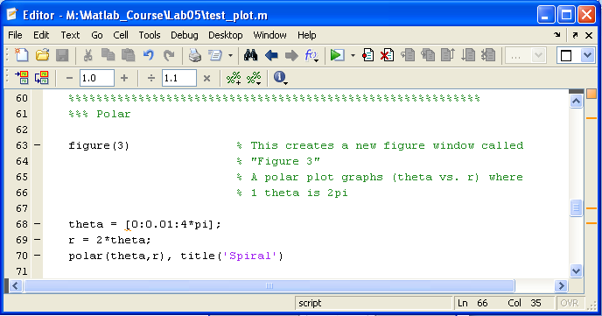
2) Polar Plots
Polar Plots

Slide 5
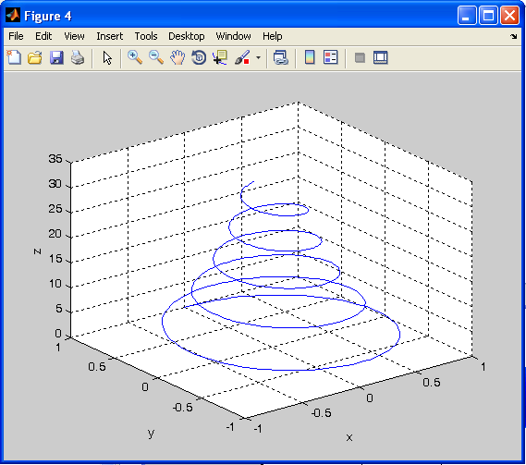
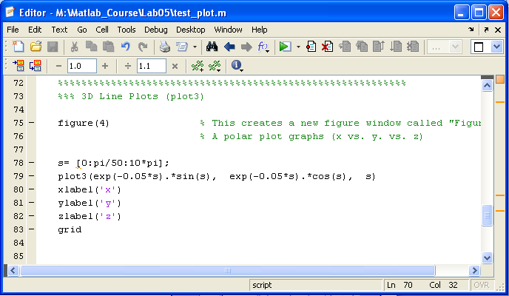
3) 3D Plots
3D Line Plots

Slide 6
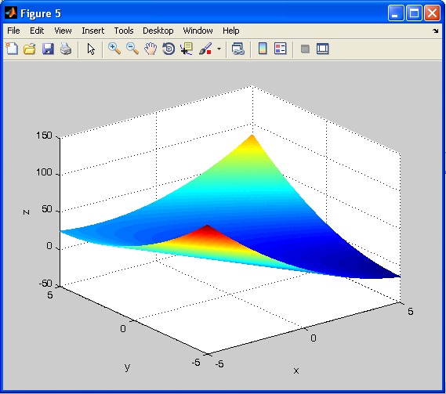
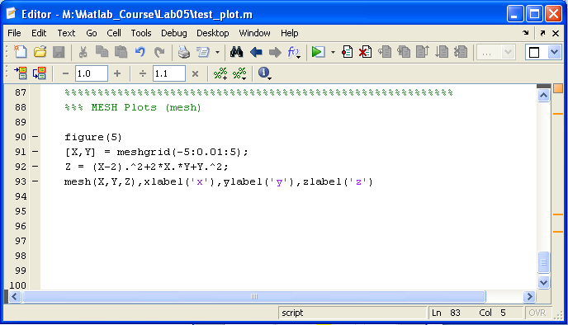
3) 3D Plots
3D Mesh

Slide 7
Lab 5 Exercise Problems
For each of these exercises, you will create a script file. Your script file will perform the calculations and then display the answers to the workspace.
Create a directory on your Z drive called “Z:\Matlab_Course\Lab05”
Change your pwd to “Z:\Matlab_Course\Lab05” (>> cd Z:\Matlab_Course\Lab05)
Perform the following exercises: Ch5: 49 Consider using a for loop to perform each evaluation of b and to create three plots on a a 1x3 subplot window.

