Slide 1
Introduction to Matlab
Module #7 – Statistics
Topics
Statistics
Histograms & Bar Plots
Scaled Histograms / Probability
Textbook Reading Assignments
7.1-7.2
Practice Problems
Chapter 7 Problems: 7.1, 7.2

Slide 2
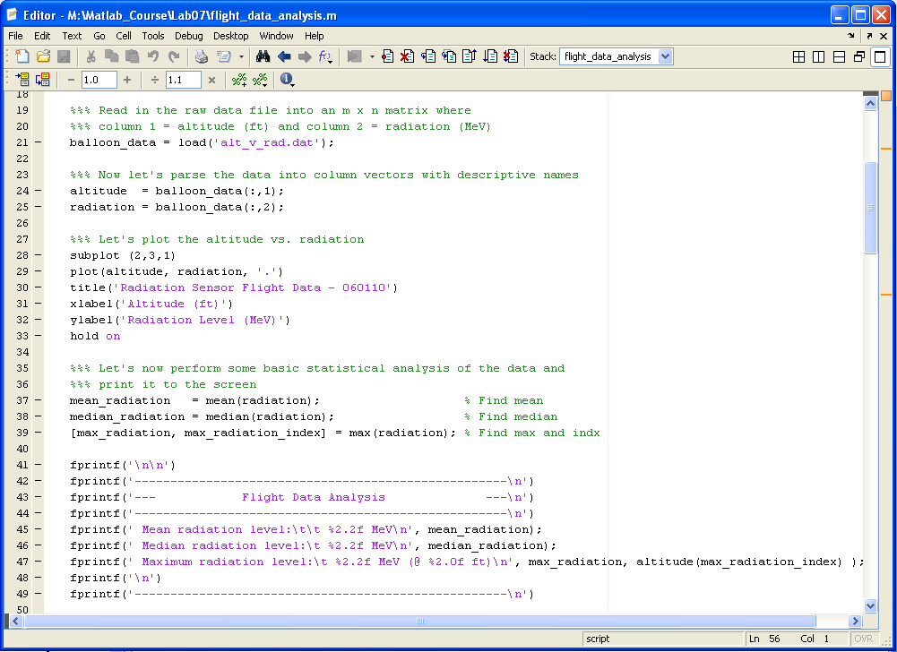
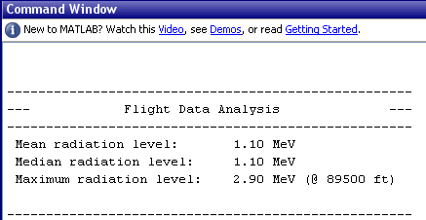
1) Statistics
Basic Statistic Commands Exist in Matlab (min, max, mean, median)

Slide 3
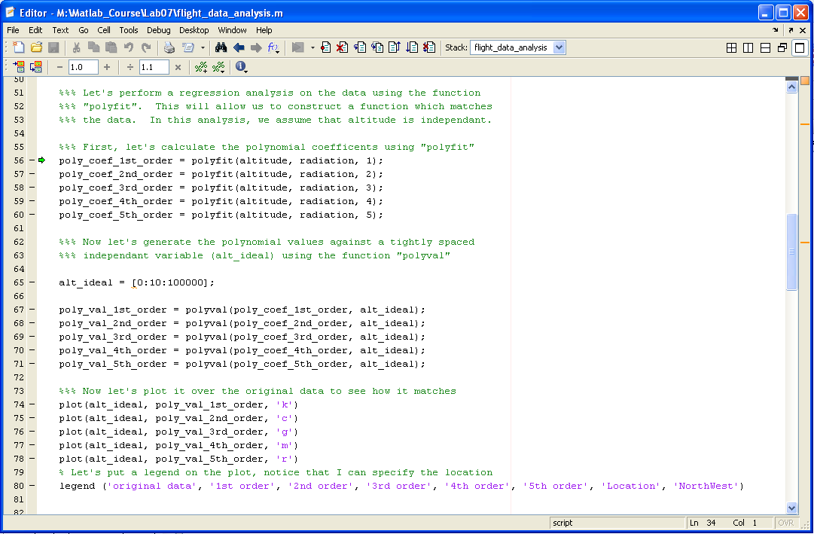
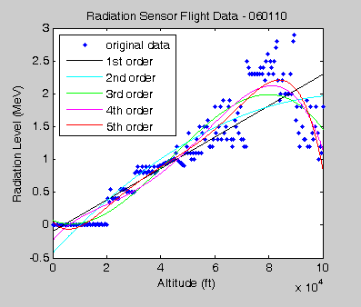
1) Statistics
Regression Analysis (polyfit, polyval)

Slide 4
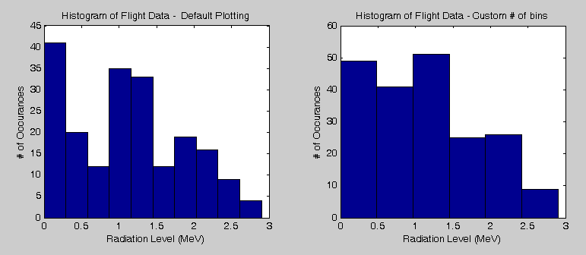
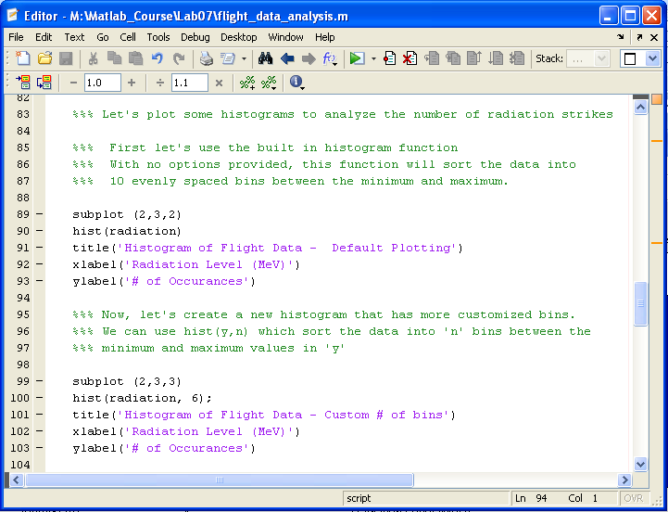
2) Histograms & Bar Plots
Histograms ( hist(y), hist(y,n) )

Slide 5
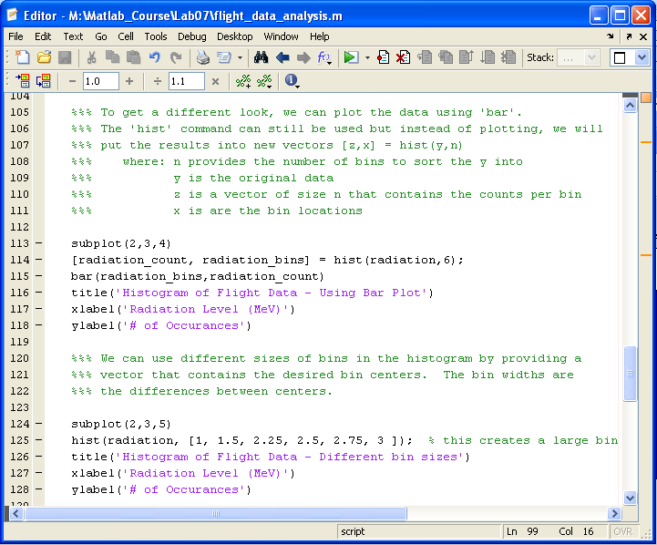
2) Histograms & Bar Plots
Histograms & Bar Plots (hist(y,n), bar(x,y) )

Slide 6
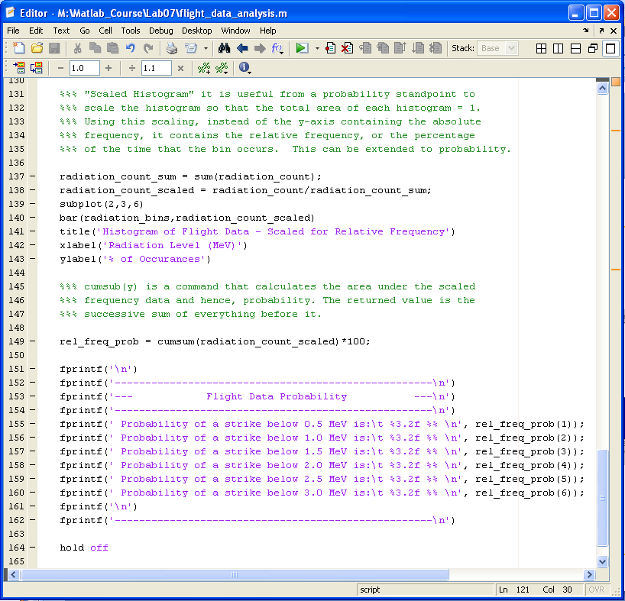
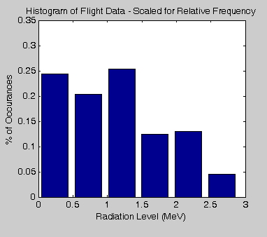
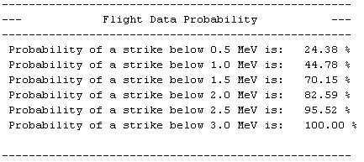
3) Scaled Histograms & Probability
Histograms & Bar Plots (hist(y,n), bar(x,y) )

Slide 7
3) Histograms / Bar Plots
Scaled Histograms (cumsum(x))

