Slide 1
Introduction to Matlab
Module #8 – Animation
Topics
getframe
pause
Plotting a set of files
Textbook Reading Assignments
Appendix B
Practice Problems
Create an animation of a sine wave with the phase varying from 0 to 2π

Slide 2
1) getframe
Animation using ‘getframe’
- ‘getframe’ is a command which will store the current plot. - this can be used in a for loop to construct an array that contains a sequence of plots. - by varying the equation being plotted in the same for loop, getframe creates a movie clip - the movie is played using >> movie(M) where M is the variable which stores the plots as an array.

Slide 3
2) pause
Animation using ‘pause’
- ‘pause’ is a command which will delay Matlab for a specied amount of time >> pause(s) % where s is seconds (i.e., pause(0.05) - this command can be used to continually plot to the same figure with a delay between plots - this is typically used in a for loop

Slide 4
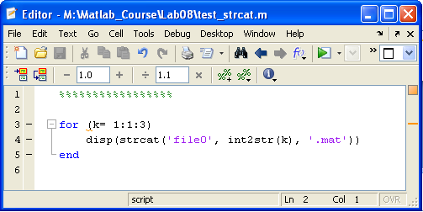
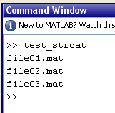
3) Plotting a Set of Files
Opening a set of files
- Often it is necessary to open and plot a large set of files that contain the data you are after.
- If the filenames have a numerical pattern (i.e, file01.mat, file02.mat, file03.mat), you can use a for loop and the command strcat - strcat will create a string by concatenate the arguments. The arguments can contain variables. - Variables can be converted to a type string using int2str

