Slide 1
Introduction to Matlab
Module #10 – Creating Graphical User Interfaces
Topics
Overview of GUI Development using GUIDE (GUI Development Environment)
Designing a GUI
Reading Assignments
Intro to GUI Programming in Matlab – by UAE University (on website)
Practice Problems
Make a GUI that will plot the sum of two functions entered in a textbox

Slide 2
1) Overview of GUI Development with GUIDE
GUI Overview
- There are three elements to a Matlab GUI 1) Components These are the graphical items in the GUI such as buttons, text boxes radio buttons, menus, etc… These are how the user interracts with the GUI and enters information 2) Figures Components exist within a figure. The figure is a box that can hold one or more components. These can be thought of as windows or subwindows. 3) Callbacks This is the code that is performed when a user clicks on a component. The callback is the operation that will be performed for each component that the user may access.

Slide 3
1) Overview of GUI Development with GUIDE
GUIDE
- GUIDE is the tool that allows you to graphically create and layout a GUI. - When you layout your GUI and save it within GUIDE, two files are created. A fig file which will launch the GUI when executed and a M-file which contains the code for each callback that will be ran when a component is accessed. - The first time you enter a component in the layout and save it, GUIDE creates a skeleton M-file in which you enter the functionality that you want for each callback.

Slide 4
1) Overview of GUI Development with GUIDE
Overview of GUI Design Process
1) Decide on the design of the GUI - graphical layout - functionality of each component 2) Use GUIDE to layout the components on a figure 3) Use the Property Inspector within GUIDE to assign a tag to each component. The tag is a unique identifier for each component and will be used to set the individual properties. 4) Save the GUI in GUIDE creating two files - fig file: This contains the actual GUI layout - M-file: This is a skeleton Matlab script that will contain the callback code 5) Write the code to implement the behavior associated with each callback function.

Slide 5
2) Designing a GUI
Step 1 – Deciding on a Design
- Let’s create a GUI that will plot y = mx + b and the user can enter the parameters (End Time, m, and b) - First, let’s sketch the layout we want:
End Time
Enter End Time
Plot Window
m
Enter m
b
Enter b
Push Button

Slide 6
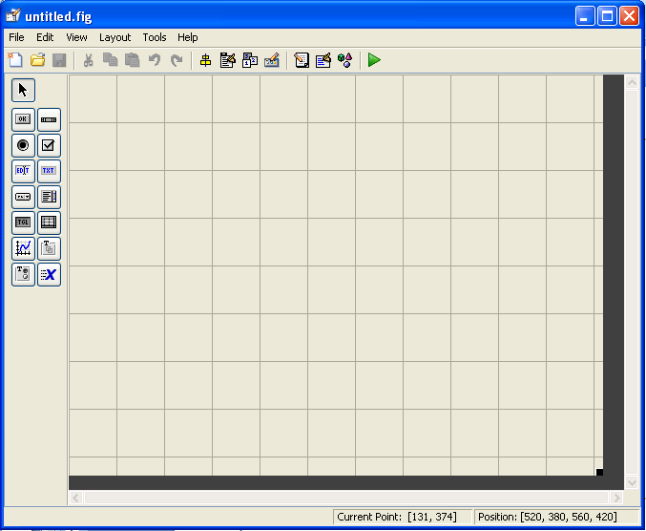
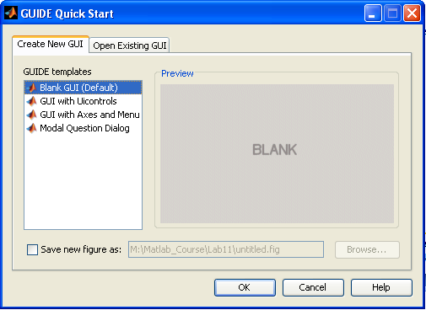
2) Designing a GUI
Step 2 – Use GUIDE to layout the window
- Start GUIDE typing guide at the prompt in Matlab
- Select “Blank GUI” and click “OK”

Slide 7
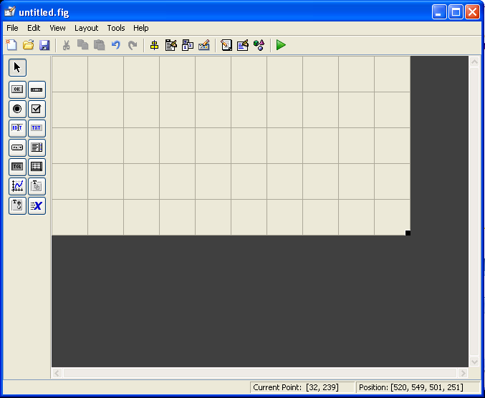
2) Designing a GUI
Step 2 – Use GUIDE to layout the window cont…
- Set the size of the layout window. This will be the default size of the window when the GUI is launched. - This is done by dragging the corners of the gridded square in GUIDE. The gridded rectangle is the GUI window that will be created.

Slide 8
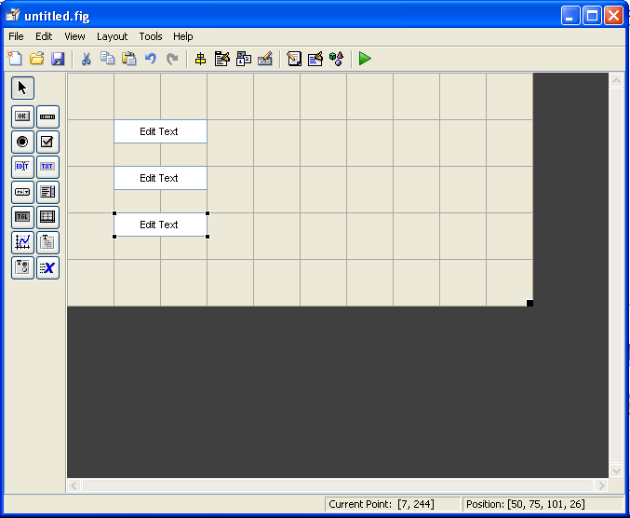
2) Designing a GUI
Step 2 – Use GUIDE to layout the window cont…
- Enter three “Edit Text” boxes by clicking on the icons on the left. Once you click the icon, click in the layout window. You can reposition and resize the fields by dragging the corners of the box. - These are where the user will enter the time range and two functions to be added.

Slide 9
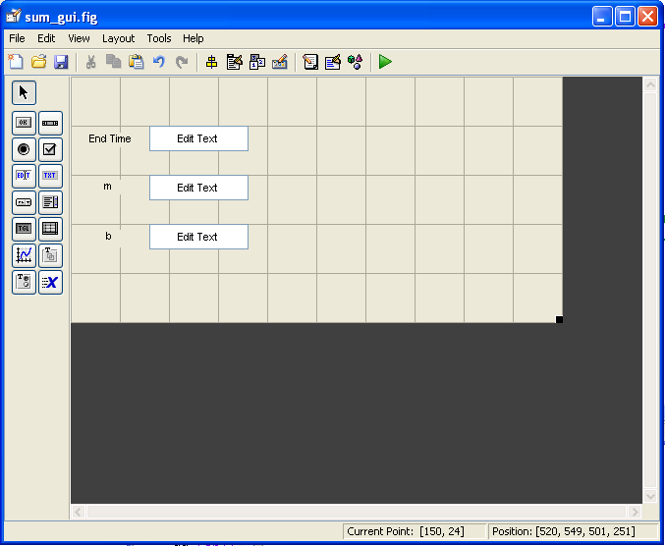
2) Designing a GUI
Step 2 – Use GUIDE to layout the window cont…
- Enter three “Static Text” boxes using the icons the left. Once you click the icon, click in the layout window. You can reposition and resize the fields by dragging the corners of the box. - Double Click on each Static Text box to launch the Inspector dialog. In this window, edit the string value for each text string to give a description of each box

Slide 10
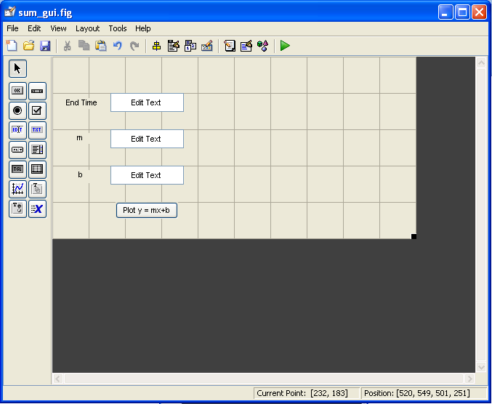
2) Designing a GUI
Step 2 – Use GUIDE to layout the window cont…
- Enter a push button using the icons on the left. - Use the Inspector dialog to give the button the text “Plot y = mx + b”

Slide 11
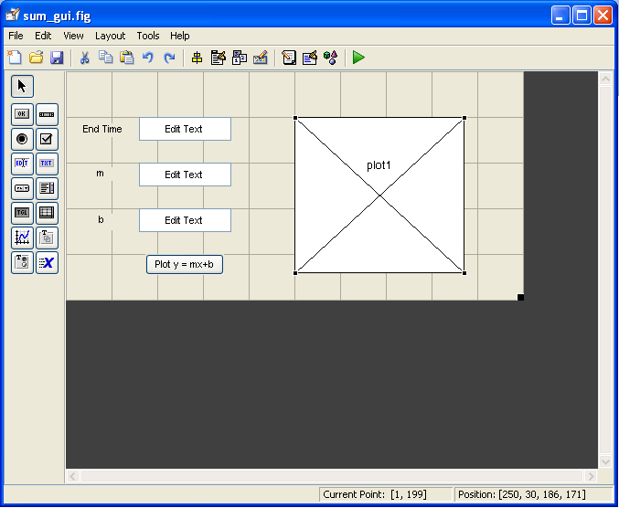
2) Designing a GUI
Step 2 – Use GUIDE to layout the window cont…
- Enter an axis using the icons on the left.

Slide 12
2) Designing a GUI
Step 3 – Assign tags using the Property Inspector
- Double Click on each component that will need a call back and assign the property for the tab tag suggestions: time_field function_field1 function_field2 pushbutton1 plot1

Slide 13
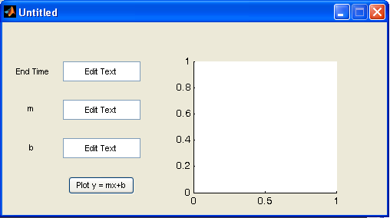
2) Designing a GUI
Step 4 – Save the GUI
- Click the Save button in GUIDE - give the name “sum_gui.fig” - This creates two files: sum_gui.fig - contains the window layout information sum_gui.m - contains the code for your callbacks. - Start the GUI by typing the name at the prompt in Matlab >> sum_gui

Slide 14
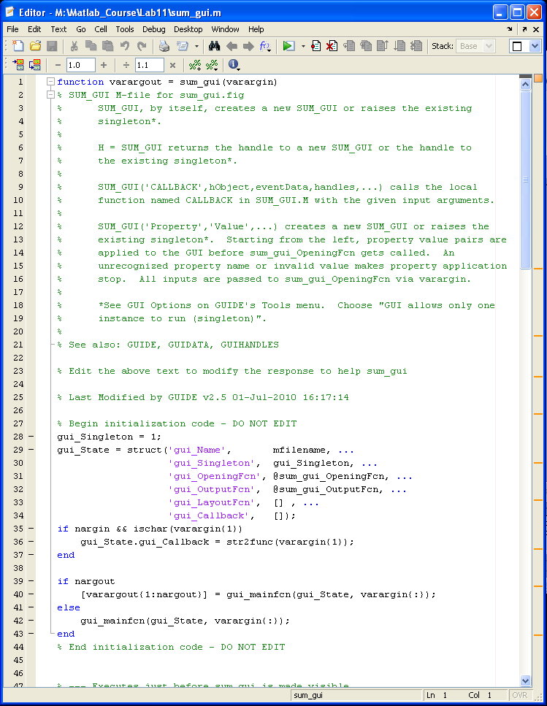
2) Designing a GUI
Step 5 – Write the code for the callbacks
- The GUI at this point does not know what to do when a user accesses the components. - We need to enter code in the sum_gui.m file for each action within the gui. - The skeleton M-file is pre-populated with the names of the component tags

Slide 15
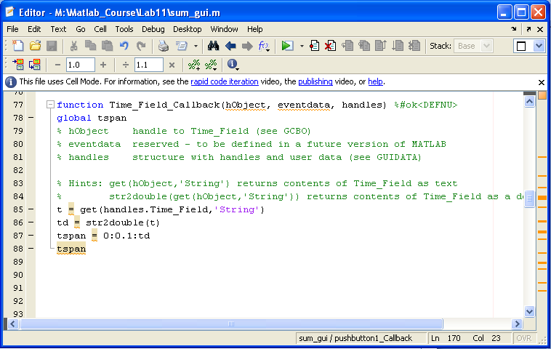
2) Designing a GUI
Step 5 – Write the code for the callbacks
- Let’s start by reading the end time that the user enters. We need to use the get command to bring in the information and assign it to a variable. The information is brought in as a string so we need to convert it using the str2double command. - Also note that we can visibility of our final time vector to other functions using the global command.

Slide 16
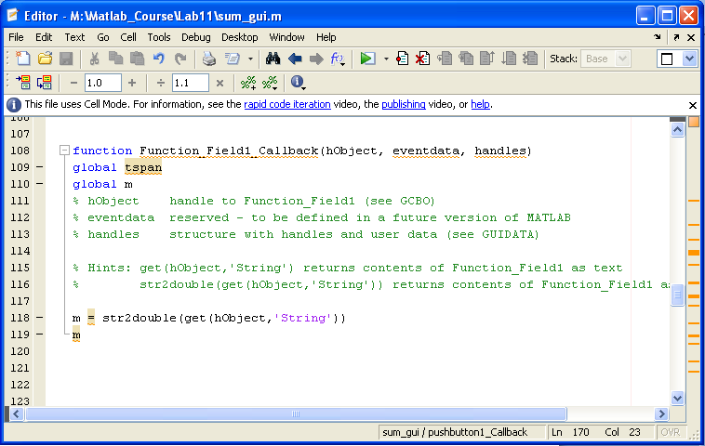
2) Designing a GUI
Step 5 – Write the code for the callbacks
- Now let’s read in m. We can combine the get and str2double into one line of code

Slide 17
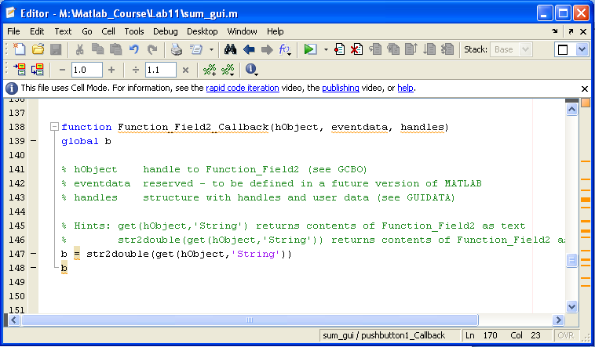
2) Designing a GUI
Step 5 – Write the code for the callbacks
- Now let’s read in b

Slide 18
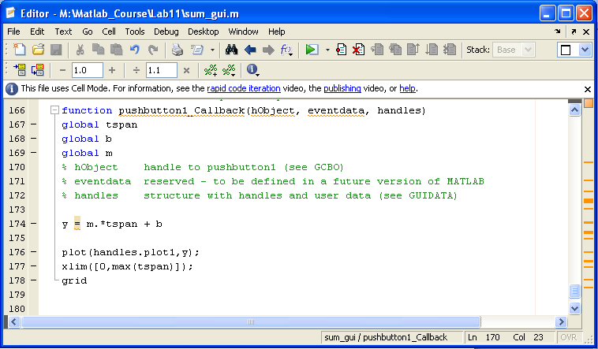
2) Designing a GUI
Step 5 – Write the code for the callbacks
- Now let’s write the plot code. We address the plot1 component using the handle.tagname argument

Slide 19
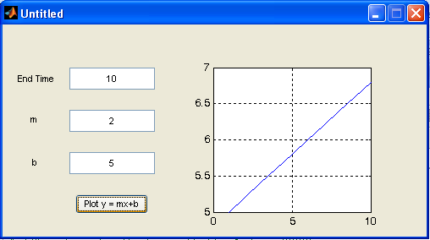
2) Designing a GUI
Test your Code

