Slide 1
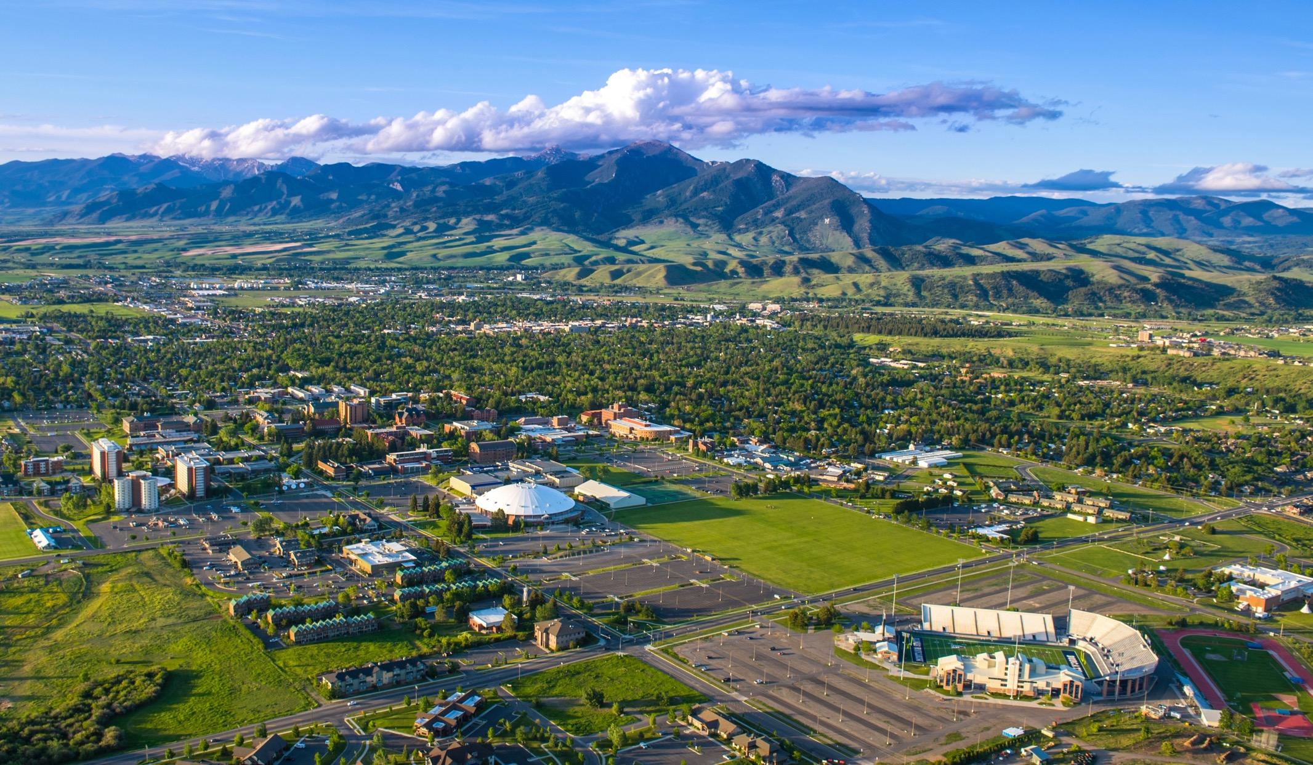
Montana State University
Bozeman, Montana

Slide 2
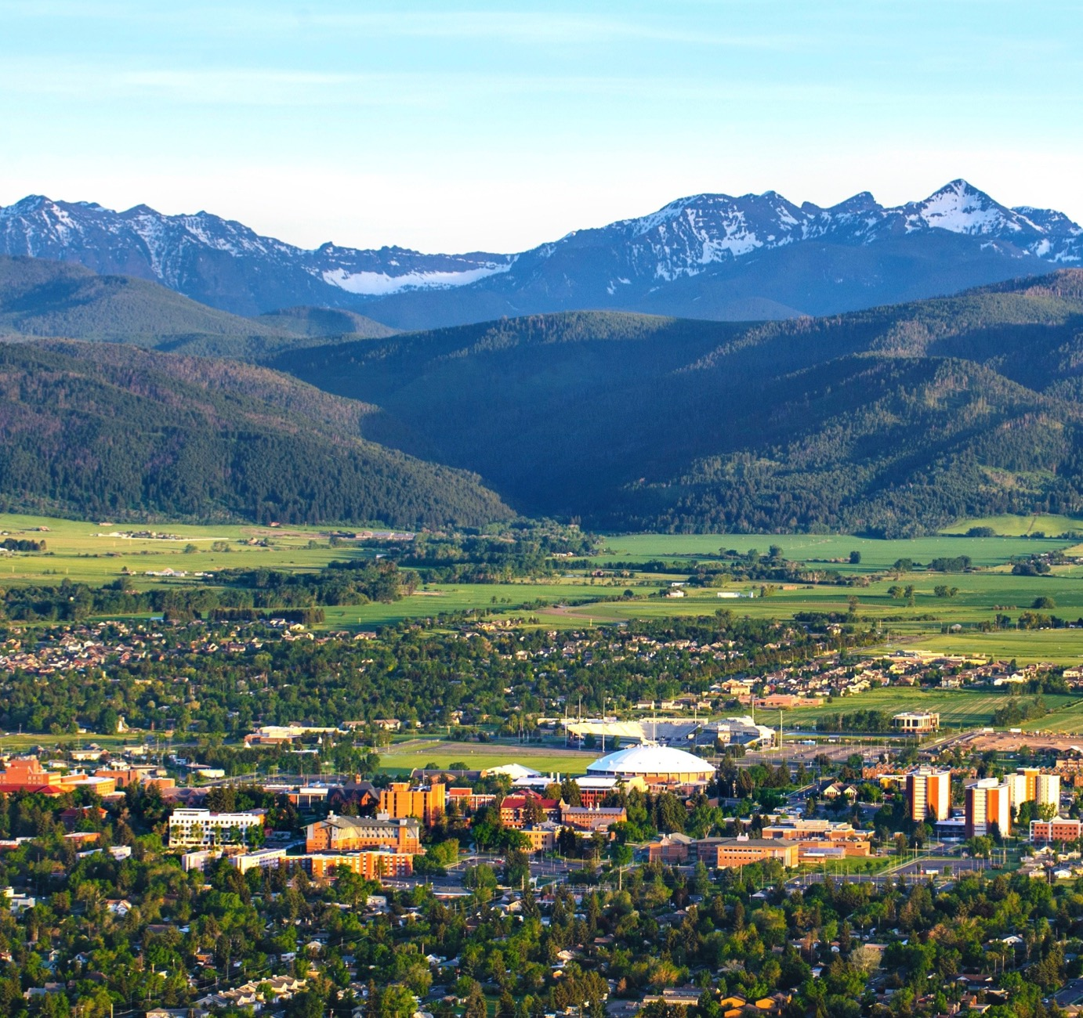
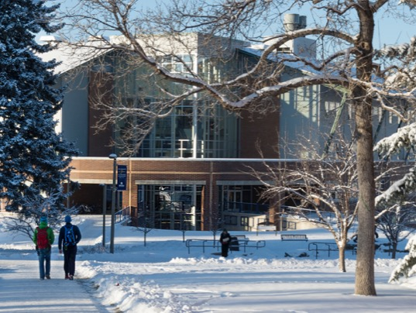

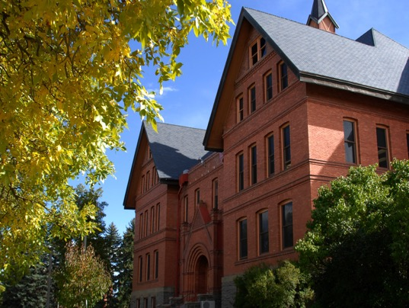
Montana State University and the peaks of the Gallatin Range

Slide 3
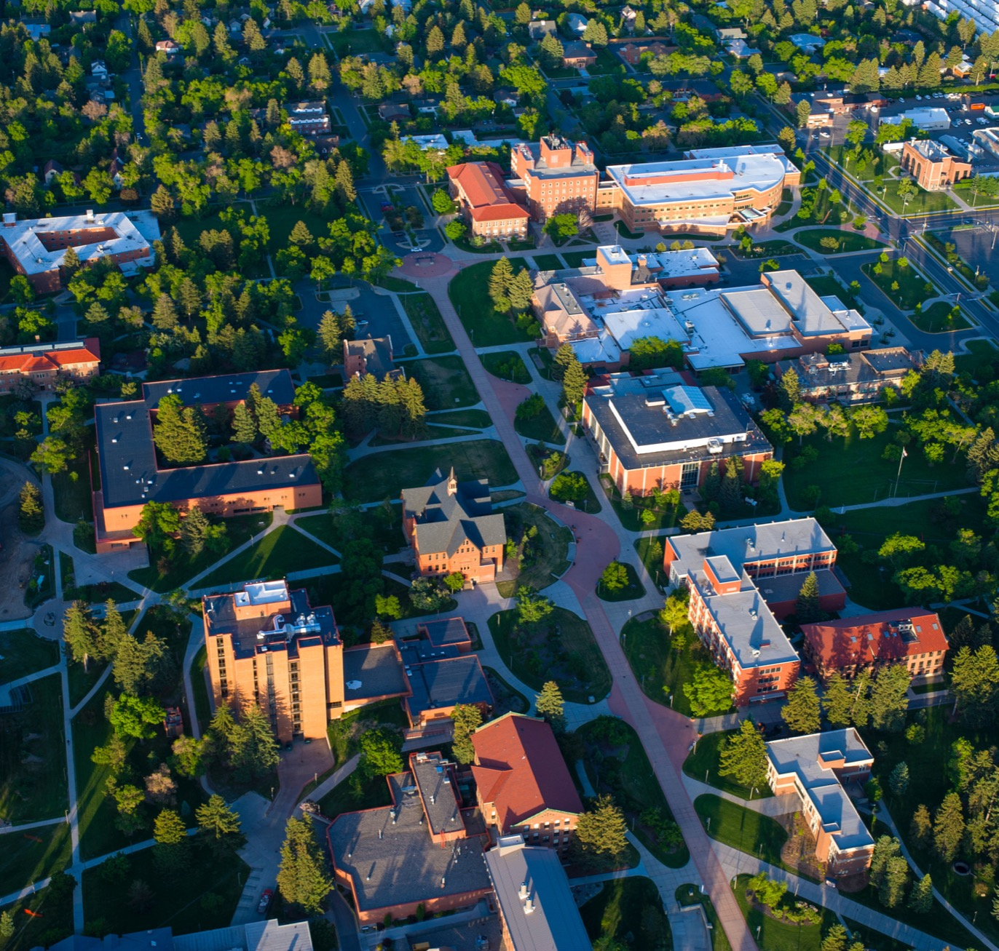
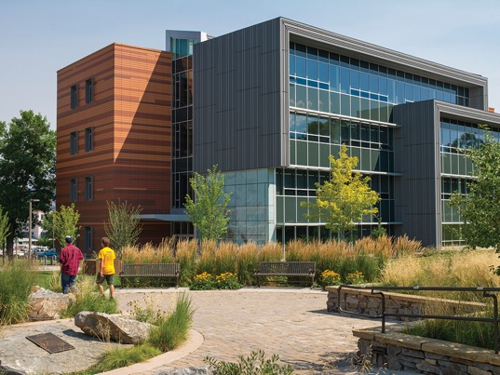
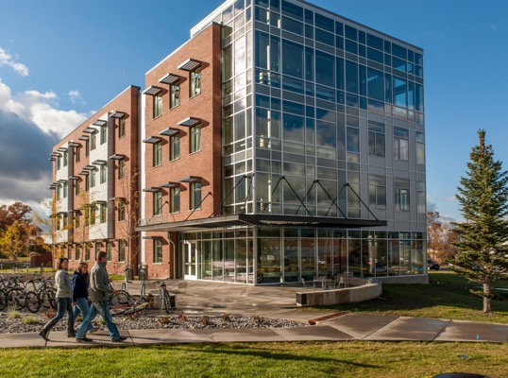
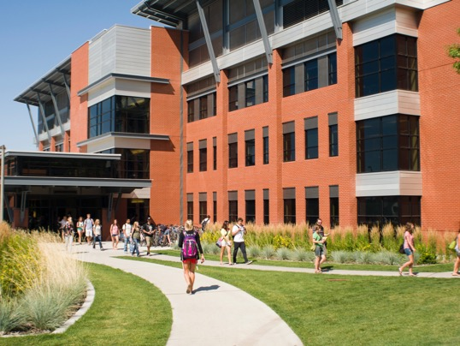
Montana State University’s campus

Slide 4
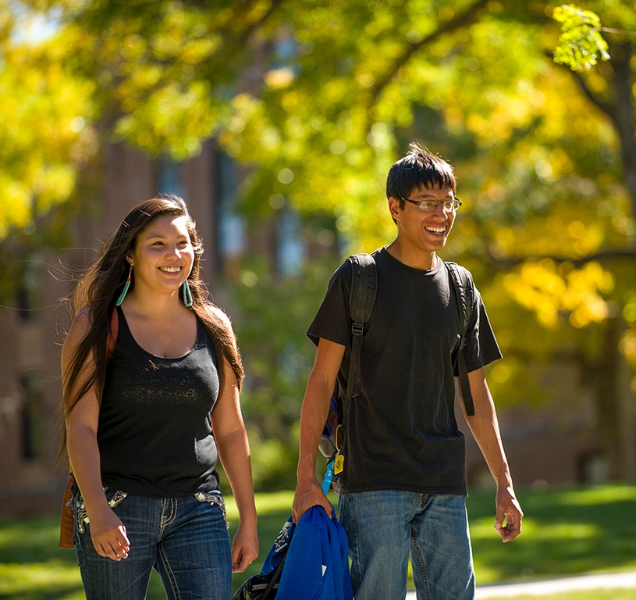
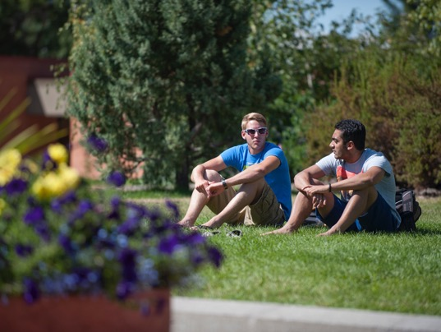
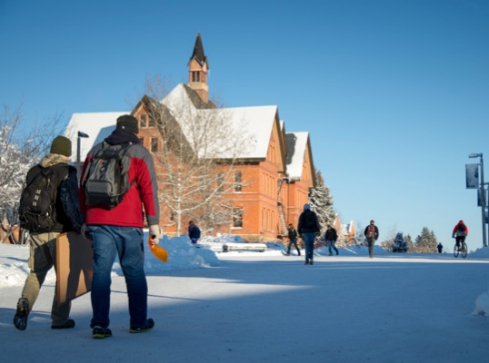
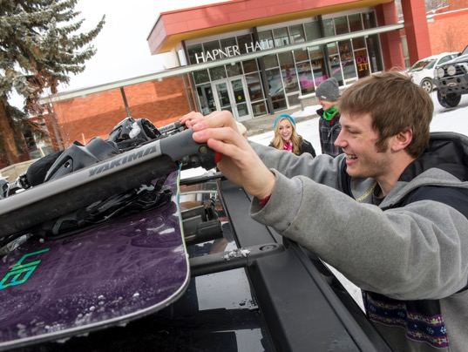
The MSU campus throughout the year.

Slide 5

MSU is:
Among the top 3 percent of colleges or universities in the nation for research expenditures.
A major research university with a unique focus on undergraduate research and creative projects.
The only university of its kind with unparalleled access to outdoor adventure and discovery.

Slide 6

MSU Facts & Stats
Enrollment FALL 2016

Slide 7

Academic Excellence
Students conduct cutting-edge research.

Slide 8
MSU Facts & Stats
Enrollment by College FALL 2016

Slide 9

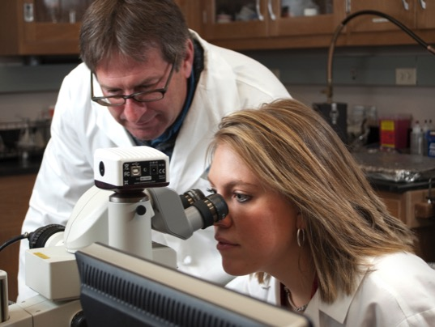
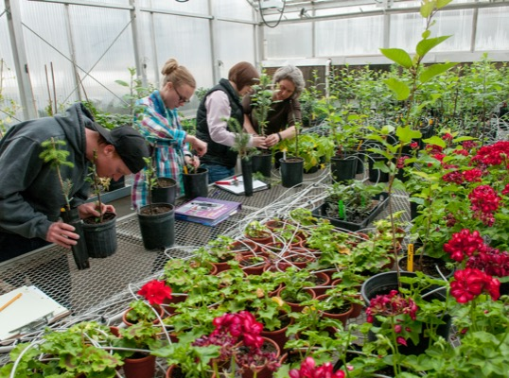

Choose from more than 225 academic programs and options.

Slide 10
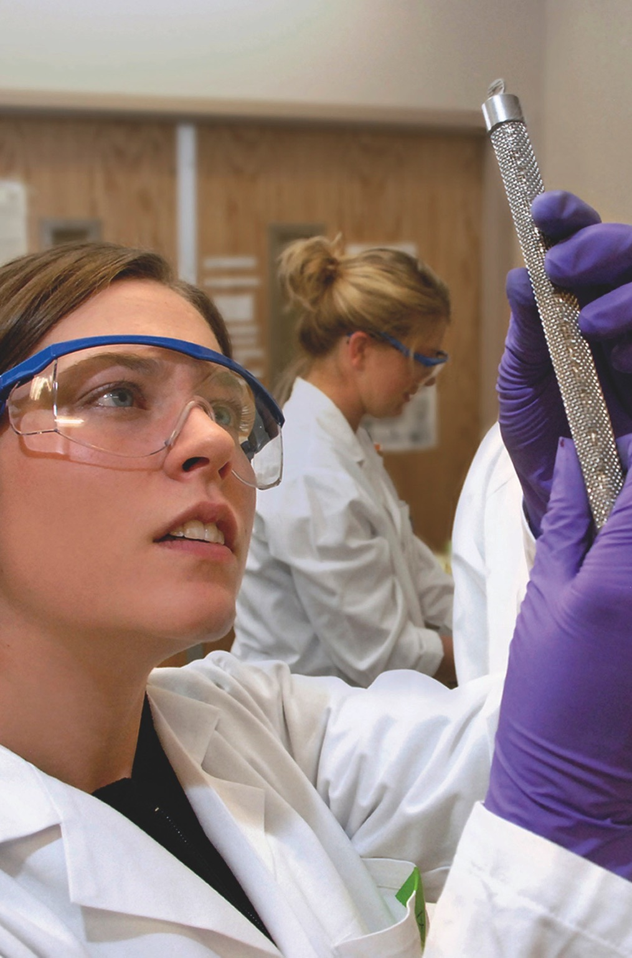
Top-Tier Research
Montana State University is among the top 3 percent of colleges or universities in the nation for research expenditures.
It is Montana’s largest research enterprise, conducting more than $100 million in research annually.
Research takes place in 44 research centers and 25 labs on campus.

Slide 11
MSU Facts & Stats
Academic Achievement
FALL 2016

Slide 12
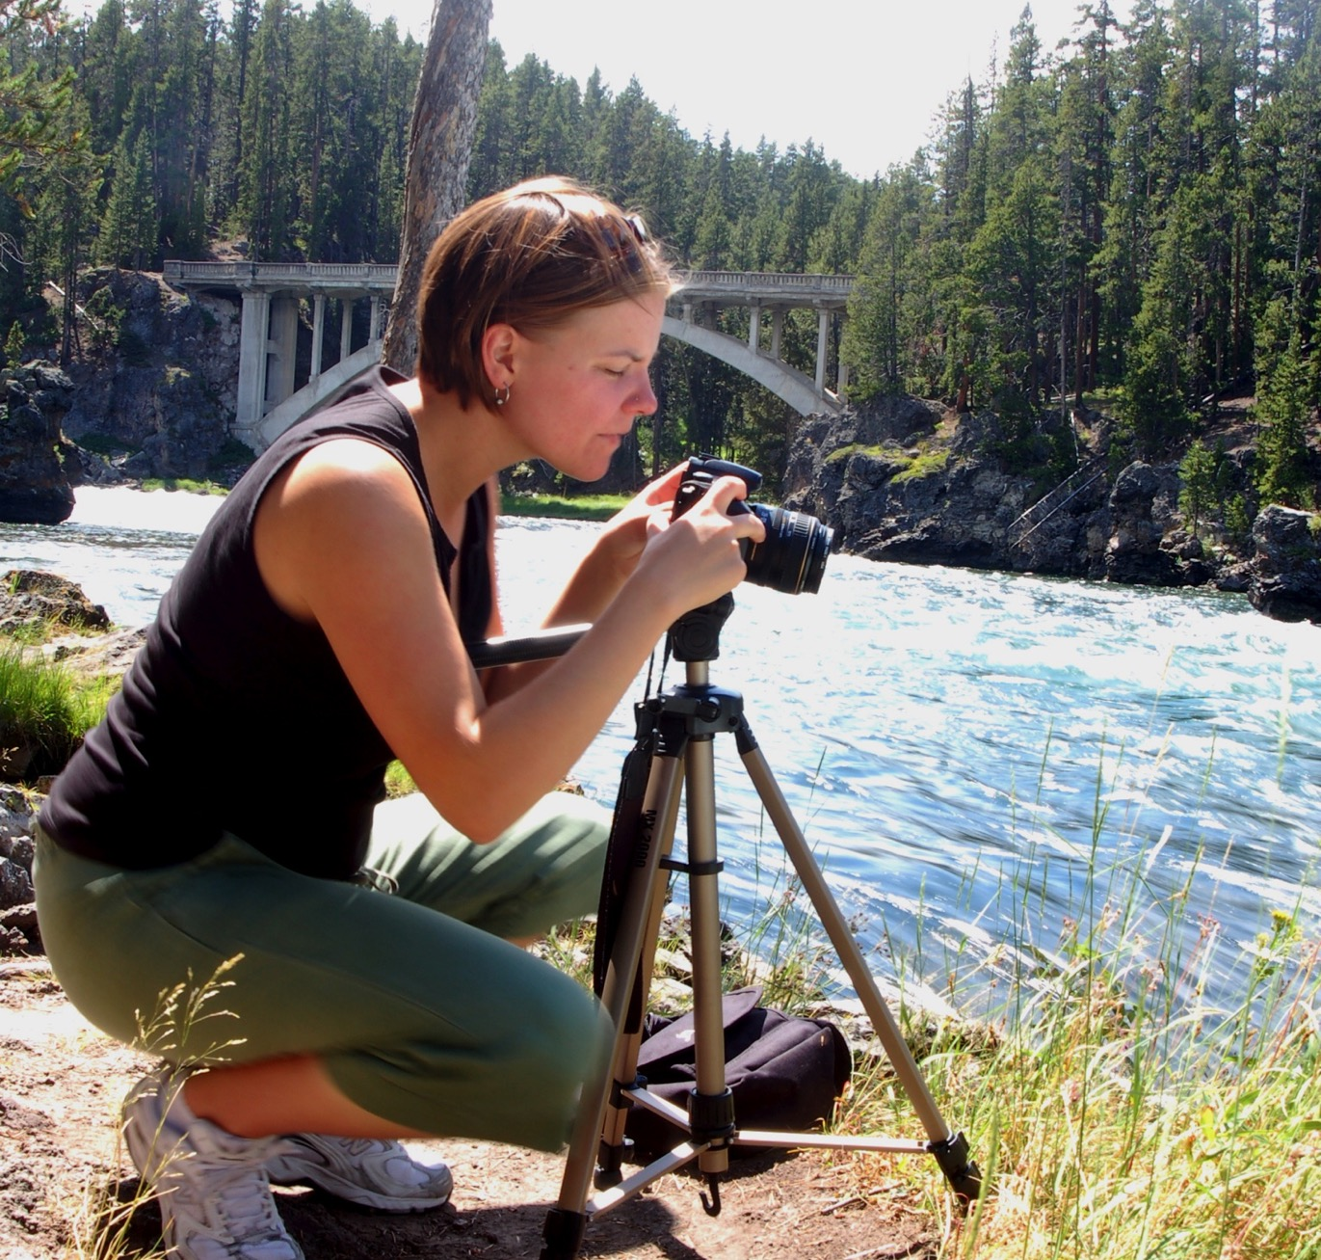
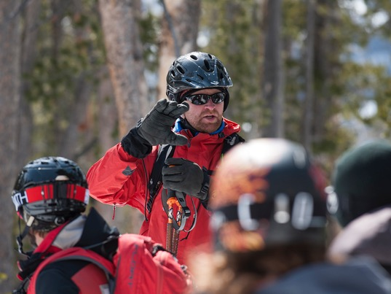
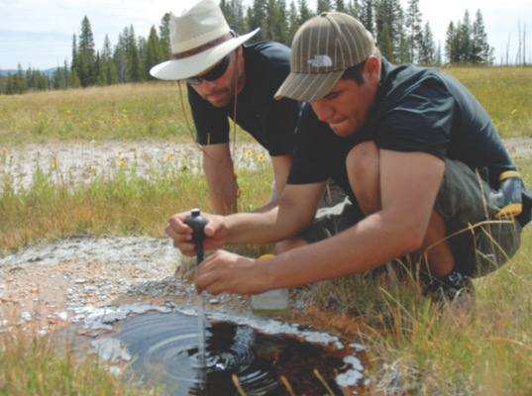
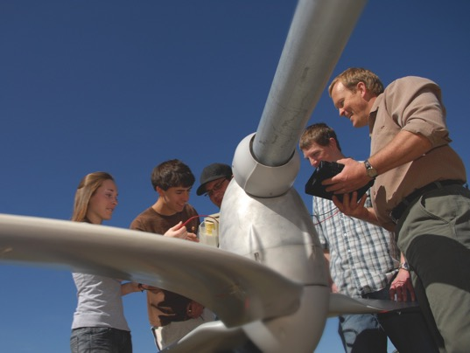
Many nearby opportunities for research and creative projects

Slide 13
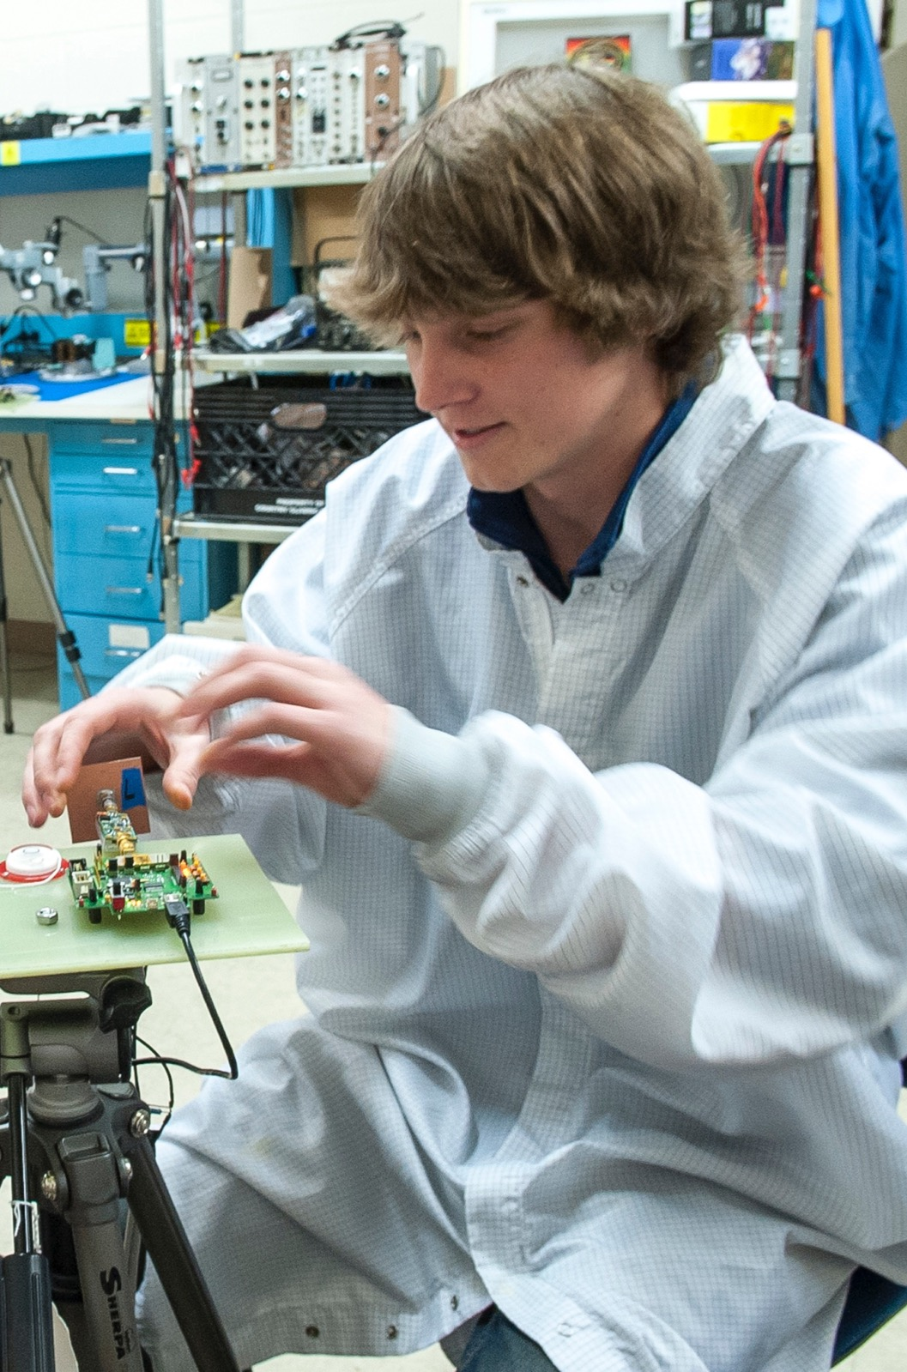
Top Scholars
MSU attracts the best and brightest from Montana and around the country. In the past academic year alone, MSU students have received prestigious scholarships including:
Rhodes (to study at Oxford University)
Marshall (grad school in the United Kingdom)
Udall (to pursue careers in the environment)
Newman Civic Fellow (public leadership)

Slide 14
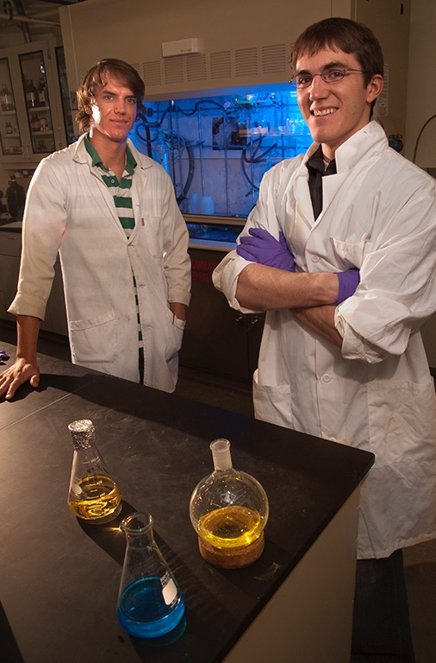
Among the Top 10
The Goldwater Scholarship is the nation’s premier scholarship for undergraduates studying math, natural sciences and engineering. MSU has produced 67 Goldwater scholars, making the university one of the nation’s top institutions for number of recipients. MSU is currently 9th in the nation—just above Yale University—for the total number of Goldwater scholars that have come from Montana State. Other schools at the top of the list include Harvard, Princeton, Duke and Stanford.

Slide 15
MSU Facts & Stats
Scholars & Research

Slide 16
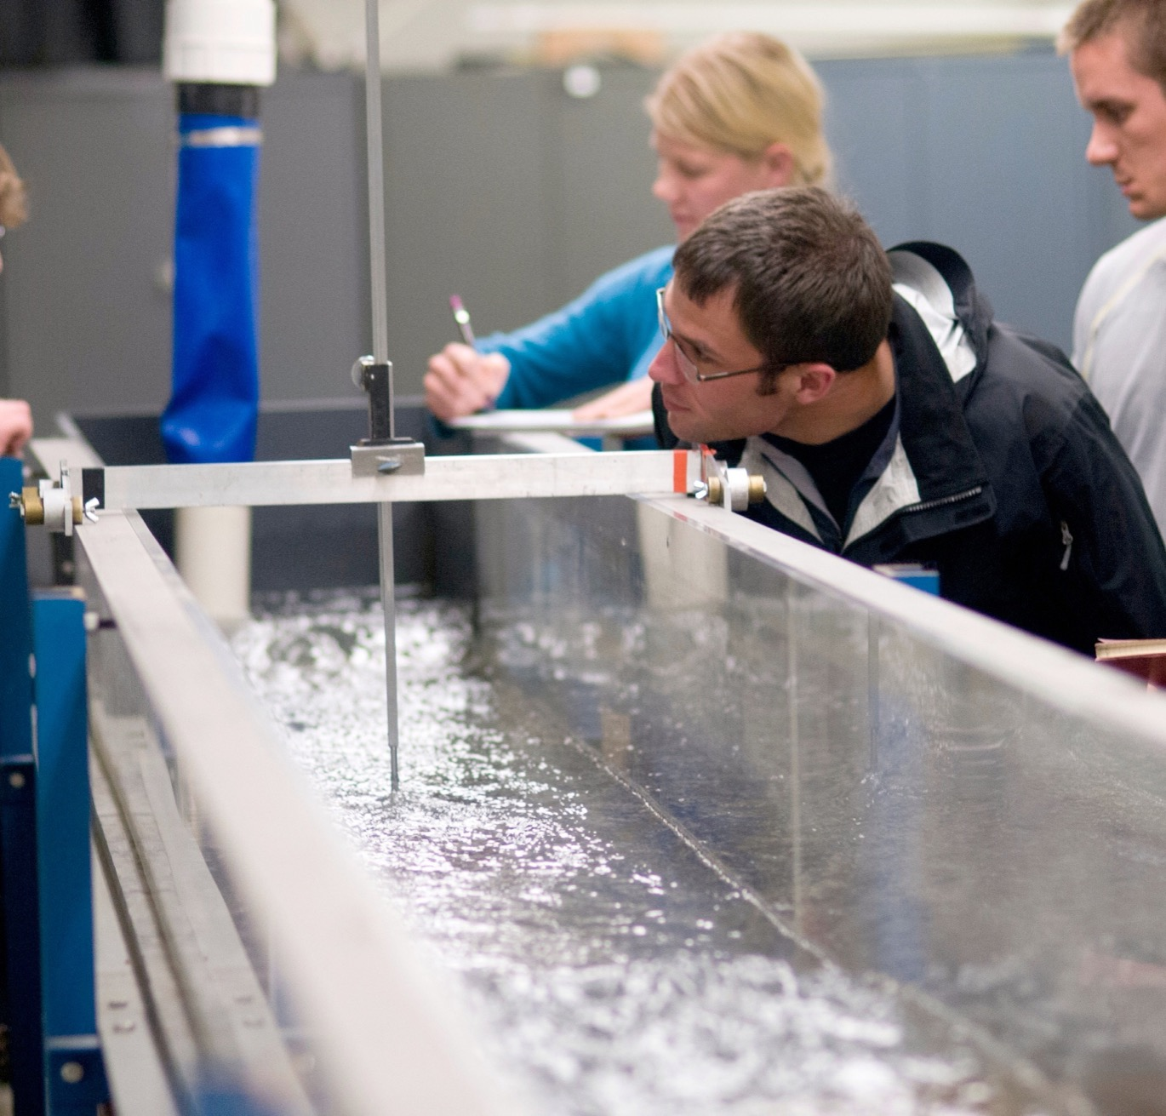



Strong academics and hands-on learning are hallmarks of MSU.

Slide 17
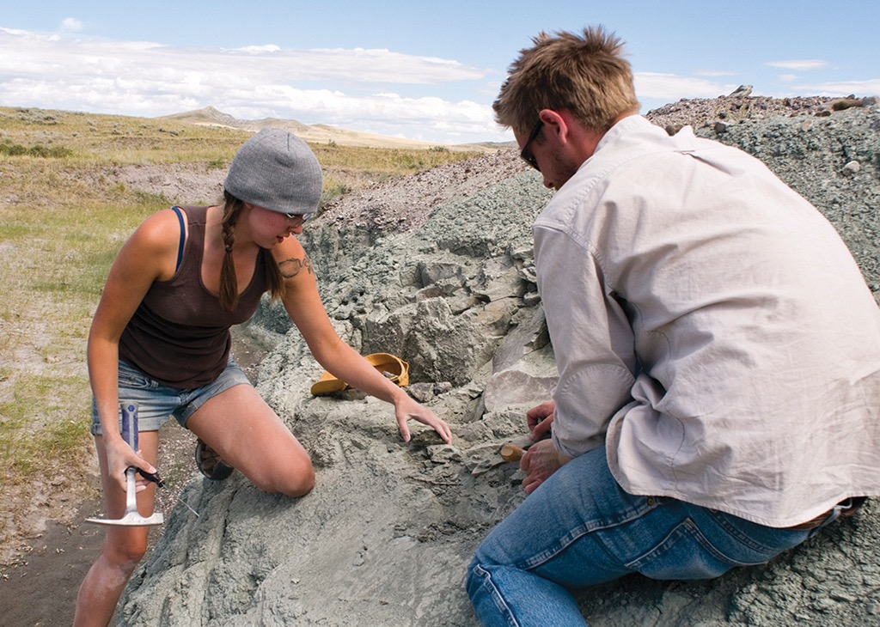
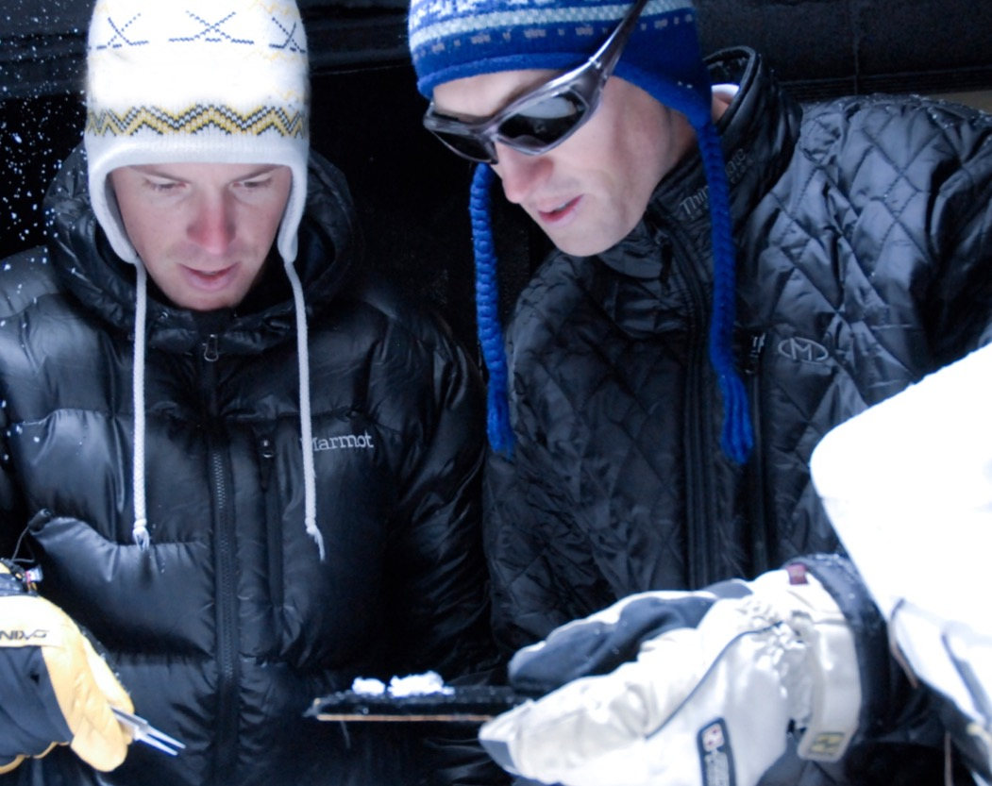
Unique Programs
MSU’s proximity to Montana’s extensive dinosaur fossil sites allow the university to offer some of the only hands-on undergraduate experiences in Paleontology.
The university’s Snow Science program features the Subzero Science and Engineering lab, named one of Popular Science magazine’s “25 Most Awesome College Labs” in the nation.

Slide 18
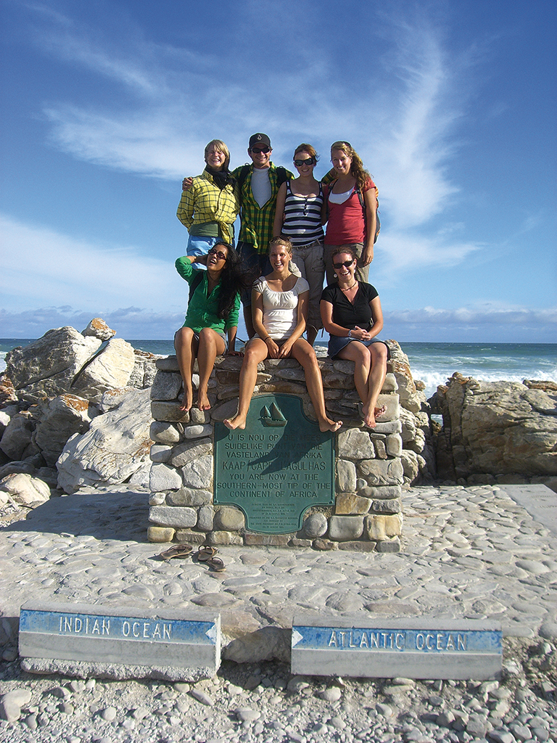
Study Abroad
The Montana State University study abroad program can place MSU students in more than 250 locations in 60 different countries.

Slide 19
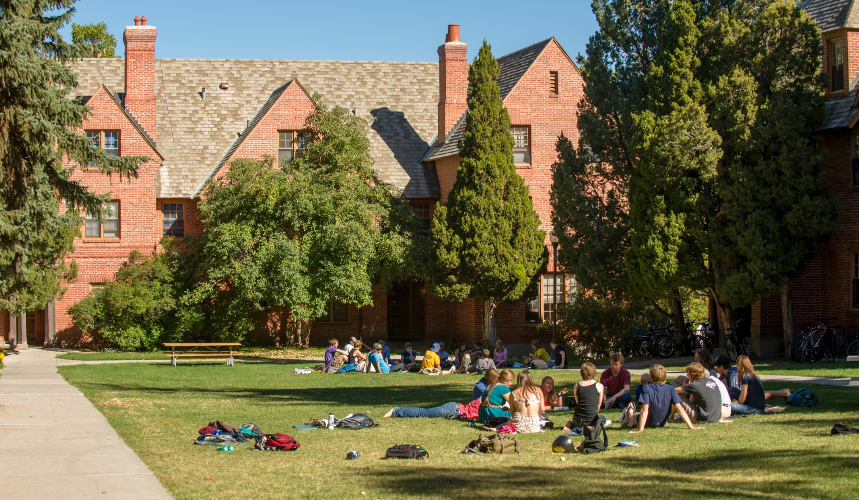
Student Focused
MSU has the largest undergraduate student population in Montana.

Slide 20
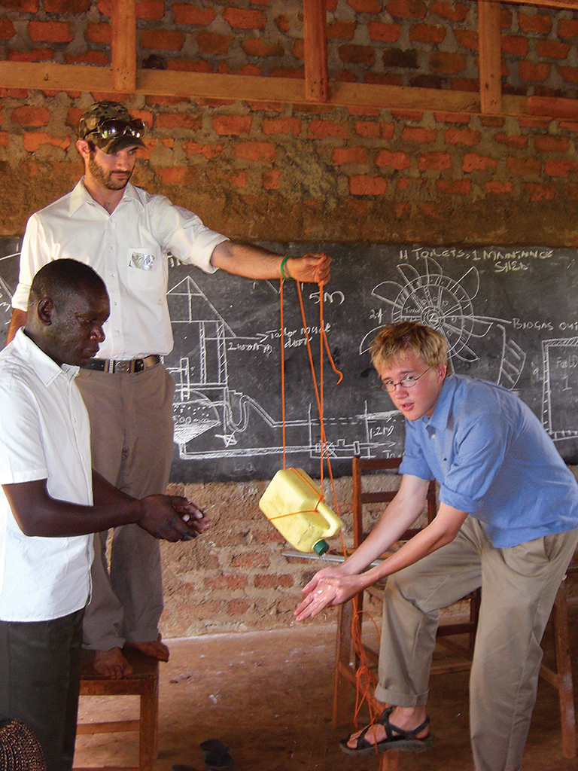
Engaged Students
MSU recently joined the ranks of colleges and universities nationally that have received the Carnegie community engagement classification. This national designation recognizes MSU’s commitment to teaching that encourages volunteer service in communities and the spreading of knowledge that benefits the public. In 2011 MSU received the prestigious C. Peter McGrath Award for Community Engagement.

Slide 21
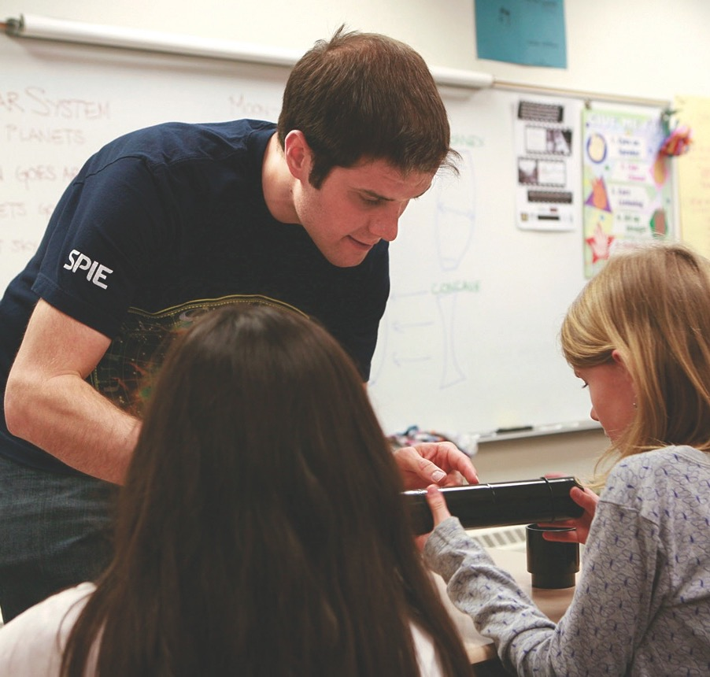

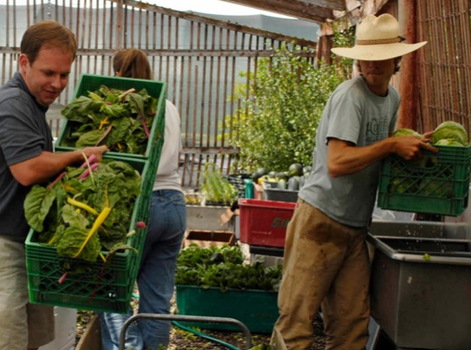
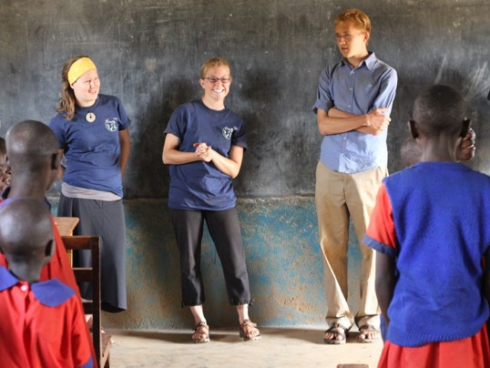
Service learning is a signature component of the curriculum at MSU.

Slide 22
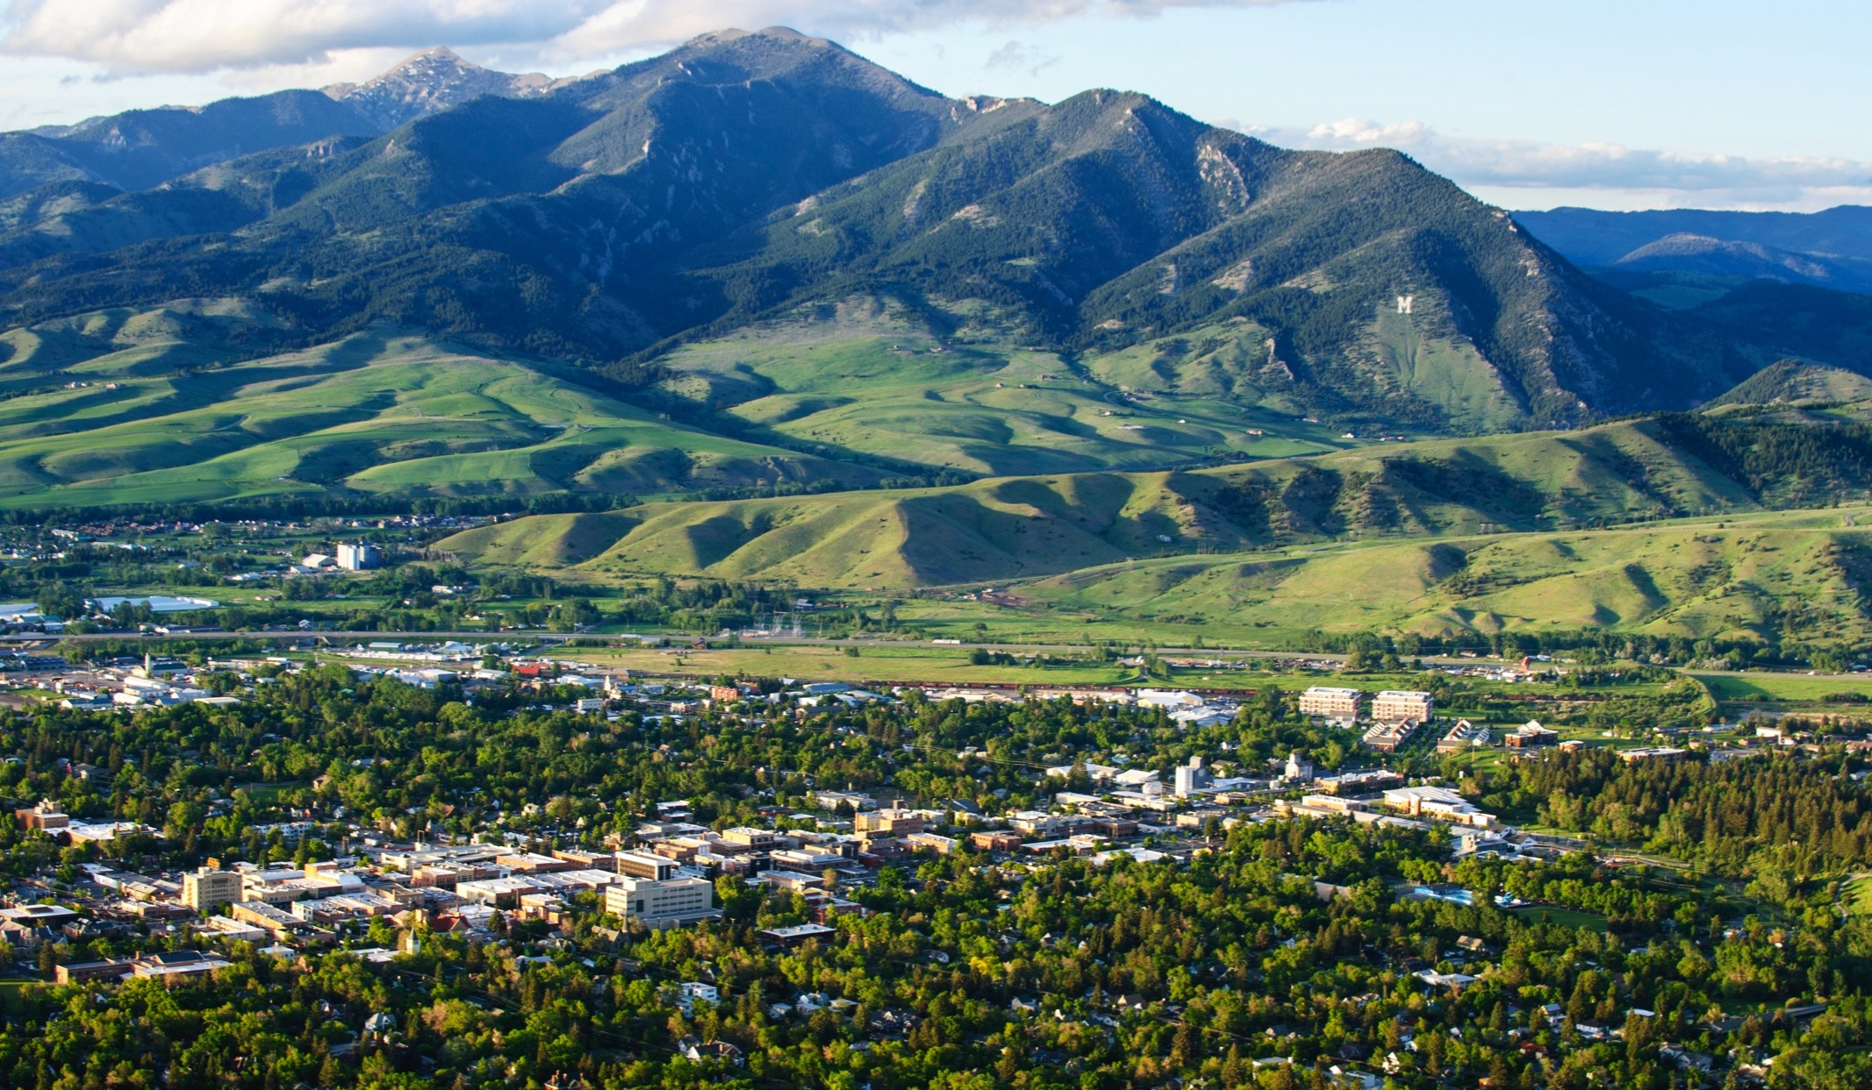
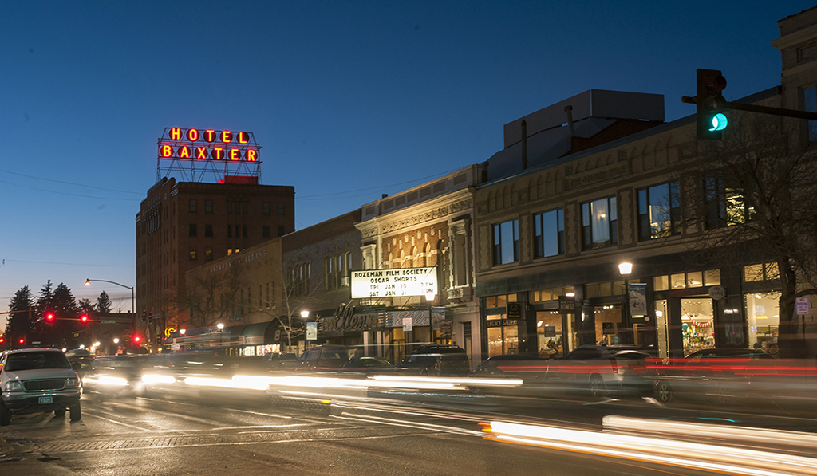
Bozeman
A great place to live and learn

Slide 23
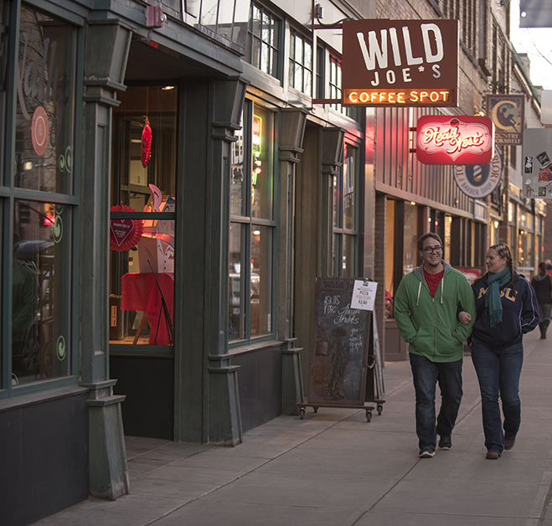

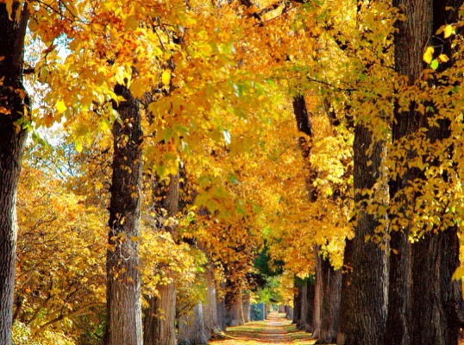

“Top 15 college town to live in forever”—College Ranker

Slide 24

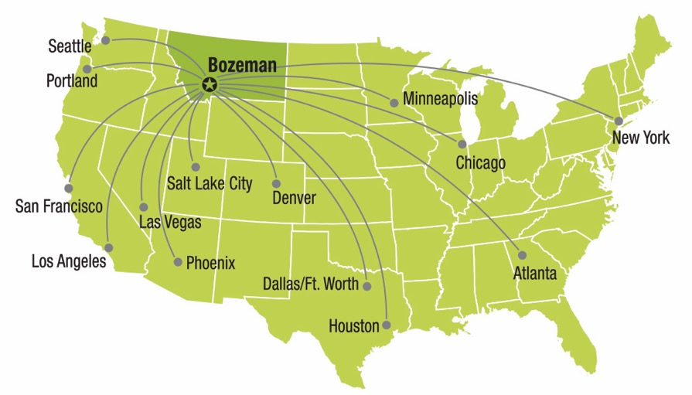
MSU Facts & Stats
Bozeman Flights

Slide 25
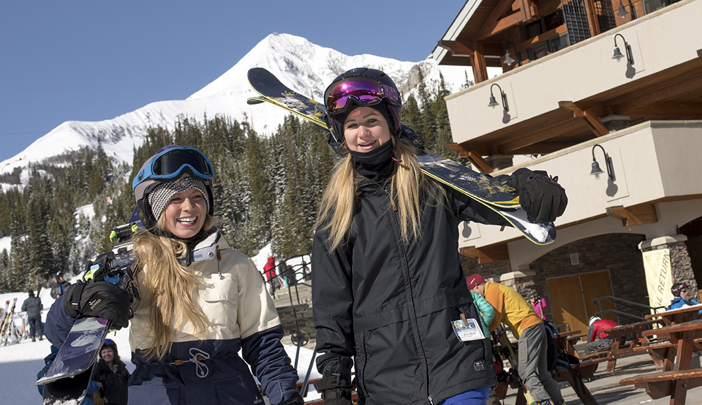
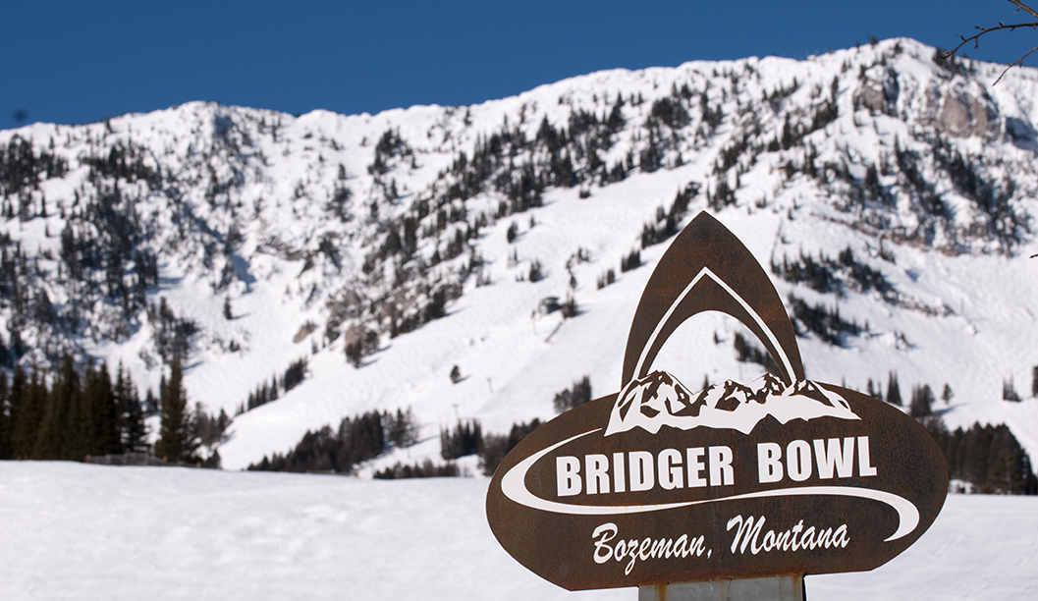
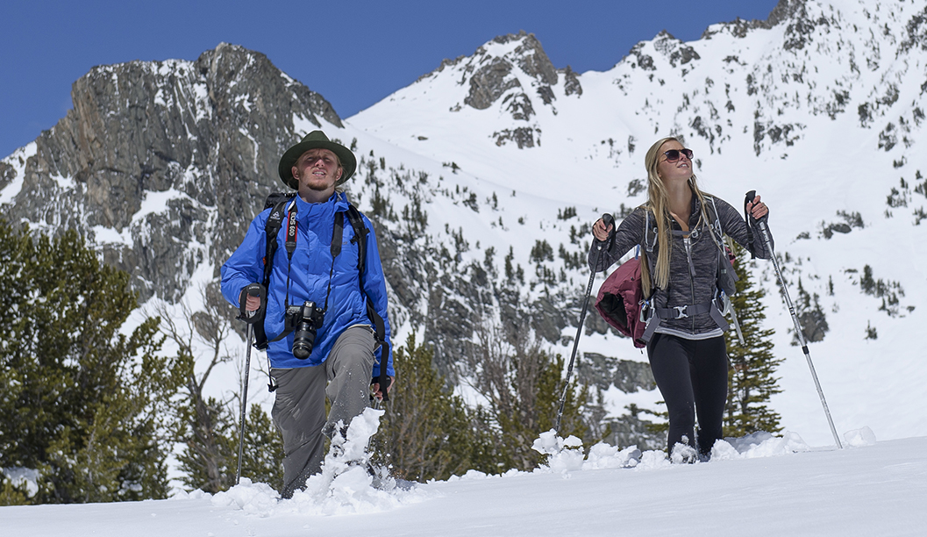
World-class adventure
Bozeman is located within an hour of two ski mountains—Bridger Bowl and Big Sky Resort. Bridger Bowl is just 20 minutes away.

Slide 26
MSU Facts & Stats
Outdoor Adventure

Slide 27
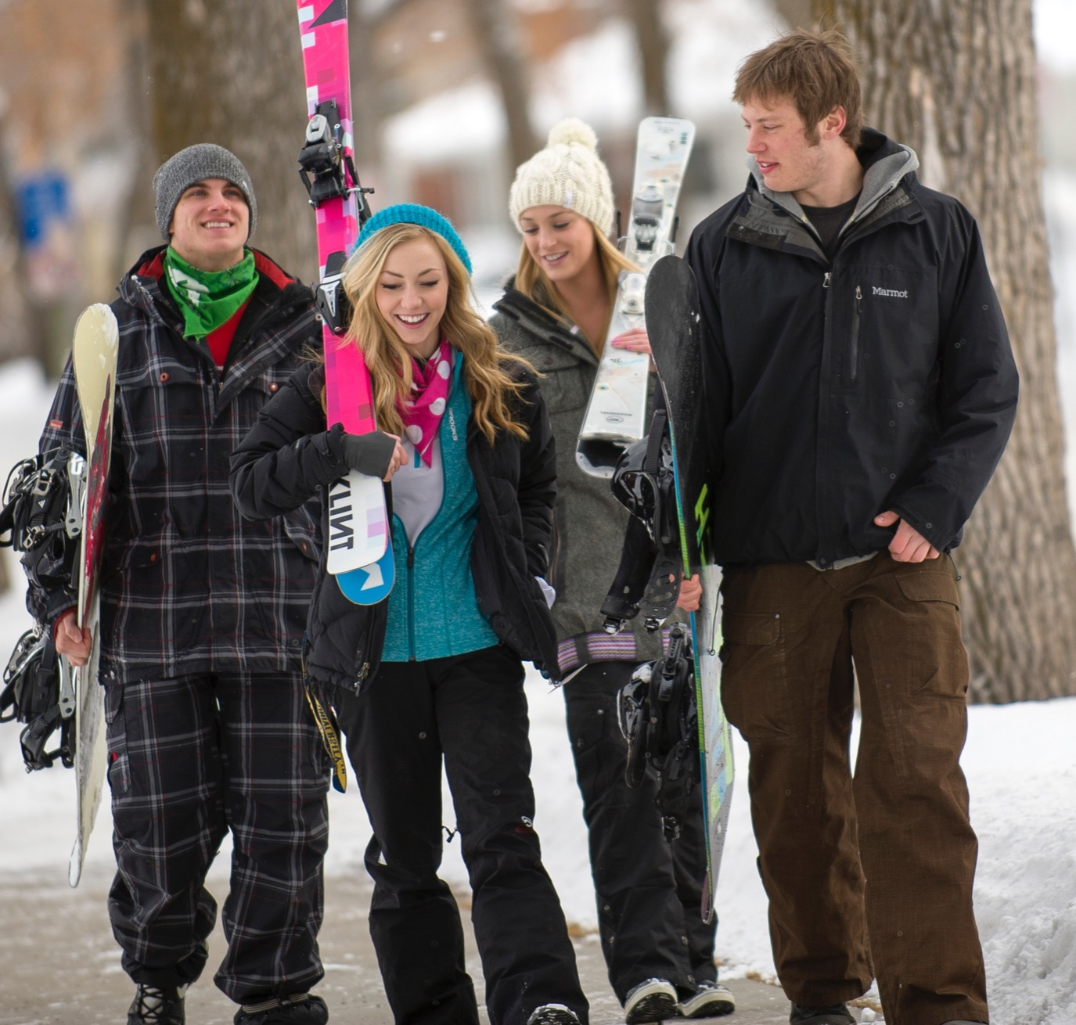
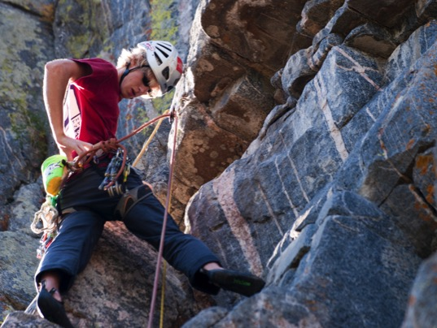

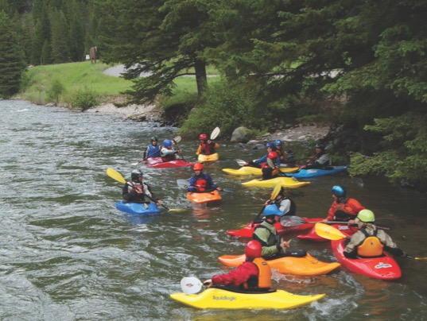
Bozeman is a mecca for adventure lovers.

Slide 28
MSU Facts & Stats
Outdoor Adventure

Slide 29
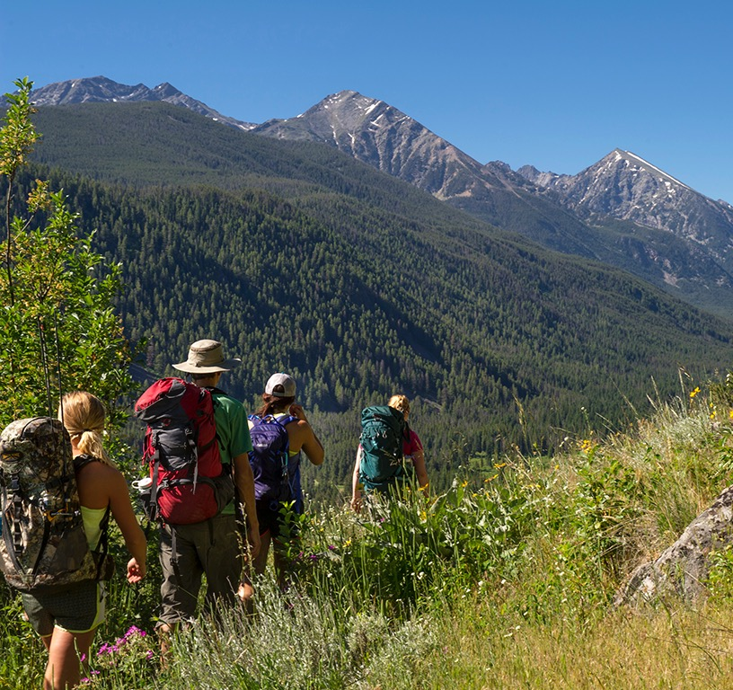
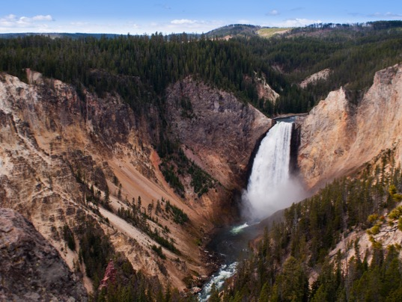
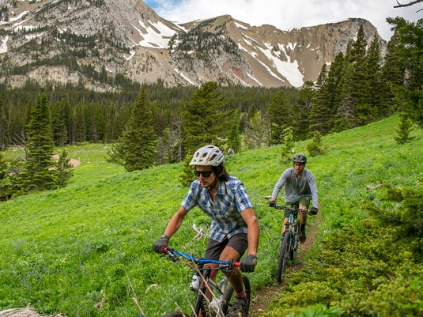
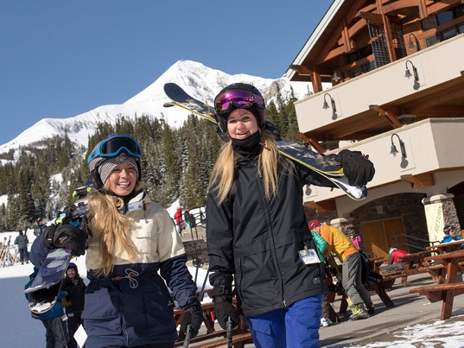
Outdoor recreation opportunities abound.

Slide 30
MSU Facts & Stats
Surrounding Environment

Slide 31
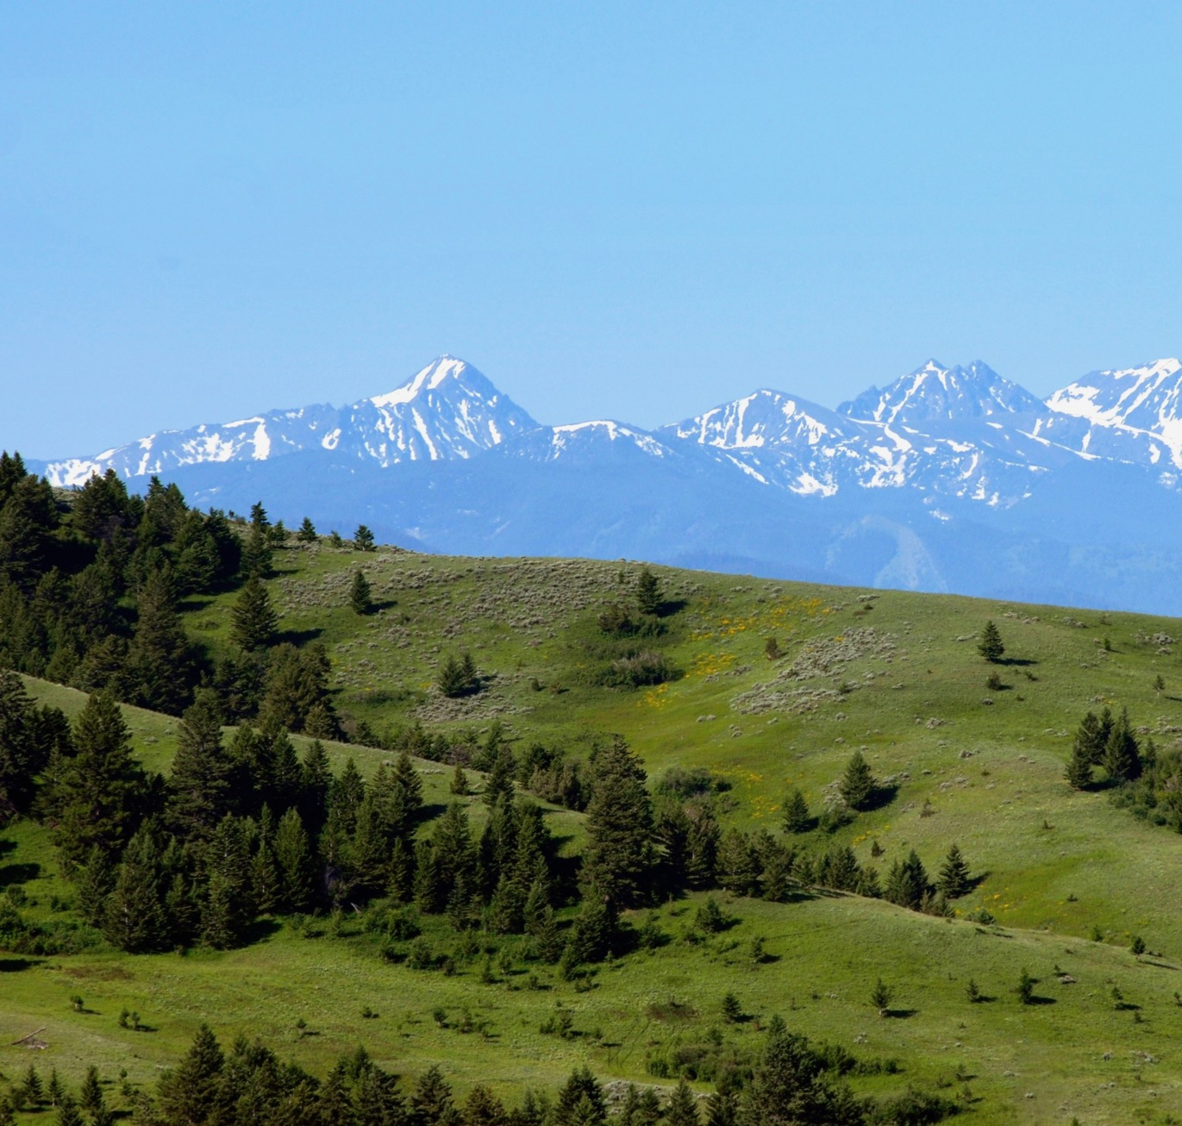
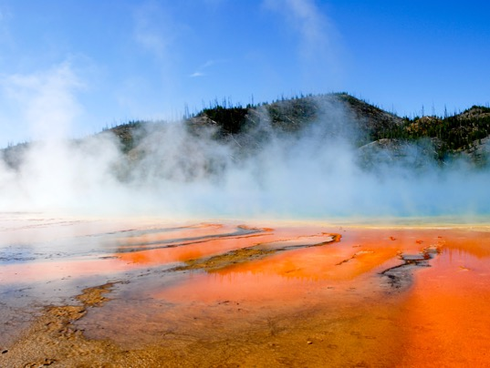
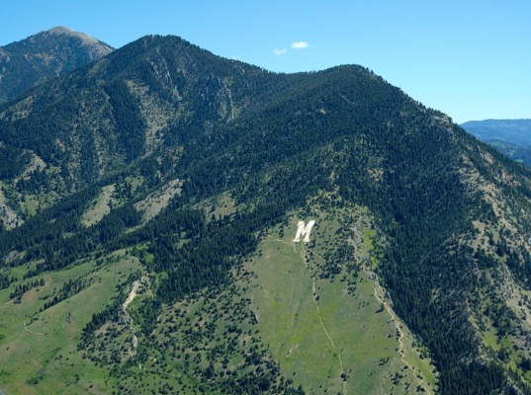
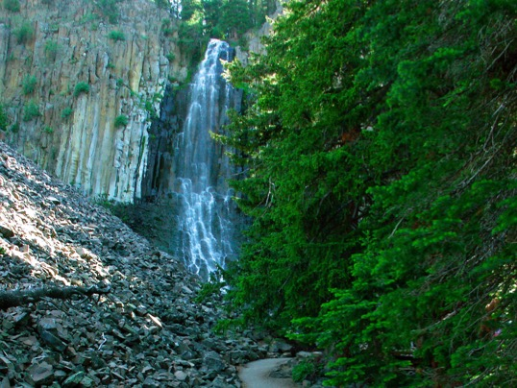
Close to wilderness, national forests and Yellowstone National Park.

Slide 32

Student Life
MSU is a friendly campus.

Slide 33

Geographic Diversity
MSU students are from all over the nation and from 70 different countries. Approximately 62 percent of MSU students are from Montana and 38 percent are from out-of-state. In 2015, 49 percent of new students are from out-of-state.

Slide 34
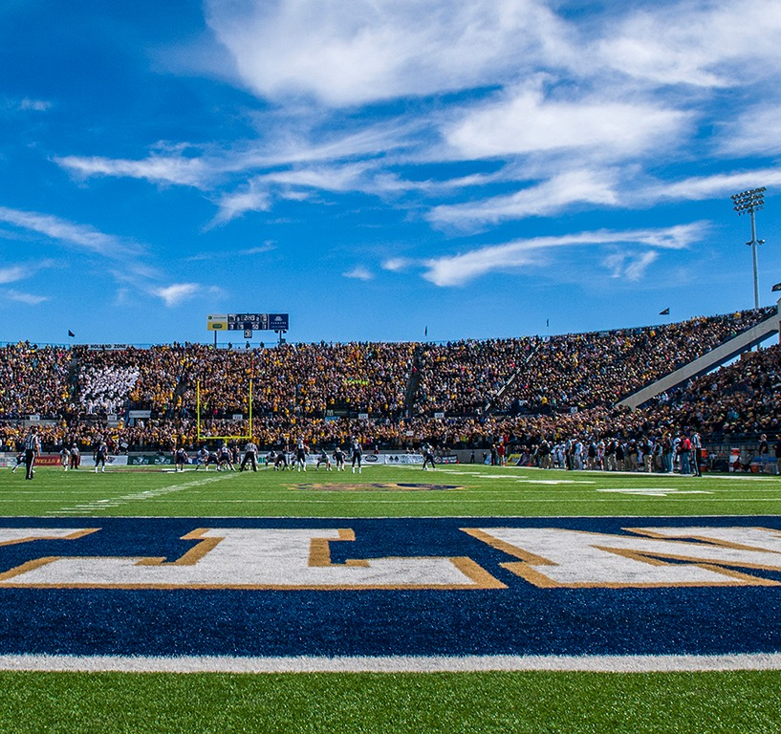



MSU has many traditions built on Bobcat pride.

Slide 35

Green Cred
The student-run Towne’s Harvest Garden recently earned national recognition from the Association of Public and Land-Grant Universities, as one of only ten exemplary outreach programs in the nation. They have also received Certified Organic status by Montana Dept. of Agriculture, and certification by the Western Sustainability Exchange.

Slide 36



Champ Change
The Champ Change program is an incentive program run by the Office of Student Success that encourages first-year students to get involved and make a smooth transition to college life at MSU.

Slide 37




All incoming freshman students live on campus their first year.

Slide 38




Several residence life facilities have been recently renovated.

Slide 39




Getting around is easy. Bozeman has a free bus system and campus is just one mile from downtown.

Slide 40


Culturally Vibrant
MSU hosts and sponsers many events, speakers and performers throughout the year, including Pow Wow and Montana Shakespeare in the Parks.

Slide 41




Fun and Fitness
The Marga Hosaeus Fitness Center at MSU was recently selected as the Outstanding Sports Facility by the National Intramural Recreational Sports Association.

Slide 42




The Bobcats compete in 13 NCAA Div. I sports.

Slide 43

Go Cats!
The MSU Bobcats were Big Sky Conference football co-champions in three of the last seven seasons.
The Bobcats won the 2016 home opener “Gold Rush” game in front of almost 19,000 gold-clad fans.
MSU student-athletes recently won the coveted President’s Cup for outstanding academic and athletic achievement in the Big Sky Conference.

Slide 44

Campus Connections
MSU has nearly 250 student clubs, from academic to recreational to community service organizations. From lacrosse to horticulture and sports marketing to paintball, it’s easy to find other students who have similar interests.

Slide 45

Montana State University
Come be a Bobcat

Slide 46

Big Ideas & Bold Adventures

