Slide 1
Examining Productivity in Rural Education: Signals of Innovative Approaches and Best Practices
Matthew Finster, Ph.D., Westat
Anthony Milanowski, Ph.D., Education Analytics (formerly Westat)
Ning Rui, Ph.D., Westat
Victoria Schaefer, Ph.D., Westat

Slide 2

Introduction
Expectations for student performance
continue to rise while many school
districts are facing constrained budgets
requiring school leaders to be more
productive—increasing outcomes for
a given expenditure.
Rural districts and schools are often
considered less productive than urban and
suburban counterparts, exhibiting, on average,
lower returns on investment (ROI) (Roza, 2015).
We examine whether rural schools are more
productive on average than nonrural schools, based
on an ROI index that incorporates district expenditures and school‒level, value‒added (VA) estimates.
2

Slide 3

Literature Review
Researchers that have compared performance levels of rural students and nonrural students and controlled for other factors, including poverty and ethnicity, have also not found a significant difference in student performance by locale (e.g., Fan & Chen, 1999; Howley, 2003).
However, researchers have noted that there is substantial variation across states in rural vs. nonrural student achievement (e.g., Howley, 2003; Lee & McIntire, 2001).

Slide 4
Literature Review (Continued)
Roza (2015) examined the productivity, defined in terms of ROI, of rural versus urban and suburban districts, and found that, on average, rural remote districts did have the lowest average ROI among different geographic types.
However, she also found that there are many (1 in 5) remote rural districts with high ROI.
Contexts of rural schools that may be advantageous
  Rural schools are smaller, and have closer connections to their communities (e.g., Beck & Shoffstall, 2005; Johnson, n.d.; Khattri et al., 1997).
  Rural schools may be innovative in how they recruit teachers, provide services to students, and leverage technology (Roza, 2015).

Slide 5
Literature Review (Continued)
One limitation of much of the existing research comparing rural and nonrural student achievement is that many of the studies compare student achievement levels without considering prior student achievement levels.
Our study uses VA estimates as the measure of effectiveness to explore the differences between Wisconsin state rural and nonrural schools levels of productivity.

Slide 6

Research Question
How does the productivity of rural schools, as measured by a ratio of VA estimates and per pupil expenditures, compare with that of urban and suburban schools with similar student compositions in Wisconsin?
“Productivity” is operationalized as a return-on-investment (ROI) index that is the school VA estimate divided by district instructional and support costs.

Slide 7

Data
Data was extracted from the
Wisconsin 2015-16 report card file, which represents school performance data from 2014-15, and merged with additional data that was extracted from files on the Wisconsin Department of Public Instruction website.

Slide 8

Data (Continued)
Notes on data.
  Information on Wisconsin VAM
  Wisconsin VA data is
  combined across grades;
  so we conducted the analysis by grade bands (e.g., K-5 ,
  6-8, and K-8).
  VA is rescaled so that a
  value-added of zero (the average value-added score) equals three.
  Instructional costs are
  centered by grade bands
  (e.g., 1 = 100% average instructional costs, 1.2 = 120%)

Slide 9

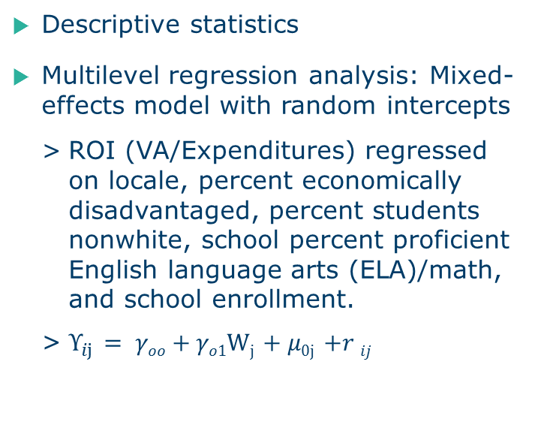
Methods
Descriptive statistics
Multilevel regression analysis: Mixed-effects model with random intercepts
  ROI (VA/Expenditures) regressed
  on locale, percent economically disadvantaged, percent students nonwhite, school percent proficient English language arts (ELA)/math, and school enrollment.
  $Υ_{ij}$ $= γοο+γο1Wj$ $+ μ0j$ $+r ij$
9

Slide 10
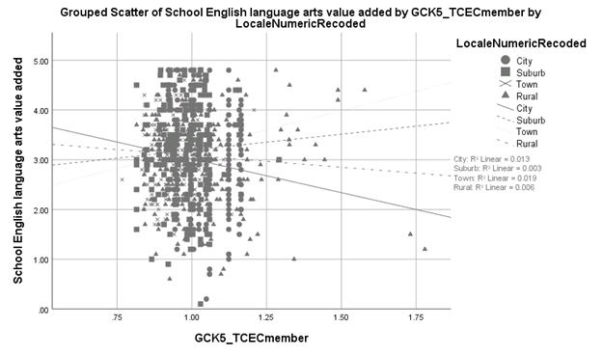
Findings: Scatter plot of ELA VA by instructional costs for K-5 schools by locale
Higher
Performance
Lower costs
Higher
Performance
Higher costs
Lower
Performance
Lower costs
Lower
Performance
Higher costs

Slide 11
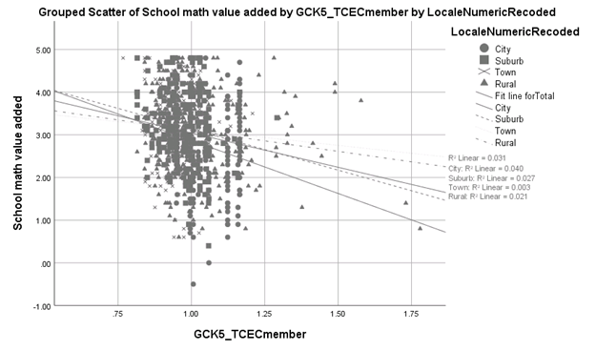
Findings: Scatter plot of Math VA by instructional costs for K-5 schools by locale

Slide 12
Findings: Comparing means of productivity metric by locale
Table 1. ROI in ELA for elementary schools (K5)
Locale | N | Mean | SD
Town | 161 | 3.313 | 0.810
Suburb | 227 | 3.270 | 0.955
Rural | 275 | 3.099 | 0.995
City | 223 | 2.873 | 0.994
Total | 886 | 3.125 | 0.966
Note. F-test significant at 9.099, p < .001. Eta = .173.
Post hoc ANOVA tests indicate differences between City vs. Town, and City vs. Suburb are significant at p < .05.

Slide 13
Findings: Multilevel regression results
Table 2. Estimates of mixed effects regression with random intercepts for K5 schools' ELA productivity metric in Wisconsin
Variables | Coeff. | SE | z | P>z | 95% CI
Rural | -0.142 | 0.135 | -1.050 | 0.294 | [-0.406, 0.123]
Town | 0.097 | 0.146 | 0.670 | 0.504 | [-0.188, 0.383]
Suburb | -0.032 | 0.130 | -0.240 | 0.807 | [-0.286, 0.223]
PctEconDis | -0.390 | 0.300 | -1.300 | 0.195 | [-0.978, 0.199]
PctLEP | 1.611 | 0.444 | 3.630 | 0.000 | [0.741, 2.482]
Pctnonwhite | -0.386 | 0.331 | -1.160 | 0.244 | [-1.035, 0.263]
SchlPctProfELA2014 | 1.344 | 0.425 | 3.160 | 0.002 | [0.511, 2.177]
SchlEnrl1516 | 0.000 | 0.000 | -1.170 | 0.243 | [-0.001, 0.000]
RATIO_STDNTS_STAFF_LICENSED | 0.030 | 0.015 | 1.970 | 0.049 | [0.000, 0.060]
Core_LT5ttl | 0.004 | 0.011 | 0.410 | 0.683 | [-0.017, 0.026]
_cons | 2.539 | 0.380 | 6.680 | 0.000 | [1.794, 3.283]
Random-effects Parameters
var(_cons) | 0.199 | 0.045 | — | — | [0.128, 0.310]
Notes. Dependent variable = ROI_K5_ELA_VA_Costs. ML regression. Number of observations = 876. Grouping variable districts. Number of groups = 337. Wald chi2(10) = 65.99. Prob > chi2= 0.0000. Log likelihood = -1130.0834. Chibar2 (01)= 45.56, Prob > chibar2 = .0000

Slide 14
Discussion
The results of the multilevel regression analysis indicate that, on average, there are not statistically significant differences between schools’ productivity levels by locale; however, approximately one
in five (18.5%) rural elementary schools were identified as being
highly productive (i.e., top 20th percentile of productivity for all elementary schools).
Further examination of school‒level funding allocations, service delivery models, and instructional practices in these bright spots may provide new insights into productivity and innovation in rural settings.

Slide 15
Limitations
Per-pupil expenditures are at the district level. Research and literature demonstrate that there is wide variation between schools’ expenditures within district (e.g., Roza, 2010).
Secondary data analysis provides little to no insight into which district- and school-level policies and practices may be more productive.

Slide 16
Thank You
Questions?

Slide 17
References
Beck, F. D., & Shoffstall, G. W. (2005). How do rural schools fare under a high stakes testing regime? Journal Of Research In Rural Education, 20(14), 1-12.
Fan, X., & Chen, M. J. (1999). Academic achievement of rural school students: A multi-year comparison with their peers in suburban and urban schools. Journal of Research in Rural Education, 15(1), 31-46.
Howley, C. (2003). Understanding mathematics education in rural context. The Educational Forum, 67(3), 215-224.
Johnson, J. (2004). Small works in Nebraska: How poverty and the size of school systems affect school performance in Nebraska. Rural School and Community Trust.
Khattri, N., Riley, K. W., & Kane, M. B. (1997). Students at risk in poor, rural areas: A review of the research. Journal Of Research In Rural Education, 13(2), 79-100.
Lee, J., & McIntire, W. (2001). Interstate variation in the mathematics achievement of rural and nonrural students. Journal of Research in Rural Education, 16(3), 168-81.
Roza, M. (2015). Promoting productivity: Lessons from rural schools. In B. Gross & A. Jochim (Eds.), Uncovering the productivity promise of rural education. The SEA of the Future, 4., San Antonio, TX: Building State Capacity & Productivity Center at Edvance Research, Inc.
Roza, M. (2010). Educational economics: Where do $chool funds go? Washington, DC: The Urban Institute Press.

