Slide 1



Designing a National Rural Talent Strategy
ISFIRE 2018
Notes:
Opening Welcome: Allen
<1 Min

Slide 2
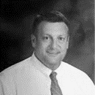
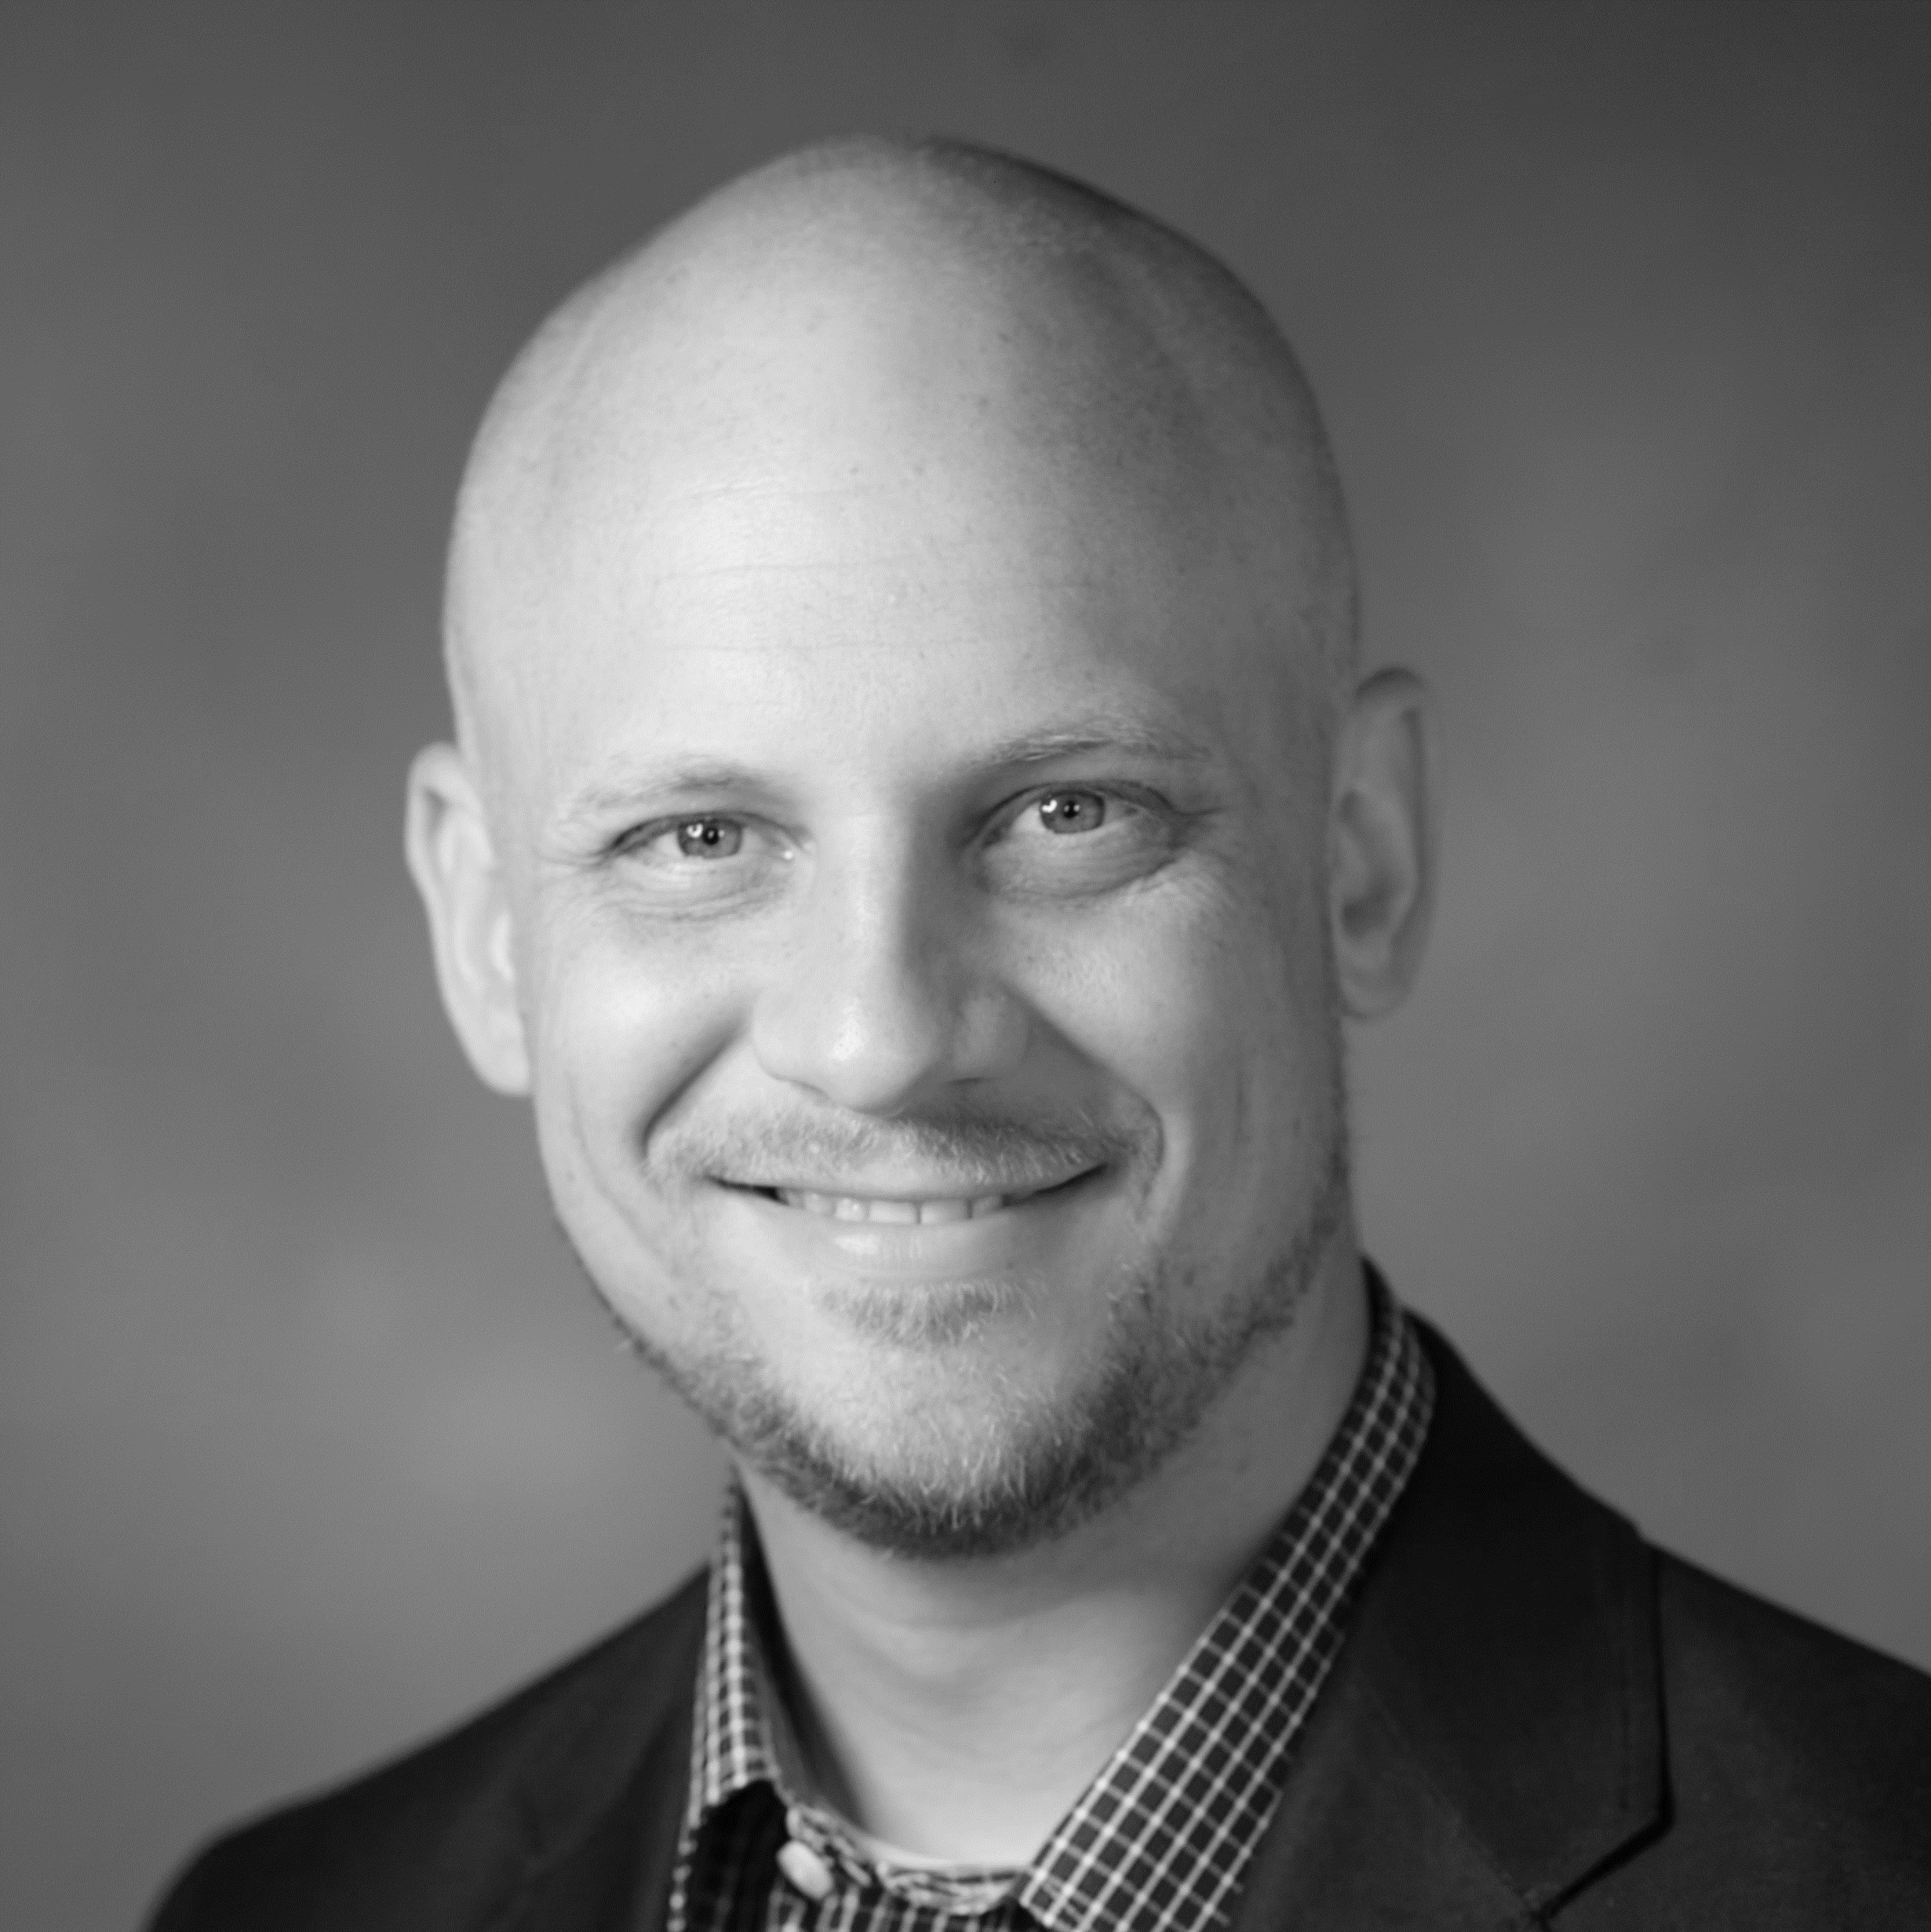
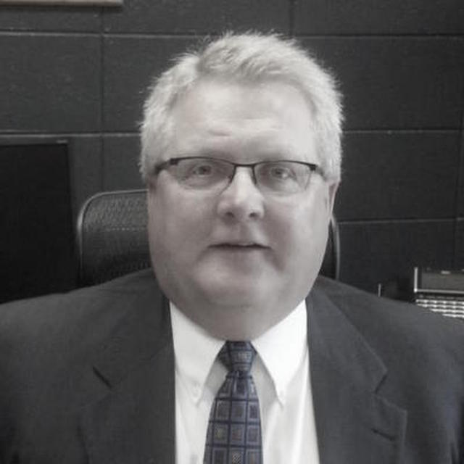
Introductions
Dr. Allen Pratt
Executive Director, NREA
Manages the day-to-day operations of the association, including educational policy, research, practitioner efforts, managing national efforts and grant funding.
Ryan Fowler
Project Director - Rural Strategy, TNTP
Directs rural community partnerships and projects, including the Bureau of Indian Education, rural schools in West Texas, the Tennessee DOE and others.
Dr. Steven Johnson
Superintendent, Lisbon Public Schools (Lisbon, ND)
Superintendent of the Lisbon Public Schools and Fort Ransom elementary districts. Board member NDASA, NDSOS, ND Rural Education Research Alliance. Serves as an Author/Peer Reviewer for Global Education Review, and advocate for Rural Schools Collaborative.
Notes:
Intros: Allen/Steven/Ryan
2 Min

Slide 3
The Project
Dr. Allen Pratt
Director, NREA
Add bio
Our Mission:
To build a national partnership that supports rural schools in attracting and retaining talent in their schools and communities.
How?
By developing a coordinated effort to connect the stories of rural communities to teaching opportunities through an online recruitment website/job board and a resource distribution network.
The Rural Talent Continuum:
Ryan Fowler
Project Director - Rural Strategy, TNTP
Directs projects focusing on rural community partnerships, including the Bureau of Indian Education, rural schools in West Texas, the Tennessee DOE and others.
Recruit
Support
Retain
Dr. Steven Johnson
Superintendent, Lisbon Public Schools (Lisbon, ND)
Add bio
Notes:
Introducing the Project: Ryan
5 Min (Slides 3-6)

Slide 4
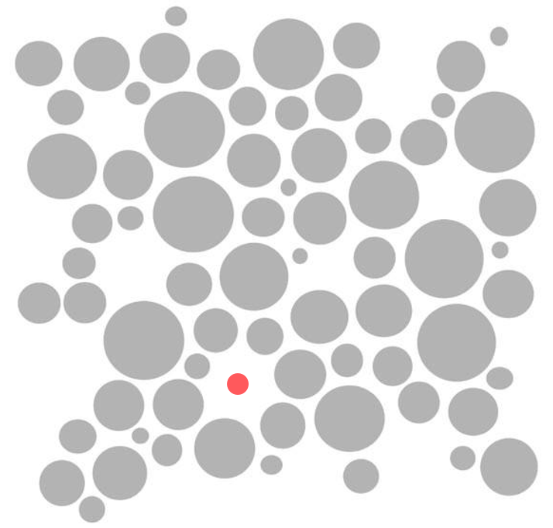
Rural Specific Recruitment Challenges
Dr. Allen Pratt
Director, NREA
Add bio
Hidden Jobs
Nearly 85% of applications received to districts come from online recruitment sources. The high volume of postings from urban districts make it hard for rural opportunities to be seen.
Ryan Fowler
Project Director - Rural Strategy, TNTP
Directs projects focusing on rural community partnerships, including the Bureau of Indian Education, rural schools in West Texas, the Tennessee DOE and others.
Dr. Steven Johnson
Superintendent, Lisbon Public Schools (Lisbon, ND)
Add bio
Notes:
Introducing the Project: Ryan
5 Min (Slides 3-6)

Slide 5


Rural Specific Recruitment Challenges
Dr. Allen Pratt
Director, NREA
Add bio
HR Capacity
Rural districts often have much more limited capacity in HR and Communications than their urban counterparts. This means rural schools often lack:
  Dedicated recruitment strategies
  Communications capacity
  Ability to provide differentiated supports and resources to principals
When this gap in capacity exists, HR compliance-driven activities often take precedence over strategic human capital work.
Ryan Fowler
Project Director - Rural Strategy, TNTP
Directs projects focusing on rural community partnerships, including the Bureau of Indian Education, rural schools in West Texas, the Tennessee DOE and others.
Dr. Steven Johnson
Superintendent, Lisbon Public Schools (Lisbon, ND)
Add bio
Notes:
Introducing the Project: Ryan
5 Min (Slides 3-6)

Slide 6
Recruitment and retention in rural communities is about connecting to the stories of the place.
Notes:
Introducing the Project: Ryan
5 Min (Slides 3-6)

Slide 7
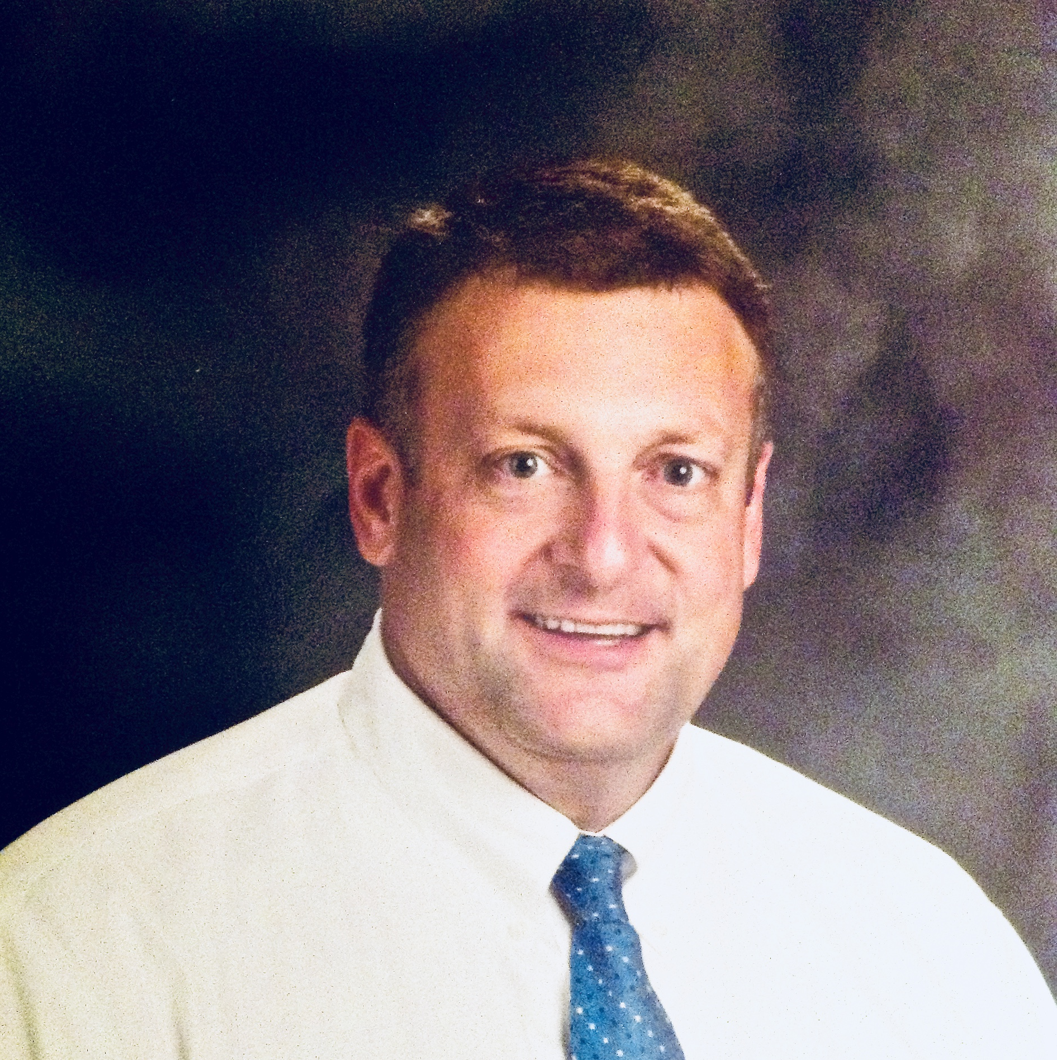
Stories from the Ground
Dr. Allen Pratt
Director, NREA
Dr. Steven Johnson
Superintendent, Lisbon Public Schools
Notes:
Stories: Allen & Steven:
Quick stories from schools/regions that point to the need to coordinate national efforts to address teacher shortage issue
5-7 Min

Slide 8
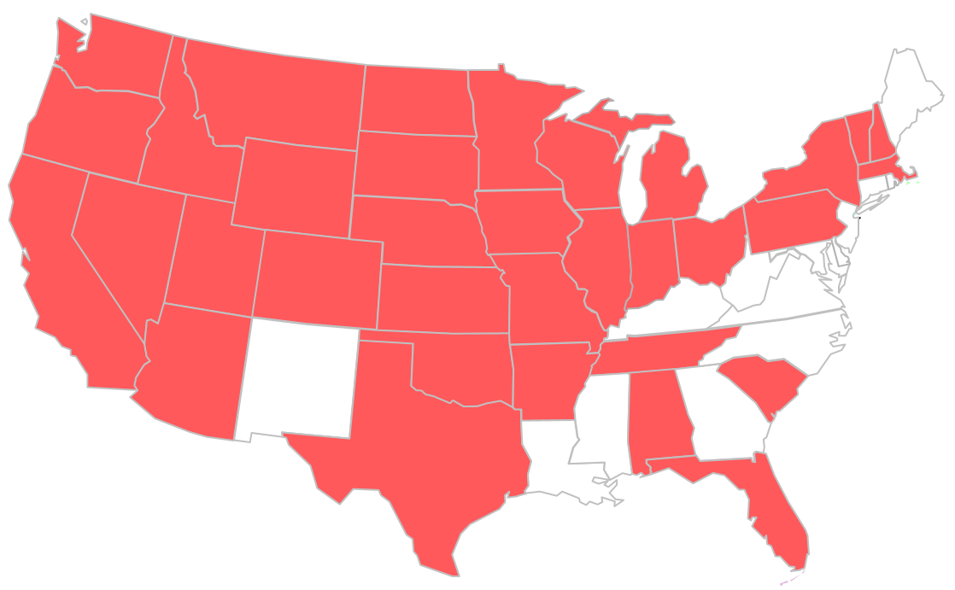
Connecting with K12
Dr. Allen Pratt
Director, NREA
Add bio
Existing National Networks
By leveraging the Regional Action Hubs of Rural Schools Collaborative and the state affiliates with NREA, we will collect career opportunities and build a platform for regional/affiliate leaders to request resources.
Ryan Fowler
Project Director - Rural Strategy, TNTP
Directs projects focusing on rural community partnerships, including the Bureau of Indian Education, rural schools in West Texas, the Tennessee DOE and others.
Dr. Steven Johnson
Superintendent, Lisbon Public Schools (Lisbon, ND)
Add bio
Above: Map of combined national coverage of RSC and NREA hubs/affiliates
Notes:
K12 Plan: Allen?
(speak to the reach of NREA and RSC networks?)
1-2 Min

Slide 9



Collaborating with Colleges of Education
Dr. Allen Pratt
Director, NREA
Add bio
Rural Schools
Flow of Information
Colleges of Education are critical partners in building strong talent pipelines for rural schools. A key element of our strategy includes developing data sharing agreements that allow regional colleges and universities to have stronger data around hiring needs of rural schools. Colleges can then use that information to align their own recruitment targets and build programming to address the unique needs of their local rural schools.
Ryan Fowler
Project Director - Rural Strategy, TNTP
Directs projects focusing on rural community partnerships, including the Bureau of Indian Education, rural schools in West Texas, the Tennessee DOE and others.
Dr. Steven Johnson
Superintendent, Lisbon Public Schools (Lisbon, ND)
Add bio
Colleges of Education
Notes:
Colleges of Education: Allen
Speak to the need for colleges and schools to be aligned on needs and ouputs
1-2 Min

Slide 10

Elevating Rural Stories
Dr. Allen Pratt
Director, NREA
Add bio
Ryan Fowler
Project Director - Rural Strategy, TNTP
Directs projects focusing on rural community partnerships, including the Bureau of Indian Education, rural schools in West Texas, the Tennessee DOE and others.
Dr. Steven Johnson
Superintendent, Lisbon Public Schools (Lisbon, ND)
Add bio
Notes:
Website Mock-up: Ryan
3-5 Min (Slides 10-14)

Slide 11

Elevating Rural Stories
Dr. Allen Pratt
Director, NREA
Add bio
Ryan Fowler
Project Director - Rural Strategy, TNTP
Directs projects focusing on rural community partnerships, including the Bureau of Indian Education, rural schools in West Texas, the Tennessee DOE and others.
Dr. Steven Johnson
Superintendent, Lisbon Public Schools (Lisbon, ND)
Add bio
Notes:
Website Mock-up: Ryan
3-5 Min (Slides 10-14)

Slide 12

Elevating Rural Stories
Dr. Allen Pratt
Director, NREA
Add bio
Ryan Fowler
Project Director - Rural Strategy, TNTP
Directs projects focusing on rural community partnerships, including the Bureau of Indian Education, rural schools in West Texas, the Tennessee DOE and others.
Dr. Steven Johnson
Superintendent, Lisbon Public Schools (Lisbon, ND)
Add bio
Notes:
Website Mock-up: Ryan
3-5 Min (Slides 10-14)

Slide 13

Elevating Rural Stories
Dr. Allen Pratt
Director, NREA
Add bio
Ryan Fowler
Project Director - Rural Strategy, TNTP
Directs projects focusing on rural community partnerships, including the Bureau of Indian Education, rural schools in West Texas, the Tennessee DOE and others.
Dr. Steven Johnson
Superintendent, Lisbon Public Schools (Lisbon, ND)
Add bio
Notes:
Website Mock-up: Ryan
3-5 Min (Slides 10-14)

Slide 14

Elevating Rural Stories
Dr. Allen Pratt
Director, NREA
Add bio
Ryan Fowler
Project Director - Rural Strategy, TNTP
Directs projects focusing on rural community partnerships, including the Bureau of Indian Education, rural schools in West Texas, the Tennessee DOE and others.
Dr. Steven Johnson
Superintendent, Lisbon Public Schools (Lisbon, ND)
Add bio
Notes:
Website Mock-up: Ryan
3-5 Min (Slides 10-14)

Slide 15
Design With Us!
Q&A
Notes:
Q&A: All
5-7 Min

Slide 16
Get Involved
1. Join our Connection List
Add your name and email to the form at your table. As our project progresses, we’ll share updates and provide new ways for you and your network to get involved.
2. Complete our Design Survey
To help us build support resources that reflect the needs in the field, please share your ideas with us via our Project Design Survey.
Notes:
Get Involved: Ryan
30 Sec

Slide 17
Contact Info
Dr. Allen Pratt
Director, NREA
Add bio
Dr. Allen Pratt, NREA
    Email: allen-pratt@utc.edu
    Twitter: @NREA1 and @PrattAllen
Dr. Steven Johnson, Lisbon Public Schools
    Email: steven.johnson@k12.nd.us
    Twitter: @johnson557377
Ryan Fowler, TNTP
    Email: ryan.fowler@tntp.org
    Twitter: @ryandfowler
Ryan Fowler
Project Director - Rural Strategy, TNTP
Directs projects focusing on rural community partnerships, including the Bureau of Indian Education, rural schools in West Texas, the Tennessee DOE and others.
Dr. Steven Johnson
Superintendent, Lisbon Public Schools (Lisbon, ND)
Add bio

