Slide 1
Strategies for Building Resiliency and Supporting Students Impacted by Trauma
Laura St. John
Project Director, SAFE-TI
School & Family Engagement- Trauma Informed
Bozeman School District
MSU Education 2/27/18
4-7-17

Slide 2
Take a moment…
Before I begin…

Slide 3
WHAT DID YOU WALK IN THIS ROOM WITH?
Good night sleep?
Visit with family?
Fight with family?
Money issues?
Someone in family battling a medical issue or a break up?
Nice meal? Too much to drink or eat?
Or maybe…bad meeting right before this??
Notes:
BEFORE I BEGIN….

Slide 4
School and Family Engagement –
Trauma Informed
(SAFE-TI)
“This project was supported by Award No. 2014-MU-MU-0017, awarded by the National Institute of Justice, Office of Justice Programs, U.S. Department of Justice. The opinions, findings, and conclusions or recommendations expressed in this presentation are those of the author and do not necessarily reflect those of the Department of Justice.”

Slide 5
Developing Knowledge About
What Works to Make Schools Safe
National Institute of Justice
Grant Award: $3,319,810 over three years
Partners:
University of Montana's Institute for Educational Research and Service - Montana Safe Schools Center and the National Children’s Trauma Center
Gallatin County Youth Court Services
Bozeman Police Department
School and community-based mental health providers (who will deliver the trauma-informed care)
Thrive

Slide 6
Our Grant
Link: Childhood trauma and behavioral health care problems
We believe that a multi-tiered package of trauma-informed interventions offers a promising alternative to a more traditional punitive disciplinary approach.
Notes:
We know that children's exposure to violence and their unresolved trauma impacts behavior and increases
risk-taking
ATOD (stress relievers)
sexual promiscuity
depression/suicide
juvenile justice system involvement
adverse academic progress
Additionally unmanaged long term stress is a health concern (as shown in the ACEs study)
If effective, our project’s suite of interventions could serve as a cost-effective model for improving school climate and promoting school safety on a national level (and more effectively help our struggling students)

Slide 7
Impacts
The project:
Is embracing the question “Does a trauma sensitive, multi-tiered, whole school approach enhance well-being and safety?”
Has potential for nationally relevant understanding on a new way of addressing school safety problems.

Slide 8
The ACE Study
The Adverse Childhood Experiences (ACE) Study is one of the largest investigations ever conducted on the links between childhood maltreatment and later-life health and well-being.
1995-1997 17,000 individuals
HMO in So California
CDC followed the individuals for mortality and health
Notes:
It was a collaboration between the Centers for Disease Control and Prevention and Kaiser Permanente's Health Appraisal Clinic in San Diego. Researchers asked 17,000 members undergoing a comprehensive physical examination (for a study related to obesity) to provide detailed information about their childhood experience of abuse, neglect, and family dysfunction.
Traumatic experiences in childhood have been linked to increased medical conditions throughout the individuals’ lives. The Adverse Childhood Experiences (ACE) Study is a longitudinal study that explores the long-lasting impact of childhood trauma into adulthood. The ACE Study includes over 17,000 participants ranging in age from 19 to 90. Researchers gathered medical histories over time while also collecting data on the subjects’ childhood exposure to abuse, violence, and impaired caregivers. Results indicated that nearly 64% of participants experienced at least one exposure, and of those, 69% reported two or more incidents of childhood trauma. Results demonstrated the connection between childhood trauma exposure, high-risk behaviors (e.g., smoking, unprotected sex), chronic illness such as heart disease and cancer, and early death.
The Adverse Childhood Experiences (ACE) Study is one of the largest investigations ever conducted to assess associations between childhood maltreatment and later-life health and well-being. The study is a collaboration between the Centers for Disease Control and Prevention and Kaiser Permanente's Health Appraisal Clinic in San Diego.
More than 17,000 Health Maintenance Organization (HMO) members undergoing a comprehensive physical examination chose to provide detailed information about their childhood experience of abuse, neglect, and family dysfunction. To date, more than 50 scientific articles have been published and more than100 conference and workshop presentations have been made.
The ACE Study findings suggest that certain experiences are major risk factors for the leading causes of illness and death as well as poor quality of life in the United States. It is critical to understand how some of the worst health and social problems in our nation can arise as a consequence of adverse childhood experiences. Realizing these connections is likely to improve efforts towards prevention and recovery.

Slide 9
ACE Study Questions
  Did you experience physical abuse?
  Did you experience physiological abuse?
  Did you experience contact sexual abuse?
  Did you experience emotional neglect?
  Did you experience physical neglect?
  Was there an alcoholic or drug-user in your household?
  Was there a member of your household imprisoned?
  Was there a member of your household that was mentally ill, or did you have a depressed parent or institutionalized family member?
  Did you witness your mother being treated violently?
  WHATSMYACESCORE.COM
Notes:
Give yourself one point for each “yes” answer, then add them up to get your ACE score
If ever experienced physical abuse = 1 point (whether happened once or multiple times or by different people) all = 1 point
American Academy of Psychotherapists, most hands raised

Slide 10

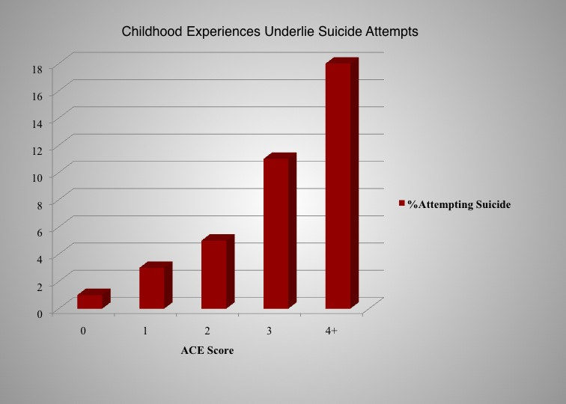

Slide 11
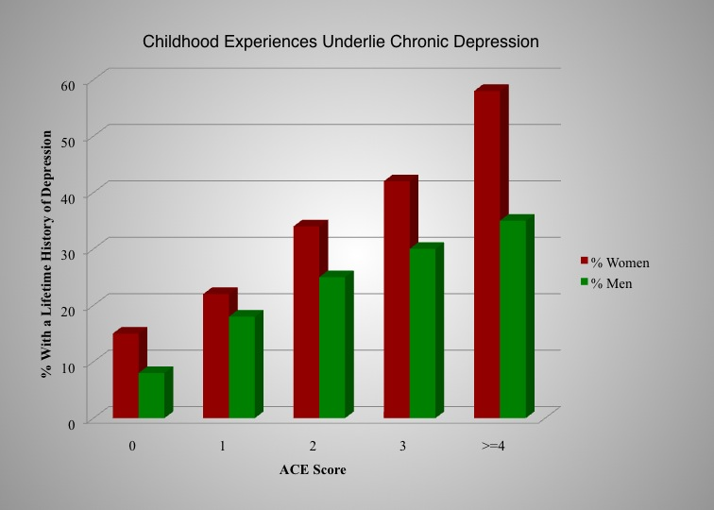

Slide 12
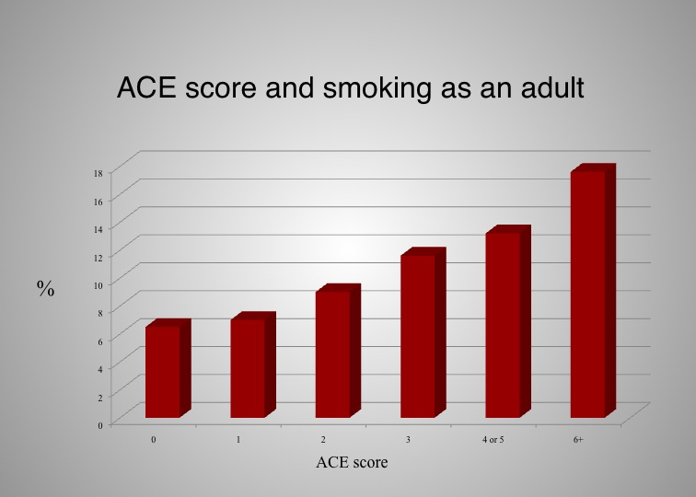

Slide 13

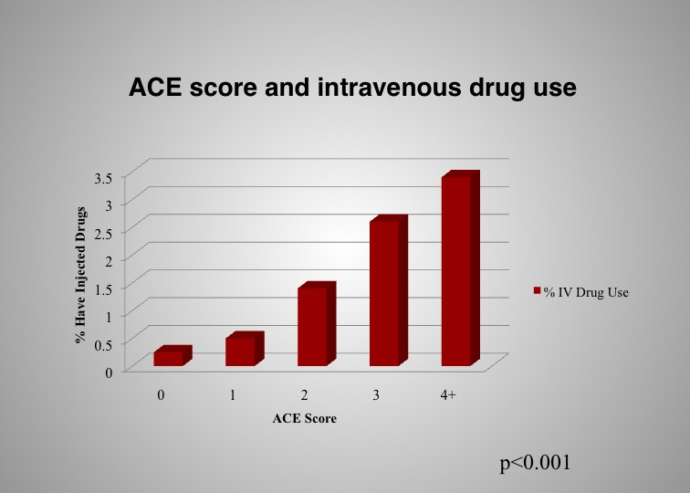

Slide 14
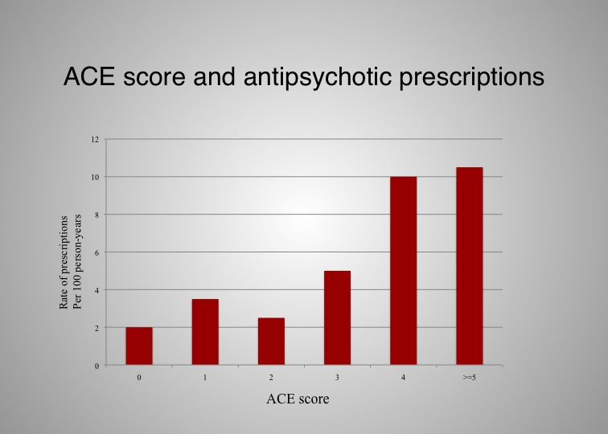

Slide 15
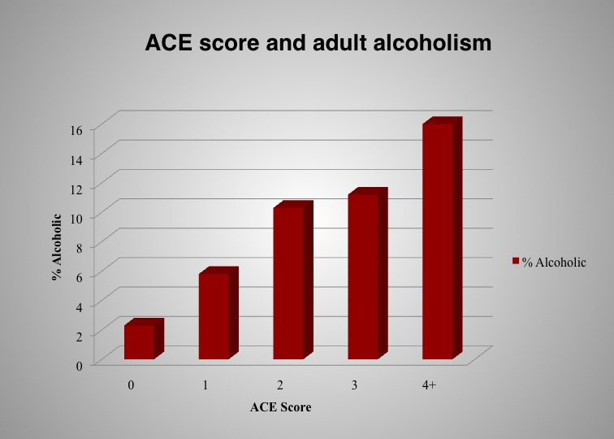

Slide 16
ACE’S IS THE WHAT…
SAFE-TI IS THE
WHAT’S NEXT??...

Slide 17
What is Trauma?
A highly stressful experience with lasting emotional and physical effects
Perceived threat to life, physical integrity, caregiver, environment
Overwhelms capacity to cope
Notes:
When a person experiences trauma – they are experiencing a highly stressful situation that overwhelms their ability to cope…usually in the face of something that is life threatening (or perceived to be), or threatening to their physical integrity, or threat of losing a caregiver or to their environment…..even with exposure to a significant experience like this, the exposure itself will not necessarily lead to a traumatic stress reaction
Chronic state can impede development of critical brain functions: eg. Memory, language, problem solving higher order thinking
Children with Traumatic stress are about “survival in the moment.” Immediate and extreme response to reminders of the trauma. Survival in the moment is governed by pathways in the brain that appraise threat, sacrifice context for speed of response, make decisions out of consciousness, mobilize the body for fight flight or freeze
Higher order brain functions are temporarily put on hold when survival is at stake.
Most creative ideas in a calm state

Slide 18
TRAUMA COMES IN MANY FORMS
    Automobile Accidents
    Life-Threatening illness
    Witnessing or experiencing community violence (shootings, stabbings, robbery, fighting at home, in the neighborhood, or at school)
    Natural Disasters
    Terrorism
    Traumatic death
    Physical or sexual abuse
    Abandonment
    Witnessing Domestic Violence
    Bullying
    Neglect
    Living in a chronically chaotic environment
    Military deployment
    Family Disruption
    Medical
Notes:
WHAT ARE YOU SEEING WITH YOUR STUDENTS??

Slide 19
Trauma Types
Acute Trauma:
  “A single traumatic event that overwhelms a child’s ability to cope.” (Fitzgerald and Groves)
Chronic Trauma
  Repeated, ongoing
  Experiencing a prior traumatic event does not toughen up a child. Instead, the effects can add up
Complex Trauma
  Multiple and/or chronic, most often of an interpersonal nature and early life onset.
  These exposures often occur within the child’s care giving system
Notes:
Some traumatic experiences occur once in a lifetime, others are ongoing
Chronic - What happens if the violence, molestation, or trauma occurs repeatedly, or several different types of traumas happen over a child's years of growing up? Children and adolescents may never have the time or support to recover from one set of posttraumatic stress reactions before new ones add to them. Young children who are abused commonly also witness domestic violence. A teenager may have been the victim of a criminal assault or rape and, at another time, have witnessed a friend being shot. Experiencing a prior traumatic event does not toughen up a child. Instead, the effects can add up, with each successive experience leading to more severe and chronic posttraumatic stress reactions and other developmental consequences. In fact, a child who has suffered from prior traumatic experiences may be apt to have more intense reactions to another trauma.
The term complex trauma describes the problem of children's exposure to multiple or prolonged traumatic events and the impact of this exposure on their development. Typically, complex trauma exposure involves the simultaneous or sequential occurrence of child maltreatment—including psychological maltreatment, neglect, physical and sexual abuse, and domestic violence—that is chronic, begins in early childhood, and occurs within the primary caregiving system. Exposure to these initial traumatic experiences—and the resulting emotional dysregulation and the loss of safety, direction, and the ability to detect or respond to danger cues—often sets off a chain of events leading to subsequent or repeated trauma exposure in adolescence and adulthood.
Many children with complex trauma histories suffer a variety of traumatic events, such as physical and sexual abuse, witnessing domestic and community violence, separation from family members, and revictimization by others. Complex trauma can have devastating effects on a child’s physiology, emotions, ability to think, learn, and concentrate, impulse control, self-image, and relationships with others. Across the life span, complex trauma is linked to a wide range of problems, including addiction, chronic physical conditions, depression and anxiety, self-harming behaviors, and other psychiatric disorders.
Beyond the consequences for the child and family, these problems carry high costs for society. For example, a child who cannot learn may grow up to be an adult who cannot hold a job. A child with chronic physical problems may grow up to be a chronically ill adult. A child who grows up learning to hate herself may become an adult with an eating disorder or substance addiction.
Children whose families and homes do not provide consistent safety, comfort, and protection may develop ways of coping that allow them to survive and function day-to-day. For instance, they may be overly sensitive to the moods of others, always watching to figure out what the adults around them are feeling and how they will behave. They may withhold their own emotions from others, never letting them see when they are afraid, sad, or angry. These kinds of learned adaptations make sense when physical and/or emotional threats are ever-present. As a child grows up and encounters situations and relationships that are safe, these adaptations are no longer helpful, and may in fact be counterproductive and interfere with the capacity to live, love, and be loved.

Slide 20
Why Do Education Programs Need to Know About Trauma
When children experience trauma it affects
  Ability to learn
  Ability to make friends/social skills
  Behaviors in the classroom
Teachers may be the first to notice symptoms
Teachers can provide social/emotional curriculum and employ classroom strategies to help
Notes:
FIGHT FLIGHT FREEZE

Slide 21
      1 out of 4 children who attend school has been exposed to a traumatic event
Or…
TOXIC STRESS
Notes:
I WANT TO TALK ABOUT THIS…POSITIVE STRESS TOLERABLE STRESS AND TOXIC STRESS

Slide 22
Basic Needs Must be Met
Learning
Esteem/Self-Love
Relationship
Safety
Physiological
Notes:
PHYSIOLOGICAL--- BREATHING– FREEDOM FROM HUNGER & THIRST – RESTED
SAFETY--- PHYSICAL SAFETY – EMOTIONAL SAFETY – FREEDOM FROM BULLYING – FREEDOM FROM HARSH PUNISHMENT
RELATIONSHIPS --- !!!
ESTEEM --- SELF RESPECT --CONFIDENCE—RESPECT FROM OTHERS --DESIRE TO SUCCEED

Slide 23

WHAT IF…

Slide 24
DO YOU…
FREEZE
FIGHT
FLIGHT

Slide 25
Bruce Perry – Child Trauma Academy
Adaptive Responses to Trauma
Hyper-arousal Continuum | Rest | Vigilance | Resistance | Defiance | Aggression
Disssocia-tive Continuum | Rest | Avoidance | Compliance | Dissociation | Fainting
Mental State | Calm | Alert | Alarm | Fear | Terror
Notes:
Brain Functioning is State Dependent
Neocortex – most calm and creative when not overstimulated or distracted – quiet rhythms of nature, stress response down; cognition is abstract; mental state is calm – our society doesn’t allow this – best learning happens in this state and the next (subcortex) – (often hit this state in the shower)
Subcortex – cognition is concrete, mental state is alert
Limbic – cognition is emotional and mental state is alarm
Midbrain – cognition is reactive, mental state is fear
Autonomic – cognition is reflexive, mental state is terror
Need sleep and non-structured reflective time
Children who grow up in chaotic environments grow up in the Emotional/Alarm/Limbic Brain State - This is their baseline – their heart rate is typically high too –
When external world is calm, with normal stressors – not on high alert all the time, only when need to be
Living in chaos, wake up in an Alarm state – eventually functioning deteriorates
As soon as threatened, start to regress down through the brain stages…
Hyper arousal Continuum: kid defiant, teacher gets in face, escalates kid’s state and behavior, highly defensive mode – pisses off adult, child gets help
Dissociative Continuum: teacher engages with kid, kid doesn’t want to be noticed, moves up the continuum, but it looks like complete compliance, then reaches complete dissociative state (the teacher might think the child is stupid or being passive aggressive) – these kids get no help, go under the radar. Later in life when these kids want to physiologically release, end up using drugs, cutting, promiscuity. Need caregivers who are loving and stable – takes time. When hyperarousal kids get pushed too far, you can tell, but dissociative kids, you can’t tell, they’ve checked out.
Need to take kids in hyper arousal states of arousal and bring them down.
Bruce Perry
This is an interesting slide….this was shared with us by Dr. Bruce Perry, the Director of the Child Trauma Academy….Dr. Perry talks about two of the major traumatic stress symptoms we can experience…hyper arousal and dissociation….and talks about them as falling along a spectrum based on our mental state…..if we tend to be the hyper aroused child, when we feel threatened we may become resistant, defiant, or aggressive…..if we tend to be the more disassociated child, in the face of fear we may appear compliant or checked out…..
If you look at the row that says Mental State….in which state listed do you think we do our best creative thinking? Calm, alert, alarm, fear, or terror? Dr. Perry says calm – when our stress response is down….
Of those Mental states….which do you think a child who lives in constantly chaotic environments wakes up in? what is their normal baseline mental state? Dr. Perry says Alarm…they wake up in a state of Alarm….
So, a child who is experiencing chronic trauma…..who is more hyper aroused, easily agitated….wakes up in a state of Alarm and is already feeling Resistant….if you are a classroom teacher, you know these kids walk into your classroom already resistant….and it doesn’t take much to trigger them towards the next state of fear….I might ask this student a question…what’s the answer to number four….and getting in this child’s proximity might be a trigger and they perceive what I did as a threat and become more fearful….and what it looks like is defiance…..I don’t know…..why are you asking me – you already know the answer….and how do teachers typically respond to defiance in their classrooms (often with reprimands and punishment)…so the student escalates, the teacher gets upset and reacts – the child becomes aggressive and then gets sent to the office….
But the child who tends to check out or dissociate may look very different when they perceive a threat….what do they look like when they wake up in the morning, according to Dr. Perry? If they wake up in the mental state of alarm, what does that look like to the rest of us…..compliant….I don’t want to rock the boat….I don’t want anything to happen to me….I’m just going to go under the radar….If the teacher triggers the child (unintentionally by asking a direct question) the child may respond by freezing…checking out….and the teacher sees this as either the child is dumb or being passive aggressive…..this child tends to go under the radar….
This is a very difficult situation because how do we know what’s going on? It’s easy to make assumptions…..easier to detect when hyper aroused kids get pushed too far…..not so easy with kids who check out….
Neither child is getting the support they need…..

Slide 26
WHAT ARE TRAUMA INFORMED SCHOOLS?
Asking…
….What’s happened to you?
Not…
....What’s wrong with you?

Slide 27
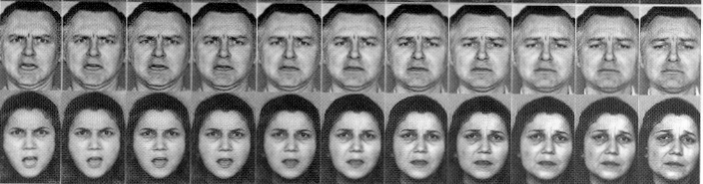
Threat Appraisal and Detection in Traumatized Children
Notes:
Threat appraisal
Repeatedly exposed to the rage of unpredictable adults, abused children appear to develop an exquisite sensitivity to the emotional signals of anger, the study finds. Shown computerized images of a face morphing gradually from sadness or fear to anger, the children who had been abused detected the angry facial expression far more quickly than did other children.
The abused children ''saw anger in faces that maybe only had 30 or 40 percent of anger mixed into them,'' said Dr. Seth Pollak, an assistant professor of psychology, psychiatry and pediatrics at the University of Wisconsin and the lead author of the study, to be published today in The Proceedings of the National Academy of Sciences.
Being attuned to the emotions of others is a way to adapt to the dangerous environment of an abused child's home, Dr. Pollak said, adding that in such a situation ''these kids' brains are doing exactly what you would want your brain to do.''
But when the children move on to other settings, where the people around them behave more rationally, their perceptual systems fail to make the shift. Instead, Dr. Pollak said, they may see anger when it is not there, or spend so much time scanning for the signs of impending rage that they miss other important social clues.

Slide 28
SORRY…..
BUT IT IS NOT ABOUT US…WE JUST HAPPEN TO BE THERE.

Slide 29
HOT BUTTON
ONE BEHAVIOR THAT PUSHES YOUR BUTTON
  How do you feel?
  HOW DID IT IMPACT YOUR RELATIONSHIP WITH STUDENT?

Slide 30
TEACHER AFFECT
Manage our own reactions and emotions
Understanding…
What pushes our buttons
We are not the cause…we just happen to be there
Secondary Trauma

Slide 31
Perceived Triggers of Danger
Reminders of trauma
  Sensory: sights, smells, sounds, touch, taste
  Emotional: anxiety, fear, vulnerability
Sudden fear - fight/flight/freeze response
Adults can unintentionally trigger children through harmless actions
Notes:
When children are reminded of trauma can feel suddenly scared/threatened….what is significant to a child who has not experienced trauma can be seen as very threatening to a child who has been traumatized. The latter then responds in a way that seems out of proportion with the situation to the uninformed observer
Fight/flight/freeze
Core cues of danger are not founded in language but within sensory, visceral, and emotional experiences. Sensory Experiences: Sights, sounds, smells, touch, tastes
Emotional Experiences: Anxiety, fear, anticipation of unknown, vulnerability, being overwhelmed, shame, loss
For a child who has been neglected cues of danger may include delays in gratification, feelings of deprivation or need, perceived rejection or abandonment. For a child who has experienced verbal abuse, triggers may include raised voice, loss of control, sense that of anger in others.
Teacher/careprovider may unintentionally trigger a fight/flight/freeze response from a child who has been traumatized through harmless action (raising voice to gain attention of class, putting hand on child’s shoulder)
Some triggers are obvious and known to the student.
Some work out of consciousness of the student, and are unobservable to outside persons
Lifelong pattern of responding to triggers, builds on itself and decreases conscious connection
For one girl I knew it the smell of salmon would reminded her of early childhood traumas, for another it was the site of small children’s coats hanging in the lockers at school (she avoided going down the Kindergarten hallway)
I worked with a student that seemed to be triggered constantly by anything and everything – just saying his name, looking at him, breathing too close to him…..appeared to set him off….his body would go into overdrive…he would lose control and tantrum, break down, cry, for 45 minutes at a time….his father was imprisoned

Slide 32


Trauma’s Impact on
Emotional Development
Difficulty with self-regulation
Difficulty describing feelings/internal states
Difficulty communicating wishes and desires
Often feel self critical, anxious, worried, ashamed, guilty - rarely experience joy
Marrow & Benamati
Notes:
One of the most prominent difficulties facing many youth who have experienced trauma is modulating their emotions, particularly when experiencing trauma reminders.
These youth may also have a limited feelings vocabulary and a limited understanding of their emotional states. It is as if they have the trial-sized box of crayons (click the remote or press the space bar) version of emotion. They know happy, sad, and angry – and thus they respond based upon this limited scope of emotional understanding, instead of having a full-sized crayon box of emotions (click the remote or press the space bar).
Emotions alert us to early warning signs of danger
May experience intense emotions out of the blue
Do not easily understand or express their emotions
Limited emotional literacy
Difficult to understand the emotions of others
Difficulty with self-regulation
Often experience negative self-critical feelings: shame or guilt
Anxious, worried, fearful
New fears
Difficulty describing feelings
in traumatic situations when there is violence against family members, they can feel like failures for not having done something helpful. They may also feel very ashamed or guilty.
School-age children get scared of the speeding up of their emotions and physical reactions, adding new fears to the danger from outside. For example, an 8 year-old child described, "My heart was beating so fast I thought it was going to break."
Children who have experienced complex trauma often have difficulty identifying, expressing, and managing emotions, and may have limited language for feeling states. They often internalize and/or externalize stress reactions and as a result may experience significant depression, anxiety, or anger.. Their emotional responses may be unpredictable or explosive. A child may react to a reminder of a traumatic event with trembling, anger, sadness, or avoidance. For a child with a complex trauma history, reminders of various traumatic events may be everywhere in the environment. Such a child may react often, react powerfully, and have difficulty calming down when upset. Since the traumas are often of an interpersonal nature, even mildly stressful interactions with others may serve as trauma reminders and trigger intense emotional responses. Having learned that the world is a dangerous place where even loved ones can’t be trusted to protect you, children are often vigilant and guarded in their interactions with others and are more likely to perceive situations as stressful or dangerous. While this defensive posture is protective when an individual is under attack, it becomes problematic in situations that do not warrant such intense reactions. Alternately, many children also learn to “tune out” (emotional numbing) to threats in their environment, making them vulnerable to revictimization.
Difficulty managing emotions is pervasive and occurs in the absence of relationships as well. Having never learned how to calm themselves down once they are upset, many of these children become easily overwhelmed. For example, in school they may become so frustrated that they give up on even small tasks that present a challenge. Children who have experienced early and intense traumatic events also have an increased likelihood of being fearful all the time and in many situations. They are more likely to experience depression as well.
Adolescents:
With the help of their friends, adolescents begin a shift toward more actively judging and addressing dangers on their own. This is a developing skill, and lots of things can go wrong along the way. With independence, adolescents can be in more situations that can turn from danger to trauma. They can be drivers or passengers in horrible car accidents, be victims of rape, dating violence and criminal assault, be present during school or community violence, and experience the loss of friends under traumatic circumstances. During traumatic situations, adolescents make decisions about whether and how to intervene, and about using violence to counter violence. They can feel guilty, sometimes thinking their actions made matters worse. Adolescents are learning to handle intense physical and emotional reactions in order to take action in the face of danger. They are also learning more about human motivation and intent and struggle over issues of irresponsibility, malevolence, and human accountability.
Young Children:
Think of what it is like for young children to be in traumatic situations. They can feel totally helpless and passive. They can cry for help or desperately wish for someone to intervene. They can feel deeply threatened by separation from parents or caretakers. Young children rely on a "protective shield" provided by adults and older siblings to judge the seriousness of danger and to ensure their safety and welfare. They often don't recognize a traumatic danger until it happens, for example, in a near drowning, attack by a dog, or accidental scalding. They can be the target of physical and sexual abuse by the very people they rely on for their own protection and safety. Young children can witness violence within the family or be left helpless after a parent or caretaker is injured, as might occur in a serious automobile accident. They have the most difficulty with their intense physical and emotional reactions. They become really upset when they hear cries of distress from a parent or caretaker.

Slide 33
OH WAIT…
MAYBE IT IS ABOUT US??!!

Slide 34
Relationship is the
Evidence-Based Practice
Engage in positive, trusting relationships
Provides new experiences with adults which includes:
  Consistent approach to communication
  Feelings are acknowledged and validated
  Protective toward them
  Unconditional regard and care even when behaviors are challenging
Notes:
Trauma results primarily from disrupted relationships
Supporting children to re-experience relationships differently is the key to trauma recovery and change.
Positive relationships: Being connected with others is more powerful than want of drugs – monkey study – when monkeys were presented with the choice between cocaine or monkey food, they became cocaine addicts; presented with cocaine versus m and m’s – they used each about equally and did not become addicts; when they could choose between cocaine or interacting with another monkey (relationship) – they always chose the relationship and did not become addicted to cocaine. (unless the monkey they could choose to interact with was their mother in law – joke). Tammy Cole

Slide 35
UNIVERSAL – TIER I
Recognize the impact of trauma on learning and behavior
Create safe environments (physically and emotionally)
Manage our own reactions and emotions
Incorporate teaching specific social skills for managing and coping with emotions
Classroom lessons – Stress Trauma & Resiliency

Slide 36
AUTOMATICS
HOMELESS
RESIDENTIAL/TREATMENT FACILITIES
RISK TO SELF
RISK TO OTHERS
YOUTH COURT SERVICES
ADOPTED
FOSTER CARE

Slide 37
Most common reasons
Anxiety
Depression
Family Disruptions
Suicidal Ideation
Non Suicidal Self Injury

Slide 38
COMMUNICATION
IDENTIFY “TRIGGERS”
IDENTIFY COPING MECHANISMS
PARENT/TEACHERS/COUNSELORS/ADMIN
504 ELIGIBLE?

Slide 39
WHAT CAN YOU DO??
CONSISTENCY—ROUTINES & RITUALS
CHECK YOUR AFFECT
CLASS MEETINGS
HELP WITH GROUNDING
CONNECT (KEEP TRACK OF WHO YOU TALK WITH!!)

Slide 40
Summary
Recognize the impact of trauma on learning and behavior
Implement a multi-tiered system of support (MBI/PBIS/Foundations/MTSS)
Create safe environments (physically and emotionally)
Manage your own reactions and emotions
Incorporate teaching specific social skills for managing and coping with emotions

Slide 41

RESILIENCE
Resilience is the ability to recover from traumatic events.
The natural ability to navigate life well.
Research has shown that 2/3 of children who experience adverse childhood events will grow up and “beat the odds”.
GUESS MAJOR FACTOR FOR RESILIENCY??
Notes:
The holiest of flowers for Hindus, the beautiful lotus is symbolic of the true soul of an individual. It represents the being, which lives in turbulent waters yet rises up and blossoms to the point of enlightenment.
Factors that contribute to resilience:
Close relationships with family and friends
A positive view of yourself and confidence in your strengths and abilities
The ability to manage strong feelings and impulses
Good problem-solving and communication skills
Feeling in control
Seeking help and resources
Seeing yourself as resilient (rather than as a victim)
Coping with stress in healthy ways and avoiding harmful coping strategies, such as substance abuse
Helping others
Finding positive meaning in your life despite difficult or traumatic events

Slide 42
RELATIONSHIPS
    Connection to family/community/cultural supports
    Optimistic temperament
    Ability to seek help/resources
    Healthy coping skills
    Helping others
    Positive view of self

Slide 43
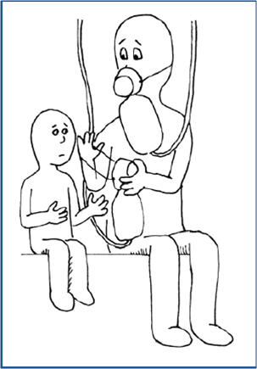
Things To Remember
You deserve as much support and good treatment as you provide others who have experienced stress, trauma or loss.
Caring for yourself results in being a more effective educator, family member, friend and human being.
Self-Care is a priority and necessity, not a luxury in the work that we do.

Slide 44
ARE YOU TAKING CARE???
ARE YOU USING SELF INDULGENCE…
OR
SELF CARE??
WHAT GIVES YOU JOY

