Slide 1

Choice, Voice, and Deeper Learning:
How a Shift to Proficiency-Based Learning Can Increase Equity and Student Engagement
Keynote Presentation at the Proficiency-Based Education Summer Symposium, Montana State University
June 2023
Dr. Karin Hess
Educational Research in Action
www.karin-hess.com
@drkarinhess

Slide 2
Session Overview
Develop a shared understanding of WHY and HOW Proficiency-Based Education/PBE has evolved across the country
Share some current research and lessons learned related to core components of PBE
Hear and see a few examples of how schools/states have approached implementing core components of Proficiency-Based Learning

Slide 3
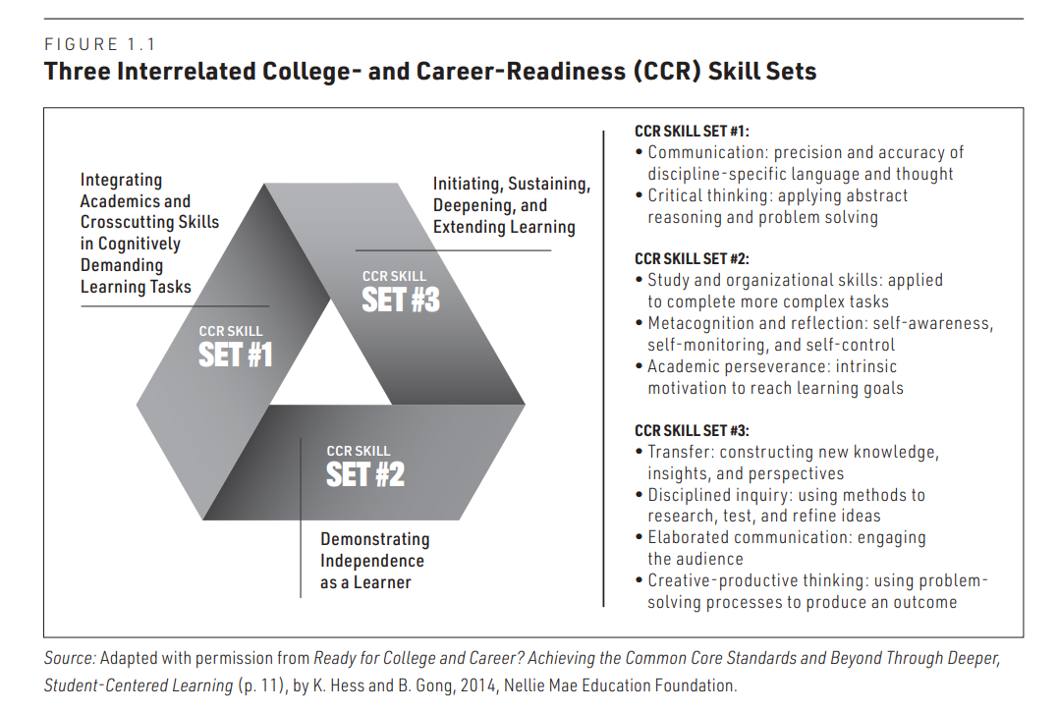
WHY Deep Learning for Every Student?
3 Interrelated College And Career-Readiness Skill Sets
Complex Tasks
Building Schema
Productive Struggle
Self-Regulation
Metacognitive Skills
Far TRANSFER
Student-Driven
Questions/Inquiry
Voice & Choice

Slide 4

2019 Gallup Report – Creativity in Learning
To what extent are we preparing students to be productive, successful employees and global citizens?
Creativity in Learning gallup report.pdf
Teachers …
“Teachers who practice creativity in learning use student-centered techniques including project-based assignments that require students to think of their own solutions to problems, as well as self-directed assignments that give students input on what they’d like to learn” (p. 6).
Students …
“A majority of students would like to spend more time on activities that help them see how their learning relates to real-life problems outside the classroom. However, only 26% of students say they often work on projects with real-world applications” (p. 4).
Notes:
Nationally representative sample – explored to what extent is creativity being fostered in American schools – preparing students to be productive and successful employees and and global citizens

Slide 5
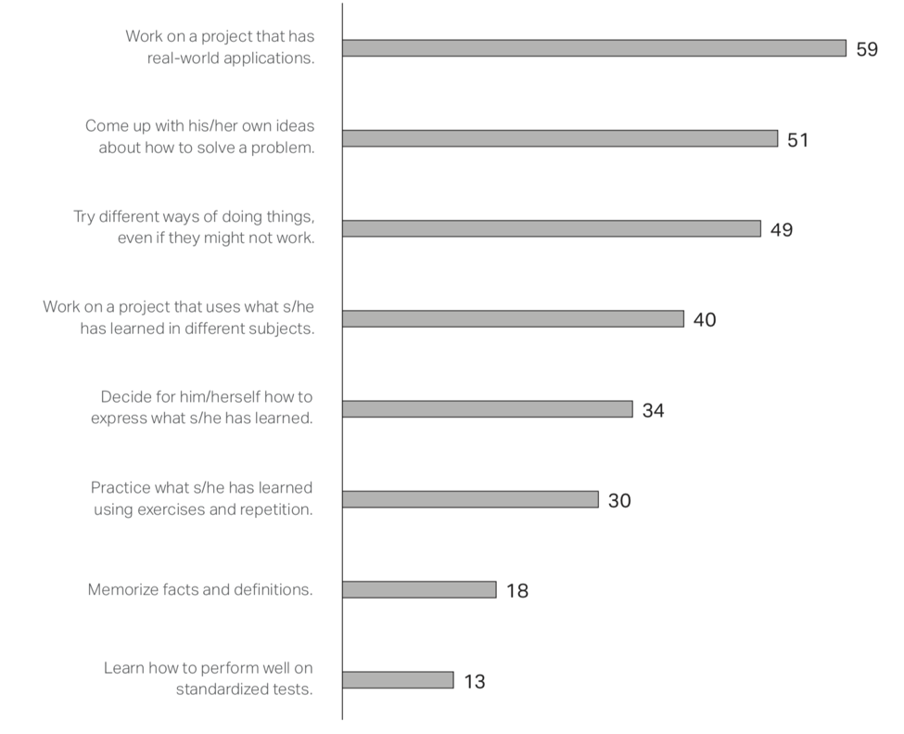
Gallup Report [2]
How parents ranked learning experiences [percentage of parents who said it’s ”very important.”]
Authentic Student-Driven Inquiry
Choice - Productive Struggle
“Far” TRANSFER - Complex Tasks
Voice – Metacognition/Reflection
“Near” TRANSFER –
Routine Tasks

Slide 6



Deeper Competency-Based Learning
(Hess, Colby, & Joseph, 2020)
Connecting Deeper Learning With
Hattie’s Visible Learning™ Influencers
Students’ ability to engage with tasks requiring that they transfer their learning (0.86)
.
Collective Teacher Efficacy (1.39)
Teacher clarity when setting expectations and designing learning activities (0.75)
Student use of self-reflection (0.75)
Teachers’ engagement with cognitive task analysis (1.29)
Student use of strategy monitoring (0.58)
Student use of metacognitive strategies (0.55)
Timely, self-regulatory feedback (0.66)
.

Slide 7
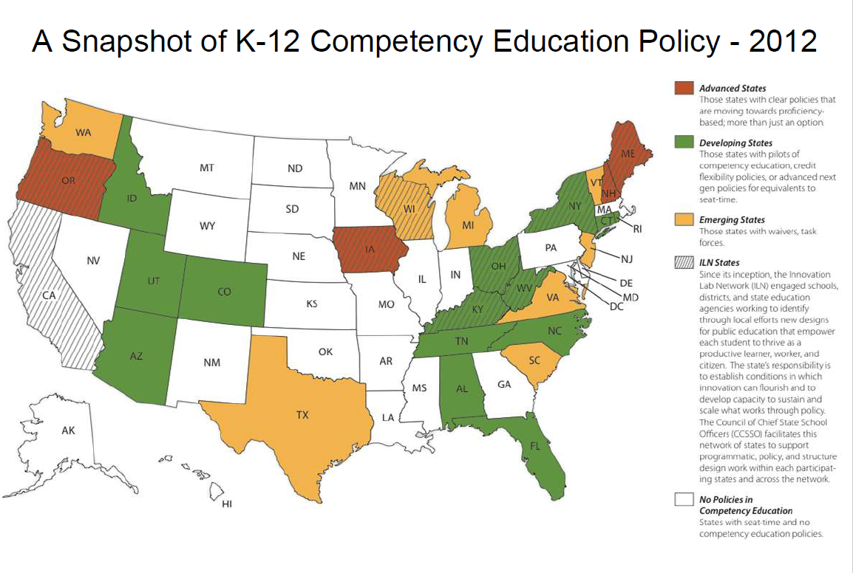

Slide 8
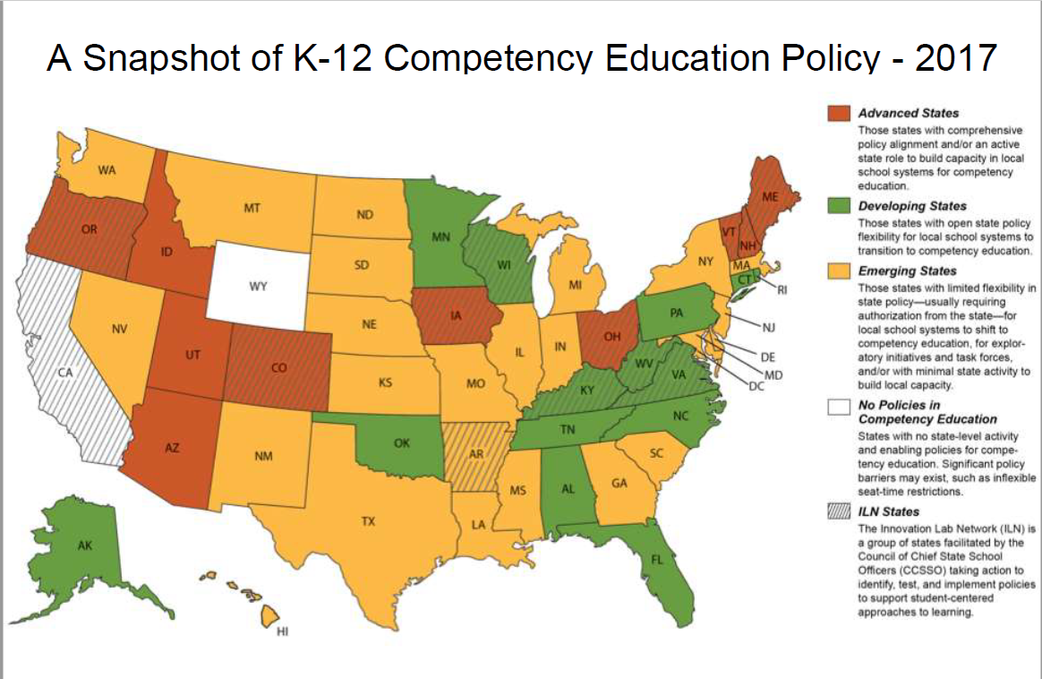

Slide 9
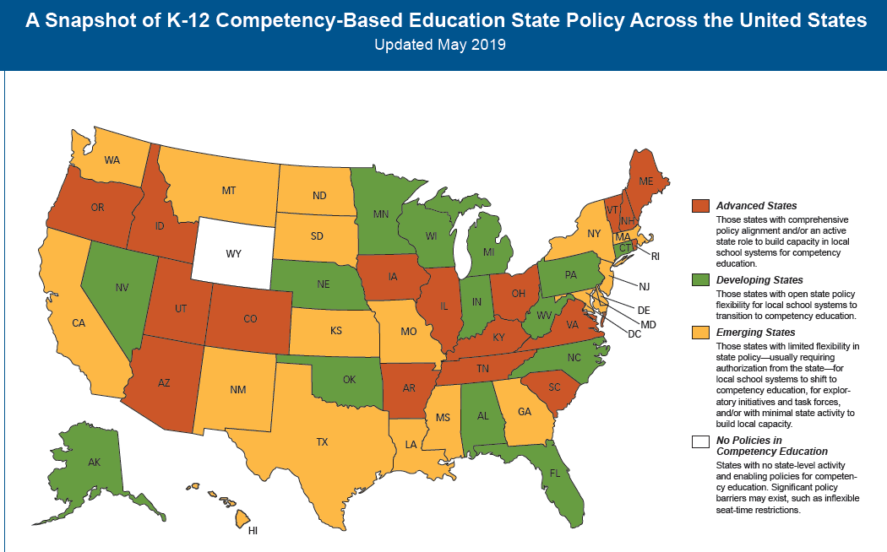

Slide 10


Slide 11
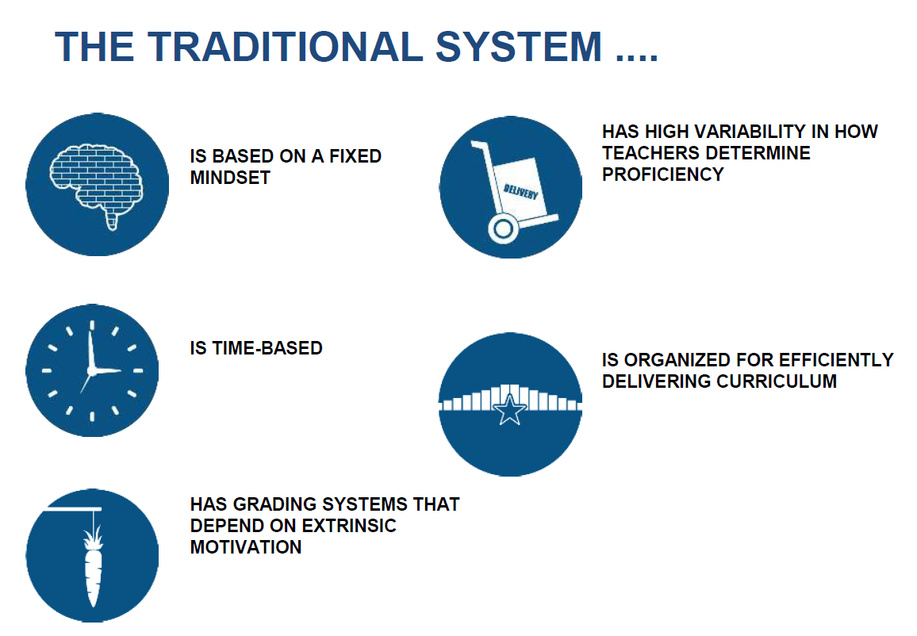

Slide 12
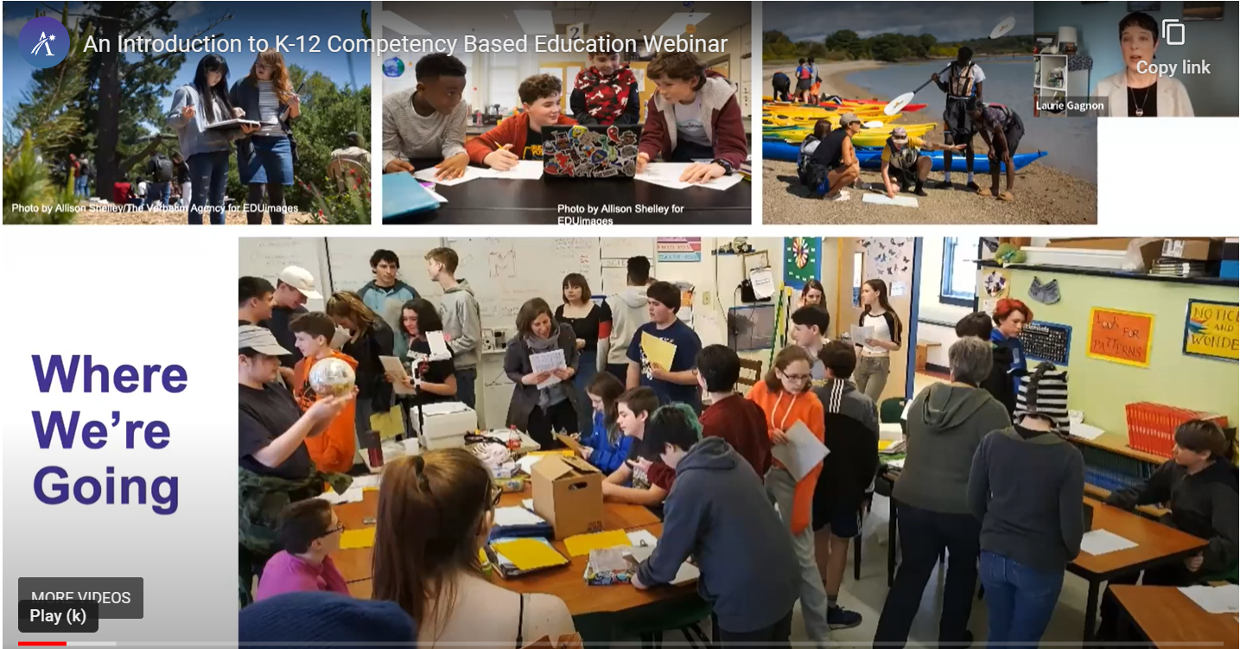

Slide 13
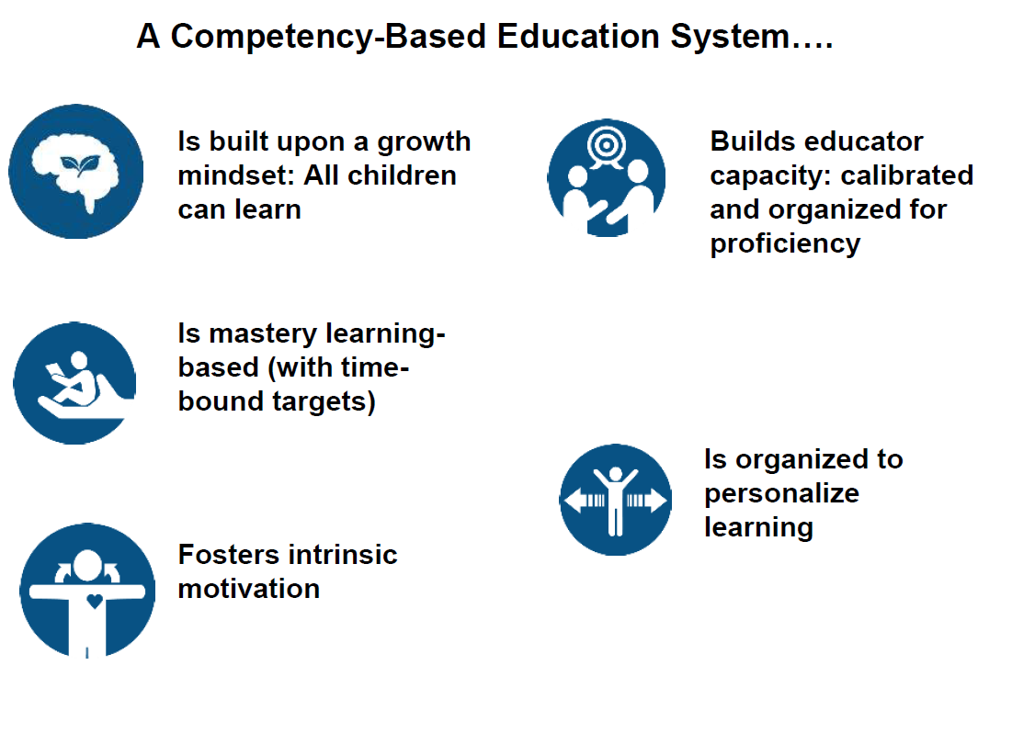

Slide 14
Aurora Institute (2019):
Competency-based education is a system in which…
Students are empowered daily to make important decisions about their learning experiences, how they will create and apply knowledge, and how they will demonstrate their learning.
Assessment is a meaningful, positive, and empowering learning experience for students that yields timely, relevant, and actionable evidence.
Students receive timely, differentiated support based on their individual learning needs.
Students progress based on evidence of mastery, not seat time.
Students learn actively using different pathways and varied pacing.
Strategies to ensure equity for all students are embedded in the culture, structure, and pedagogy of schools and education systems.
Rigorous, common expectations for learning (knowledge, skills, and dispositions) are explicit, transparent, measurable, and transferable.

Slide 15

What does it mean for a student to be proficient?
Start with a common vision…then build policies, practices, & tools
Notes:
Competency-Based Education - Aurora Institute (aurora-institute.org) start at minute 13:00 – 17:22

Slide 16
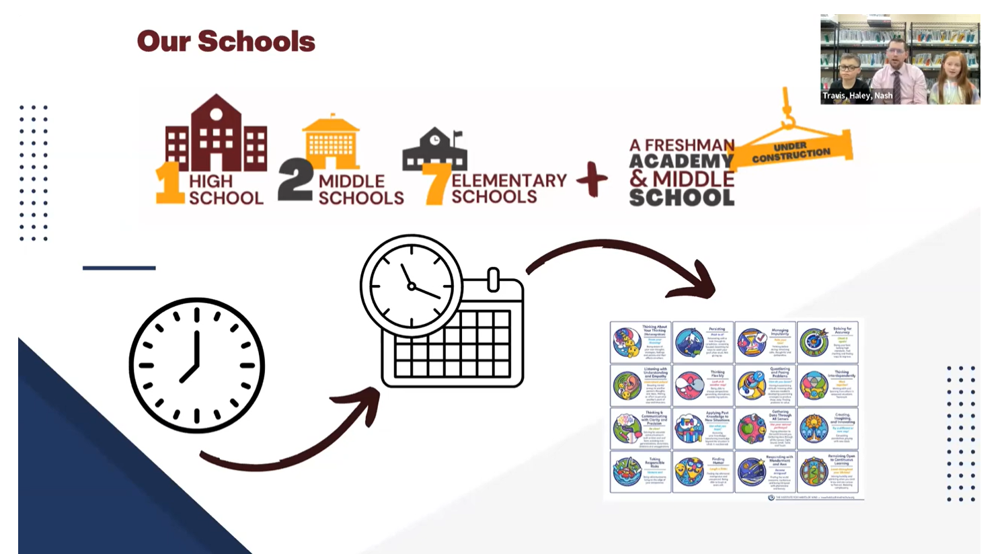
Listen to Harrisburg, SD’s development process (13:00 – 17:22)
Competency-Based Education - Aurora Institute (aurora-institute.org)
Notes:
Competency-Based Education - Aurora Institute (aurora-institute.org) start at minute 13:00 – 17:22

Slide 17
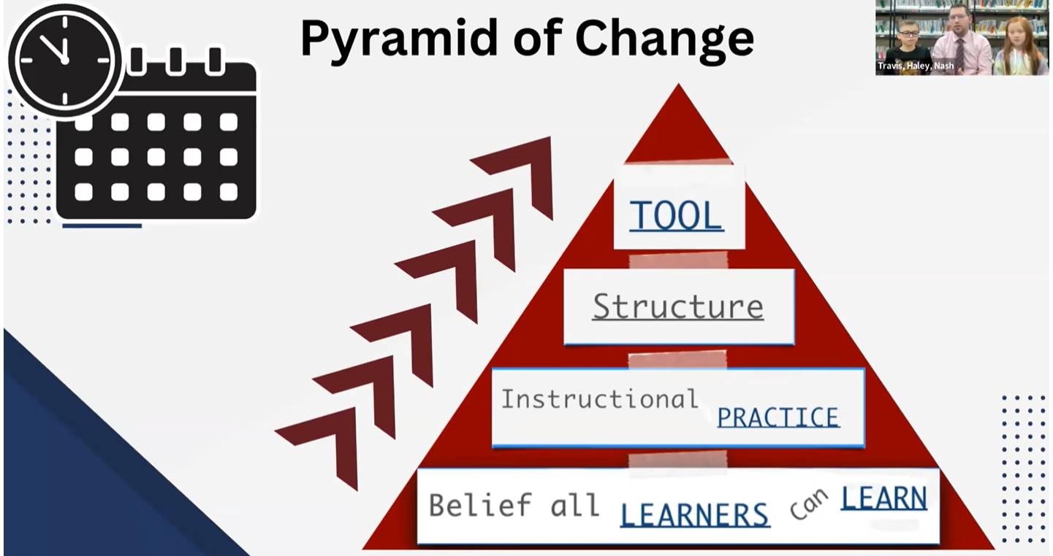
Notes:
Show clip starting at

Slide 18


Deeper Competency-Based Learning
(Hess, Colby, & Joseph, 2020)
Core Components of Competency-Based Education for Deeper Learning
Competencies
Broadly-stated academic goals and personal success skills that are measurable, rigorous, and transferable, empowering student learning beyond a single lesson, unit of study, or course.
Personal Success Skills
Life skills explicitly referenced in a school’s portrait of the graduate, including workplace habits, self-management skills, and skills for interacting and working effectively with others.
DEEPER
LEARNING
Evidence-Based Grading
Scoring and reporting based on a body of evidence (BOE) that reflects progress or mastery of unit, course, and graduation competencies.
Performance Assessments
Multistep assessments with clear criteria, expectations, and processes that measure how well a student transfers knowledge and integrates complex skills to create or refine an original product.
Learning Pathways
Descriptions of how students will develop and demonstrate deeper, broader, and more sophisticated understanding over time, with flexible pacing of learning.

Slide 19
Personal Success Skills: Personalization, Profile of the Graduate/Profile of the Learner, Work Study Practices
Most states and schools have started with a focus on personalization – E.g., VT, RI, KY, SC, NH, UT, ND, and …
Life Skills Promote Engagement, Ownership, Agency, Equity
Collaboratively identify skills that can be applied to learning inside school (academics) and outside of school (internships, personal interests, capstone projects, etc.).
Challenges: How to measure/assess “personal” skills; Scale-up: Implementation throughout the system
Notes:
Common entry point - personalization

Slide 20
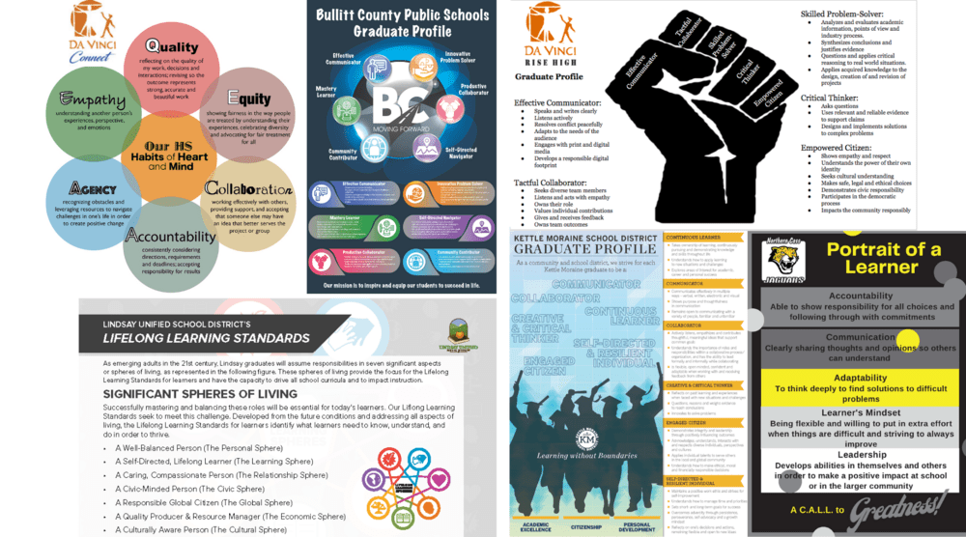
Notes:
Read about different schools - Northern Cass School District, North Dakota, Lindsay Unified School District, California, Bullitt County Public Schools, Kentucky, Da Vinci Schools, California

Slide 21
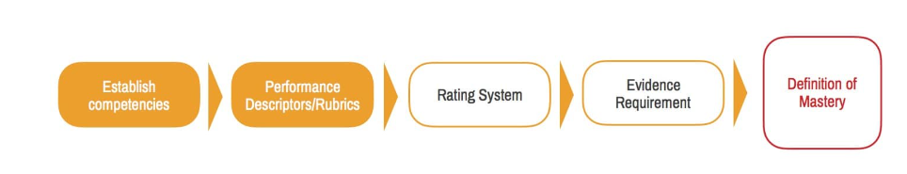
Developing Academic Competencies
Broadly-stated academic goals that are measurable, rigorous, and transferable, empowering student learning beyond a single lesson, unit of study, or course.
Designed based on prioritizing nationally valued standards and organized by subject area, resulting in fewer, broader learning goals that could be integrated across subjects
Challenges: Consistency within Systems, Scale-up, Assessment, Integration with Personal Skills, Data Management, Evidence-Based Grading
Five Key Lessons for Mastery Learning Startup - Aurora Institute (aurora-institute.org)

Slide 22
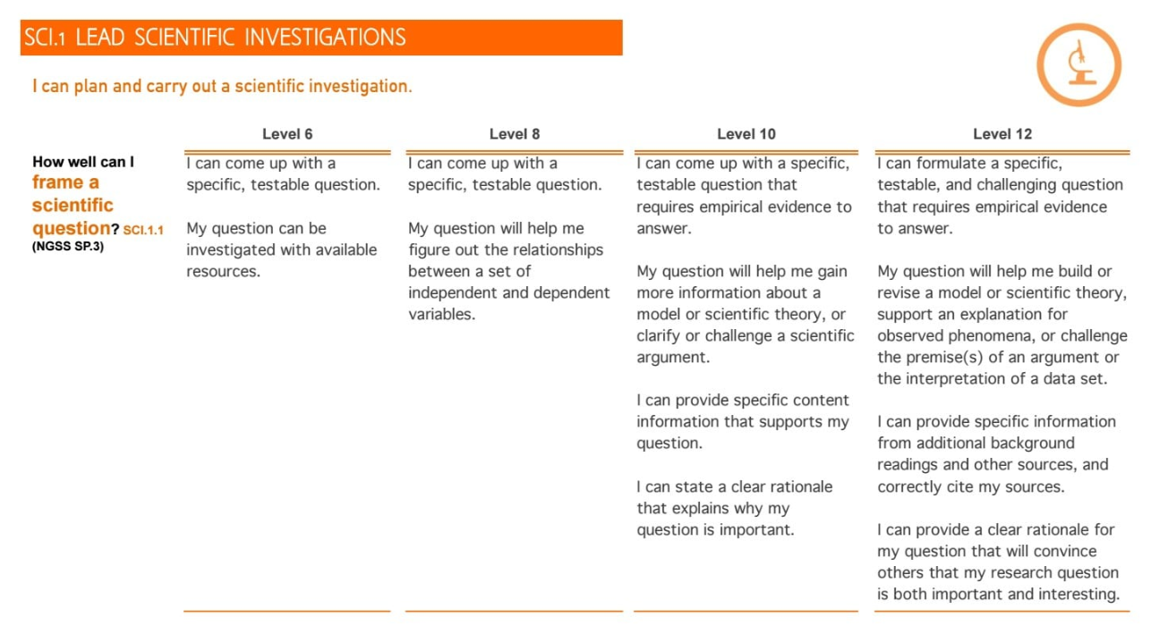
“… an excerpt of the continuum that matches the science competency referenced above, for the first skill “Ask a testable question:” [Five Key Lessons for Mastery Learning Startup - Aurora Institute (aurora-institute.org)]
Notes:
Five Key Lessons for Mastery Learning Startup - Aurora Institute (aurora-institute.org)

Slide 23
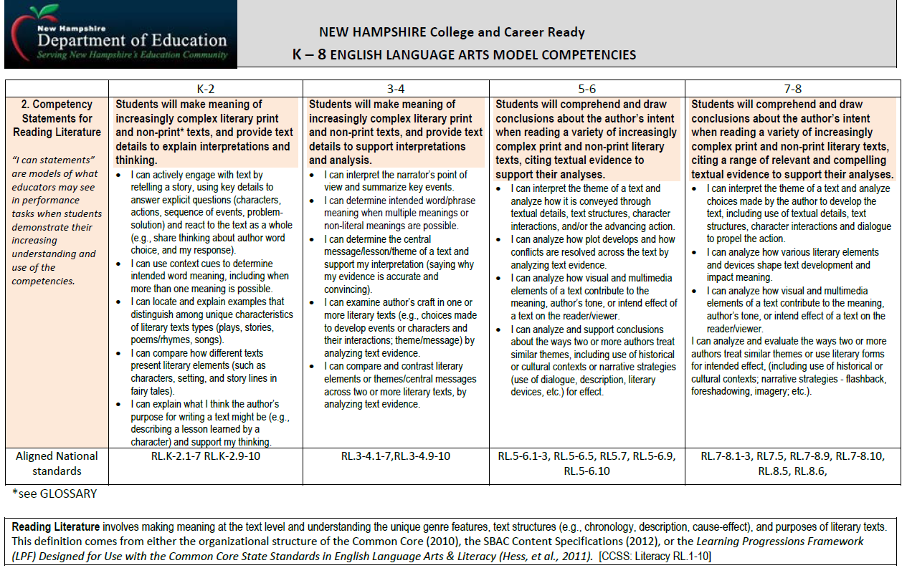
Notes:
Create learning progressions within and across grade spans

Slide 24
Performance-Based Assessments
Problem-Based Learning - Performance Tasks
A student-centered approach in which students learn about a subject by working in groups to solve an open-ended problem. This problem is what drives the motivation and the learning. The approach is also inquiry-based when students are active in creating/identifying the problem.
Project-Based Learning & Extended Projects
A student-centered approach to learning focusing on developing content knowledge through extended projects addressing a real-world problem or answering a complex question. Students develop a public product or presentation (beyond the classroom) to share their learning.

Slide 25

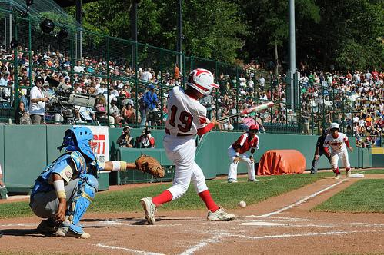
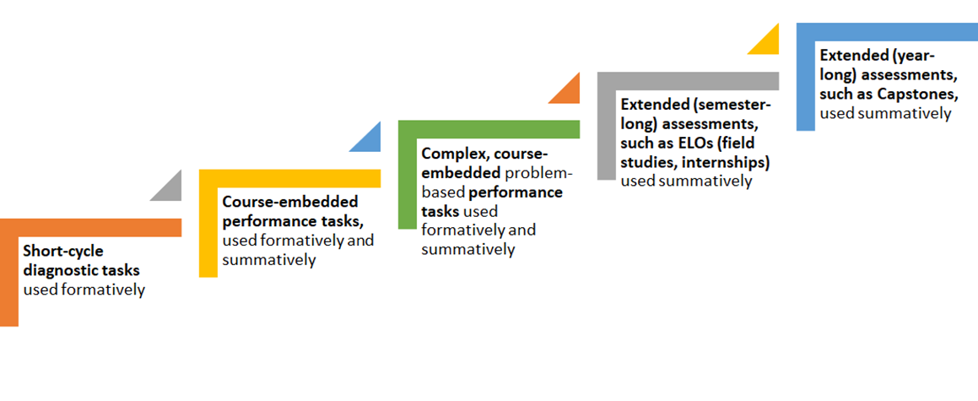
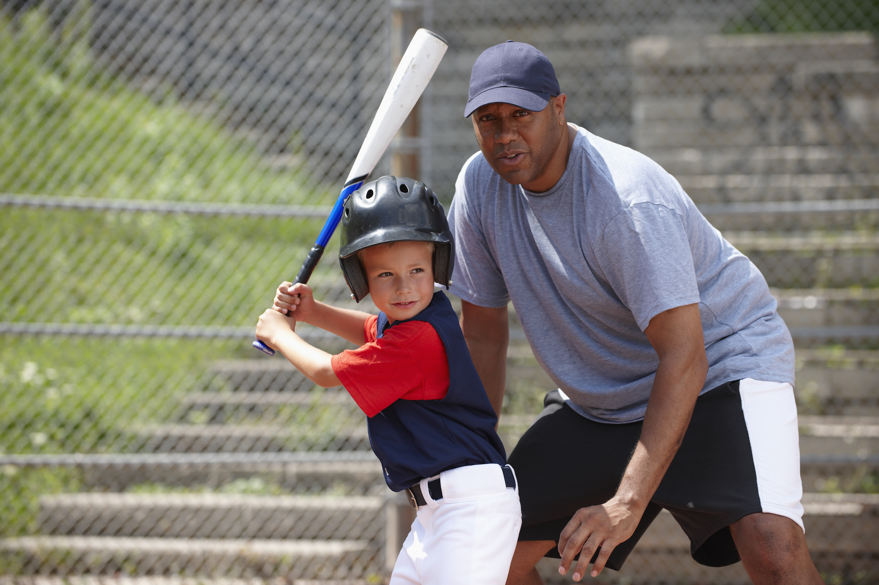
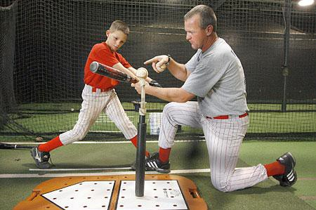

NOT one performance assessment, but a continuum of increasingly complex performance assessments [Deeper CB Learning, p. 65]

Slide 26
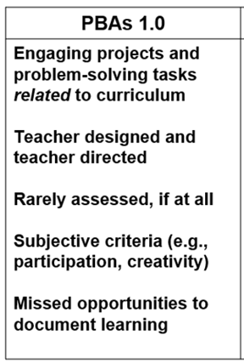
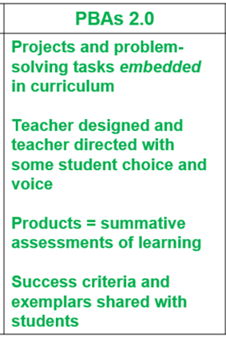
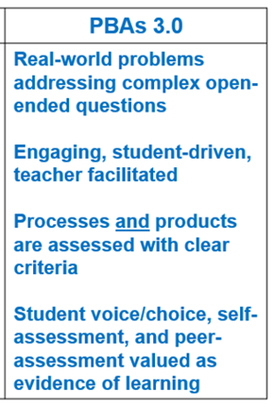
Design complex tasks, emphasizing student input and evidence-based solutions. (Rigor by Design, Not Chance, Hess, 2023)

Slide 27
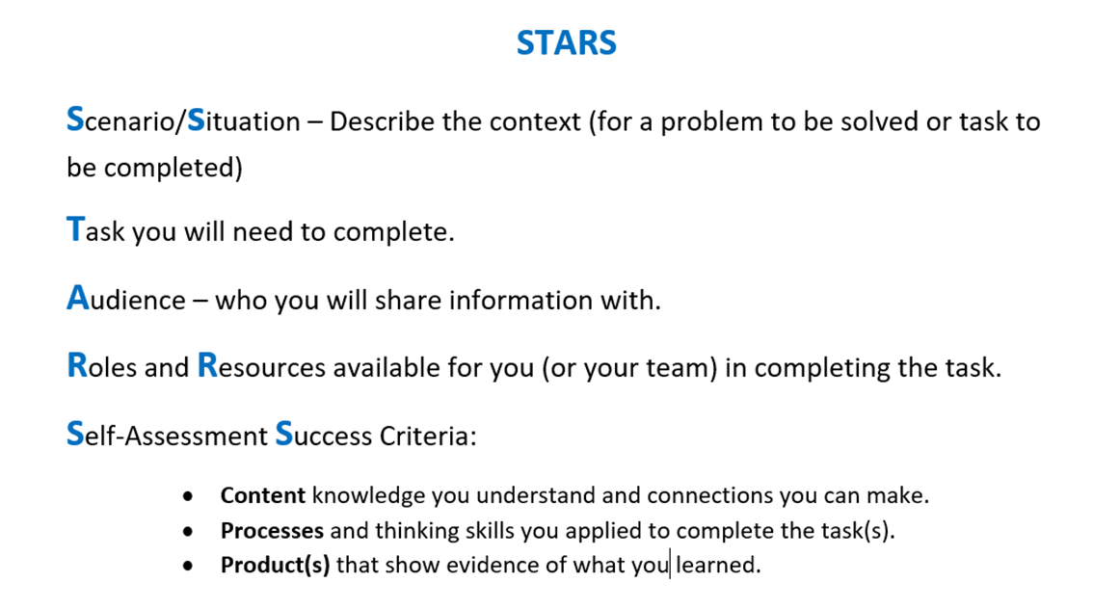
Developing Complex Performance Tasks
[Hess, RbD, pp. 103-107]
Start Here

Slide 28
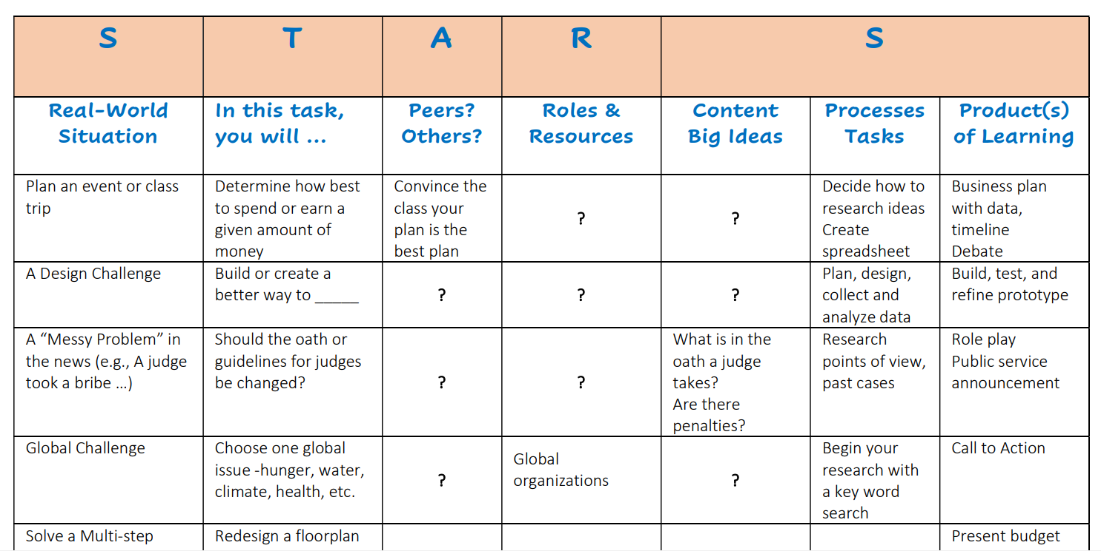
Creating a PB task prompt…
Decide what content & processes students will transfer
Identify a real-world context for the learning
What input/choices will students have?

Slide 29
EQ: How do authors use rhetorical strategies to communicate the content of a message?
Content & skills to transfer
We’ve been learning about how authors use rhetorical strategies to communicate a message. Now you’ll incorporate the use of rhetorical strategies to develop either:
  ●an original advertisement,
  ●a speech on a debatable issue, or
  ●a debatable scientific treatise.
The final product will be critiqued by your peers.
And, you’ll write a reflection evaluating the effectiveness of the strategies you used.

Slide 30
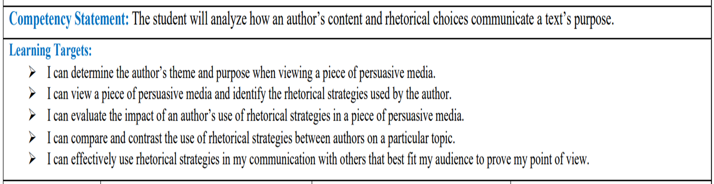
Clarify and Order a Series of Learning Targets to Demonstrate Competency from least to more complex.
Is there more than one Performance-Based Assessment?
Start with the least complex target

Slide 31
EQ: How can statistics be manipulated to sway opinions?
We have been learning about how the media can oftentimes skew data to sway viewers to think about a specific topic in a certain way, leading to a harmful ‘media bias’ where consumers of media are, in some way, being told lies. Now, you’ll have the opportunity to practice identifying ‘media bias’ by:
Analyze a persuasive article and form your own opinion based on the information.
Evaluate the given data sets to identify any false biases within the article.
Use math concepts to disprove/prove potential biases of the article.
4) Write a letter to (the author) to justify your opinion using the data/math discovered throughout the lesson as evidence for your claims.
Content & skills to transfer

Slide 32
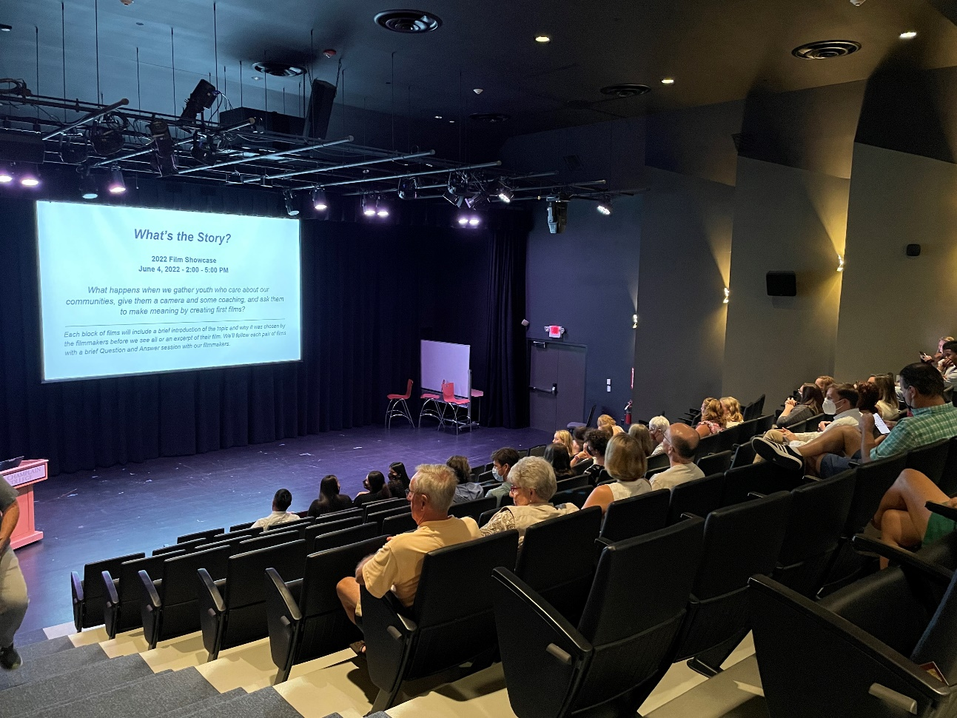
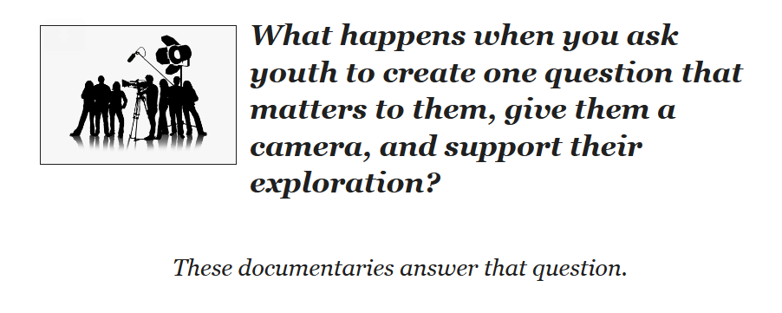
Student-Designed PBAs - “What’s the Story?”
Students create the content based on a topic or issue important to them. They are guided through a process of researching, story boarding and script writing, video taping and editing, and presenting documentaries to an authentic audience.

Slide 33

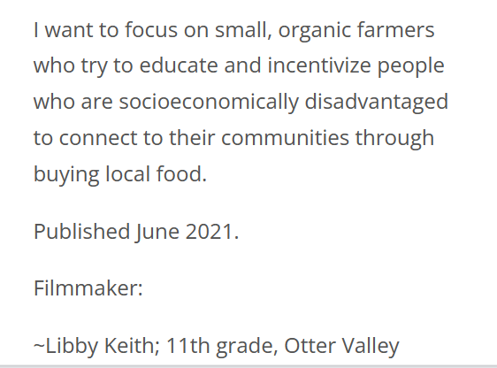


Sample Stories

Slide 34
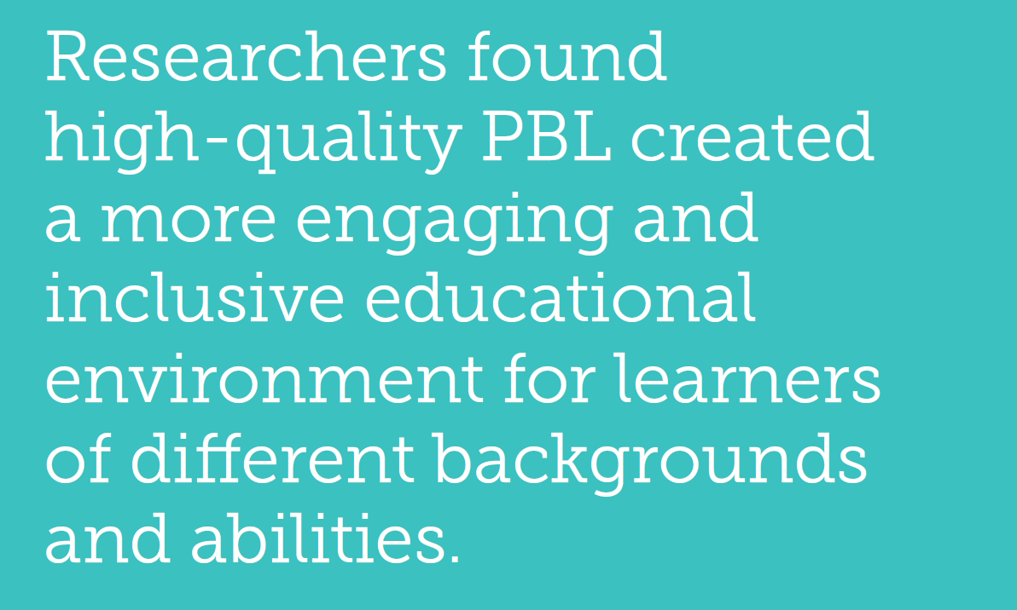
Deepening Project-Based Learning: Lessons from Powerful New Research and Practice - Aurora Institute (aurora-institute.org)

Slide 35
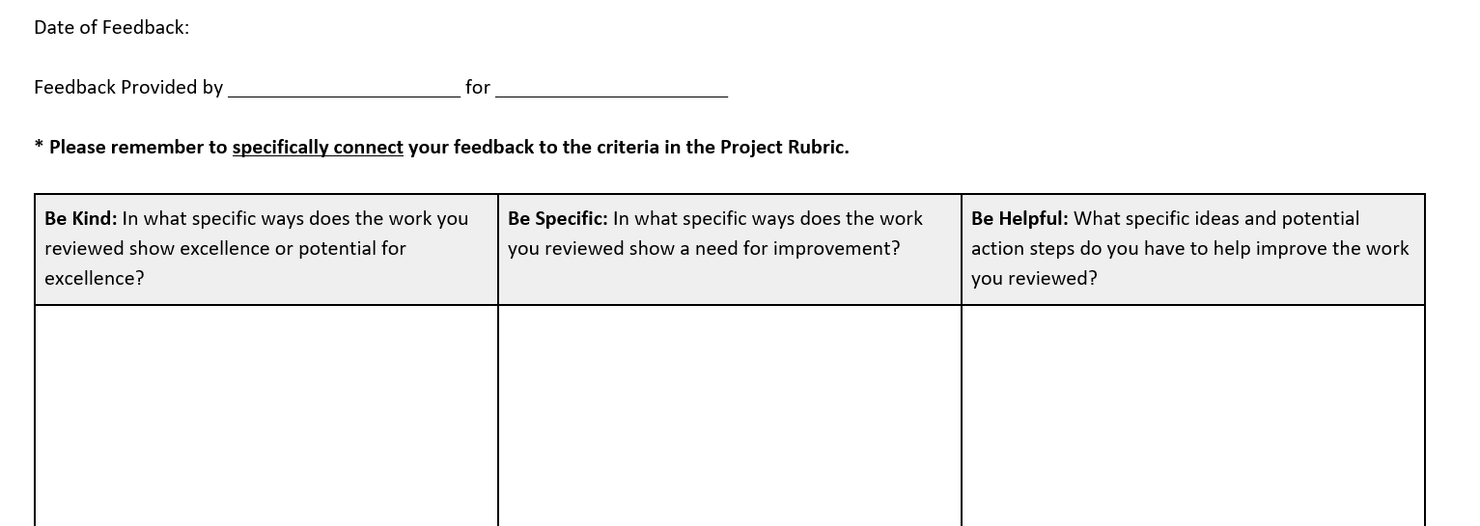
Using Peer-to-Peer Feedback to Improve Work Quality
Use with short-cycle formative tasks or parts of longer performance-based tasks that integrate multiple academic skills and concepts with personal skills (creativity, collaboration, self-direction).

Slide 36
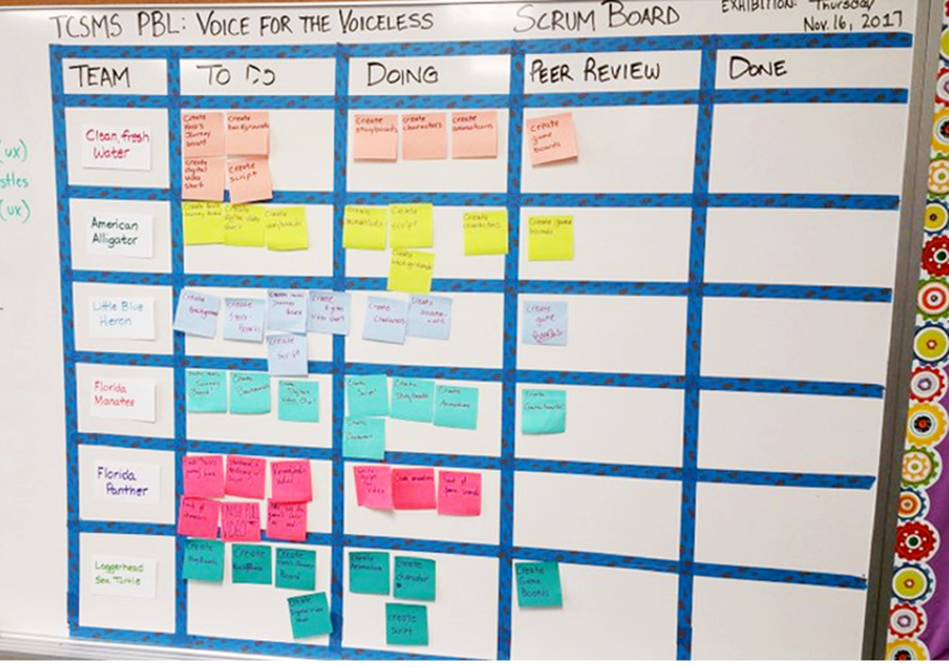
Build in Peer
Group
Critique/
Feedback for Complext Tasks
DURING
LEARNING
With Multi-Step
Project-Based
Scrum Boards
Scrum Boards
RbD, pp. 88-89

Slide 37
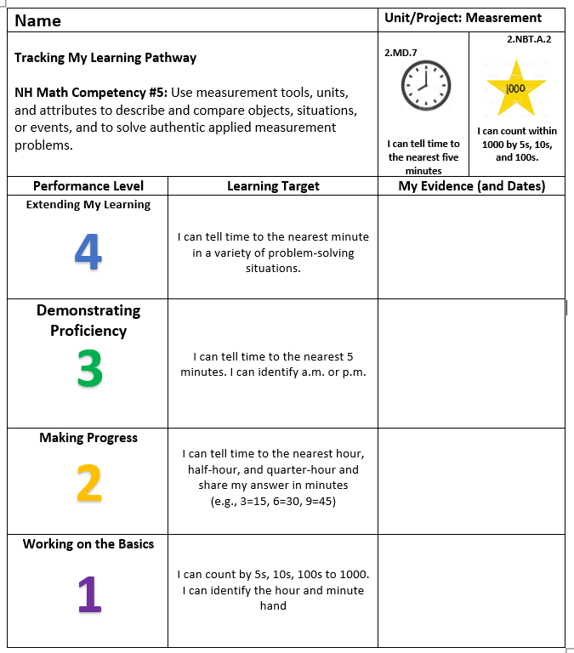
Students monitor their progress and identify evidence for their personal Body of Evidence
(Deeper CB Learning, Hess, Colby, & Joseph, 2020)
1. List the learning goal/standards
2. Describe “proficient” performance
Student Documents Evidence
3. Describe “getting started” and “making progress”

Slide 38

Using Reflective Journaling for Complex Tasks
©Karin Hess (2023) Rigor by Design, Not Chance
Sample Prompts
How did you determine your focus and develop your ideas?
What prior knowledge /skills did you apply (transfer)?
How will your______ reflect what you learned?
What decisions did you make to create OR IMPROVE your final product?
What new insights are you starting to develop about the topic?
What connections can you make to the Essential Question?
Notes:
Content-process-form-impact-knowledge construction

Slide 39
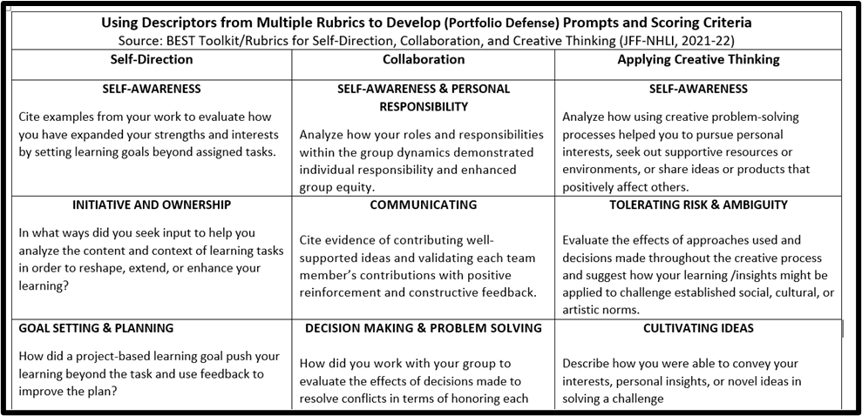
Student-Led Conferences
Evidence-Based Criteria: Rubrics for Academic & Personal Skills
Students Prepare Using Their Body of Evidence (e.g., Digital Portfolios)

Slide 40
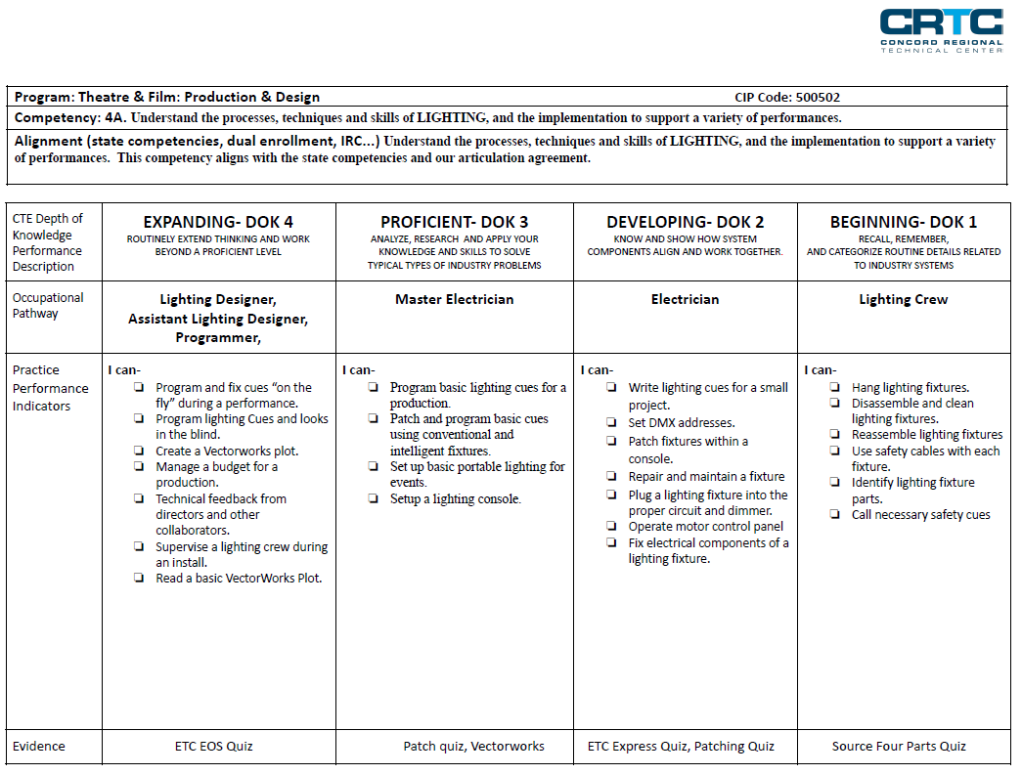
Notes:
Watch a SPUR conference video 0:00 – 2:30 min)

Slide 41

In what ways can student input and decision making make learning and performance-based assessments meaningful for students?

Slide 42
Research Tidbits & Lessons Learned about Implementing PBE
Students who had a teacher with specific training in embedding and assessing work study practices performed higher in academic domain knowledge than students who were not taught by a teacher with work study practice professional learning. Scaling Up Deeper Learning: Results From New Hampshire’s Statewide Efforts - NHLI | New Hampshire Learning Initiative (nhlearninginitiative.org)
If your objectives from student POG exhibitions include students producing rich artifacts of learning and having some practice runs leading up to a rigorous Defense of Learning performance summative assessment – it is imperative that students exhibit and exhibit often. From Good to Great, Initial to Ideal: A Way to Improve Exhibitions and Other Performance Assessments - Aurora Institute (aurora-institute.org)
Results have shown that student recognition positively impacts student retention and academic success. The results of this research investigation provide quantifiable and qualitative evidence that adds to the literature and contributes additional factors in the domain of competency-based education by which future research can proceed. The impact of student recognition of excellence to student outcome in a competency‐based educational model - Bliven - 2021 - The Journal of Competency-Based Education - Wiley Online Library
As educators saw student engagement flourish in PBL environments, teachers felt empowered to support the growth and sustainability of project-based learning. … student engagement supported the adoption and implementation of PBL and motivated teachers to deepen their change in practices in positive ways. Enabling-Conditions-for-Scaling-PBL-White-Paper.pdf (lucasedresearch.org)

Slide 43
Resources Referenced [1]
Hess Cognitive Rigor Matrices - Cognitive Rigor and DoK | Karin Hess, PhD (karin-hess.com)
Karin Hess books Amazon.com: Karin J. Hess: books, biography, latest update
NH BEST K-12 Self-Direction , Collaboration, & Creative Thinking Rubrics) Archived Postings | Karin Hess, PhD (karin-hess.com) Developed for NH Schools Work Study Practices
Karin’s CBE and PLB Resources APPLYING RIGOR TO PBL-CBE | Karin Hess, PhD (karin-hess.com)
Every State Now Lets Schools Measure Students' Success Based on Mastery, Not Seat Time (edweek.org) and "WYOMING'S FUTURE OF LEARNING” COLLABORATIVE LAUNCHES FIRST PILOT PROGRAMS - Wyoming Department of Education
An Overview of K-12 Competency-Based Education for Education Leaders and Teachers - Aurora Institute (aurora-institute.org) [2017] and related Webinar (21) Webinar | Overview of K-12 Competency-Based Education - YouTube
what-is-competency-based-education-an-updated-definition-web.pdf (aurora-institute.org) 2019
Competency-Based Education - Aurora Institute (aurora-institute.org) 2023 Document and Webinar

Slide 44
Resources Referenced [2]
Portrait of a Graduate in Practice: Examples and Competencies | NGLC (nextgenlearning.org) and POG Reports — NGLC MyWays (nextgenlearning.org)
What’s the Story? The Vermont Young People Social Action Team www.whatsthestory.middcreate.net/vermont
What's the Story? (Links to teaching resources); Introductory Lesson; and Process Steps- Use to share a personal perspective or reflection on "life" events
COMPETENCYWORKS BLOG Our Journey Towards A Competency-Based System (aurora-institute.org) May 5, 2023
KnowledgeWorks Blog Tearing Down the Wall Between General and Special Education – KnowledgeWorks May 31, 2023 Karla Phillips-Krivickas
STUDENT-LED CONFERENCES
SPUR Sample Conference Video (NH CTE Students Meet with Teachers to discuss their evidence of learning) www.youtube.com/watch?v=ueRcBg8uYS8
The Power of Performance Assessments: Oakland Unifi ed’s Graduate Capstone Project” (5:26 min video) - www.youtube.com/watch?v=V5ts4gZSux8
Student-Led Conferences: Kindergarten Video (Trinity shares work with parents and sets goals) www.youtube.com/watch?v=dmIReiqI1ec

