Slide 1
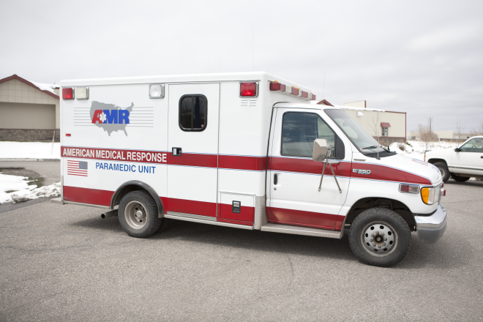
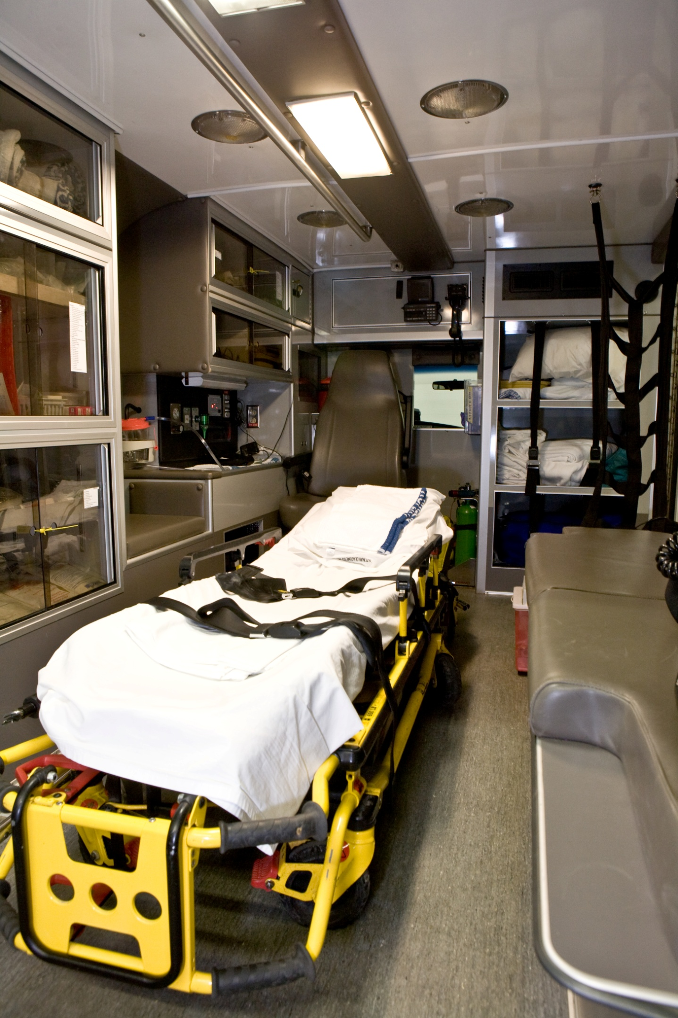
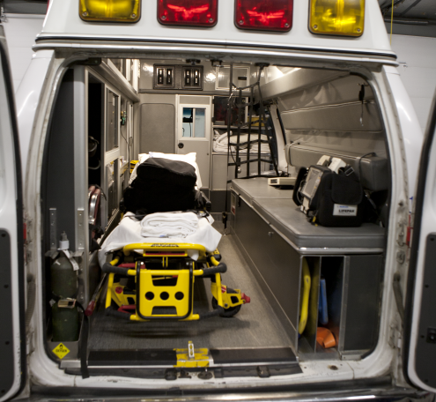
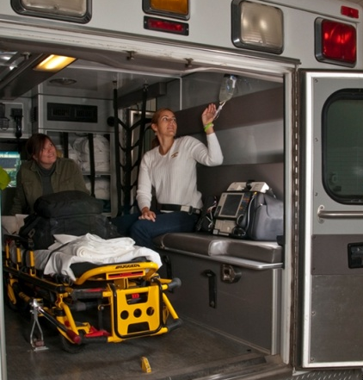
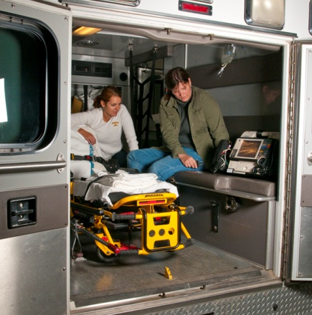
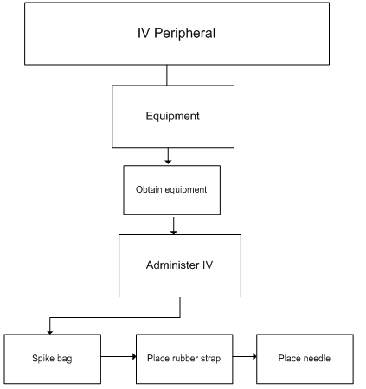
Rural EMS Worker Restraint Usage and Feasibility in Emergency Response Vehicles
Tawny Hoyt¹, Dr. Laura Stanley¹, Nels Sanddal², and Teri Sanddal²
¹Western Transportation Institute – Montana State University Bozeman and ²Critical Illness and Trauma Foundation, Bozeman, MT
Background
Emergency medical service (EMS) workers have a fatality rate of 12.7 per 100,000¹. Of these fatalities, 74% of them are transportation related².
Objective
This study observed EMS worker restraint usage feasibility while performing the most common procedures.
Methods
Reach Envelope Analysis
Results
A reach envelope is the area in which the performance of manual tasks can be completed conveniently, or at all, by a seated, restrained medic.
Pareto Analysis
Envelopes were created from the diagram at left where b is the biacromial breadth and r is the radius of reach.
A Pareto analysis is a statistical technique of selecting significant factors in a system. This method was used to determine common procedures during transport.
r
b
Overhead ambulance layout was created from measurements of in use ambulance.
The envelopes were then laid over the overhead drawing of the ambulance to assess restraint feasibility.
The primary cause of transportation related deaths is the lack of restraint use in the patient compartment of the ambulance. A recent survey of working medics showed that only 3% of medics report actually wearing their seatbelts all the time³.
Feasibility varies by population percentile. However, on average restraint usage is feasible 42% of the time the patient is being treated.
Mock Up Presentations
Reach envelopes for 50th percentile male
Zone of convenient reach: Task Feasibility
Mock up presentations performed by two experienced EMS workers (male - paramedic, 32 years old with 11 years experience; male – EMT-Basic, 60 years old with 35 years experience) were filmed to further understand procedures outlined in Pareto analysis. Analysis was conducted inside a Ford F-150 model ambulance.
Task Analysis
Maximum reach: Equipment Access Feasibility
Conclusions
Restraint use is feasible for an average of 42% of the time the patient is being treated. With simple design modifications (e.g. relocation of IV bag hook, placement of medication admin equipment) this can be increased to 50% of the patient treatment time. These improvements would increase safety of medics riding in the rear of the ambulance
A task analysis is method of documenting how a user (EMS worker) moves through a system (procedural completion). Task analyses were conducted for each of the common procedures in transport situations. This was used to understand duties and body postures during these procedures.
So why are medics riding unrestrained during emergency transport situations?
Medics report the inability to access patient and provide proper care as the primary reason³. In this way it is the procedures that are required of the EMS workers may cause them to ride unrestrained.
Reach envelopes were created for three population percentiles (5th percentile female, 50th percentile male, and 95th percentile male) and computer aided drawings were created to assess the reach feasibility of seated and restrained medics.
Acknowledgements
We would like to thank the Critical Illness and Trauma Foundation for their support. Also, Brian Carroll and Jessica Mueller for their contributions to this project. We would like to acknowledge the American Medical Response in Bozeman for their assistance. Finally, thank you to the Western Transportation Institute supporting this effort.
Literature Cited:
¹ "Ambulance Crash-Related Injuries Among Emergency Medical Services Workers –United States, 1991 - 2002." Journal of American Medical Association, 2 Apr.2003. Web. 25 Sept. 2009. <http://jama.amaassn.org/cgi/content/full/289/13/1628>.
² "NAEMSP Releases Ambulance Safety Data." EMS Responder, 1 July 2009. Web. 30 Sept. 2009. <http://emsresponder.com/features/article.jsp?id=9805&siteSection=25>.
³Gilad, Issachar, and Eyal Byran. “Ergonomic Evaluation of the Ambulance Interior to Reduce Paramedic Discomfort and Posture Stress.” Human Factors: The Journal of the Human Factors and Eronomics Society.” (2007) 49, 1019.

