Slide 1

Structure:
the Strategy of Style
If a man can group his ideas, then he is a writer.
Robert Louis Stevenson
Ending
Middle
Beginning
Notes:
On these notes pages, the page and chapter numbers refer to The Craft of Scientific Writing, 3rd edition (Springer-Verlag, 1996). Also referred to is the “Writing Guidelines for Engineering and Science Students,” which can be found at the following address:
http://writing.eng.vt.edu/exercises/
At that page, you will find links to the “Writing Exercises for Engineers and Scientists” and to the “Handbook for Instructors.” If you would like a 60-day evaluation copy of The Craft of Scientific Writing, please go to the following web page:
http://www.springer.de/textbooks/textbook_inspect.html
This first slide is a title slide for a discussion about the structure for a general document. Note that structure comprises not only organization, which students have studied in other writing courses, but also emphasis, depth, and transition between sections (aspects they have probably not studied). Corresponding discussions of these definitions are in Chapter 2 and Chapter 3.

Slide 2
The organization of a scientific document can be viewed as a beginning, middle, and ending
Conclusions
Back Matter
Ending
Middle Sections
Middle
Title
Summary
Introduction
Beginning
Notes:
This slide maps a discussion of organization for a general scientific document that is to follow. In this discussion, a general scientific document is considered. Other discussions exist for the stylistic peculiarities of specific scientific documents, such as proposals, lab reports, and correspondence.

Slide 3
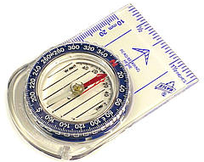


Beginnings prepare readers for understanding the work
Title
orients readers to
document
Summary
tells readers what
happens in document
Introduction
prepares readers
for the middle
Notes:
This slide presents the major parts to the beginning of a scientific document: titles, summaries, and introductions.Note that you might have other elements in a document’s beginning: table of contents, acknowledgments, and definitions of key abbreviations. These you might want to mention on this slide. The three presented here are ones that present significant writing challenges to the students because there are several different approaches for each.

Slide 4
A strong title orients readers to
your area of work
Effects of Humidity
on the Growth
of Avalanches
Effects of Humidity
on the Growth
of Electron Avalanches
in Electrical Gas Discharges
Notes:
When presenting this slide and the next, I ask the students to critique the title on the left. Often I ask what type of avalanche is the writer discussing. Most students, after prodding, will assume that it’s a snow or rock avalanche which makes the point that the title does not identify the area of work. Then I advance the animation to bring in the revision. (Pages 17-18)

Slide 5
A strong title also separates your
work from everyone else's work
Studies on the
Electrodeposition
of Lead on Copper
Effects of Rhodamine-B
on the Electrodeposition
of Lead on Copper
Notes:
This slide presents another “before” and “after” example of a title. Note that although the ideal title separates one’s work from everyone else’s, such a title is often not possible to create in only three or four details. As the book points out, titles with too many details are difficult to understand. For that reason, engineers and scientists often have to balance precision with conciseness. (Pages 18-19)

Slide 6
Several names for summaries exist
Summary
Technical
Abstract
Informative
Abstract
Abstract
Descriptive
Abstract
Executive
Summary
Notes:
This slide presents names for the many varieties of summaries that exist. The “Writing Guidelines” discusses some of the differences, and the textbook discusses the two main approaches. You will probably have your students write summaries of the type that you see most often in your discipline. This slide then is a starting point for that discussion. (Pages 20-27)

Slide 7
Although several names exist for summaries,
there are essentially two approaches
This paper describes a new inertial navigation system for mapping oil and gas wells. In this paper, we will compare the mapping accuracy and speed for this new system against the accuracy and speed for conventional systems.
Descriptive
This paper describes a new inertial navigation system that will increase the mapping accuracy of oil wells by a factor of ten. The new system uses three-axis navigation that protects sensors from high-spin rates. The system also processes its information by Kalman filtering (a statistical sampling technique) in an on-site computer. Test results show the three-dimensional location accuracy is within 0.1 meters for every 100 meters of well depth, an accuracy ten times greater than conventional systems.
Informative
Notes:
This slide shows examples of two common approaches for writing summaries. Consider using these two approaches as a springboard to describe the type of summary that you desire for documents in your course. (Pages 20-27)

Slide 8
A document's introduction prepares readers for the discussion
Topic?
Importance?
Background?
Arrangement?
Introduction
Notes:
This slide shows the questions that should be answered for the readers once they finish reading the “Introduction.” In showing this slide, I begin by asking the students what questions they have about a topic when they are first introduced to it. The analogy I use is that an introduction section is like a car or bus ride to a place where the readers will learn something. I ask the students to imagine that I am leading them out the door to a parked car or bus that will take them someplace where they will learn something. I then ask what questions they have as they are walking out the door. The students will guess the first two questions right off (“what topic are we going to learn about?” and “why is that topic important?”) and after prodding will get the fourth one (“how long will this trip take?” or “will we come back in time for our next class?”). Although they rarely guess the third question (“what information do I need to know to understand this subject?”), the third question makes sense to them because they usually associate “background” with “introduction.” I usually remind them that in this section, the document is referred to in the present tense (“This report presents…”). (Pages 27-33)

Slide 9
The introduction defines the scope and limitations of the work
Women may not
experience the
same effects
Medical histories
not considered
scope
Proposed Study
on Effects of Alcohol
on Life Expectancy
Ten-year study
Three classes of drinkers:
non-drinkers
moderate drinkers
heavy drinkers
Men surveyed
Other effects,
such as exercise,
not considered
limitations
Notes:
Page 28.

Slide 10
A strong introduction tells readers
why the research is important
This paper presents a design for a platinum catalytic igniter in hydrogen-air mixtures. This igniter has application in nuclear reactors. One danger at a nuclear reactor is a loss-of-coolant accident. Such an accident can produce large quantities of hydrogen gas when hot water and steam react with zirconium fuel rods. In a serious accident, the evolution of hydrogen may be so rapid that it produces an explosive hydrogen-air mixture in the reactor containment building. This mixture could breach the containment walls and allow radiation to escape.
Our method to eliminate this danger is to intentionally ignite the hydrogen-air mixture at concentrations below those for which any serious damage might result.
importance
Notes:
Pages 29-30.

Slide 11
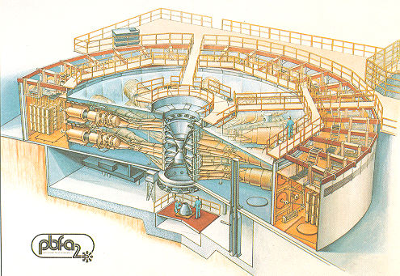
In the middle of a report, you
present your work
Choose a logical
strategy
Make sections
and subsections
Heading
Subheading
Subheading
Heading
Subheading
Subheading
Subheading
Heading
[Sandia, 1985]
Notes:
Mapping slide for discussion of middles in scientific documents.
Citation for picture: VanDevender, P. “Ion-Beam Focusing: A Step Toward Fusion,” Sandia Technology, vol. 9, no. 4 (December 19850, pp. 2-13.

Slide 12
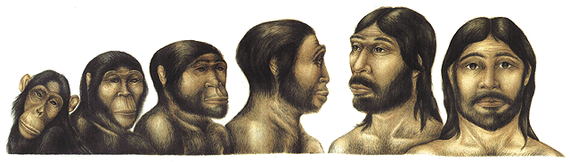
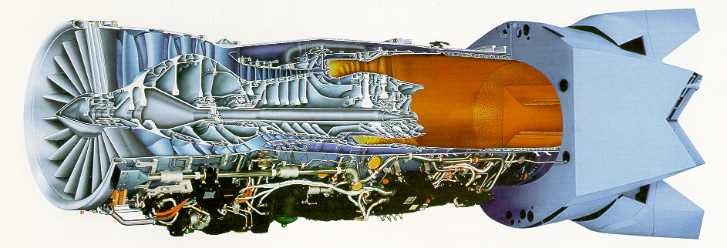
Common strategies exist
for the middles of scientific reports
Chronological
[Maizels, 2001]
Spatial
[Pratt & Whitney, 2000]
Notes:
This slide encompasses much information, but I usually don’t spend a lot of time on it because the students have studied this material (the organizational strategies) time and again in their high school and freshman writing classes. I usually begin by asking what the common organizational strategies are in engineering and science. The students almost always remember a chronological strategy. In showing that strategy, I mention that when engineers or scientists describe a laboratory procedure or a process (as exemplified by the evolution of man in the top picture), they usually follow that strategy. I also mention that when engineers or scientists describe a piece of equipment they often use a spatial strategy. For example, in discussing the Pratt & Whitney turbine engine in the bottom picture, a spacial strategy would be left to right. (Pages 33-37)
Citation for top picture: Maizels, Deborah Jane, http://www.zoobotanica.u-net.com/GIF%20files/Palaeontological/Evolman.GIF

Slide 13

Common strategies exist
for the middles of scientific reports
Parallel
Parts
Corel Corporation
Flow
[Sandia, 1985]
Notes:
With this slide, I mention that a parallel parts strategy is common, particularly at the major heading level. The example given here is the types of reptiles found in a particular nature reserve (images from the Corel Corporation). I also mention that the flow of a variable through a system, such as the flow of energy through the nuclear fusion experiment at Sandia National Laboratories(see page 35). This strategy would involve beginning with the electrical energy as it charges up the Marx generators on the outer ring and following that energy as it becomes an electrical line pulse that produces a particle beam. This particle beam is focused onto deuterium-tritium pellets in the center to produce fusion energy. In concluding this discussion, I mention that most engineers and scientists usually choose an appropriate strategy in their writing; what they often fail to do, though, is to reveal that strategy with their headings, subheadings, and transitional phrases. (Pages 33-37)
Citation for bottom picture: VanDevender, P. “Ion-Beam Focusing: A Step Toward Fusion,” Sandia Technology, vol. 9, no. 4 (December 19850, pp. 2-13.

Slide 14
Section headings should be descriptive and parallel
Non-Parallel
Non-Descriptive
Parallel
Descriptive
Introduction
Background
Marx Generators
Line Pulse
Beam Generation
Transporting Beam
Pellets
Results
Conclusions
Introduction
Past Designs for Particle Beam Fusion
New Design for Particle Beam Fusion
Charging Marx Generators
Forming Line Pulse
Generating Particle Beam
Transporting Particle Beam
Irradiating Deuterium-Tritium Pellets
Results of New Design
Conclusions and Recommendations
Notes:
This slide discusses the headings and subheadings that students should create when the format does not already dictate what those headings and subheadings should be. The students should note that for a document such as a laboratory report that has prescribed headings and subheadings, the audience has certain expectations for what those sections and subsections will contain. For that reason, while “Background” might be appropriate as a heading in a laboratory report in which the audience expects a certain type of background information for that section, “Background” might not be a particularly strong heading for a design report in which the audience has no expectations for what that section would contain. In such a case, the students would do better to choose parallel descriptive phrase as in the slide. (Pages 37-40)

Slide 15
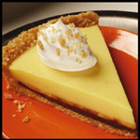
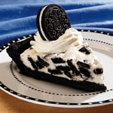
When you divide a section into subsections, all the pieces should be of the same pie
New Design for Particle Beam Fusion
Charging Marx Generators
Generating Particle Beam
Irradiating Deuterium-Tritium Pellets
New Design for Particle Beam Fusion
Charging Marx Generators
Generating Particle Beam
Pellets
Notes:
This slide works through a simple example to point out the expectations by the audience of parallelism in headings. View the slide in the slideshow mode to see the sequence. (Pages 37-40)

Slide 16
Organization is hidden when headings occur in a long list without secondary headings
Performance of
the Solar One Receiver
Introduction
Steady State Efficiency
Average Efficiency
Start-Up Time
Operation Time
Operation During Cloud Transients
Panel Mechanical Supports
Tube Leaks
Conclusion
Performance of
the Solar One Receiver
Introduction
Receiver’s Efficiency
Steady State Efficiency
Average Efficiency
Receiver’s Operation Cycle
Start-Up Time
Operation Time
Operation During Cloud Transients
Receiver’s Mechanical Wear
Panel Mechanical Supports
Tube Leaks
Conclusion
Notes:
This slide discusses the importance of hierarchy in headings and subheadings. The slide also reveals that having a long list of headings is not memorable for the reader. (Pages 37-40)

Slide 17
Many journal articles follow a set organization named IMRaD
Introduction
Materials and Methods
Discussion
Results
Notes:
In the biological sciences, most journal articles follow a set organization for the headings and subheadings: Introduction, Materials and Methods, and Results and Discussion.

Slide 18
In a strong ending, you analyze results and give a future perspective
Conclusions
Analysis of Results
Analyze results from overall perspective
Future Perspective
Several options:
Make recommendations
Discuss future work
Repeat limitations
Notes:
This slide is a springboard for a discussion of conclusion sections. It is difficult to characterize what conclusion sections do for all reports and say something specific enough to benefit all the students. The first part, analyzing results from an overall perspective, holds true for most documents, but the second part, providing a future perspective, occurs in several forms: making recommendations, discussing future work, and raising questions about the subject. The conclusion section is one of the most difficult sections for the students to write because it contains the most analysis. The students also have to evaluate which details (or results) are more important and emphasize those details (or results).
On this slide, I usually point out to the students that in this conclusion section, the document is referred to in a different tense (“This report has shown…”) from how the document is referred to in the “Introduction” and “Summary” where the writer should use the present tense (“This report presents…”). (Pages 40-45)

Slide 19
Use appendices to supply background for secondary audiences
Appendix A
Concern About the Greenhouse Effect
For almost a hundred years, experts have been concerned with the increasing concentrations of gases such as carbon dioxide, methane, and nitrogen oxides in the earth's lower atmosphere. These gases are natural by-products of combustion. Figure A-1 illustrates the correlation between global temperature and carbon dioxide concentrations...
Notes:
This slide introduces one kind of appendix that engineers and scientists often have to write—namely one that presents primary information (necessary for understanding or accepting the work) to a secondary audience. Another type is one that presents secondary information (perhaps tangential information) to a primary audience.
Note that many students don’t realize that while in some cases, you write appendices that are informal (perhaps just a title and an illustration), in other situations you write appendices that are formal (standing alone and having beginnings, middles, and endings). On assignments in which you want formal appendices, you should specify that to the students. (Pages 46-48)

Slide 20
Use appendices to supply secondary or tangential information to primary readers
Appendix B
Project Stormfury
In 1961, the United States Weather Bureau and the Department of Defense (Navy) began a project to reduce the strength of hurricanes. The project, called Project Stormfury, uses cloud seeding, a process used to produce rainfall and reduce hail in thunderstorms. In Project Stormfury, silver iodide crystals, similar in structure to ice, are dispersed by airplanes in the upper reaches of cloud formations just outside the hurricane's eye where the winds are highest. Initial results showed that wind speeds decreased between 15–30% after seedings...
Notes:
This slide introduces one kind of appendix that engineers and scientists often have to write—namely one that presents secondary information (perhaps tangential information) to a primary audience. Another type is one that presents primary information (necessary for understanding or accepting the work) to a secondary audience. (Pages 48-49)

Slide 21
For secondary readers, use a glossary
to define unfamiliar terms
Glossary
burst point: the exact point in space where an atomic bomb is detonated.
clear visibility: a viewing range of twenty miles.
fallout: the descent to the Earth's surface of radioactive particles from a cloud contaminated with the fission products of a nuclear explosion.
hypocenter: the point on the earth's surface directly below the burst point; also called ground zero.
Notes:
This slide presents an example “Glossary,” which is essentially a special type of appendix. Several ways exist to format and incorporate a glossary—the “Writing Guidelines” introduces one. Note that the definitions in a glossary should be formal definitions, which are discussed in Chapter 7. Also note that you might have terms in a glossary that you have already defined in the document if the term is used in more than one section in the document and you believe an audience might turn to one of those sections without reading the section where it is defined. You might also have a term appearing in the glossary that is also defined in the text, if the glossary definition contains more information than the text definition. (Pages 49-51)

Slide 22
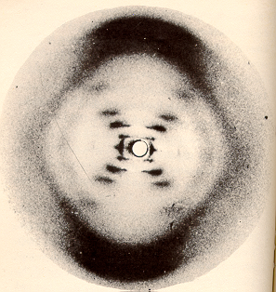
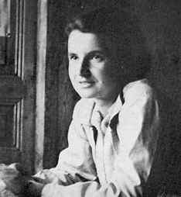
Failing to cite the contribution of others can be a fatal flaw in your career
[Franklin, 1952]
[Luzzati, 1950]
James Watson surreptitiously looked at Rosalind Franklin’s work
Watson did not give enough credit to Franklin
Notes:
This slide presents an opportunity to discuss citing and documenting reference. When doing so, I stress that failing to cite the contributions of others is perhaps the single worst error that an engineer or scientist can make because it can ruin your reputation. Linus Pauling was accused by Lawrence Bragg and others of failing to cite the work of others (see Anthony Serafini, Linus Pauling: A Man and His Science (New York: Paragon House, 1989)). Those accusations damaged his reputation. James Watson, who with Francis Crick was credited with the discovery of DNA, was also accused of slighting the contribution of Rosalind Franklin, whose DNA photograph Watson surreptitiously used (see Sharon Bertsch McGrayne, Nobel Prize Women in Science (Seacaucus, NJ: Citadel Press Book, 1998)).
Photo on left: Rosalind Franklin and R.G. Gosling, "Evidence for a 2-chain Helix in the Crystalline Structure of Sodium Deoxyribonucleate," Nature, vol. 172, no. 156 (1953).
Franklin Photo taken by Vittorio Luzzati, 1950. For more information about Rosalind Franklin, read Anne Piper, “Light on a Dark Lady,” http://www.physics.ucla.edu/~cwp/articles/franklin/piper.html (Los Angeles: UCLA, 2002).

