Slide 1
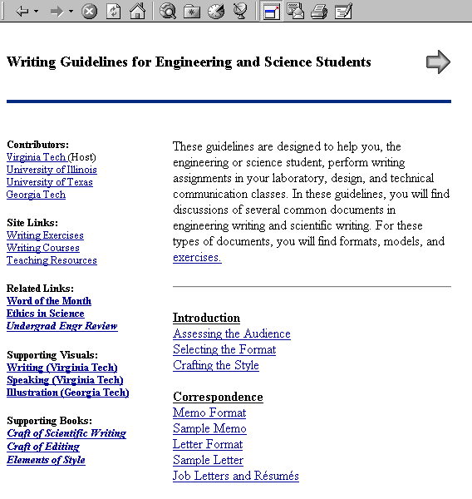
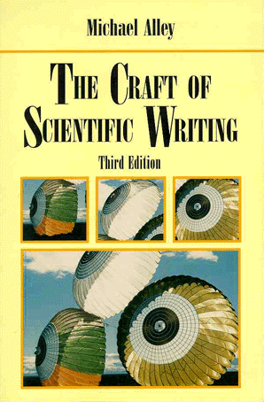
Scientific Writing:
An Introduction
Writing Guidelines for Students
http://writing.eng.vt.edu/
The Craft of Scientific Writing
3rd edition (Springer-Verlag, 1996)
Notes:
These slides, which are used in graduate and undergraduate engineering courses at Virginia Tech, come from Chapters 1, 16, and 17 in The Craft of Scientific Writing (3rd ed., Springer-Verlag). If you would like a 60-day evaluation copy of The Craft of Scientific Writing, please go to the following web page:
http://www.springer.de/textbooks/textbook_inspect.html
This first slide is a title slide for an introductory lecture about writing in engineering and science. The purpose of this presentation is two-fold: (1) to inspire students to invest time into learning how to write and speak well, and (2) to show students where to begin the process of writing a scientific or engineering document.
With this title slide, you have the opportunity to give your own testimony as to the importance of writing in engineering and science. This slide is also an opportunity for you to mention two references (the shown web site and textbook) that students have for improving their writing.
Note that these slides use the term “scientific writing” to encompass the writing done by engineers and scientists and the term “scientific documents” to encompass the documents written by engineers and scientists. If you prefer the more general term “technical,” you can use the Replace command to replace “scientific” with “technical” throughout. Likewise, if you desire a term more specific than “scientific,” you can use the same command to insert your preferred term (“engineering” or “biological” would be two examples). Note that all future references to chapters and pages are for The Craft of Scientific Writing (3rd edition).

Slide 2
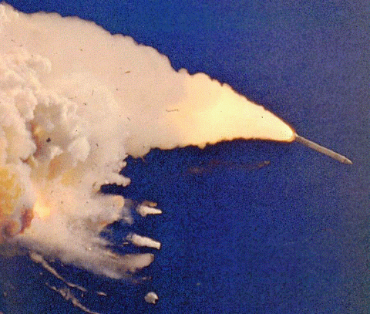
This presentation discusses the importance of scientific writing and introduces key principles
Importance of Scientific Writing
Key Principles
audience
occasion
purpose
[Report, 1986]
Notes:
Mapping slide for this introductory presentation on scientific writing. This presentation has two divisions: (1) a discussion of the importance of scientific writing, and (2) a discussion of key principles. These principles include analyzing the situation, distinguishing between style and form, and making the process efficient.
Reference for picture: Report to the President on the Space Shuttle Challenger Accident, vol. 1 (Washington, D.C.: Presidential Commission, 6 June 1986), p. 33.

Slide 3



How well you communicate affects your career
Survey (Richard M. Davis)
Successful engineers spent 25% of work week writing
Survey (Wisconsin)
Professional engineers found writing their most useful subject in college
Survey (Virginia Tech)
Recruiters claim that engineers need more work on their writing
Notes:
With this background slide, I try to convince students of the importance of scientific writing. This slide presents three surveys that show different points about the importance of writing for engineers. The first survey was performed by Richard M. Davis of the Air Force who surveyed 245 distinguished engineers. This survey not only found the result presented on this slide (25% of work week spent on writing), but also found that those surveyed attributed their success in part to their ability to communicate. Source: Richard M. Davis, Technical Writing: Its Importance in the Engineering Profession and Its Place in the Engineering Curriculum, AFIT TR 75-5 (Wright-Patterson AFB, Ohio: Wright-Patterson Air Force Base, 1975).
The second survey was performed by Dean John Bollinger from the College of Engineering at the University of Wisconsin who contacted 9000 engineers who had graduated. The slide shows an important result of that survey (that the engineers found writing to be their most useful subject). Interestingly, the second most useful skill cited was the ability to speak. Source: Dean John G. Bollinger, “Alumni Survey Results,” Perspective (Madison: College of Engineering, University of Wisconsin, Summer 1994), p. 2.
The third survey was performed by the College of Engineering at Virginia Tech. Here, recruiters to Virginia Tech were polled. The purpose of the survey was to determine what skills that engineering graduates needed most improvement upon. Source: Virginia Tech, College of Engineering, “Summary Report of Employer Focus Group” (October 2000).

Slide 4
How well you communicate affects the well-being of others
Explosion was caused by failure of O-rings in the solid rocket boosters
Engineers knew of O-ring problems well before fatal launch
Engineers failed to communicate seriousness of problem
[Report, 1986]
Space Shuttle Challenger
(January 28, 1986)
Notes:
With this background slide, I try to convince students of the importance of scientific writing. The photograph shows the explosion of the Space Shuttle Challenger. Engineers were deeply concerned about the O-ring design on the booster rocket before the launch, but were unable to convince managers at NASA of that concern. Richard Feynman’s paper from Physics Today (February 1988) gives a good account of this case study.
In teaching scientific writing to engineers and scientists, convincing them about the importance of scientific writing is probably the single most important argument that you will make. My experience has been that professional engineers and scientists recognize the importance, while students do not. For that reason, with students, I spend more time on this argument. Source: Richard P. Feynman, “An Outsider’s Inside View of the Challenger Inquiry,” Physics Today (February 1988), pp. 26-37.
Reference for picture: Report to the President on the Space Shuttle Challenger Accident, vol. 1 (Washington, D.C.: Presidential Commission, 6 June 1986), p. 33.

Slide 5
Scientists and engineers are called upon to communicate in many different situations
Reports
Articles
Proposals
Web Pages
Conferences
Lectures
Meetings
Posters
specific
technical
audiences
general
technical
audiences
non-technical
audiences
Notes:
This slide makes the point that engineers and scientists have to communicate in many different situations. Not only are they called upon to write different types of documents and speak in different occasions, but they also face several different audiences. Given this variety, coming up with a set of rules to handle every situation is difficult, not impossible. Engineers and scientists therefore have to learn to analyze each situation and decide upon the best way to communicate in that situation. This news is hard for many engineering and science students to accept. (Pages 2-3)

Slide 6
This presentation discusses the importance of scientific writing and introduces key principles
Importance of Scientific Writing
Key Principles
audience
occasion
purpose
[Report, 1986]
Notes:
Repeat of mapping slide for this presentation on scientific writing. This slide introduces the second part of the presentation: a discussion of key principles. These principles include analyzing the situation, distinguishing between style and form, and making the process efficient.
Reference for picture: Report to the President on the Space Shuttle Challenger Accident, vol. 1 (Washington, D.C.: Presidential Commission, 6 June 1986), p. 33.

Slide 7
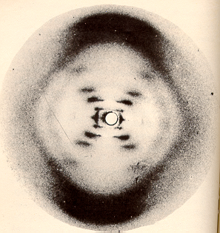
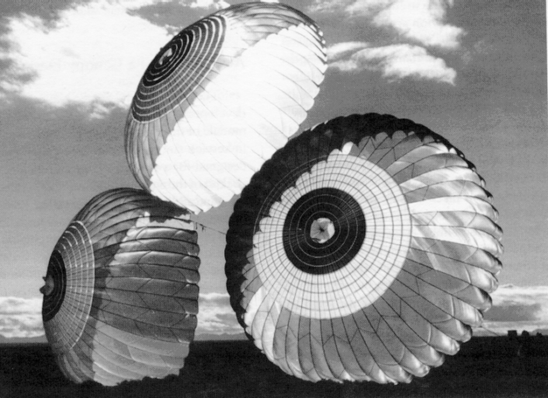
Scientific writing differs from other kinds of writing
Subject Matter
Writing Constraints
audience
occasion
purpose
[Franklin,
1952]
Purpose of Writing
Writing Style
To inform
To persuade
[Peterson, 1987]
Notes:
With this slide, I try to impress upon the students the differences between scientific writing and other types of writing that they have studied. While the students will draw upon many of the things that they have learned in other writing courses, students have to be critical thinkers as far as taking advice that may pertain to literary writing or journalism and applying it to scientific writing. For instance, in scientific writing, the most important goal of language is precision--a goal that poets sometimes subordinate for the sake of rhythm. (Chapter 1)
By the way, the photograph in the upper left is from Rosalind Franklin’s x-ray work that greatly influenced the discovery of the structure of DNA by James Watson and Francis Crick. The story is an interesting one from both a communications perspective and an ethical perspective. Watson has documented it in The Double Helix, but take a look at the Norton critical edition, which presents other viewpoints, including the one that Rosalind Franklin deserved considerably more credit than Watson or Crick gave to her in their original article.
Reference for parachute photo: Peterson, C.W., and D.W. Johnson, Advanced Parachute Design, SAND86-8006 (Albuquerque: Sandia National Laboratories, 1986).

Slide 8
You should begin the writing process by analyzing your constraints
Who they are
What they know
Why they will read
How they will read
Audience
Format
Formality
Politics and ethics
Process and deadline
Occasion
To inform
To persuade
Purpose
Notes:
This slide is perhaps the most important slide of the set because it shows what constraints students are under as they begin writing a scientific document. In other words, this slide tells students where they should begin the writing process (an assumption here is that the students understand the content of their document and now must communicate that content). The constraints of audience, purpose, and occasion are discussed in Chapter 1.
The aspect of format is also discussed in Chapter 16 and in the “Writing Guidelines for Engineering and Science Students.” The aspect of process refers to how the student actually puts words onto paper. Will the student write as an individual or part of a group? Does the student have a fixed deadline? Chapter 17 discusses this aspect in more detail. Formality refers to the expectations that the audience has as far as mechanics, which is also discussed in Chapter 1, Appendix A, and Appendix B. Interactive exercises for mechanics can be found in the “Writing Exercises for Engineers and Scientists.”
On this slide, you should make it clear to the students that no simple recipes exist for the challenging documents that they will have to write. Students should assess the audience, format, formality, and other constraints of the situation before committing words to paper. The slides that follow elaborate on each of the constraints.

Slide 9
Three aspects of writing affect the way that readers assess your documents
Content
Style
Form
Notes:
One problem that many students have is that they don’t have a sense of hierarchy about aspects of writing. These students might equate a small aspect of form such as using a contraction with a serious mistake in content such as leaving out important information, or style, such as not emphasizing the most important result. With this slide, I try to distinguish these three terms. While there certainly is overlap among these terms, their definitions are distinct. Content is the message given, style is the way that message is presented (structure, language, and illustration), and form is the appearance of the message (grammar, punctuation, usage, spelling, and format). (Chapter 1)

Slide 10
Style is the way you communicate the content to the audience
[Peterson, 1987]
words
wordswords
wordswordswords
wordswordswordswords
Illustration
wordswordswords
wordswordswords
wordswordswords
wordswordswords
Structure
Language
style
Notes:
If the constraints are what the engineer or scientist does not control in the writing process, then style is what the engineer or scientist does control. Style comprises three perspectives: structure, language, and illustration (all three are defined in Chapter 1). Students should note that unlike most terms in engineering and science, most terms in writing do not have universal definitions. For that reason, you and your students should agree upon a few definitions so that your discussions about writing make sense. So often, I have seen discussions about writing become unproductive because people invoke terms that others either do not understand or have different definitions for. Terms often used in discussions of writing, but not often understood by students, are format, style, structure, language, illustration, tone, active voice, passive voice, past tense, and the major parts of speech. These are defined in the textbook’s glossary.
Reference for parachute photo: Peterson, C.W., and D.W. Johnson, Advanced Parachute Design, SAND86-8006 (Albuquerque: Sandia National Laboratories, 1986).

Slide 11
Form embodies the format and mechanics of the writing
mechanics
grammar
usage
punctuation
spelling
format
typography
layout
Notes:
Information about the format of scientific writing can be found on pages 6-7 and in Chapter 16. Information about the mechanics of scientific writing can be found in Appendices A and B (and in The Craft of Editing (Springer-Verlag, 2000). Both of these subjects are discussed in separate presentations.

Slide 12
We can split the writing process into stages
Getting in the Mood
Writing the First Draft
Revising, Revising, Revising
Finishing
Notes:
Discussion of making the process of writing more efficient to perform can be found in Chapter 17. When I first started teaching, I discussed the process of writing towards the end of the course. Recently, I have begun incorporating discussions of it throughout the course, particularly just before assignments are due.

Slide 13
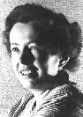
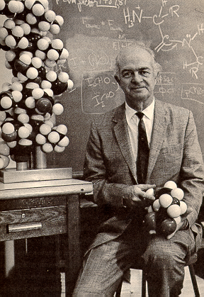
An excellent way to improve your writing is to choose good models
AIP
Cal-Tech
Maria Goeppert Mayer
Linus Pauling
Notes:
Conclusion slide to this presentation. One of the best ways to improve one’s writing is to select strong models. Conversely, a reason that so many engineers and scientists write so poorly is that they select poor models. Two excellent models of scientific writing are Maria Goeppert Mayer, who won the Nobel prize in Physics for her work on the structure of the nucleus and Linus Pauling, who won a Nobel Prize in Chemistry for his work on covalent bonds. Both were excellent communicators of their work.

