Slide 1

Alpine Glacial Features Quiz
Everest Base Camp

Slide 2
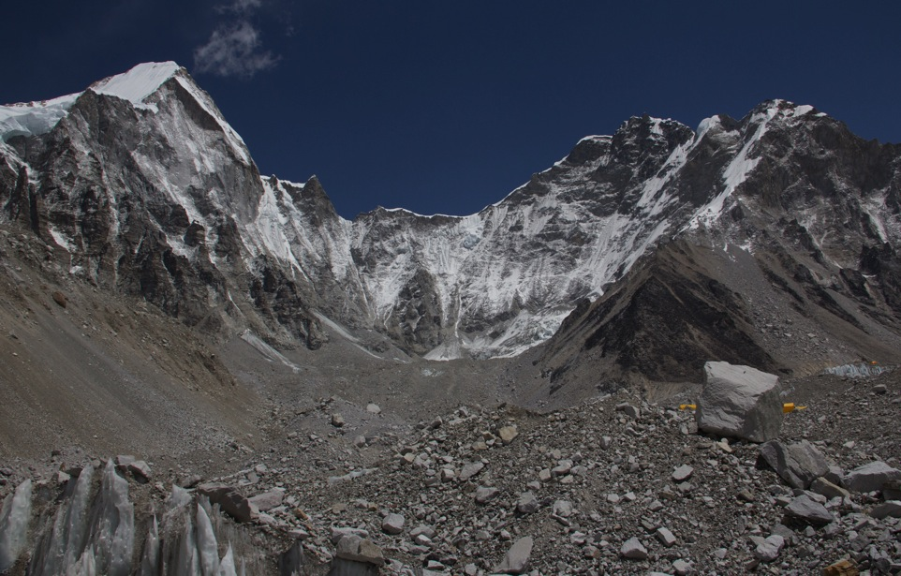

Slide 3
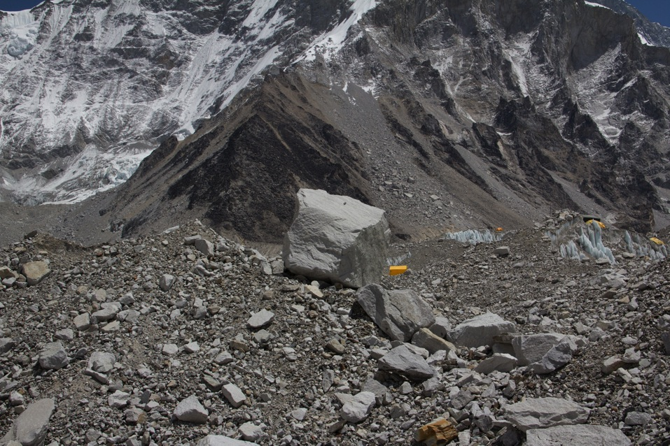

Slide 4
