Slide 1
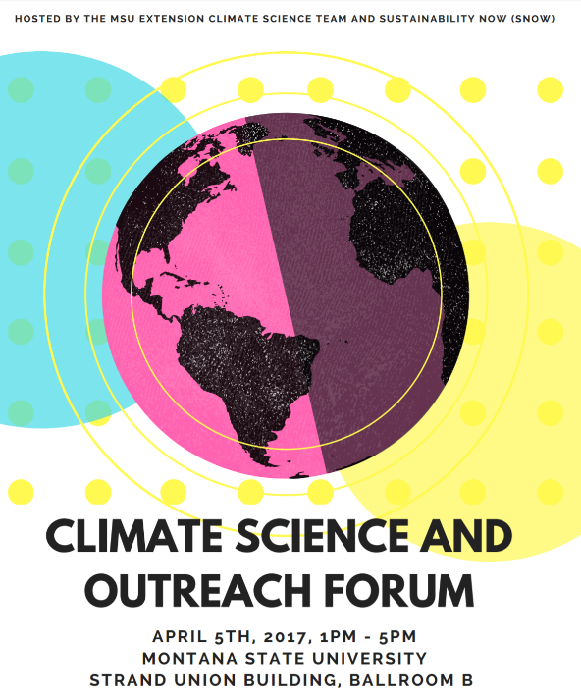


COOL
Carbon
Concepts
http://bit.ly/2oYx3W5
Soil
Interrogation
Lab
Tony
Hartshorn

Slide 2
Backwards Design
If we were wildly successful, what would success look like?
  Increased carbon literacy for K-20+ audiences
  Improved engagement
  Improved content knowledge
  Improved skills
  Improved attitudes

Slide 3
Backwards Design
If we were wildly successful, what would success look like?
  Increased carbon literacy for K-20+ audiences
  Improved engagement
  Improved content knowledge
  Improved skills
  Improved attitudes
From measurable student learning outcomes (mSLO) to measured and reported SLO (MrSLO)…

Slide 4
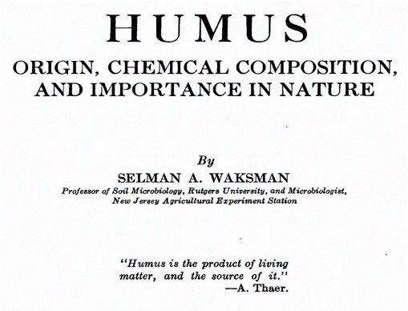
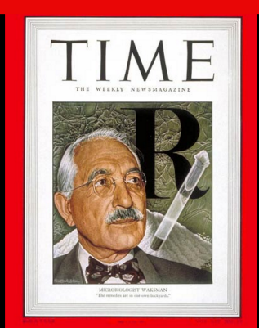
In 1949…”the remedies are in our own backyards”

Slide 5
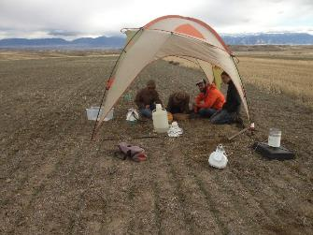
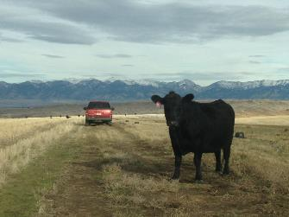
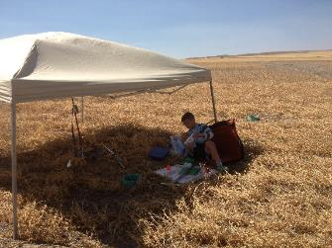
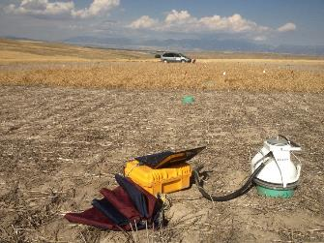
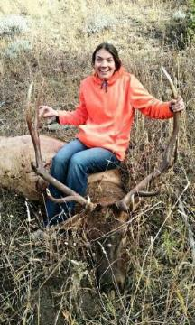
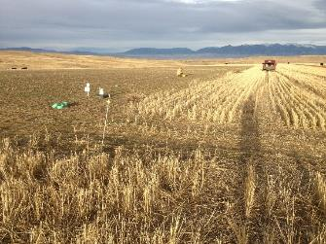
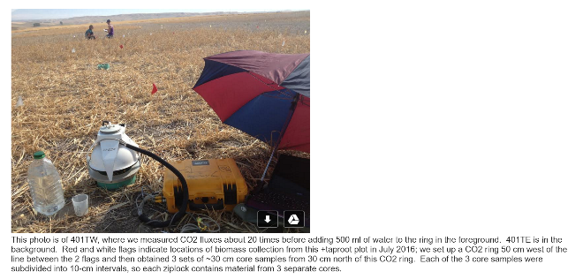
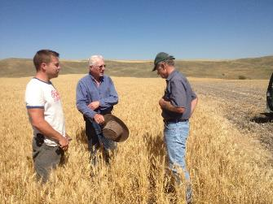
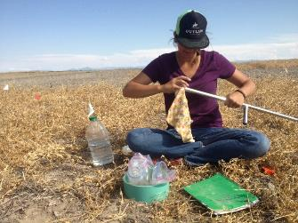

Slide 6
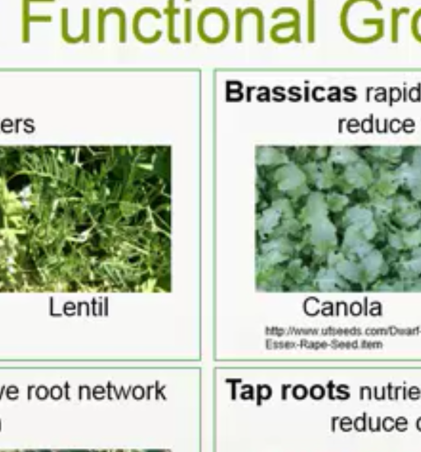
Housman et al. 2014 via Camtasia @ 16:37 http://bit.do/cYy8b

Slide 7
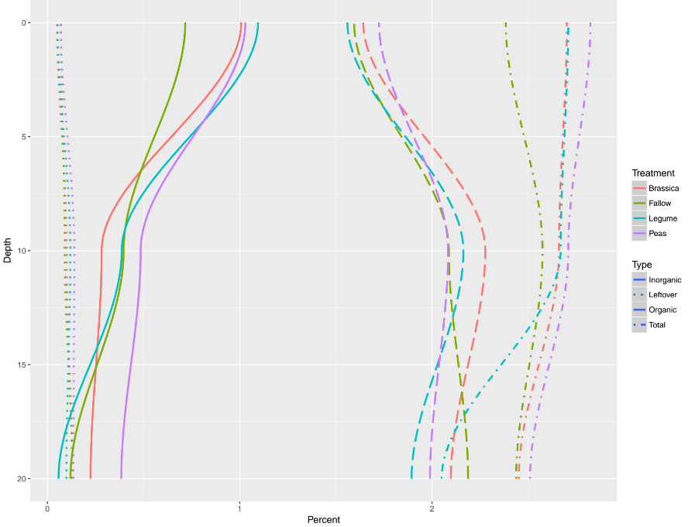
Total carbon
Inorg. carbon
Org. carbon
“Leftovers”

Slide 8
Total carbon
Inorg. carbon
Org. carbon
“Leftovers”
Is it time to get excited about ~0.3% soil organic carbon?

Slide 9
COOL
Carbon
Concepts

Slide 10
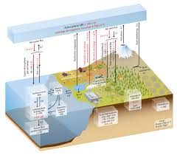
COOL
Carbon
Concepts?

Slide 11
COOL
Carbon
Concepts?
NOT

Slide 12
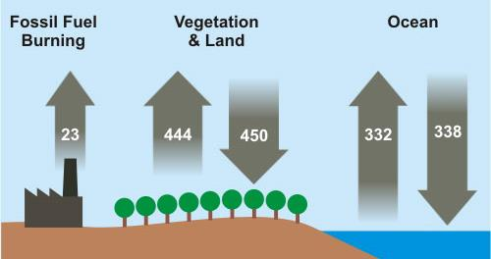
skepticalscience.com (Pg CO₂/year)
COOL
Carbon
Concepts?

Slide 13
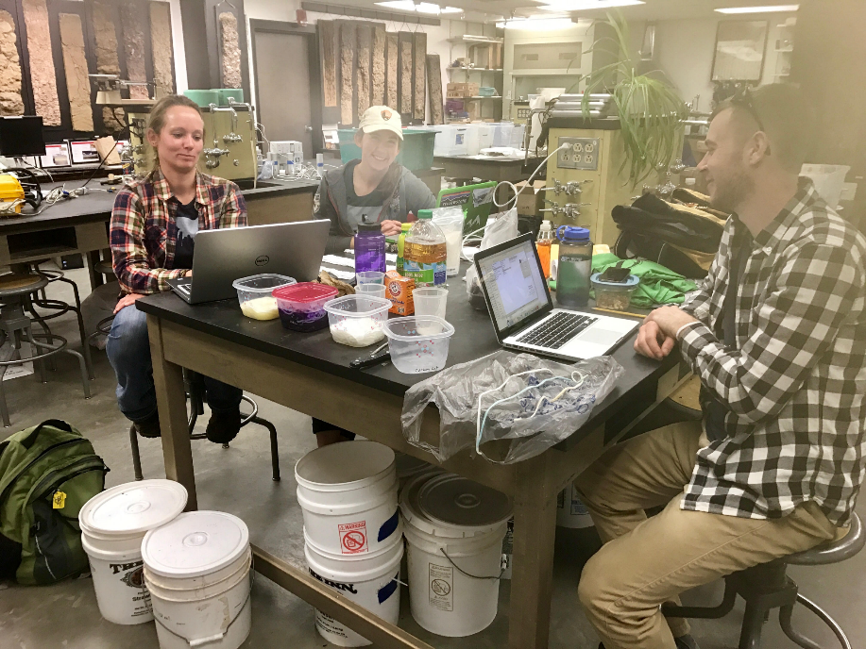
Team C =
Lauren, Mary, Susan, Wes, Kirby, Kyle

Slide 14
Backwards Design
If we were wildly successful, what would success look like?
  Increased carbon literacy for K-20+ audiences
  Improved engagement
  Improved content knowledge
  Improved skills
  Improved attitudes

Slide 15
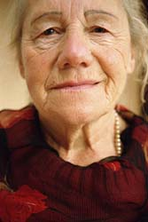
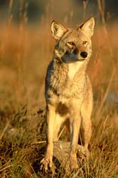
Tracing Matter
(GRANJOHN Worksheet)
Environmental Literacy Research Group
Grandma Johnson
?
Describe the path of a carbon atom from Grandma Johnson’s remains, to inside the leg muscle of a coyote. NOTE: The coyote does not dig up and consume any part of Grandma Johnson’s remains.
http://envlit.educ.msu.edu/

Slide 16
Inputs and Outputs – Tracing Carbon
Grandma Johnson
Decomposers
Destruction of organic carbon
- Cellular Respiration
C₆H₁₂O₆
CO₂
Creosote Bush
Rabbit
C₆H₁₂O₆
Generation of organic carbon
- Photosynthesis
Coyote
C₆H₁₂O₆
http://envlit.educ.msu.edu/
Transfer of organic carbon
- Food Chain

Slide 17
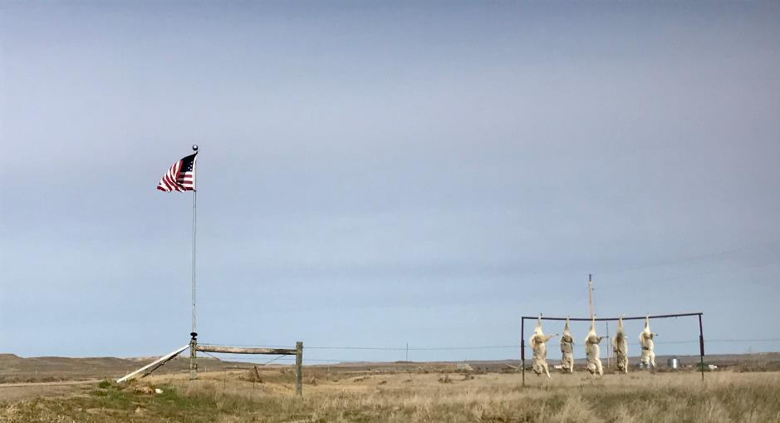
Carbon literacy?

Slide 18

Tracing Matter
(WTLOSS Worksheet)
Environmental Literacy Research Group
When a person loses weight, what happens to the mass of the fat?
(a) The mass leaves the person's body as water and carbon dioxide
(b) The mass is converted into energy
(c) The mass is used up providing energy for the person's body function
(d) The mass leaves the person's body as feces
4 students in 20
9 students in 20
5 students in 20
3 students in 20
http://envlit.educ.msu.edu/
Note: 1 student chose both C and D

Slide 19
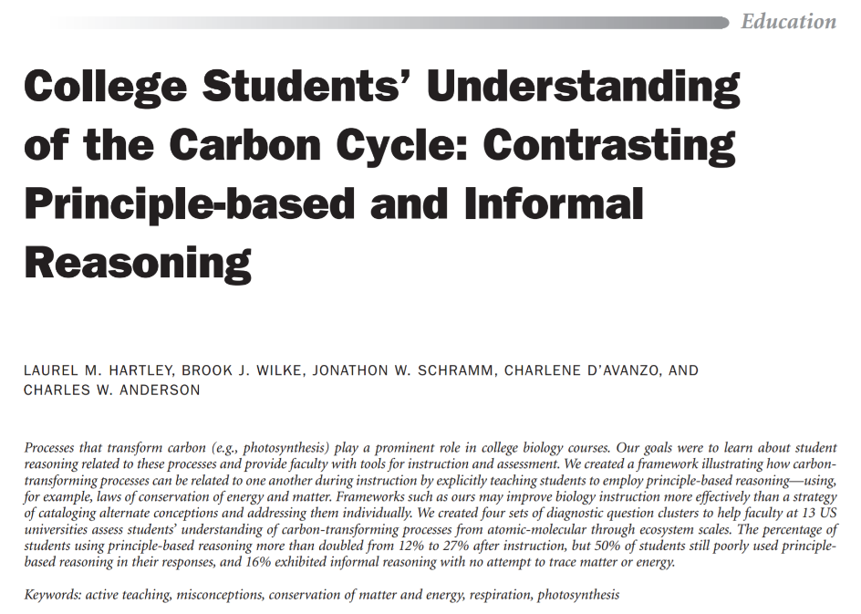
Hartley et al. 2011

Slide 20
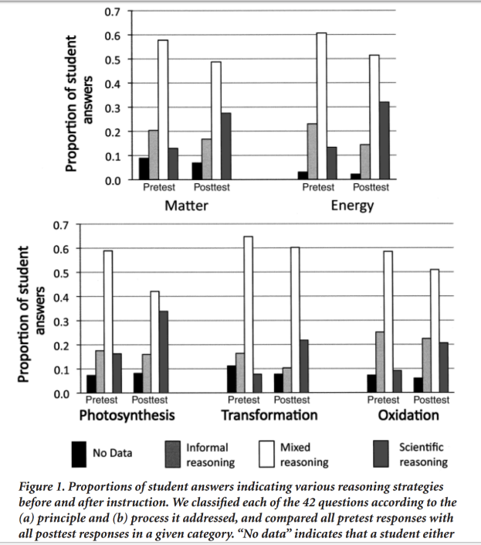
Hartley et al. 2011

Slide 21
Take home message: Modest gains in “scientific reasoning” related to matter after an intervention.
Hartley et al. 2011

Slide 22
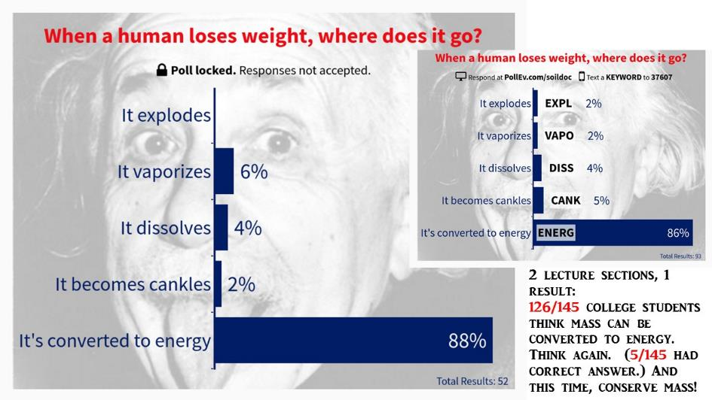
Fall 2016: 87% of MSU students think humans convert mass to energy
Hartshorn, unpubl. data

Slide 23
Fall 2016: 87% of MSU students think humans convert mass to energy
Hartshorn, unpubl. data

Slide 24
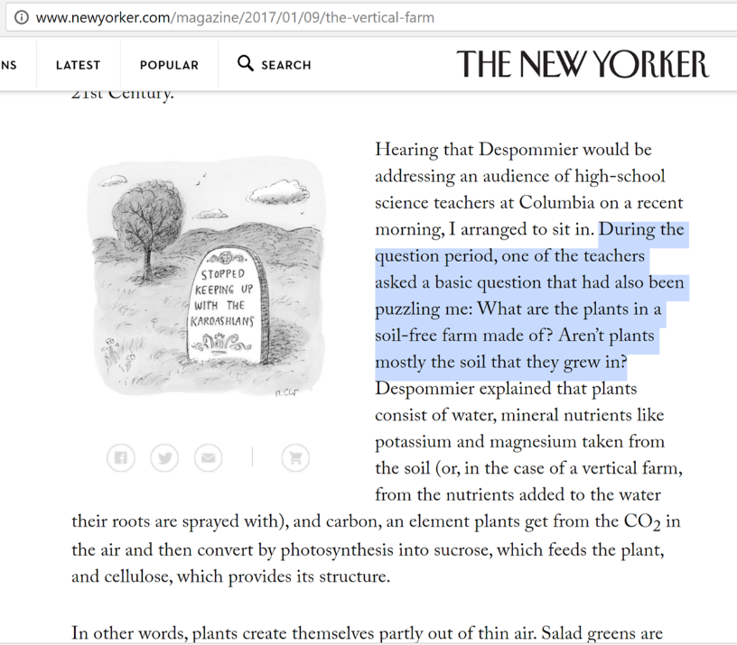

Slide 25

an innumerate

Slide 26
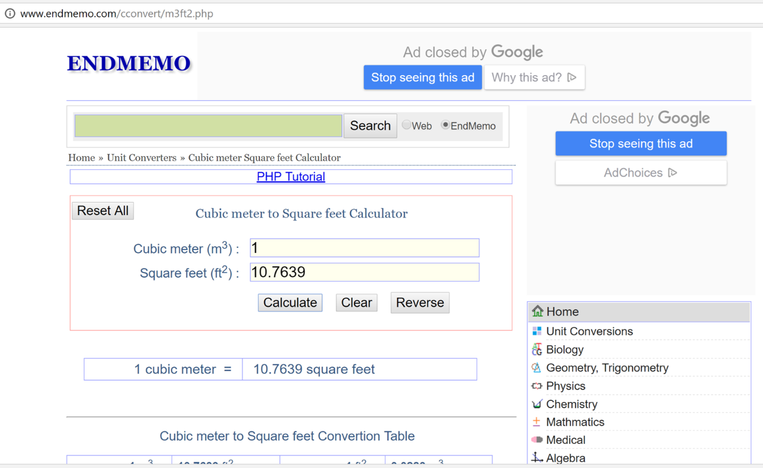

Slide 27
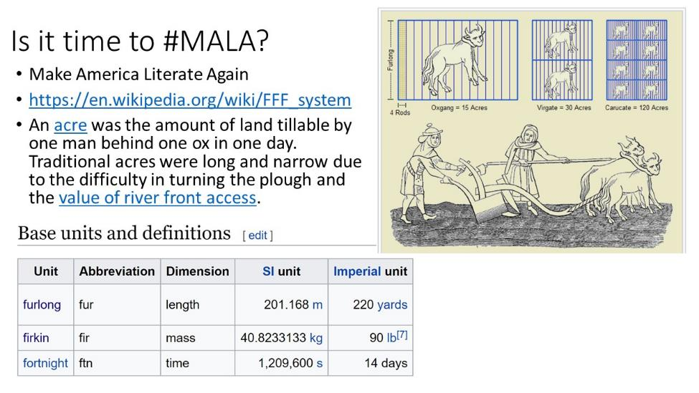

Slide 28
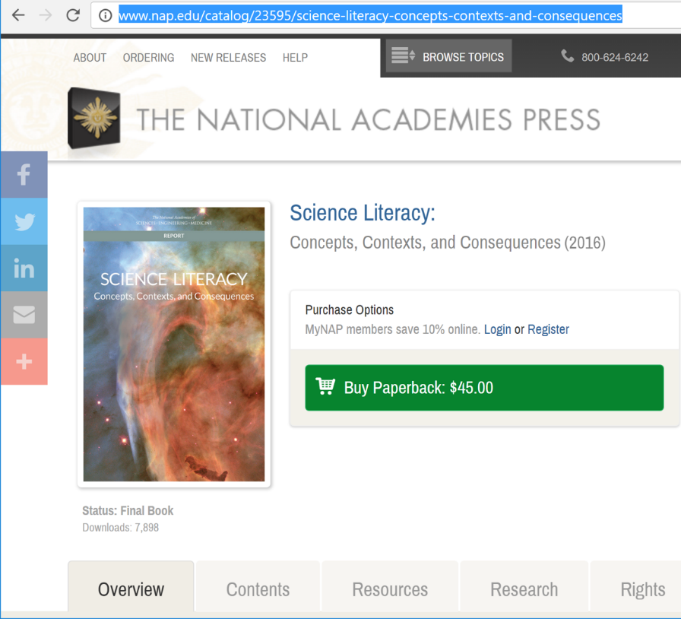

Slide 29
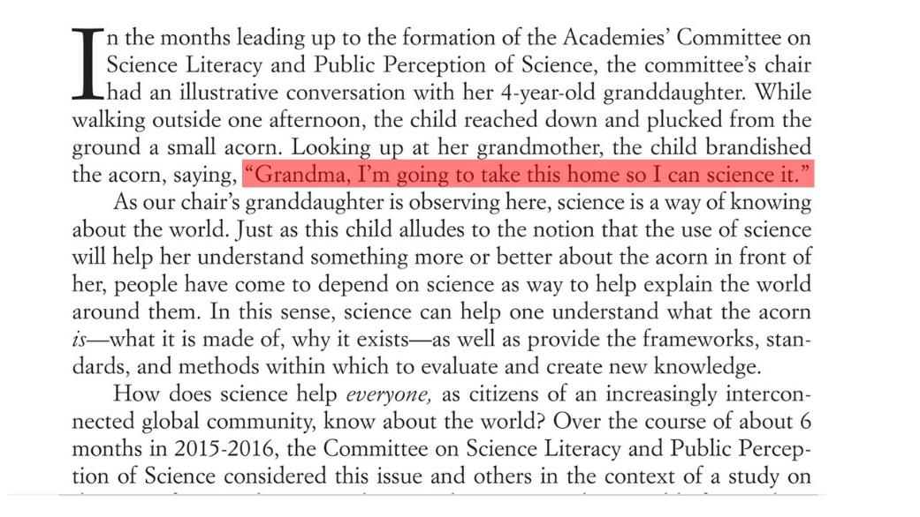

Slide 30
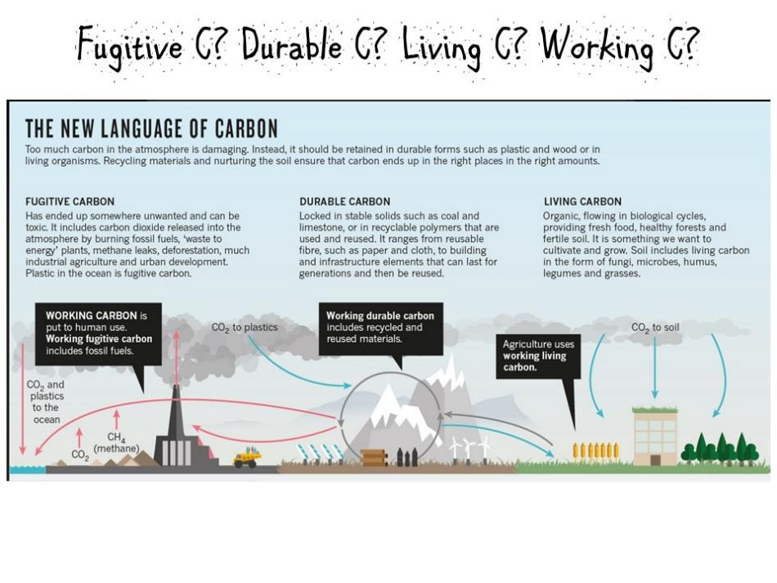

Slide 31
Solar
Wind

Slide 32
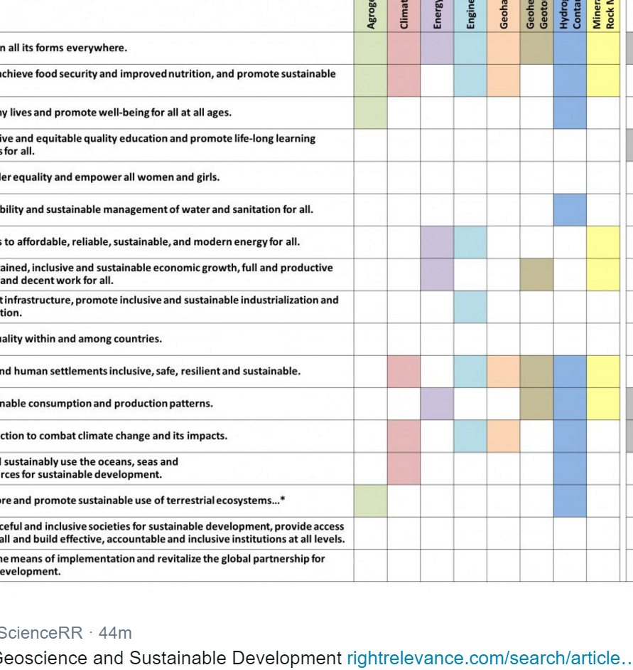

Slide 33



Slide 34

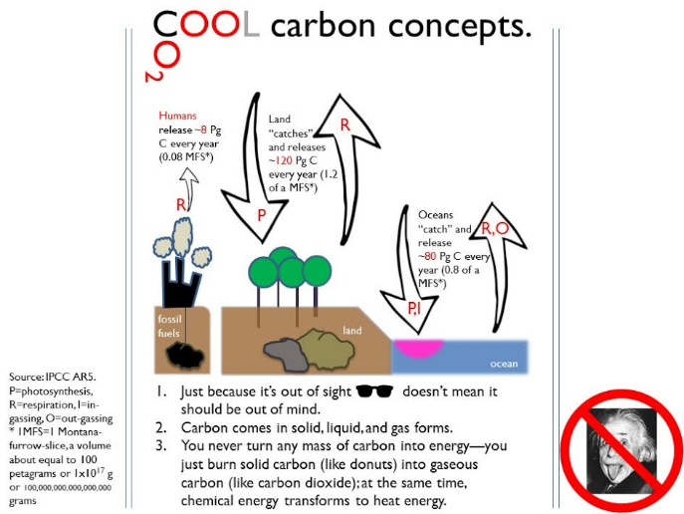
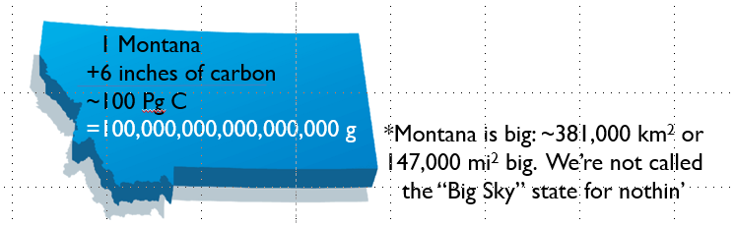
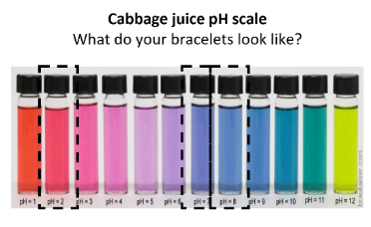

Slide 35
skepticalscience.com (Pg CO₂/year)

Slide 36
1. AR5 (2013) # instead of AR4 (still Pg CO₂/year)
AR4 #s below in fig:
AR5 #s, respectively:
= 8, ~120, ~80 Pg C/y
= 29, 440, 290 Pg CO2/y
29
~440
~290

Slide 37
2. Convert to Pg C/year
AR4 #s below in fig:
AR5 #s, respectively:
= 8, ~120, ~80 Pg C/y
= 29, 440, 290 Pg CO2/y
8
~120
~80

Slide 38
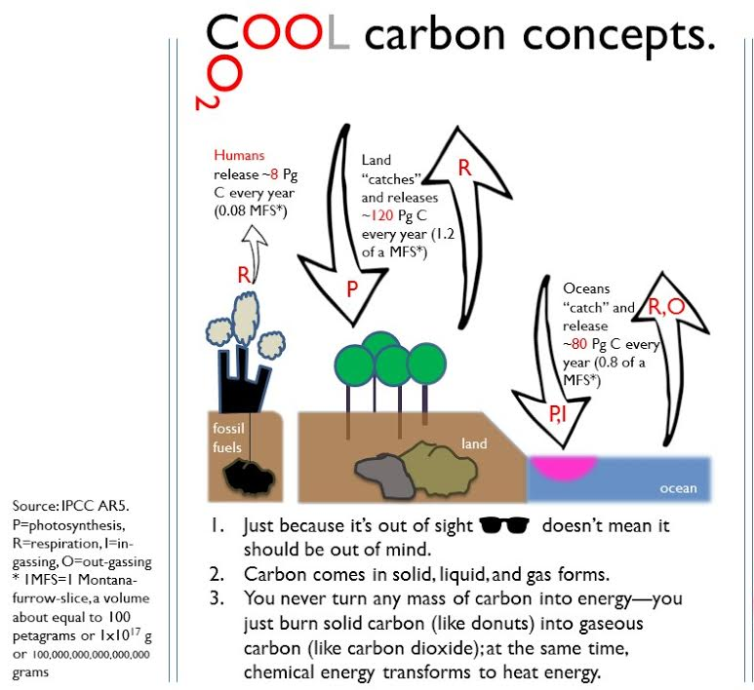

Slide 39


Slide 40
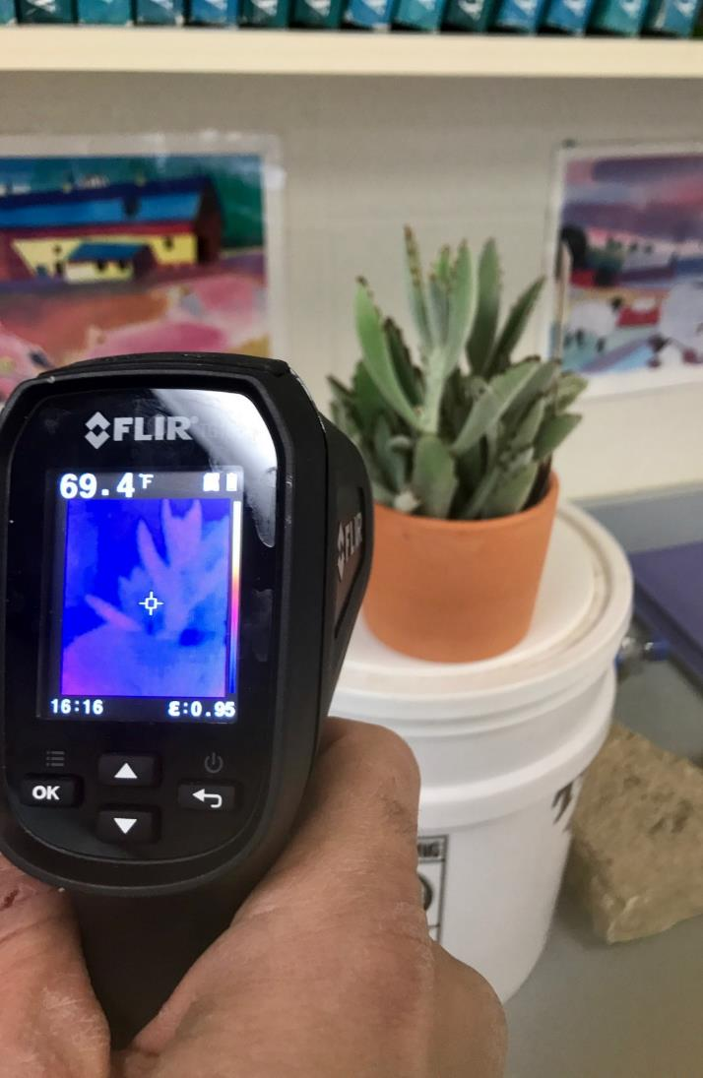
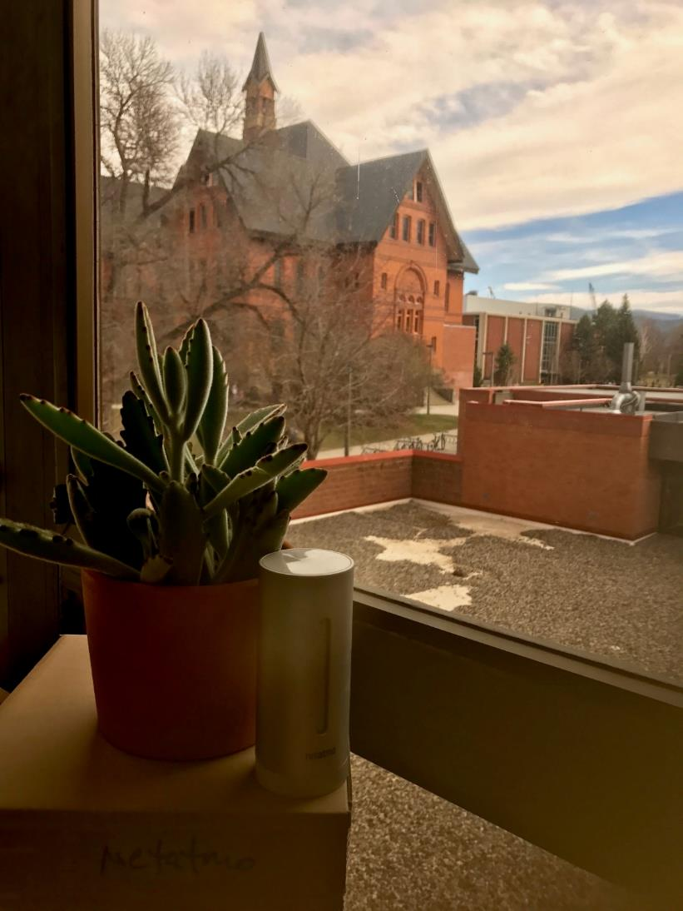
Thermalcam to the rescue?
Netatmo to the rescue?

Slide 41
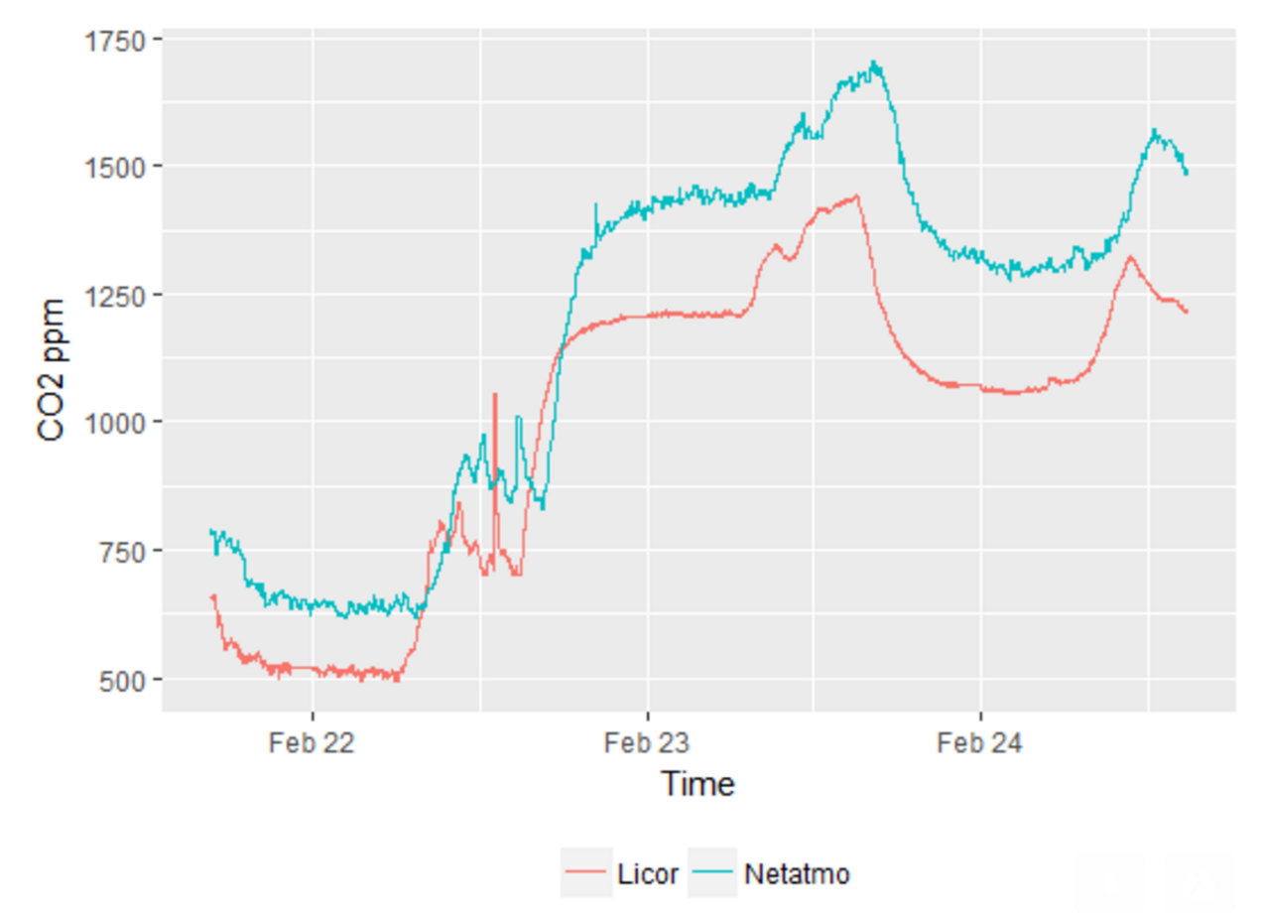
Netatmo to the rescue?

Slide 42
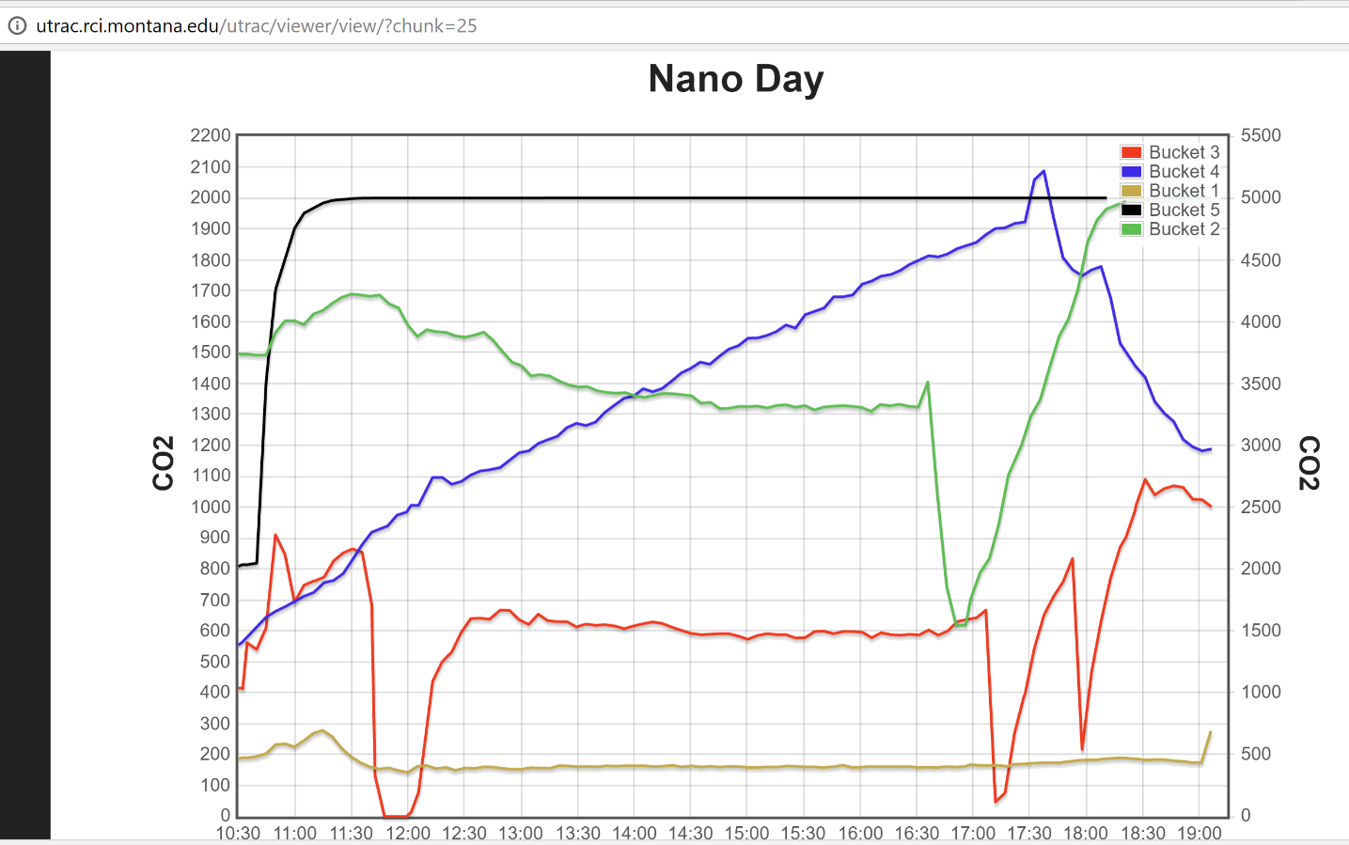
Netatmo to the rescue?

Slide 43
Netatmo to the rescue?
photosynthesis
respiration

Slide 44
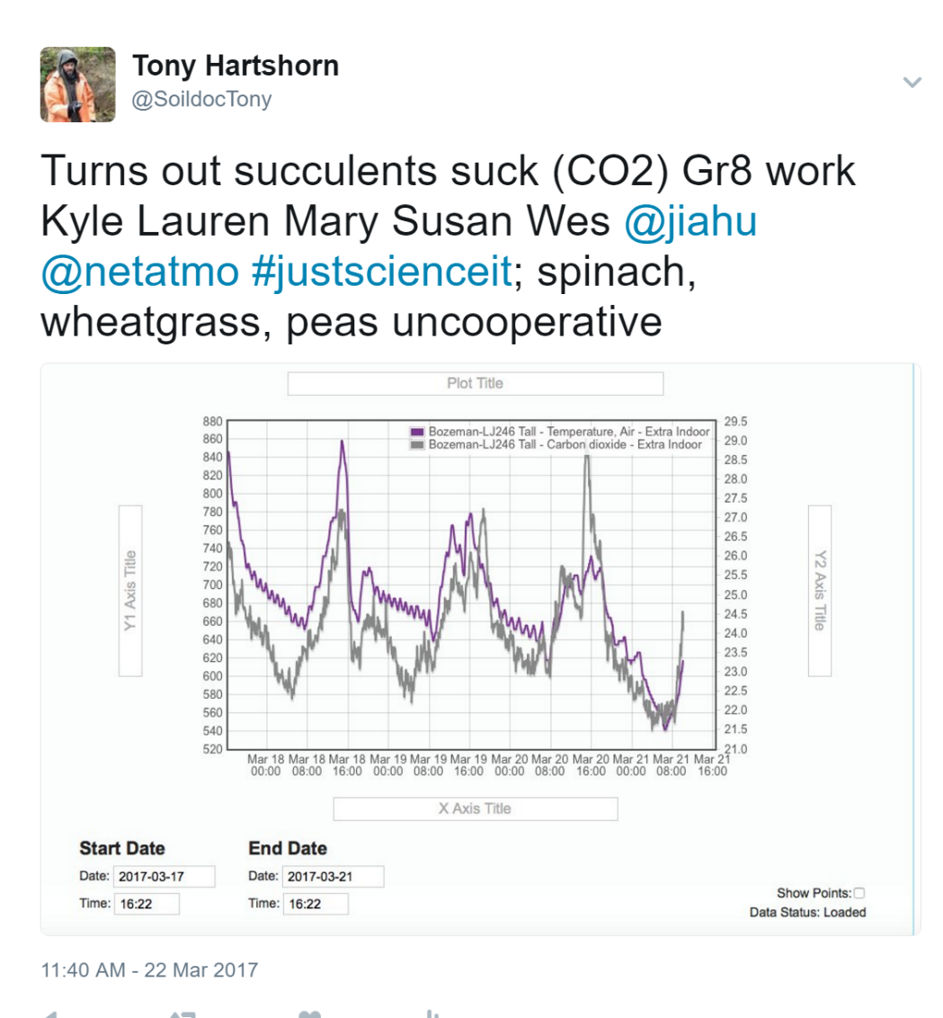
Netatmo to the rescue?

Slide 45
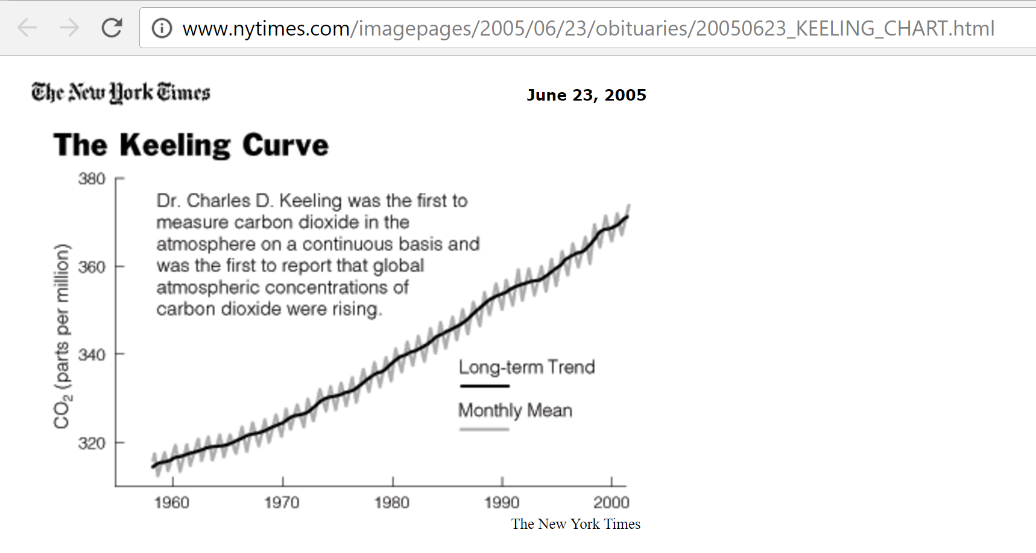

Slide 47
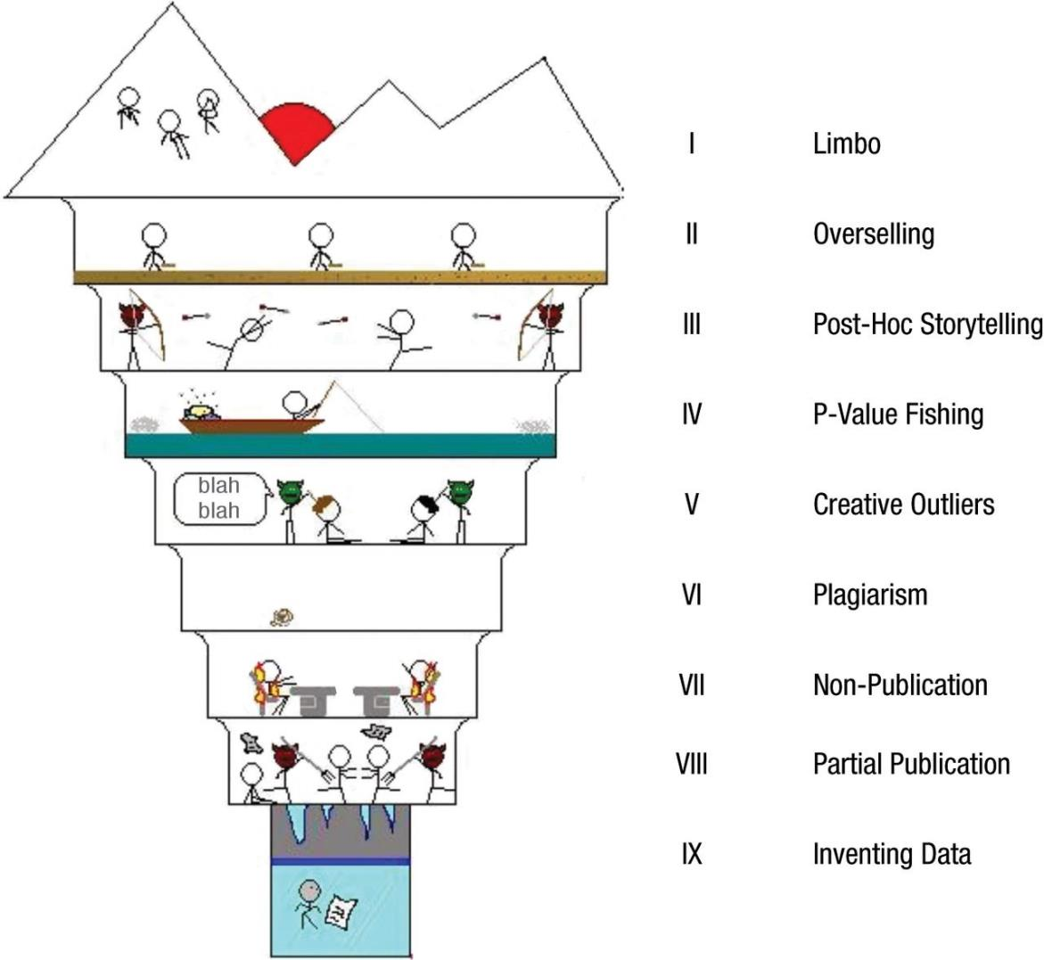

Slide 48
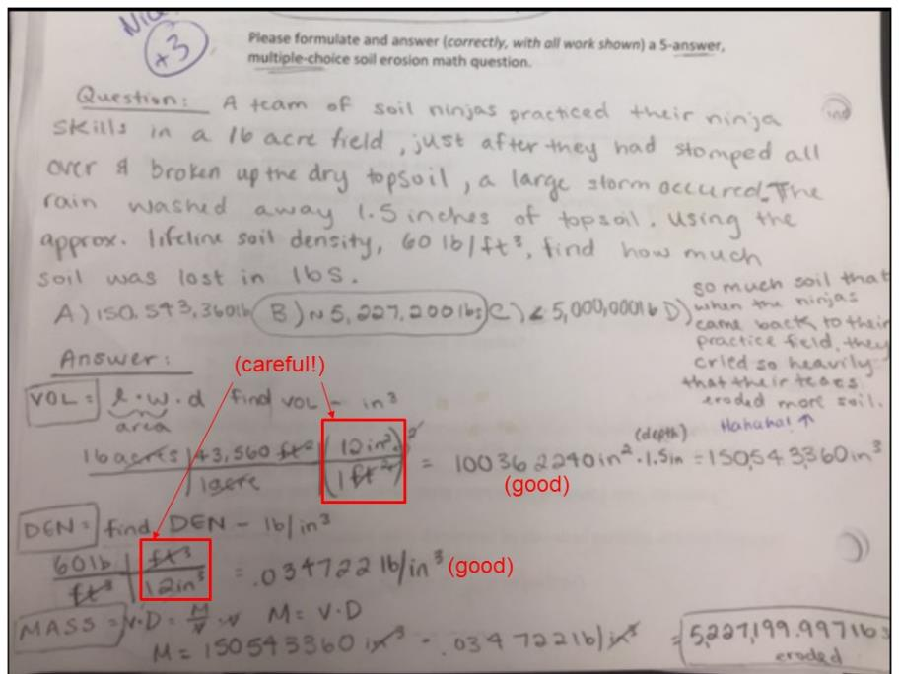

Slide 49
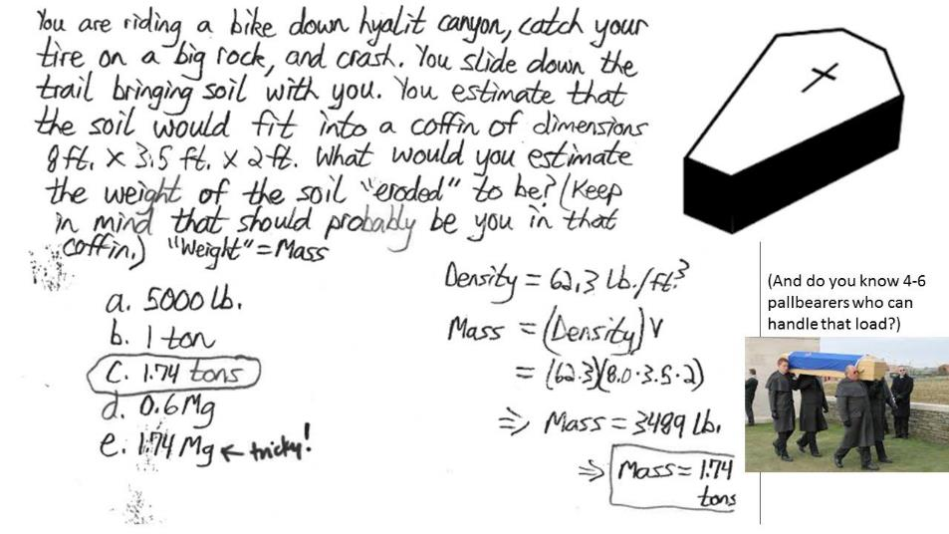

Slide 50
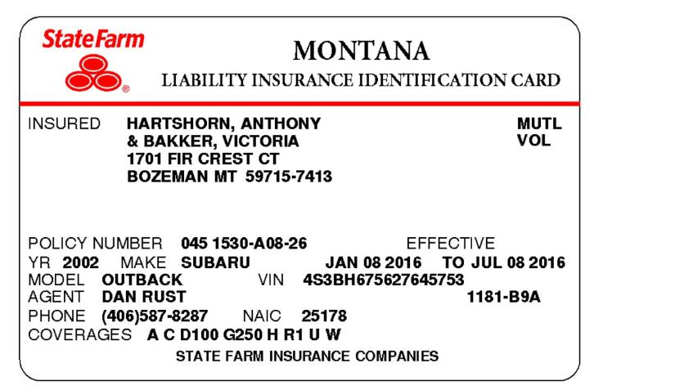

Slide 51
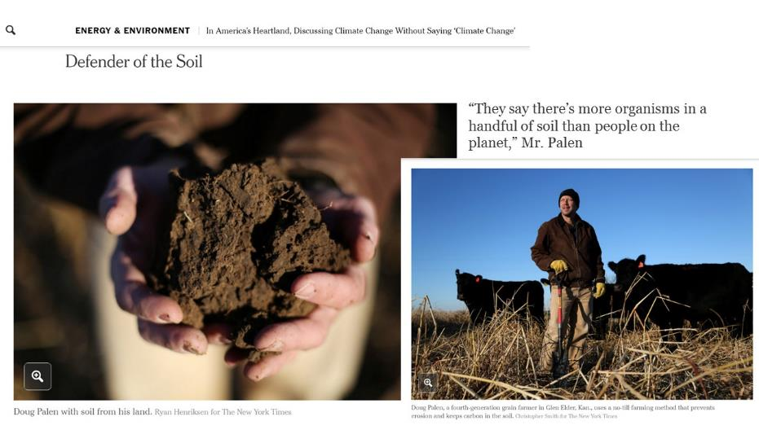

Slide 52
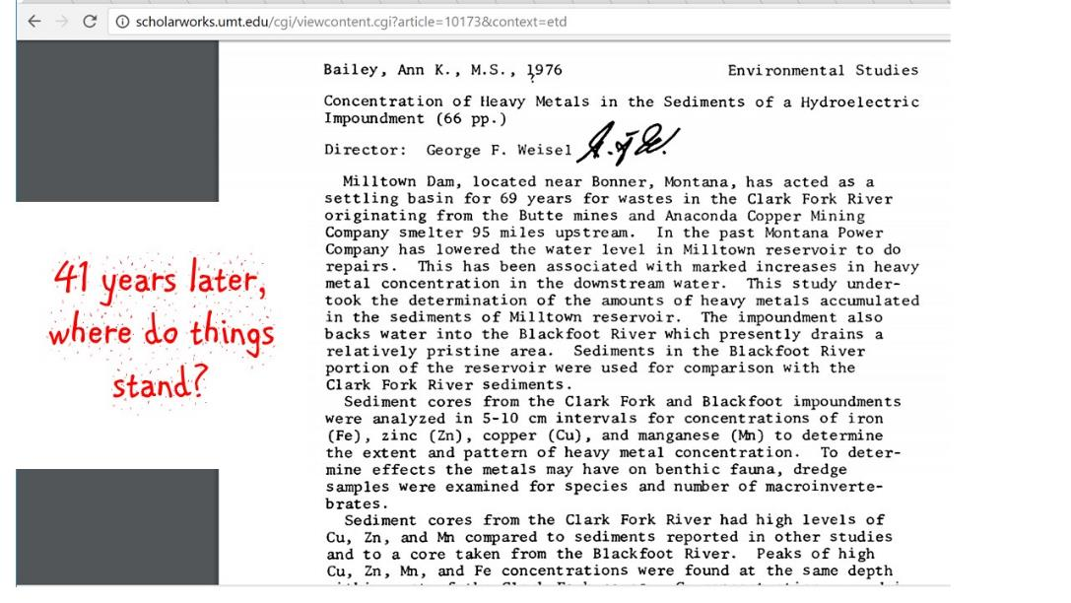

Slide 53
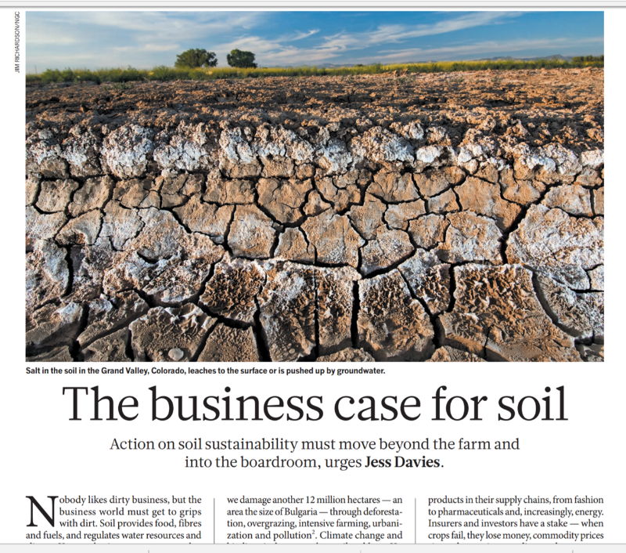

Slide 54
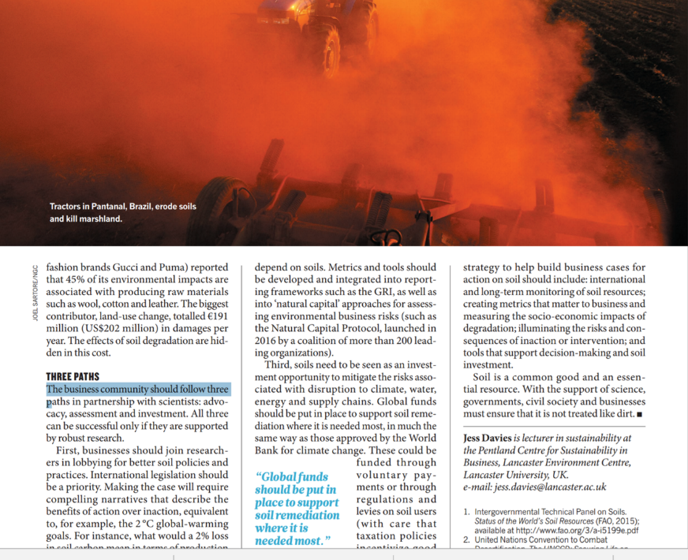

Slide 55
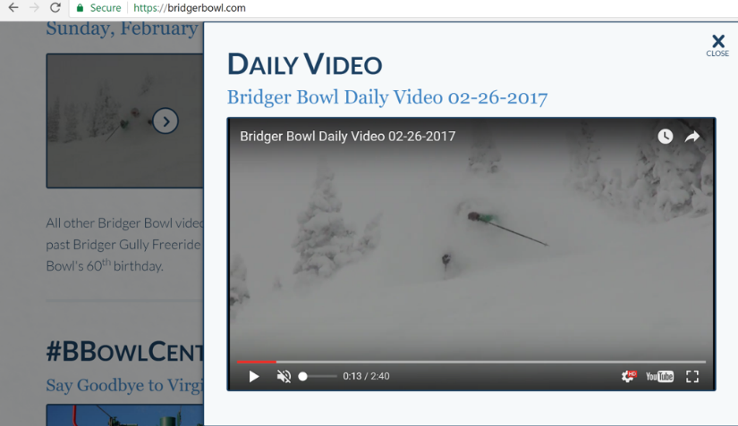

Slide 57
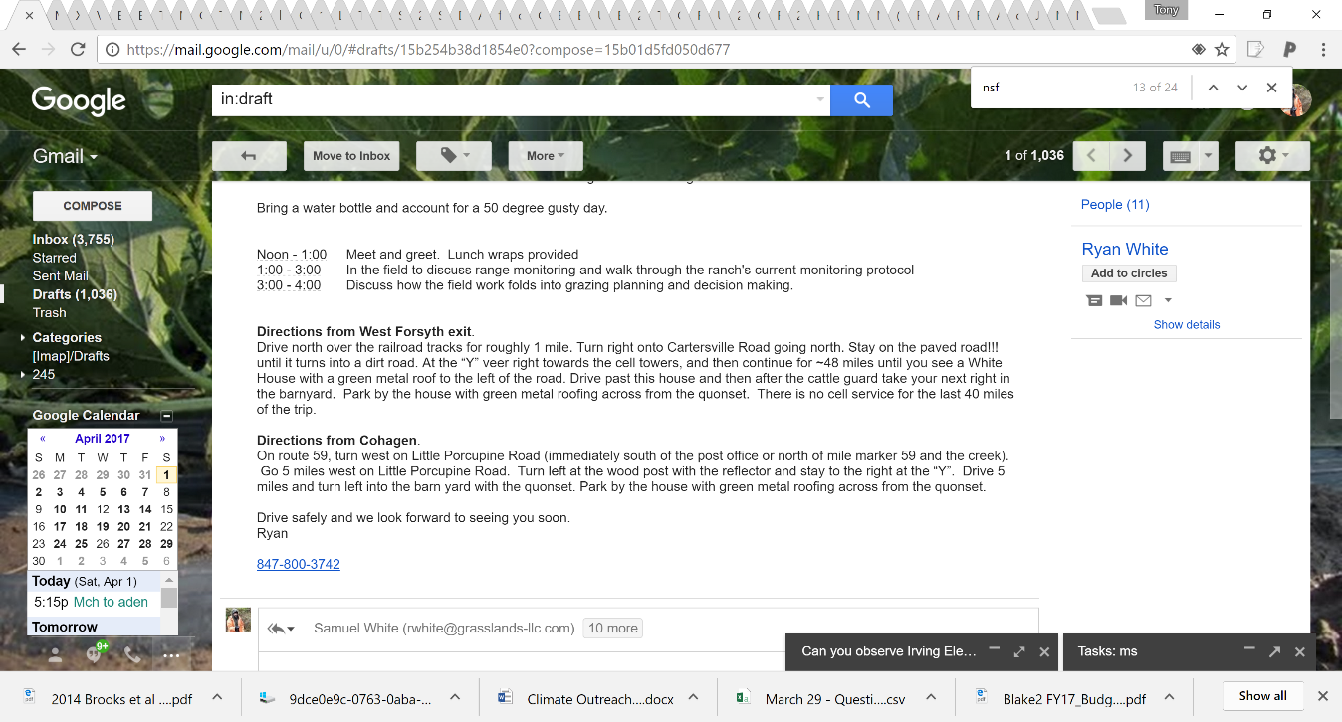

Slide 58
COOL carbon concept: When CO₂ dissolves in water, it makes it more acid.

Slide 59


PEDOSPHERE
+CO2+H2O→O2+CH2O
more SOM
less SOM

Slide 60
KAlSi₃O₈ + H₂CO₃ ➔ kaolinite + K⁺ + H₄SiO₄
Cl o r p t

Slide 61

Figure 2.2
Cl o r p t

Slide 62
Figure 2.2
KAlSi₃O₈ + H₂CO₃ ➔ kaolinite + K⁺ + H₄SiO₄
Cl o r p t

Slide 63

“Soil regolith”
Secondary mineral
primarymineral

Slide 64
Figure 2.2
KAlSi₃O₈ + H₂CO₃ ➔ kaolinite + K⁺ + H₄SiO₄
Cl o r p t

Slide 65
“Soil regolith”
Parent material + acid
Secondary minerals
Plant-available elements
Parent material
Primary minerals
Non plant-available elements

Slide 66


Cl o r p t

Slide 67

Four steps to a simple 2-handed carbon cycle
1. Outline your left and right hands
L
R

Slide 68





2-handed carbon cycle
2. Say your left hand is a leaf photosynthesizing. This requires energy! Leaves transform solar energy (left pinkie) to chemical energy (sugar like DONUTS!! = left thumb). Your right hand could be you, respiring or breathing. With every breath, you are converting chemical energy (right thumb) into (mostly) heat energy (right pinkie).
ENERGY
sugar
sugar
ENERGY
Leaves
Respire

Slide 69
+
+
+
O₂
+
H₂O
→
O₂
→
H₂O
+
+
CO₂
CO₂
CH₂O
CH₂O
2-handed carbon cycle:
3. But… you must conserve mass for each hand: Ring fingers are carbon dioxide, middle fingers are water (liquid on left, gas on right), index fingers are oxygen, thumbs (CH₂O) are shorthand for sugar (1/6th of the formula for glucose: C₆H₁₂O₆). Count the C’s, H’s, O’s on each side of the arrows!!
L
R

Slide 70

+
+
+
O₂
+
H₂O
→
O₂
→
H₂O
+
+
CO₂
CO₂
CH₂O
CH₂O
2-handed carbon cycle
4. No mass is converted to energy. No energy to mass. No E=mc².
ENERGY
sugar
sugar
ENERGY
Leaves
Respire

Slide 71
+
+
+
O₂
+
H₂O
→
O₂
→
H₂O
+
+
CO₂
CO₂
CH₂O
CH₂O
ENERGY
sugar
sugar
ENERGY
Leaves
Respire
“Photosynthesis” “Reverse photosynthesis”, “breathing”, “respiration”, “decomposition”, “oxidation”, “combustion”

Slide 72
Want to learn the carbon cycle?
It’s in your hands.*
*Just don’t forget to conserve mass and transform energy.
And bonus: the space between your hands can be used to show whether your chemical energy is ‘fossil fuel’ or not. The further your hands are apart, the more likely it’s a fossil fuel.

Slide 73



“Fresh fuels”
“Fossil fuels”*
*Like the coal, oil, and natural gas we use to charge our phones, get from A to B in our cars, and heat our homes and cook with.

Slide 74
How much of Earth’s carbon cycle is fresh- vs. fossil-fueled?
Well, when Lewis & Clark were exploring Montana, it was ALL fresh-fueled.

Slide 75
How much of Earth’s carbon cycle is fresh- vs. fossil-fueled?
Well, when Lewis & Clark were exploring Montana, it was 100% fresh-fueled.

Slide 76

How much of Earth’s carbon cycle is fresh- vs. fossil-fueled?
In 2013*, it was 97% fresh-fueled.
=23/(444+332)
=23/776
=0.03
=3%
*Source: https://www.skepticalscience.com/graphics.php?g=2;
units are billion tons of carbon dioxide per year

Slide 77

1 Montana
+6 inches of carbon
~100 Pg C
=100,000,000,000,000,000 g
*Montana is big: ~381,000 km² or 147,000 mi² big. We’re not called the “Big Sky” state for nothin’
AR4 #s below in fig:
AR5 #s, respectively:
= 8, ~120, ~80 Pg C/y
= 29, 440, 290 Pg CO2/y

Slide 78
Humans release ~8 Pg C every year (1/12 MFS)
fossil
fuels
land
ocean

Slide 79




COOL carbon concepts.
Humans release ~8 Pg C every year (1/12 MFS)
Land “catches” and releases ~120 Pg C every year (1.2 MFS)
Oceans “catch” and release ~80 Pg C every year (4/5 of a MFS)
CO₂
fossil
fuels
land
ocean
Carbon comes in solid, liquid, and gas forms!
Carbon like coal can be used to make electricity.
You do not turn any mass of carbon into energy—you just turn solid carbon (donuts) into gaseous carbon (carbon dioxide). At the same time, you turn chemical energy into heat energy (mostly)!

Slide 80



COOL carbon concepts.
4. Carbon dioxide and water combine to form a weak acid, carbonic acid.
5. Coal is just really old plant material that was photosynthesized millions of year ago.
6. The two most abundant greenhouse gases in the atmosphere are water vapor (~2% or 20,000 ppm) and carbon dioxide (0.04% or 400 ppm.
7. Every year, the carbon dioxide levels in the atmosphere increase by ~2 parts per million (ppm).
8. Without greenhouse gases, the Earth’s average temperature would be 0°F, well below the freezing point of water; with greenhouse gases, the Earth’s average temperature is ~60°F.
9. Some carbon in rock form (limestone, coal) was formed hundreds of millions of years ago.
10. Solid carbon like coal can be burned to make electricity; liquid hydrocarbons like gasoline or diesel can be burned to power our transport; “natural gas” is a carbon gas (not carbon dioxide) we burn to heat water, our homes, and to cook and bake with.
O₂
Humans release ~8 Pg C every year (0.08 MFS*)
R
Land
“catches”
and releases
~120 Pg C
every year (1.2
of a MFS*)
R
P
R,O
Oceans
“catch” and release
~80 Pg C every year (0.8 of a MFS*)
fossil
fuels
P,I
land
ocean
Just because it’s out of sight doesn’t mean it should be out of mind.
Carbon comes in solid, liquid, and gas forms.
You never turn any mass of carbon into energy—you just burn solid carbon (like donuts) into gaseous carbon (like carbon dioxide); at the same time, chemical energy transforms to heat energy.
Source: IPCC AR5. P=photosynthesis, R=respiration, I=in-gassing, O=out-gassing
* 1MFS=1 Montana-furrow-slice, a volume about equal to 100 petagrams or 1x10¹⁷ g or 100,000,000,000,000,000 grams

Slide 81

COOL carbon concepts.
4. Carbon dioxide and water combine to form a weak acid, carbonic acid.
5. Coal is just really old plant material that was photosynthesized millions of year ago.
6. The two most abundant greenhouse gases in the atmosphere are water vapor (~2% or 20,000 ppm) and carbon dioxide (0.04% or 400 ppm.
7. Every year, the carbon dioxide levels in the atmosphere increase by ~2 parts per million (ppm).
O₂
Humans release ~8 Pg C every year (0.08 MFS*)
R
Land
“catches”
and releases
~120 Pg C
every year (1.2
of a MFS*)
R
P
R,O
Oceans
“catch” and release
~80 Pg C every year (0.8 of a MFS*)
fossil
fuels
P,I
land
ocean
Just because it’s out of sight doesn’t mean it should be out of mind.
Carbon comes in solid, liquid, and gas forms.
You never turn any mass of carbon into energy—you just burn solid carbon (like donuts) into gaseous carbon (like carbon dioxide); at the same time, chemical energy transforms to heat energy.
Source: IPCC AR5. P=photosynthesis, R=respiration, I=in-gassing, O=out-gassing
* 1MFS=1 Montana-furrow-slice, a volume about equal to 100 petagrams or 1x10¹⁷ g or 100,000,000,000,000,000 grams

