Slide 1
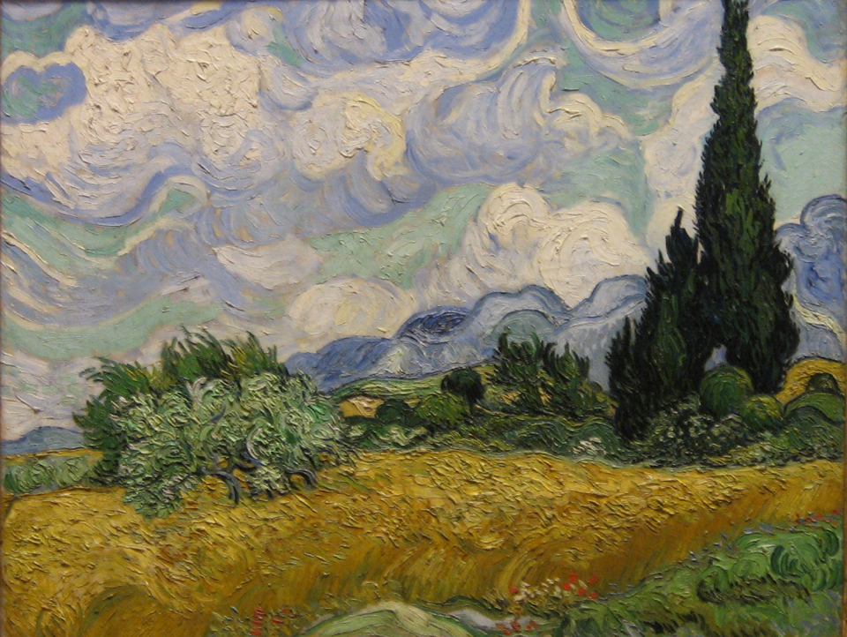
Climate change Implications for Montana agriculture
Fabian Menalled, Irene Grimberg, Tim Seipel, Sue Ishaq,
Selena Ahmed, Zach Miller, and Elis Colter
menalled@montana.edu
406-994-4783

Slide 2
THE CLIMATE IS CHANGING

Slide 3
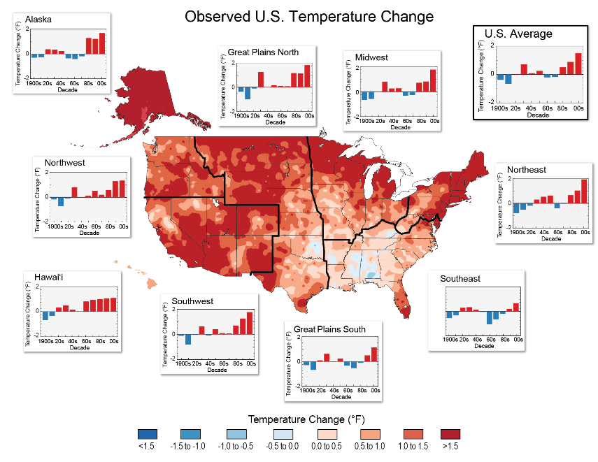
Temperature change (from 1991) relative to 1900-1960
Increase in temperature across most of the Northern Plains.
National Climate
Assessment 2014

Slide 4
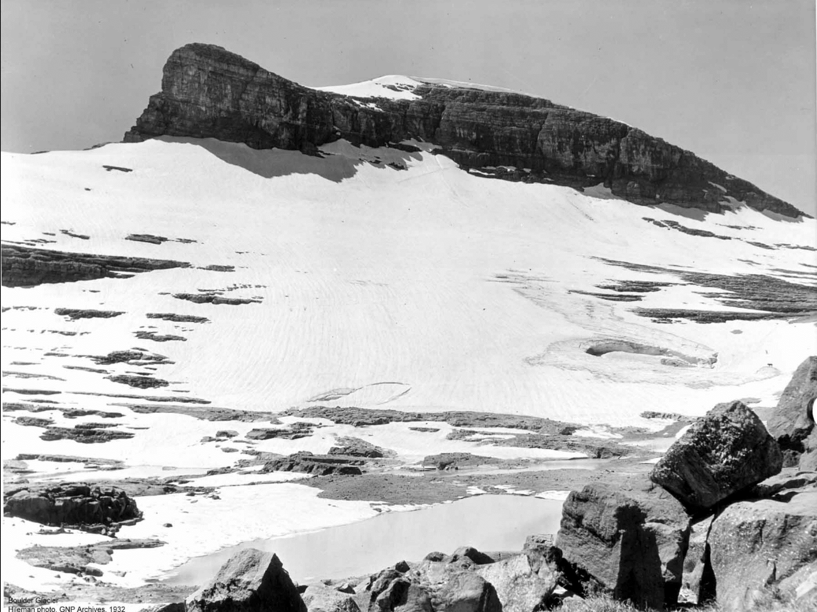
Boulder Glacier, 1932

Slide 5
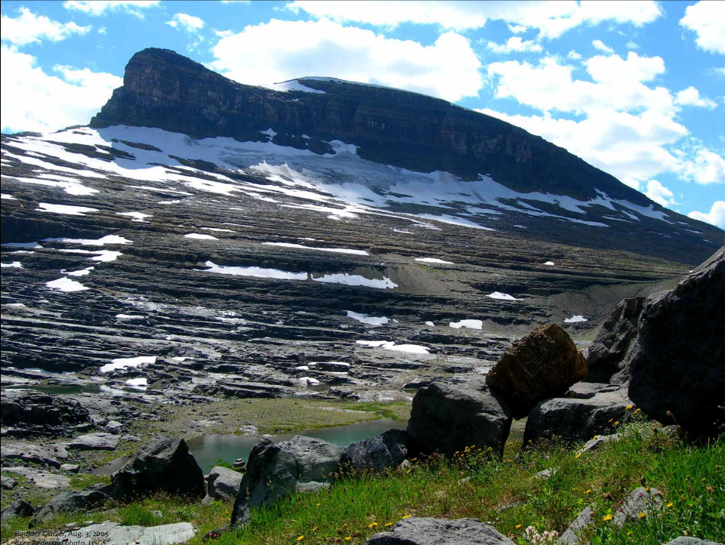
Boulder Glacier, 2005

Slide 6
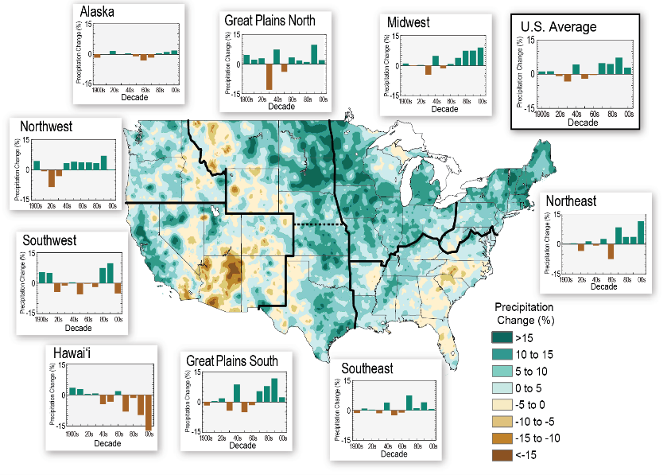
Precipitation change (from 1991) relative to 1900-1960
Decrease in precipitation across western part of Northern Plains.
National Climate
Assessment 2014

Slide 7
Precipitation change (from 1991) relative to 1900-1960
Increase in precipitation across eastern part of Northern Plains.
National Climate
Assessment 2014

Slide 8
THE CLIMATE WILL CONTINUE CHANGING

Slide 9
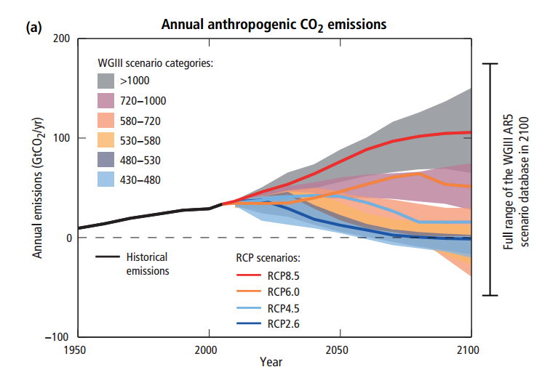
http://www.ipcc.ch/

Slide 10
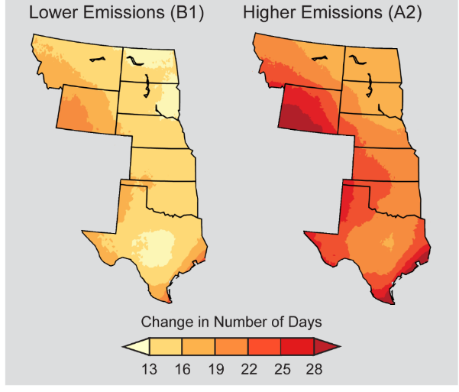
Projected Change in Number of Warm Days
Projected changed by mid-century (2041-2070) as compared to 1971-2000
National Climate Assessment

Slide 11
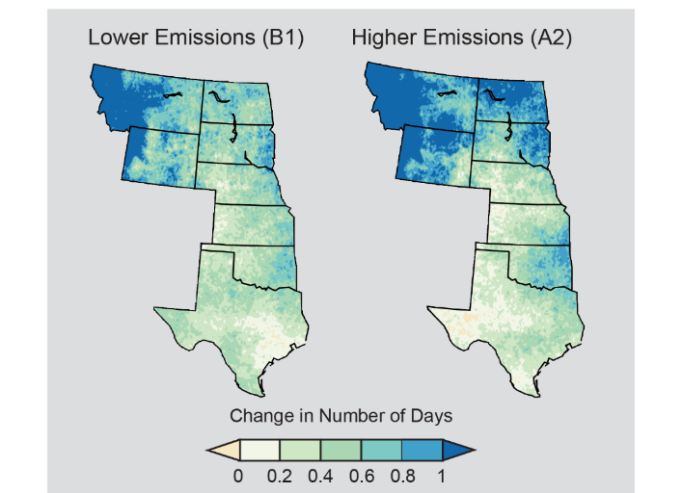
Projected Change in Number of Heavy Precipitation Days
Projected changed by mid-century (2041-2070) as compared to 1971-2000
National Climate Assessment

Slide 12
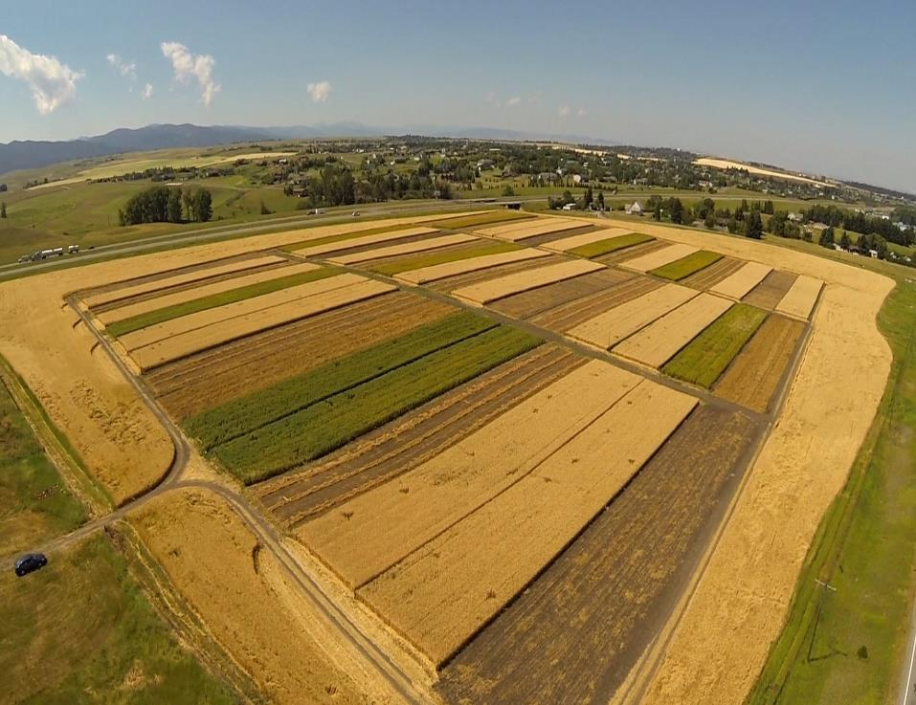
What does this mean for Montana ag?

Slide 13
What does this mean for Montana ag?
MSU - Ft. Ellis Experimental Farm
17.8” annual precipitation
High moisture
her

Slide 14
What does this mean for Montana ag?
How will climate change impact crops and weeds?
Does climate change impact conventional and organic systems equally?
her

Slide 15
5-yr rotation
Safflower(clover)
Sweet clover
Winter wheat
Lentils
Winter wheat
Organic – till (conventional)
Organic – grazed (Alt.)
Chemical No-till
Organic grazed is no-till 36/60 months
Notes:
This is the Fort Ellis research site just north of I-90, immediately east of Bozeman. Custer never actually set foot in this fort but it was an active military post from 1867 to 1883, when the Bozeman trail was abandoned as too dangerous for wagon travel as railroads were being cut across the continent. A large allotment from that 32,000 acre military fort became part of Montana State University. Enough history. At this site we run a 5-yr rotation common to three alternative management systems. At the outset we deemed our biggest weed threat to be the perennial, creeping thistle, aka Canada thistle. So we designed a rotation using mostly deep-rooted crops (all but lentil) to compete with thistle. All phases of the rotation are present each year and 2016 was the 4th year of this study … so almost one rotation complete. The organic systems became certified mid-summer 2015. The Organic Tillage system was intended to represent conventional organic management in Montana; this image shows green manure plowdown occurring on an organic farm in northern Montana. Sheep were used to avoid tillage in an alternative system. We were not sure how successful we could be with avoiding tillage, especially with a weed-susceptible crop such as lentil providing an economic anchor to this rotation. It turns out that we can prevent all tillage for a 36-month period beginning with the spring planting of safflower and ending with the spring planting of lentil. We use the wheat stubble as feedlots during both phases, to avoid fall tillage and we typically allow only one pre-seed tillage event prior to planting of lentil, phase-5 winter wheat, and safflower, which is undersown to biennial sweet clover. We also have a chemical no-till system intended as a high benchmark during the early phase of this study. Note that this would be a very unusual rotation for no-till systems in Montana.

Slide 16
Increased temperature

Slide 17
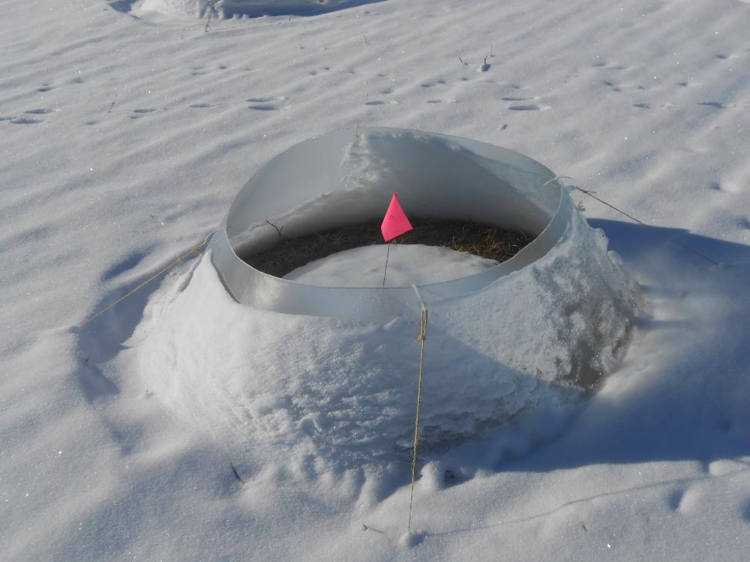
Increased temperature

Slide 18
Increased temperature and reduced moisture

Slide 19
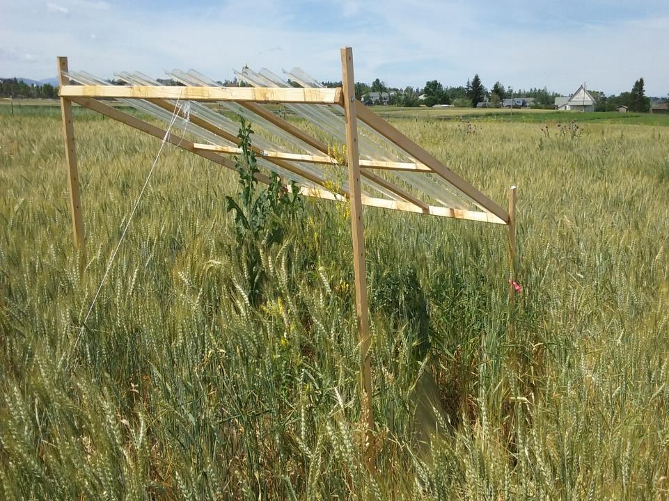
Increased temperature and reduced moisture

Slide 20
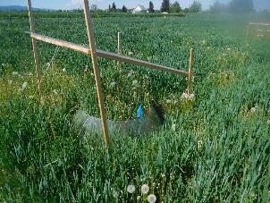
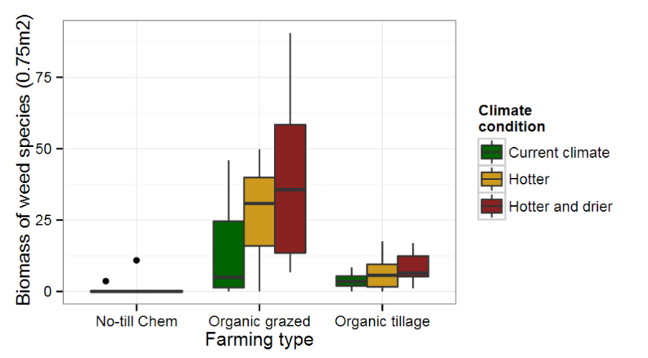
Weeds and climate
Biomass
Farming systems P= 0.08

Slide 21
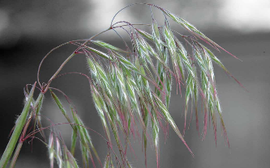
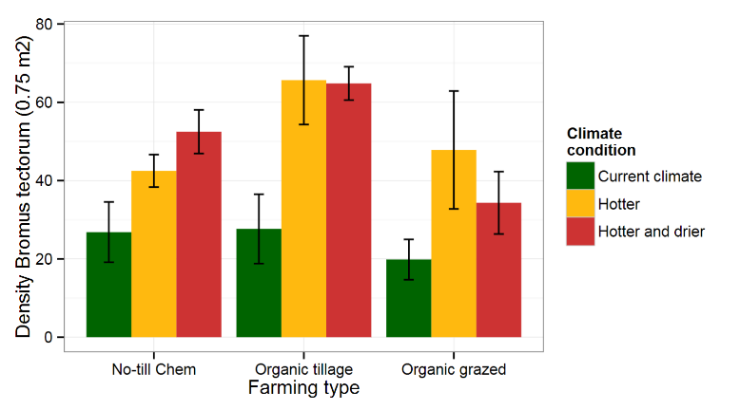
Cheatgrass and climate
Biomass

Slide 22
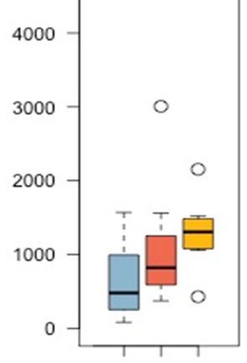
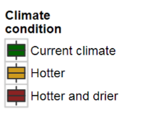
Cheatgrass and climate
Seed production
Kg / ha
Current
Hotter
Hotter & drier

Slide 23
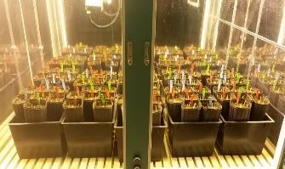
Cheatgrass and CO₂
Biomass
Elevated CO₂
Ambient CO₂
Trial 1
Trial 2
Trial 3

Slide 24
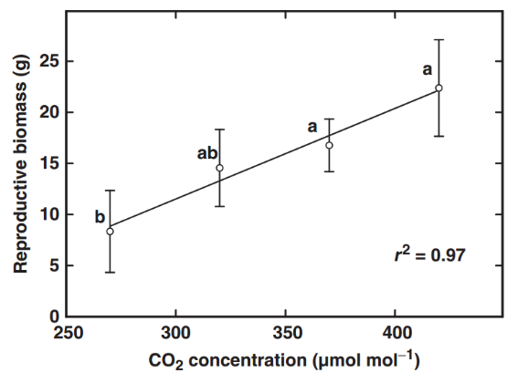
Cheatgrass and CO₂
Seed production
After Ziska et al. 2005. Global Change Biology 11: 1325-1332
Mid- to long-term shift in weed communities?

Slide 25
Wheat yield
Hotter
Hotter
& drier
Current climate

Slide 26
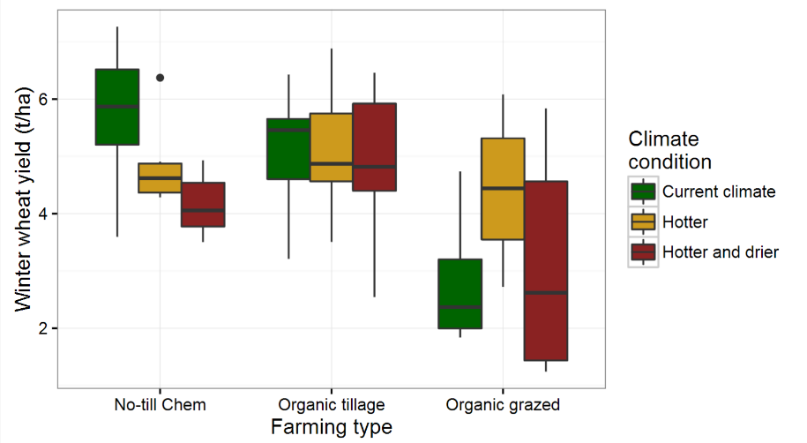
Wheat yield
P = 0.02
ns
ns

Slide 27
What does this mean for Montana ag?
How will climate change impact crop and weeds?
Reduced yield, increased weed growth
Does climate change impact conventional and organic systems equally?
Evidences suggest that organic systems are more resilient
Opportunities?

Slide 28
What does this mean for Montana ag?
How will climate change impact crop and weeds?
Reduced yield, increased weed growth
Does climate change impact conventional and organic systems equally?
Evidences suggest that organic systems are more resilient
Opportunities?

Slide 29
What does this mean for Montana ag?
How will climate change impact crop and weeds?
Reduced yield, increased weed growth
Does climate change impact conventional and organic systems equally?
Evidences suggest that organic systems are more resilient
Opportunities?

Slide 30
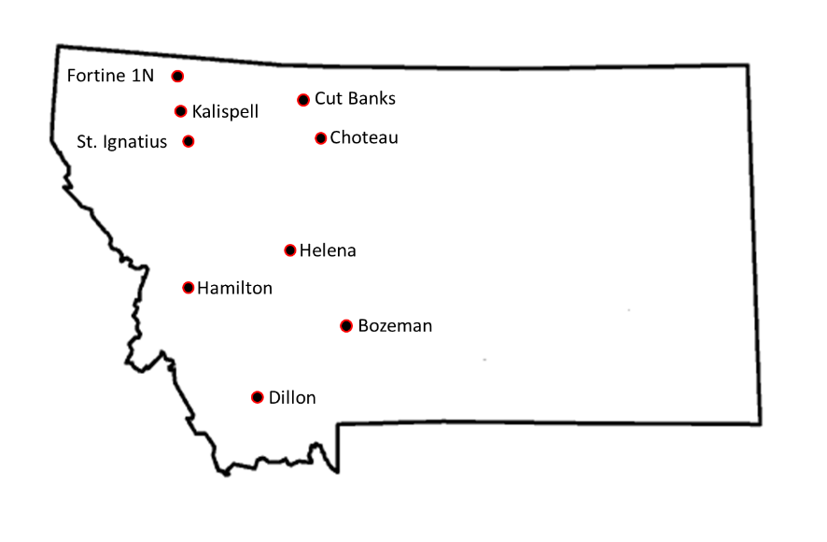
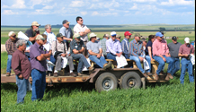
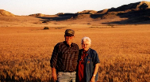
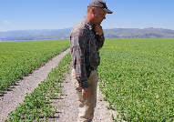
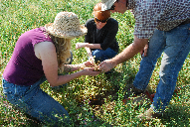
Montana’s citizens

Slide 31
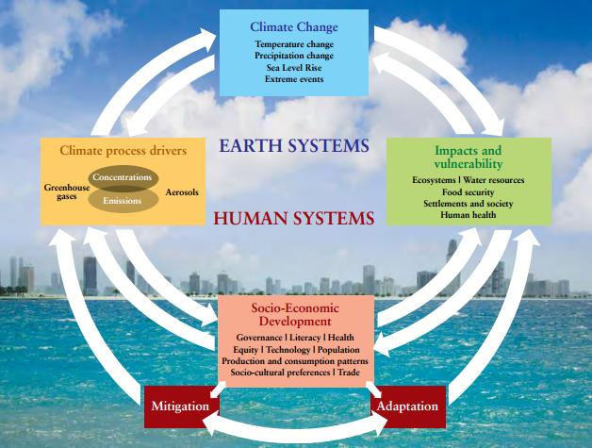
Observed changes in the environment
Attitudes, concerns, and believes
Observed changes in production
Adaptation and mitigation strategies
IPCC, 2007: Towards New Scenarios for Analysis of Emissions, Climate Change, Impacts, and
Response Strategies. Expert Meeting Report.
Notes:
Background: schematic of the compounding factors that impact climate. Changes in climate result from the interaction of earth and human systems. Climate change process drivers (anthropogenic) and Impacts and vulnerability directly impact changes in climate. In turn drivers of climate change and impacts and vulnerabilities affect socio-economic developments that determine mitigation and adaptation practices. Climate change drivers are anthropogenic (greenhouse gases, aerosols, and land coverage), Impacts and vulnerability are predicted to affect terrestrial and aquatic ecosystems, water resources, food security, settlements, and human health. Social and economic developments includes: education, policies, health programs, cultural trends, production and consumption practices.
Animation 1: we developed a survey to capture the components of this schematic. Including1) a section on believes about drives of climate change, and attitudes and concerns towards climate change, 2) a section on observed environmental changes, 3) a section on observed changes in production, and 4) a section on adaptation and mitigation practices.

Slide 32
Montana agricultural stakeholders perceptions
Do stakeholders acknowledge climate change?
Is climate change perceived as an imminent problem?
Are humans capable to mitigate the impacts of climate change?
What are the causes of climate change?

Slide 33
Attitude: What best describes your attitude towards climate change? 1. The climate has not changed; 2. Not alarmed; 3. Somehow alarmed; 4. Very alarmed.
Seriousness: Do you think that changes in climate will be a serious issue? 1. Never; 2. Only in the present; 3. In the near future; 4. Always.
Capability: Do you think people have the capability to reduce the impacts of change in climate? 1. The climate has not changed; 2. No; 3. Not sure; 4. Yes.
Cause: What is the main cause of climate change? 1. The climate has not changed; 2. Man-made activities; 3. Natural terrestrial cycles and catastrophes (e.g., the seasons, volcanic eruptions); 4. Extraterrestrial natural phenomena (e.g., Sun’s spots, meteorites); 5. Non-physical causes (e.g. God); 6. Other.

Slide 34
Demographic
Location
Affiliation
Age
Income
Political view
Gender
Race/ethnicity

Slide 35
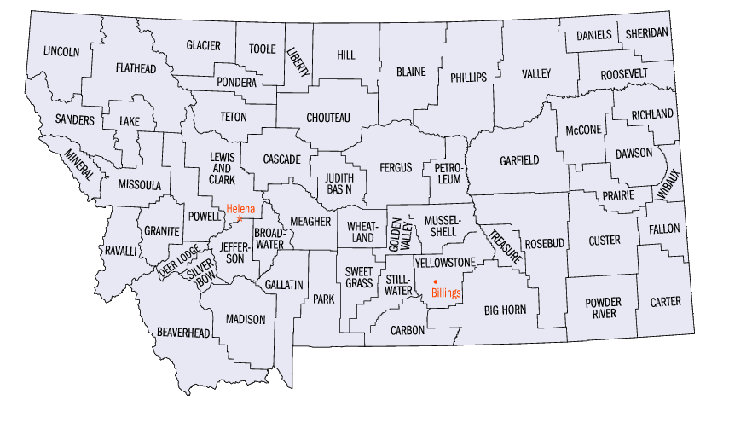
Montana’s citizens
110
Golden Triangle
(66)
Highline
(110)
Greater
Flathead Lake
(11)
Judith Basin
(36)
Five-Valley Region
(57)
South-east
(21)
Headwaters
(123)

Slide 36
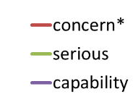
Political view vs. perceptions
Liberal
7. Conservative

Slide 37
Political view vs. perceptions
How concern are you about the impact of climate change on Montana’s agricultural production?
Concern
Seriousness
Capability
Liberal
7. Conservative

Slide 38
Political view vs. perceptions
How serious do you think climate change will become in the future?
Concern
Seriousness
Capability
Liberal
7. Conservative

Slide 39
Political view vs. perceptions
Do you think people have the ability of mitigating climate change?
Concern
Seriousness
Capability
Liberal
7. Conservative

Slide 40
Political view & causes of climate change
Man made
Other causes
Not changing
1
2
3
4
5
6
7
Liberal
Conservative

Slide 41
Do Montana agricultural stakeholders acknowledge climate change?
Yes, between 89-95% of Montana agricultural stakeholders acknowledge climate change.
Is climate change perceived as an imminent problem?
Yes, 83.5% of Montana agricultural stakeholders think climate change is a serious problem now, near- or in the long-term future.

Slide 42
Are humans capable to mitigate the impacts of climate change?
46% of Montana agricultural stakeholders think humans can mitigate the effects of climate change
What are the causes climate change?
About 36% of Montana agricultural stakeholders attribute climate change to human activities and 43% to natural causes.

Slide 43
Mitigation
Management
Prevention
DATA
Adaptation
Costs
Benefits
De-politicize the causes of climate change

Slide 44
“The dogmas of the quiet past are inadequate to the stormy present. The occasion is piled high with difficulty, and we must rise with the occasion. As our case is new, so we must think anew, and act anew.”
Abraham Lincoln, 1862
Fabian Menalled
menalled@montana.edu
406-994-4783

Slide 45
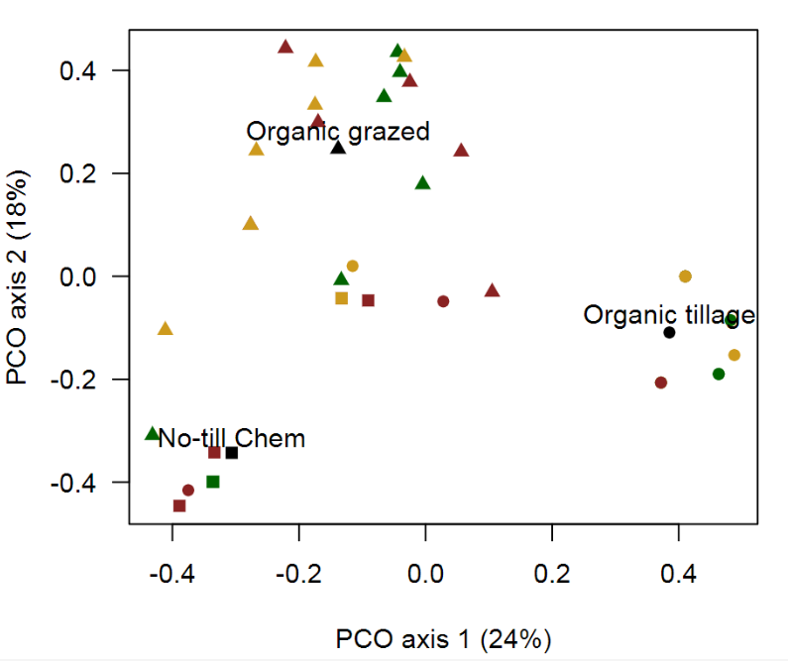
Weeds and climate
Weed communities
Farming systems P= 0.001

