Slide 1
Climate Change policy
The Daily Climate
Notes:
Intro: Douglas Fischer, been journalist for almost 25 yrs.

Slide 2
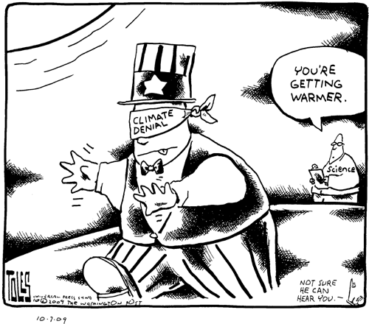
Notes:
We’ve spent the day talking about science and science outreach. The logical next question is how does all this impact policy. The flip answer is that it doesn’t. So let me start by showing you someone having a huge impact on policy.

Slide 3
Notes:
You were expecting Donald Trump? This is Claire Vlases. Eighth grader here in Bozeman. She took the school board to task for not including solar on a recent building upgrade. Raised $110k for solar on her school. And she sparked district-wide conversation and policy change on green building standards.

Slide 4
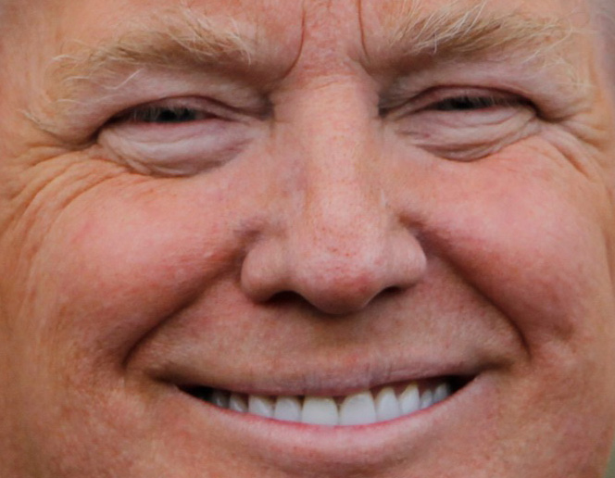
Notes:
Can’t have a conversation about climate policy without talking President Trump. At a loss here. Wrecking ball. Interesting to me: Aim is not to build, but to destroy. Progress on emissions, bring policy in line with the threat outlined by science, come to a halt – at least to the extent Trump can do so. But Trump can’t build this wall. Pressure change going to come thru cracks. Going to come up in local communities via the Claire Vlases.

Slide 5
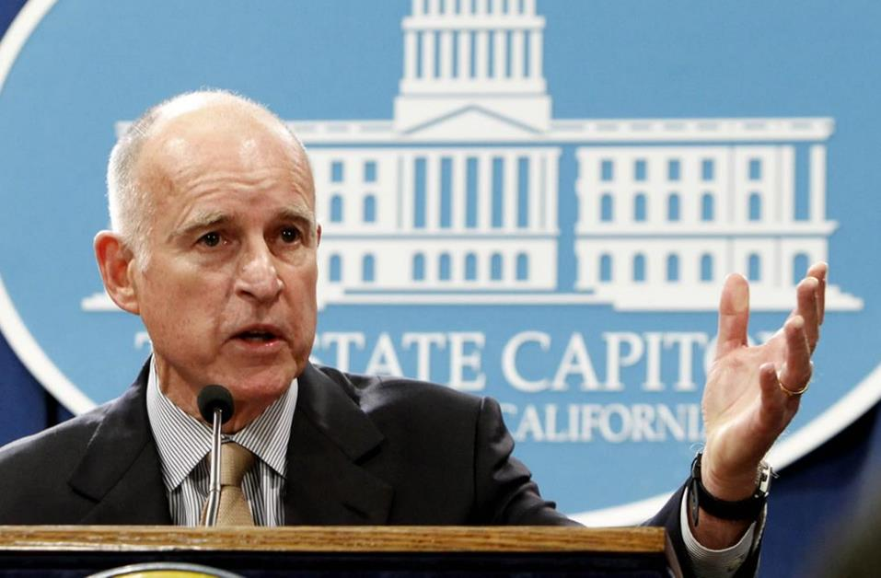
Notes:
Going to come from Calif. Gov. Jerry Brown. There’s no stronger political force to stand against Trump than California. One quick example: California can set its own fuel efficiency stds for cars. Exemption under fed law: 10 percent of domestic car market. Other states - California rules instead of the EPA’s. 13 states: 30 percent of the market.

Slide 6
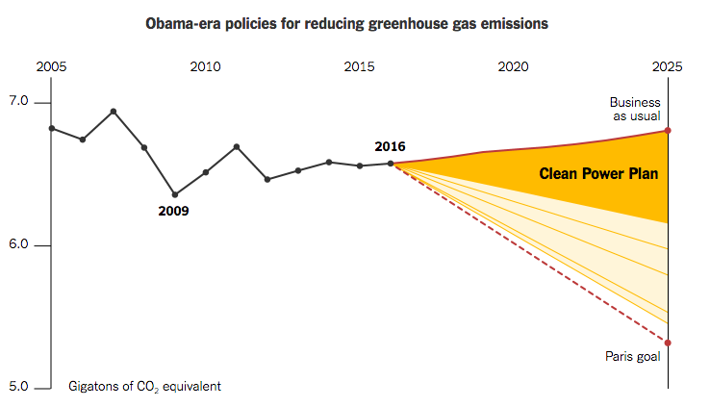
Source: New York Times
Notes:
Let me show how this plays out in policy: Paris 2015, global community cuts; here’s path mapped by Obama. 26-28% below 2005. Clean Power Plan (ban on new coal plants);

Slide 7
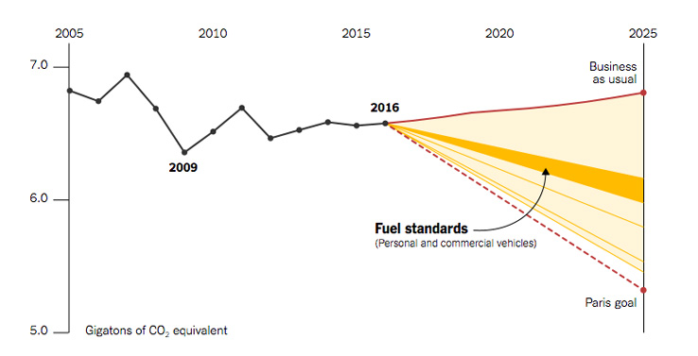
Source: New York Times
Notes:
fuel standards for vehicles

Slide 8
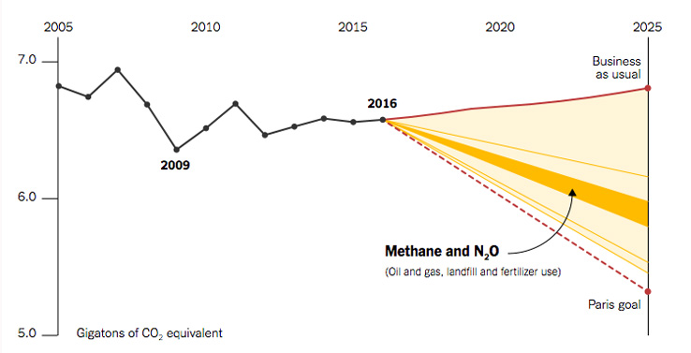
Source: New York Times
Notes:
methane & nitrogen emissions from oil & gas fields, agriculture;

Slide 9
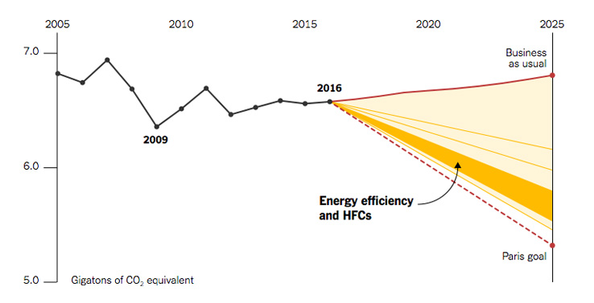
Source: New York Times
Notes:
Fuel efficiency efforts (social cost of carbon)

Slide 10
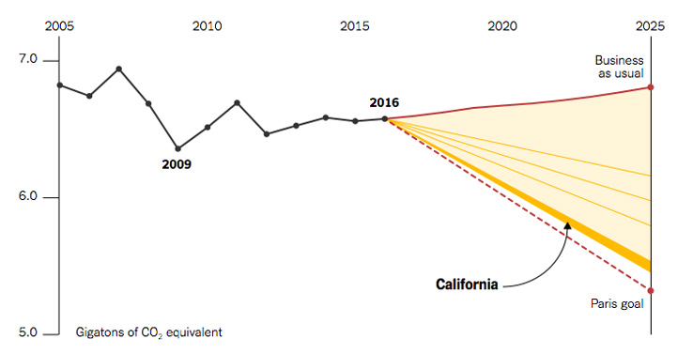
Source: New York Times
Notes:
and finally, California alone – 5 pct. Separate from auto emissions.

Slide 11
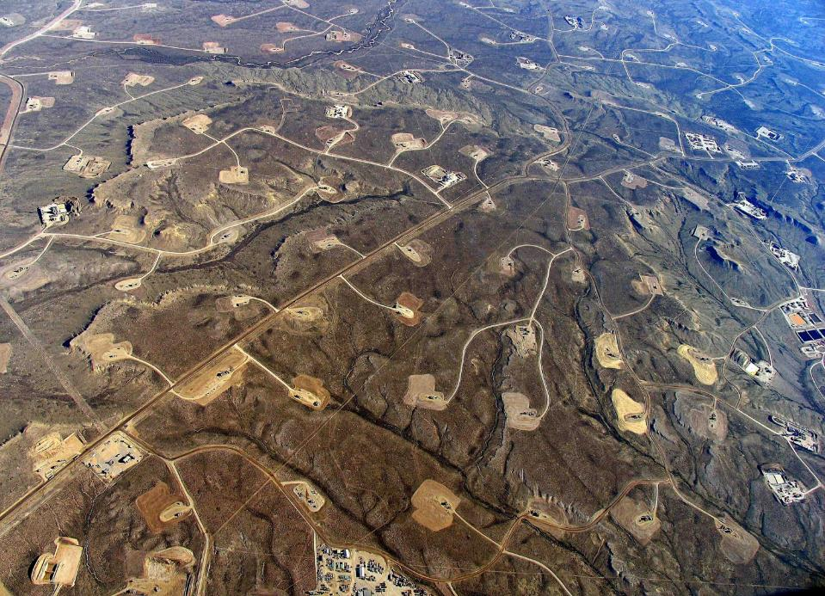
Notes:
So that’s policy. But the question I have is how much driven by policy, and how much is market? Or: how much control does the federal gov’t have over big shifts in market? Impact of fracking technology on our electrical market is a prime example: Fracking wells east of Pinedale, Wyoming. Before 2006, didn’t have the technology to tap this gas.

Slide 12
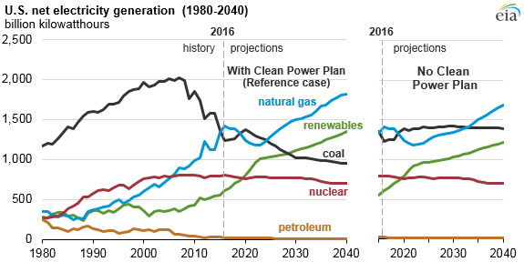
Notes:
But you can see what happened once we learned to tap that gas. This shows 30-years’ of history on where we get electricity in the US. Black line is coal: For decades, back to ‘50s, half the electricity generated by coal. Fracking comes online: Cheap, plentiful gas. Obama’s clean power plan continued that trend. But even without it, coal isn’t coming back. The market has changed, and these new power plants are going to last 40, 50, 60 years.

Slide 13
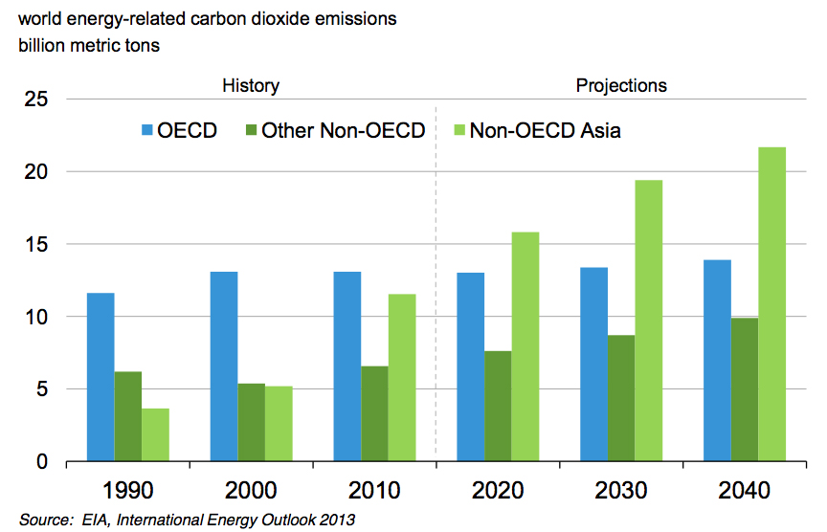
Notes:
But let me quickly step back, and give you a global view for two minutes. Because you can argue that cuts in the US – or lack thereof – are irrelevant. Global energy-related carbon emissions. Blue is Organization for Economic Cooperation and Development – rich countries (America, Europe, Japan). Emissions stay fairly flat. Green shows the rest of the world. Light green is Asia – mostly China. 60 percent of increase in energy use, 70 percent of increase in energy-related CO2 emissions, comes from Asia over the next 20 years.

Slide 14
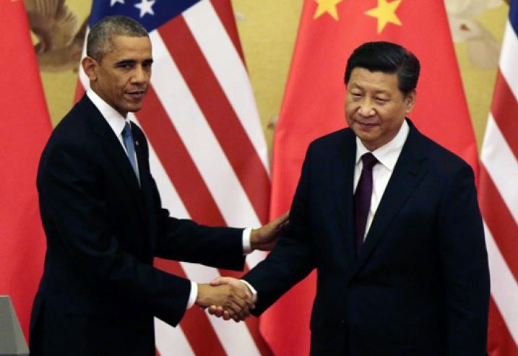
Notes:
But US leadership cannot be overstated here. China has its own reasons to get off coal – air quality is a big issue. But the reason we have a Paris agreement: Obama and China’s president SHI ZJINping reached a bilateral deal right before that 2015 meeting.

Slide 15
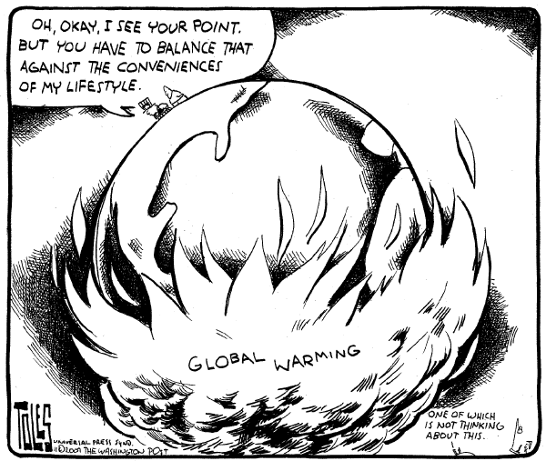
Notes:
No easy answer. I’ve argued that Trump shows Obama’s efforts left a significant portion of the US behind. I got a 15 minute rant from my wife poking holes in my argument. But fundamentally, we don’t have an easy solution. We have forces moving on this. But we’re also stuck in some key ways, and until we have a more palatable solution, we’ll continue to be polarized and politicized.

