Slide 1
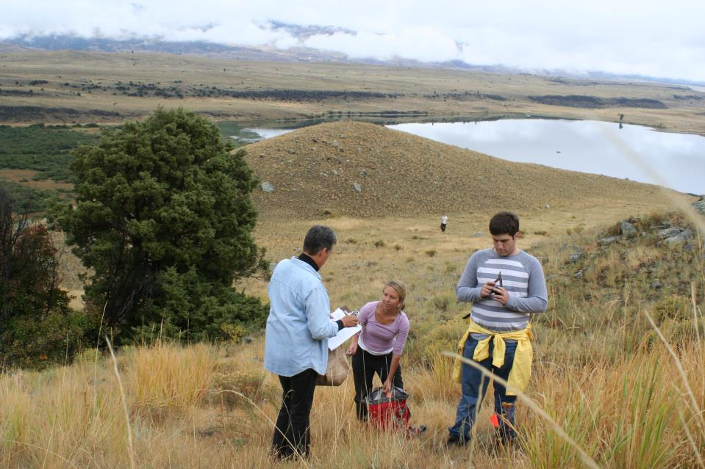



Climate In My Backyard
Montana NSF EPSCoR
http://eu.montana.edu/climb/
Contact Suzi Taylor: taylor@montana.edu

Slide 2
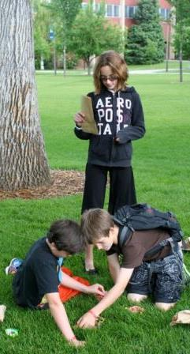
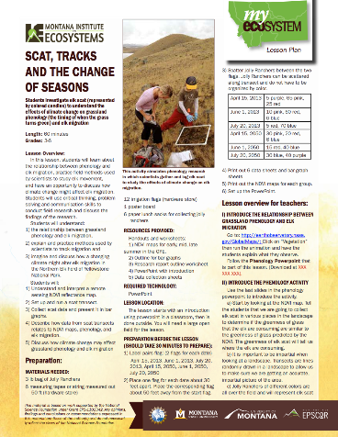
Elk Grazing and Phenology

Slide 3
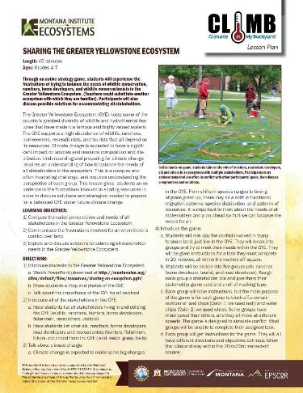
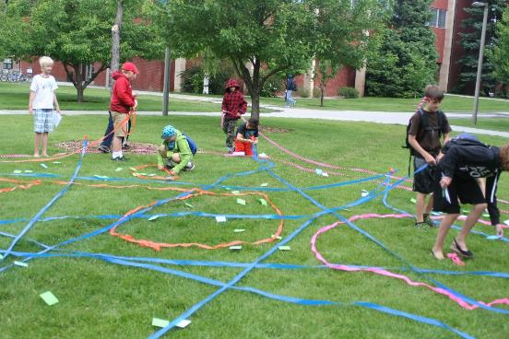
Sharing the Greater Yellowstone Ecosystem

Slide 4
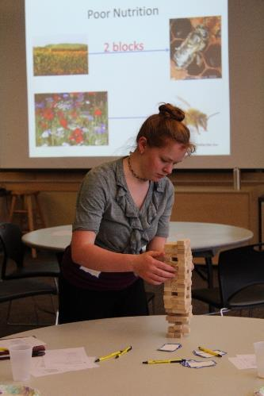
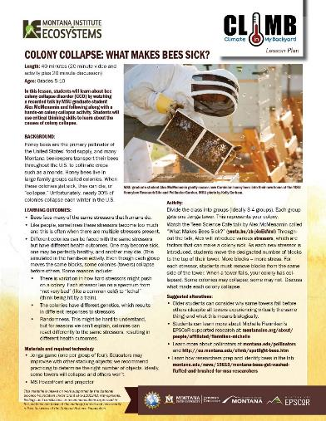
Colony Collapse: What makes bees sick?

Slide 5
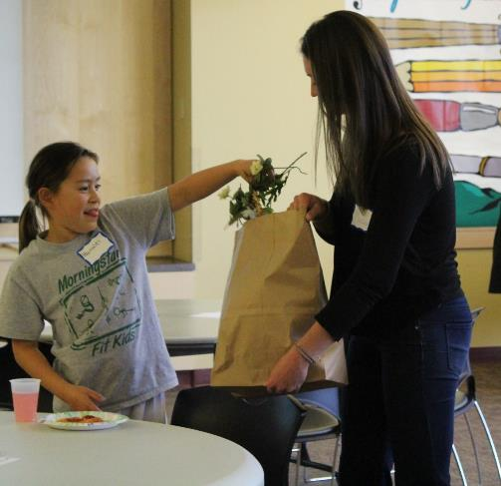
How do Scientists Collect Data?

Slide 6

Exploring Ecosystems

Slide 7
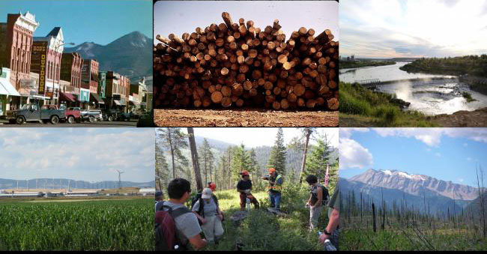
Montana's Changing Climate
Online Course

Slide 8
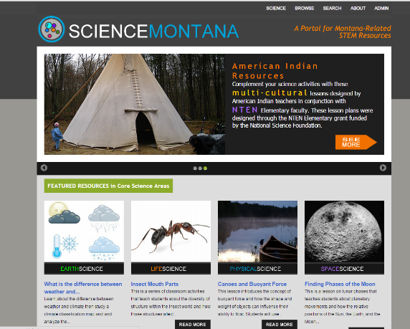
Science Montana Database
A database of STEM lesson plans created by the Montana University System that are relevant to Montana in some way.
Sciencemontana.org
Contact Jamie Cornish: jcornish@montana.edu

Slide 9


Thank you!
Questions?
sarah.hendrikx@montana.edu
taylor@montana.edu

